Slide 1

DM detections at Higgs Factory
Shigeki Matsumoto (Kavli IPMU)
Many dark matter experiments already exist and are planned.
It is thus important to quantitatively figure out what kind of role the Higgs factory plays compared to other experiments.
Notes:
30 & 20 min. (7 & 8 slides)
0. タイトル
Future lepton colliders
Thermal WIMP & Strategy
Singlet (Scalar)
Singlet (Fermion)
Case 1
Case 2
Case 3
Summary
B.U. Weak-charged

Slide 2
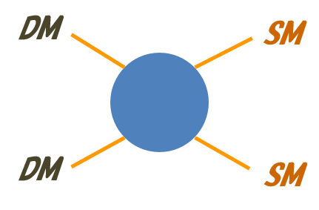
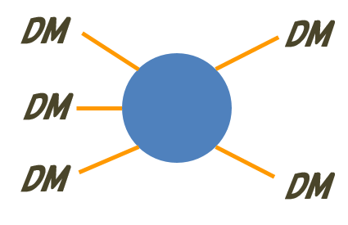
Dark matter candidates
1/6
10^{–22}eV < m < 10³⁵g
What is DM?
10^{–22}eV < m < 0.1GeV
0.1 eV < m < 10¹⁹GeV
10¹⁹GeV < m < 10³⁵g
Wave-like
Particle
Macroscopic
Eg. Axion
Eg. PBH
Thermal
Non-thermal
10^{–2}GeV < m < 10⁵GeV
Eg. Sterile ν
…
Freeze-out
Asymmetric
SIMP-like
…
WIMP-like
Freeze-out mechanism is known
to describe BBN, recombination phenomena very successfully!!!

Slide 3
Thermal WIMP-like Dark Matter
2/6
We take the following method to study the dark matter systematically.
Classifying the dark matter in terms of its quantum numbers and constructing the minimal renormalizable Lagrangian in each case.
(Here, quantum numbers mean spin, weak isospin, & hypercharge.)
Putting the thermal relic abundance condition and imposing all the (expected) limits from DM searches before future lepton colliders.
Discussing the role of the colliders in allowed parameter regions.
According to the above study, uncharted WIMP-like DM candidates are
Leptophilic DM: Singlet fermionic DM interacting mainly with leptons.
CPV H-portal DM: Singlet fermionic DM governed by the χiγ₅χ |H|² int.
Weak-charged DM: Fermionic DM closed to SU(2)_{L} gauge eigenstate.
Light DM: Singlet fermionic DM whose mass is much below the EW scale.

Slide 4
Uncharted WIMP-like DM candidates
3/6
Leptophilic DM
E.g. DM interacts with leptons via a mediator having a lepton number.
The DM is realized in the framework of MSSM, slepton-Bino system,
and it is possible to explain the muon anomalous magnetic moment.
[Yokozaki, et al., arXiv:1210.3122; L. Calibbi, et. al, arXiv:1804.00009]
The DM is efficiently detected by the mono- g
signal (ee → g c c) at future lepton colliders!!
[J. List, et. al, arXiv:2001.03011]
→ Talk by Yokozaki-san for more details!
γ
Mediator
μ
μ
χ
CPV Higgs-portal DM
E.g. DM interacts with the Higgs boson via the interaction, χiγ₅χ |H|².
The DM is known to be the simplest one to explain the anomalies at AMS-02 (anti-p) and Fermi-LAT (G.C. γ-ray) w/ about 50GeV mass.
[I. Cholis, et al, arXiv:1903.02549]
The DM is efficiently detected by the precise
invisible Higgs decays search when m_{χ} < m_{h}/2.
[ILD collaboration, arXiv:2003.01116]
→ Talk by Abe-san for more details!
χ
h
χ

Slide 5
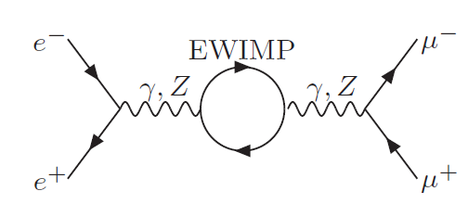
Uncharted WIMP-like DM candidates
4/6
Weak charged DMs
DM cand. described (almost) by an eigenstate of the weak interaction.
Those are predicted by attractive BSMs (AMSB, Focus Point, … )
The canonical way to detect the DM is the direct
production of DM & SU(2) partner at lepton col.
[H. Baer, et al, arXiv:1912.06643]
Precise measurement of ee → ff is also efficient.
[K. Harigaya, et al, arXiv:1504.03402; Suehara, et al, 1902.04245]
→ Talk by Chigusa-san for the search at future hadron colliders!
Light fermionic DM
DM candidate whose mass is much smaller than the scale of the EWSB.
A singlet and bosonic Z₂-even mediator must be introduced to have a renormalizable interaction between the light DM and SM particles.
When the mediator is a light scalar, DM has a large self-scattering X-section, while its annihilation X-section is p-wave suppressed.
vs.
The DM can have a large self-scattering , and solve the s
se are predicted by attractive BSMs (AMSB, Focus Point, … )
The canonical way to detect the DM is the direct
production of DM & SU(2) partner at lepton col.
[H. Baer, et al, arXiv:1912.06643]
Precise measurement of ee → ff is also efficient.
[K. Harigaya, et al, arXiv:1504.03402; Suehara, et al, 1902.04245]
→ Talk by Chigusa-san for the search at future hadron colliders!
χ
χ
χ
Med
It can solve the small
scale crisis of universe.
Med
χ
χ
χ
χ
Med

Slide 6

Uncharted WIMP-like DM candidates
5/6
Indeed, it is possible to find the parameter region that solve the small scale crisis (core-cusp problem) and is consistent with all constraints from DM searches as well as conditions such as the thermal relic one.
[S.M., Y. S. Tsai, P. Y. Tsng, JHEP07 (2019)]
The most efficient way to detect the dark matter in the parameter
region is the search for the exotic Higgs decay; h → φφ (→ eeee)!
Since the life time of φ is quite long, this exotic
decay is observed as the invisible Higgs decay.
The branching fraction of the exotic decay,
h → φφ is expected to be above 1% ;-)
φ
SM
SM
h
SM
φ
SM

Slide 7
Summary
6/6
Future lepton colliders can play important roles to detect the thermal (WIMP-like) dark matter. Well-motivated examples are as follows:
DM candidates Motivation Signal @ Lepton Collides
CPV H-funnel DM Anti-p excess Invisible H-decay
Leptophilic DM g_{μ} - 2 Mono-γ process
Light DM Small scale crisis Exotic H-decay
Weak-charged DM SUSY models Oblique correction
It is also interesting to study how important role the future lepton colliders can play for dark matter candidates in different categories!

