Slide 1
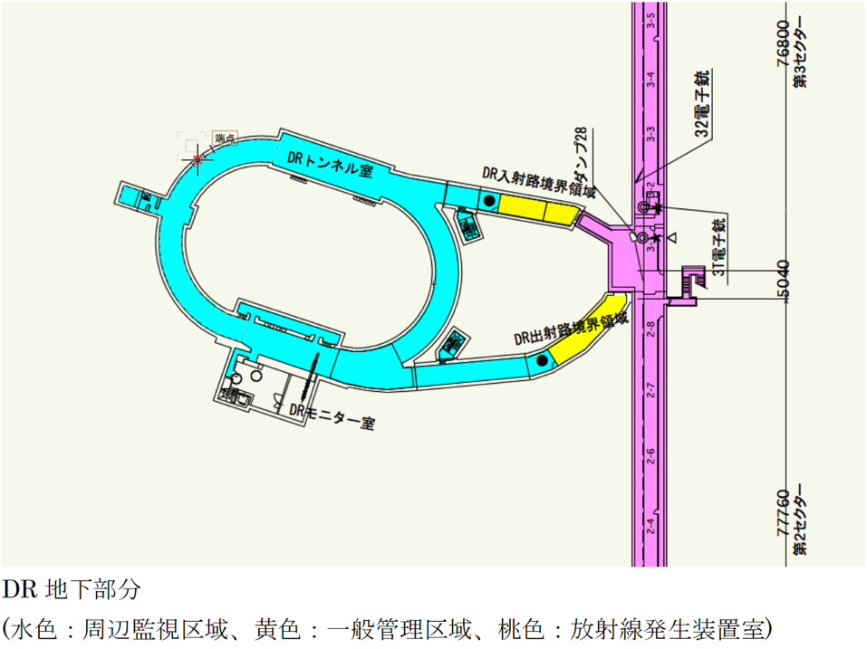
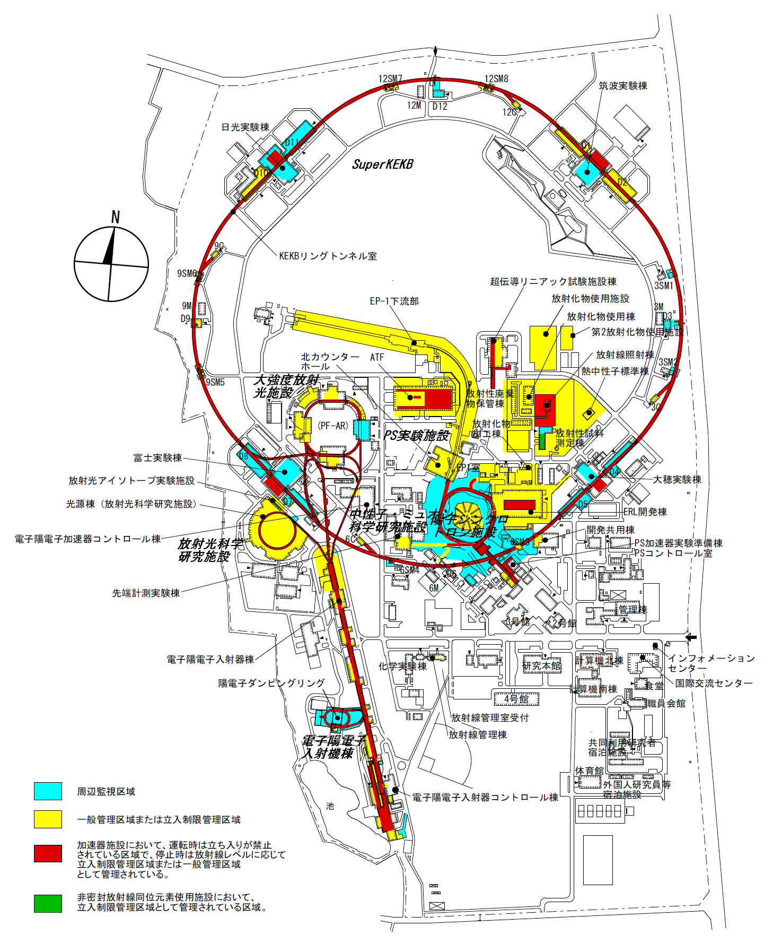
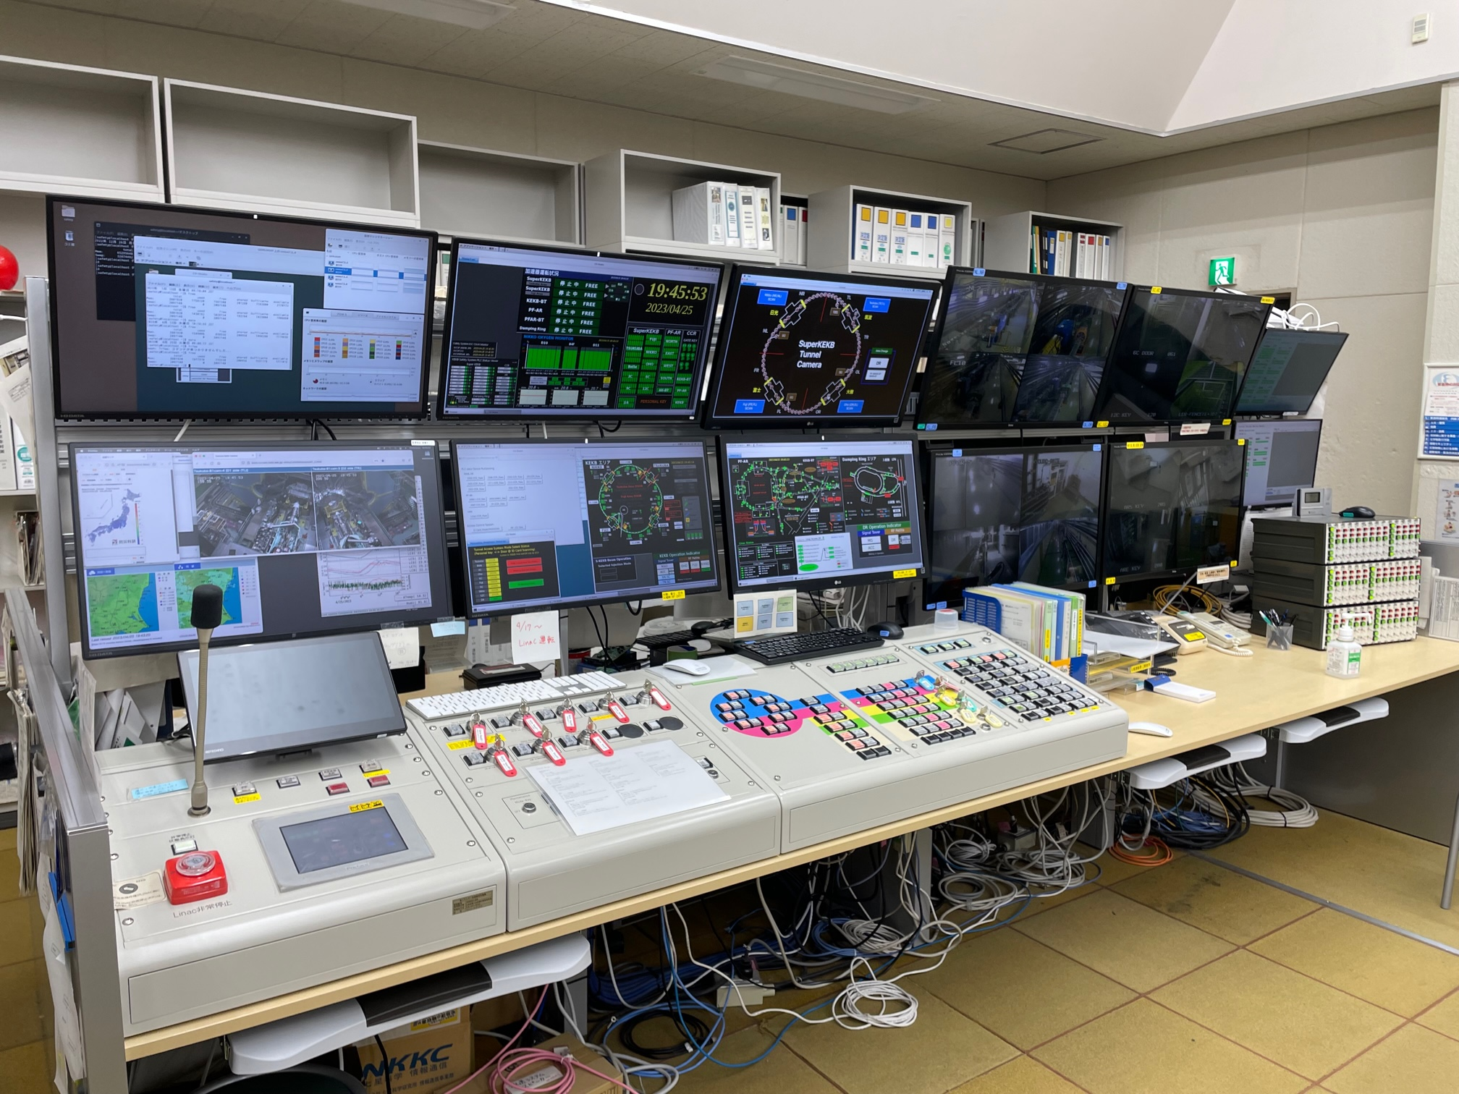
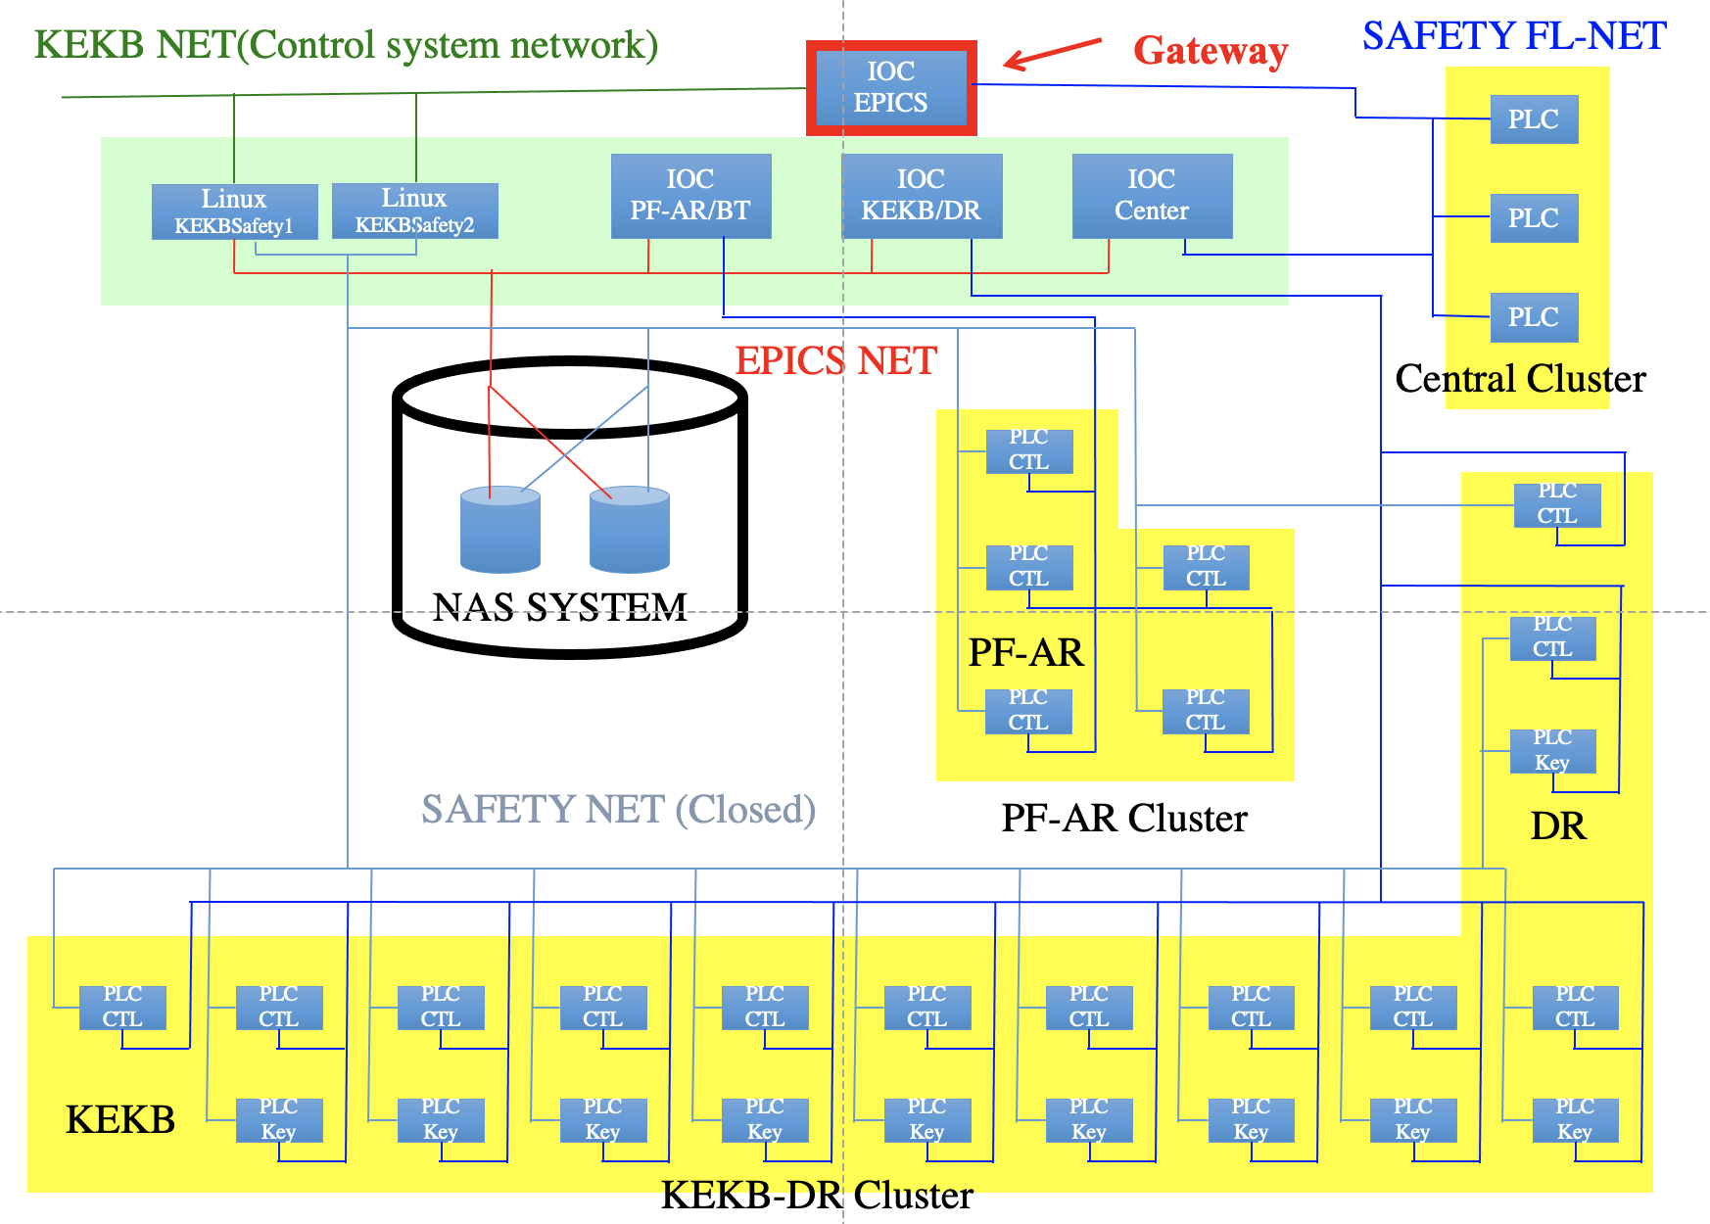
OPID:PO09 PID:38
How to rejuvenate personnel protection system of SuperKEKB
T. Mimashi†, M. Ono, K. Kudo, High Energy Accelerator Research Organization, Tsukuba, Japan M. Tanaka, N. Tanaka, Mitsubishi Electric System ＆ Service Co. Ltd., Tsukuba Japan E.Ogawa, Cyber Techno Limited Company, Hachiouji, Japan
Abstract
The personnel protection system (PPS) of SuperKEKB takes care of many accelerators. Since they are closely related with each other, the PPS cannot be modified or updated during the accelerator operation period. The period for the system upgrade suffers great restrictions by the accelerator operation schedule. Furthermore, due to the construction of PF-AR/BT line and PDR and Super-KEKB, PPS must be updated to fit the corresponding accelerator operation. This paper describe how the system has responded these request.
PDR
PPS Design Philosophy
The interlock system uses hard wires and dose not uses the network nor general purpose computer. The PLCs are installed in each local control room, and the information used for interlock is gathered as ON / OFF logic signal to the central PLC system through the optical fiber. The information gathered through the Ethernet are used for monitor purpose, never used for the safety interlocks.
Accelerator | #of Key | Door (Entrance) | Emergency Button | Indicator Light | Surveillance Cameras
SuperKEKB | 176 | 44(9) | 118 | 160 | 85
SuperKEKB/BT | 16 | 14(2) | 24 | 22 | 25
PDR | 16 | 8(1) | 11 | 21 | 14
PF-AR | 80 | 18(4) | 39 | 38 | 24
PF-AR/BT | 8 | 6(2) | 12 | 23 | 10
User Interface
1:Interlock control : Console in CCR
2: Monitor : EPICS + CSS, BOY
3: Logging : CSS archiver
Requirement for the ppS
(1) PPS renewal work (construction of PF-AR/BT, PDR and Super-KEKB) must be compatible to the operation of accelerator .
(2) An access control to radiation controlled areas must be continued without interruption.
Modularization of local/central PLC system.
PLCs of each local control room and CCR are exchanging only logic signals through the optical fiber. The PLC system can mix a plurality of vendor models.
The access control system (Configured independently from the main PPS)
It communicates with the main PPS by the logic signal, it can be updated separately from the main PPS.
The monitoring system ( Separated from interlock system )
The reliability of the interlock system must be very high and have to be constructed as the level of hard wire. But the reliability of the monitoring system is a little more acceptable and can be constructed with various technologies such as networks and server computers.
Pilot system for logic debugging
The programing and its verification has been done with simulation system. All input and output are simulated with PLC internal relay. Input operations and status monitor has been made through EPICS frame work.
PLC & EPICS System
1:Yokogawa Electric FA-M3V Leading Edge Controller
2: Network
(1) Safety Net : Download the rudder program.
(2)FL-Net : Status Monitoring
(3) EPICS Net : Send info to EPICS System
Date | History
2010.6 | KEKB Terminate
2010.6 | SuperKEKB Accelerator Construction Start
 | PDR Tunnel Construction Start
2013.3 | PF-AR/BT Tunnel Construction Start
2014.3 | PDR Tunnel Complete
2014.5 | PF-AR/BT Tunnel Complete
2016.1 | SuperKEKB Phase 1 Start
2016.6 | SuperKEKB Phase 1 End
2016.6 | PF-AR/BT Accelerator Construction Start
2017.2 | PF-AR/BT Operation Start
2018.1 | DR Operation Start
2018.3 | SuperKEKB Phase 2 Start
2018.7 | SuperKEKB Phase 2 End
2019.3 | SuperKEKB Phase3 Start
2021.9 | Fuji Mode Operation Start
FL-Net Cluster
FL-Net is used only as a monitoring purpose and does not contribute to interlock.
Accelerator | # of Node | Cluster name
SuperKEKB | 18 | KEKB Cluster
SuperKEKB/BT | 2 | PF-AR Cluster
PDR | 2 | KEKB Cluster
PF-AR | 5 | PF-AR Cluster
PF-AR/BT | 1 | PF-AR Cluster
Central | 2 | Central Cluster

