Slide 1
Update on high-Q cavities at SHINE
Jinfang Chen
SARI / ShanghaiTech, SHINE project
TTC，September 8th，2022

Slide 2
OUTLINE
Introduction
Progress on high-Q cavities at SHINE
  Gradient improvement on N-doped cavities
  Better fast cooling schemes in VT
  High-Q preservation after He-tank welding
Summary

Slide 3
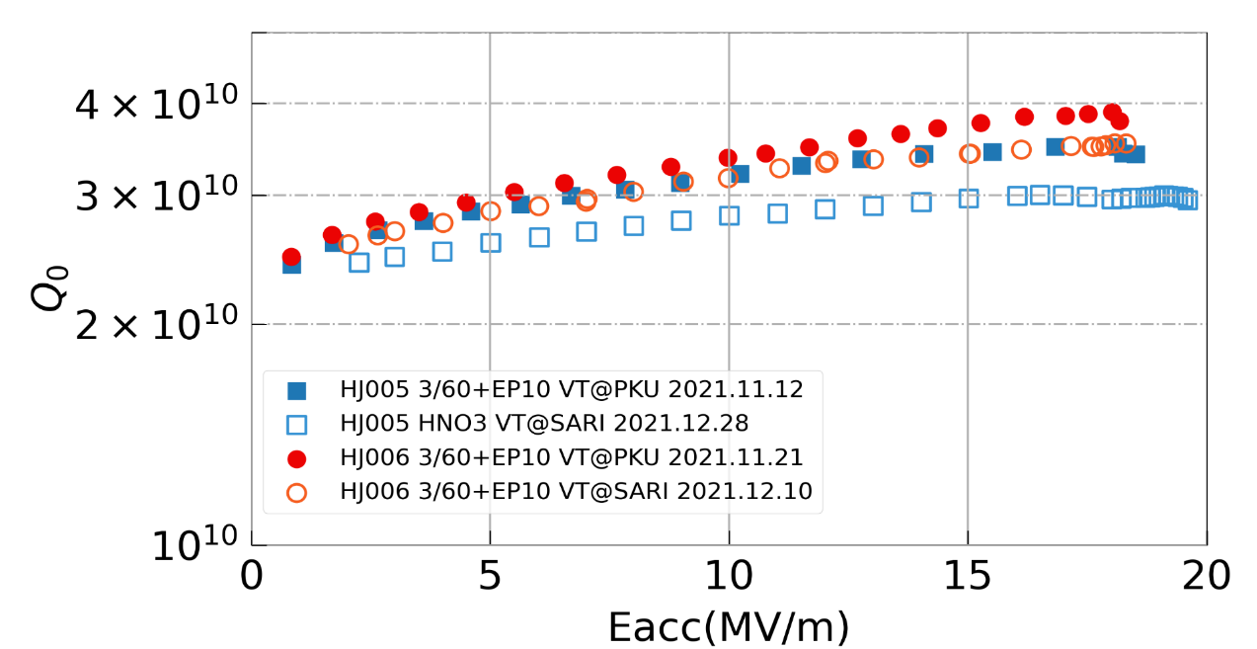
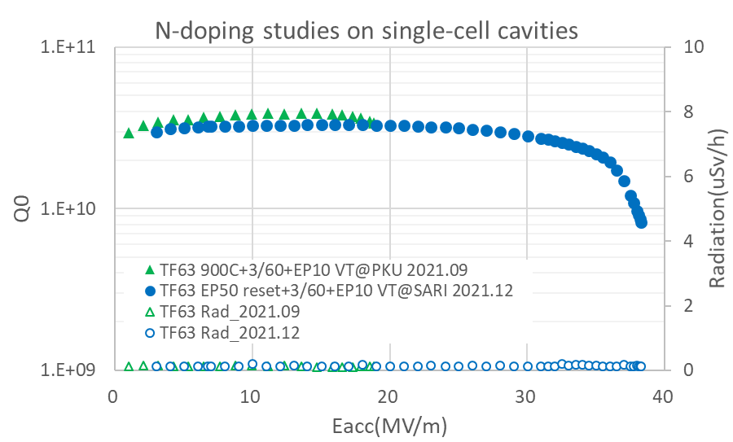

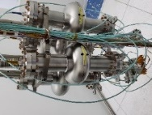
Introduction - Results on the previous TTC meeting (Jan. 25th)
High-Q studies at SHINE, based on the SHINE new facilities in the co-built Wuxi platform.
Reports on Jan. 25, 2022
  High-Q achieved with both N-doping and mid-T baking recipes
  At beginning, max gradient limited at around 18.5 MV/m on N-doped cavities
  On single-cell cavity，max gradient was improved by EP reset (~split bulk EP) and re-doping
  Lower Q₀ (10%~30%) in SARI VT, likely due to poor flux expulsion
N-doping on 9cell cavities
~19 MV/m
38 MV/m

Slide 4
Outline
Introduction
Progress on High-Q cavities at SHINE
  Gradient improvement for N-doped cavities
  Better fast cooling schemes in VT
  High-Q preservation after He-tank welding
Summary

Slide 5
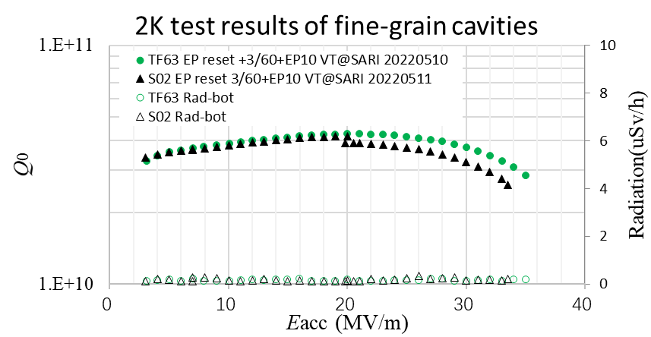
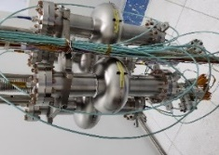
Gradient improvement on single-cell cavities
R&D to improve max Eacc for N-doped single cavity
  Cav1(TF63): After 50um EP reset and re-doping at 800C, max Eacc doubled, ~38 MV/m while maintain high-Q.
  Cav2(S02): with same recipe as Cav1, RF performance repeated!
~19 MV/m
3.E+10
Admin limit
4.E+10
38 MV/m

Slide 6
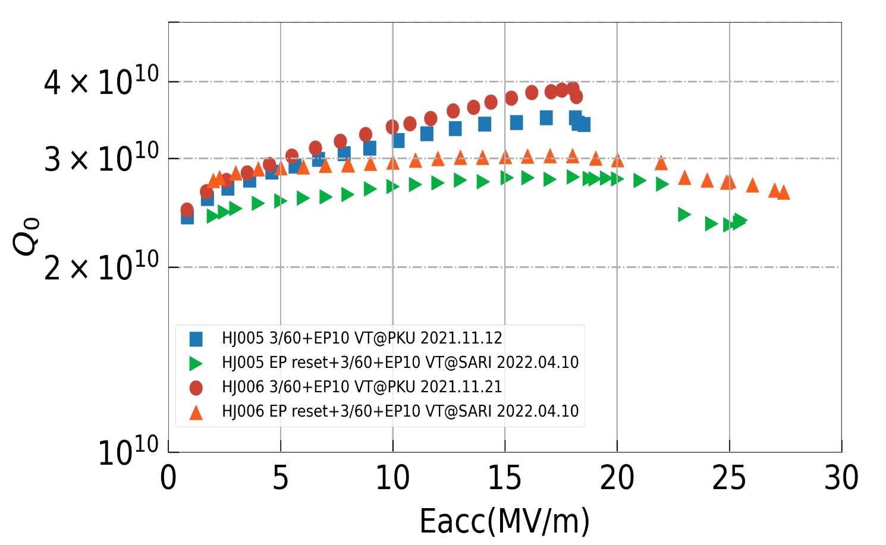
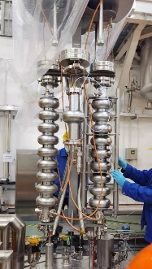
Gradient improvement on 9-cell cavities
Surface treated with SHINE facilities in Wuxi
Recent progress on N-doped 9cell cavities: Q₀>2.8E+10@16MV/m, Eacc>25 MV/m
Q₀ difference likely due to different fast cooling at PKU and SARI (improved since May)
N-doped 9-cell cavities
~ 8MV/m
Same processes applied:
EP 50um reset, acid T≤10℃
Ramp up to 800C, hold 30mins
3 mins N2 injection, 60 mins annealing
EP 10um, acid T≤10℃

Slide 7
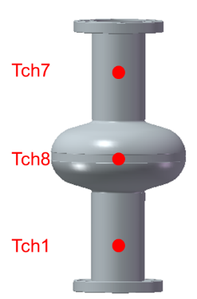
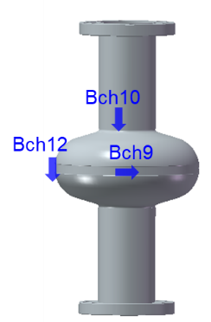
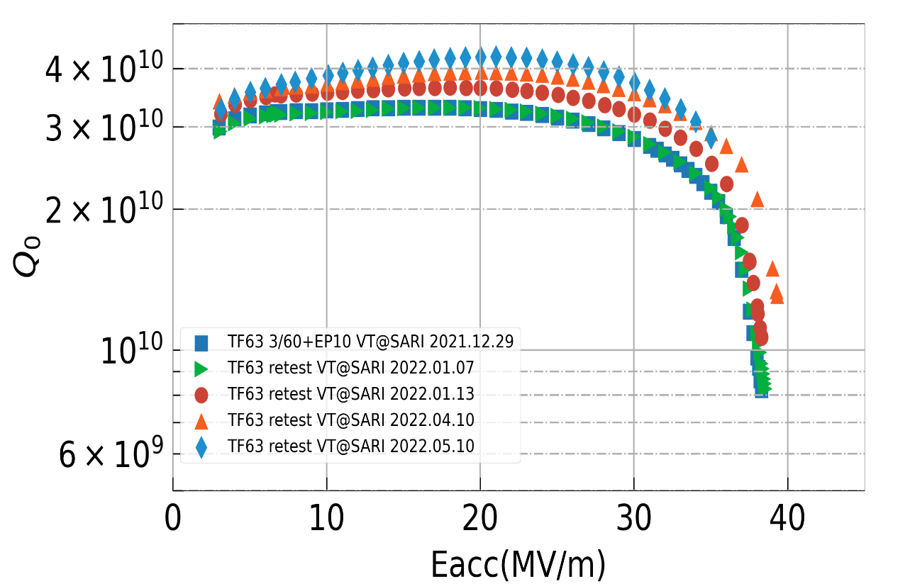
Better fast cooling schemes in VT
R&D on fast cooling schemes in vertical tests at SHINE: higher thermal gradient for a better flux expulsion.
Now we are able to test cavity of Q₀> 4E+10.
~ 25% increased
T-sensors
Admin limit
N-doped single-cell cavity
9.2K
Fast cooling for the VT (5.10)

Slide 8
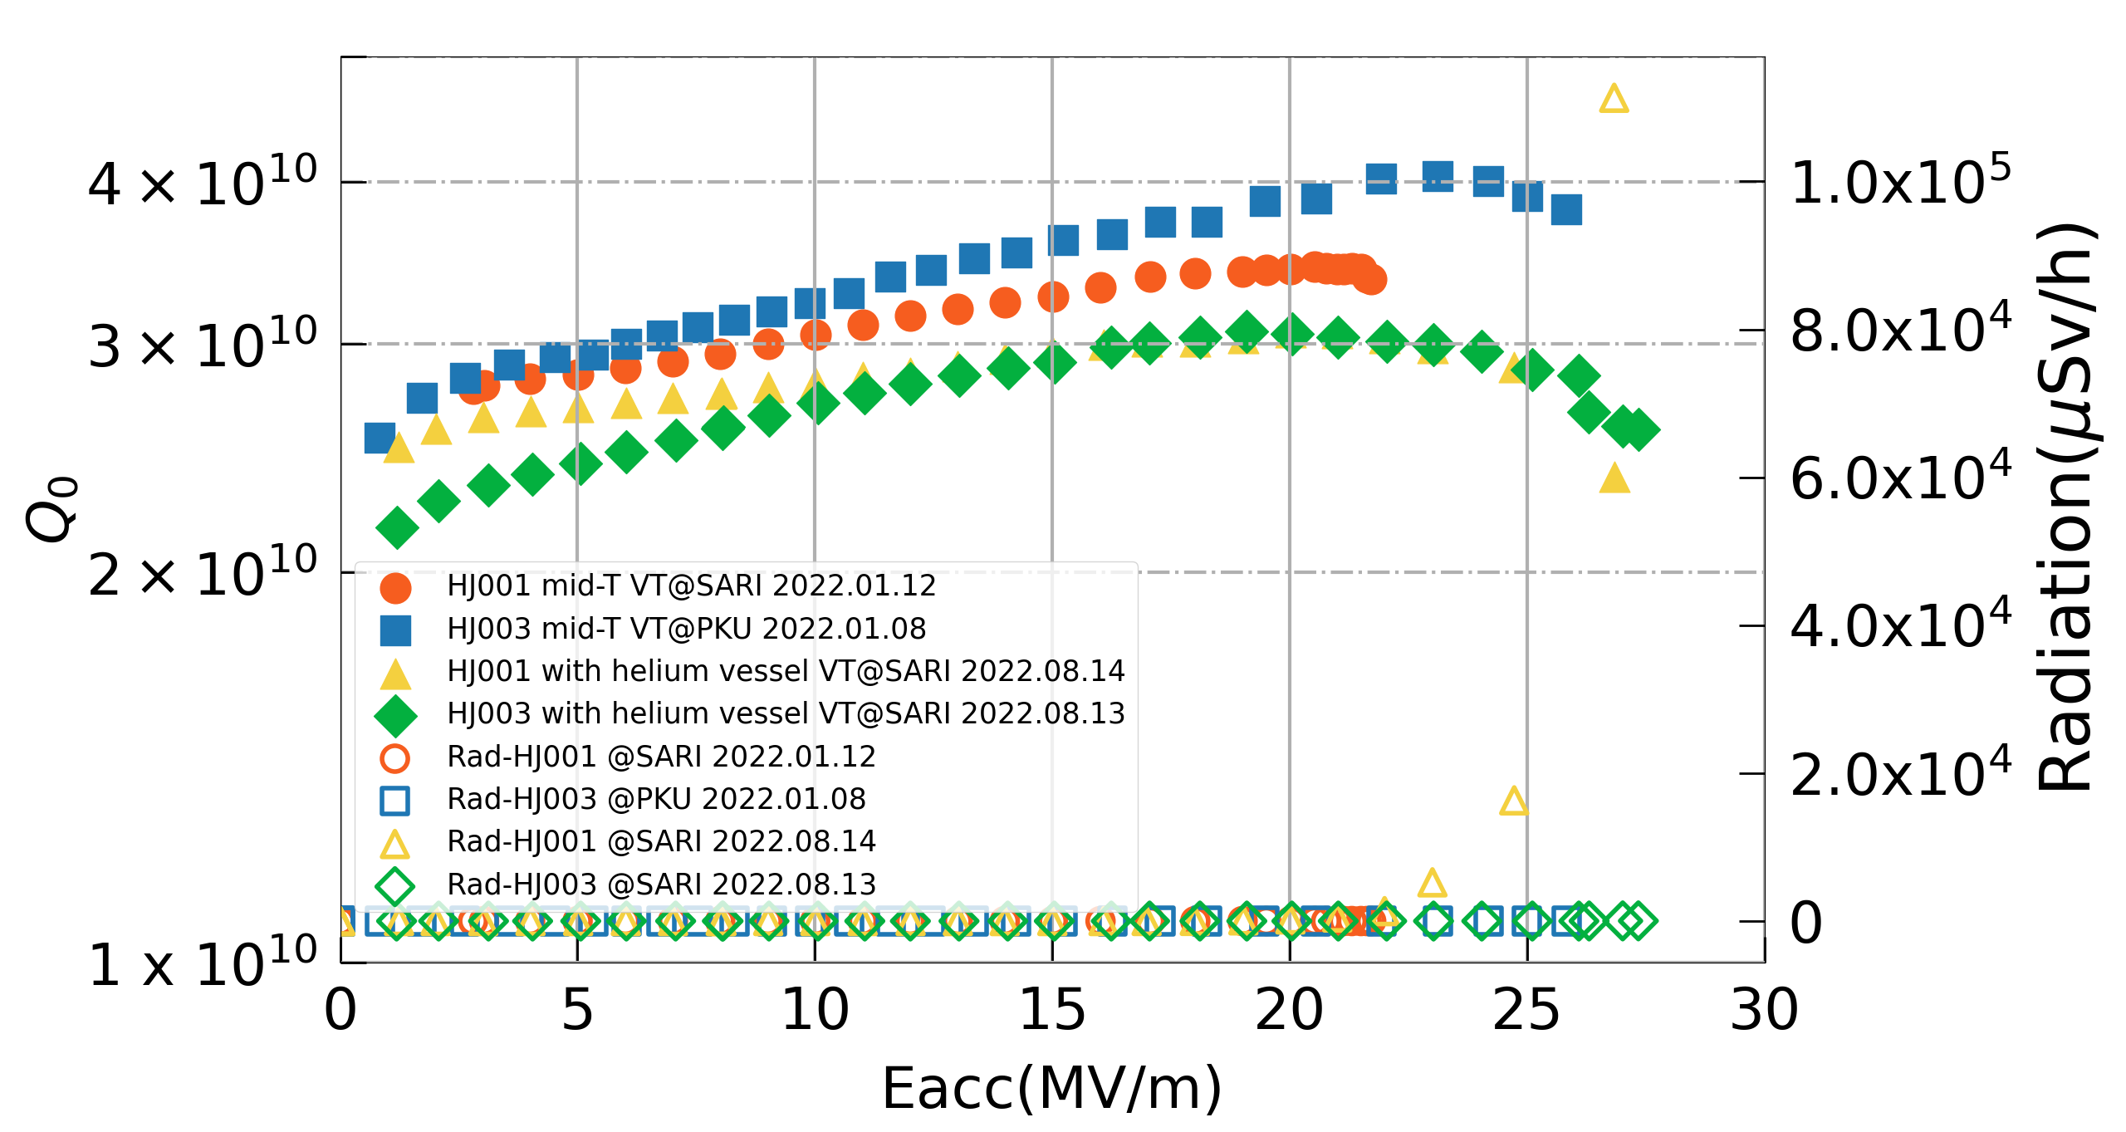
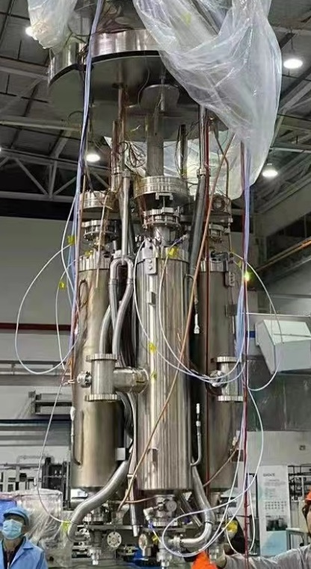
High-Q preservation: bare to dressed cavity
Four 9-cell cavities treated in Wuxi platform, have been welded with He-tank.
Two midT-baked cavities, high-Q preserved after He-tank welding. The other two N-doped dressed cavities are under test.
Mid-T baked 9-cell cavities
Bare cavities
Dressed cavities
(300C/3h)

Slide 9
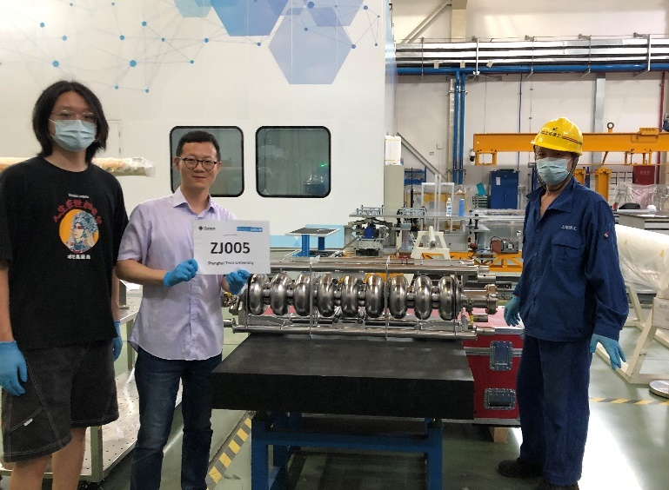
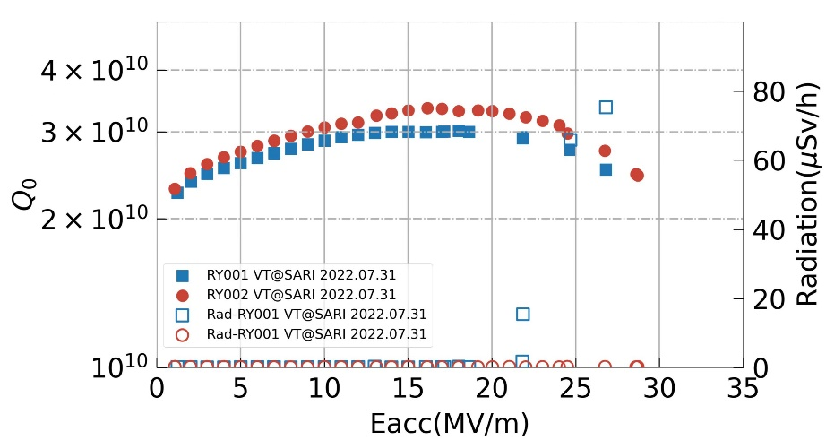
High-Q: transfers to cavity manufactories
High-Q recipes have been transferred to manufactories, including foreign vendors.
High-Q achieved on the first bare cavities, tested in Shanghai. Cavities will be sent back to vendors for Helium-tank welding.
First 2 bare cavities produced by vendor B with High-Q recipes offered by SHINE
2nd cavity produced by vendor A, arrived

Slide 10
Outline
Introduction
Progress on High-Q cavities at SHINE
  Gradient improvement for N-doped cavities
  Fast cooling schemes in VT
  High-Q preservation after He-tank welding
Summary

Slide 11
Summary
High-Q cavities R&D has been carried out at SHINE, based on the newly constructed infrastructures for cavity surface-treatments, cavity test etc.
Progress achieved on high-Q cavities R&D in the past months, including the N-doping, MidT baking, flux expulsion in vertical test etc. Now, we are able to achieve
  On single-cell cavities: Q₀>4.0E+10 @16-21 MV/m, max Eacc >33 MV/m;
  On 9-cell cavities (both N-doping and midT baking): Q₀>2.8E+10 @16-21 MV/m, max Eacc >25 MV/m;
  Better fast cooling schemes for high-Q cavity tests;
  High-Q maintaining from bare to dressed cavities;
  High-Q recipes transferred and realized in manufactories.
Next step, the 1st prototype CM with 8 high-Q cavities is in preparation for assembly, including 4 midT-baked cavities from IHEP, 2 midT-baked and 2 N-doped cavities from SARI, and 2 Large-grain cavities (cooperated with DESY) as backup.

Slide 12
References:
Ari D. Palczewski’s talk, High Qo/High gradient at JLab: LCLS-2 HE 3N6 doping, furnace issues and FNAL 75˚C retests, TTC meeting, at TRIUMF, Feb 5th – 8th 2019.
Dan Gonnella’s talk, The LCLS-II-HE R&D Program - New Insights into Improving the Performance of Nitrogen-Doped SRF cavities, IPAC’21
Kensei Umemori’s talk, New results of KEK New results of KEK，TTC meeting, at CERN, Feb 4th 2020.
Feisi HE, et al., Experimental study of simplified mid-T furnace baking at IHEP, Supercond. Sci. Technol. 34 (2021)
  Special thanks
  To Wuxi Creative, OSTEC, HIT, PKU, IHEP, DESY, INFN-LASA, KEK, RI, ZANON and many other cooperative institutions and companies
To everyone in SHINE cryomodule team and cryogenic team, as well as to Zhi Liu’s team in ShanghaiTech University.
Thanks for your attention!

