Slide 1
The Frequency shift measurements of mid-T treated cavities
Rezvan Ghanbari
on behalf of SRF R&D team
14 December 2022

Slide 2
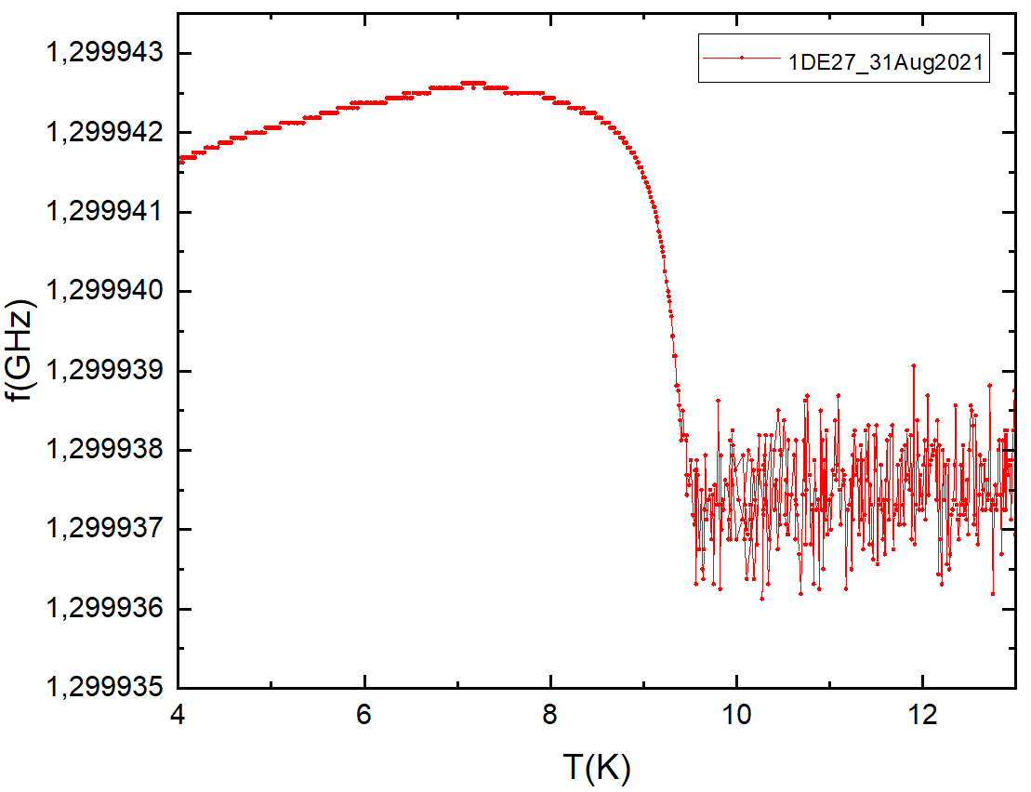
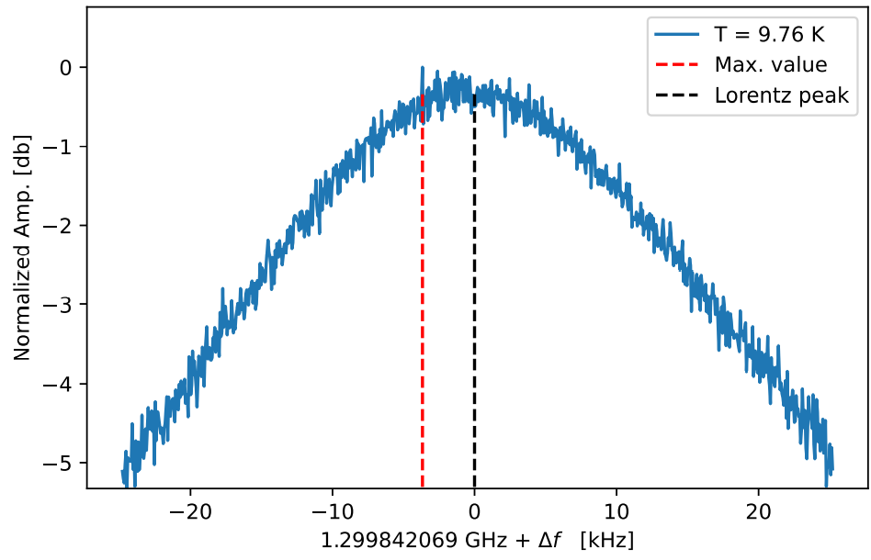
Too much noise prevent resolution of the dip
VNA cannot sample fast enough
In first attempts, low SNR above 9K prevented dip behavior studies
Warm-up / cool-down process to fast to improve SNR by simple VNA adjustments

Slide 3
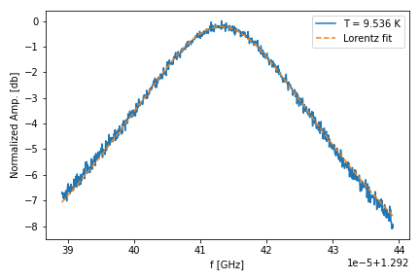
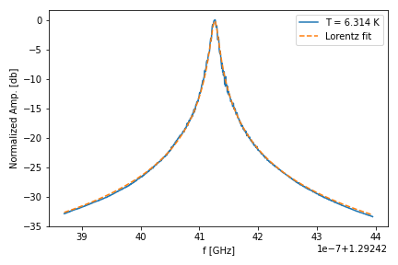
Accurate f₀ due to Lorentz fit
Record spectrum of each frequency sweep
Fit the Lorentz curve to each spectrum
Significant improvement above 9K
Below 9K results are identical due to high SNR
$$P\left(f\right)= A_{0}^{2}\frac{γ^{2}}{[{(f−f_{o})}^{2}+γ^{2}]}$$

Slide 4
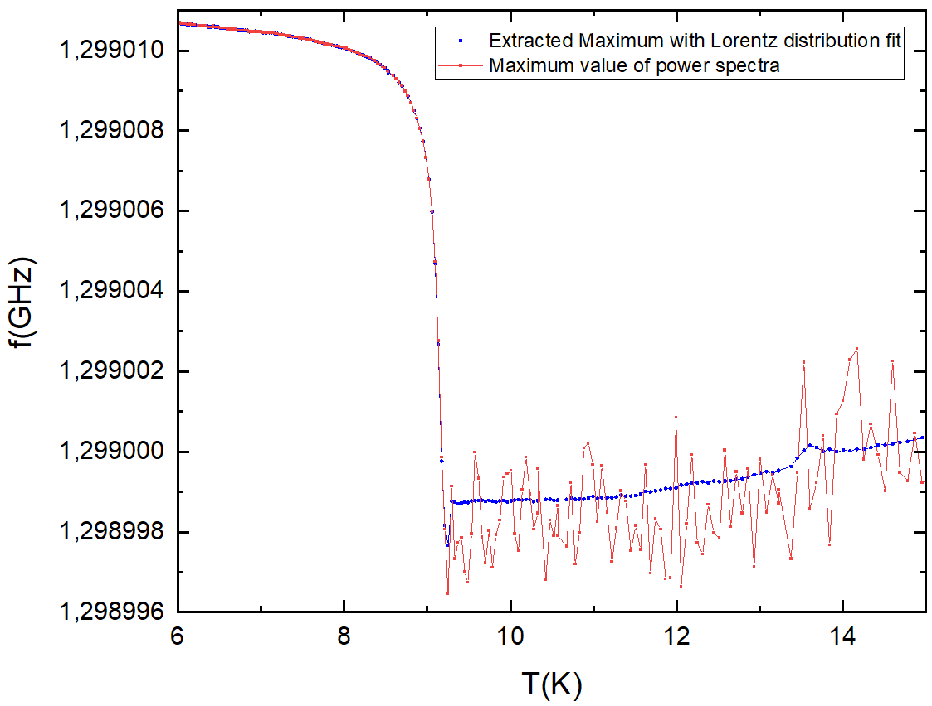
Dip behavior is now resolved

Slide 5
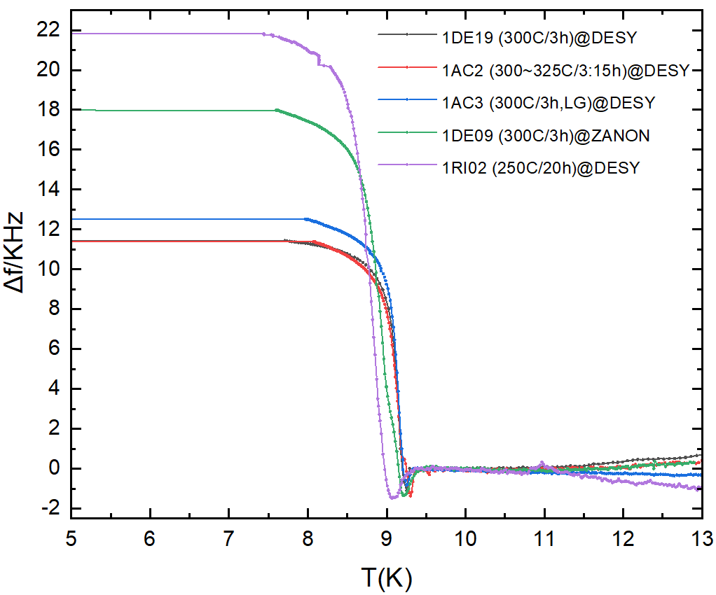
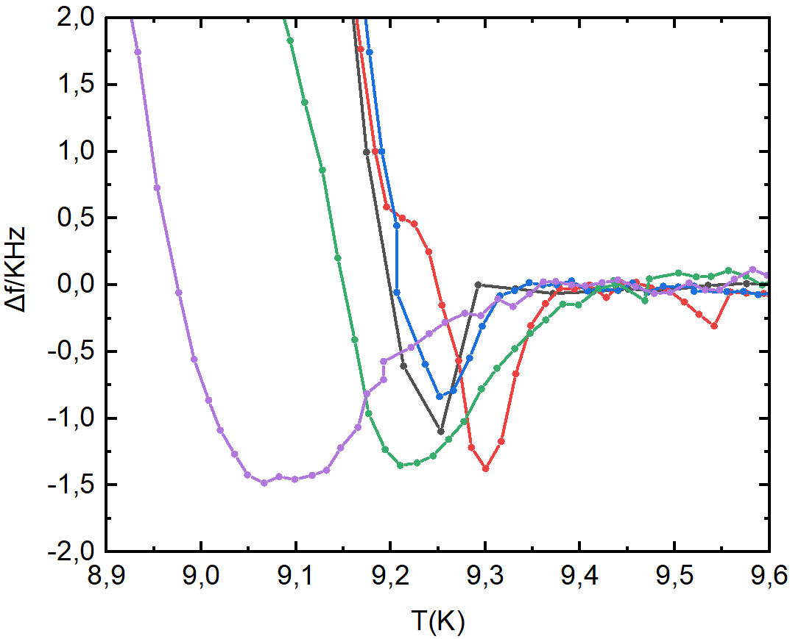
f vs. T of 5 Cavities
Cavity | Δf / kHz | Δf_{dip} / kHz | ΔT_{dip} / K
1DE19 | 11.45 | 1.10 | 0.04
1AC2 | 11.47 | 1.34 | 0.08
1AC3 | 12.84 | 0.88 | 0.09
1DE09 | 17.69 | 1.35 | 0.23
1RI02 | 21.77 | 1.48 | 0.29
Δf
Δf_{dip}
ΔT_{dip}
Note: A change of f is observed above T_{C} of Nb.
Temperature of cavity & sensor maybe not in equilibrium due to too fast cool down
Hence a relative definition of the dip position ΔT_{dip}

Slide 6
Summary
Improved resolution of f vs. T measurements with noise reduction procedure
Tested five mid-T treated cavities:
20h@250°C shows larger f shift as well as larger dip depth
LG cavity shows lower dip depth and higher f shift compare to FG cavity after the same treatment
Similar results after the same mid-T treatment in the same furnace
Temperature sensor and cavity might not be in equilibrium due to warm-up rate
Next steps:
Increase statistics: continue frequency shift measurements for mid-T treated cavities
Develop an optimal length of input antenna suitable for all RF measurements
Optimize VNA settings to further reduce noise floor
Improve heating control system in cryostat during cool-down and warm-up

Slide 7
Thank you
Contact
Deutsches Elektronen-
Synchrotron DESY
www.desy.de
Rezvan Ghanbari
Institute of Experimental Physics
University of Hamburg
E-mail: rezvan.ghanbari@desy.de Phone: (+49) 040-8998-4321

