Slide 1
Experimental study of phase space rotation for high luminosity beam generation at STF
Keisuke Date
Hiroshima University M

Slide 2
Outline
① Need for ILC
② Research Background
③ Theory of phase space rotation (RFBT and TLEX)
④ Simulation of RFBT
⑤ Summary

Slide 3
① Need for ILC
○ What is the ILC?
・ILC (International Linear Collider )
・Electron-Positron collision type linear accelerator
・Planned to be built in Iwate Prefecture
・Center mass energy 250GeV
○ Objective of ILC
・Reproducing the Big Bang by electron-positron annihilation
・Explore unknown elementary particles
○ Features
・No energy loss due to synchrotron radiation
→Highly efficient at high energy
・Repeated collisions are not possible
→Need to increase reaction probability

Slide 4
② Research Background
○ Event frequency per unit time at collision point $N$
○ Electricity requirements
○ Energy spread caused by Beamstrahlung
$ℒ$：Luminosity（Specific to accelerators）
$$N=ℒσ$$
$σ$：cross section
$$ℒ=\frac{{f_{rep}n}_{b}N^{2}}{4πσ_{x}σ_{y}}$$
$$f_{rep}:repeat frequency$$
$$n_{b}:Bunch number per pulse$$
$$N:particle number$$
$P_{w}=2ηEf_{rep}n_{b}N$
$$∆E∝{(\frac{1}{σ_{x}+σ_{y}})}^{2}$$
$σ_{x}$：Beam size in x-direction
$σ_{y}$：Beam size in y-direction
→To reduce power consumption and energy spread while increasing luminosity ...
Asymmetric emittance beam ($σ_{x}≫σ_{y}$ , $ε_{x}≫ε_{y}$ )required

Slide 5
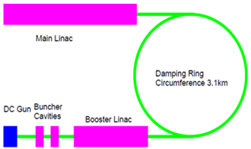
To create extremely asymmetric emittance beams
○ Basic design of the ILC
・With a Damping Ring of 3.1 km in circumference
・Generating asymmetric emittance beam using Damping Rings
・At the point of impact $ε_{x}=$10𝜇𝑚 , $ε_{y}=$0.04𝜇𝑚 Emittance required
○ Our proposal
・Emittance exchange (RFBT, TLEX) in 6D phase space
・RFBT : generate x,y extremely asymmetric emittance
・TLEX：exchange x,z emittance
・Damping Rings are no longer required
→Construction costs can be reduced and design simplified.

Slide 6
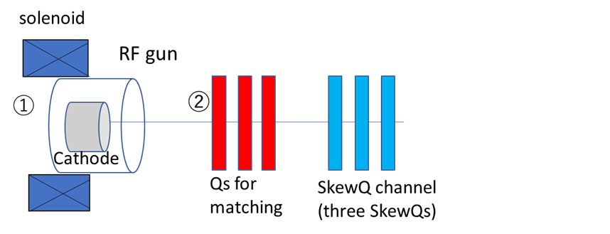
③ Theory of phase space rotation (RFBT)
RFBT(Round to Flat Beam Transformation)
①Solenoid generates magnetic field on cathode surface
$$X=\left(\begin{matrix}x \\ x^{′}−ky\end{matrix}\right)$$
$$Y=\left(\begin{matrix}y \\ y^{′}+kx\end{matrix}\right)$$
$$k=\frac{eB}{2P_{z}}$$
$$Σ=\left[\begin{matrix}σ^{2} & 0 & 0 & kσ^{2} \\ 0 & k^{2}σ^{2}+σ^{′2} & −kσ^{2} & 0 \\ 0 & −kσ^{2} & σ^{2} & 0 \\ kσ^{2} & 0 & 0 & k^{2}σ^{2}+σ^{′2}\end{matrix}\right]$$
→$ℒ=kσ^{2}$：angular momentum
→$ε=\sqrt{ε_{u}^{2}+ℒ^{2}}$ （$ε_{u}=σσ′$）
②Matching twiss parameter with quadrupole
$$α_{x}=α_{y} β_{x}=β_{y}$$
③Remove x-y correlations with 3 skew quadrupole
$ε_{x}=\sqrt{ε_{u}^{2}+ℒ^{2}}+ℒ$ $ε_{y}=\sqrt{ε_{u}^{2}+ℒ^{2}}−ℒ$

Slide 7
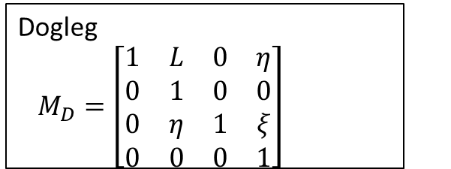
③ Theory of phase space rotation (TLEX)
TLEX(Transverse to Longtidunal Emittance eXchange)
Cavity (thin lens)
$$M_{C}=\left[\begin{matrix}1 & 0 & 0 \\ 0 & 1 & k \\ \begin{aligned}0 \\ k\end{aligned} & \begin{aligned}0 \\ k\end{aligned} & \begin{aligned}1 \\ 0\end{aligned}\end{matrix} \begin{matrix}0 \\ 0 \\ \begin{aligned}0 \\ 1\end{aligned}\end{matrix}\right]$$
○4D phase space vector
$$s=(x,x^{′},z,δ)$$
○EEX transfer matrix
Create a x’-z,x-δ correlation
↓
Transverse kick proportional to the z-position of the particle
↓
Remove the correlation
$$M_{EEX}=M_{D}M_{C}M_{D}$$
$$1+kη=0$$
$k$：transverse kick strength
$η$：transverse dispersion
$ξ$：momentum compaction
$$\left[\begin{matrix}x_{i} \\ {x′}_{i} \\ \begin{aligned}z_{i} \\ δ_{i}\end{aligned}\end{matrix}\right]=\left[\begin{aligned}\begin{matrix}−\frac{L}{η}z_{i}+\left(η−\frac{ξL}{η}\right)δ_{i} \\ −\frac{1}{η}z_{i}−\frac{ξ}{η}δ_{i} \\ −\frac{ξ}{η}x_{i}+\left(η−\frac{ξL}{η}\right){x′}_{i}\end{matrix} \\ −\frac{1}{η}x_{i}−\frac{L}{η}{x′}_{i}\end{aligned}\right]$$
$$\left[\begin{matrix}x_{f} \\ {x′}_{f} \\ \begin{aligned}z_{f} \\ δ_{f}\end{aligned}\end{matrix}\right]=$$
$$M_{EX}=\left(\begin{matrix}0 & 0 & kL & η+ξkL \\ 0 & 0 & k & kξ \\ kξ & η+ξkL & 0 & 0 \\ k & kL & 0 & 0\end{matrix}\right)$$
$\left|M_{EEX}\right|=1$ and the x-z elements are swapped so the emittance is exchanged

Slide 8
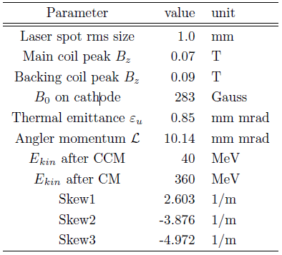
④ Simulation of RFBT
STF(Superconducting RF Test Facility)beam line
 | $ε_{x.norm}$(μm) | $ε_{y.norm}$(μm) | $${ε_{x}}/{ε_{y}}$$ | $$ε_{x}ε_{y}$$
theoretical value | 20.32 | 0.04 | 508 | 0.72
simulation | 20.36 | 0.05 | 407 | 1.02

Slide 9
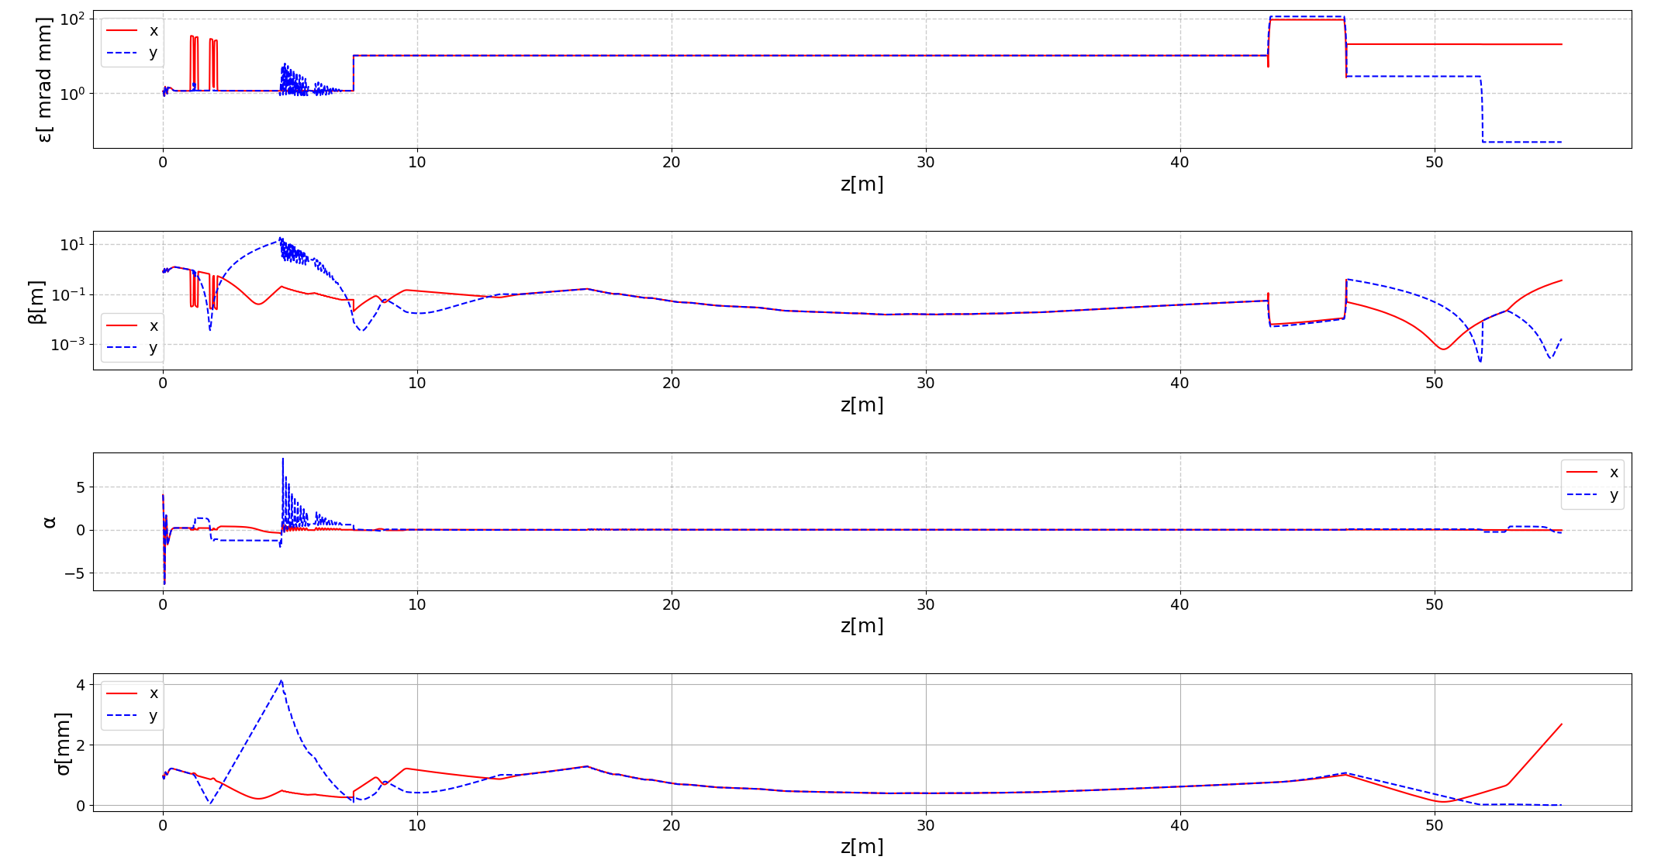

Slide 10
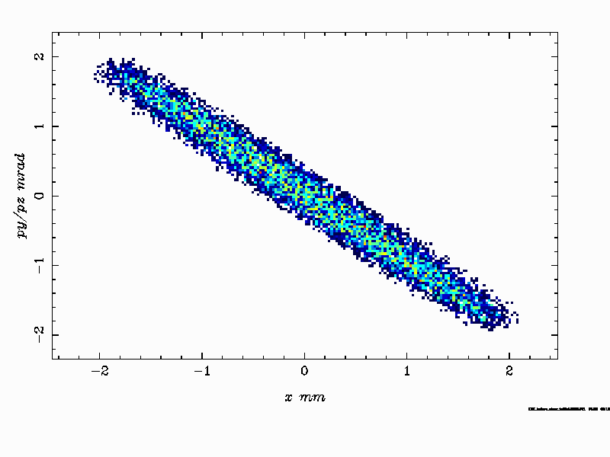
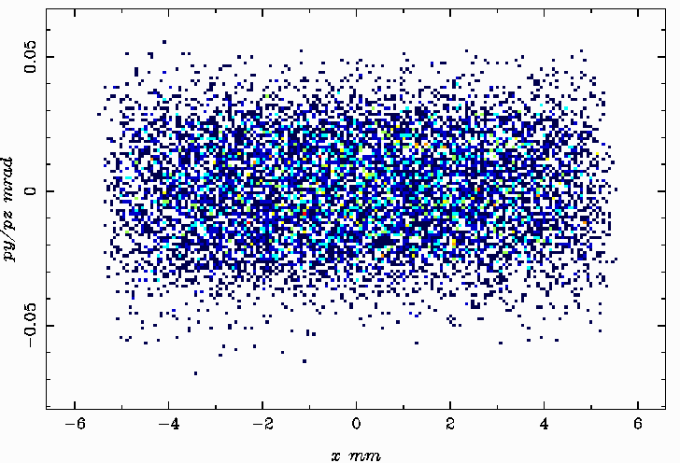
x-y’ correlation disappeared

Slide 11
⑤ Summary
To generate highly asymmetric emittance beams, we propose to use a phase space rotation technique.
RFBT was confirmed by simulation with ASTRA
We are currently in the phase of exploring conditions, including space charge effects, to minimize emittance growth in the upstream region.
Aim to connect RFBT and TLEX to design in the future

