Slide 1
Theoretical Approach and Nonlinear Optimization for Transverse Resonance Island Buckets Operation in Storage Ring
ISBA2023, Pohang, 6. Aug
K. M. Nam¹, Youngmin Park¹, G. S. Yun^{1,} Y. W. Parc^{2*}
¹Division of Advanced Nuclear Engineering, Pohang University of Science and Technology (POSTECH)
²Pohang Accelerator Laboratory, Pohang University of Science and Technology, Pohang 37673, Korea
*young1@postech.ac.kr

Slide 2
Table of Contents
1. Introduction
2. Theory - Hamiltonian of a storage ring - Structure of Hamiltonian and Optimization
3. Result
4. Summary

Slide 3
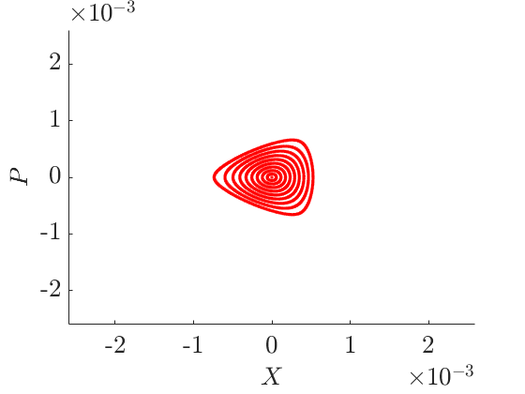
Introduction
In general, the horizontal phase space in a storage ring exhibits the shape shown above.
It has only one stable orbit and is not spatially separated.
It is necessary to separate and store the beams.
Therefore, a separate space is required to separate and store the beams.

Slide 4
Introduction
In general, the horizontal phase space in a storage ring exhibits the shape shown above.
It has only one stable orbit and is not spatially separated.
It is necessary to separate and store the beams.
Therefore, a separate space is required to separate and store the beams.

Slide 5
Introduction
In general, the horizontal phase space in a storage ring exhibits the shape shown above.
It has only one stable orbit and is not spatially separated.
It is necessary to separate and store the beams.
Therefore, a separate space is required to separate and store the beams.

Slide 6
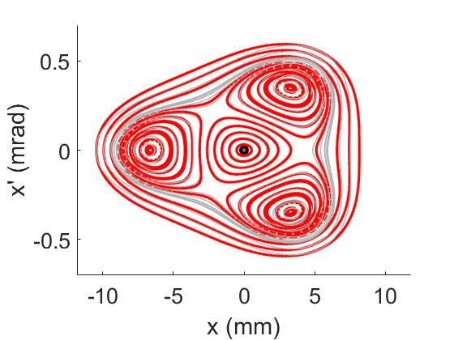
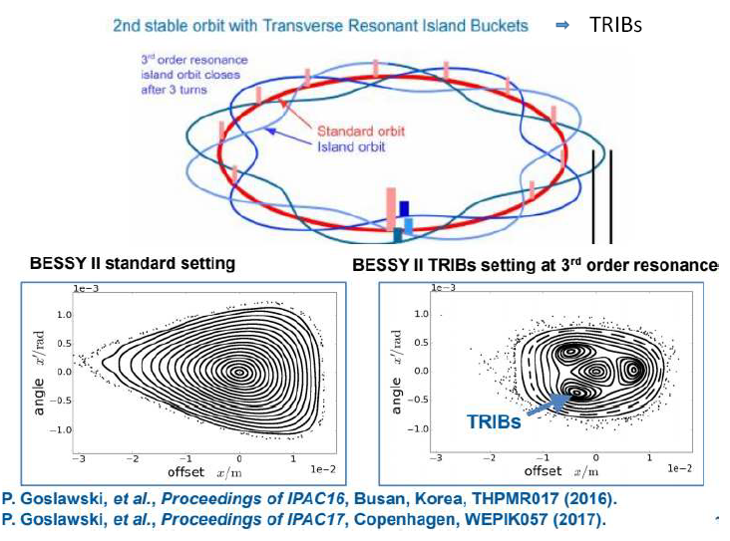
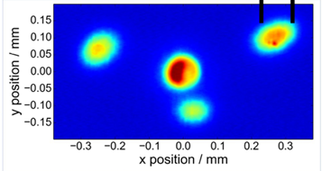
Introduction
Operating Machine close to horizontal 3rd order resonance
It makes 3 additional stable second orbit
It can separate or store the beam stably

Slide 7
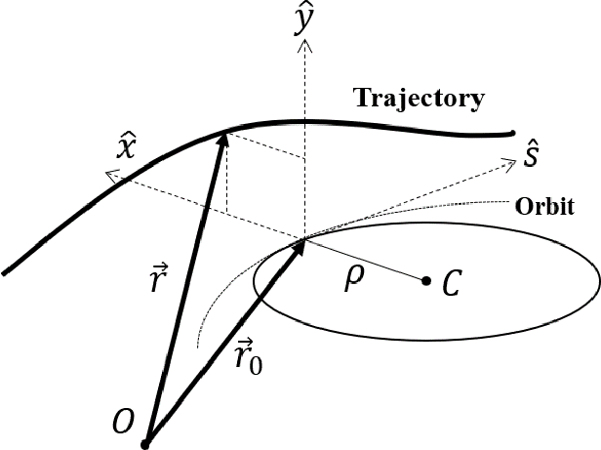
Theory
Hamiltonian of in Frenet-Serret coordinate system $ℋ=\frac{1}{2}x^{′2}+\frac{1}{2}k\left(s\right)x^{2}+\frac{1}{6}m\left(s\right)x^{3},$ where $k(s)$ is quadrupole strength distribution, $m\left(s\right)$ is sextupole strength distribution.
After canonical perturbation in action-angle variable (detailed derivation will be published), s-independent Hamiltonian is given by
$$ℋ_{4}\left(ψ,J\right)=\left(ν_{x}−\frac{l_{3ν_{x}}}{3}\right)J+g_{3,0,l_{3ν_{x}}}\cos{ξ_{3,0,l_{3ν_{x}}}}\cos\left(3ψ\right)J^{\frac{3}{2}}+\frac{1}{2}α_{−1}J^{2},$$
where $ν_{x}$ is horizontal tune, $l_{3ν_{x}}$ is integer closet to 3$ν_{x}$, $g_{3,0,l_{3ν_{x}}}$ is resonance strength, $α_{−1}$ is nonlinear detuning parameter.
To enable a convenient comparison between normalized coordinate ($x_{n}=\sqrt{I}\cos{φ}$, $p_{n}=−\sqrt{I}\sin{φ}$), we introduce the following quantities
$$X=\sqrt{J}\cos{ψ}, P=\sqrt{J}\sin{ψ}→ℋ_{4}\left(X,P\right)=δ_{ν}\left\{X^{2}+P^{2}\right\}+g_{3,0,l_{3ν_{x}}}\left\{X^{3}−3XP^{2}\right\}+\frac{1}{2}α_{−1}{\left\{X^{2}+P^{2}\right\}}^{2}$$

Slide 8
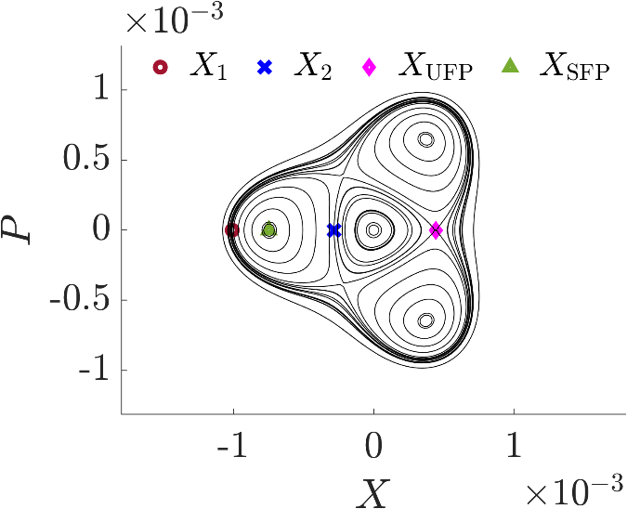
Theory
$ℋ_{4}\left(X,P\right)=δ_{ν}\left\{X^{2}+P^{2}\right\}+g_{3,0,l_{3ν_{x}}}\left\{X^{3}−3XP^{2}\right\}+\frac{1}{2}α_{−1}{\left\{X^{2}+P^{2}\right\}}^{2}$
$g_{3,0,l_{3ν_{x}}}=\frac{\sqrt{2}}{24π}\int_{0}^{C}{m\left(s\right)β_{x}^{\frac{3}{2}}\left(s\right)\cos\left(3χ_{x}\left(s\right)−\frac{3δ_{ν}s}{R}\right)}ds$
$α_{−1}=\frac{3}{2}\left(\sum_{n=−∞,n≠l_{3ν_{x}}}^{∞}{3\frac{g_{3,0,n}^{2}}{n−3ν_{x}}}+\sum_{n=−∞}^{∞}{\frac{g_{1,0,n}^{2}}{n−ν_{x}}}\right)$
$ℋ_{4}(X,P)$ consist of 3 island buckets and 1 triangle called center triangle.
It has 4 characteristic points $\left(X_{UFP},X_{SFP},X_{1},X_{2}\right)$. $X_{SFP}$ is center of island buckets and the others are boundaries between island buckets and center triangle. $X_{UFP} and X_{SFP}$ are given by
$$X_{UFP}=\frac{−3g_{3,0,l_{3ν}}+\sqrt{9g_{3,0,l_{3ν_{x}}}−16α_{−1}δ_{ν}}}{4α_{−1}},X_{SFP}=\frac{−3g_{3,0,l_{3ν}}−\sqrt{9g_{3,0,l_{3ν_{x}}}−16α_{−1}δ_{ν}}}{4α_{−1}}$$
$X_{1} and X_{2}$ are defined by intersection between $x$-axis and contour of $ℋ_{4}\left(X,P\right)=ℋ_{4}\left(X_{UFP},0\right)$ and denoted as follows:
$$X_{1}=\frac{−\left(g_{3,0,l_{3ν_{x}}}+\sqrt{9g_{3,0,l_{3ν_{x}}}−16α_{−1}δ_{ν}}\right)−\sqrt{4g_{3,0,l_{3ν_{x}}}^{2}+4g_{3,0,l_{3ν_{x}}}\sqrt{9g_{3,0,l_{3ν_{x}}}−16α_{−1}δ_{ν}}}}{4α_{−1}}, \\ X_{2}=\frac{−\left(g_{3,0,l_{3ν_{x}}}+\sqrt{9g_{3,0,l_{3ν_{x}}}−16α_{−1}δ_{ν}}\right)+\sqrt{4g_{3,0,l_{3ν_{x}}}^{2}+4g_{3,0,l_{3ν_{x}}}\sqrt{9g_{3,0,l_{3ν_{x}}}−16α_{−1}δ_{ν}}}}{4α_{−1}}$$

Slide 9
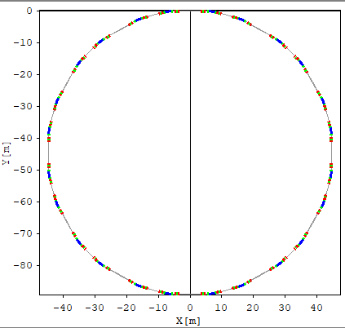
Theory
?
Now we can calculate 4 characteristic points of TRIBs. Thus we can expect the normalized horizontal phase space of electrons without a tracking simulation.
However, we have still two problems - We are uncertain about which sextupole strengths can yield the desired phase space. Scanning through all the ranges is challenging due to the numerous sextupole pairs in the cell. - When varing the sextupole strength to determine $g_{3,0,l_{3ν_{x}}}$ and $α_{−1}$, other parameters determined by the sextupole also change simultaneously.
To address this issue, we will utilize the definitions of each parameter to find the sextupole strength that simultaneously satisfies g, alpha, horizontal chromaticity, and vertical chromaticity.

Slide 10
Theory
Horizontal chromaticity $ξ_{x}$, vertical chromaticity $ξ_{y}$ and resonance strength $g_{3,0,l_{3ν_{x}}}$ can be denoted as a linear function of sextupole strength as follows:
$$ξ_{x}=−\frac{1}{4π}\int_{0}^{C}{\left(k−mη_{x}\right)β_{x}ds}=−\frac{1}{4π}\int_{0}^{C}{kβ_{x}ds}+\frac{1}{4π}\int_{0}^{C}{mη_{x}β_{x}ds}=ξ_{x,nat}+\sum_{i=1}^{4}{S_{i}ζ_{x,i}}$$
$$ξ_{y}=\frac{1}{4π}\int_{0}^{C}{\left(k−mη_{x}\right)β_{y}ds}=\frac{1}{4π}\int_{0}^{C}{kβ_{y}ds}−\frac{1}{4π}\int_{0}^{C}{mη_{x}β_{y}ds}=ξ_{y,nat}+\sum_{i=1}^{4}{S_{i}ζ_{y,i}}$$
$$g_{3,0,l_{3ν_{x}}}=\frac{\sqrt{2}}{24π}\int_{0}^{C}{m\left(s\right)β_{x}^{\frac{3}{2}}\left(s\right)\cos\left(3χ_{x}\left(s\right)−\frac{3δ_{ν}s}{R}\right)}ds=\sum_{i=1}^{4}{S_{i}μ_{i}}$$
Detuning parameter $α_{−1}$ is given as a quadratic function of sextupole strength as follows:
$$α_{−1}=\sum_{i,j=1}^{4}{S_{i}S_{j}𝒜_{i,j}}$$
For the given $\left(X_{1}, X_{2}\right),$ relations between $\left(X_{1}, X_{2}\right)$ and $\left(X_{UFP}, α_{−1}, g_{3,0,l_{3ν_{x}}}\right)$ are given by as follows:
$$−X_{UFP}=−\frac{2X_{1}X_{2}}{X_{1}+X_{2}}, α_{−1}=\frac{2δ_{ν}}{X_{UFP}^{2}+2X_{UFP}\left(X_{1}+X_{2}\right)+X_{1}X_{2}}, g_{3,0,l_{3ν_{x}}}=−\frac{α_{−1}}{2}\left(2X_{UFP}+X_{1}+X_{2}\right)$$

Slide 11
Theory
Optimization Phase Space
1. Find the target values - $X_{1}=0.002,\frac{X_{2}−X_{1}}{X_{1}−X_{UFP}}=1→X_{1}=0.002, X_{2}=b, X_{UFP}=c→α_{−1}=640.9337,g_{3,0,l_{3ν_{x}}}=−0.2589, ξ_{x}=0,ξ_{y}=0$
2. Finding $S_{1},S_{2},S_{3}$ as a function of $S_{4}$
3. Finding $S_{4}$
$$α_{−1}=\sum_{i,j=1}^{4}{S_{i}S_{j}𝒜_{i,j}}=ℬ_{2}S_{4}^{2}+2ℬ_{1}S_{4}+ℬ_{0}→S_{4}=−\frac{−ℬ_{1}±\sqrt{ℬ_{1}^{2}−ℬ_{2}\left(ℬ_{0}−α_{−1}\right)}}{ℬ_{2}}$$

Slide 12
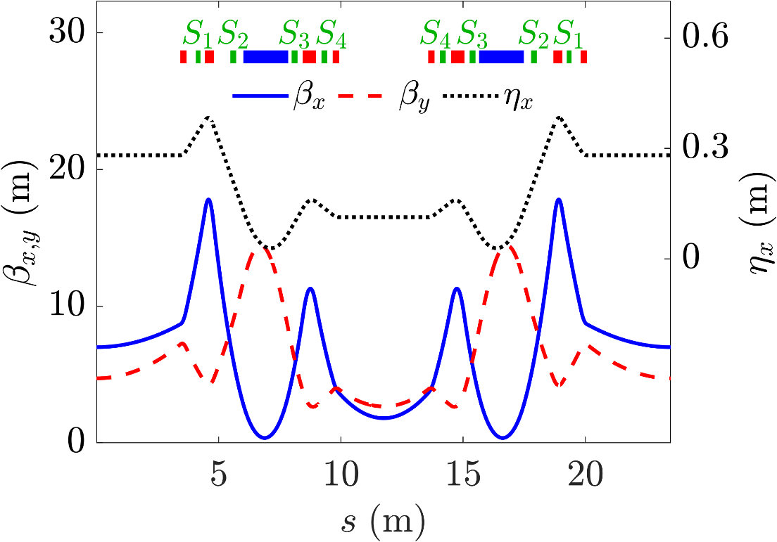
TRIBs Lattice
Sextupole | $$k_{2} (1/m^{3})$$
$$S_{1}$$ | 35.334
$$S_{2}$$ | -38.5
$$S_{3}$$ | -47.4
$$S_{4}$$ | 41.51
PLS-II Based Lattice
12 Cell$,ν_{x}=1.3325$
$ξ_{natural,x}=−3.016,ξ_{natural,y}=−0.7526$

Slide 13
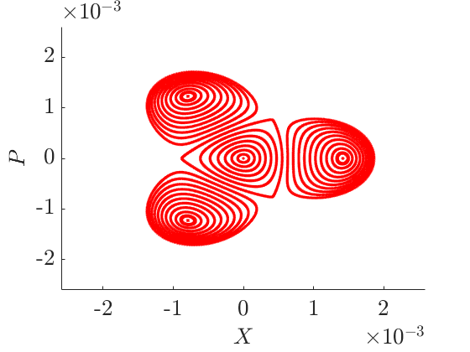
Tracking Result
Goal
Tracking Result
Goal : $α_{−1}=640.9337,g_{3,0,l_{3ν_{x}}}=−0.2589$ Result : $α_{−1}=641.25,g_{3,0,l_{3ν_{x}}}=−0.2578$ $ξ_{x}=−0.002, ξ_{y}=0.001$
Sextupole | $$k_{2} (1/m^{3})$$ | $$k_{2,opt} (1/m^{3})$$
$$S_{1}$$ | 35.334 | 32.33
$$S_{2}$$ | -38.5 | -37.85
$$S_{3}$$ | -47.4 | -62.90
$$S_{4}$$ | 41.51 | 61.02

Slide 14
Summary
We found the Hamiltonian and the relation between resonance parameters and island sizes for general situation.
We found how to determine the sextupole strengths while maintaining chromaticity.
We can show that theory is well matched with tracking result in PLS-II based test lattice.

Slide 15
Thank You for Your Attention

Slide 16
APPENDIX
$$α_{−1}=\frac{3}{2}\left(\sum_{n=−∞,n≠l_{3ν_{x}}}^{∞}{3f_{3,0,n}g_{3,0,n}}+\sum_{n=−∞}^{∞}{f_{1,0,n}g_{1,0,n}}\right)$$
$$\begin{aligned}g_{3,0,n}\cos{ξ_{3,0,n}}=\frac{\sqrt{2}}{24π}\int_{0}^{C}{m\left(s\right){\left(\sqrt{β_{x}}\right)}^{3}\cos\left(−3ν_{x}\frac{s}{R}+3χ_{x}\left(s\right)+n\frac{s}{R}\right)ds} \\ g_{3,0,n}\sin{ξ_{3,0,n}}=\frac{\sqrt{2}}{24π}\int_{0}^{C}{m\left(s\right){\left(\sqrt{β_{x}}\right)}^{3}\sin\left(−3ν_{x}\frac{s}{R}+3χ_{x}\left(s\right)+n\frac{s}{R}\right)ds} \\ g_{1,0,n}\cos{ξ_{3,0,n}}=\frac{\sqrt{2}}{8π}\int_{0}^{C}{m\left(s\right){\left(\sqrt{β_{x}}\right)}^{3}\cos\left(−ν_{x}\frac{s}{R}+χ_{x}\left(s\right)+n\frac{s}{R}\right)ds} \\ g_{1,0,n}\sin{ξ_{3,0,n}}=\frac{\sqrt{2}}{8π}\int_{0}^{C}{m\left(s\right){\left(\sqrt{β_{x}}\right)}^{3}\sin\left(−ν_{x}\frac{s}{R}+χ_{x}\left(s\right)+n\frac{s}{R}\right)ds},\#\end{aligned}$$
$$\begin{aligned}f_{a,0,n}=−\frac{g_{a,0,n}}{aν_{x}−n} for a∈\left\{1,3\right\}.\#\end{aligned}$$

