Slide 1
Study of INC model for alpha incident reaction at 230MeV/u
*Furuta Toshimasa¹ Uozumi Yusuke¹ Yamaguchi Yuji²
1Kyushu university 2JAEA

Slide 2
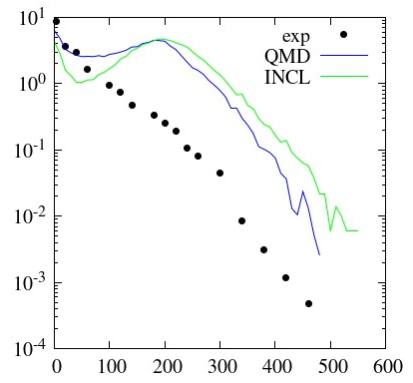
Introduction
The calculation of α-particle incident reaction
・・・space development or design of facilities related nuclear power
DDXs of Al(α,px) 230MeV/u 15°
Problem of α-particle incident reaction
Calculation accuracy of DDXs of α-particle incident reaction at few hundred MeV
Reason …
・ Lack of experimental data
・ Understanding of fragmentation reactions
・ Treatment of composite particles
DDX[mb/sr/MeV]
proton energy [MeV]

Slide 3
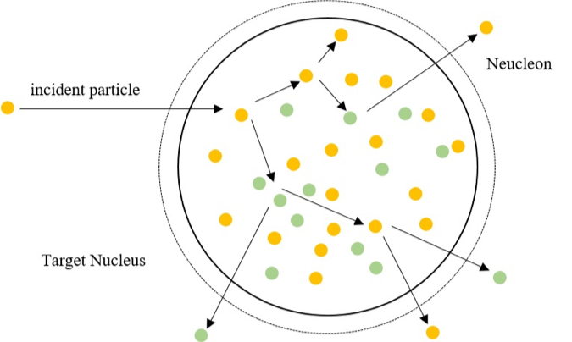
Introduction
Particles transport calculation code to evaluate radiation dose
PHITS(Particle and Heavy Ion Transport code System)
Examples of physics models to describe nuclear reactions
INC ：Intra-Nuclear Cascade
QMD ：Quantum Molecular Dynamics
GEM ：Generalized Evaporation Model
INC(Intra Nuclear Cascade) model
・Nuclear reactions
= Two body collision between
incident particle and intra nuclear particle
・Nucleus
= Aggregation of free particles
・The box-shaped potential in nuclear
・Using relativity for kinematics of particles
The image of INC model

Slide 4
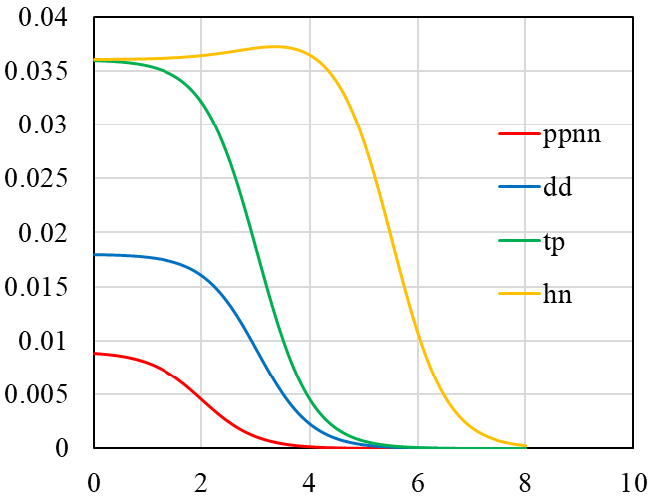
Fragmentation reaction
alpha
target
Cluster states are formed in α-particle
（overlap of cluster states）
⇓
α-particle is broken up by interaction with target nucleus
break up
b-parameter dependence
probability of cluster states
・・・Woods – Saxon function
$$f=\frac{f_{0}}{1+exp⁡(\frac{b−r_{t}}{s})}$$
probability
b-parameter [fm]
probability of cluster states

Slide 5
Cascade process
Nucleon-Nucleon collision
Only positional relationship between two particles involved collision is used for collision detection
$$r_{ij}<\sqrt{σ/π}$$
The Cugnon formula is used for Nucleon-Nucleon cross section
Cluster-Nucleon collision
It is replaced by Nucleon-Nucleon collision between a representative particle and a nucleon in target nucleus
Momentum transfer of the representative particle is regarded one of cluster
Pauli Blocking
Collisions generating nucleons with energy less than Fermi energy are prohibited
Other process
Knock out and indirect process are introduced

Slide 6
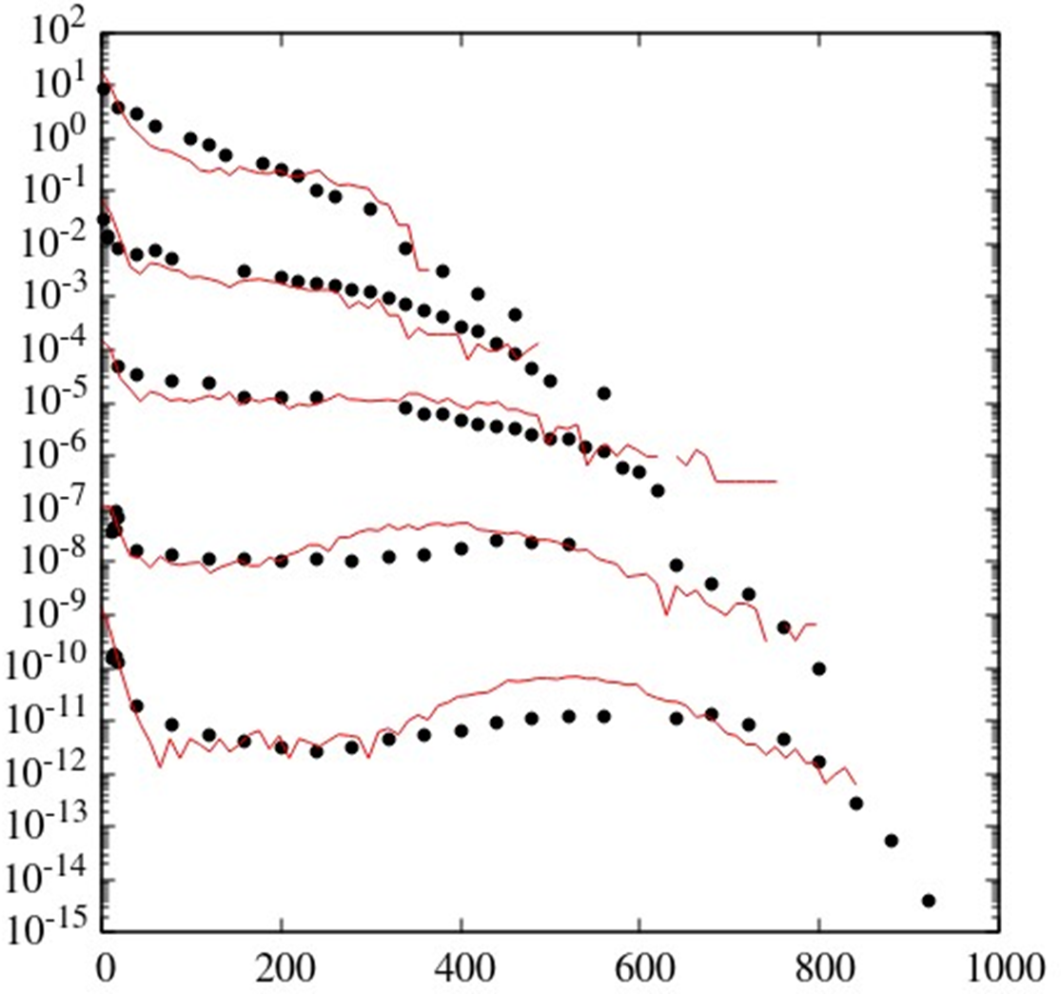
Result
DDXs of Al(α,x) 230MeV/u 15˚
Experimental results for target Al for proton, deuteron and triton emission are well reproduced
DDXs of Al(α,α’x) and (α,³Hex) reaction at 15˚ are slightly overestimated
almost particles emitted at 15˚ are generated from incident α-particle
proton
deuteron(×10⁻²)
triton(×10⁻⁴)
DDX[mb/sr/MeV]
³He(×10⁻⁷)
alpha(×10⁻¹⁰)
Energy [MeV]

Slide 7
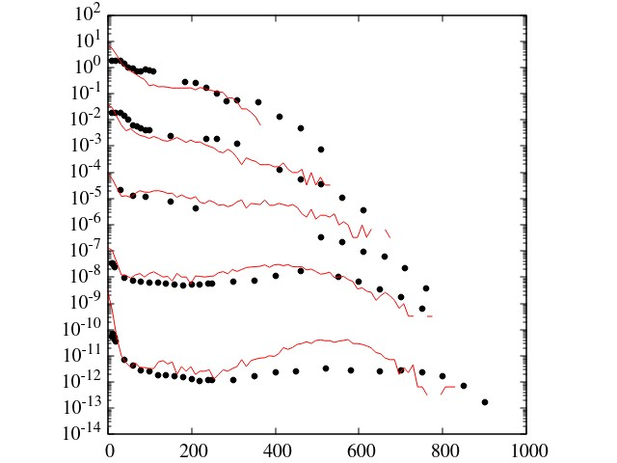
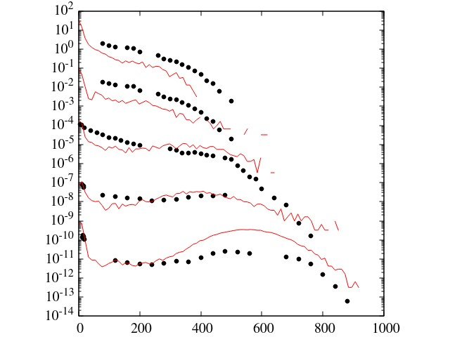
Result
DDXs of C(α,x) 230MeV/u 15˚
DDXs of Co(α,x) 230MeV/u 15˚
proton
proton
deuteron(×10⁻²)
deuteron(×10⁻²)
DDX[mb/sr/MeV]
triton(×10⁻⁴)
triton(×10⁻⁴)
³He(×10⁻⁷)
³He(×10⁻⁷)
alpha(×10⁻¹⁰)
alpha(×10⁻¹⁰)
Energy [MeV]
Energy [MeV]

Slide 8
Conclusion
Calculation
・The model that α-particle is constructed by overlap of some cluster state was used in this study
・Original treatment for composed particles is introduced
・Some process are introduced
Result
DDXs for (α,x) reaction at 15˚ at 230 MeV/u were mostly reproduced by calculation of INC model
Problem
・Improvement of calculation accuracy for DDXs at backward angles
・Resolving overestimate of DDXs for (α,α’x) reaction

