Slide 1
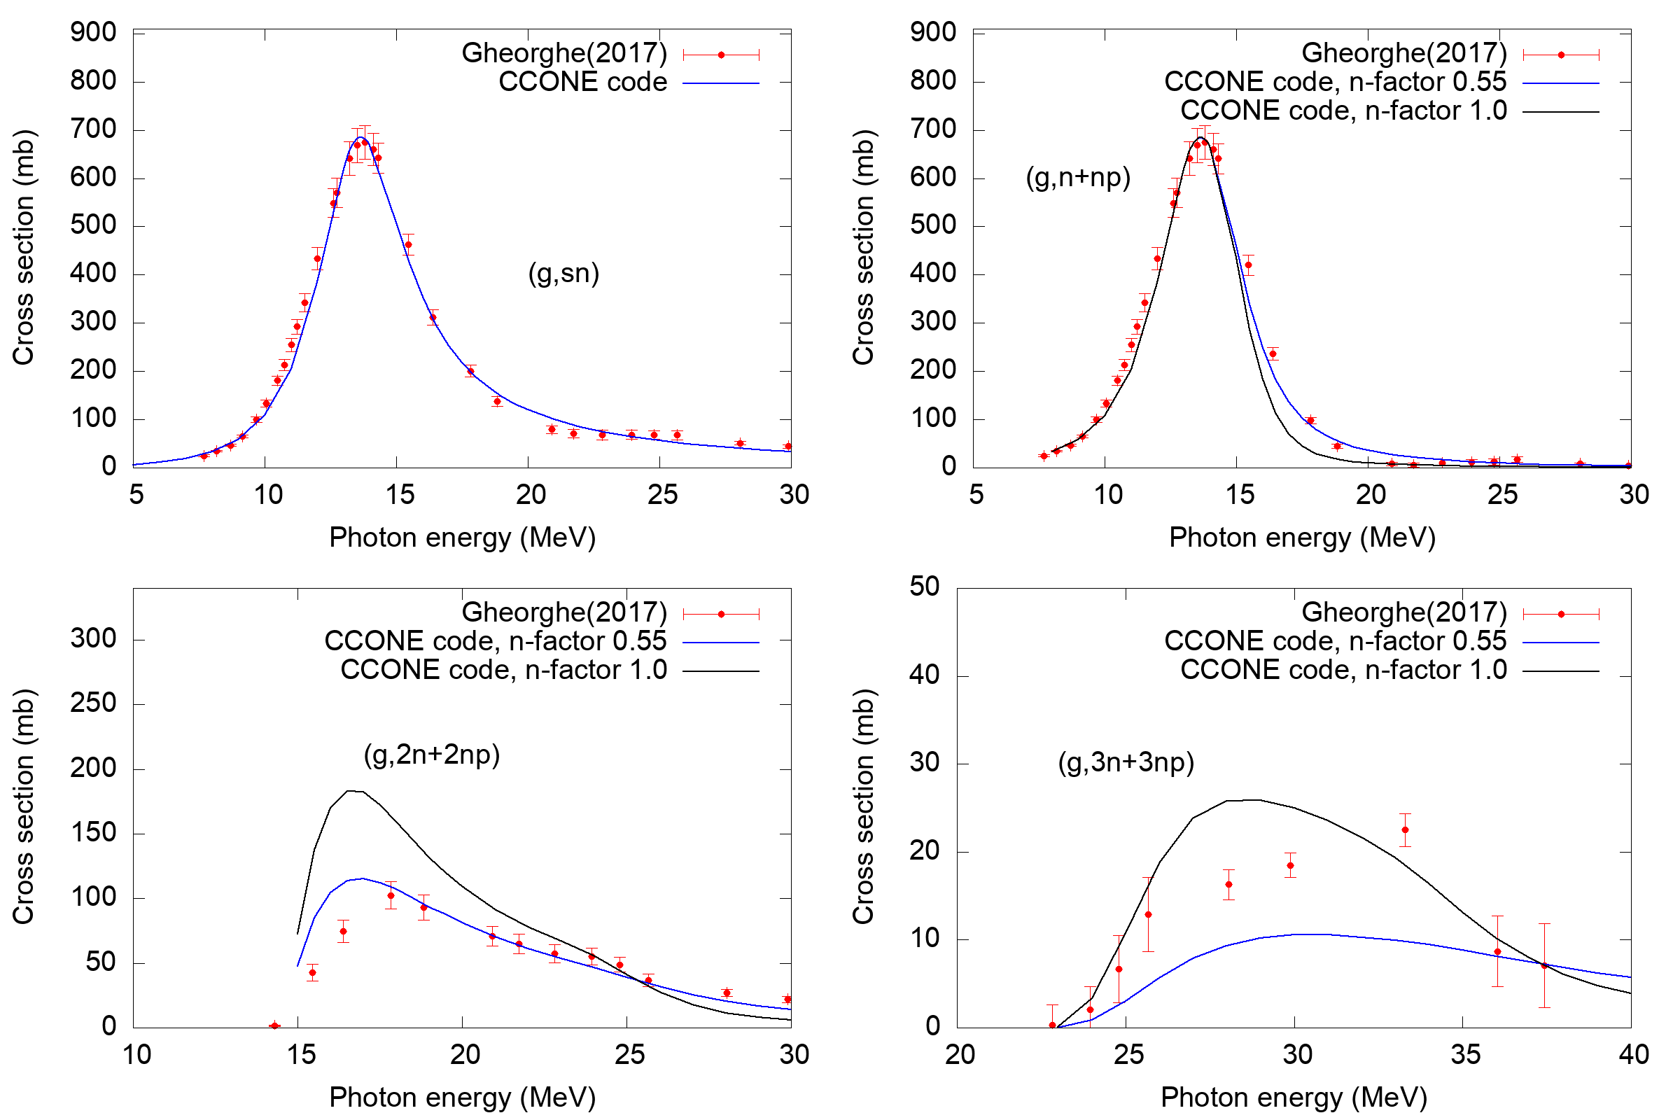
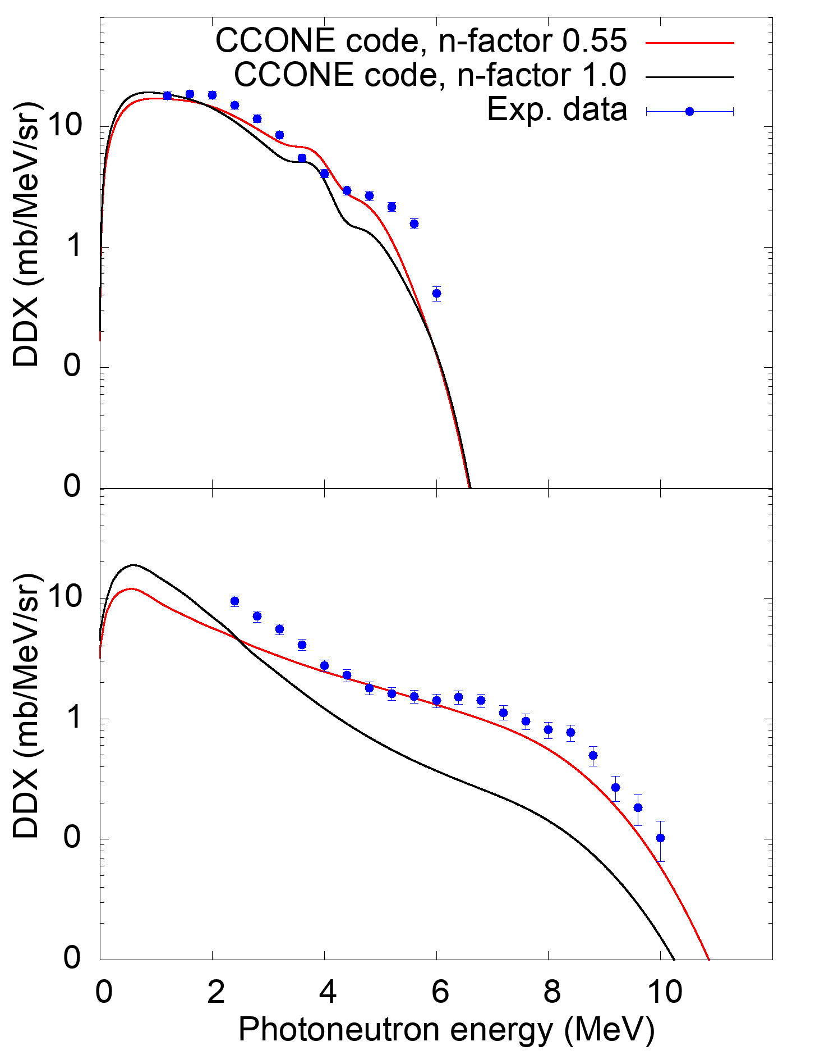
Evaluation of Photonuclear Reaction Data for ²⁰⁹Bi
at 13 and 17 MeV photon energy
*T.T.H.Nguyen¹, N. Iwamoto², T.Sanami^{1,3}
(1. SOKENDAI, 2. JAEA, 3. KEK)
SYMPOSIUM
ON NUCLEAR DATA
2023
2. METHODOLOGY
2.1 Evaluation using the CCONE code system [4] and the experimental reaction cross-section data by I. Gheorghe [5].
2.2 Usual procedure of photonuclear data evaluation
Reproduction of reaction cross-section data
Download the experimental cross-section data of ($γ,xn$), ($γ,sn$), ($γ,n+np$), ($γ,2n+2np$) from EXFOR library.
Reproduction of ($γ,sn$) cross-section: adjust parameters of level density and gamma strength function.
Reproduction of ($γ,n+np$), ($γ,2n+2np$) cross-section: adjust the production of pre-equilibrium photoneutrons.
Print out the photoneutron energy spectrum to compare with the experimental data.
2.3 Applying the measured photoneutron energy spectra at 13 and 17 MeV photon energies: adjust the multiplying factor for the single neutron average density (n-factor) in the exciton model (describing the preequilibrium process).
ABSTRACT
Experimental data on photoneutron energy spectra for ²⁰⁹Bi at 13 and 17 MeV photon energies were applied to photonuclear data evaluation using CCONE code system and the experimental reaction cross-section data. The evaluation by the CCONE fits the spectrum at 13 MeV but doesn’t that at 17 MeV.
1. INTRODUCTION
Photonuclear data in the JENDL-5 evaluated nuclear data library [1] is obtained mainly from the experimental reaction cross-section data. The experimental neutron energy spectra are not yet included its evaluation process.
Bismuth, one of the monoisotopic elements, has the available data of photoneutron energy spectra at 13 and 17 MeV photon energies given in [2–3].
⇒ Measured photoneutron energy spectra at 13 and 17 MeV photon energies are applied to the evaluation of photonuclear data for ²⁰⁹Bi.
3. RESULTS AND DISCUSSIONS
($γ,sn$) cross-section:
13 MeV photon energy: 640 mb
17 MeV photon energy: 200 mb
The n-factor value of 0.55 is selected based on the measured photoneutron energy spectra:
For 13 MeV photon energy (only ($γ,n+np$)): Good reproduction for ²⁰⁹Bi.
For 17 MeV photon energy (($γ,n+np$) + ($γ,2n+2np$)): the evaluation somehow can reach the experimental data for neutron above 4 MeV and underestimates for neutrons below 4 MeV.
Good reproduction for ($γ,n+np$) and ($γ,2n+2np$) for photon energies above 17 MeV.
The same procedure should be done for other targets having photoneutron energy spectra data.
13 MeV $γ$
17 MeV $γ$
References
[1] O. Iwamoto, N. Iwamoto, S. Kunieda, et al., J. Nucl. Sci. Technol., 60(1), (2023), pp. 1-60.
[2] T. Nguyen, T. Sanami, H. Yamazaki, et al., AESJ Fall Meeting, 3N06, (2022).
[3] T. Nguyen, T. Sanami, H. Yamazaki, et al., AESJ Fall Meeting, 3N03, (2023).
[4] O. Iwamoto, et al., Nuclear Data Sheets, 131, (2016), pp 259-288.
[5] I. Gheorghe, H. Utsunomiya, S. Katayama, et al., Phys. Rev. C, 96(4), (2017), 044604.

