Slide 1
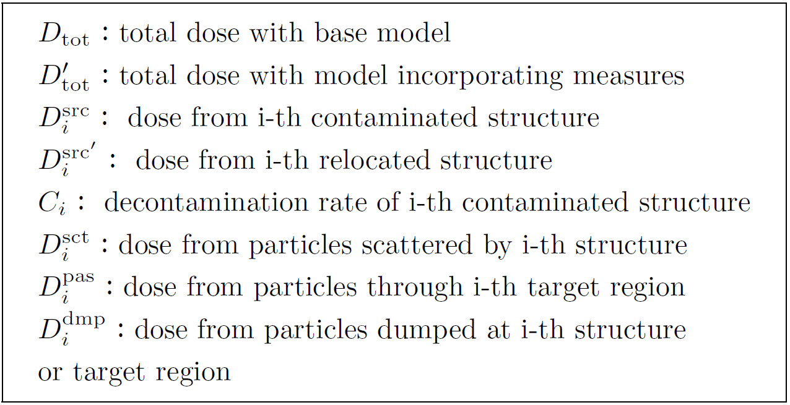
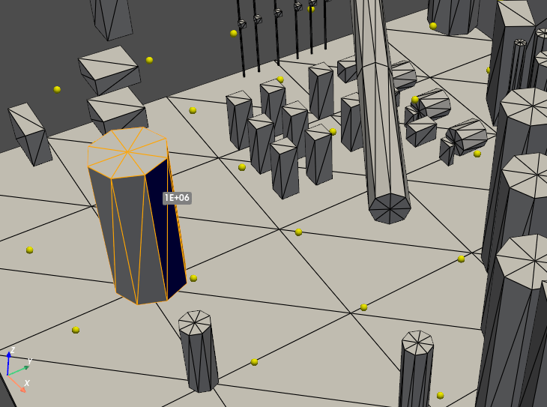
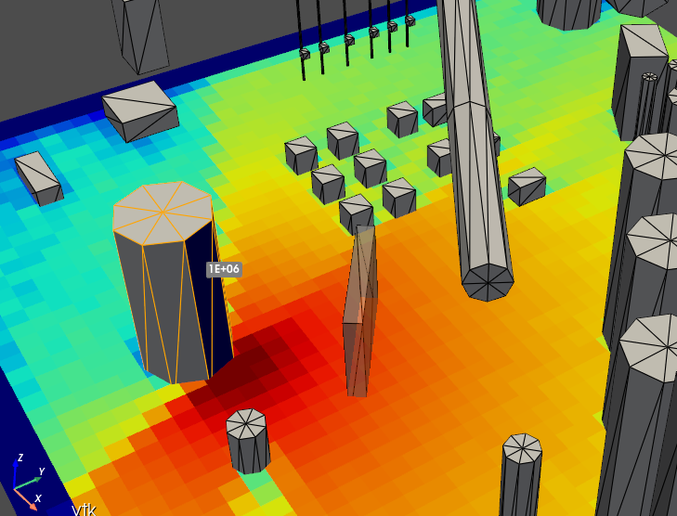
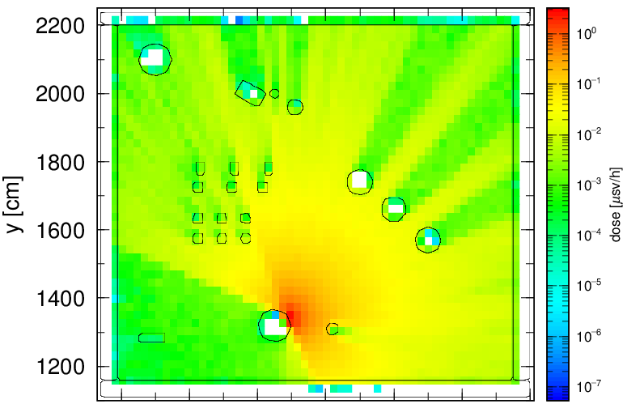
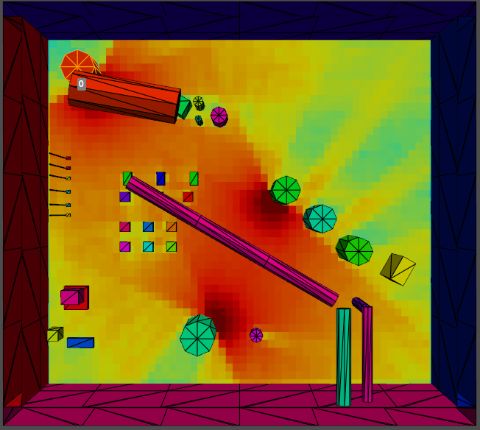
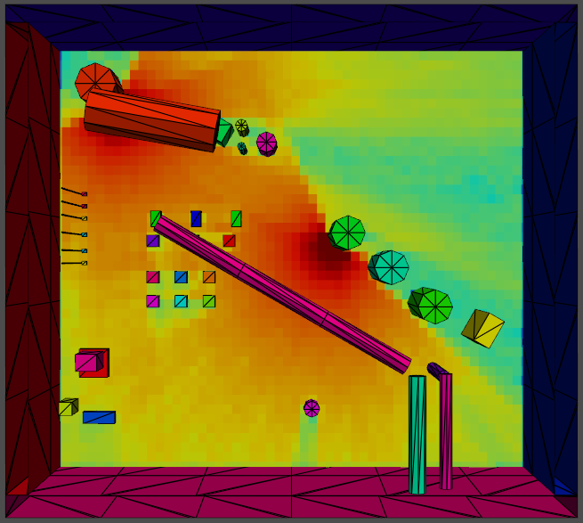
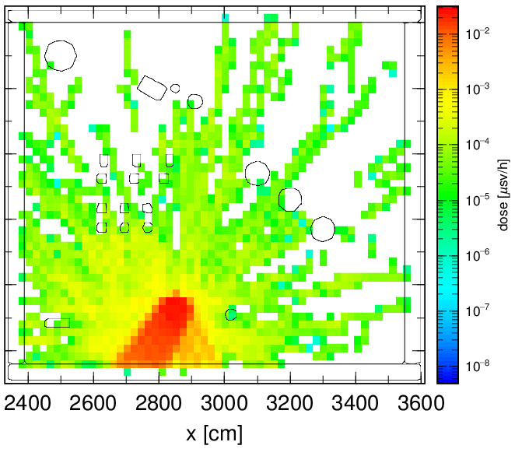
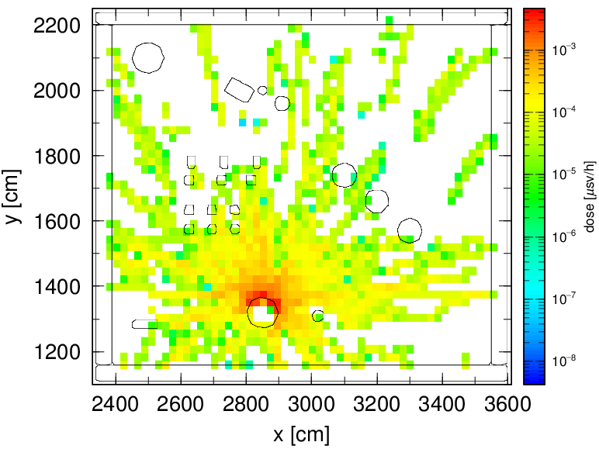
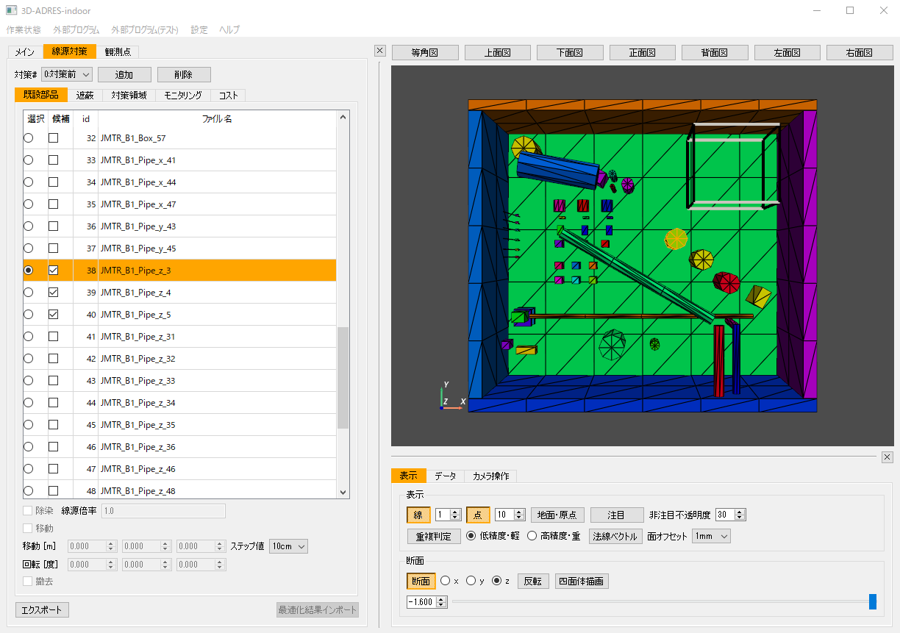
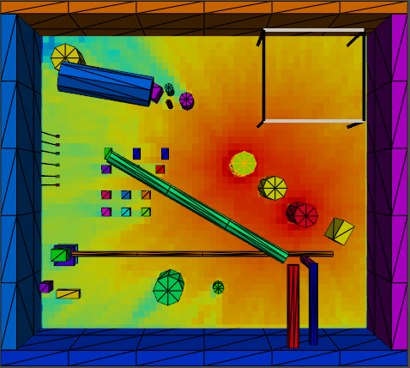
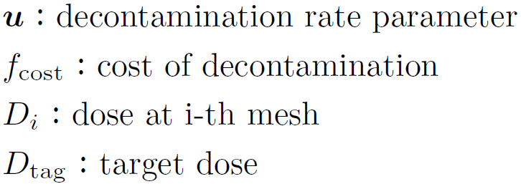
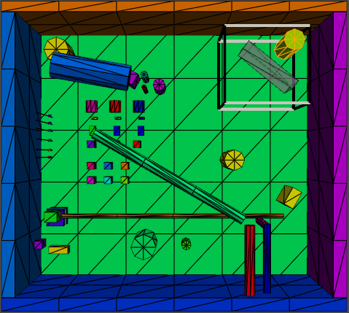
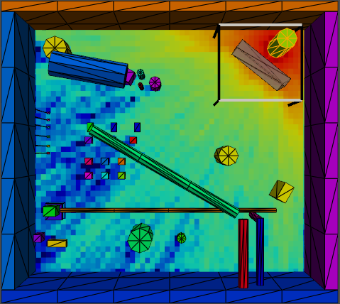
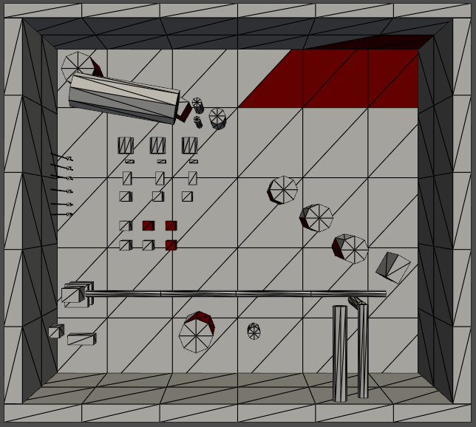
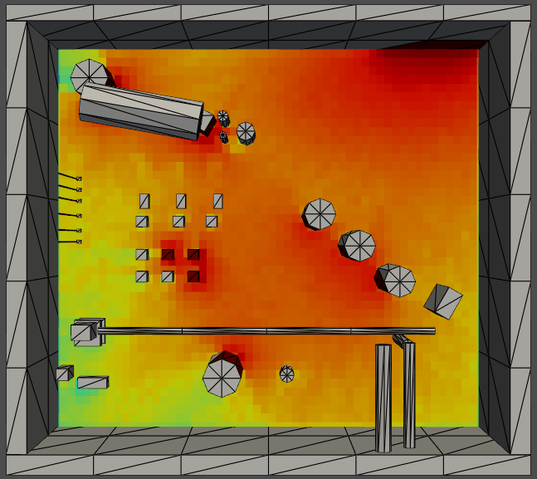
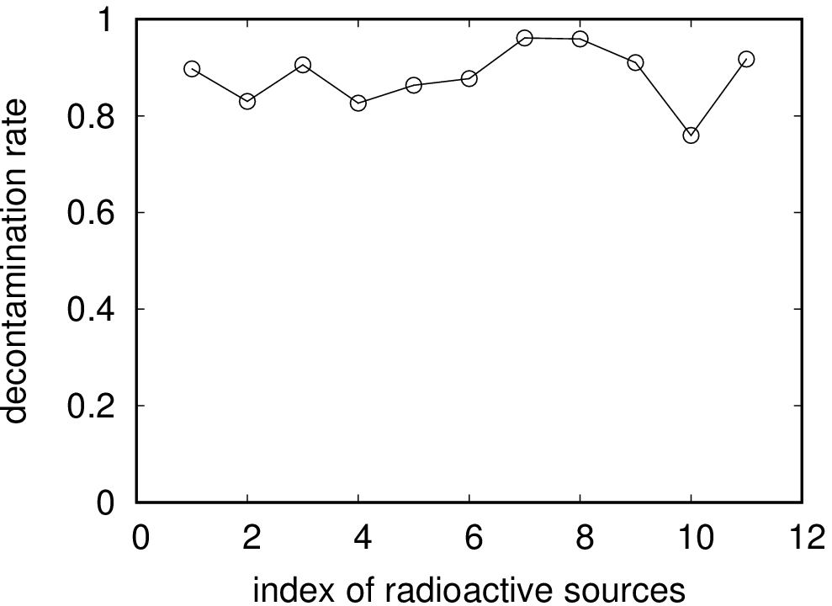
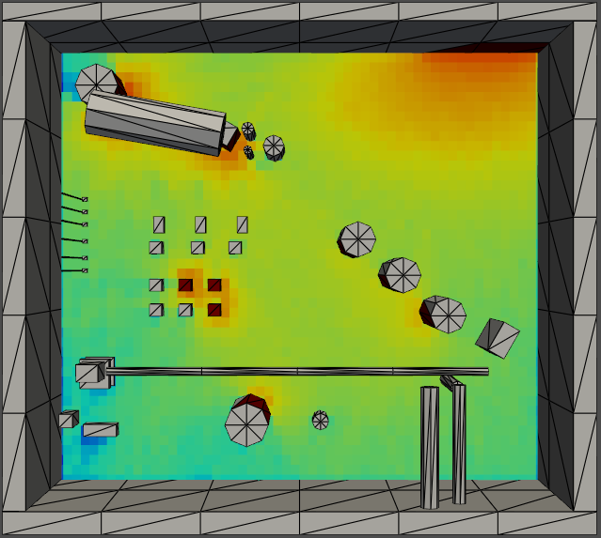
Development of a PHITS simulation technique and a numerical method to optimize measures against radioactive sources
N. Furutachi¹, T. Yoshida¹, H. Yanagi¹, Y. Hasegawa¹, and M. Machida²
Research Organization for Information Science and Technology (RIST)
Japan Atomic Energy Agency (JAEA)
Introduction
PHITS simulation technique for planning of measures against radioactive sources
We have developed the radiation dose evaluation system for indoor environments:
3D-ADRES-Indoor.
3D-ADRES-Indoor is mainly designed for two applications:
Estimation of radioactive source distributions with the
machine learning technique
Planning of measures against estimated radioactive sources
3D-ADRES-Indoor uses Particle and Heavy Ion Transport code System (PHITS) for the ambient dose rate calculation required for these applications.
A technique to reduce calculational cost of simulating four kinds of measures against radioactive sources: decontamination, removal, relocation, and shielding
Dose with models incorporating measures is deduced by following two-step process:
Step 1 – Tally decomposed dose and dump particles impinged on contaminated structure or target region in normal PHITS simulation with base model
Step 2 – Execute simulation using dump source with model incorporating measures and construct dose from equations listed below
Dose decomposed by PHITS “counter” feature
Estimation of radioactive source distribution
3D-ADRES-Indoor
Planning of measures against radioactive sources
Ambient dose calculated by PHITS
Observation of ambient dose
Relocation
decontamination
relocation
Contribution matrix A calculated by PHITS
Removal
Shielding
removal
shielding
Estimated high-intensity radioactive source
Decontamination
Machine learning – Lasso(and Lasso variants)
Operations by 3D-ADRES-Indoor GUI
Example of constructing dose for removal
G = |Y – AX |² + λ|X |
Minimize G to determine X
Ambient dose with models incorporating measures is deduced by present PHITS simulation technique
Y : observation vector, X :source vector
A : contribution matrix (dose component at observation point calculated by PHITS)
＝
－
＋
In this work,
A PHITS simulation technique for planning of measures against radioactive sources
A Numerical method to optimize decontamination rate
have been developed.
Removal
Base model without removal
Number of history required for dump source simulation of above example
 | Number of history
Normal simulation | 1000000
Removal × 1 | 6025
Removal × 2 | 12699
Removal × 3 | 14179
Calculational cost of present technique is notably small compared to normal simulation
Planning of measures against radioactive sources in 3D-ADRES-Indoor
Numerical method to optimize decontamination rate
Conditions of four kinds of measures can be set by 3D-ADRES-Indoor GUI
PHITS input required for present technique is automatically generated
Decontamination rates that suppress dose in target region under certain value with minimum cost are obtained by solving constrained optimization problem with penalty term
Evaluation function
Penalty term to suppress dose under target value
Contaminated structures:
100[Bq/cm²]
Minimize evaluation function to determine decontamination rates by
List of structures
Particle Swarm Optimization (PSO) method
Setting of measures
Step 1: Normal PHITS simulation without measures
Radioactive sources widely distributed
Dose without decontamination
Shielding
Relocation
100[Bq/cm²]
Suppress dose in target region under 0.1[µSv/h] by decontamination
Removal
Step 2: Dump source simulation and construction of dose with measures
[µSv/h]
Solve constrained optimization problem by PSO
Dose after decontamination
[µSv/h]
Summary
Import
The PHITS simulation technique for planning of measures against radioactive sources and the numerical method to optimize decontamination rate have been implemented in 3D-ADRES-Indoor. Users can try more variations of measures with the advantage of the present technique for better planning of measures against radioactive sources. The present work is only a part of various developments around 3D-ADRES-Indoor. Development of 3D-ADRES-Indoor is ongoing.
Optimized decontamination rate obtained
Under 0.1[µSv/h]

