Slide 1
(Axial)Vector meson decay and angular distribution
In Woo Park
Yonsei University Nuclear Theory and Hadron Group
Author: Hiroyuki Sako, Kazuya Aoki, Philipp Gubler, Su Houng Lee

Slide 2
Purpose
In vacuum, longitudinal and transverse modes of spin 1 are identical.
In medium, their masses differ when they move with respect to the medium.
Therefore we want to see whether if we can distinguish the transverse and longitudinal mode through their two body decay distribution.
Here, we will concentrate on K* and K1 because they are chiral partners.
S.H.Lee,``Chiral Symmetry Breaking and the Masses of Hadrons: A Review,‘’ Symmetry 15, 799 (2023)

Slide 3
Contents
Lagrangian and coupling constant for each decay process
Polarization tensor of the initial particle and angular dependence
General angular distribution calculation
  Phenomenological Lagrangian
  Wigner rotation matrix
Summary

Slide 4

Effective Lagrangian
$ρ→ππ$
$K^{∗}→Kπ$
$K_{1}→ρK, K_{1}→K^{∗}π$
Effective lagrangian reference: 10.1016/j.physletb.2021.136388

Slide 5
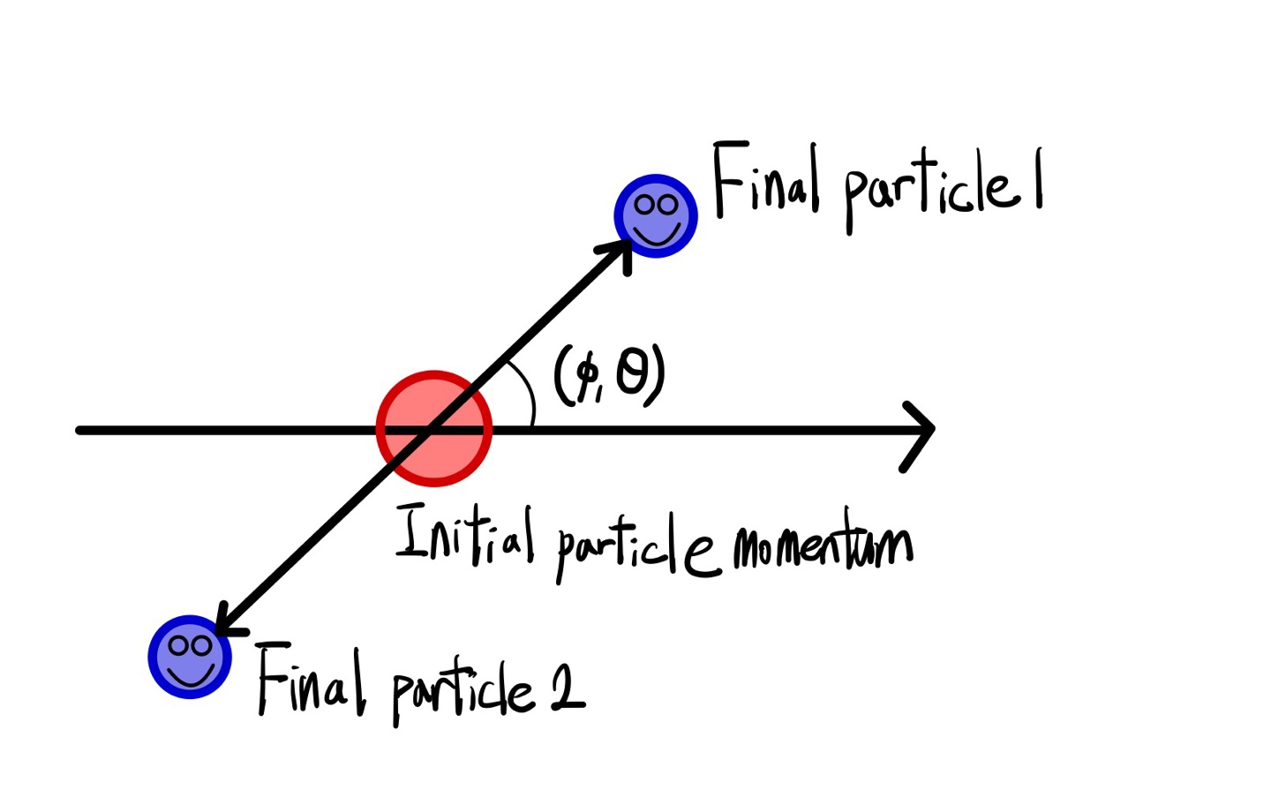
Kinematics
Initial quantization axis is along the 3- momentum of the initial particle in its own rest frame.

Slide 6


Decay width and coupling constant
$ρ→ππ, K^{∗}→Kπ$
$K_{1}→ρK,K_{1}→K^{∗}π$
Decay | $Γ$(MeV) | g
$$ρ→ππ$$ | 149 | 5.96
$$K^{∗}(892)→Kπ$$ | 51.4 | 3.27
$$K_{1}\left(1270\right)→ρK$$ | 34.2 | 3.26
$$K_{1}\left(1270\right)→K^{∗}\left(892\right)π$$ | 18.9 | 0.71

Slide 7
Polar angle distribution for polarization mode

Slide 8
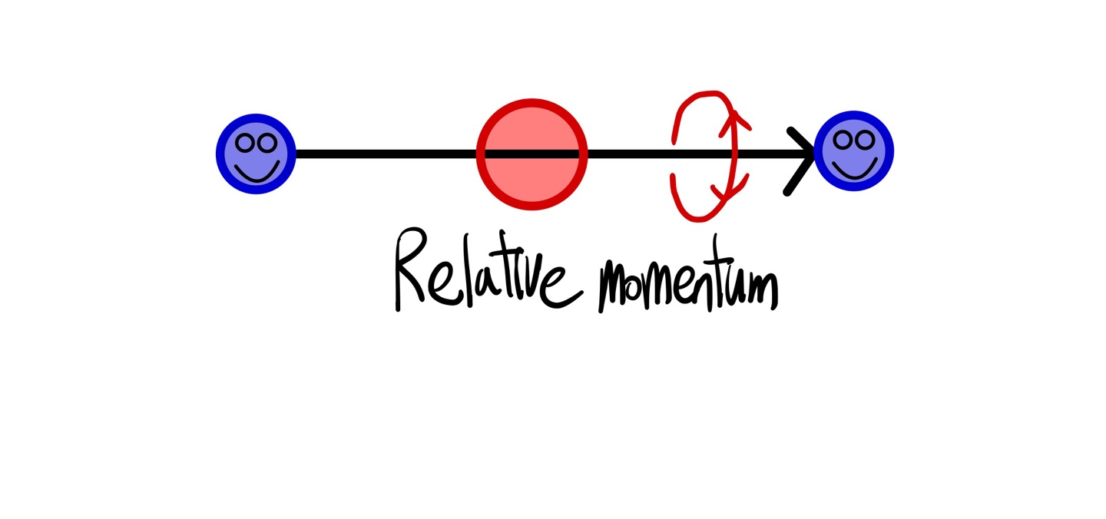
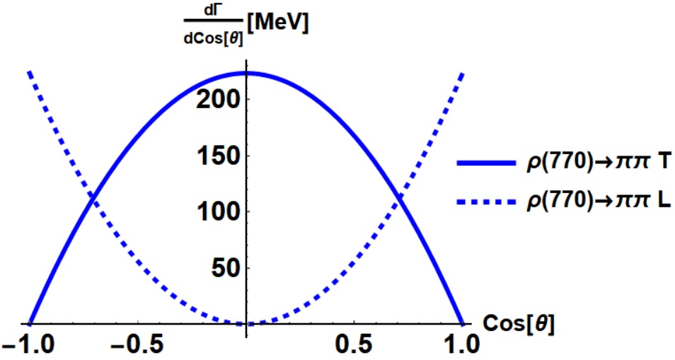
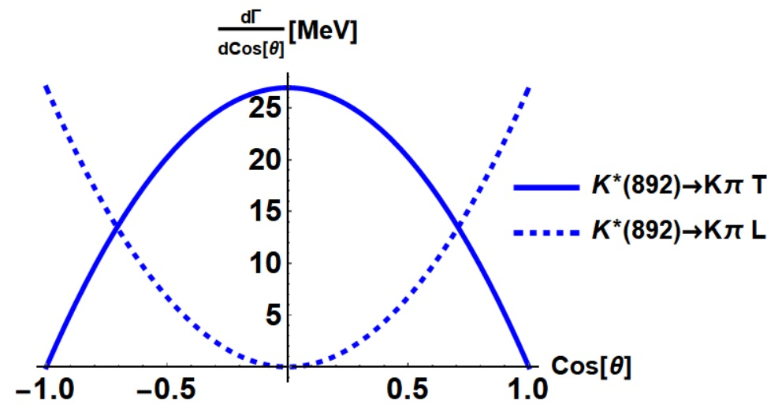

Transverse and longitudinal disentangled
$ρ→ππ,K^{∗}→Kπ$

Slide 9
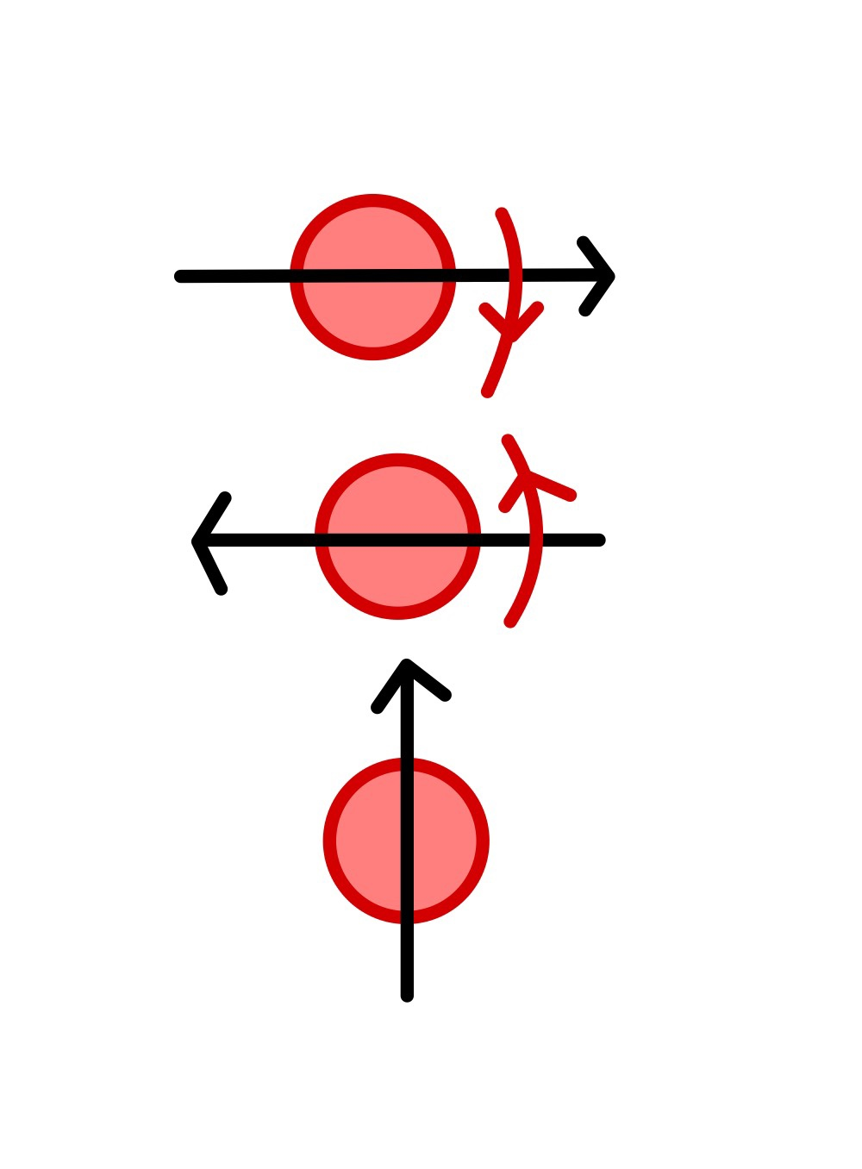

Transverse and longitudinal disentangled
$K_{1}→ρK,K_{1}→K^{∗}π$

Slide 10
Polar, azimuthal angle distribution

Slide 11

General angular distribution 1. Phenomenological Lagrangian
Initial (axial)vector meson state is a superposition of 3 different helicity states of J=1 particle.
$a_{λ_{V/{K_{1}}}}$: Respective amplitude
$ρ_{λ_{V/{K_{1}}}λ_{V/{K_{1}}}^{′}}=a_{λ_{V/{K_{1}}}}a_{{λ^{′}}_{V/{K_{1}}}}^{∗}$

Slide 12
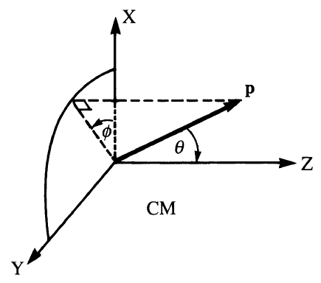
General angular distribution 2. Wigner rotation matrix
Spin in Particle Physics E.~Leader, Camb. Monogr. Part. Phys. Nucl. Phys. Cosmol. 15, pp.1-500 Cambridge University Press, 2023

Slide 13
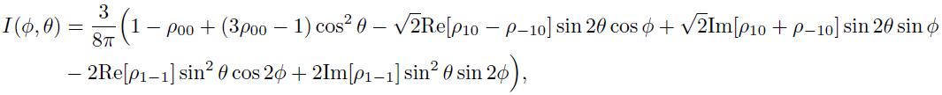
General angular distribution

Slide 14

$$K_{1}→VP$$
$\left|p_{1}\right|≪m_{1}$

Slide 15

Method to discriminate T and L mode of $K_{1}$
Initial $K_{1}$ polarization is hardly distinguished
Measure the final vector meson polarization $K_{1}→VP$

Slide 16
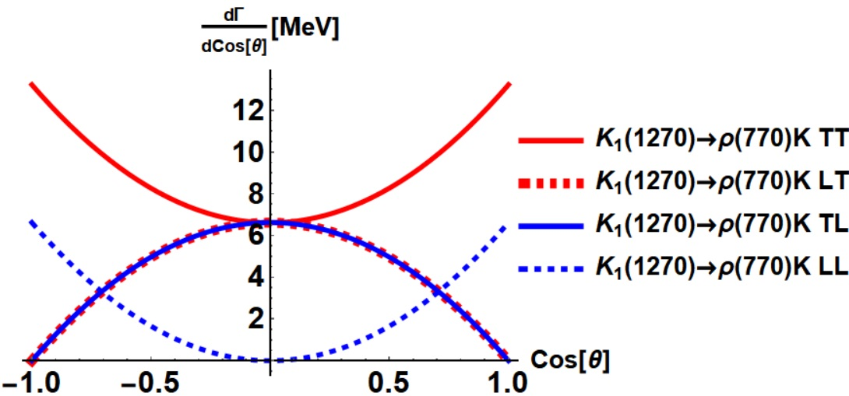
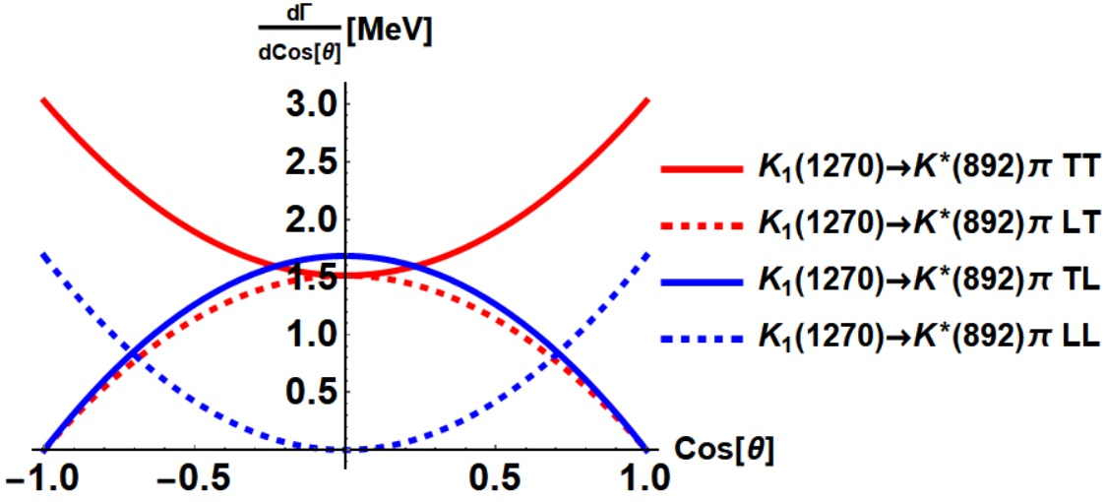


$$K_{1}\left(1270\right)→ρK$$
$$K_{1}(1270)→K^{∗}π$$

Slide 17

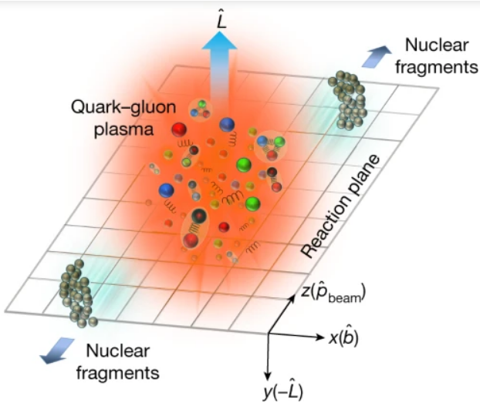
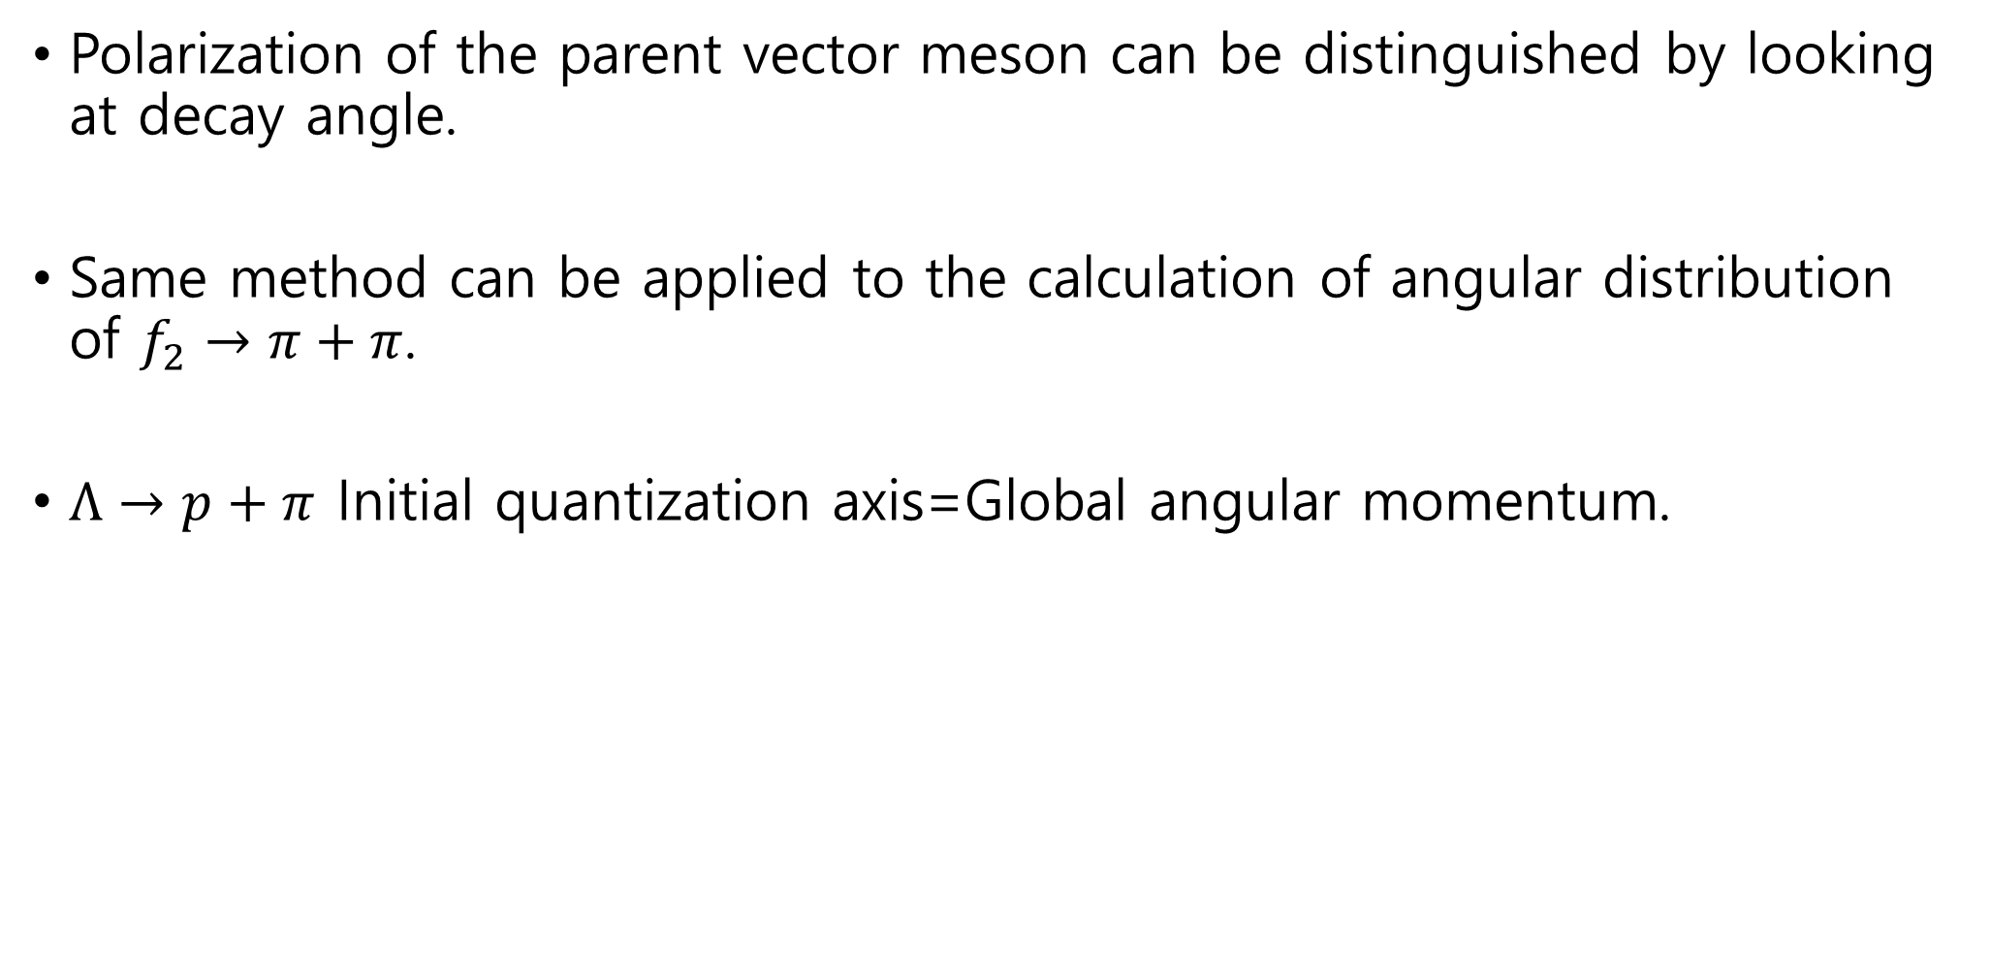
Summary
Polarization of the parent vector meson can be distinguished by looking at decay angle.
Same method can be applied to the calculation of angular distribution of $f_{2}→π+π$.
$Λ→p+π$ Initial quantization axis=Global angular momentum.

