Slide 1
Introduction Marc Hannig
KEK/SOKENDAI Summer Student Program 2024

Slide 2
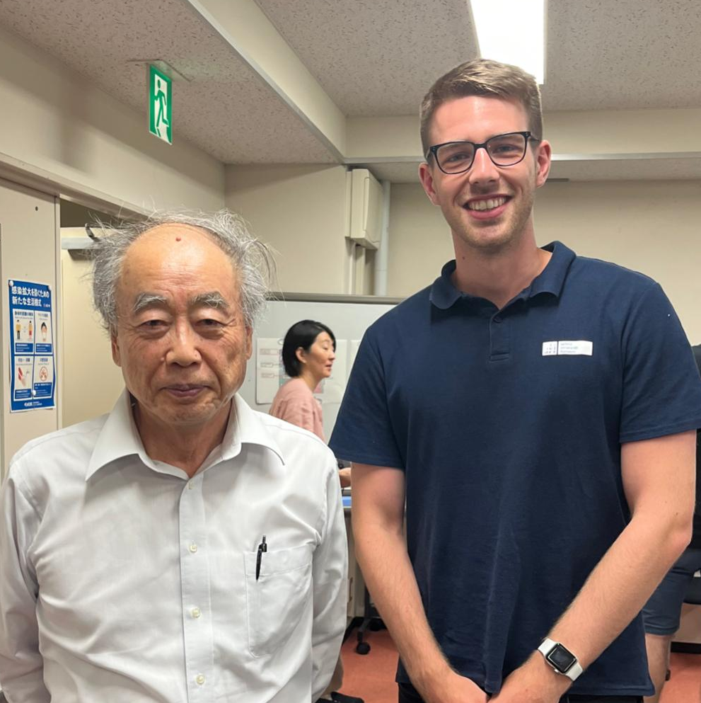
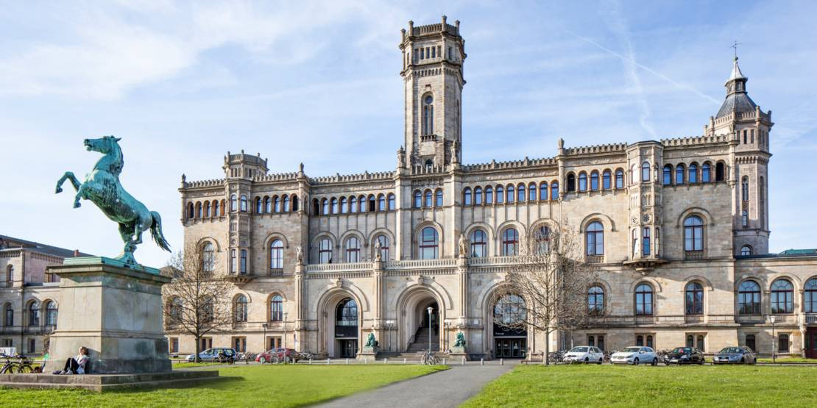
Background
24 years old
Master Physics student from Germany
Home university: Leibniz University Hannover

Slide 3
Education
2018
2021
2023
Graduation from school
Exchange semester with Erasmus in Latvia
Summer Student at DESY in Hamburg, Germany
2019
2023
2024
Start of a Bachelors degree in Physics
Finished Bachelors degree: B.Sc. Physics
Start of Masters degree
Summer Student at J-PARC, Tokai, Japan

Slide 4
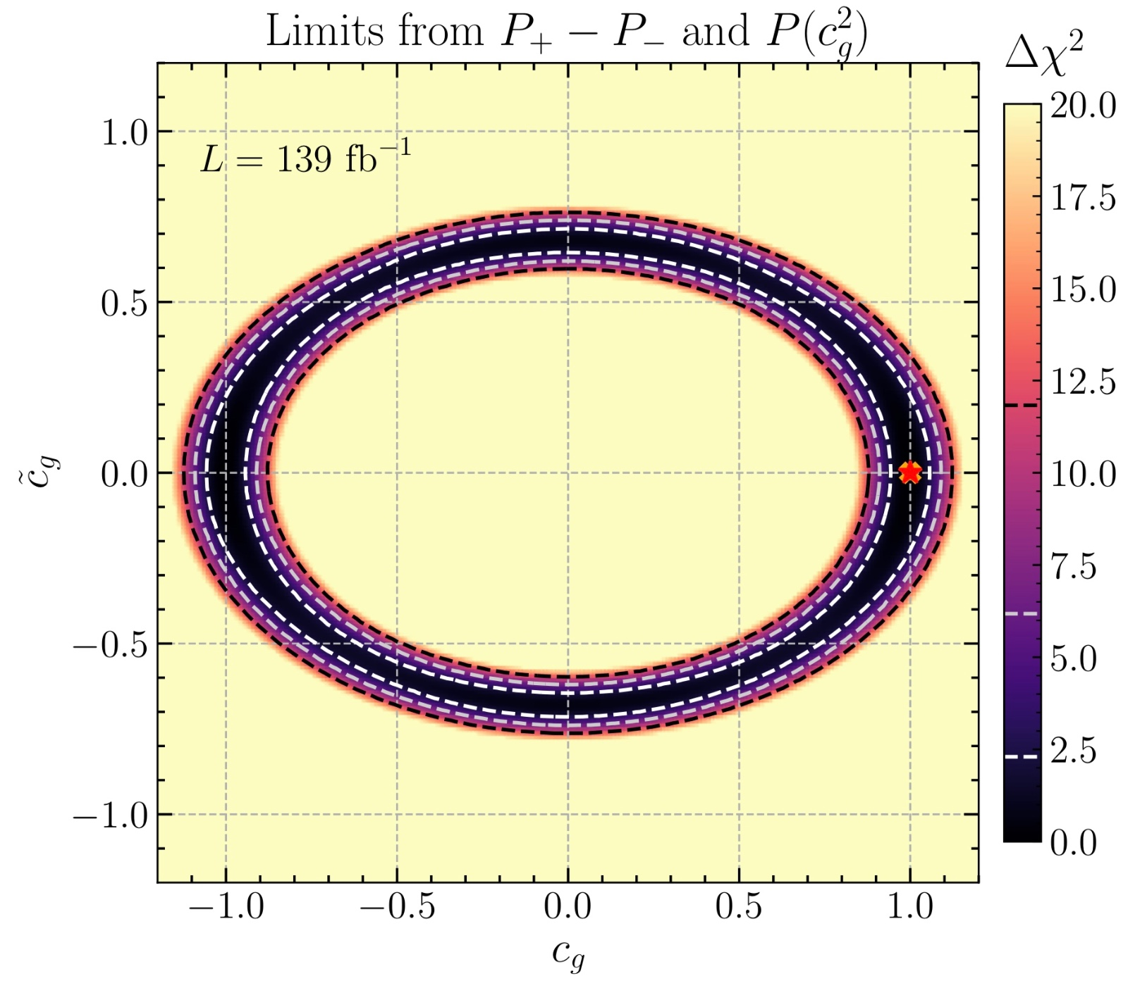
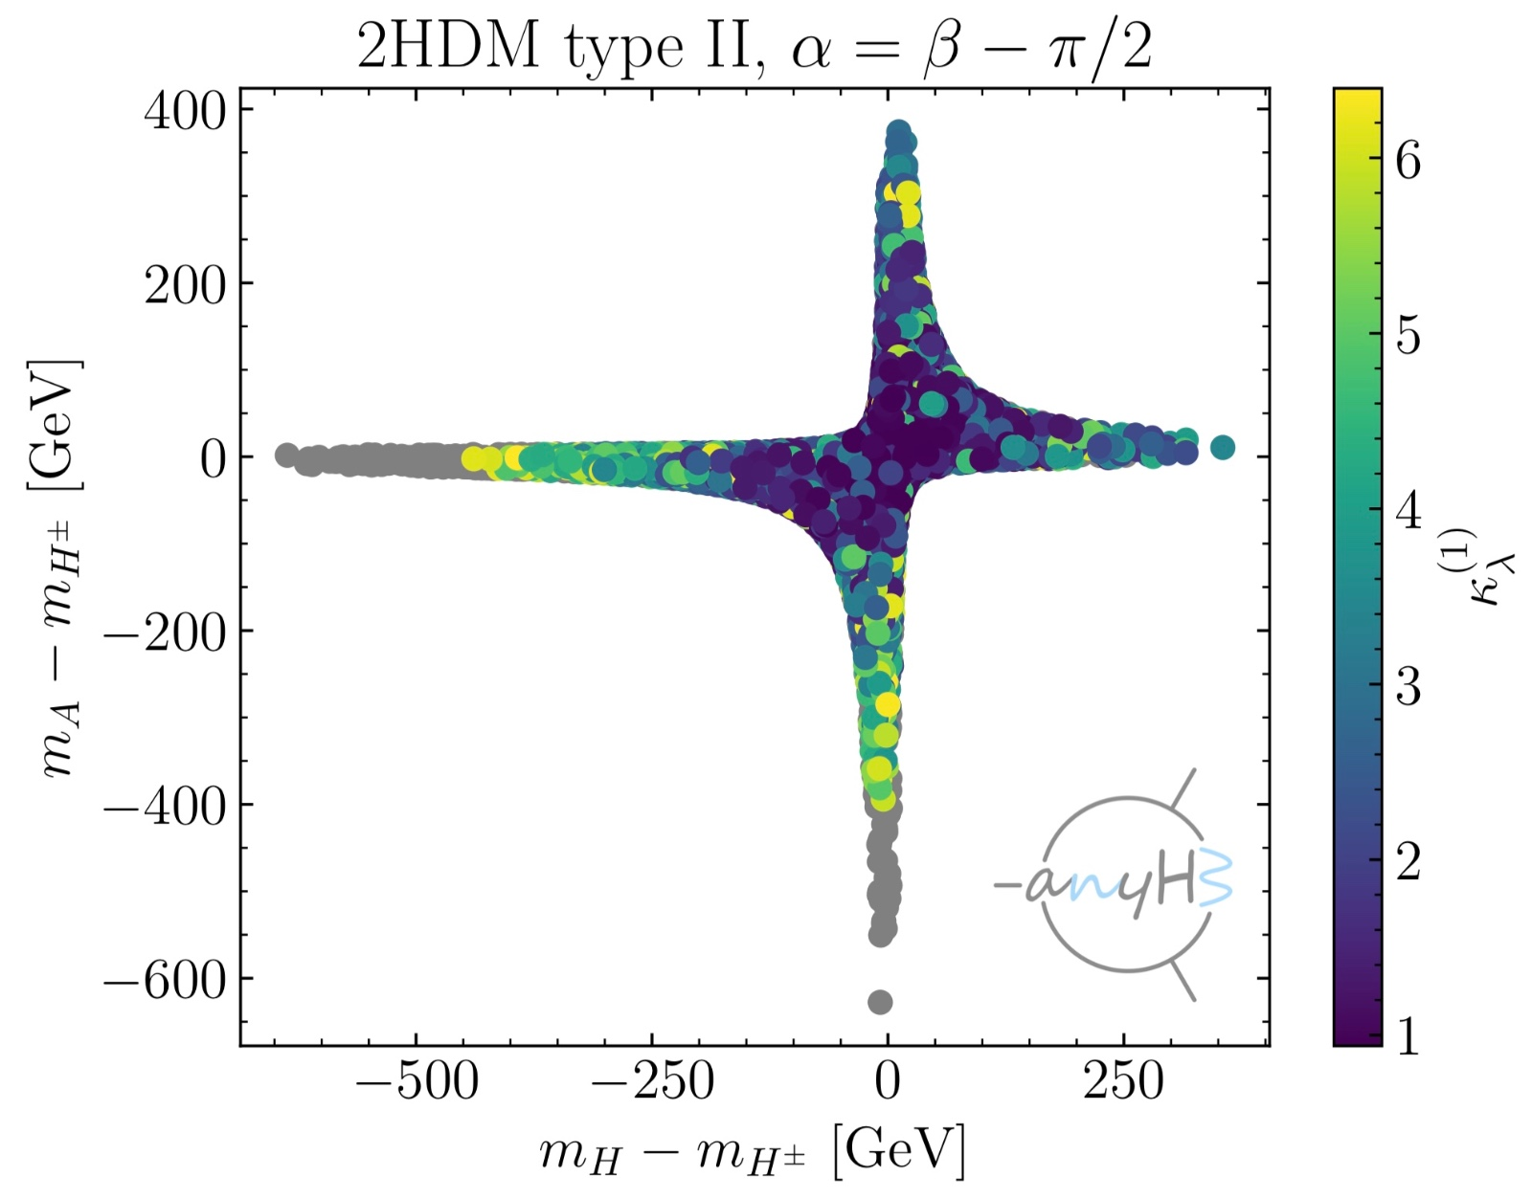
Previous Research
Bachelor Thesis
Title: « Enhancing the Sensititvity to CP Violation in the Higgs-Top Interaction with Machine Learning »
Developement of a data analysis method to examine possible CP violation in the production of Higgs bosons using neural networks
Previous Summer Student Project
Title: « Implementation of the Trilinear Higgs Coupling in 2HDM Parameter Scans »
Examine of the Higgs self-couplings in models beyond the Standard Model

Slide 5
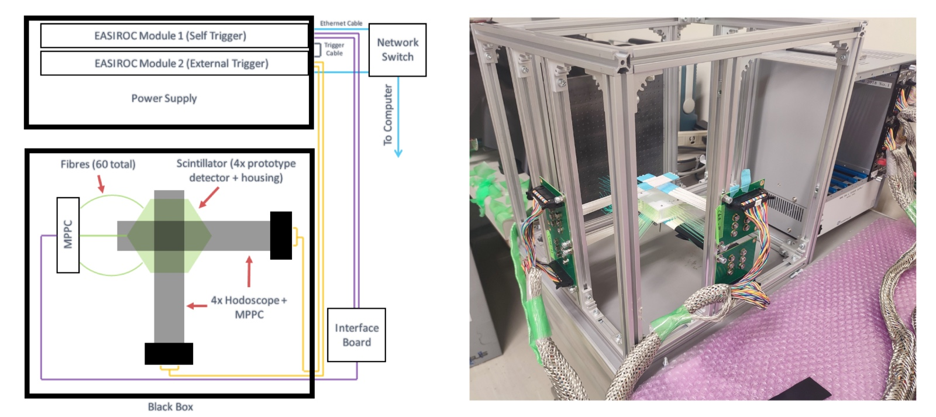
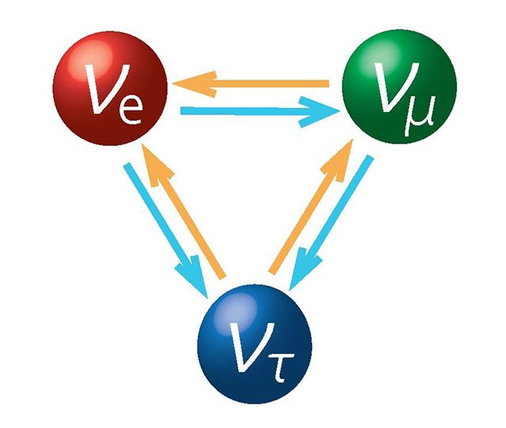
J-PARC Project
Supervisors: Ken Sakashita, Tsunayuki Matsubara, Hikaru Tanigawa
Project work will start this week
Topic: Assessment of a new neutrino detector design for T2K -> contributing to the examination of neutrino oscillations

Slide 6
THANKS!
Let’s have a nice party !
marchannig@gmx.de
Please keep this slide for attribution

