Slide 1
Self-introduction
Junsang Hwang, Seoul National University

Slide 2
Self-Introduction
Junsang Hwang
Senior undergraduate student of Seoul National University, located at Seoul, South Korea.
Department of Physics & Astronomy
Will graduate on August 29th this year

Slide 3
Seoul National University

Slide 4
At J-PARC
Will participate muon g-2 experiment project at J-PARC
g is the gyromagnetic ratio of the particle known to be a little larger than 2
Experiments results show some discrepancy from Standard Model calculation
J-PARC is planning to measure the value
$$\vec{μ}=g(\frac{q}{2m})\vec{s}$$

Slide 5
At J-PARC
Measure ambient magnetic field at J-PARC H2 site muon source chamber
Build a feedback system to suppress ambient magnetic field
Important for keeping muon trajectory & spin polarization under control since the measuring unit is ppb

Slide 6
Magnet field fitting
Magnet field measurement data was obtained and I performed fitting using 2 methods
Linear Regression: $B_{i}=\sum_{j}{a_{ij}x_{j}}+b_{i} (i,j=1, 2, 3)$
Dipole fitting: $\vec{B}=\sum_{i}{\frac{μ_{0}}{4π}\frac{3\left(\vec{m_{i}}∙\vec{r_{i}}\right)\vec{r_{i}}−r_{i}^{2}\vec{m_{i}}}{r_{i}^{5}}}$

Slide 7
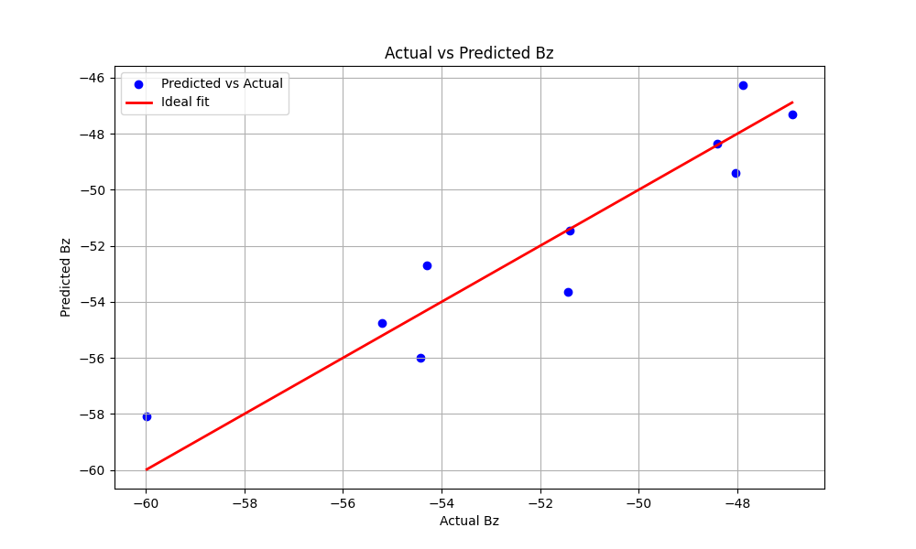
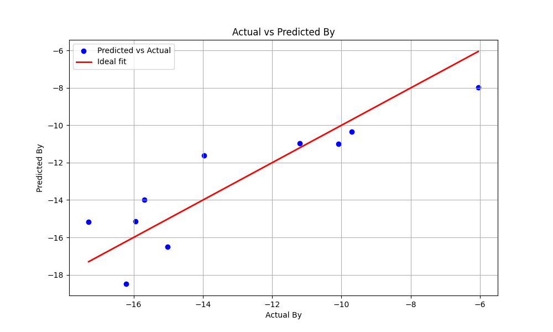
Linear Regression
Error average about 1-2uT
Singular point at Bx data (error larger than 10uT)

Slide 8
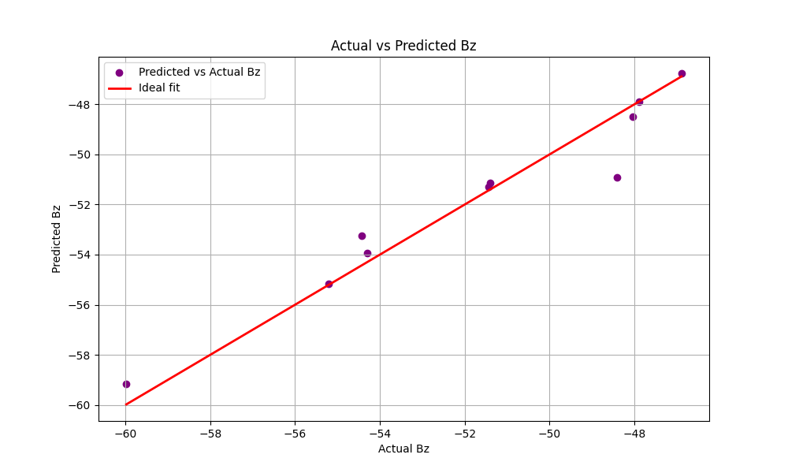
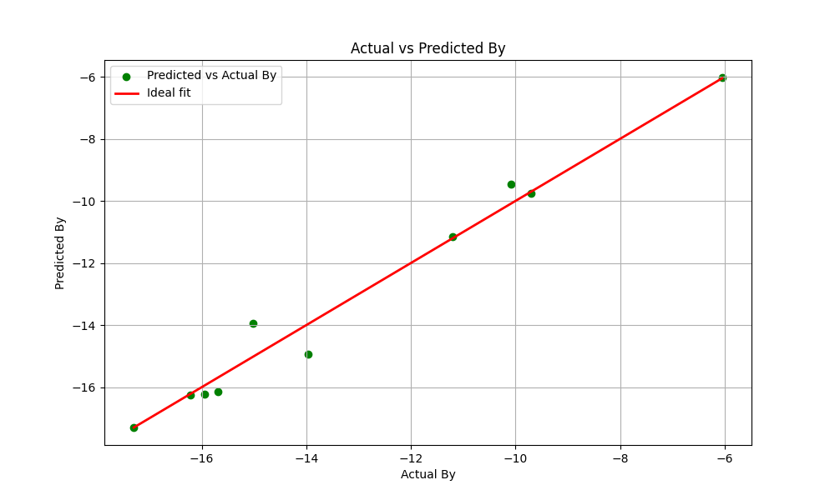
Dipole fitting
Error average less than 1uT
A singular point at Bz data (error about 2.5uT)

Slide 9
Thank you for listening!

