Slide 1
BI @ 2nd Workshop for CERN/JPARC-KEK collaboration
11-Oct-2024
T.Lefevre
C.Pasquino, F. Roncarolo, J.Storey, R.Veness, C.Zamantzas

Slide 2
BI @ KEK- JPARC
As a reference: CERN-J-PARC 2019 Collaboration Meeting (Rhodri’s presentation)
The next slides will shortly address possible areas of interest for collaboration:
Slow Extraction - Spill Monitor
CERN offers expertise in detector development and DAQ
Secondary Emission Monitors (SEM) absolute calibration
Opportunity for knowledge exchange with J-PARC
Fixed target instrumentation
Beam-gas monitors
Low density materials
Beam Loss Monitors

Slide 3
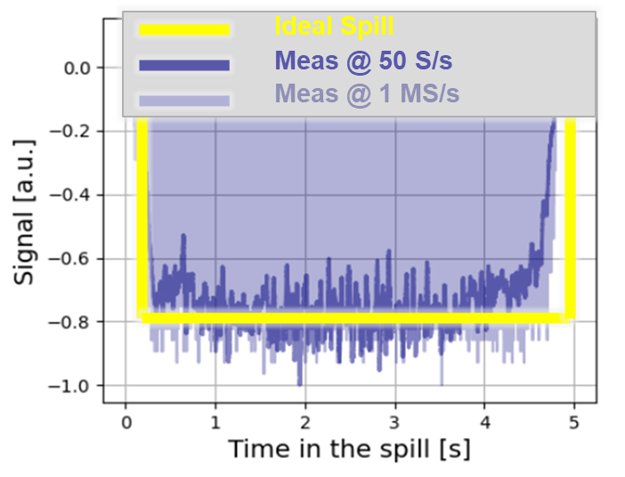
Slow Extraction – Fast Spill Monitor
CERN developing advanced spill monitoring system:
Publishes harmonics from 50Hz to > 1GHz (ShiP coming)
Optimizes spill quality and assists fixed target experiments
Detector technologies:
OTR-PMT and Cherenkov detectors tested
dBLS (diamond Beam Loss Monitors) as alternative
New data acquisition and processing:
Real-time analysis in time and frequency domains
Enhanced feedback-feedforward for power converters
Recent presentations:
SX Workshop 2024
IBIC 2024

Slide 4
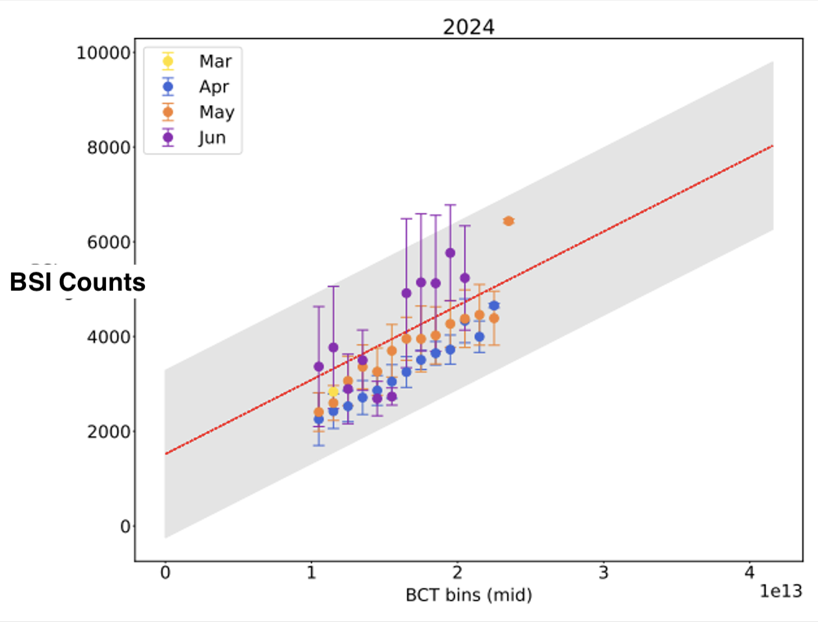
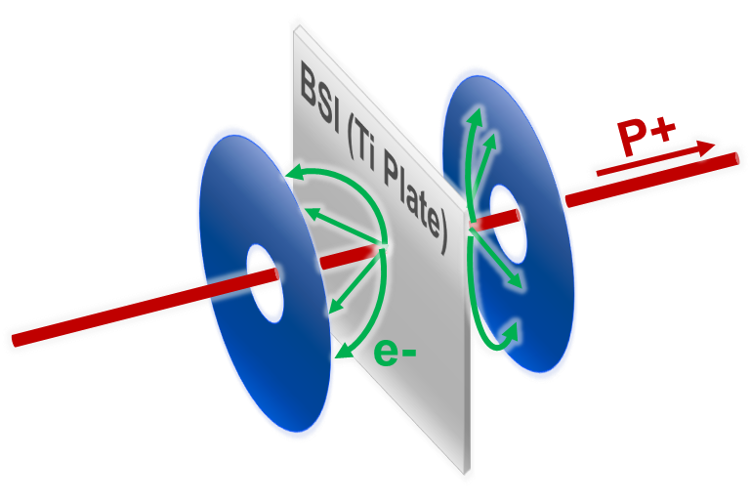
Secondary Emission Monitors
Absolute calibration, to monitor protons on target
Challenging determination of SEY and it’s evolution in time for different materials
Cross calibration difficult
Option for CCC
Presentation at SX workshop 2023

Slide 5
Fixed Target Instrumentation
CERN has experience for AD, nToF, SBDS, LBDS (see BI presentation at NBI 2022 and 2024)
New challenges related to ECN3, e.g. monitoring of dilution et al. (see ECN3 @ BIFT )

Slide 6
Low density materials research
CERN SY-BI is currently working on a new generation of wire made of Carbon Nanotubes to substitute the current 34um diameter carbon fiber wire.
Significant reduction of the provided signal – Avoid saturation
Increased energy and intensity capabilities
Partnerships
Active collaboration with Prof. Inoue and Prof. Sugime from kindai University (Osaka) on CNT wire development and testing.
Exploring partnerships with Japanese institutes due to:
Expertise in manufacturing and postprocessing of these materials.
Expertise to test CNT wires under high-energy beam conditions
Image 1 – University of Kindai CNT wire SEM image

Slide 7
Beam Gas Ionisation Profile Monitors
Collaboration since 2015 with Kenichiro Sato (KEK / J-PARC), to develop non-destructive & continuous beam profile monitors based on ionisation of residual gas (IPM = Beam Gas Ionisation (BGI) profile monitor at CERN.)
Areas of Past Collaboration:
Development of a novel field cage design for PS BGI, aimed at mitigating the effects of secondary electrons generated by ions impacting the cathode.
Co-development of Virtual-IPM - suite of tools for simulating (residual) gas based beam profile monitors, that is crucial for the optimisation of IPM designs.
Potential Areas for Future Collaboration:
Development of IPM based on Timepix4 mounted on a ceramic, which also serves as the vacuum feedthrough (potential joint development with Japanese industry.)
Maintainence of Virtual-IPM.

Slide 8
Fluorescence Profile Monitors
BGC – Beam Gas Curtain device is installed in the LHC and successfully measures vertical and horizontal beam profiles from Injection Energy to Flat Top. Collaboration ongoing with Cockcroft Institute (UK) for the supersonic gas jet profile simulation and measurements.
Potential Areas for Future Collaboration: conception of a new instrument based on fluorescence for beam halo monitoring.

Slide 9
BLMs
In the past, CERN SY-BI has provided expertise in shielding BLM systems from EMI (e.g. JPARC problems with x-rays interference)
CERN looking currently at
TimePix based BLM for low noise, large dynamic range, bunch-by-bunch measurements
Detector technologies suitable for FCCee beam loss monitoring.
Possible synergies with KEK-JPARC?

