Slide 1
Design and simulation of Electron gun and Magnet of C-Band 80MW klystron for CEPC LINAC
Noman Habib
(PhD Scholar Accelerator Division, IHEP)
Supervisor: Prof. Zu-Sheng Zhou
7thInternational School on Beam Dynamics and Accelerator Technology (ISBA24) 1 to 9 Nov. 2024 , in Chiang Mai, Thailand

Slide 2
Content
5721/80MW klystron
Design consideration of klystron includes
1-Electron Gun
2-Electrostatic Electron Gun
3-Ideal/Reference field
4-Solenoid/Magnet
5-Ceramic Seal
6-Mechanical Design
7thInternational School on Beam Dynamics and Accelerator Technology (ISBA24) 1 to 9 Nov. 2024

Slide 3
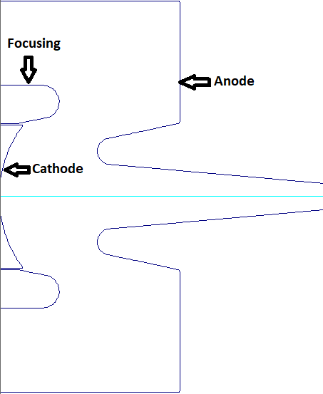
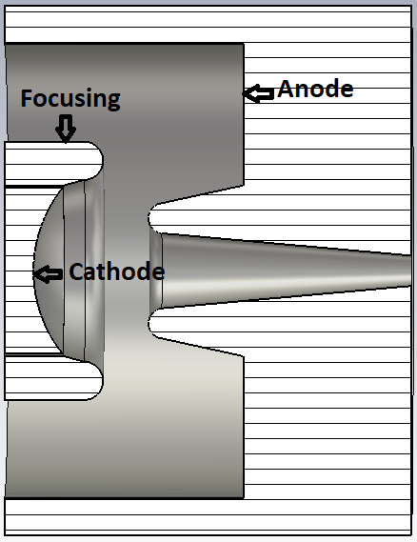
Electron Gun
A 2D & 3D view of the Klystron pierce electron gun shown in figure 1, was modeled in DGUN & CST Code with parameters given in table 1. This is a thermionic diode gun having cathode, focusing electrode and anode.
Parameters | Values
Anode Diameter (mm) | 120
Focusing electrode diameter (mm) | 68.304
Cathode - anode spacing (mm) | 76.1
Cathode - focusing electrode spacing (mm) | 1.1
Cathode diameter (mm) | 87.8
Figure 1: 2-D & 3-D model of the gun produced by DGUN &CST.
Table 1: Beam Optics Design Parameters
7thInternational School on Beam Dynamics and Accelerator Technology (ISBA24) 1 to 9 Nov. 2024

Slide 4
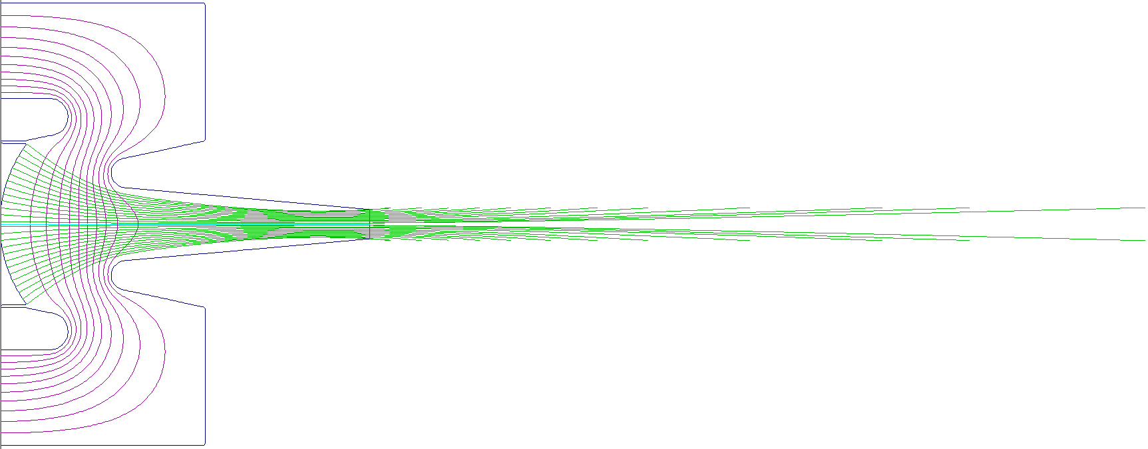
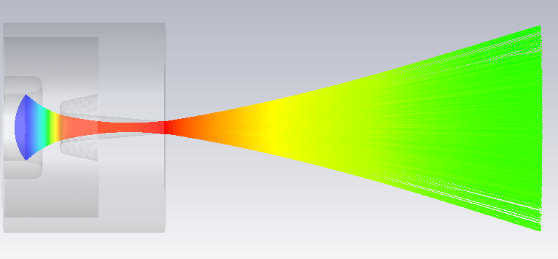
Electrostatic Electron gun
An electrostatic electron gun was designed and simulated with the potentials given in table 2 in DGUN and CST shown below in figure 2(a , b) by using the parameters given in table 1 previously,
2a
Parameter | Units | Values
Cathode voltage | kV | 0
Anode voltage | kV | 425
2b
Table2: Potentials of Gun
7thInternational School on Beam Dynamics and Accelerator Technology (ISBA24) 1 to 9 Nov. 2024

Slide 5
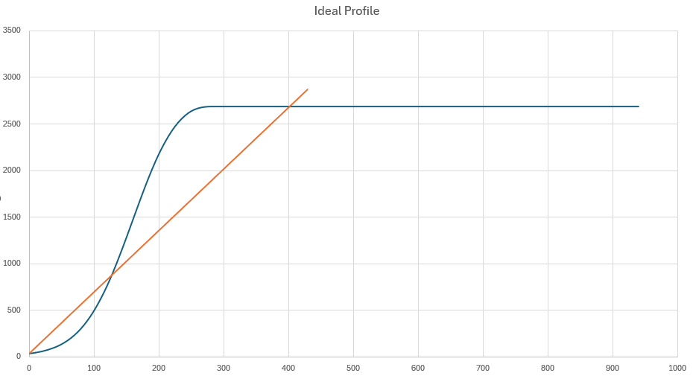
Ideal magnetic field
To reduce the beam ripple rate and make the average radius according to our requirement a Brillouin ideal/reference magnetic field was made by using Brillouin equations in Excel as shown in figure 3.
$$B_{b}≈8.32×\frac{\sqrt{I}}{V^{1/4}r_{0}}$$
$$B_{b}≈8.32×\frac{\sqrt{425.1}}{{\left(425000\right)}^{1/4}\left(7.3031\right)}×1000 \\ B_{b}=919.95 Gauss$$
Figure3: Ideal Magnetic field
7thInternational School on Beam Dynamics and Accelerator Technology (ISBA24) 1 to 9 Nov. 2024

Slide 6
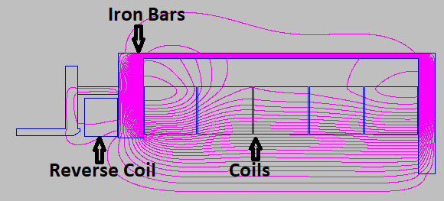
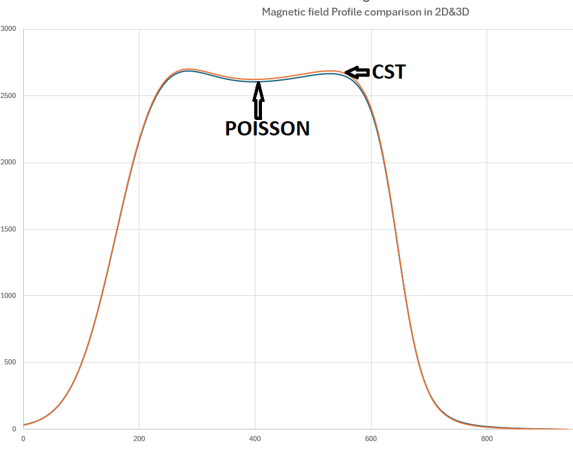
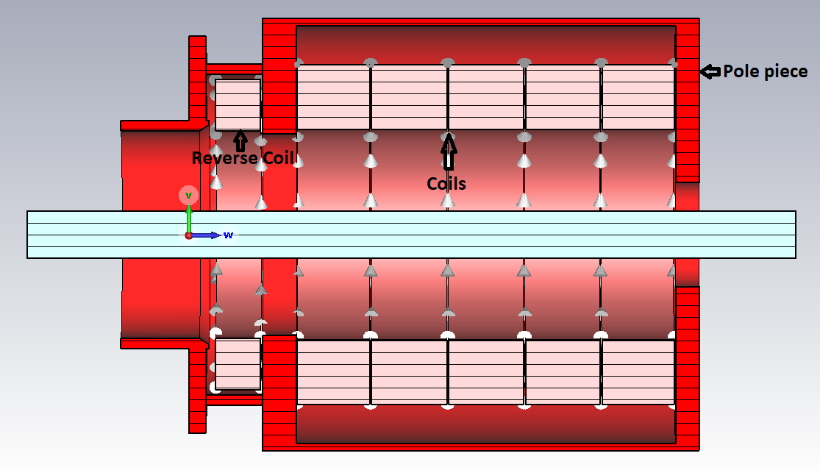
Solenoid
We used POISSON and CST code to design solenoid as given in Fig. 4(a , b) with a Reverse Current Coil at the cathode for beam trajectories matching in the field free region. The obtained magnetic field comparison of POISSON and CST in Excel is given in Fig 5.
4a
Figure5 : Comparison of fields in Excel
4b
7thInternational School on Beam Dynamics and Accelerator Technology (ISBA24) 1 to 9 Nov. 2024

Slide 7
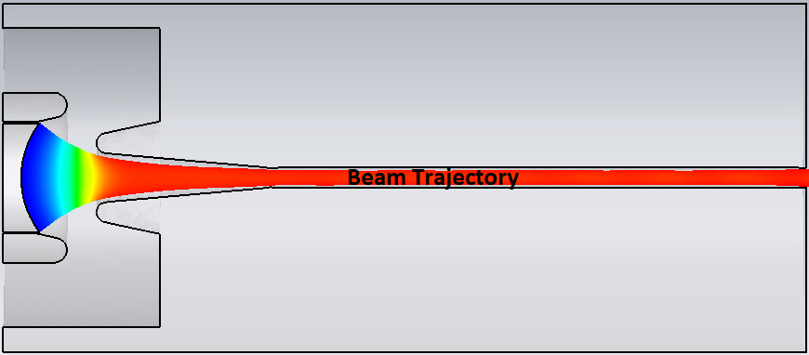
Magnetostatic Electron gun
The gun was then simulated in DGUN and CST Codes for the beam optics analysis. To get the maximum beam convergence, high emission density and low perveance in the field free region we used the parameters as listed in table (1,2). We obtained an electron beam of average radius of 5.55 mm in DGUN and 5.73 mm in CST. The electron beam trajectories are shown in figure 6(a , b).
6a (DGUN)
6b (CST)
7thInternational School on Beam Dynamics and Accelerator Technology (ISBA24) 1 to 9 Nov. 2024

Slide 8
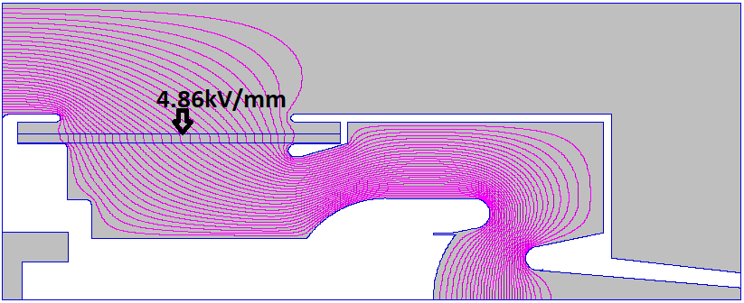
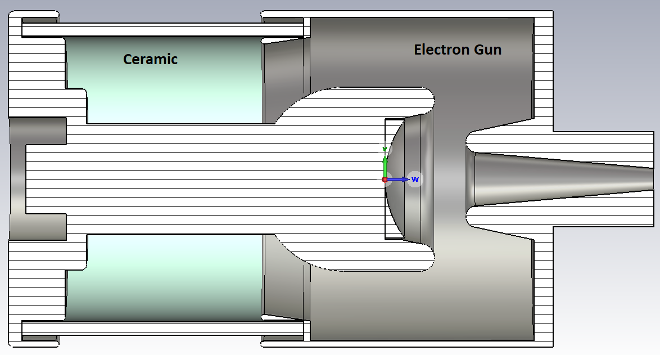
Ceramic seal
We used POISSON and CST code to design Gun envelope and calculate its electric field (4.86kV/mm) as shown below in figure 7(a , b)
7a
7b
7thInternational School on Beam Dynamics and Accelerator Technology (ISBA24) 1 to 9 Nov. 2024

Slide 9
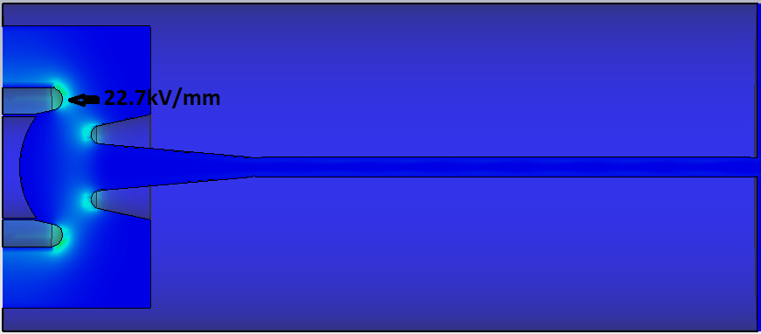
Results and Discussion
A maximum electric field value of 19.3kV/mm in POISSON SUPERFISH and 22.7 kV/mm in CST at the focusing electrode is obtained as the potential lines are spaced very close to each other as can be seen in the Figure 8(a , b).
8a (DGUN)
8b (CST)
7thInternational School on Beam Dynamics and Accelerator Technology (ISBA24) 1 to 9 Nov. 2024

Slide 10
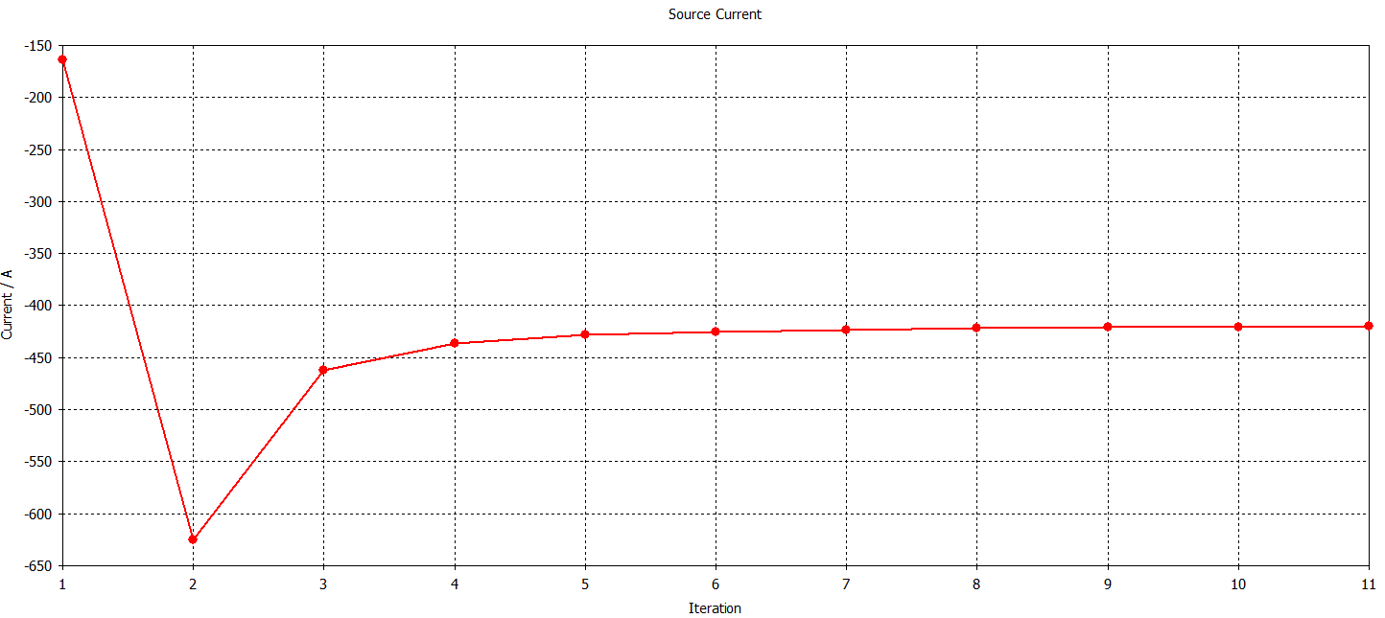
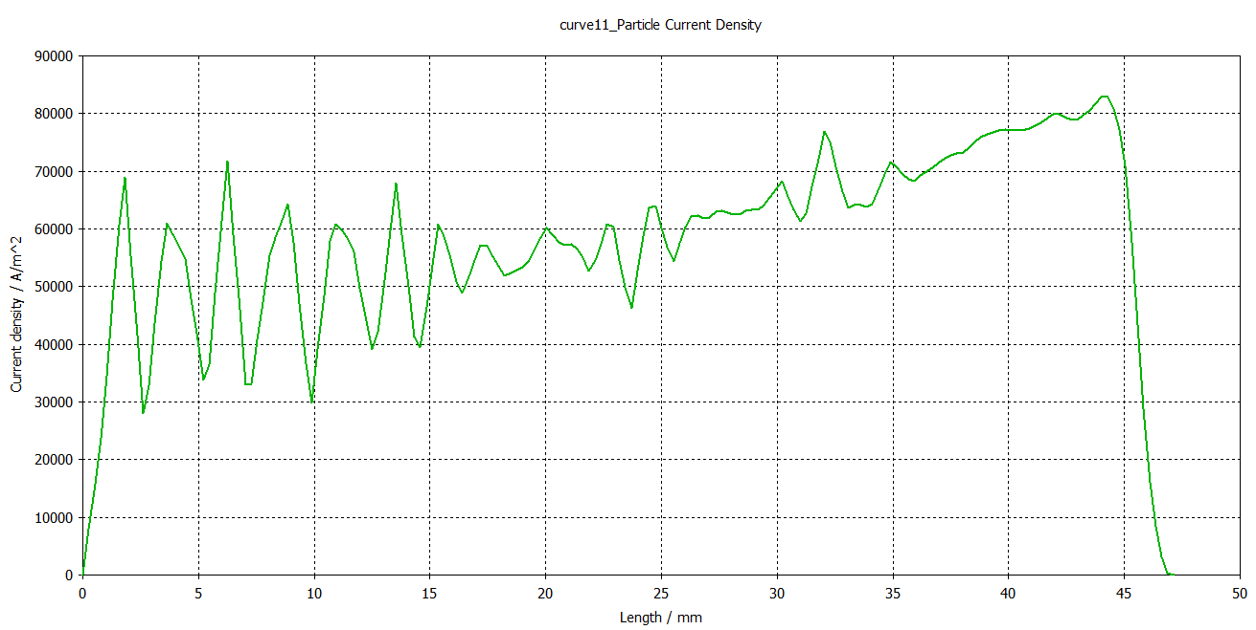
Results and Discussion
A space charge current of 418A is obtained as can be seen in the Figure 9 below:
The perveance is calculated to be 1.5 µP as shown in figure 10 below:
7thInternational School on Beam Dynamics and Accelerator Technology (ISBA24) 1 to 9 Nov. 2024

Slide 11
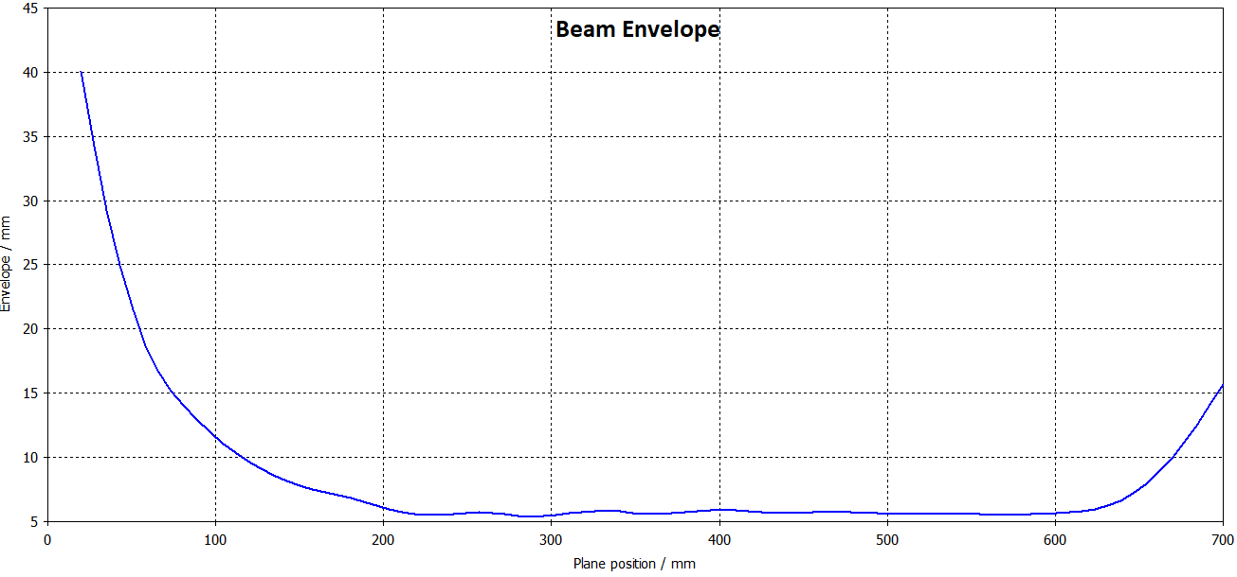
Results and Discussion
The values of the maximum & minimum beam size under the magnetic field is shown in Figure 11 below:
7thInternational School on Beam Dynamics and Accelerator Technology (ISBA24) 1 to 9 Nov. 2024

Slide 12
Summary
A thermionic high-power diode electron gun in a simple structure is designed (modeled), simulated and analyzed .A summary of the calculated parameters are given in table 3 below:
Parameters | Units | CST | DGUN | POISSON
Acceleration voltage | kV | 420.7 | 425 | 425
Current | A | 418 | 425.1 | NA
Maximum Cathode current density | A/cm^2 | 8.8 | 8.8 | NA
Perveance | µP | 1.5 | 1.5 | NA
Maximum radius | mm | 6.04 | 5.86 | NA
Ripple rate | % | 6.5% | 5.6% | NA
Electric field @ focusing electrode | kV/mm | 22.7 | 19.3 | 22.7
Electric Field @ ceramic | kV/mm | 4.86 | NA | 4.86
Maximum Magnetic field @ drift tube | Gs | 2687 | 2687 | 2687
7thInternational School on Beam Dynamics and Accelerator Technology (ISBA24) 1 to 9 Nov. 2024

Slide 13
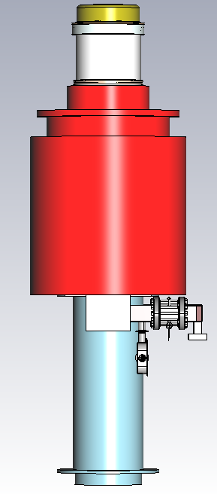
Mechanical design
Mechanical design of C-band 80MW klystron is ready and now it is under fabrication process in a Chinese company shown below:
7thInternational School on Beam Dynamics and Accelerator Technology (ISBA24) 1 to 9 Nov. 2024

Slide 14
THANK YOU
7thInternational School on Beam Dynamics and Accelerator Technology (ISBA24) 1 to 9 Nov. 2024

