Slide 1
Analysis of parameter characteristics of the ILC e-driven positron source by GEANT4
Yodai Sasaki, Masao Kuriki, Tohru Takahashi,
Zachary Liptak, Shunpei Kuroguchi (Hiroshima Univ.)

Slide 2
ILC Positron Source
The International Linear Collider: A next-generation electron-positron collider, ECM=250~1000GeV.
2x10¹⁴ positron/sec is required.
The system is designed to optimize efficient positron generation, the positron yield $η=N_{e^{+}}/N_{e^{−}}=1.48$.
$N_{e^{+}}$: The number of positrons in the damping ring acceptance
$N_{e^{−}}$: The number of electrons in the drive beam
Schematic layout of the ILC electron-driven positron source
Seimiya et al., “Positron Capture Simulation for the ILC Electron-Driven Positron Source.”

Slide 3
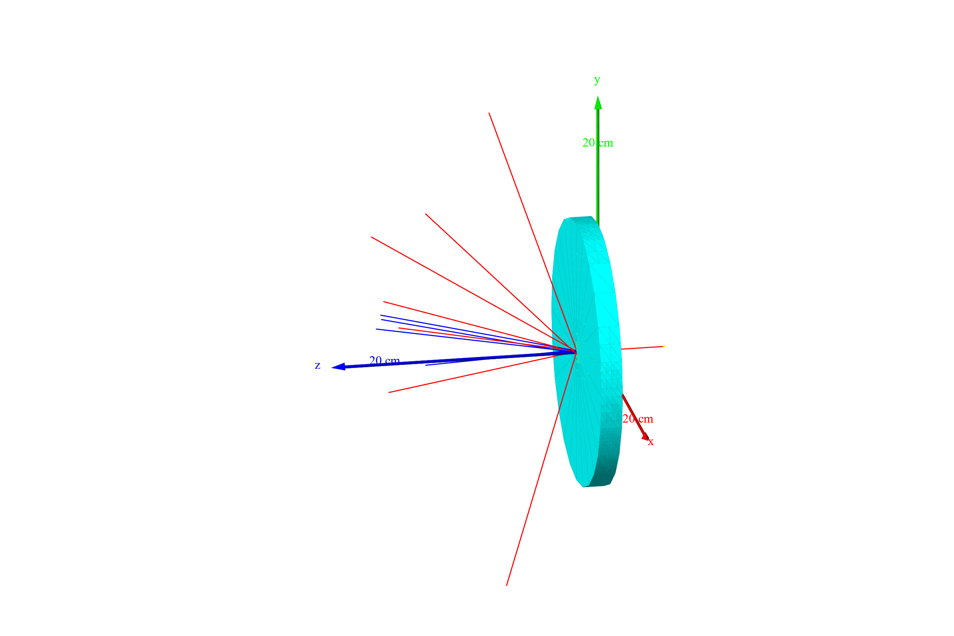
Purpose
Accelerator components and the operation parameters had been optimized well (see Mr. Kuroguchi’s presentation).
We try a precise optimization of drive beam and target parameters.
We analyse the phase space distribution of positrons at the downstream of the tungsten target, with GEANT4: Simulation software for the particle and material interaction based on Monte Carlo method.
Present parameters
Parameters | Values
Drive beam energy $E_{−}$ | 3 GeV
Drive beam size $σ$ | 2 mm
Target thickness | 16 mm
Electromagnetic showers

Slide 4
Methods
Set the acceptance at the end of the target, by tracing the particles that fit within the DR acceptance backwards.
1480 positions are obtained. (Accepted positron)
DR acceptance
Backward trace

Slide 5
Transverse acceptance
Distribution Accepted positron at the end of target.
We set the acceptance on each distribution in $2σ_{x} (σ_{y})$ region.
Standard deviation was obtained by Gaussian fitting.

Slide 6
Longitudinal acceptance
Adiabatic matching device (Bz(s)) suppresses the transverse momentum, giving also conditions as
$p_{z}<10$ [MeV/c] (Adiabatic condition.)
$p_{t}/p_{z}<1$ (Debunching due to the large spiral trajectory.)
$p_{z}>mc$ (Debunching due to low momentum.)

Slide 7
Results
The positron generation efficiency is evaluated as the ratio of Accepted positron to number of electrons at the target, $N_{e^{−}}=10000, σ=2$mm.
The results agree with the following simplified model.
$$E_{−}/2^{t_{max}}=E_{c} (critical energy)$$
$$→t_{max}=\ln\left(E_{−}/E_{c}\right)/\ln{2}$$
$$→N_{max}=2^{t_{max}}=E_{−}/E_{c}$$

Slide 8
Normalized yield: $η/E_{−}=N_{e^{+}}/N_{e^{−}}/E_{−}$
All positrons
Accepted Positron
The number of positrons as a function of target thickness moves to a larger value for Accepted positron.
This is because when the target is thin, the positrons are not sufficiently “thermalized” and do not satisfy the adiabatic condition, i.e. P_{z} is too high.

Slide 9
Discussion
The optimum thickness for Accepted positron is thicker than that for all positrons. This is because a sufficiently thermalized positron fits to the longitudinal acceptance.
The normalized yield is higher for lower drive beam energy. It is suggested that the power efficiency is greater with lower drive beam energy.
We will analyze the efficiency regarding the energy density of the target, which is the index for the potential target damage that is the biggest concern.

Slide 10
Conclusions & Future work
Acceptance of the end of the target was estimated from the previous simulation data.
The estimated positron yield normalized by drive beam energy is lower when the energy is higher.
Future work
Deeper understanding of the results
Evaluation of the peak energy deposition density

Slide 11
Appendix

Slide 12
Adiabatic condition
$B_{z}\left(s\right)=\frac{B_{0}}{1+μs}$
$ε=\frac{μp}{eB_{0}}≪1$
The validity of the adiabatic condition is expressed by: $ε≈\frac{μp_{z}}{eB_{0}}≤0.5$
$B_{0}=5.0$[T], $μ=77$ [/m]
$p_{z}≤0.5\frac{eB_{0}}{μ}=$9.7 [MeV/c]

Slide 13
Distribution of positrons after the target

