Slide 1
My research and topics of interest
Atacan KILICGEDIK
Kandilli Detector, Accelerator and Instrumentation Laboratory (KAHVE-Lab), Turkey
01.11.2024
ISBA24, Chiang Mai University, Thailand

Slide 2
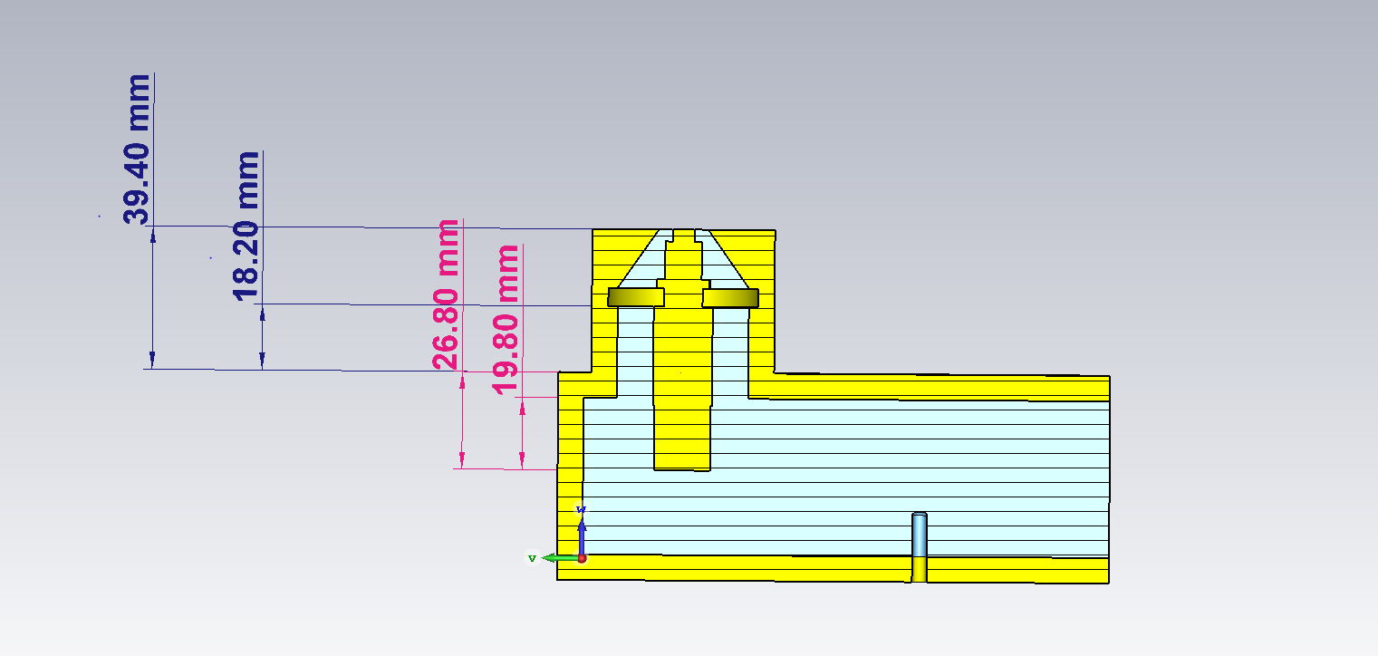
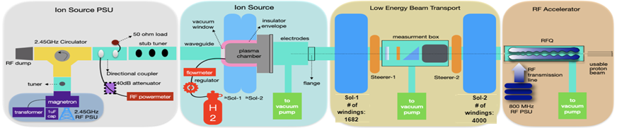
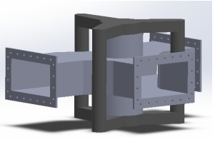
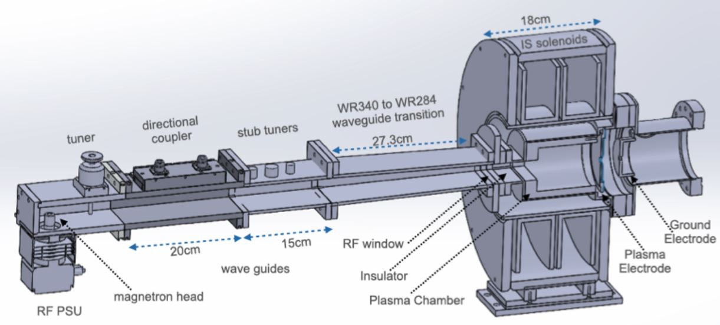
Kandilli Detector, Accelerator and Instrumentation Laboratory (KAHVELab)- PTAK Project:
MAGNETRON HEAD
MEASUREMENT BOX
includes:
*faraday cup (beam current)
*phosphor screen (transverse beam shape)
*pepper-pot (transverse emittance)
MICROWAVE DISCHARGE ION SOURCE
the applied magnetic field > 875 G
2.45 GHZ CIRCULATOR
*is a passive device with three ports
*serves to protect the power supply from reflected power.
20 kEV H⁺
ISBA24, Chiang Mai University, Thailand
1

Slide 3
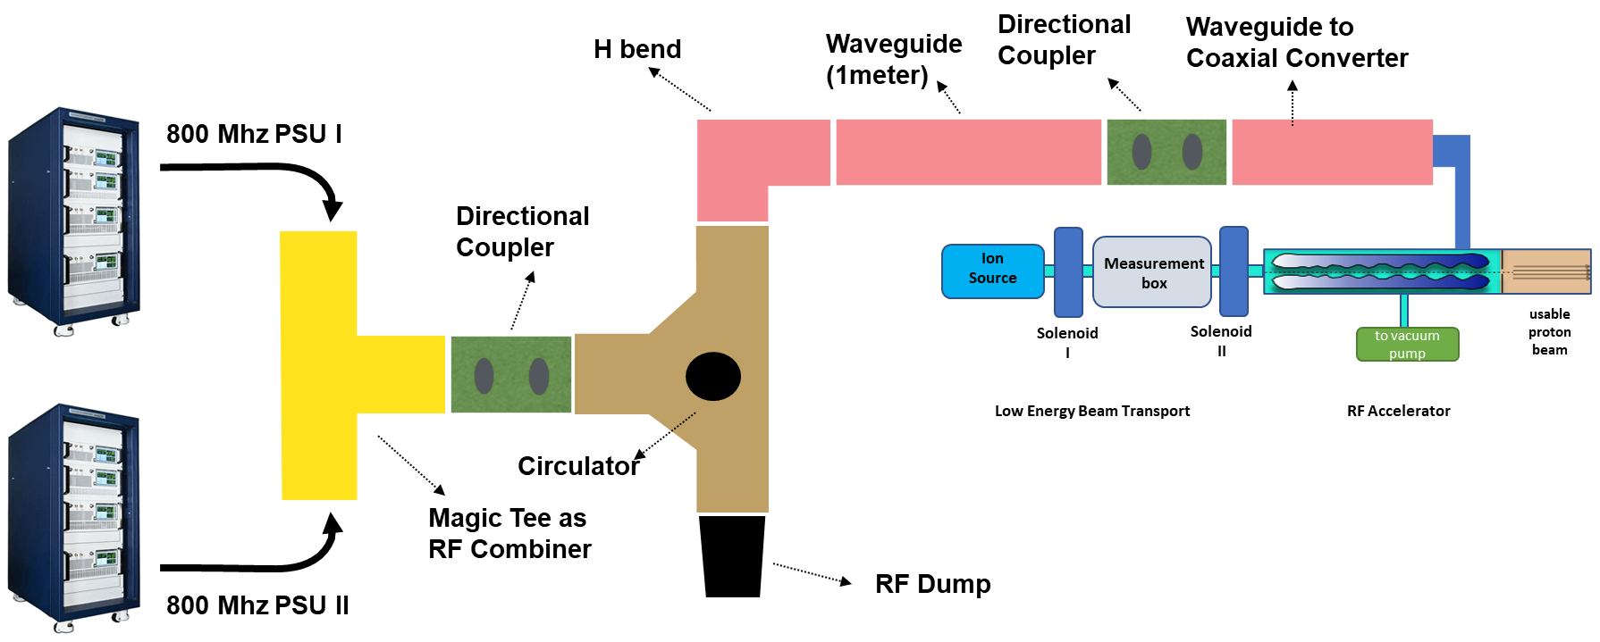
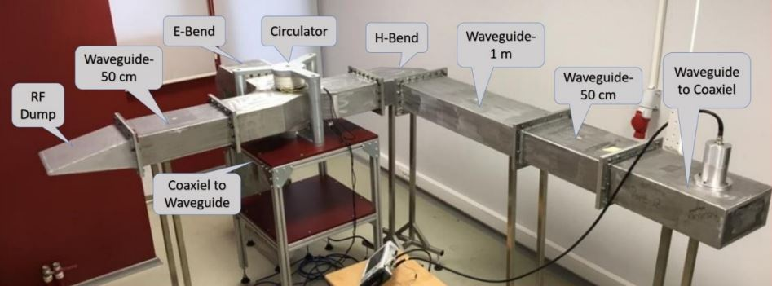
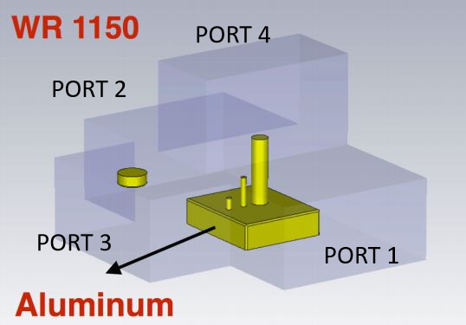
The 800 MHz RF Transmission Line in the KAHVELab
An solid-state power amplifier capable of up to 5 kW and TH582 tetrode tubes.
800 MHZ CIRCULATOR
Each PSU can deliver up to 35 kW peak power for a typical pulse duration of about 100 µs
800 MHZ RF TRANSMISSION LINE
MAGIC TEE
ISBA24, Chiang Mai University, Thailand

Slide 4
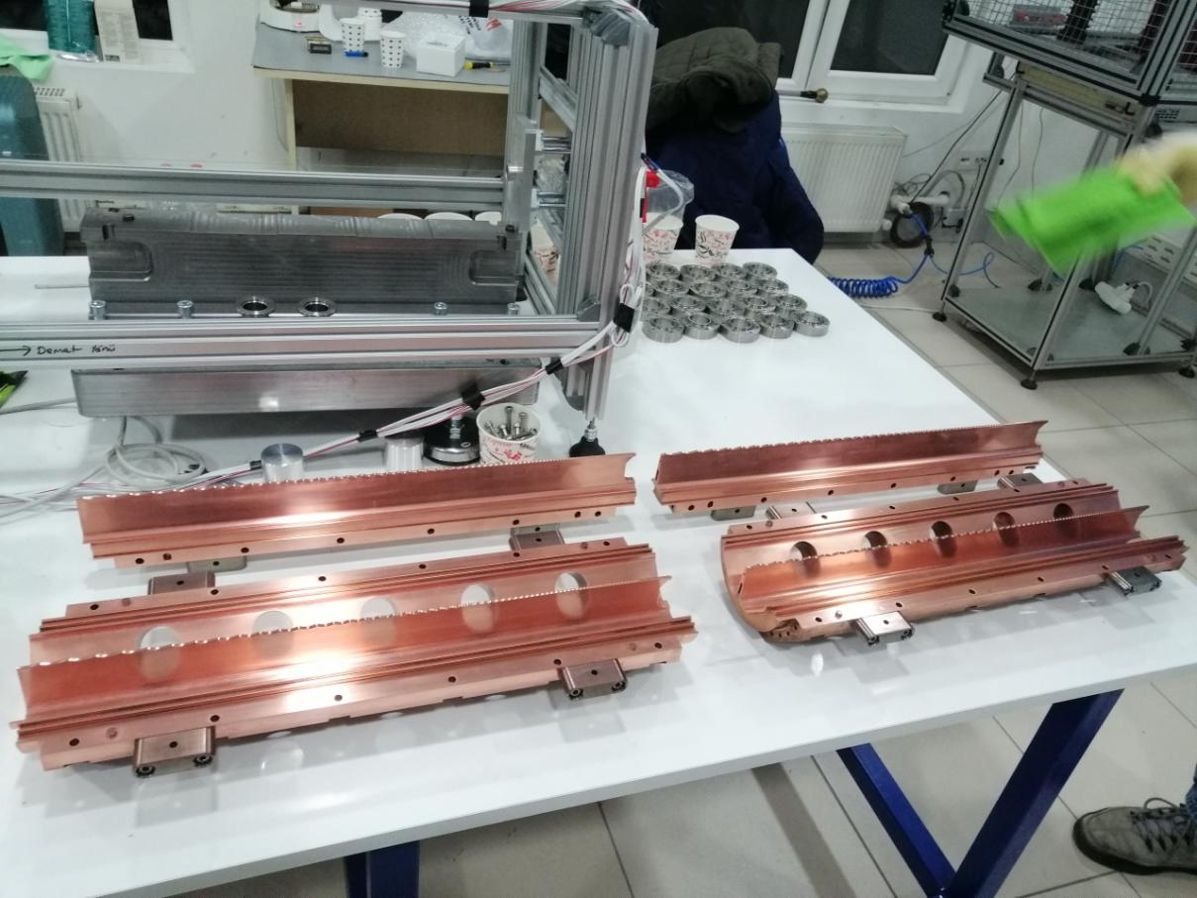
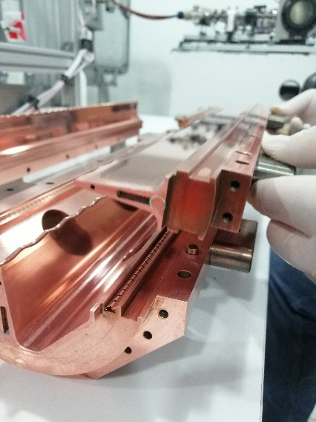
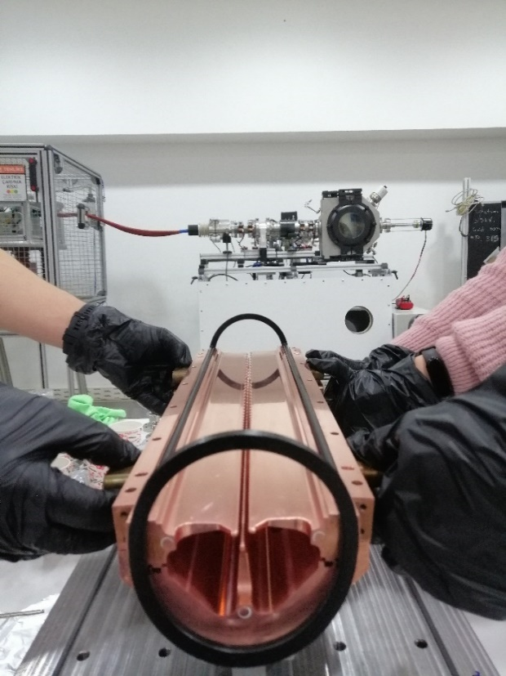
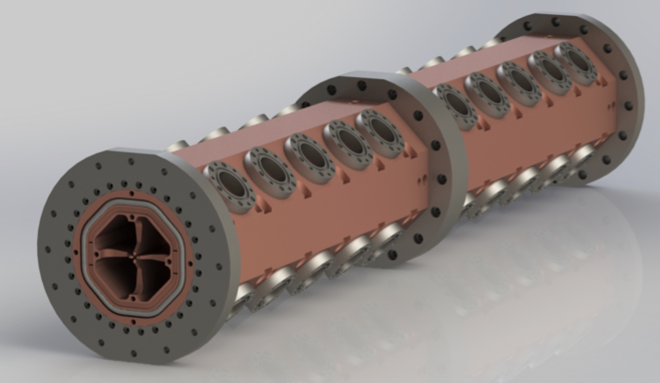
The PTAK-RFQ at KAHVELab
A RFQ has four electrode (called vanes).
The vanes have a longitudinal modulation. This creates a longitudinal component of the electric field. Therefore, not only transverse focusing, but also acceleration of particles can be provided.
PTAK-RFQ utilizes:
*a 3-D special vacuum seal (formed by two circular O-ring and four flat pieces) to obtain the needed vacuum level
*some finger-type RF shields to prevent RF leaks
-HF-RFQ designed in CERN– for use in medical applications,
-PIXE-RFQ designed in CERN– for use in materials science applications
PTAK-RFQ, diameter: 130mm and total length: 980mm
A photo of the four-vane of the PTAK-RFQ module 0
ISBA24, Chiang Mai University, Thailand

Slide 5
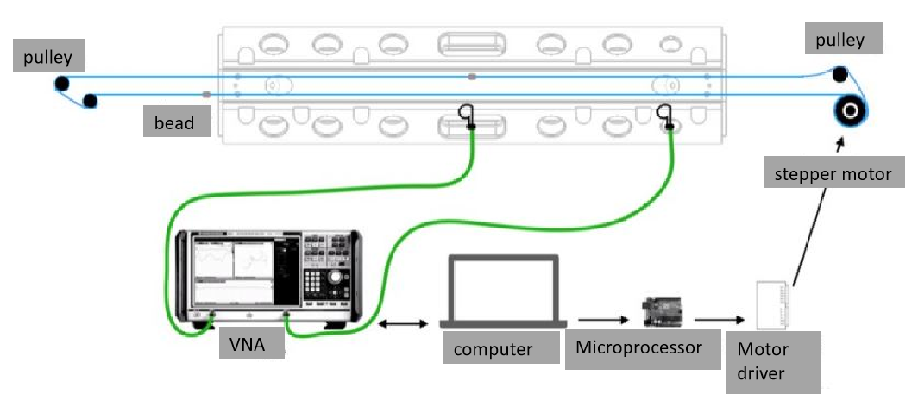
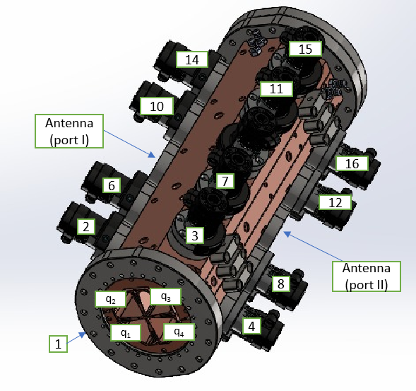
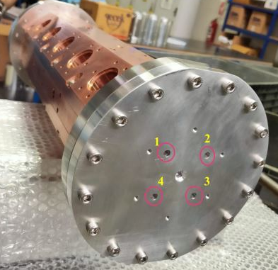

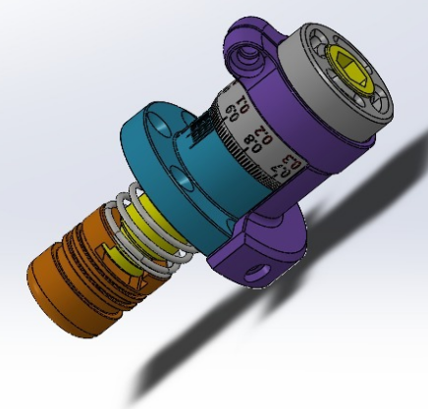
Bead-pull Measurements for PTAK-RFQ Module 0
For a cavity on resonance, the electric and magnetic stored energies are equal.
If a small perturbation is made on the cavity wall, this will generally produce an unbalance of the electric and magnetic energies, and the resonant frequency will shift to restore the balance.
-insert a metallic bead attached to a fishing line into the cavity in small steps along the cavity's longitudinal axis,
-measure the shift in the resonant frequency of the cavity.
ISBA24, Chiang Mai University, Thailand

Slide 6
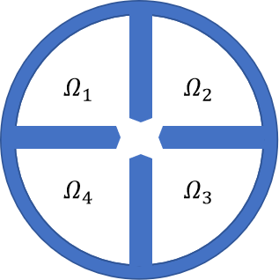
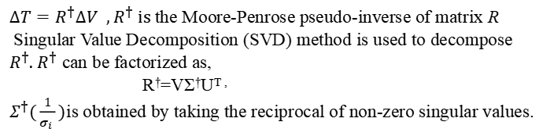






The Field Amplitudes and the Field Tuning Algorithm
The relative quadrant amplitudes of the magnetic field is based on by taking the square root of the smoothed data from each quadrant and assigning proper signs (+, -, +, -) to take into account the alternating field orientation of the TE₂₁₀ mode denoted as
The algorithm gives possible length settings of tuners placed on the module 0 to tune magnetic field distribution.
$$∆V=R∆T$$
$$∆V=\frac{{∂V}_{current,k}}{{∂T}_{current,l}}∆T$$
$Ω_{1}=+\sqrt{∆φ_{1}}$, $Ω_{2}=−\sqrt{∆φ_{2}},$
$$Ω_{3}=+\sqrt{∆φ_{1}}, Ω_{4}=−\sqrt{∆φ_{4}},$$
$$Q^{amp}=\frac{Ω_{1}−Ω_{2}+Ω_{3}−Ω_{4} }{4}$$
$$D_{s}^{amp}=\frac{Ω_{1}−Ω_{3} }{2}$$
$$D_{t}^{amp}=\frac{Ω_{2}−Ω_{4} }{2}$$
$∆T=R^{†}∆V , R^{†}$ is the Moore-Penrose pseudo-inverse of matrix R
Singular Value Decomposition (SVD) method is used to decompose $R^{†}$. $R^{†}$ can be factorized as,
R†=VΣ†U^{T}$,$
$Σ^{†}(\frac{1}{σ_{i} })$is obtained by taking the reciprocal of non-zero singular values.
A general arrangement of the magnetic fields obtained by the perturbation measurements in quadrants of the RFQ.
ISBA24, Chiang Mai University, Thailand

Slide 7
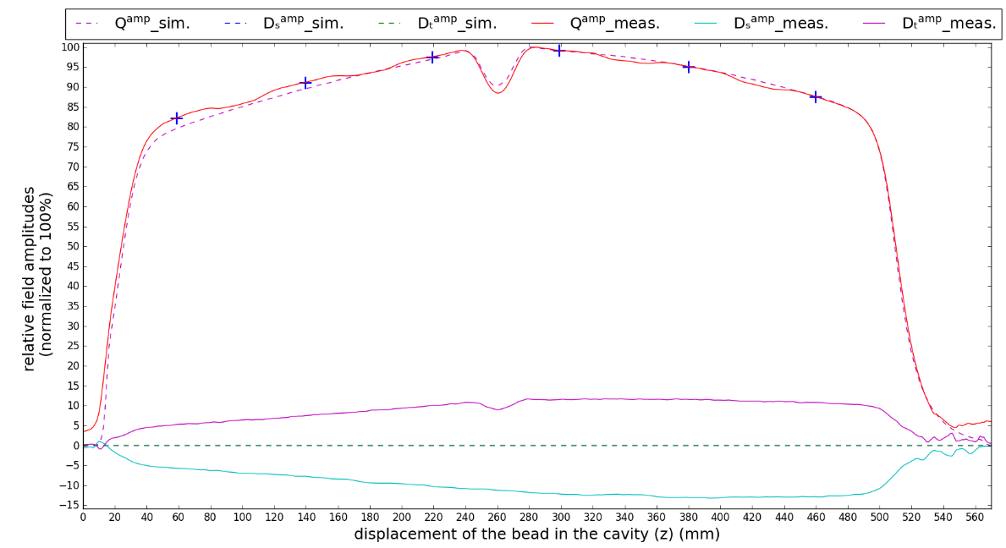
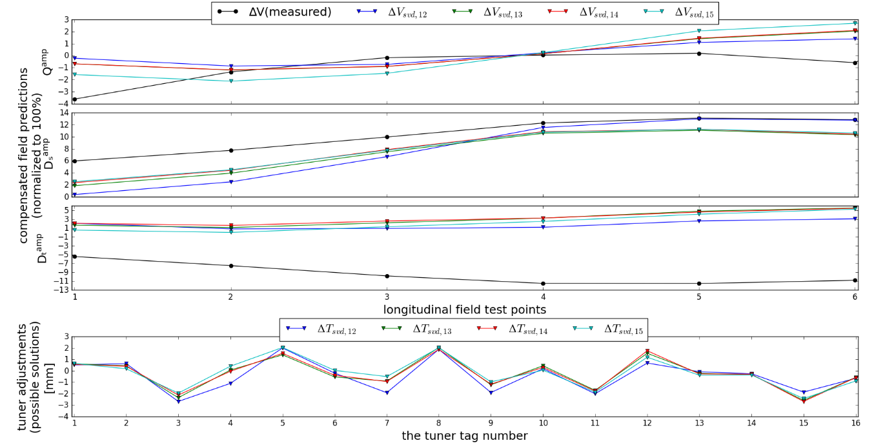
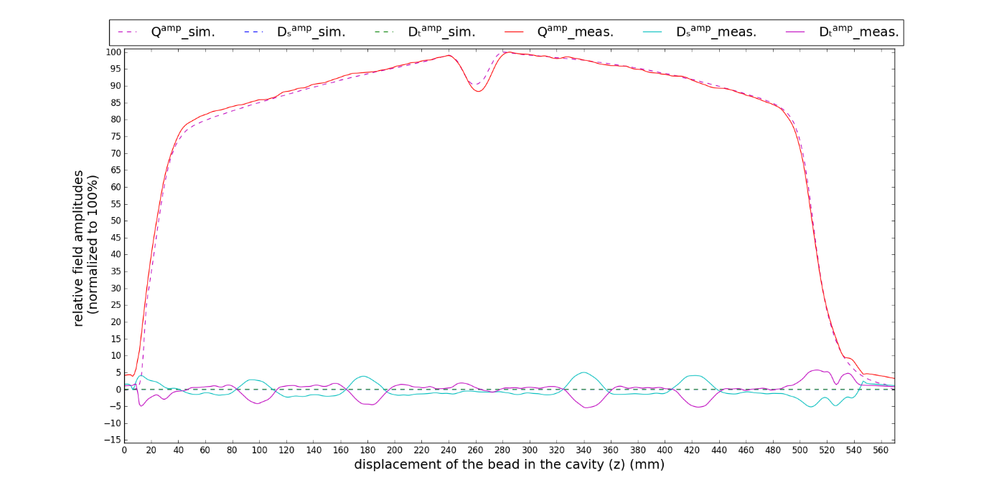
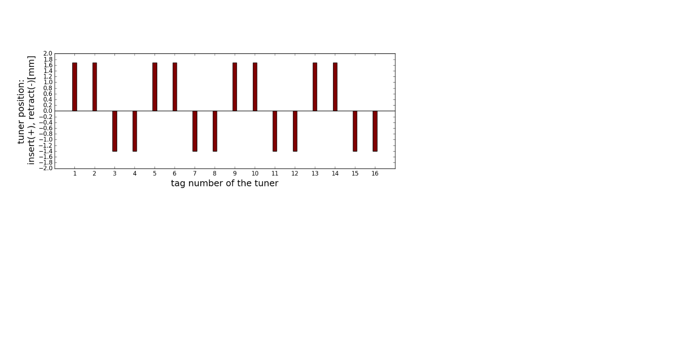
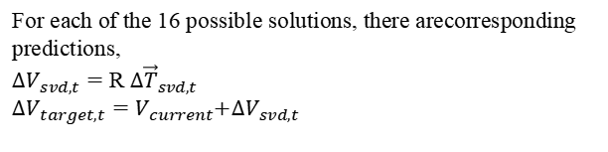
Possible solutions, Field Amplitudes and Final Tuner Positions
For each of the 16 possible solutions, there arecorresponding predictions,
${∆V}_{svd,t}=$ R $∆{\vec{T}}_{svd,t}$
$∆V_{target,t}=$ $V_{current}$+${∆V}_{svd,t}$
The comparison between simulated and measured field components:
Before
+'s refer to field test points used for the tuning algorithm
Final Tuner Positions:
After
ISBA24, Chiang Mai University, Thailand

