Slide 1
Single Electron Storage Experiment at UVSOR-Ⅲ
Grad. Sch. Ad. Sci. Eng. Hiroshima Univ.
Yuya Asai

Slide 2
Introduction～about myself～
Name : Yuya Asai
Hometown : Saitama Prefecture
Pastime : Baseball Watching

Slide 3
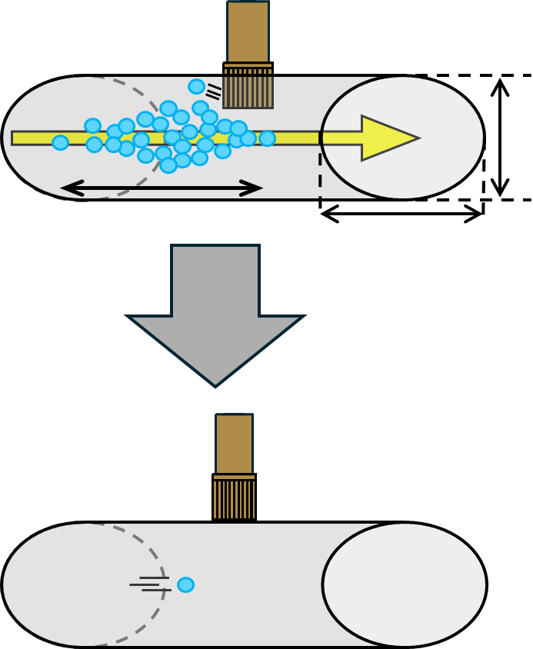
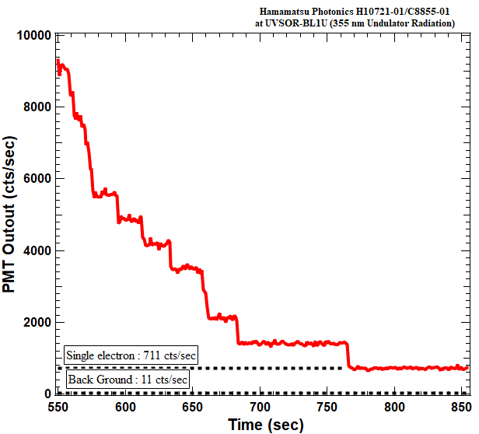
Introduction～Single Electron Storage～
〇 Single Electron Storage : investigate the electromagnetic emission and motion
of a single electron in a synchrotron radiation storage ring.
@UVSOR
Beam scraper
$$N_{e}={10}^{10\sim 11}$$
$I_{b}\sim 100$ mA
Electrons collide and disappear
Synchrotron radiation to PMT
38
mm
・step-function-like change :
shows that the loss of one electron
results in the loss of radiation
intensity by the same amount
～100 ps
110 mm
Observe changes in synchrotron radiation intensity
$$N_{e}=1$$
$I_{b}\sim 1$ pA
pull out
beam scraper
maintain single electron state
Using this intensity of light for research.

Slide 4
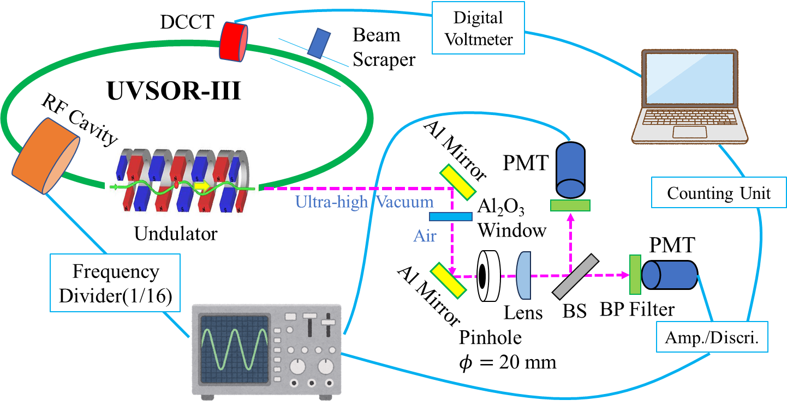
Introduction～Single Electron Storage～
〇 Experimental schematic diagram at UVSOR-Ⅲ

Slide 5
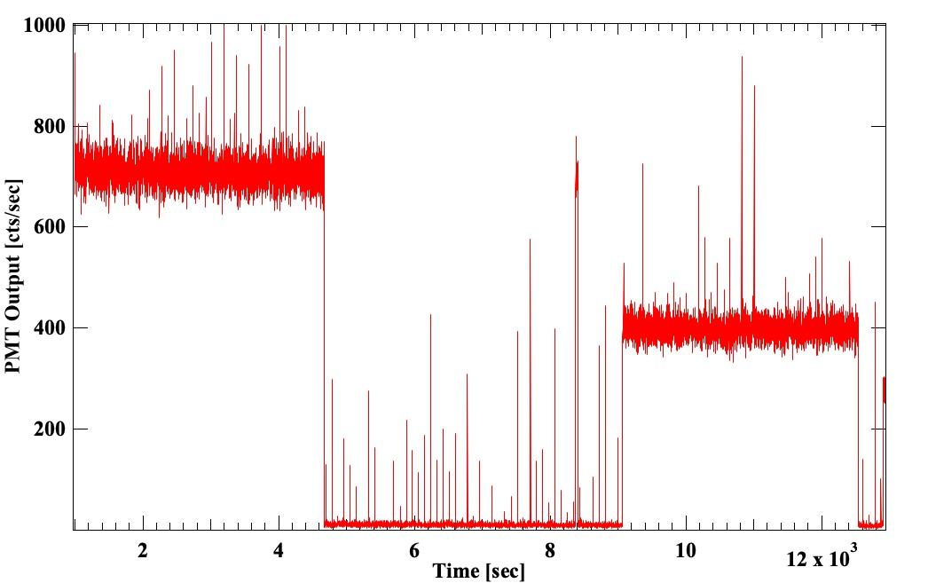
Introduction～Single Electron Storage～
〇 Single Electron Storage : investigate the electromagnetic emission and motion
of a single electron in a synchrotron radiation storage ring.
If nothing is done, it can continue circling for a long time.
Downstream undulator
Beam shutter closing
Upstream undulator
~ 3 Hours

Slide 6
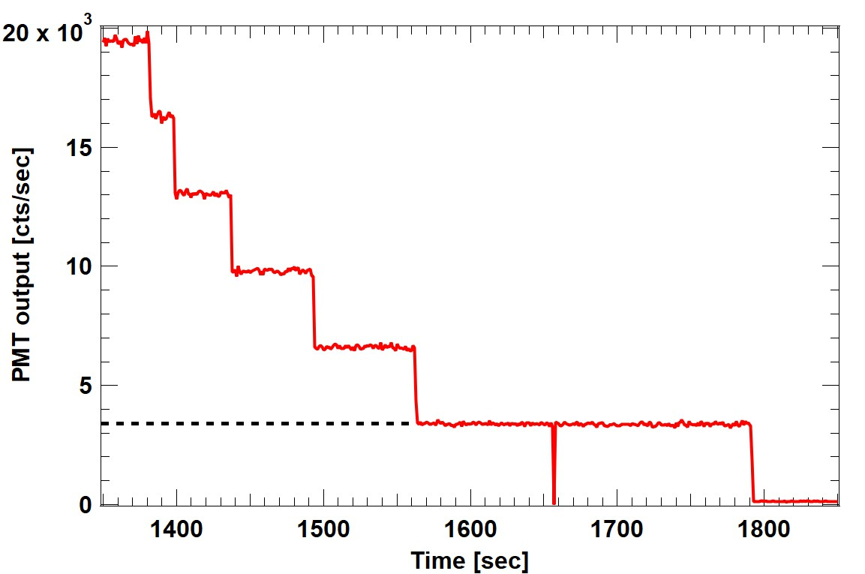
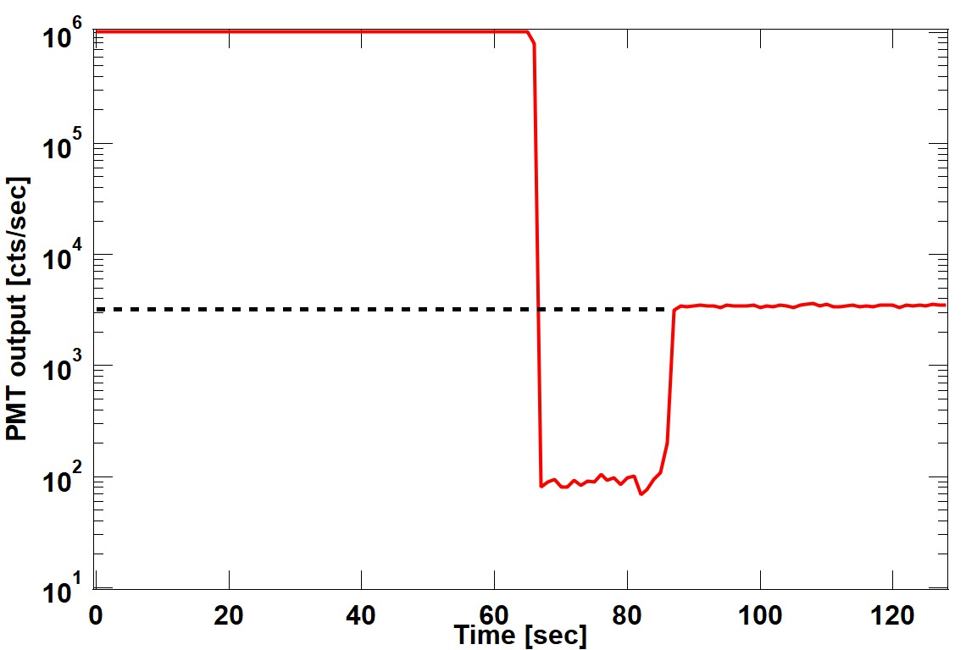
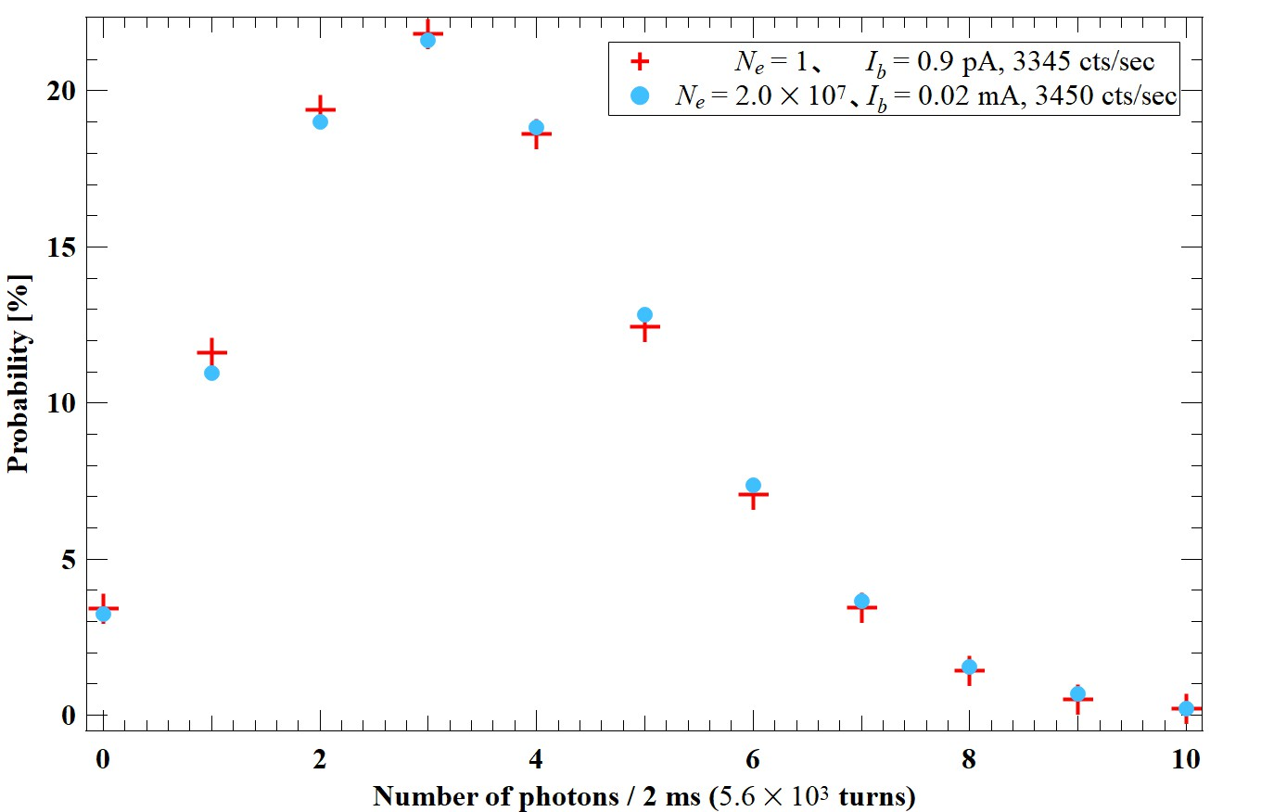
Experiments～Research using single electron storage～
〇 Comparison of photon statistics for different numbers of electrons
$$N_{e}=1$$
$$N_{e}\sim 2.0×{10}^{7}$$
Insert
ND90
mean : 3450
mean : 3350
Poisson distribution
Notes:
They consistent with Poisson distribution regardless of number of electrons.

Slide 7
Thank you for listening

