Slide 1
Emittance Calculation with the Method of Envelope Matrix
Dai Yixian, IHEP

Slide 2
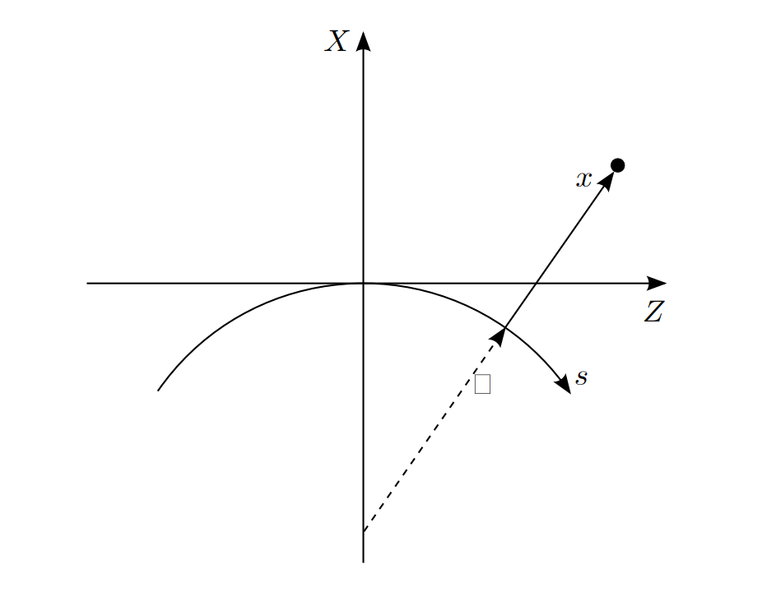
Coordinate
The phase space is described by six variables $(x,p_{x},y,p_{y},z,δ)$
The momenta is the canonical conjugate
$$p_{x}=\frac{[K_{x}+eA_{x}]\hat{x}}{p_{0}}$$
$$p_{y}=\frac{[K_{y}+eA_{y}]\hat{y}}{p_{0}}$$
$$δ=\frac{E−E_{0}−eΦ}{E_{0}}$$
Hamiltonian would be like:
$$H\left(x,p_{x},y,p_{y},z,δ\right)=δ−eA_{s}/p_{0}−\sqrt{{(1+δ+\frac{eΦ}{cp_{0}})}^{2}−{\left(p_{x}−\frac{eA_{x}}{p_{0}}\right)}^{2}−{(p_{y}−\frac{eA_{y}}{p_{0}})}^{2}}$$
Figure1:y is perpendicular to this plane

Slide 3
Emittance
Emittances : n conserved quantities which corresponds to the phase space volume.
If there is a bunch of particles, the emittance can be calculated as following formula:
$$ε_{x}=\sqrt{\left\langle x^{2}\right\rangle \left\langle p^{2}\right\rangle −{\left\langle xp\right\rangle }^{2}}$$
$$p_{x}$$
$$x$$
Figure2: Emittance in phase space
$$Area=2πε$$

Slide 4
Distribution
Suppose the distribution of beam is Guassian.
Therefore, the covariance matrix can fully describe the distribution.
$$Σ_{ij}(s)=\left\langle x_{i}{\left(s\right)x}_{j}(s)\right\rangle$$
One-turn Map $M$
$$Σ_{ij}(s+C)=\left\langle {M(x}_{i}{\left(s\right))M(x}_{j}(s))\right\rangle$$
Equilibrium: $Σ_{ij}(s)=Σ_{ij}(s+C)$

Slide 5
Quantum Excitation
Only consider the zeroth and first order of the map $M_{ds}$.
$${M_{ds}(x}_{i})=M_{ij}x_{j}+d_{i}$$
$M_{ij}$ :transfer matrix with damping
$d_{i}$ :the constant part with random effect.
$\left\langle d_{i}\right\rangle$ vanishes, but $\left\langle d_{i}d_{j}\right\rangle$ has non-zero values!
$$d_{i}\left(s\right)=\sqrt{2C_{q}γ^{2}\frac{C_{γ}}{2π}\frac{E_{0}^{3}}{ρ^{2}}} {(0,\frac{p_{x}}{1+δ},0,\frac{p_{y}}{1+δ},0,1) }^{T}$$
$$γ$$
Figure3: Particle emits a photon

Slide 6
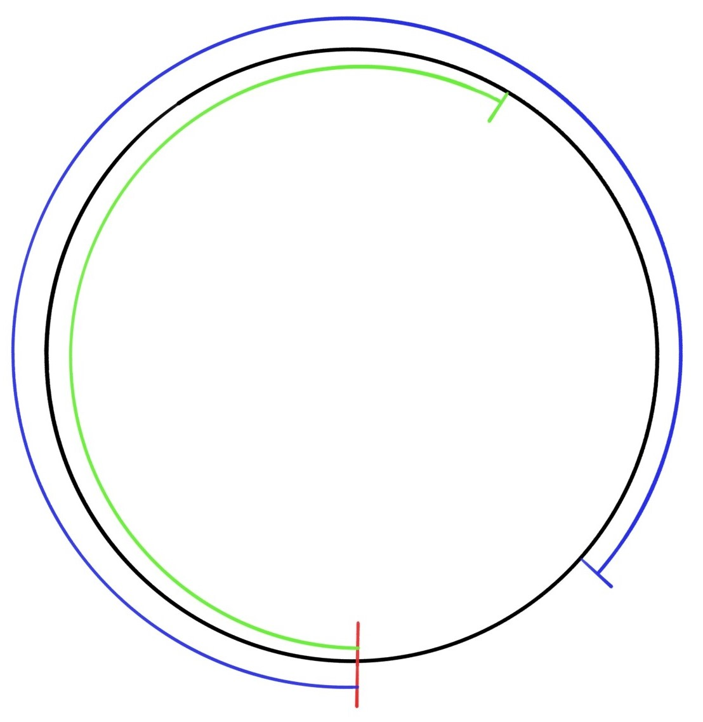
Quantum Excitation
Denote that $D_{ij}(s)=\left\langle d_{i}(s)d_{j}(s)\right\rangle$,
What would $D_{ij}(s)$ be like when it travels to s’?
Since $d_{i}$ acts on the coordinates of the particle, it transfers just like coordinates.
$D_{ij}(s+ds)=M_{ds}d_{i}(s){d_{j}}^{T} (s){M_{ds}}^{T}$
To get $D_{ij}$ of the ring, named as $\overline{D_{ij}}$,
we need an integral.
$$M({s,s}_{1})$$
$$D(s_{2})$$
$$M({s,s}_{2})$$
$$\overline{D_{ij}}=\int_{s}^{s+C}{M\left(s+C,s^{′}\right)d_{i}(s^{′})d_{j}^{T}(s^{′})M^{T}\left(s+C,s^{′}\right)ds′}$$
$$s$$
$${D(s}_{1})$$
$\overline{D}=M\left(s,s_{1}\right)D\left(s_{1}\right)M^{T}\left(s,s_{1}\right)+M\left(s,s_{2}\right)D\left(s_{1}\right)M^{T}\left(s,s_{2}\right)$+…
Figure4: How $\overline{D_{ij}}$ calculates

Slide 7
Emittance Calculation
Now we have a one-turn map for $Σ_{ij}$
$$Σ_{ij}\left(s+C\right)=MΣ_{ij}\left(s\right)M^{T}+D_{ij}$$
It’s a linear equation and can be easily solved.
$$ε_{x}=\sqrt{\left\langle x^{2}\right\rangle \left\langle p^{2}\right\rangle −{\left\langle xp\right\rangle }^{2}}$$
Note that it breaks down when there is coupling. Wolski’s approach is more general: the eigenvalues of $ΣS$.

Slide 8
Ohmi, Kazuhito, Kohji Hirata, and Katsunobu Oide. "From the beam-envelope matrix to synchrotron-radiation integrals." Physical Review E 49.1 (1994): 751.
Wolski, Andrzej. Beam dynamics in high energy particle accelerators. 2014.

Slide 9
Thank you

