Slide 1
Optimization of electron gun design for linear acceleration
Rajendra Satriya Utama
Nuclear Engineer – Universitas Gadjah Mada

Slide 2
Introduction
BRIN wants to develop a 6 MeV Linac for industrial purpose
Electron gun performance is crucial for Linac's efficiency
The design is based on an electron gun for Linac at SLRI, Thailand
This study focuses on improving beam characteristics through geometric optimization using CST Particle Studio software

Slide 3
Electron gun design
Pierce-type electron gun design for 6 MeV Linac
Thermionic cathode with spherical surface
Efficient electron emission
Focused beam generation
Three-electrode structure
Pierce electrode with slope and nose
Focusing electrode
Anode with nose design

Slide 4
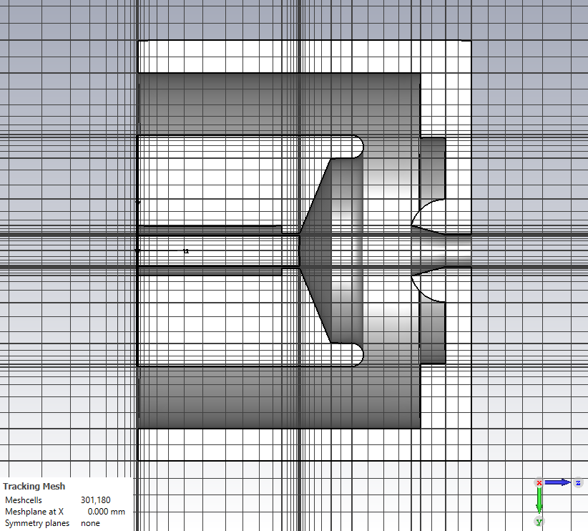
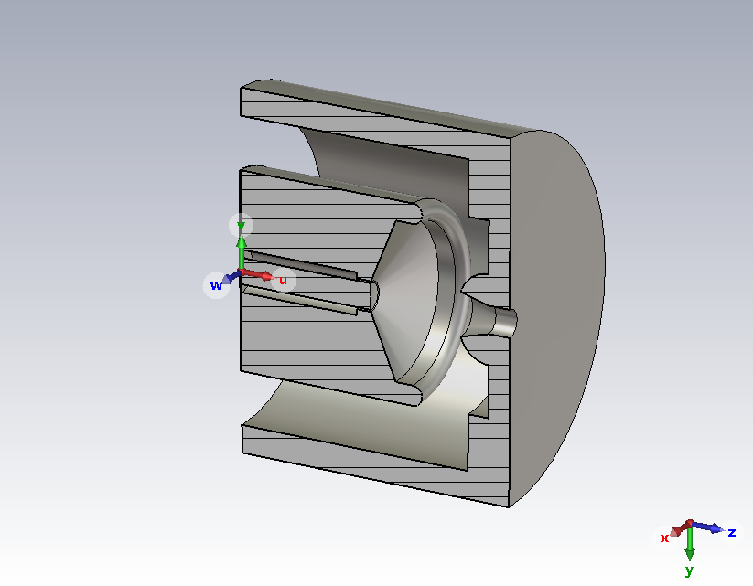
Methodology
Model development
3D CAD sketching -> CST PS implementation
Parametric modeling for optimization
Simulation configuration
Electrostatic solver:
30 kV voltage difference (cathode-anode)
Hexahedral meshing
Space charge limited emission model
Electron trajectory analysis
Optimization & documentation
Parameter optimization studies
Engineering drawings (Inventor)

Slide 5
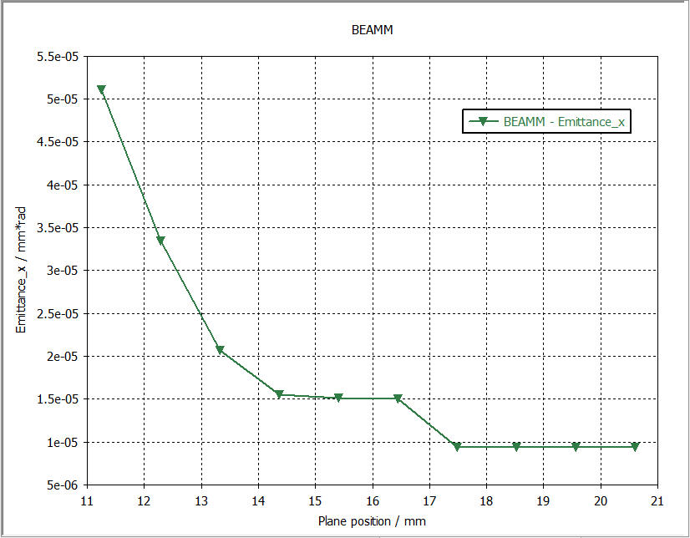
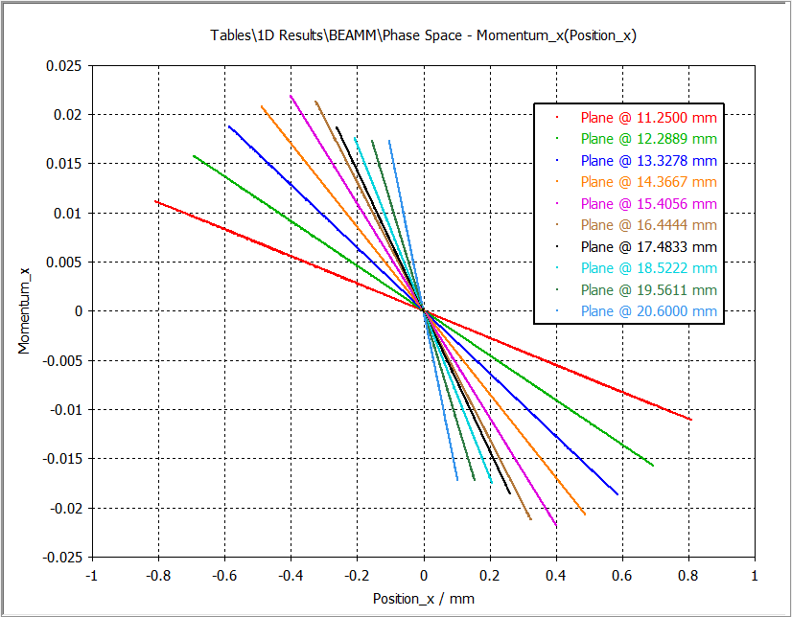
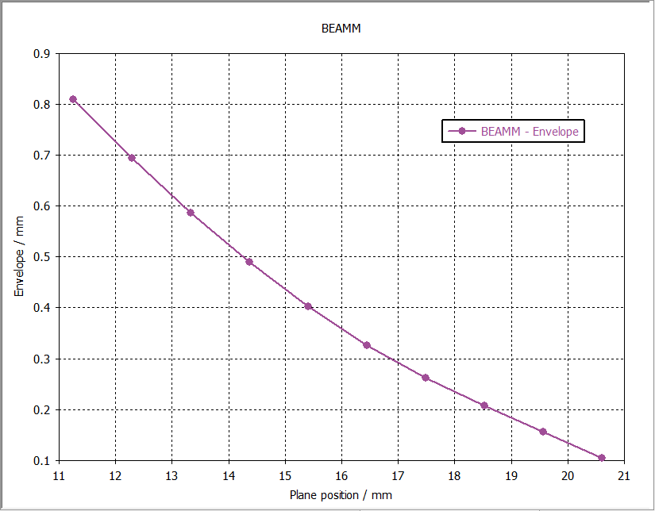
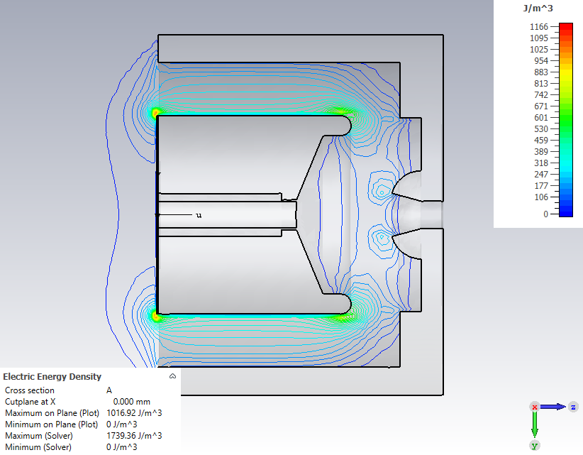
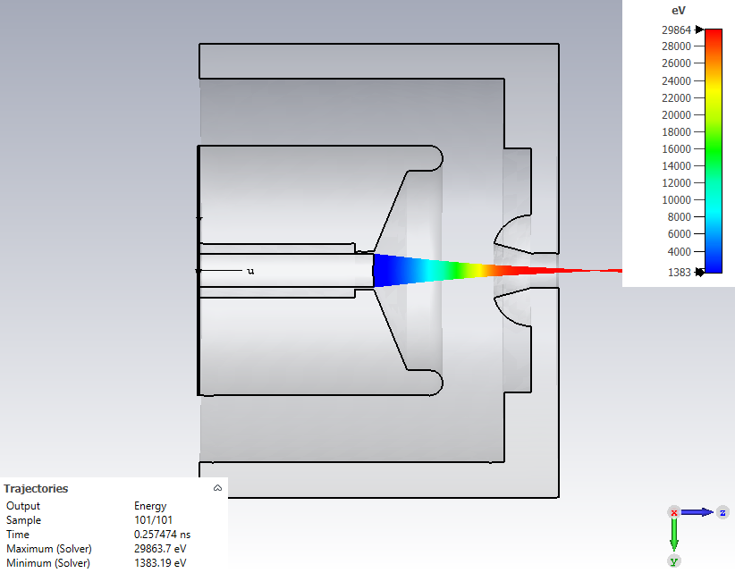
simulation result

Slide 6
Results
Current | 0,51 | A
Perveance | 9,80E-08 | A/V^(3/2)
Emittance (x) | 9,41E-06 | mm.rad
Emittance (y) | 8,30E-06 | mm.rad
RMS Beam Size | 0,0756 | mm
Diameter Beam | 0,3024 | mm

Slide 7
Thank You
1-9 Nov 2024 ISBA24

