Slide 1
Cavity Design for a 6 MeV Linear Accelerator
Hairum Musa

Slide 2
Desain Goals
The objective is to achieve an optimal cavity design that maximizes the shunt impedance and quality factor in the on-axis coupling configuration, with an accelerating electron beam of 6 MeV resonating in the π/2 mode, and a resonant frequency of 2856 MHz using RF source capacity.

Slide 3
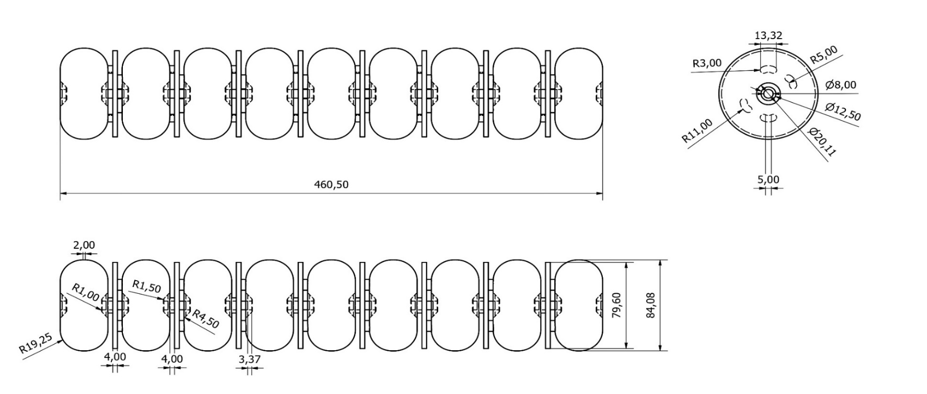
Desain Cavity and Result

Slide 4
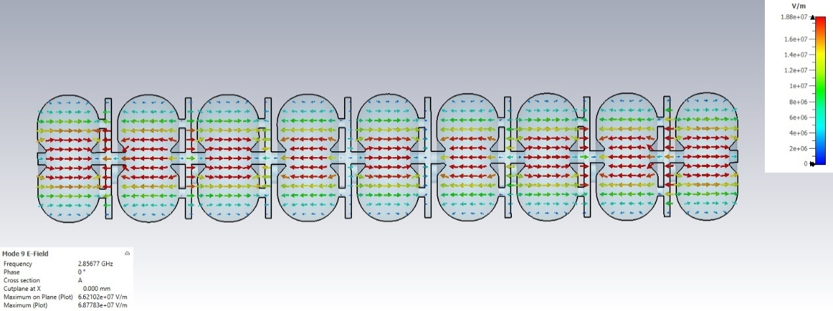
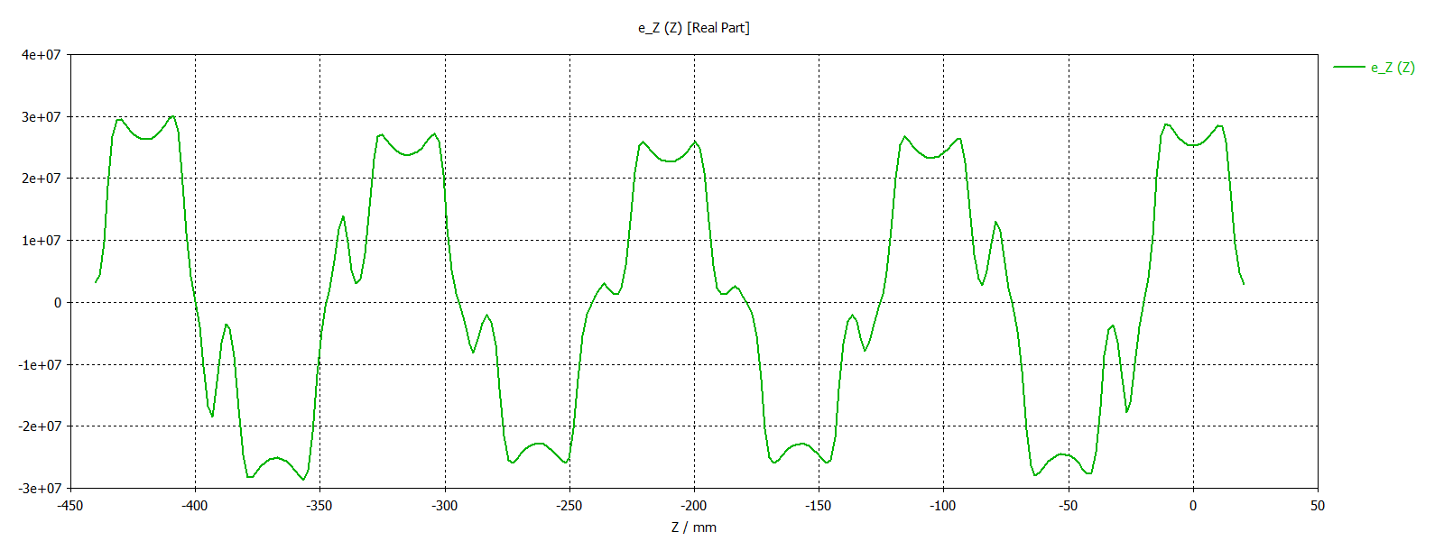

Slide 5
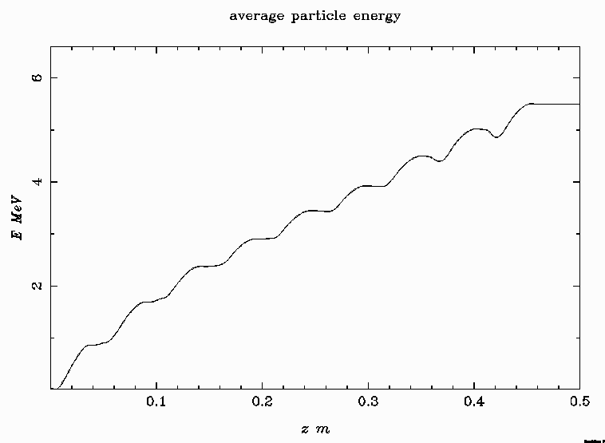
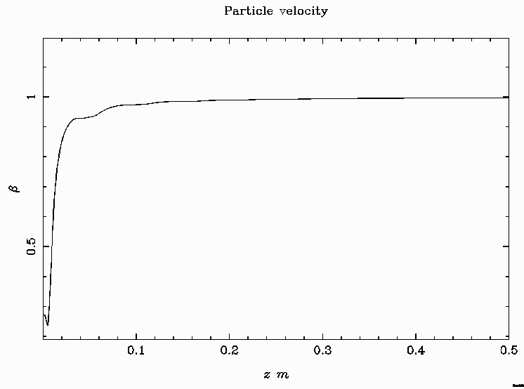
Parameter | Value
Frequency (GHz) | 2,8560296
Quality Factor | 17421,69
Shunt Impedance (MΩ/m) | 155,9017535
Power Loss (Watt) | 45260$8$
Average Kinetic Energy (MeV) | 5.500

Slide 6
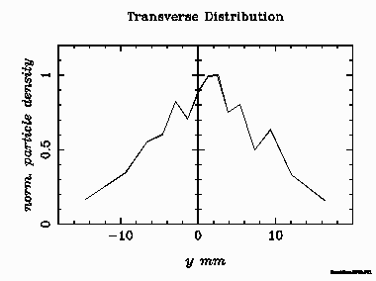
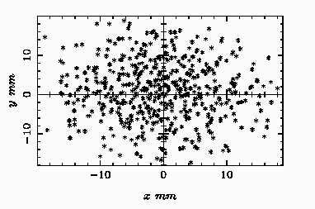
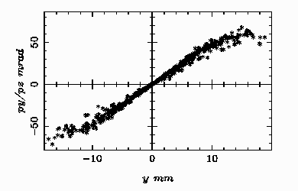
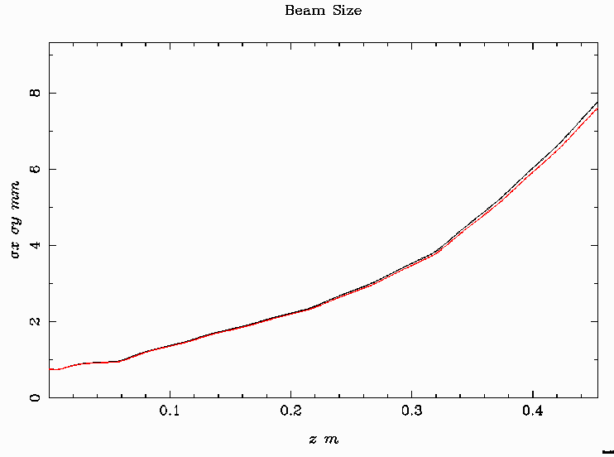
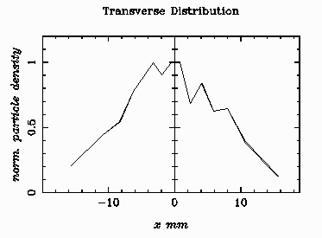
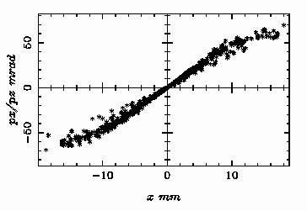

Slide 7
Thank You

