Slide 1
Unitarity of String Geometry Theory
Matsuo Sato (Hirosaki U.)
M.S. Int.J.Mod.Phys.A34 (2019)1950126
M.S. , Y. Sugimoto (POSTECH) Eur.Phys.J.C80 (2020) 789
M.S. , Y. Sugimoto Nucl.Phys.B956 (2020) 115019
M. Honda (Waseda U.), M.S. Int.J.Mod.Phys.A 35 (2020) 2050176
M. Honda, M.S., T. Tohshima (Hirosaki U.) Adv.High Energy Phys. (2021) 9993903
M.S., Y. Sugimoto, K. Uzawa (Kwansei Gakuin U.) Phys.Rev.D 106 (2022) 8, 086006
M.S., K. Uzawa Phys.Rev.D 107 (2023) 6, 066023
M.S., T. Tohshima To appear in Adv.High Energy Phys.
K. Nagasaki (Hirosaki U.), M.S. arXiv:2309.10394
K. Hatakeyama (Kyoto U.) , M.S., G. Tanaka (Meiji Gakuin U.) arXiv:2404.19413
K. Nagasaki, M.S. in preparation
K. Nagasaki, M.S. in preparation

Slide 2
Review

Slide 3
What we have done in string geometry theory
String geometry theory is one of the candidates of non-perturbative formulation of string theory.
M.S. (2019)
The theory unifies particles and the space-time.
Macroscopically, space-time = string manifold, particle = a fluctuation of string manifold M.S. (2019)
In string geometry theory, we identified perturbative vacua in string theory, which include general string backgrounds. M. Honda, M.S. (2020)、 M.S., Y. Sugimoto, K. Uzawa (2022)、K. Nagasaki, M.S. (2023)
From the fluctuations around these vacua, we derived the path-integrals of Type IIA, IIB, SO(32) I, E8xE8 het, and SO(32) het perturbative strings on the string backgrounds up to any order. M.S. (2019)、M.S., K. Uzawa (2023)、K. Nagasaki, M.S. (2023)
We obtained differential equations that determine perturbative vacua explicitly. K. Nagasaki, M.S. (2023)
We solved the differential equations up to the 8-th order and obtained a potential for string backgrounds explicitly up to the 8-th order by restricting the potential in string geometry theory to the perturvative vacua. K. Nagasaki, M.S. (in preparation)

Slide 4
The action of string geometry theory

Slide 5







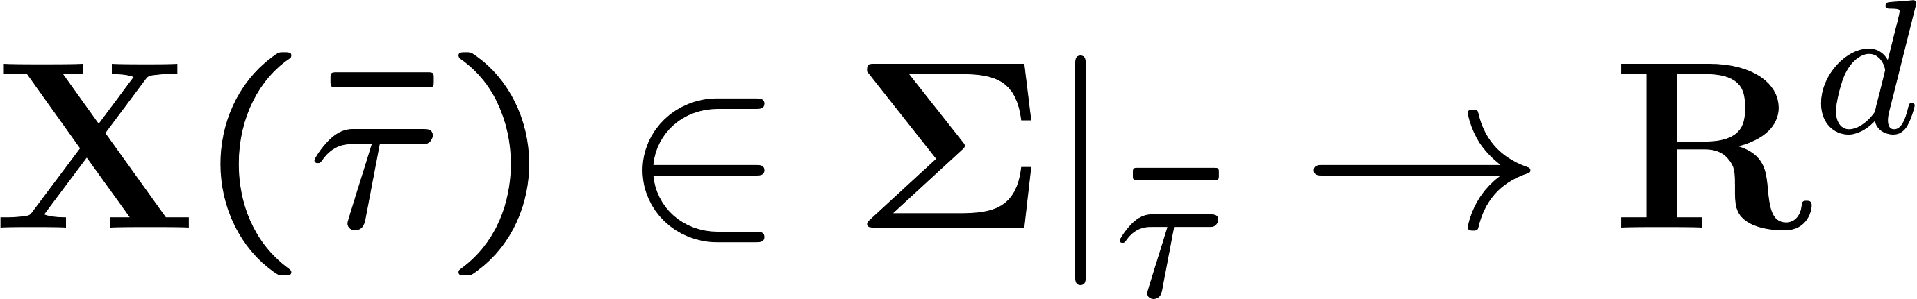


String geometry
infinite dimensional manifold made of strings
model space of finite dim. manifolds
model space of string geometry
3 kinds of coordinates
: string geometry time
: super vierbein
super Riemann surface
(discrete variable)
: many body states of strings
string geometry time global time on
String manifolds are constructed by patching open sets of the model space.

Slide 6
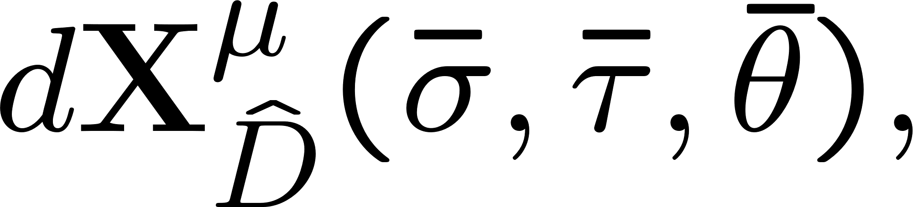
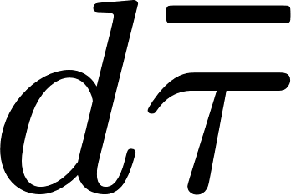
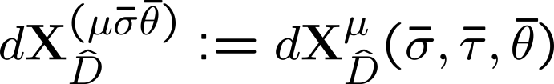





Sign of metrics
<cotangent vectors>
cotangent space of manifolds are spanned by continuous variables:
Treat as indices
summarize
<metric>
<sign of metrics>
Only the direction of , which is the zero mode of gives the negative sign

Slide 7



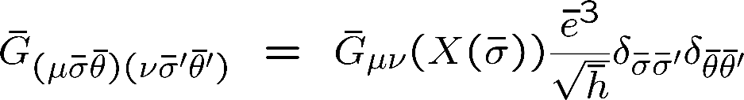

Fields on string manifold
Index and SUSY
Any action is invariant under the SUSY transformation,
(on type II charts)
or
(on heterotic charts)
* Target SUSY is not assumed
For example, includes fermionic fields because it is a superfield
It is enough to consider metrics, scalars, non-Abelian gauge fields, and completely anti-symmetric tensors
We assume that the background field on string geometry can include string backgrounds
Ex.
Minimum set
Fields on string geometry:
Hermitian gauge field

Slide 8
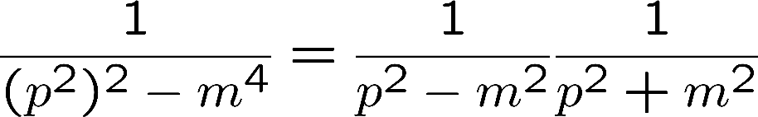





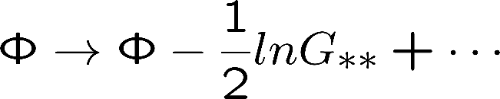
Determine an action
We assume the following conditions
The action should have at most second order derivatives so as not to include a ghost mode
c.f.
Truncate the action by setting zero and make a dimensional reduction on one direction
The truncated action should be invariant under the T-dual transformation between type IIA and IIB vacua
M.S., T. Tohshima 2024
Truncate the action by setting zero and …
The truncated action should be invariant under … between heterotic SO(32) and vacua
(Shown up to the 1st order in )
Under the T-dual trans. in * direction,
No scalar potential
The action will be determined almost uniquely as

Slide 9
Unitarity
For simplicity, only bosonic closed sector are analyzed

Slide 10








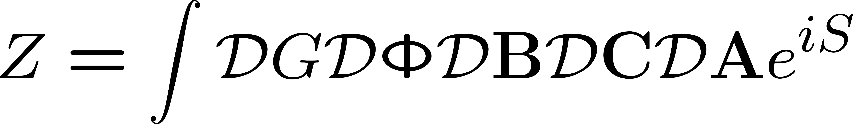
Unitarity theorem
[1]
Hamiltonian is Hermite.
Unitary
for one-particle asymptotic states that satisfy
[2]
One-particle asymptotic states are BRS singlets and BRS quartets only.
and No satisfying
BRS quartets have zero norm.
From [1] and [2], to prove a theory is unitary, all you have to do is to prove
(1) Hamiltonian is Hermite.
(2) Categorize the one-particle asymptotic states and prove that the BRS singlets have positive norm.
(1) is satisfied because the time evolution of string geometry theory is ( : real Hamiltonian )
Path-integral

Slide 11





Categorize the one-particle asymptotic states K. Nagasaki, M.S. in preparation
Action
Gauge-fixing conditions
F. P. ghost terms
Fluctuations around the flat background (up to the second order in the action)
We assume that the compete system of one-particle asymptotic states consists of free fluctuations.
Simultaneous canonical commutation relations
Euclidean time
We calculate commutation relations of asymptotic fields with arbitrary different times.
Expansion formula
are functions satisfying
Because of no time integral, we can calculate commutation relations with arbitrary different times.
From equations of motion,
Stop in the middle

Slide 12




















Categorize the one-particle asymptotic states
As a result, general commutation relations:
Covariant result, is not special
Fourier transformation
To separate unphysical modes, we fix to a special Lorentz frame, by residual gauge symmetry
where
: zero mode of
The gauge fixing conditions delete
Unphysical modes:
Physical states including direction give negative modes.
Physical modes:

Slide 13




Categorize the one-particle asymptotic states
General commutation relations among the modes (inner products)
*1
*2
*3
BRS charge
BRS quartet
BRS singlet
*1、*2、*3
Positive norms
String geometry theory around the flat background is unitary.

Slide 14
Outlook

Slide 15


Outlook
Perform BRS analysis around the perturbative vacua
Unitarity around the perturbative vacua is expected.
Unitarity will be destroyed if the perturbative vacua are deformed beyond the moduli space.
In this case, we will find that unitarity of string geometry theory choose perturbative vacua in string theory.
That is, the origin of Weyl invariance will be BRS symmetry in string geometry theory.
We can identify not only with string states but all the physical states.
The physical states will include D-brane states.
Scalar fluctuation of the metric

Slide 16
Backups

Slide 17



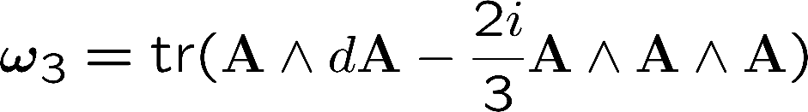

作用の決定
作用はゴースト項が含まれないように微分は２階まで
c.f.
を０におき、一つの方向に次元還元をすることでtruncate
作用はタイプIIA IIB間のT双対変換で不変
M.S., T. Tohshima 2024
を０におき、一つの方向に次元還元をすることでtruncate
作用は のT双対変換で不変
(示されているのは 1次まで）
ヘテロSO(32) 間
理論に含まれるスカラー , の＊方向のT双対変換：
スカラーポテンシャルはない
にほぼ唯一に決定されるだろう。
ここで

Slide 18
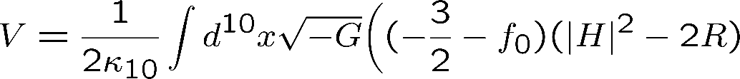
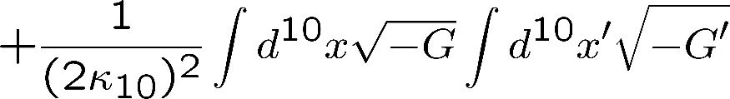
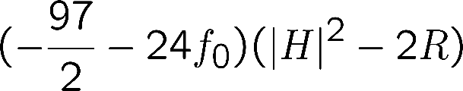

真の真空を決定するポテンシャル
摂動論的真空に限った場合、ゆらぎの無矛盾性(Weyl不変性）から
場の配位は弦の補正の入った超重力理論の運動方程式の解である必要がある
古典ポテンシャルにラグランジュ未定乗数法により運動方程式が課されたポテンシャルの最小により
真の真空が決定される
場の4次まで Nagasaki-M.S. 2023
bilocal:
Realization of the typical feature of effective potential of quantum gravity.
Coleman(1988), Asano-Kawai-Tsuchiya(2012), Hamada-Kawai-Kawana(2014)
where
: arbitrary constant

Slide 19

真の真空を決定するポテンシャル
最小では、このポテンシャルの変分が０となる
つまり、最小配位はその運動方程式（弦の補正の入った超重力の運動方程式を含む）の解
ポテンシャル最小により、解が唯一に選ばれ、それに伴って境界条件も唯一に選ばれる
宇宙の初期条件もポテンシャル最小で選ばれる
現象論的に考えられた無や、自然な境界条件が選ばれるのかどうかが判定される
※ のゼロモード 方向のみマイナス符号なので、摂動論的真空を構成する弦背景は正しく、
ローレンツの符号を持っている。つまり、時間発展する宇宙が真空として選ばれ得る。

Slide 20
真の真空を決定するポテンシャル
まずは摂動論的真空が一般配位よりポテンシャルを小さくすることが示せるかもしれない。摂動論的真空アンザッツから変形して確かめることができる。「摂動論的真空で我々の４次元時空＋標準模型＋αを与える６次元コンパクト空間がポテンシャルを最小にする。」と予想している。

Slide 21

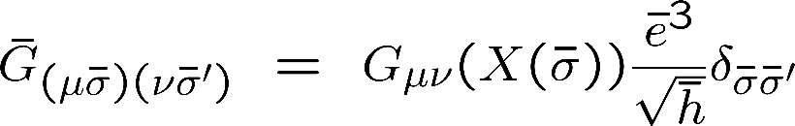



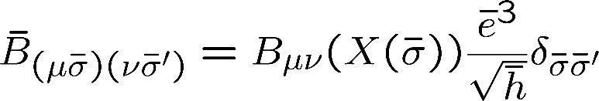

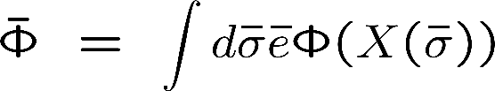
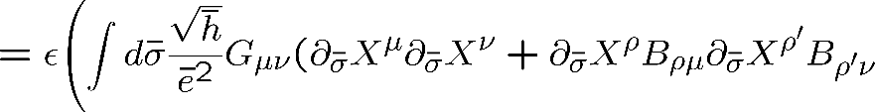
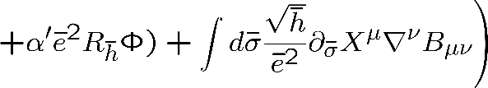
弦の摂動論的真空
弦幾何には世界面のgenusの情報が含まれている
で理論が定義されているにもかかわらず
理論は弦の高次の摂動論的効果や非摂動論的効果を含む。
注：すべての穴の足し上げが入っていて、一つの場の配位は穴の数を特定できないので
摂動論的定式化ではない。
Perturbative vacua
: string backgrounds
is a solution to a 2nd order differential equation,
The others are０

Slide 22



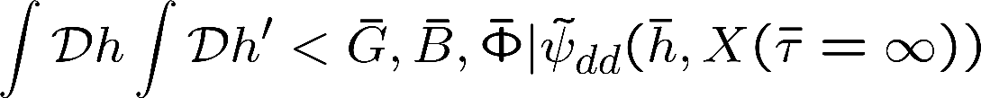
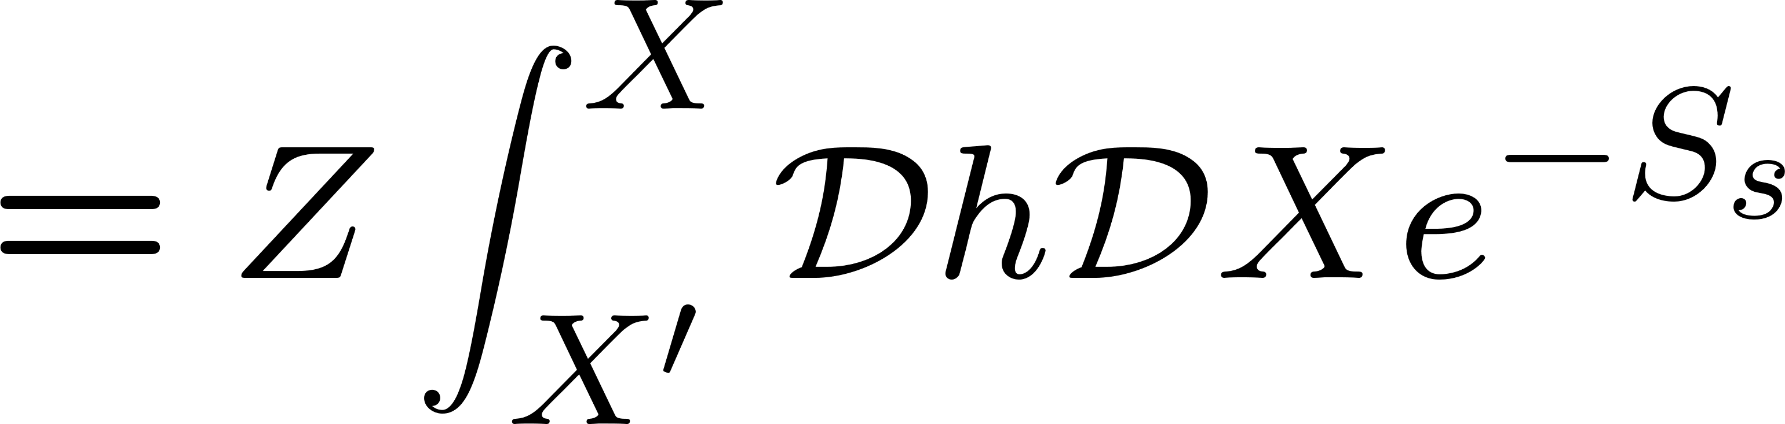
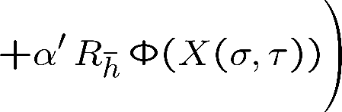
弦の摂動論の導出
計量のスカラーゆらぎ の量子論的状態 の2点関数は
弦背景 上の弦の全オーダー経路積分となっている: K. Nagasaki, M.S. ’23
ここで
つまり、 は弦の状態を表す。
第一量子化では励起状態の生成演算子をかけてこの２点関数を計算することで弦の散乱振幅を得る。

Slide 23




