Slide 1


Plan of Medical RI production by Superconducting Electron Accelerator
AFAD WG3, Tohoku University 06/18/2025
Hitoshi Hayano
NovAccel co. ltd.

Slide 2
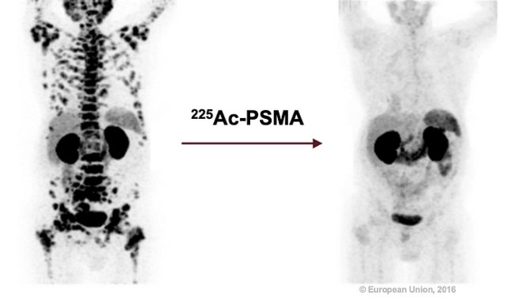

Scattered lesions of prostate carcinoma disappeared with TAT
TAT: Targeted Alpha-radiation Therapy
12/2014
7/2015
Kratochwil, Clemens et al. “225Ac-PSMA-617 for PSMA-Targeted α-Radiation Therapy of Metastatic Castration-Resistant Prostate Cancer.”
Journal of nuclear medicine : official publication, Society of Nuclear Medicine vol. 57,12 (2016): 1941-1944.
We will manufacture Actinium (Ac-225) from Radium (Ra-226), and supply it to pharmaceutical manufacturers worldwide.
Our customers produce TAT drugs using Ac-225.

Slide 3
RI production by Electron Accelerator
Cabinet Office created action plan 2022 for utilization of medical-use-RI
  Domestic production and stable supply of important RI
  Promotion of research and development for RI domestic production
  Domestic production by both nuclear plant production and accelerator production is required
NovAccel contributes by Superconducting Electron Accelerator
RI-production-dedicated-Accelerator with stable operation
  Low cost, compact, low power consumption
  →easy to increase number of accelerator → contribute to stable supply
  →cost cut of RI production
  Easy maintenance

Slide 4
Concept and Features
of Superconducting Electron Accelerator : RiSA-01
Dedicated Accelerator on RI production
Compact size and Stable accelerator operation.
Acceleration gradient and beam quality (beam emittance) are optimized.
Use 2.6GHz 4K Superconducting Acceleration technology.
Size, cost, gradient, production technology are considered.
Scale-down of world-wide well-established 1.3GHz technology.
Use 4K conduction cooling technology and Nb₃Sn coated cavity.
compact cryo-cooler with high-pressure-regulation free,
same performance cavity of well-established 2K Nb cavity,
compact solid-state power amplifier
E_{acc} 10〜20MV/m
Emittance_{beam} 〜10mm.mrad

Slide 5
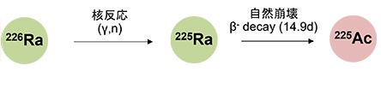
Compact electron Accelerator for medical-use RI production
100ms
RiSA-01 4kW beam
1ms beam train width, 10Hz repetition
162.5MHz beam repetition with 60pC/bunch
4K S.C.
RF-gun
4K Superconducting Accelerator
Target
¹⁰⁰Mo
²²⁶Ra
3m
Electron beam
40 MeV,100μA
Nuclear reaction
Decay
Extraction
α-decay(10d)
^{99m}Tc
²²⁵Ac
10m
RI production by compact, high-efficiency, easy-maintenance Superconducting Electron Accelerator

Slide 6
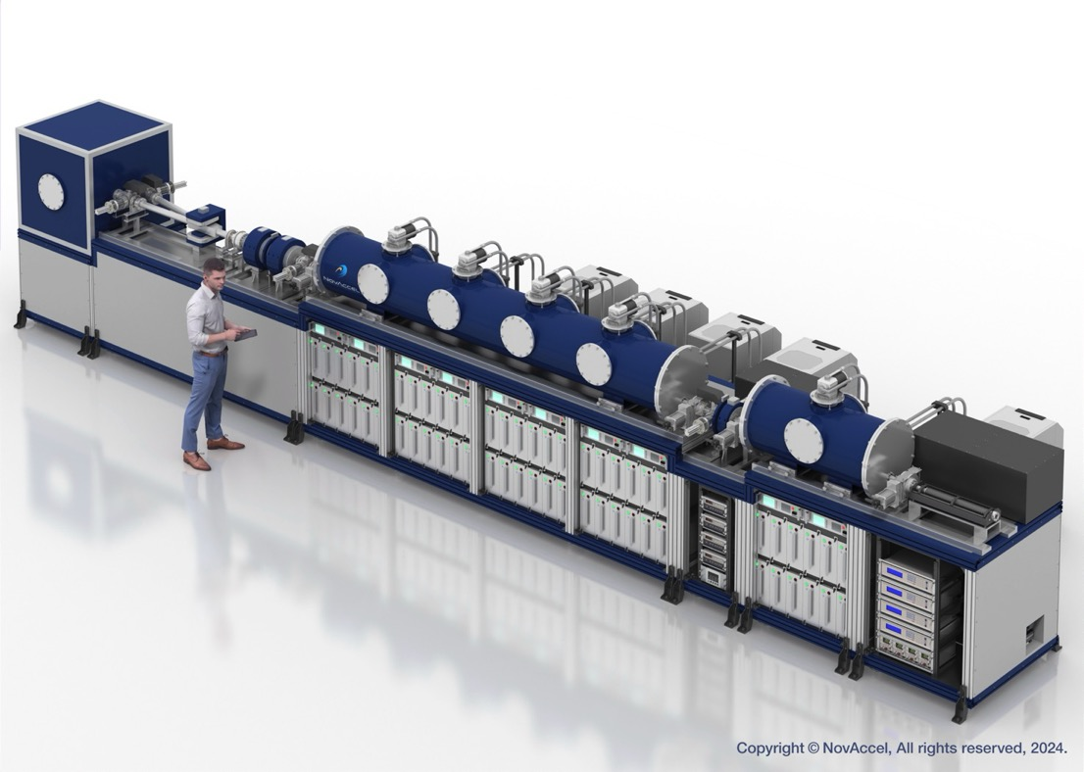
Superconducting Electron Accelerator
RI production purpose Superconducting Compact Accelerator : RiSA
Product Name : RiSA-01
Patent pending (特願2024-215957)
Design Registration(意願2024-05230
意願2024-05231
意願2024-05232)
Research Collaboration with
Hiroshima University
Tokyo University
and preparing with other 3 institutes

Slide 7
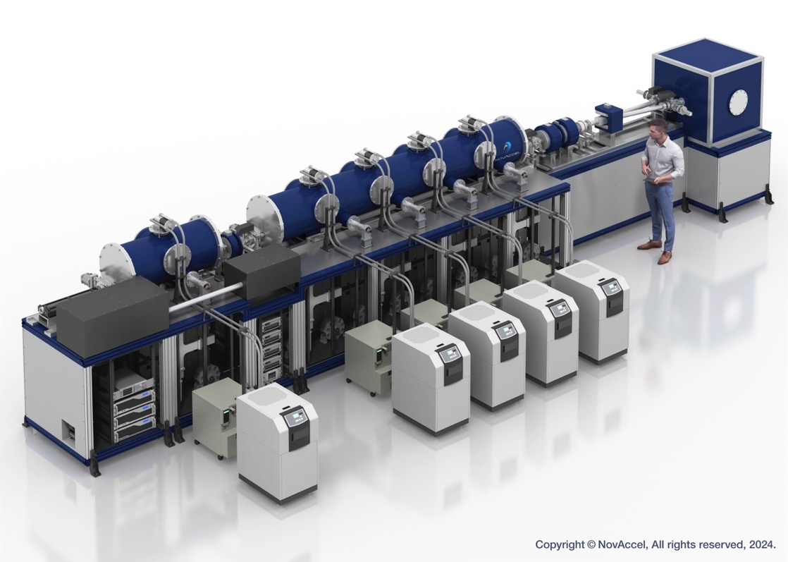
Superconducting Electron Accelerator
Patent pending (特願2024-215957)
Design Registration(意願2024-05230
意願2024-05231
意願2024-05232)
Research Collaboration with
Hiroshima University
Tokyo University
and preparing with other 3 institutes

Slide 8
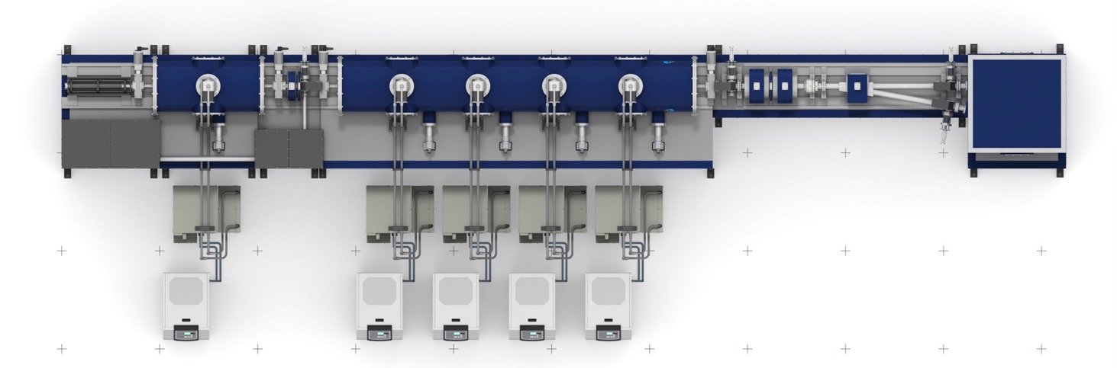
Size of Superconducting Electron Accelerator
10m
Electron-Gun & Accelerator 5.5m
Beam Line 2.5m
1.2m
Laser
RI production
He compressor
3m
Chiller Unit
Diameter:40cm length:3.6m
Superconducting Accelerator module
Diameter:40cm length:1m
Superconducting RF-gun module

Slide 9
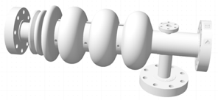
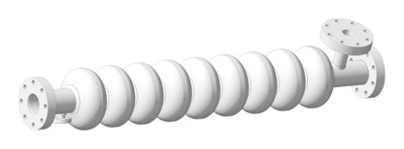
Target performance of Superconducting Electron Accelerator : RiSA
Electron beam： 40MeV、100μA (4kW beam power)
2.6GHz Superconducting RF gun
Photo-cathode : Mg cathode 0.1% Q.E. 266nm Laser
162.5MHz repetition、1ms train width、10Hz train repetition
60pC/bunch、average beam current 97.5μA、peak beam current 9.6mA
Cavity：3.5cell 4K Nb₃Sn surface E_{cathode} 28MV/m, E_{acc} 10〜20MV/m １cavity
2.6GHz Superconducting Acceleration Cavity
Cavity：9cell 4K Nb₃Sn surface E_{acc} 10〜20MV/m P_{beam acc} 96kW ４cavity

Slide 10
RiSA Accelerator Technology

Slide 11

4K Superconducting Cavity
2.6GHz Scaled-Design from world-wide established 1.3GHz design,
and thin Nb₃Sn coating inside for 4K operation.
Nb₃Sn coating by
Sn plating
Cornel Univ：
1cell cavity 11MV/m proved
Zeming Sun,et.al. Supercond. Sci. Technol. 36 (2023) 115003 (15pp)
cavity
2.6GHz 9-cell TESLA-cell structure
Nb₃Sn coating 4K, Q₀ 1x10⁹ 10〜20MV/m
Electric field calculation done by superfish

Slide 12
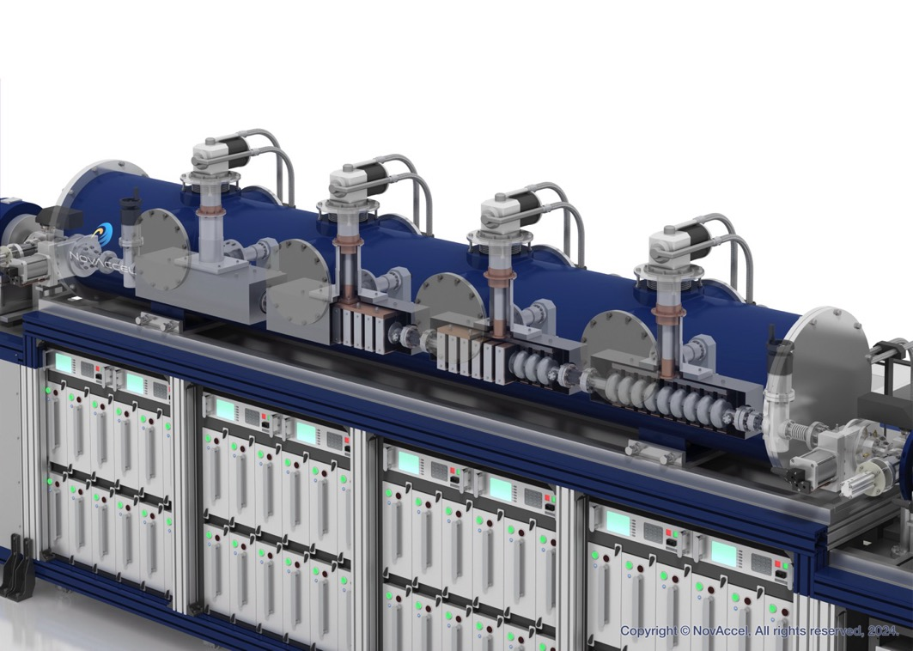
4K Superconducting Cavity
4K cooling by Compact GM-cryocooler and conduction cooling technology
1ms width, 10Hz, 20MV/m RF operation make 1W thermal power input
Conduction cooling
4K 2W GM-cryocooler
for every cavity

Slide 13
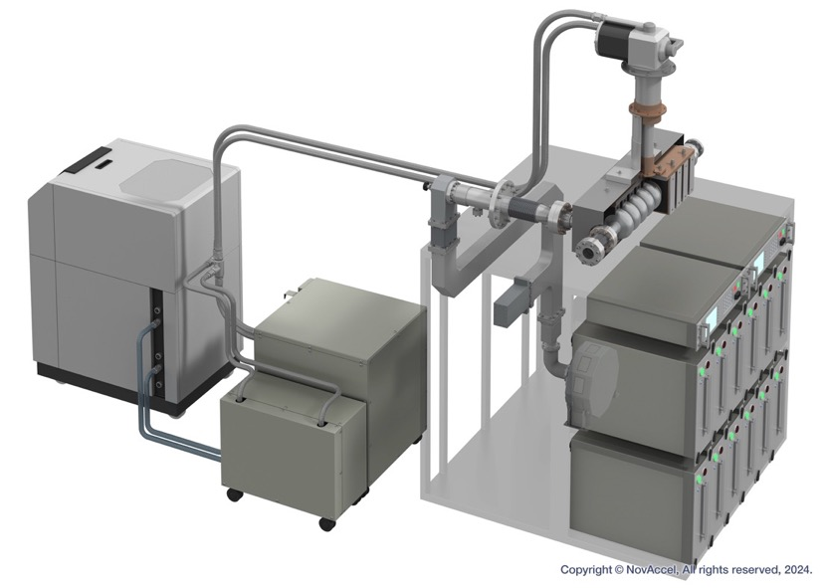
Input coupler : put power into cavity
2.6GHz Scaled-Design from world-wide established 1.3GHz coupler design
Y. Yamamoto,et.al. Proc.of 14th annual meeting of particle accelerator society of Japan (2017) WEP001
Co-axial window input coupler
1ms width, 10Hz, 20MV/m
RF operation make
1W thermal power input
to the coupler
Door-knob type
Coax-to-waveguide
converter
Configuration of 1 cavity unit

Slide 14
RF power into cavity by Solid-state Amplifier
2.6GHz Scaled-Design from established world-wide SRF-XFEL accelerator
Required specification
1ms width 100kW output 10Hz
Staging introduction
Initial 20kW
40kW upgrade
Finally by replace of transistor
100kW upgrade
Digital RF controller
Tuner controller
Solid-state
RF Amplifier
Configuration of 1 cavity unit

Slide 15
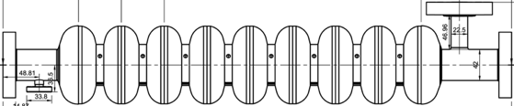
Digital control of RF power in cavity
Three digital feedback loop
cavity amplitude
cavity phase
cavity frequency tuning
Design work was finished
amplitude
control
Pf amplitude
Pt amplitude
Phase shifter
Amplitude
Modulator
RF
Switch
Pref
cavity
amplitude
lock loop
cavity
phase
lock loop
Phase Detector
offset Phase adjust
Acc Phase
adjust
Pref
Pt
Pt
Pf
Phase Detector
cavity
tuning
loop(slow)
offset Phase adjust
AMP
Lorenz Force
compensator pulse
（from external source）
Pf
door-knob
DC-FM
Phase adjust
Frequency control
piezo
driver (HV)
Pt
WG converter
waveguide
cryostat
co-axial
input coupler
mecha
tuner
piezo tuner
cavity
pickup
beam

Slide 16
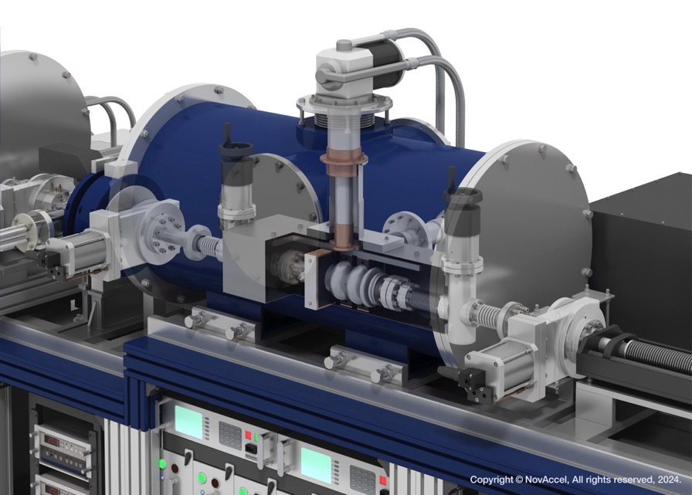
4K Photocathode Superconducting RF gun
2.6GHz Scaled design from established RF gun design of ELBE accelerator
A. Arnold,et.al. NIM.A 577 (2007) 440-454
Photocathode RF gun
4K superconducting
RF gun cavity
Small beam charge,
High beam pulse repetition
for small target irradiation
For no beam loss and
no radioactive part

Slide 17
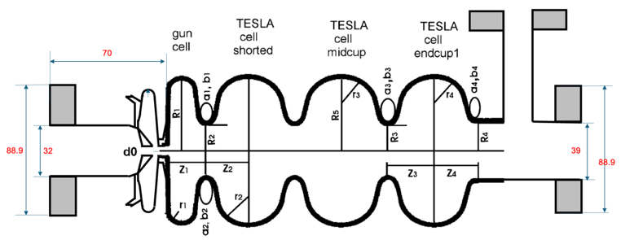
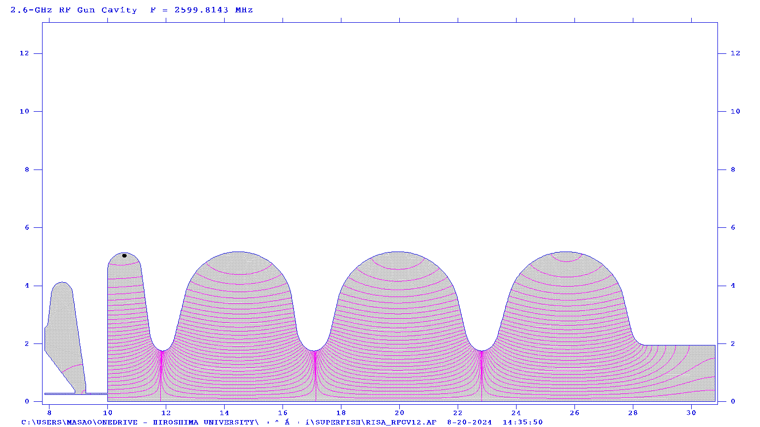
4K Photocathode Superconducting RF gun
Gun cavity
2.6GHz 3.5-cell
TESLA cell
Nb₃Sn coating
4K, Q₀ 1x10⁹
10〜20MV/m
Photocathode
Mg cathode
QE 0.1%
(ELBE operation）
Laser
162.5MHz
1ms, 10Hz
266nm
0.5W
A. Arnold,et.al. NIM.A 577 (2007) 440-454
Sn plating method for Nb₃Sn Coating on complicated structure
will be good way
Electric field calculation done by superfish

Slide 18
Accelerator component lattice configuration
カソード交換・挿入器
ST-01 Steering magnet
Beam Window / Beam stop
RFgun Laser Injection
ST-02 Steering magnet
9cell SC Cavity
9cell SC Cavity
9cell SC Cavity
9cell SC Cavity
QF-01 Q magnet
GV-01 ICF114
GV-03 Manual
GV-05 ICF114
GV-08 ICF114
QD-01 Q magnet
GV-02 manual
GV-04 ICF114
GV-06 Manual
GV-07 Manual
ACCT
Bend magnet
SC RFgun
Solenoid 1
BPM-01
BPM-02
BPM-03
BPM-04
PRM-04
250mm
1094mm
607mm
3661.66mm
1500mm
800mm
PRM-01
Vacuum port
PRM-02
Vacuum port
outer Φ60.5 beam pipe
(inner φ57.2mm)
outer Φ60.5 beam pipe
(inner φ57.2mm)
BPM-05
PRM-03
Beam Window

Slide 19
Accelerator performance was confirmed by GPT simulation code
At center of solenoid magnet
At entrance of no.1 accelerator cavity
Beam waist at S=2.67m
At exit of accelerator
Beam size 6mm
Beam size along accelerator
Less than 8mm
Beam energy
40MeV attained
Beam emittance
Less than 10mm.mrad
GPT results: Beam can be accelerated to 40MeV without beam loss

Slide 20
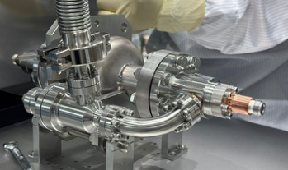
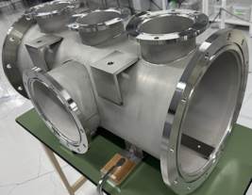
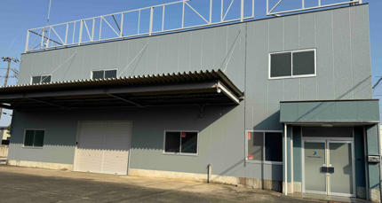
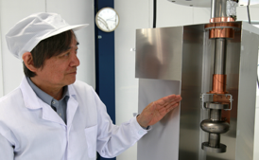
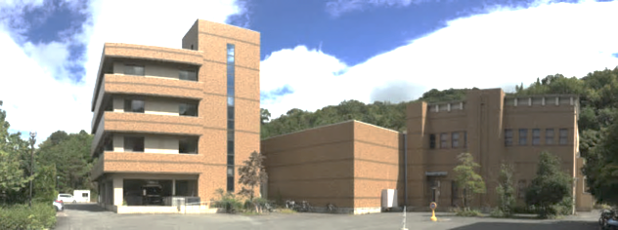
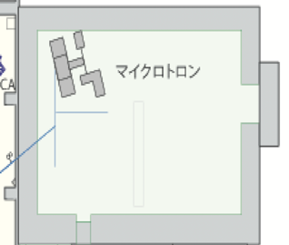
RiSA-01 Development Site
Tsukuba Lab
Accelerator Assembly
Infrastructure,
and developments
two-story, total 279m²
1-cell cavity test
is on-going
Hiroshima
University
HiSOR
HiSOR injector room
12m
7.5m
RiSA-01
Accelerator operation &
RI production

Slide 21
2024.12.12 version
Development schedule of Superconducting Accelerator
2024
2025
2026
2027
Development Infrastructure
1cell accelerator cavity
9cell accelerator cavity
Superconducting electron RF gun
Build-up & operation of Accelerator
Electron beam acceleration and irradiation
Target 150GBq/y in 2027

Slide 22
Summary
Cabinet Office action plan 2022 for utilization of medical-use-RI. NovAccel will contribute by Superconducting electron accelerator.
RI production dedicated electron accelerator RiSA-01
design optimized to low cost, compact, low power consumption
→easy to increase number of accelerator
  →stable RI supply
  →cost cut of RI production
²²⁵Ac 150GBq/y production is initial target in 2027

Slide 23
Thanks

