Slide 1
Low-Pressure TPC with GEM readout for Low-Energy Ion Beam Experiments
A. Bondar, V. Parkhomchuk, A. Petrozhitskiy, T. Shakirova, A. Sokolov
Budker Institute of Nuclear Physics
Novosibirsk State University

Slide 2
What is Accelerator Mass Spectrometry (AMS)?
Ultra-sensitive method for detecting rare long-lived cosmogenic isotopes: ¹⁰Be, ¹⁴C, ²⁶Al, ³⁶Cl and ¹²⁹I.
Isotopes primarily produced in the atmosphere by interaction with cosmic radiation.
The content of cosmogenic isotopes ranges from 10⁻¹² to 10⁻¹⁵ relative to the total content of the element.
Their concentration decreases over time due to radioactive decay.
The remaining concentration allows estimation of the radiometric age of materials (e.g. radiocarbon dating).
0
Principle of AMS operation
1. Formation of a negative ion beam from atoms of the test sample
2. Ion selection at low energy
3. Ion acceleration
4. Recharging of atomic ions and destruction of molecular ions
5. Ion acceleration
6. Ion selection at high energy
7. Identification and counting of ions
Stripping cell
Magnetic mass
analyzer
Magnetic mass
analyzer
3
4
5
2
6
+HV
Ion source
Ion
detector
Tandem Accelerator
1
7
Notes:
Our work is focused on experiments with low-energy ion beams, which we generate using an Accelerator Mass Spectrometry system.
AMS is an ultra-sensitive method for detecting rare, long-lived cosmogenic isotopes, such as ¹⁰Be, ¹⁴C, ²⁶Al, ³⁶Cl, and ¹²⁹I.
These isotopes are mainly produced in the atmosphere through interactions with cosmic radiation.
Their concentration is extremely low — from 10⁻¹² to 10⁻¹⁵ relative to the total amount of the element.
Over time, their amount decreases due to radioactive decay.
Measuring the remaining concentration allows us to estimate the radiometric age of materials — for example, in radiocarbon dating.
The figure shows a simplified diagram of an AMS system.
Accelerator Mass Spectrometry uses an ion source, electrostatic acceleration, and mass filters to separate rare isotopes.
A negative ion beam is first created from the sample and selected at low energy.
Then it is accelerated to MeV energies by a tandem accelerator, where molecular interferences are destroyed.
Finally, at high energy, the ions are identified and counted using specialized detectors, such as ionization detector.

Slide 3
AMS facilities in Novosibirsk
 | BINP AMS | MICADAS
Measured isotope | Now ¹⁴C In the future ¹⁰Be, ²⁶Al, ¹²⁹I | Only ¹⁴C
Production | Budker Institute of Nuclear Physics | Ionplus (Switzerland)
Ion beam energy | 4.025 MeV | 408.6 keV
Future Plans | Development of a multi-isotope system for ¹⁰Be, ²⁶Al, and ¹²⁹I based on the existing 1 MV accelerator | Development of a domestic radiocarbon dating system based on a compact low-voltage AMS.
Current challenges | Suppression of isobaric background in multi-isotope measurements. | Development of all AMS system components, including the ion detector.
Notes:
Today, there are about 200 AMS facilities operating worldwide.
Two of them are located in Russia — both in Novosibirsk.
The BINP AMS was developed at the Budker Institute of Nuclear Physics.
It is mainly used for radiocarbon (¹⁴C) measurements, but the system design allows for multi-isotope studies. The ion energy is about 4 MeV.
The second system is MICADAS, produced by Ionplus (Switzerland).
It is a compact AMS designed for radiocarbon dating, with an ion energy of about 400 keV.
In the future, based on our experience, we plan to develop a multi-isotope system for ¹⁰Be, ²⁶Al, and ¹²⁹I based on the existing 1 MV accelerator. We also plan to develop of a domestic radiocarbon dating system based on a compact low-voltage AMS.
However, there are still challenges:
– Suppression of isobaric background in multi-isotope measurements
– Development of all AMS system components, including the ion detector.

Slide 4
Cosmogenic isotopes
Analyzed isotopes | Half life | Stable isotopes | Stable isobars (background)
¹⁰Ве | 1.39 million years | ⁹Be | ¹⁰B
¹⁴C | 5730 years | ^{12,13}С | ¹⁴N*
²⁶Al | 717 thousand years | ²⁷Al | ²⁶Mg*
³⁶Cl | 301 thousand years | ^{35,37}Cl | ³⁶Ar*, ³⁶S
⁴¹Ca | 102 thousand years | ^{40,42,43,44}Ca | ⁴¹K
¹²⁹I | 15.7 million years | ¹²⁷I | ¹²⁹Xe*
In the current BINP AMS setup the time-of-flight technique is used for the isotopes separation. But that technique has a serious problem of separating the isobars - different chemical elements having the same atomic mass. The typical example is radioactive isotopes ¹⁰Be and ¹⁰B.
* - isobars that do not form stable negative ions.
Notes:
This slide shows a table with cosmogenic isotopes, their half-lives, stable isotopes, and stable isobars.
Isobars are different chemical elements that have the same mass number — for example, ¹⁰Be and ¹⁰B, or ¹⁴C and ¹⁴N.
In the table, a star (*) marks the isobars that do not form negative ions.
These isobars are suppressed at the ion source stage, because only negative ions are selected.
However, isobars that do form negative ions cannot be suppressed by the AMS system.
In the current BINP AMS setup, we use a time-of-flight technique for isotope separation.
To improve isobar separation, we propose a new method based on measuring ion track ranges and their energies in a low-pressure Time Projection Chamber (TPC), with signal amplification using a Gas Electron Multiplier (GEM).

Slide 5
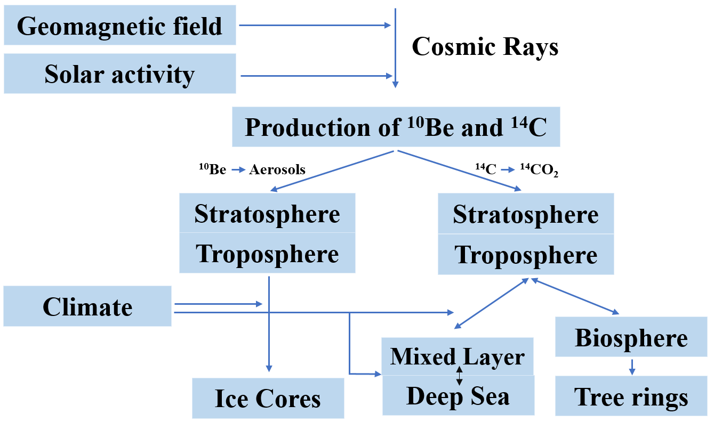
Formation and application ¹⁰Be
Time intervals of dating:
¹⁴C from 100 years to 50 thousand years
¹⁰Be from 1 thousand years to 10 million years
Application in-situ and
meteoric ¹⁰Be:
exposure dating to identified the growths and decays of the Antarctic ice sheet;
understanding ice shelf collapse history;
paleomagnetic excursions history reconstructions using ice cores;
understanding the erosion rates using depth profiles of mid latitudes outcrops;
identifying the timing of formation of the impact crater and so forth.
Notes:
¹⁰Be is the second most important radionuclide in Earth and Environmental Sciences, after radiocarbon.
Beryllium has a much longer half-life than radiocarbon, so it allows dating over a wider time range — from 1 thousand to 10 million years.
The radioactive isotope of beryllium is produced by continuous cosmic radiation, both in the atmosphere and in situ within rocks.
Atmospheric ¹⁰Be is adsorbed by aerosols and then deposited onto the Earth’s surface, where it accumulates in various sediments.
Beryllium has many important applications, such as:
– Exposure dating to study the growth and decay of the Antarctic ice sheet
– Understanding the history of ice shelf collapse
– Estimating erosion rates, and more

Slide 6
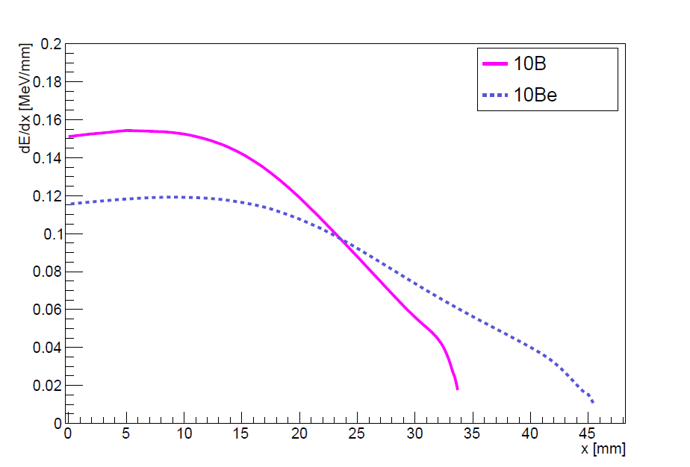
Traditional concept of ion identification at AMS
Detectors used to count the AMS ions:
silicon detectors;
time-of-flight systems;
ionization chambers.
∆Е-Е detectors
Anode 1
Anode 2
Anode 3
Frisch grid
e⁻
Ion track
$$\vec{E}$$
Window
Ions⁺
Cathode
Schematic drawing of a sample gas ionization detector with split anode. Such a detector is installed at AMS that carry out multi-isotope measurements.
Mean stopping power for ¹⁰B and ¹⁰Be projectiles against penetration depth in 50 torr isobutane.
6
Notes:
Different types of ion detectors are used in AMS to count isotopes. These include silicon detectors, time-of-flight systems, and ionization chambers.
Silicon detectors and time-of-flight systems can separate isotopes because ions with different masses have different energy and velocity.
However, to separate isobaric ions, ionization chambers with split anodes are used.
The figure shows a typical multi-element ionization chamber.
As ions pass through the chamber, they create electrons, which drift toward the anode under a transverse electric field.
The anode is divided into sections. Each section collects electrons formed underneath it.
Since ions with different atomic numbers (Z) lose energy at different rates, the energy loss pattern helps us distinguish isobars.
The main disadvantage of this type of detector is its low signal-to-noise ratio.
This is because it works in ionization mode, which requires more sensitive electronics.

Slide 7
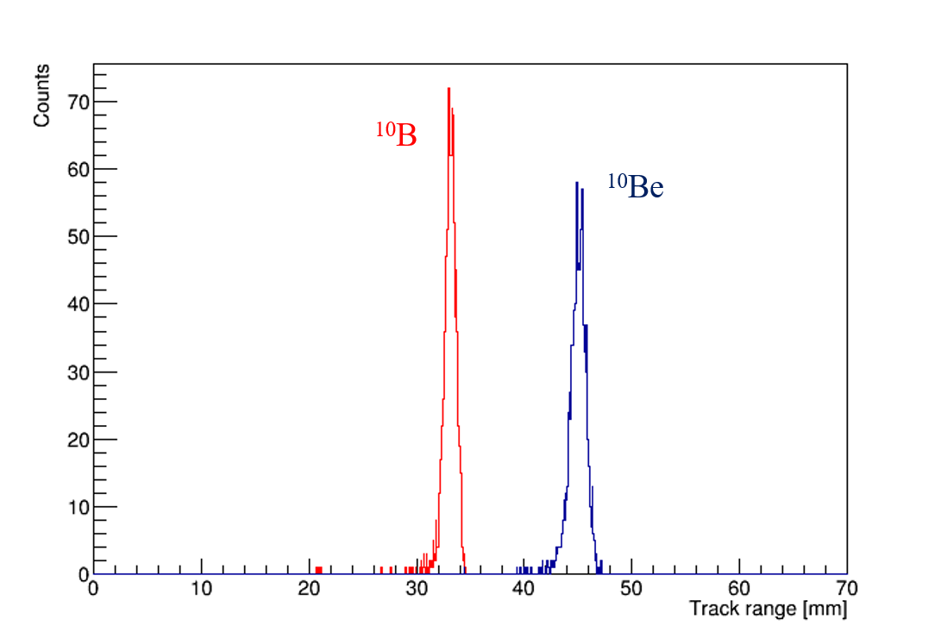
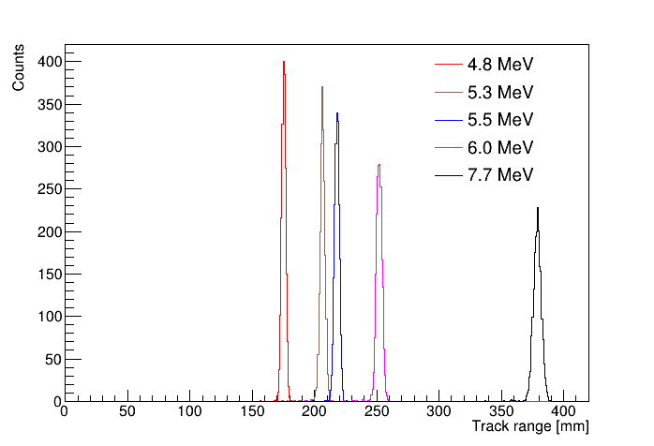
New concept of ion identification: measuring track ranges
SRIM simulation
SRIM simulation
Track ranges distribution of 4 MeV ¹⁰Be and ¹⁰B passing through 200 nm silicon nitride window into 50 torr isobutane at room temperature.
Track ranges distribution of alpha particles with different energies passing through 200 nm silicon nitride window into 50 torr isobutane at room temperature.
Notes:
The idea of isobar separation is based on measuring track ranges.
Ions with different atomic numbers (Z) lose energy at different rates, so they travel different distances in matter.
We used the SRIM simulation software to check whether ¹⁰Be and ¹⁰B can be separated based on their track lengths.
The first figure shows the simulated track ranges distribution of 4 MeV ¹⁰Be and ¹⁰B ions passing through a 200 nm silicon nitride window into isobutane at 50 Torr and room temperature.
The track ranges differ by about 12 mm.
This means a TPC with spatial resolution of 2–3 mm is enough to separate them.
To estimate the actual resolution of the TPC, we used an alpha source from ²²⁶Ra.
This source emits five alpha particles with known energies.
The alpha particle tracks were also simulated under the same conditions. The result is shown in the second figure.
Two alpha particles with energies of 5.3 and 5.5 MeV have the same track range difference as ¹⁰B and ¹⁰Be — about 12 mm.
If we can separate these alpha tracks in our detector, we will also be able to separate boron and beryllium ions at AMS.

Slide 8
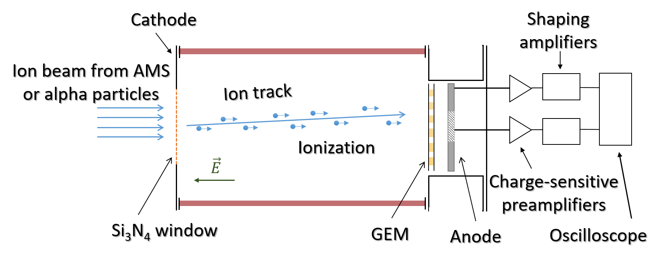
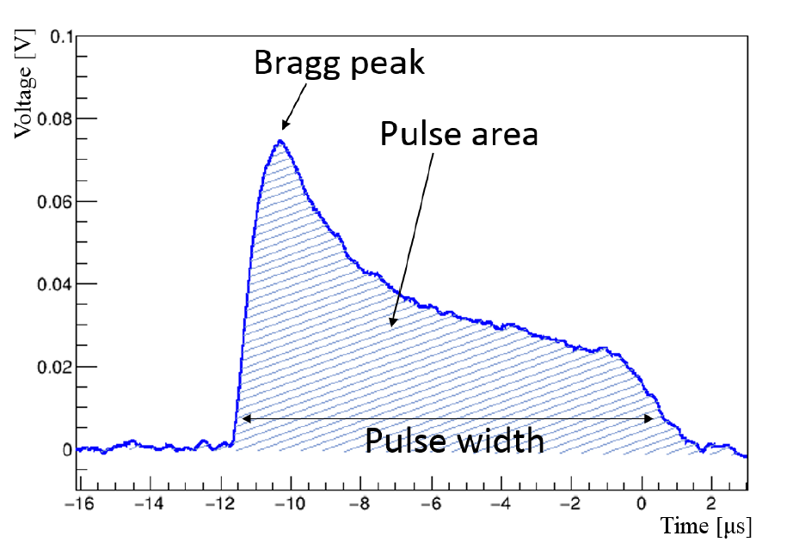
Proof of concept: low-pressure TPC
A waveform example from alpha particle in the low-pressure TPC
Schematic layout of the low-pressure TPC
Diameter ≈ 8 cm
Length ≈ 11 cm
Gas filled - Isobutane
pulse width $\sim$ track range
pulse area $\sim$ energy
Notes:
As a proof of concept, we developed a low-pressure Time Projection Chamber (TPC) with charge readout using a Gas Electron Multiplier (GEM).
The first figure shows a schematic of the detector.
The chamber is a ceramic cylinder, 11 cm long and 8 cm in diameter.
It contains copper field-shaping rings that create a uniform electric field inside the volume.
The chamber is filled with isobutane gas at 50 Torr and room temperature.
One flange holds a silicon nitride entrance window, 10×10 mm² in size and 200 nm thick.
This window allows the passage of 4 MeV ions from AMS or alpha particles from a radioactive source.
On the opposite flange, the GEM is mounted on nylon rods, followed by an anode.
The whole TPC is placed inside an external chamber that is pumped to vacuum.
When alpha particles or ions enter the chamber, they ionize the gas.
The electrons drift toward the GEM, where they are multiplied by avalanche.
The resulting signal is read out at the anode, amplified, and digitized.
The second figure shows a typical waveform from an alpha particle.
During analysis, we measure the pulse width (which is related to the track range) and the pulse area (which is related to the deposited energy).

Slide 9
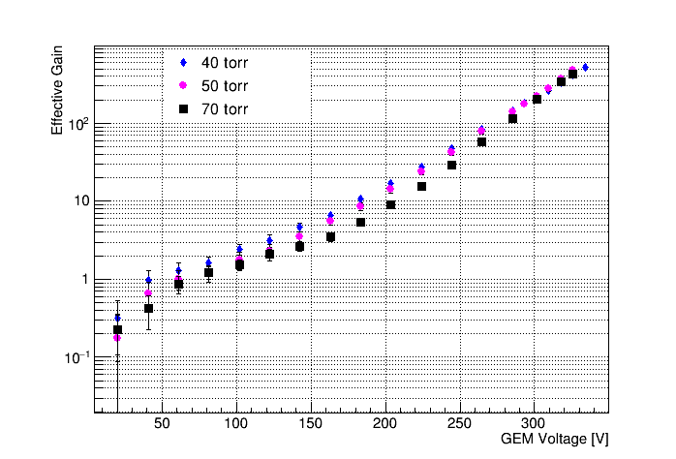
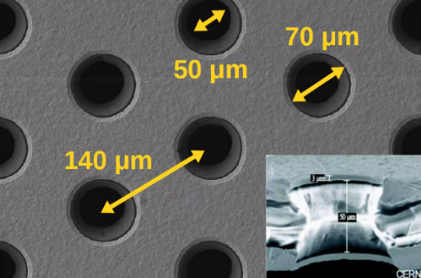
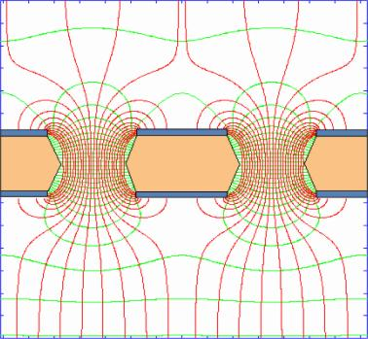
Signal amplification with GEM
Electric field inside the holes.
GEM effective gain as a function of the voltage in isobutane at pressures varying from 40 to 70 torr in the low-pressure TPC.
9
Notes:
To amplify the charge signal in our detector, we use a Gas Electron Multiplier (GEM).
We studied the GEM performance at different gas pressures and voltages.
This figure shows the effective gain of the GEM as a function of the applied voltage.
The measurements were performed in isobutane, at pressures ranging from 40 to 70 Torr, inside the low-pressure TPC.

Slide 10
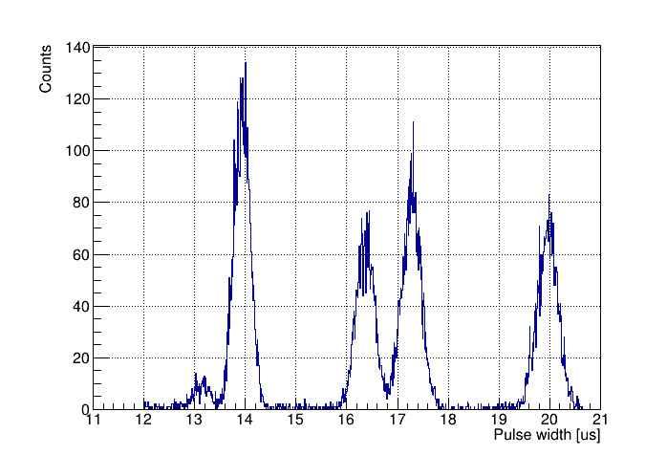
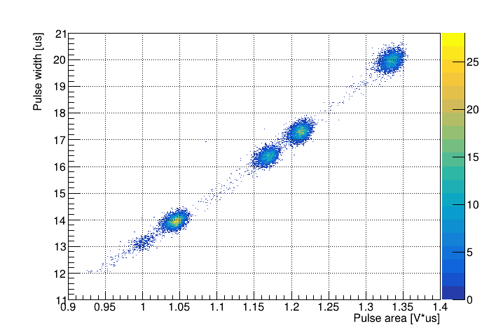
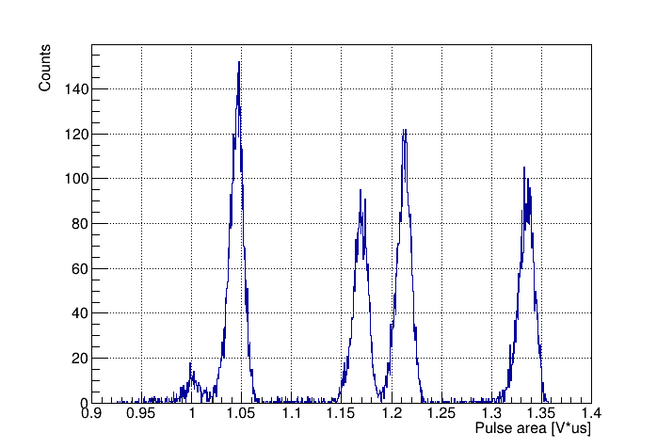
Measurements of energy spectra and track ranges from alpha particles
The alpha-particle source - ²²⁶Ra
$$E_{α}=4. 8 MeV$$
$$E_{α}=5.3 MeV$$
$$E_{α}=5.5 MeV$$
$$E_{α}=6.0 MeV$$
$$E_{α}=7.7 MeV$$
Pressure = 50 Torr
Gain = 225
Source | Sigma/Range | Separation level
²²⁶Ra | 1.13% | 5σ
Using these results and SRIM simulations it is shown that isobaric boron and beryllium ions can be effectively separated at AMS at the 5σ level.
10
Notes:
We measured the energy spectrum of an alpha-particle source using the low-pressure TPC with GEM readout.
The figure shows a 2D distribution of pulse width vs. pulse area.
Projections on both axes are also shown.
We can clearly see four clusters, corresponding to alpha particles with energies of 4.8, 5.3, 5.5, and 6 MeV.
These clusters are well separated in both pulse width and area.
One more alpha particle, with energy 7.7 MeV, has a track longer than the detector length, so it is not fully measured.
We are especially interested in the two clusters in the center.
Their track range difference is the same as for ¹⁰B and ¹⁰Be ions.
We were able to separate these peaks with a precision of 5 sigma.
Based on this and on SRIM simulations, we show that boron and beryllium isobars can also be separated at AMS with the same level of accuracy.

Slide 11
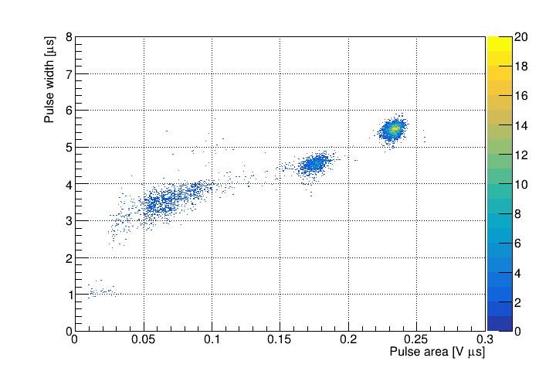
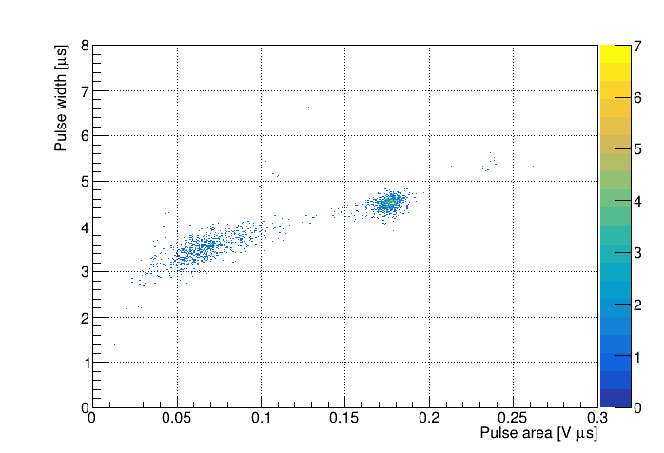
Measurements of energy spectra and ion ranges at BINP AMS
2D plots of pulse width versus pulse area for ions from BINP AMS measured in low-pressure TPC in isobutane at 50 torr.
¹⁴C
Reference Sample
Australian National University standard.
Made from sucrose (sugar) and is one of the IAEA-certified radiocarbon standards.
Background Sample
Blank carbon samples was made from fine-grained dense graphite (dead carbon without 14C).
11
Notes:
We installed the low-pressure TPC after the time-of-flight system at BINP AMS, so testing doesn’t interfere with routine measurements.
We tested the detector using two samples: a reference with known ¹⁴C content made from sucrose and a blank made from dead carbon. In routine measurements, all results are background-corrected and calibrated using reference samples.
The 2D plots show pulse width versus area for ions in isobutane at 50 torr.
In the reference sample, we see three clusters. In the blank sample — only two. So, the extra cluster corresponds to ¹⁴C ions. The time-of-flight detector at BINP AMS effectively suppresses this background, as these ions have different flight times.

Slide 12
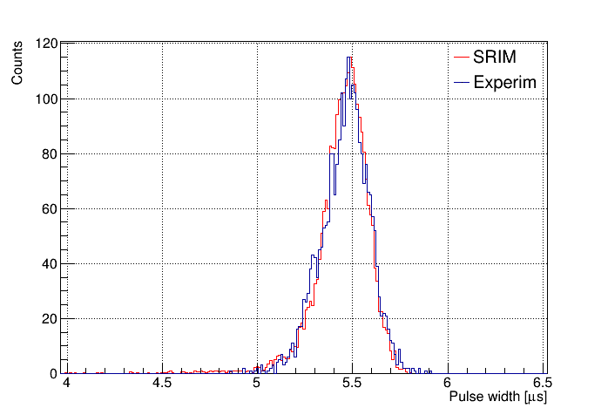
Carbon-14: experiment vs simulation
Distribution of pulse width from carbon-14 ions. Low-pressure TPC measurements are fitted with simulation using SRIM.
Experiment: υ_{dr} = 0.53 cm/µs
Drift velocity in Isobutane at 50 torr and E = 13.5 V/cm is calculated using Magboltz.
Magboltz: υ_{dr} = 0.58 cm/µs
Experiment and simulation are in good agreement.
There is currently work in progress on determination of experimental errors.
12
Notes:
Here we compare experimental data with simulation.
We measured the pulse width distribution for ¹⁴C ions and fitted it to a SRIM-based simulation. The drift velocity in the experiment was 0.53 cm/µs.
For comparison, Magboltz gives 0.58 cm/µs in isobutane at 50 torr and 13.5 V/cm.
The experiment and simulation show good agreement. We're now working on estimating the experimental uncertainties.
After upgrading the BINP AMS system, we plan to test samples with beryllium.

Slide 13
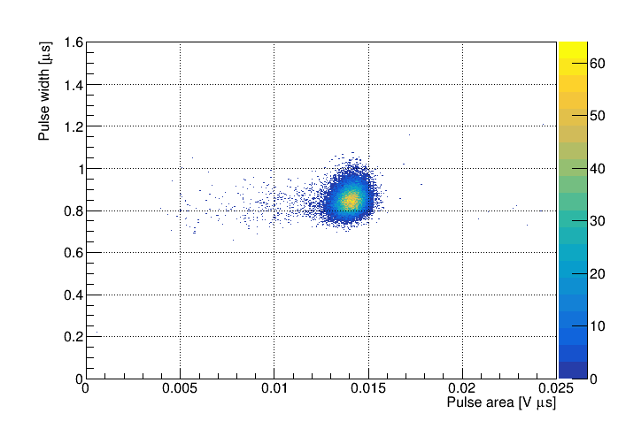
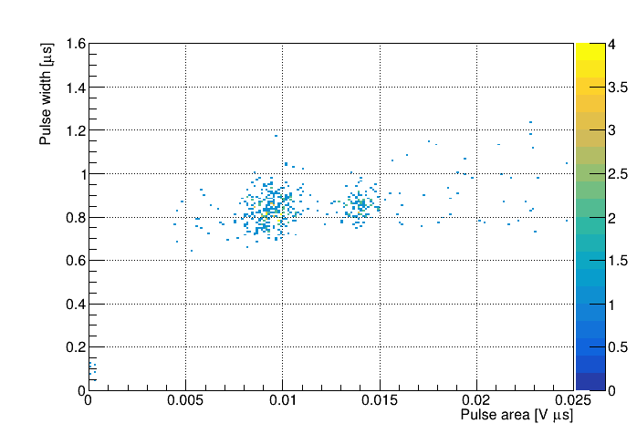
Measurements of energy spectra and ion ranges at Micadas
2D plots of pulse width versus pulse area for ions from Micadas measured in low-pressure TPC in isobutane at 50 torr.
¹⁴C
Reference Sample
Australian National University standard.
Made from sucrose (sugar) and is one of the IAEA-certified radiocarbon standards.
Background Sample
Blank carbon samples was made from fine-grained dense graphite (dead carbon without 14C).
13
Notes:
We also tested the low-pressure TPC as an ion detector for a future domestic radiocarbon dating system. For this, we installed it on Micadas.
Again, we used two samples: a reference and a blank. The 2D plots show pulse width versus pulse area, measured in isobutane at 50 torr.
In the reference sample, we clearly see the ¹⁴C peak. Interestingly, ¹⁴C ions also appear in the blank — likely due to contamination during graphitization.
These are preliminary results, and we plan to continue the experiments.

Slide 14
Results
We have developed and successfully tested the low-pressure TPC with GEM readout for AMS.
A new ion identification technique based on measuring both ion track ranges and ion energies in low-pressure TPC has been developed.
Using these results and SRIM simulations, it was shown that isobaric boron and beryllium ions can be effectively separated at BINP AMS at a level of 5σ. It provides efficient dating up to 10 million years (for geochronology of Cenozoic Era).
Low-pressure TPC was installed at BINP AMS. Measurements were successfully carried out with samples containing radiocarbon. After BINP AMS upgrade, we plan to carry out multi-isotope studies.
It has been demonstrated that the low-pressure TPC can be used as an ion detector in future domestic AMS complex.
14

Slide 15
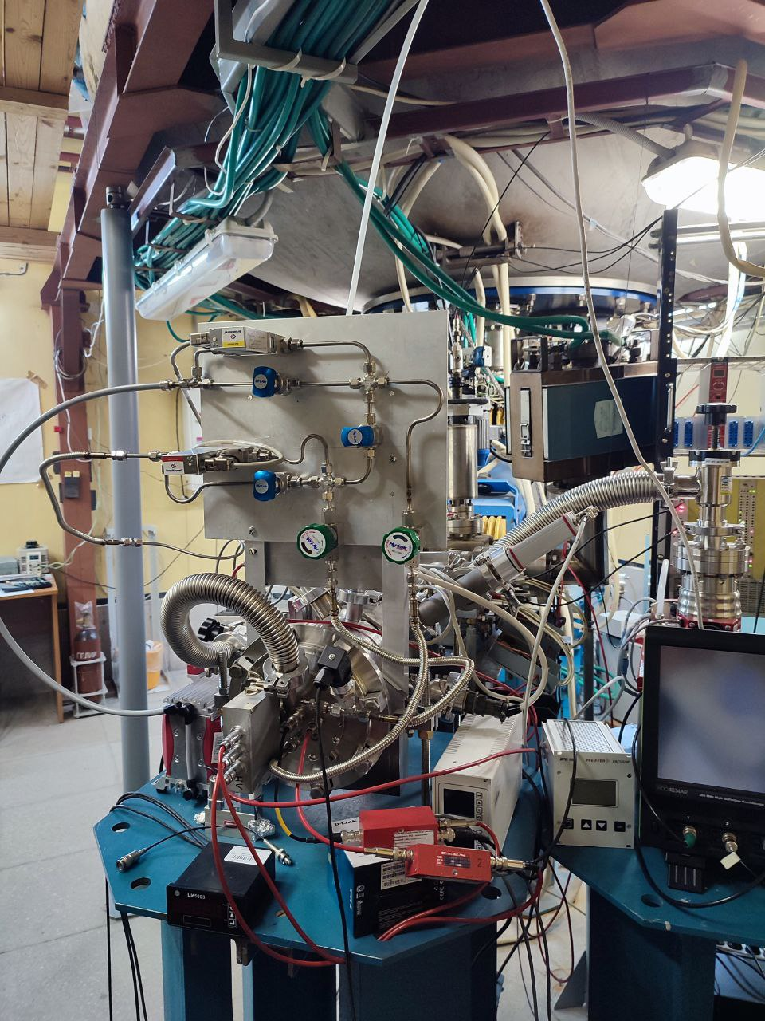
Thank you for
your attention
15

Slide 16
Backup slides
16

Slide 17
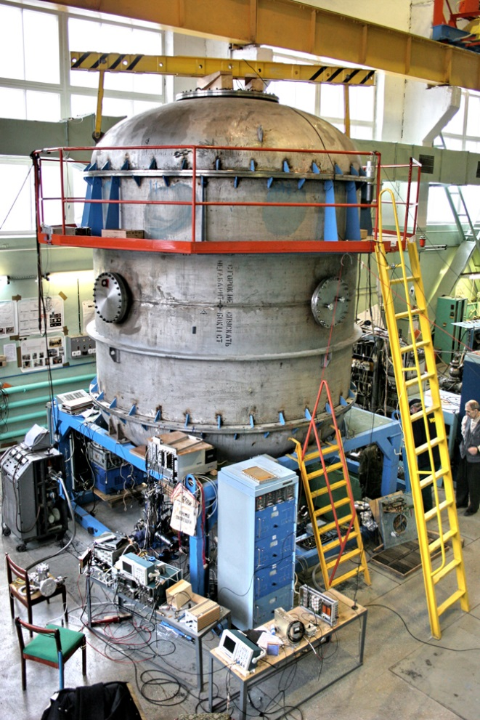
Accelerator Mass Spectrometry
Accelerator mass spectrometry (AMS) is an ultra-sensitive method of counting individual atoms.
Typical application – radiocarbon dating
Date interval – less than 50000 years to 100 years
Sample size – 1 mg
Count rate – 100 Hz
Accuracy – 0.2 %
AMS facilities operate in more than 140 physical laboratories worldwide, one of which is located in Novosibirsk at Geochronology of the Cenozoic Era Center for Collective Use.
Notes:
Accelerator Mass Spectrometry (AMS) is the standard technique for measuring rare cosmogenic radionuclides with long half-lives. It works by extracting individual atoms from a sample and counting the isotopes of interest.
A common example of AMS application is radiocarbon dating. With AMS, the radiocarbon age of a small sample (around 1 mg) that is less than 50,000 years can be determined with high accuracy.
There are about 140 AMS systems worldwide, including one developed at the Budker Institute of Nuclear Physics (BINP). This photo shows the BINP AMS, where radiocarbon dating is currently being carried out successfully.

Slide 18
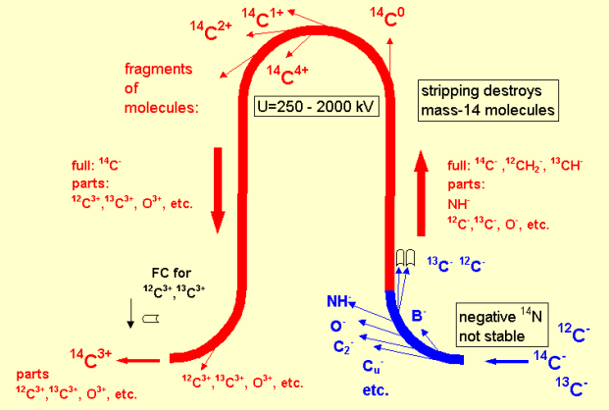
BINP AMS
1. Formation of an ion beam from atoms of the test sample
2. Ion selection at low energy
3. Ion acceleration
4. Recharging of atomic ions and destruction of molecular ions
5. Ion selection in a high voltage terminal
6. Ion acceleration
7. Ion selection at high energy
8. Identification and counting of ions
BINP AMS provides reliable separation of a pure beam of radiocarbon ions from the accompanying ion background.
Notes:
This figure shows the operating principle of the BINP AMS. Negative ions are generated from the sample in a cesium sputter source and mass-analyzed by a magnet. For ¹⁴C, using negative ions eliminates the isobaric background because ¹⁴N (nitrogen) does not form stable negative ions.
The mass-analyzed negative ions are accelerated to the positive high-voltage terminal of the tandem accelerator, where they pass through a magnesium vapor stripper. Here, molecular ions are destroyed, and atomic ions are recharged to a 3+ state. A unique feature of this accelerator is the 180° electrostatic bend, allowing only 3+ ions to pass.
These positively charged ions are further accelerated to ground potential in the second stage of the tandem accelerator. Another magnetic analyzer selects the ions of interest.
Finally, individual ions are identified and counted by a detector. A time-of-flight system is installed in the BINP AMS to ensure reliable separation of radiocarbon ions from the background.

Slide 19
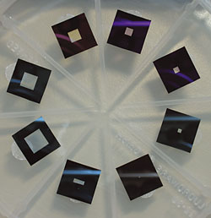
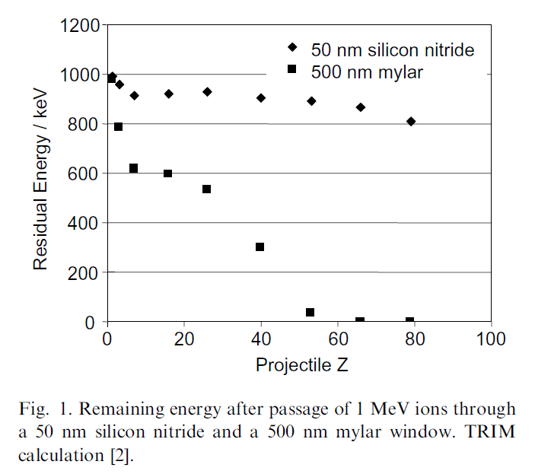
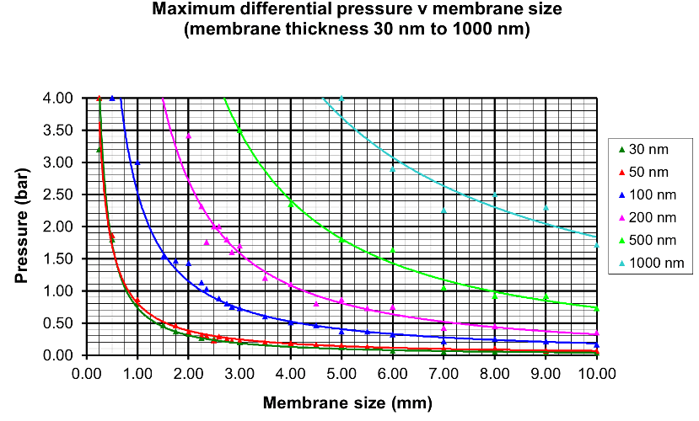
Silicon nitride membrane windows
Figure of silicon nitride membrane windows
M. Dobeli et al., Nucl. Instr. and Meth. B, 219-220 (2004) 415-419 doi:10.1016/j.nimb.2004.01.093
19

Slide 20
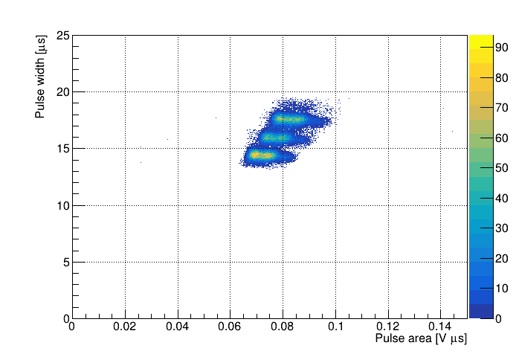
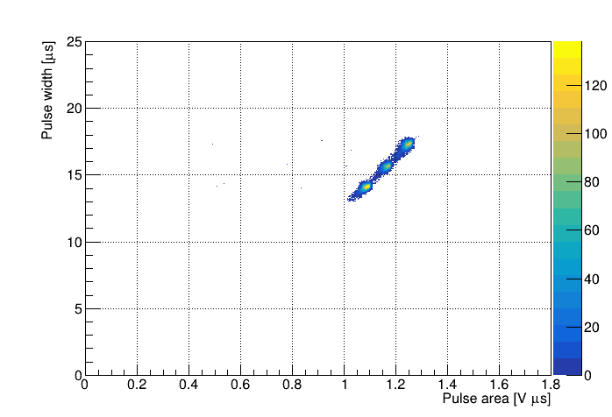
THGEM versus GEM
2D plot of pulse width versus pulse area for alpha particles from ²³³U (4.8 MeV), ²³⁹Pu (5.2 MeV) and ²³⁸Pu (5.5 MeV) source, measured in low-pressure TPC in isobutane at 50 torr and room temperature using THGEM amplification with gain of 320.
2D plot of pulse width versus pulse area for alpha particles from ²³³U (4.8 MeV), ²³⁹Pu (5.2 MeV) and ²³⁸Pu (5.5 MeV) source, measured in low-pressure TPC in isobutane at 50 torr and room temperature using GEM amplification with gain of 230.
20

