Slide 1
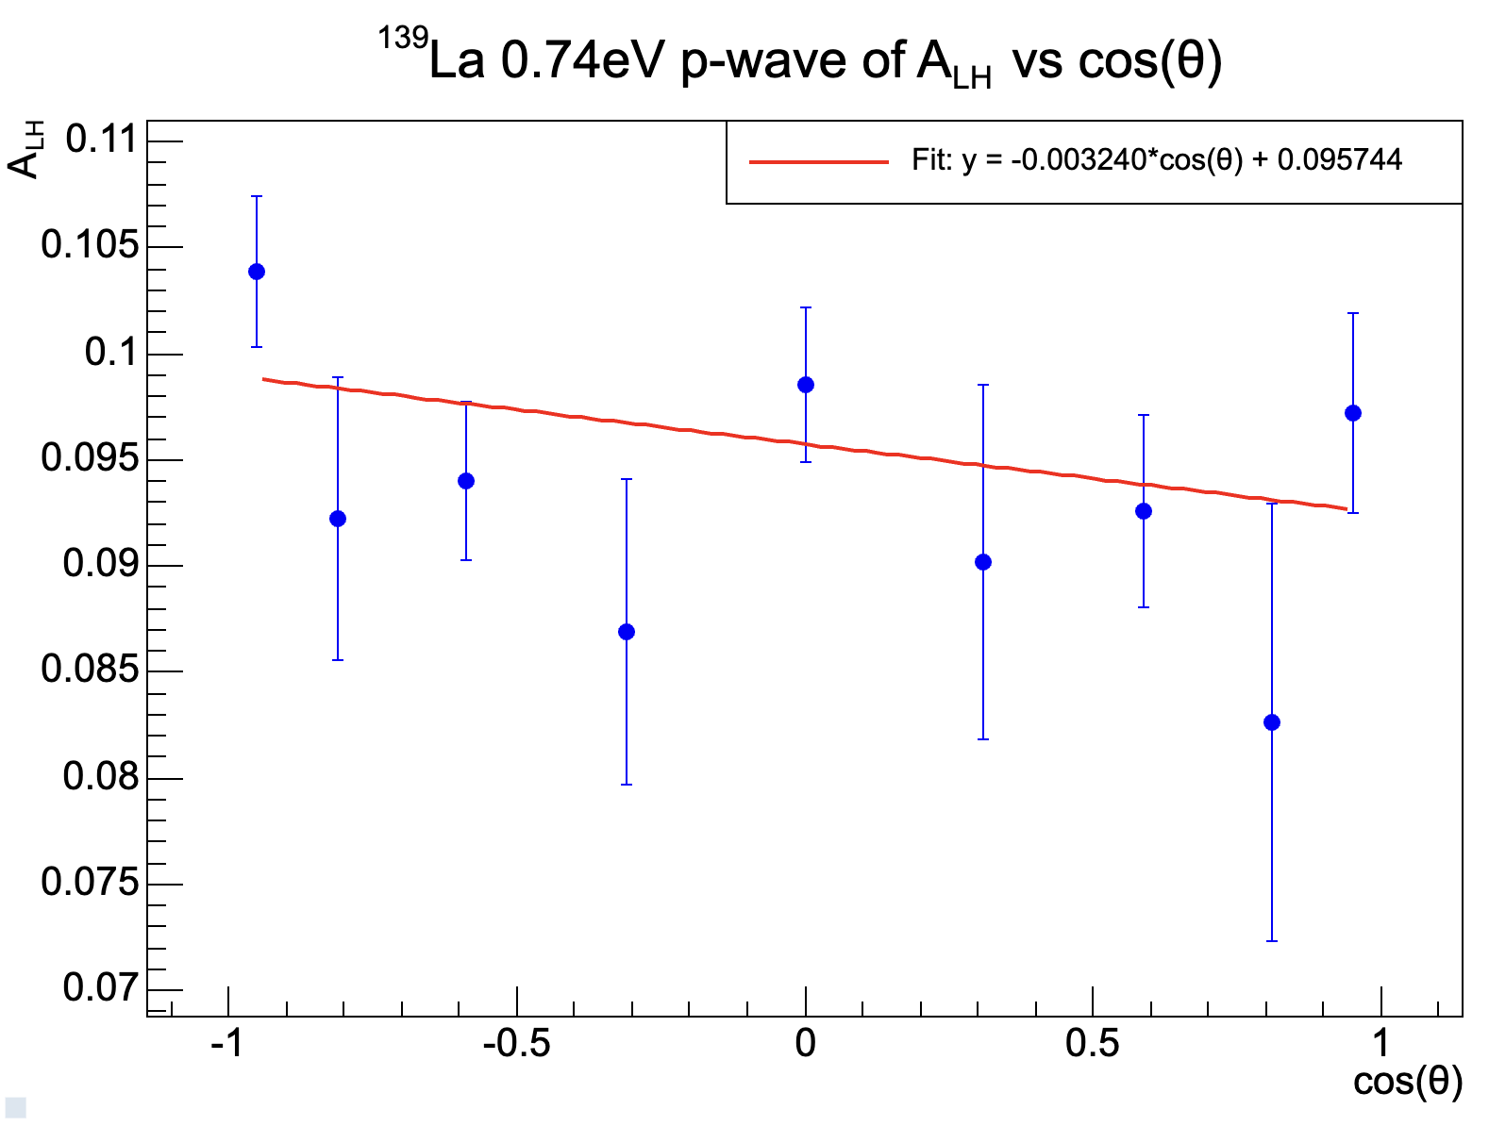
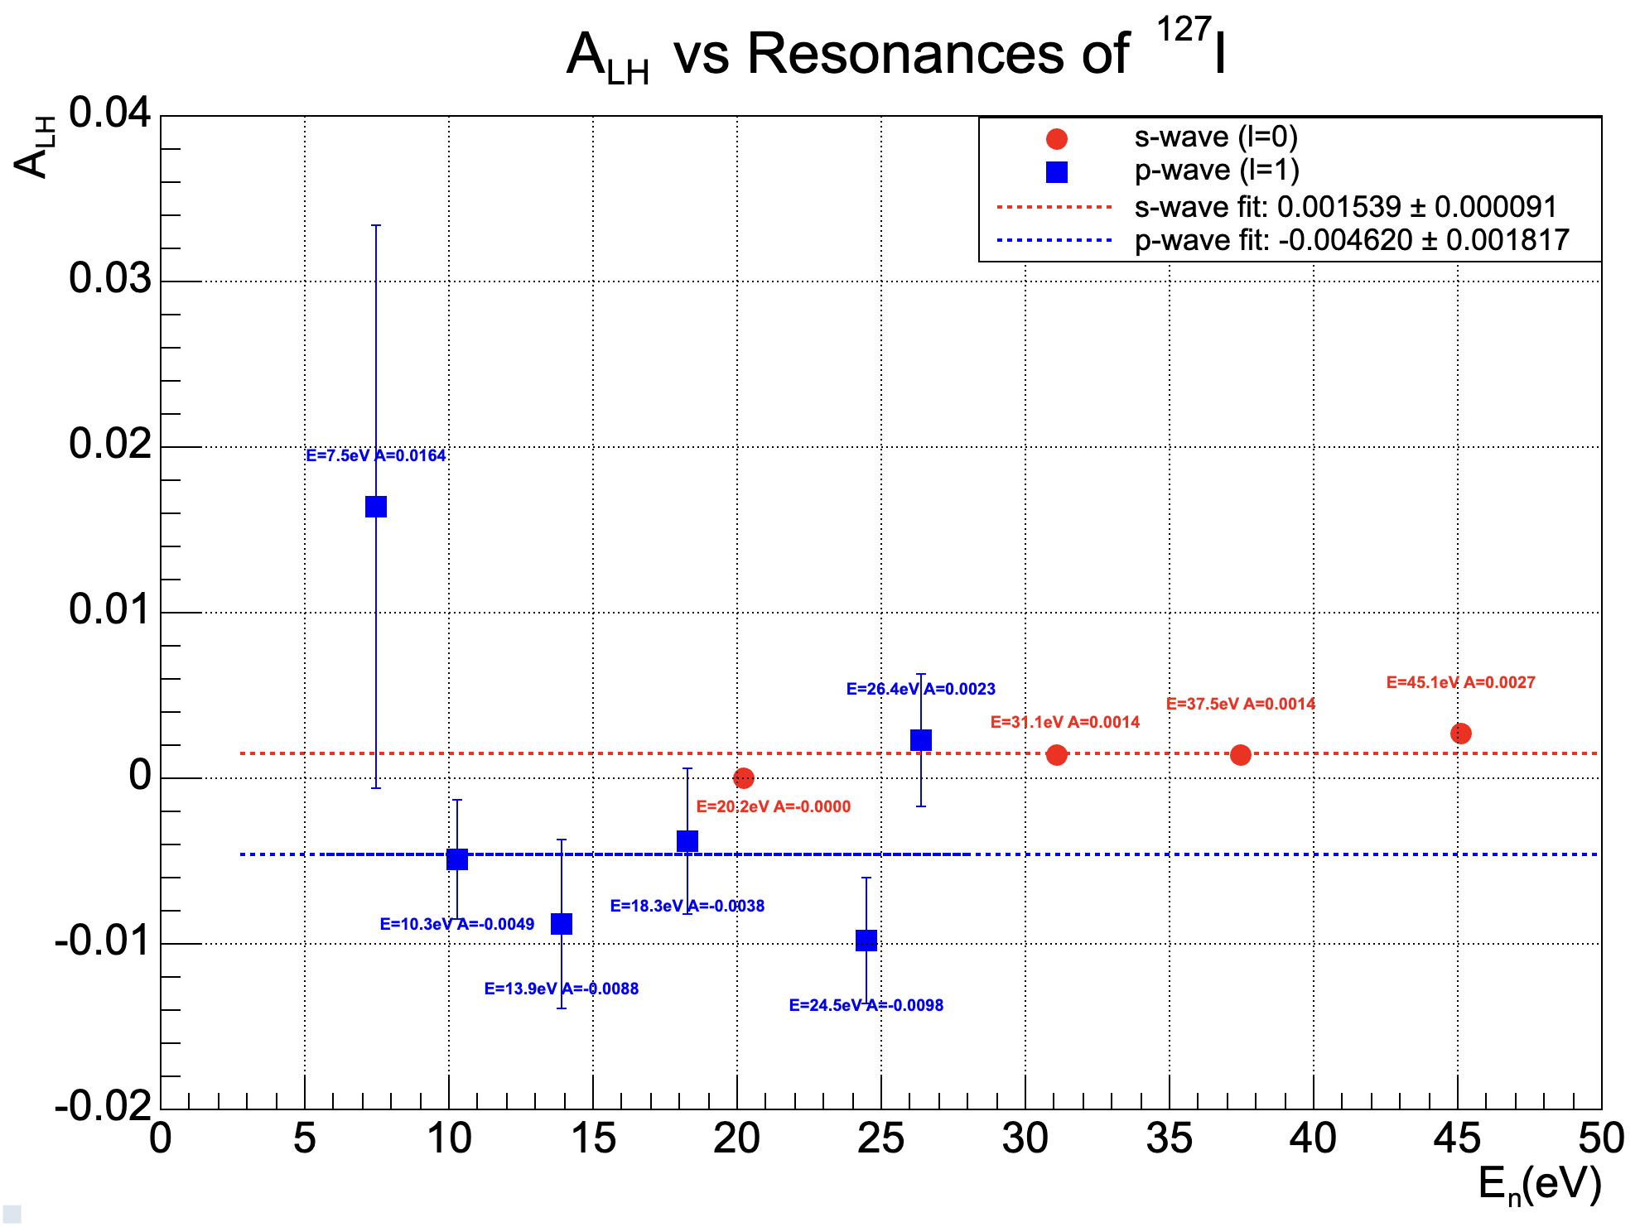

γ angular distribution analysis in (n, γ) reactions of the low energy neutron resonances of ^{nat}La and NaI using the GTAF BaF₂ array at CSNS Back-n White Neutron Source
- Mofan Zhang
Preliminary
Preliminary
Preliminary
Preliminary
Preliminary
Preliminary
Preliminary
Preliminary
Summed gamma energy cut: 3MeV < Egsum < 5.5MeV
Cluster multiplicity cut: 2 < Multi < 10
The above plot shows the slope A = -0.00324 +/- 0.00243 of the fit A⋅cos(θ) + B by GTAF on the 0.74eV p-wave resonance of ¹³⁹La.
A = −0.0037 ± 0.0014, measured by ANNRI with summed gamma energy range (2MeV, 5.17MeV) for the same resonance [1].
Due to multiple resonances exists in the <50eV range of ¹²⁷I, the above “statistical” approach in A_{LH} of ¹²⁷I low energy resonances was applied. There is a clear separation between the s-(red) and p-(blue) waves may suggest a possible new method for p-wave determination.
SSP2025 in Nara, on Sep. 23-28, 2025
[1]. T. Okudaira, et al. Phys. Rev. C 109, 029903 (2024)

