Slide 1
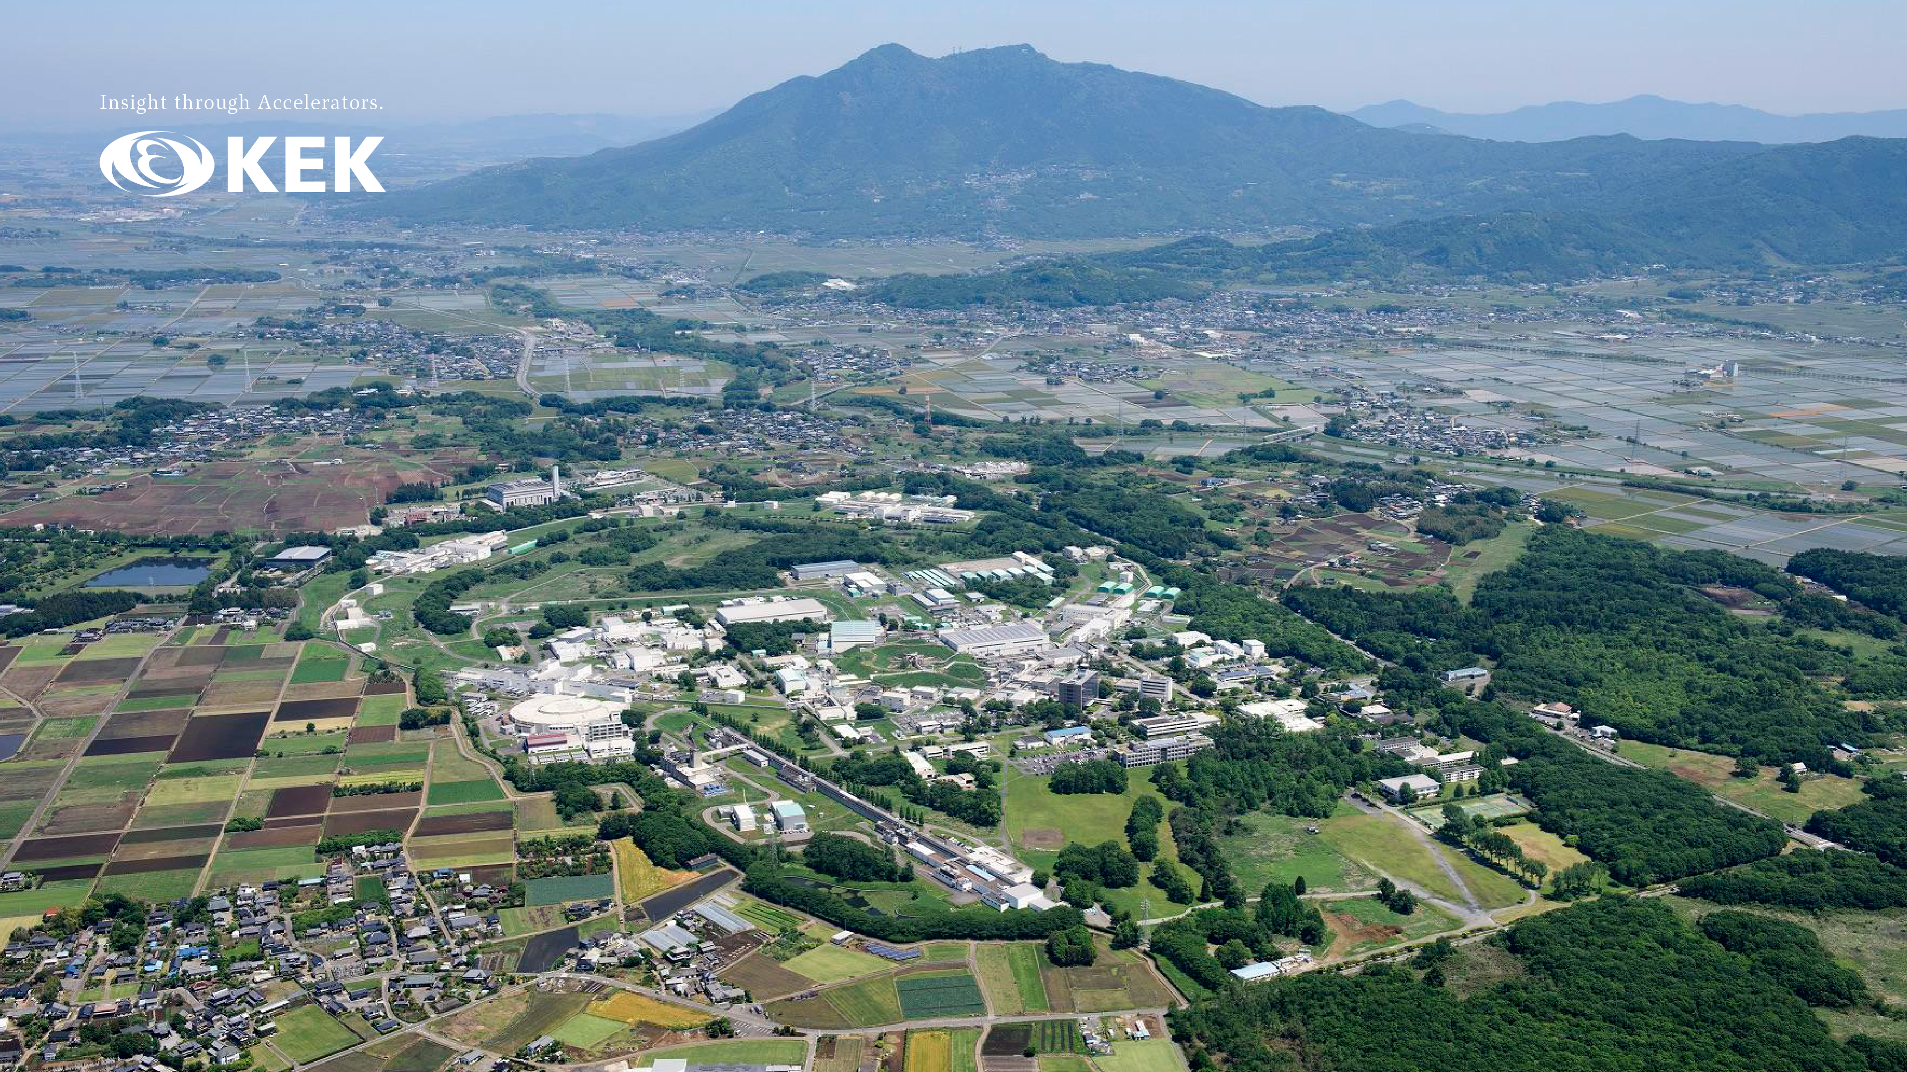
IWAA2026
Organizational Announcements
Yuichi Okayasu / IWAA2026 Organizing Committee
5 October 2026

Slide 2
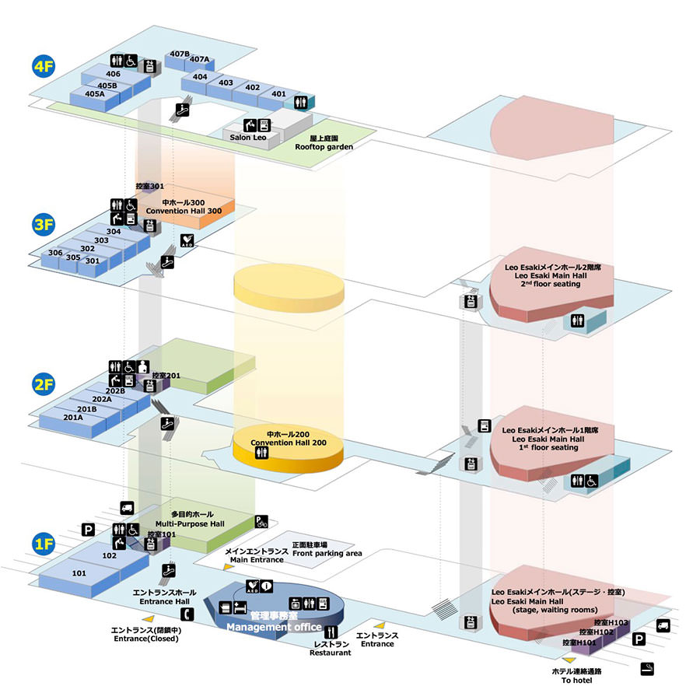
Floor guide
LOC secretariat
Rm 407
・All oral presentation @ Convention Hall 200
・Poster @ Rm 202B
・LOC secretariat @ Rm 407
(for receipt reissuance/correction, inquiries,
donations, etc.)
・2 AEDs @ 1F & 3F
・Smoking area is located outside this building
to the northwest.
Smoking outside designated areas
may result in a fine of 2,000 JPY.
・Other : coin lockers (coin-return type)
and a portable charger rental service (330 JPY
for a two-day rental; credit cards OK) @ 1F
Poster
Rm 202B
We’re here
Convention Hall 200
Main entrance
Smoking area
(outside this build.)

Slide 3
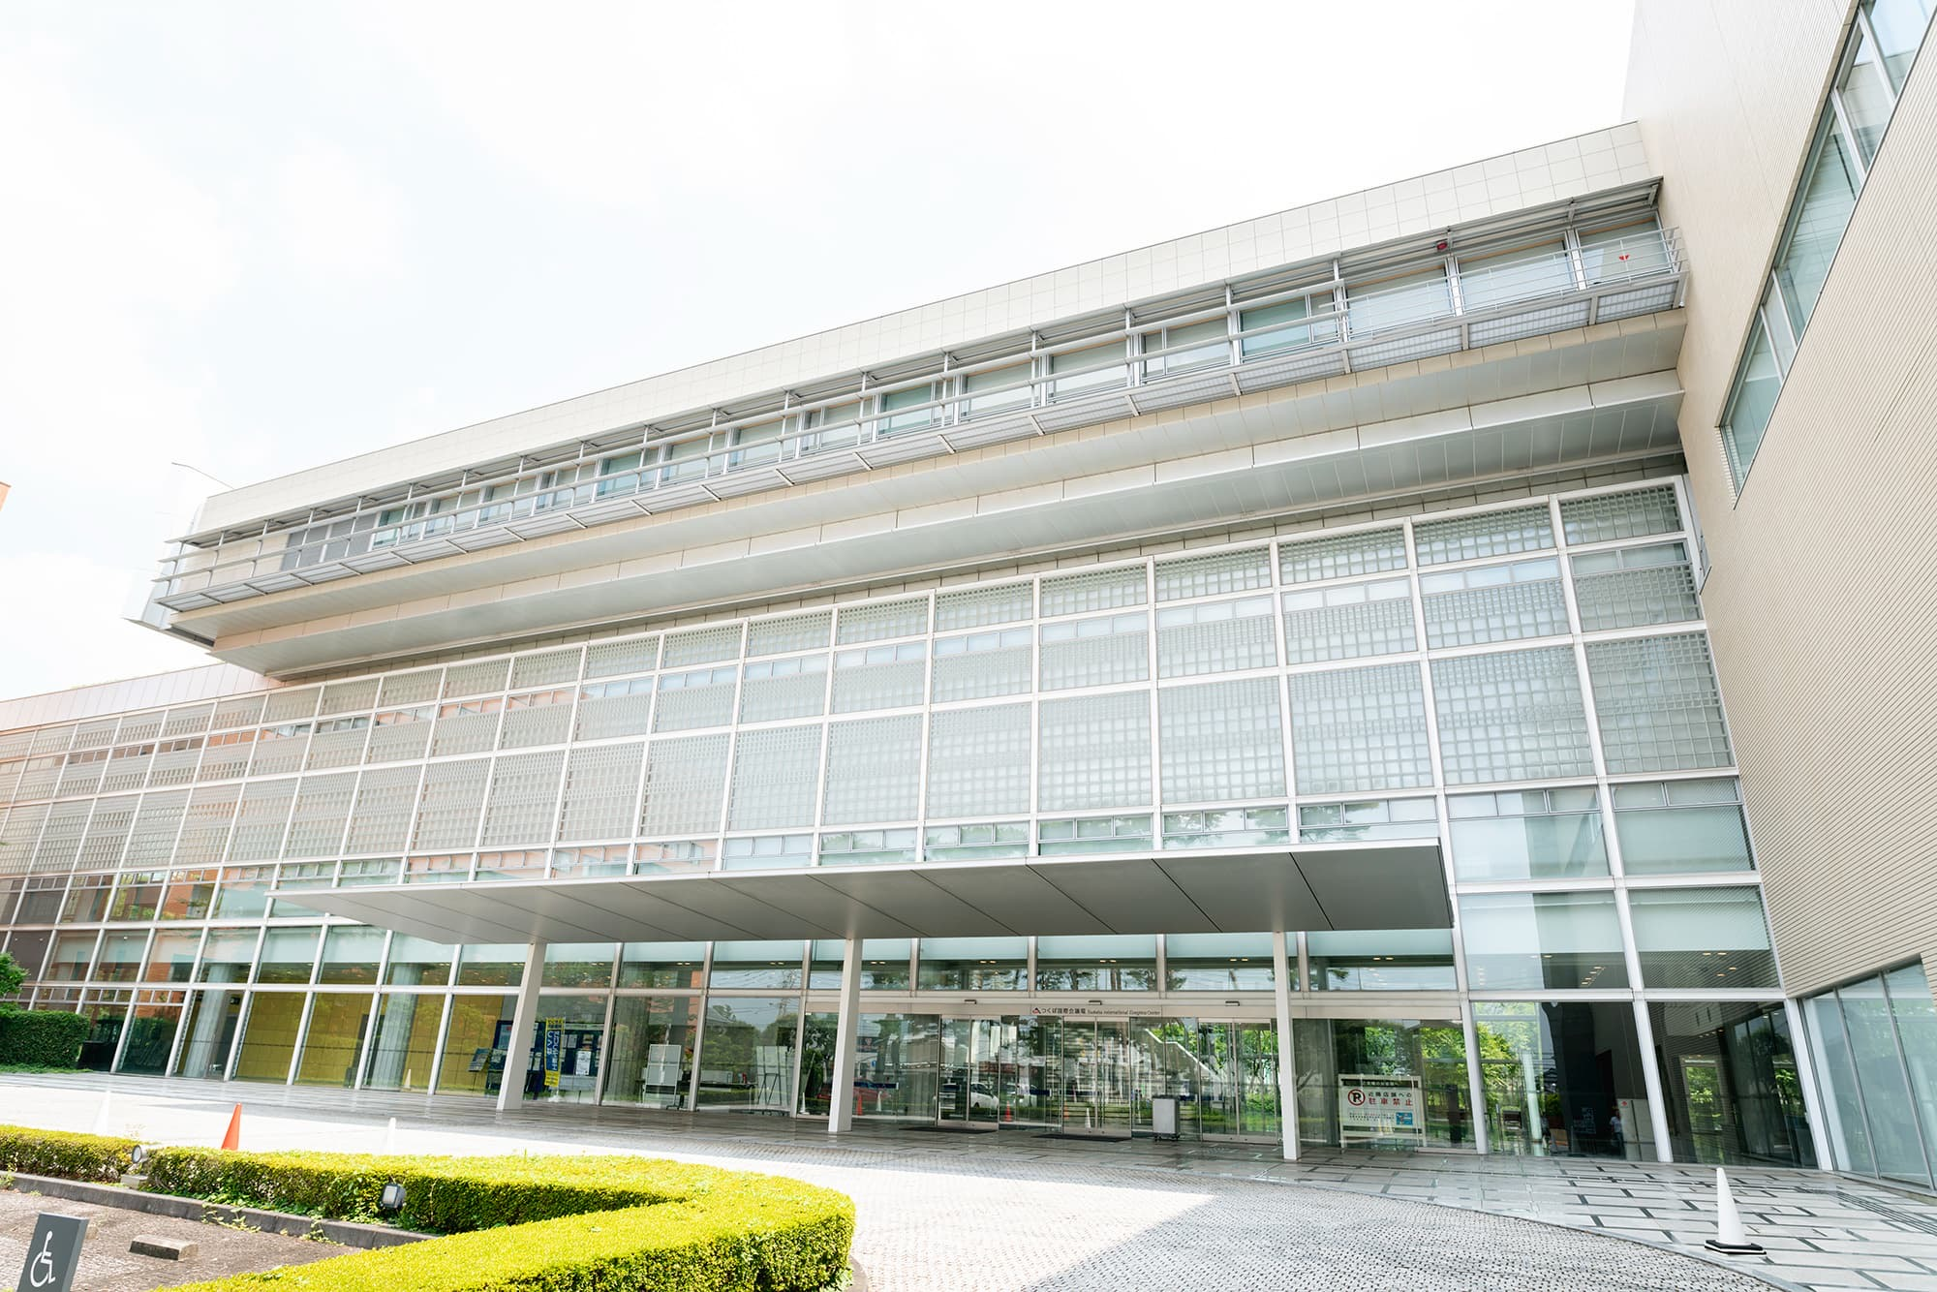
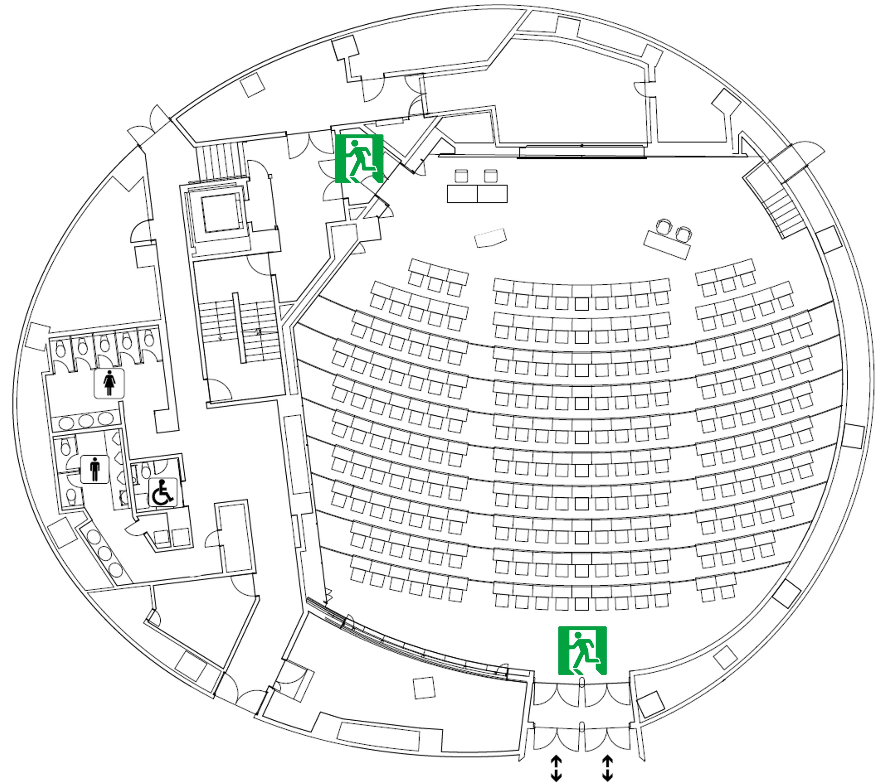
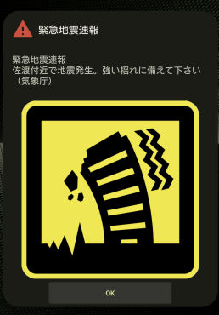
Tsukuba Int’l Congress Center (EPOCHAL TSUKUBA) emergency evacuation
In the event of a disaster such as a fire or earthquake,
do not remain inside the building;
please evacuate outside through the main entrance.
In the event of a major earthquake requiring evacuation,
some cell phone models will provide an advance warning
with a loud alert sound.

Slide 4
Wi-Fi
We have arranged Wi-Fi service for IWAA2026.
All participants can use it for free in Convention Hall 200 and Room 202B.
SSID / passphrase : see your name tag.
Unfortunately, eduroam is not available.

Slide 5
Format
Presentations
・If you haven’t already, please send me your slide, we will upload it to the indico / laptop.
・20 minutes to present
・5 minutes for discussion after talk
・We will have microphones
Poster session
・Poster session will be on Thursday 10:10 – 11:25 and 14:45 – 15:50 @ Rm 202B
・Core times;
Odd # program codes : 10:10 – 11:10
Even # program codes : 14:45 – 15:45
・Please bring your posters with you on Thursday morning and remove them by 16:00
(Note : any posters remaining after this will be removed by the LOC staffs)
・Best poster award. Please vote for the best poster.
The ballot is inside your name tag. The ballot box is placed in Rm. 202B.

Slide 6
General
Lunch (and dinner)
・Restaurant (same as ICE breaker party)
・7-Eleven Convenience Store (for those looking to save money; coffee is good.)
・My recommendations are listed in “Practical Information” of the IWAA2026 indico.
Coffee breaks
・We will have coffee, tea, water and pastries @ entrance of this hall
Please do not bring your drink w/o a lid to this all (Rm 202B is OK)
・We will signal 5 minutes before the end of the coffee break
Excursion, KEK tour and banquet
・The excursion and the KEK tour are packaged together
・If you wish to participate, please notify the secretariat
by the end of the final session on Wednesday
・The bus will travel in the following order: excursion, KEK tour, banquet, and Tsukuba Center.
・The bus departs from the main entrance of this venue at 13:00 on Thursday;
please gather promptly
・Participants joining only the excursion and KEK tour are asked to make their own way
from KEK to Tsukuba Center Station using public bus transportation

Slide 7
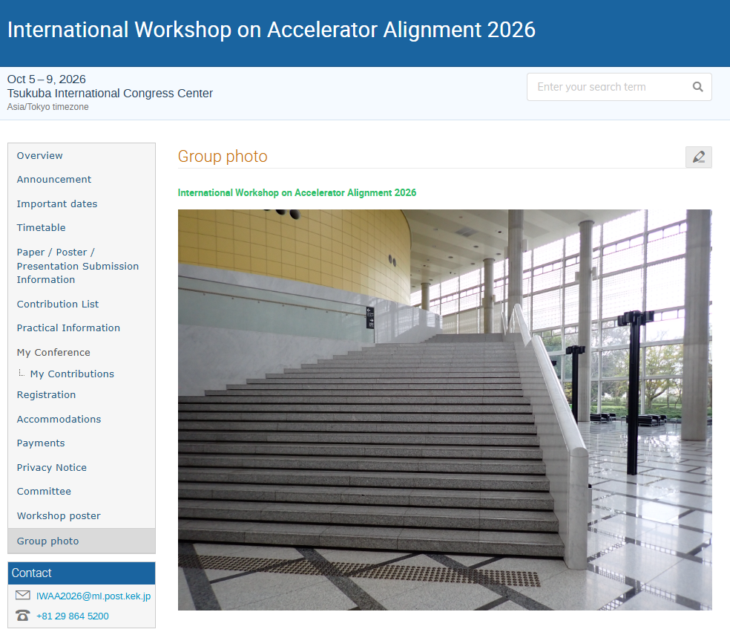
Group photo
We will take a group photo after the morning session on October 7.
The photo will be taken on the stairs at the venue exit.

Slide 8
General
Participation
・We have 74 participants from 35 different institutions
Advanced Metrology Co., Ltd | ALBA Synchrotron Light source | Argonne National Laboratory | Brookhaven National Lab | Canadian Light Source | CEA
CERN | Conservatoire Nationale des Arts et Métiers | DESY | Duke University | ESRF | European Spallation Source ERIC
Fermi National Accelerator Laboratory | GSI Helmholtzzentrum Darmstadt | INFN-LNF | Institute of Modern Physics, Chinese Academy of Sciences | Institute for Rare Isotope Science | Janicki Industries
Korea University | Laboratoire Commun de Métrologie LNE-Cnam | Leica Geosystems AG | Los Alamos National Laboratory (LANL) | MAX IV Laboratory | Mishima Engineering & Technology Consultancy
National Institute of Physics, University of the Philippines Diliman | National Synchrotron Radiation Laboratory, University of Science and Technology of China | NSRRC | SA Engineering Co., Ltd. | SDK Co.,Ltd | SLAC National Accelerator Laboratory
Suzhou national laboratory | Synchrotron Light Research Institute | Synchrotron SOLEIL | University of Science and Technology of China | KEK
We would like to express our sincere gratitude to everyone who participated.

Slide 9
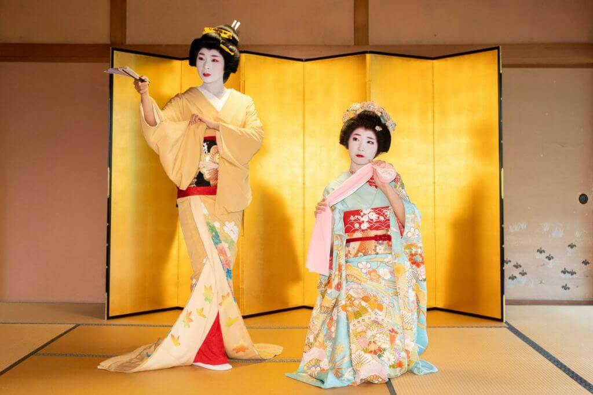
Name tag straps
I made them using Japanese tatami-mat edge tapes.
(Note : they are not made from the tatami in my own home.)
I got a bit carried away and made 100 of them, so we still have some in stock.
If you bring it for your colleague or family,
please come by Rm. 407!
Tatami edge tape

