Slide 1
Building a European alignment community: key outcomes from EUWAA 2025 and 2026
Hélène Mainaud Durand and David Martin, on behalf of all participants

Slide 2

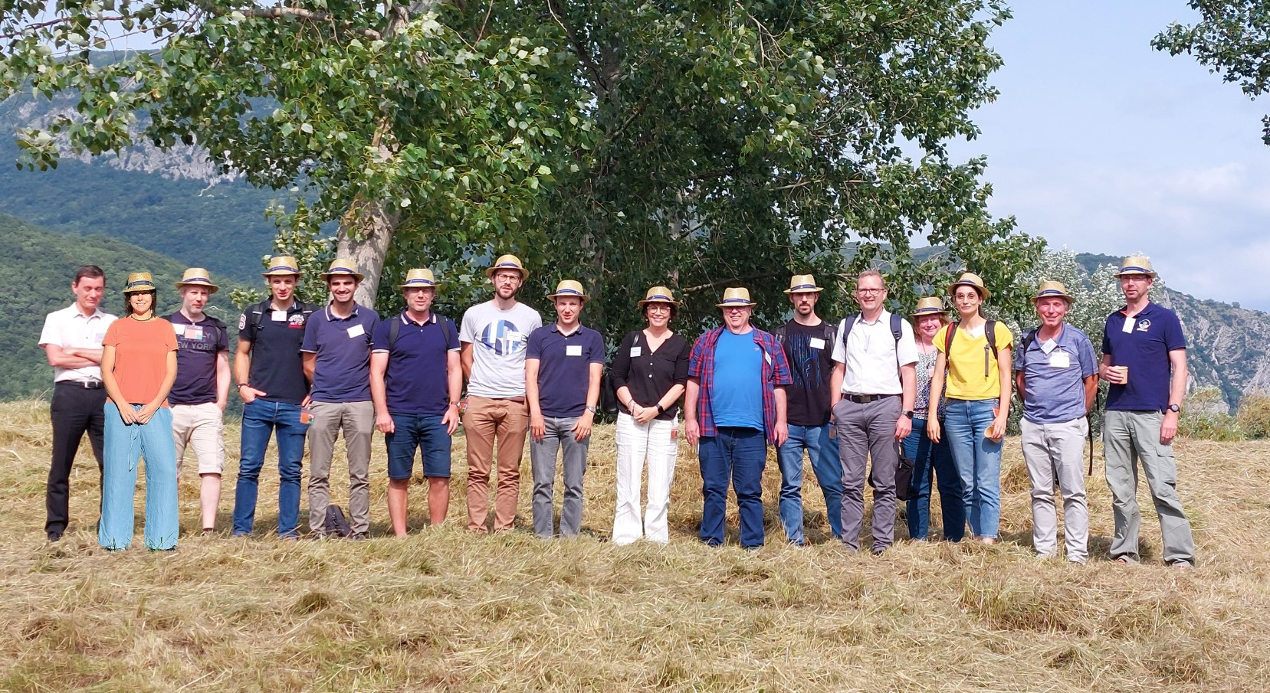

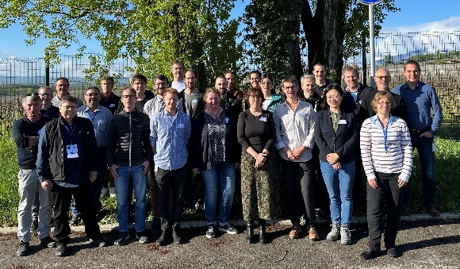

EUWAA BACKGROUND
Presentation of the first outcomes at IWAA 2024

Slide 3
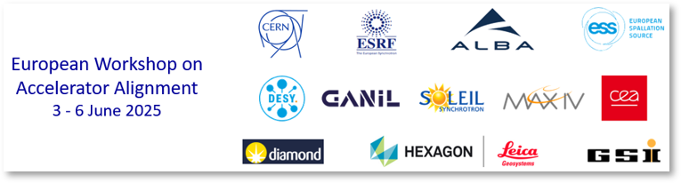
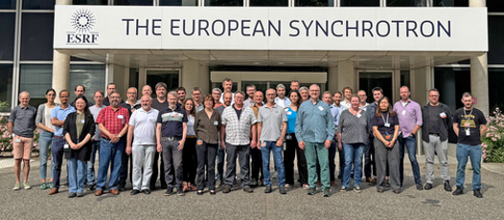
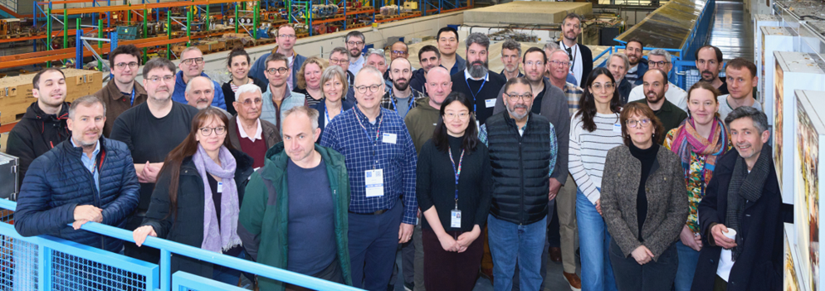
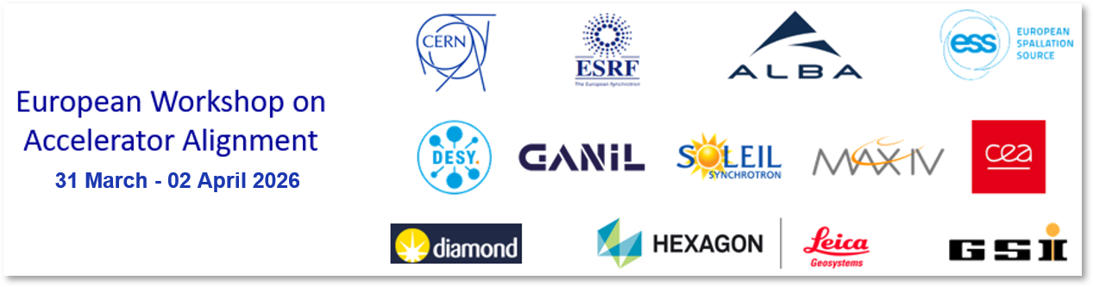
PRESENTATION OF EUWAA 2025 and 2026
With a focus on the Inter Laboratory Comparison measurements

Slide 4
WHAT IS EUWAA?
The EUWAA seminar provides a forum for building a coordinated European approach to Accelerator, Detector, and Beamline alignment.
Bringing together research, industry, and the scientific community to define priorities, share experience, and explore new methods—from instrumentation and measurement to AI and workforce development—shaping the skills and capacity Europe needs for the future.
In a nutshell:
  Share – good practises, ideas, procedures, challenges, issues, etc.
  Learn – about methods, instruments, measurement uncertainty, etc.
  Build – a strong community, with coherent methods and procedures, attractive to a new generation, getting everybody motivated!

Slide 5
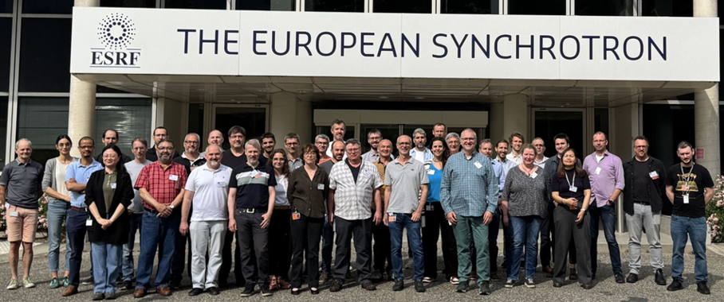
EUWAA 2025 - FORMAT
EWAA (3-June 5, 2025) · Indico
The third seminar was held from 3–5 June 2025 at the ESRF, bringing together eleven laboratories. The format of this version, as with all the EUWAA workshops, was intentionally open and informal. It consisted of seven sessions of roundtable discussions, with co-chairs guiding and moderating the debates, on the following topics:
  Software & databases
  Engineering-to-alignment workflow
  Instruments & methods
  Open brainstorming session
  Uncertainty in measurement
  Discussion with industrial partners
  Looking to the future
42 participants from 11 labs
2 industrial partners

Slide 6
EUWAA 2025 - OUTCOME
Actions were defined around four pillars:
  Preparation of a glossary and common best practice guide on measurement uncertainty
  Creation of a task force on recruitment, training, and knowledge transfer
  Launch of a software inter-comparison
  Launch of an Inter-Lab comparison, resulting in a scientific paper on the state-of-the-art in our community
The first post-meeting action was to find an official name via vote: EUWAA was chosen.
EWAA becomes EUWAA…

Slide 7
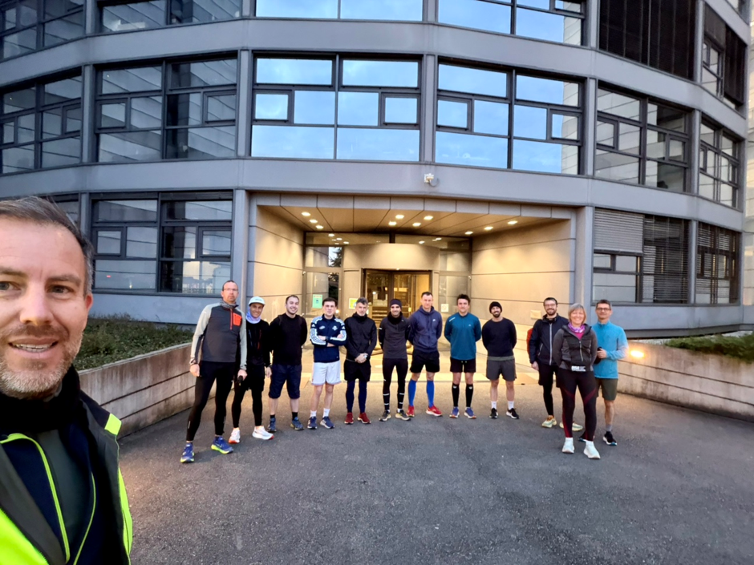
EUWAA 2026
Access to Indico website
The format remained unchanged, with ample time for discussion—at coffee breaks, during lunch, and at the networking dinner.
Three main sessions:
  Actions from the previous EUWAA
  Inter-Lab comparison
  Digital twins and 3D deployment in similar fields
Two parallel brainstorming sessions, followed by summary and plenary discussion.
Three guest speakers:
  Tania Landes (INSA Strasbourg)
  Prof. Stephan Kyle (University College London)
  Daniel Heisselmann (PTB)
EUWAA2Run for the first time!
Topics of the 1st brainstorming session | Topics of the 2nd brainstorming session
ATS800: applications and feedback | Calibration, Check and testing of instruments & equipment: best practices, frequencies, how to deal with ISO recommendations
How to deal with refraction? | How to develop and qualify alignment systems? Challenges of supporting systems and initial alignment on girders
Working with a service contract (invitation to tender, documentation, etc.) | How to recruit the best person for the job? How to involve universities and engineering schools? How to perform Knowledge Transfer and training?

Slide 8
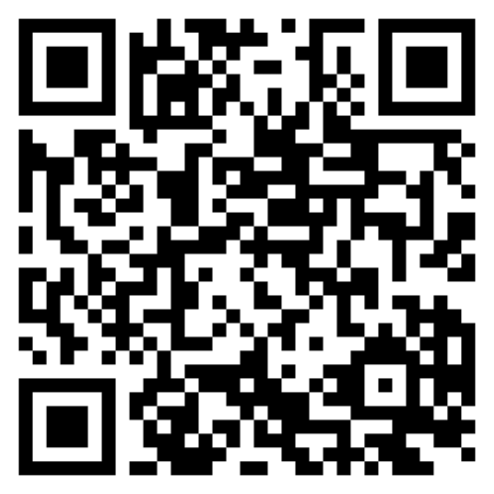
EUWAA 2026 – MAIN OUTCOMES
Main outcomes – Actions from last EUWAA:
  1. Open-Source Tool (LGC)
    LGC—CERN's high-precision 3D least-squares adjustment tool—is now open source (details available online). ESRF is currently using it; DESY is exploring it as a potential future user. Planned developments include flexible geoid-model support.
  2. Software Inter-Comparison Study
    Results from a December 2025 survey were presented.
    Four to five software tools are widely used in our community: PANDA, LGC, GCP, USMN, and SOLEIL6D.
    Test datasets are being prepared for various network-adjustment configurations (starting with form-only computation).
    Next step: run computations with domain experts.
  3. Recruitment, Knowledge Transfer, and Outreach
    Investigating repository solutions for document storage and options to establish EUWAA as a formal entity.
    Proposed advertising job positions via LinkedIn.
    First publication of EUWAA LinkedIn account published.

Slide 9
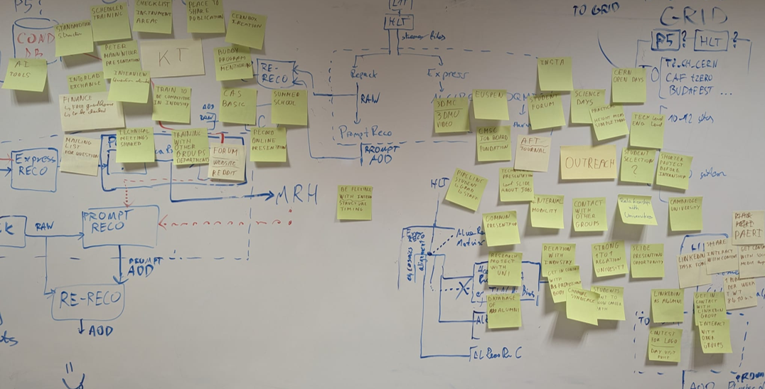
EUWAA 2026 – MAIN OUTCOMES …
Main outcomes – Brainstorming sessions:
  Refraction: Still not fully understood. The topic should be approached at a
  larger scale, encompassing environmental effects and extreme measurement
  conditions (e.g., cold cryo environments).
  ATS800: a lot of exchanges between users, future users and the manufacturer Hexagon
  Service Support Contract Strong interest in exchanging technical specifications, issues, and related matters—while preserving confidentiality. A dedicated WG will be formed for ongoing dialogue.
  Calibration Check and Test: Manufacturer certification dominates for laser trackers, though transport remains a drawback; ancillary equipment (prisms, etc.) calibration must not be neglected. Total-station calibration is being phased out.
  Fiducialisation measurements & supporting systems: Various fiducialisation techniques were reviewed; a common approach for aligning and fiducialising different magnets on the same girder would be a significant advantage. Discussions also covered the automation and standardization of adjustment procedures.
  Recruitment: Many ideas were gathered, to be taken forward by a task force comprising one representative per laboratory.

Slide 10
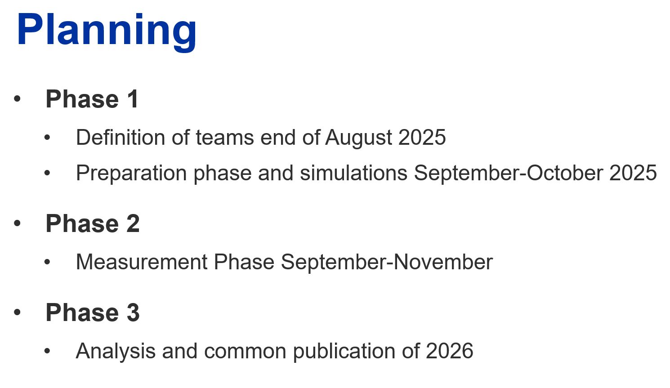
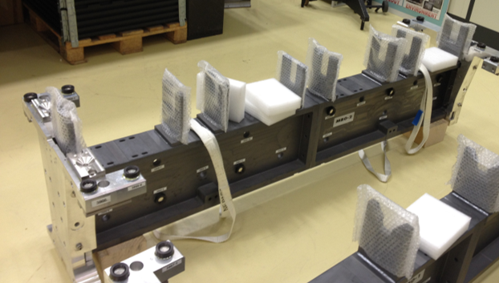
INTER LAB COMPARISON (ILC) – ESRF 2025 how it started …
The Motivation – we recognized:
  A need for a common understanding of measurement uncertainty in accelerator alignment.
  That alignment requirements are not always well defined.
  That we needed to show physicists and decision makers what we can realistically achieve.
Question: What measurement uncertainty can we achieve on a typical 2m long girder? The answer depends on:
  requirements;
  object dimensions;
  measurement conditions;
  instruments and technologies.
Our approach
  Same object. Same conditions. Same objective.
  Compare the results across laboratories.
  This gives us a first experimental benchmark to build on.

Slide 11
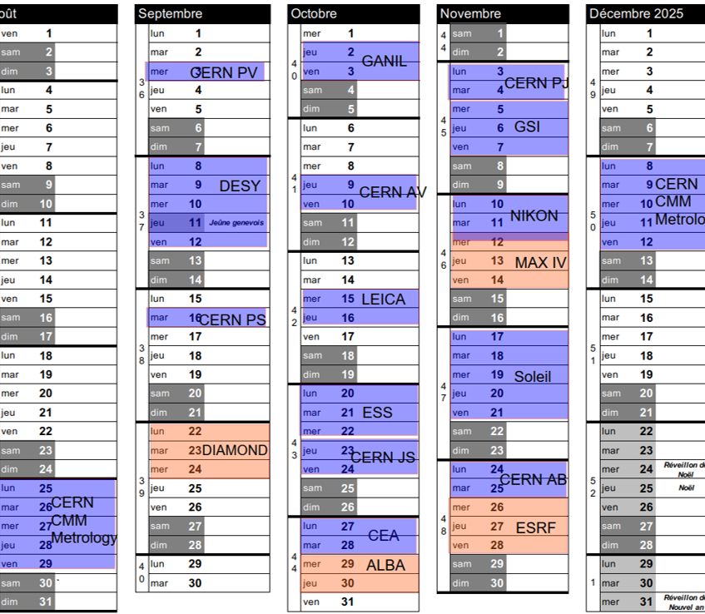
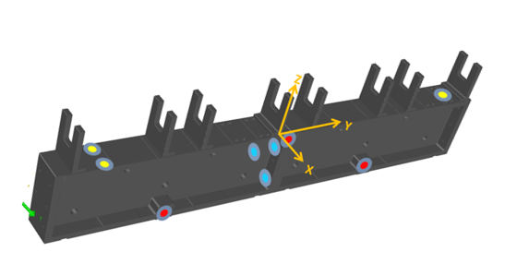
INTER LAB COMPARISON – preparation
ILC instruments
AT401, 402, 403
AT500
AT930, AT960
T-scan
T-probe
Photogrammetry V-STARS, DPA
Measurement arm Hexagon Absolute 8, Romer Arm
ATS800
Nikon Laser Radar
Faro Vantage
Participants:
  11 laboratories
  2 commercial instrument manufacturer
  20 teams
Instruments & methods:
  58 measurements
  Clearly laser tracker and Hexagon dominated
  Different measurement strategies:
    Measurement time from 1h to 8h
    2 to 8 stations
    4 to 18 additional network points
    1 and 2 face fast to precise mode.
Before the comparison, each team submitted its measurement procedure and associated measurement uncertainties for both the relative analysis and the absolute coordinates, including reference-frame realization.

Slide 12
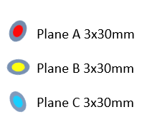
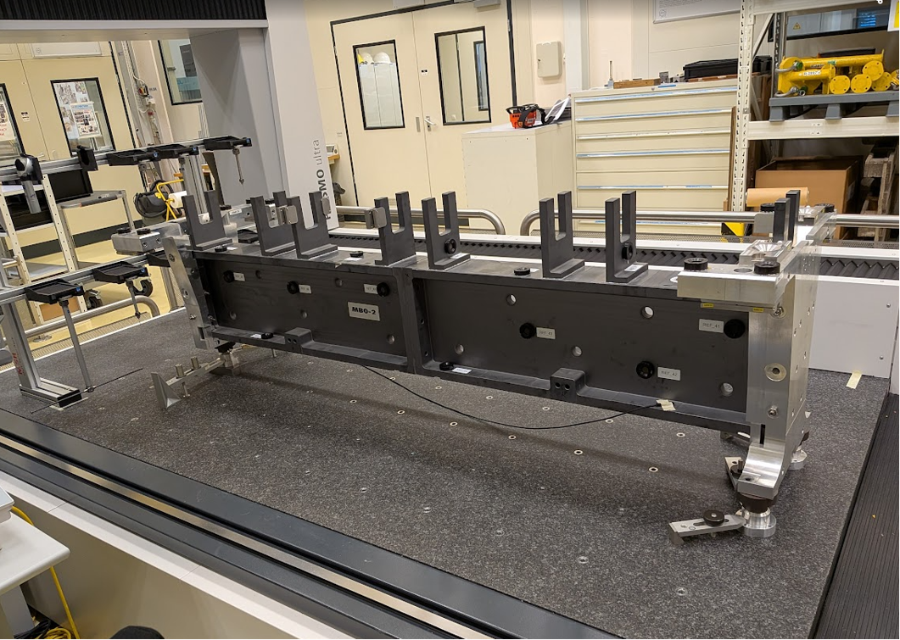
INTER LAB COMPARISON – preparation
The girder has 22 fiducial nests (1.5″) and 9 reference surfaces (30 mm diameter) defining the three planes of the reference frame.
All labs agreed on the frame definition:
  Primary axis Y: intersection of red and yellow plane
  Secondary axis: normal of the red plane (preserving perpendicularity with Y axis)
  Tertiary axis: pointing upwards forming a right-handed cartesian system
  Origin: Intersection of Y axis with blue plane
Reference measurements were performed with a 3D CMM in the CERN metrology laboratory, before and after the measurement campaign.
The girder remained fixed throughout the measurement campaign and was moved only for the CMM measurements before and after the campaign.
The measurement area was maintained at around 17°C, with temperature variations below 0.8 K.

Slide 13
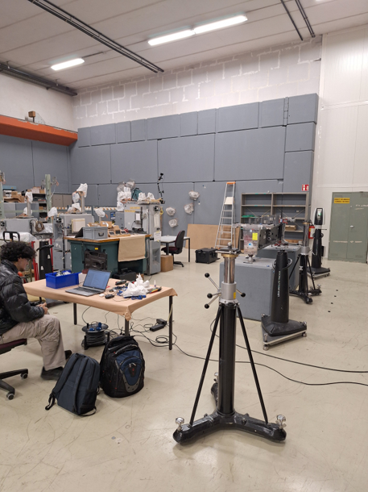
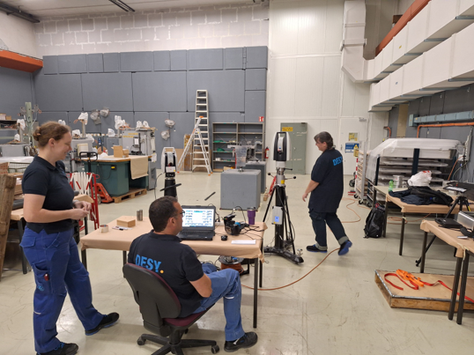
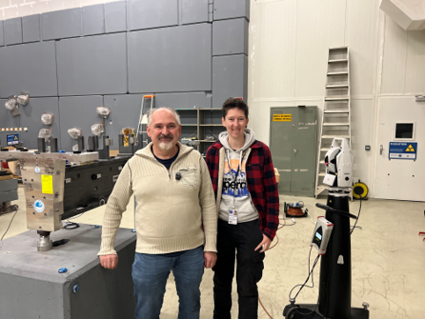
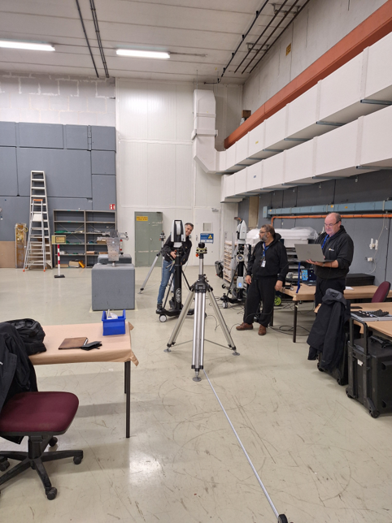
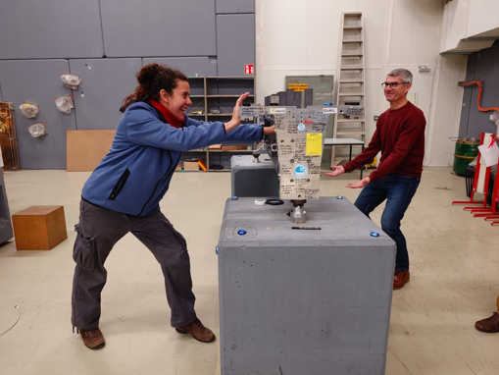
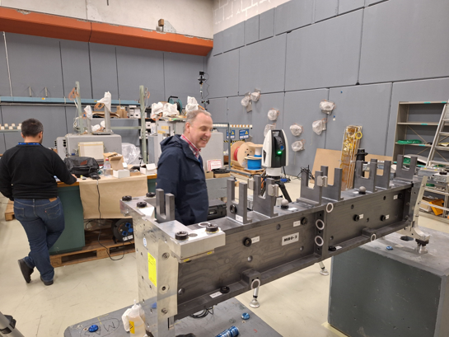
INTER LAB COMPARISON – measurement campaign (1)

Slide 14
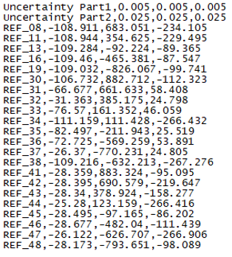
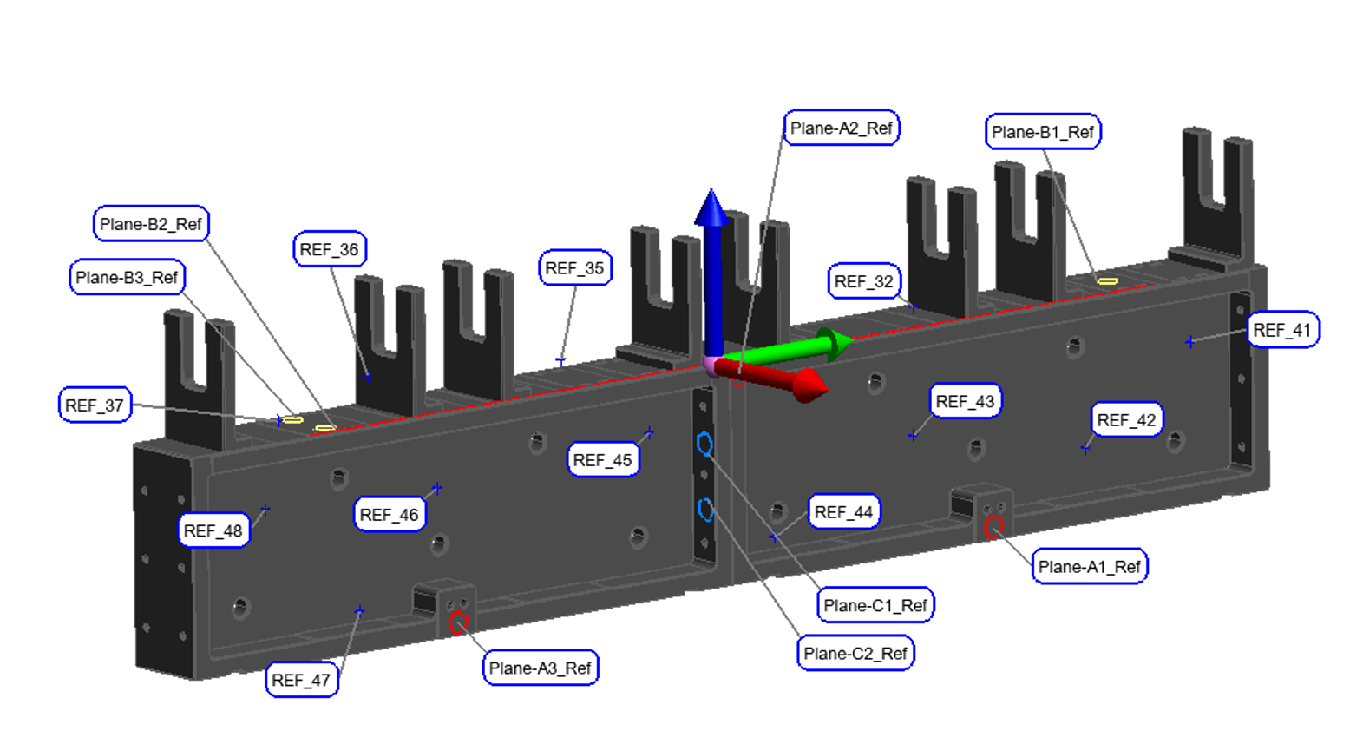
INTER LAB COMPARISON – measurement campaign (2)
All measurements were performed between September and November 2025.
Results were submitted within four weeks of measurement.
Results were reported in the prescribed coordinate frame as a comma-separated text file: ID, X, Y, Z in mm.
The analysis was performed anonymously: the analysis team received only the result files and selected metadata.

Slide 15
INTER LAB COMPARISON - analysis
Preliminary results
  A paper is currently in preparation for Physical Review Accelerators and Beams (PRAB). Only preliminary results can be presented here.
  A task force with four working groups was established to prepare the PRAB paper.
  The paper will consider laser-tracker measurements only.
Reference measurements
  Comparison of the two reference datasets using a Helmert transformation revealed residuals > 10 µm at two points.
  Additional reference measurements and further investigations were performed. These are presented in the poster by Bingru Yang.

Slide 16
INTER LAB COMPARISON - analysis
Relative coordinate results
  Nearly 100% of laser-tracker results were within 15 µm.
Frame coordinate results
  55% of laser-tracker measurements had errors below 30 µm in all coordinates.
  All methods achieved errors within 50–200 µm.
A-priori uncertainty estimates
  Comparison with the observed results using normalized deviations showed that none of the laboratories correctly estimated its measurement uncertainty; uncertainties were either over- or underestimated.

Slide 17
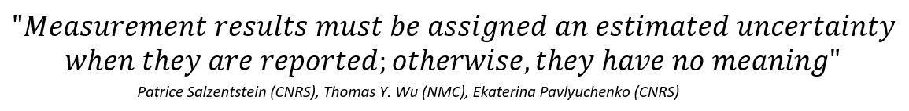
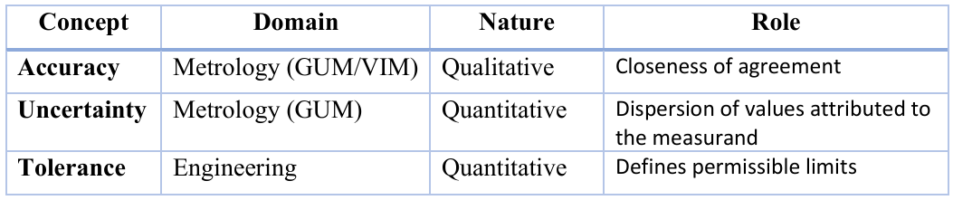
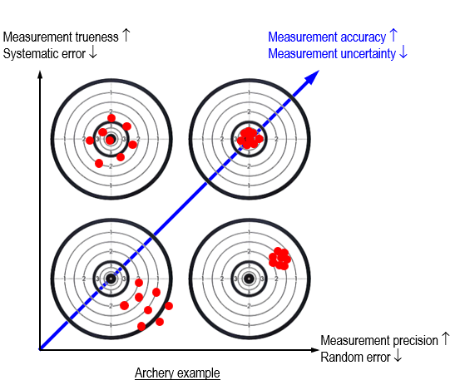
INTER LAB COMPARISON – key take aways uncertainty
Two reference documents:
JCGM 200:2012: International Vocabulary of Metrology- basic and general concepts and associated terms
JCGM 100:2008(E): Evaluation of measurement data – Guide to the expression of uncertainty in measurement
A guide to standardized terminology and uncertainty analysis is being prepared and will soon be available to the accelerator community.

Slide 18
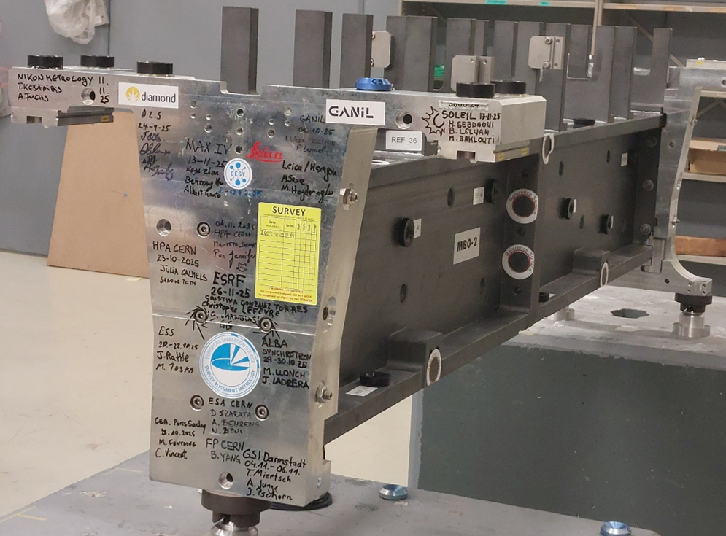
INTER LAB COMPARISON – some key take-aways
Instrument Uncertainty $≠$ Alignment Uncertainty
Replace “alignment tolerance” with “alignment requirement”.
The way alignment requirements are specified varies considerably between laboratories, making direct comparisons difficult.
Alignment uncertainty is not instrument uncertainty. The complete alignment chain may include magnetic measurements, fiducialisation, transport, opening and closing of components, mechanical positioning, tunnel alignment and smoothing, with uncertainty introduced at each stage.
Preparing a common paper across eleven laboratories is a substantial undertaking, but the work is converging. The collaboration has generated sufficient material for several papers.

Slide 19
INTER LAB COMPARISON & EUWAA – next steps
Main paper
  Pre-review by selected physicists — October 2026
  Final version and submission — November 2026Parallel papers — by the end of 2026
Parallel papers — by the end of 2026 early 2027
  Inter-laboratory comparison
  Measurement uncertainty
  Reference measurements
  …
Further analysis
  Each laboratory will receive its own datasets for comparison with the anonymized results from the other laboratories.
Joint analysis of lessons learned and best practices across all participating laboratories.

Slide 20
SUMMARY
The Inter-Laboratory Comparison went beyond the initial objective.
Initially, our main aim was to produce a peer-reviewed reference paper for the design of future accelerators, beamlines and detectors.
The comparison also revealed significant scope for improving and harmonizing best practice.
We also generated a rich dataset and supporting material that can be exploited further, including in follow-up publications.
There are still other actions in progress: on software comparison, outreach & recruitment, etc.
We still have many ideas to develop within our community, including organizing further intercomparisons (fiducialisation of magnets, measurements of other geometric artefacts, etc.), developing common testing facilities and processes, and drafting guidelines that promote unified and harmonized methodologies.
Next EUWAA meeting will be at DESY in 2027, date to be confirmed.

Slide 21
Thank you very much for your attention…

