Slide 1
Research on HALF storage ring smoothing adjustment method
Qiuyu Zhang
Oct 6th, 2026
IWAA2026, Oct 5th - 9th, 2026 | Tsukuba, Japan

Slide 2
01 Background
目 录
02 Geometric Modal Representation
03 Geometry-to-Beam Mapping and Attribution
04 Magnet Selection and Realignment
05 Conclusions

Slide 3
01
Background

Slide 4

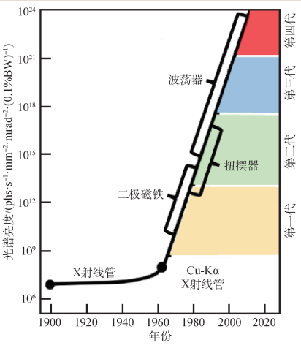
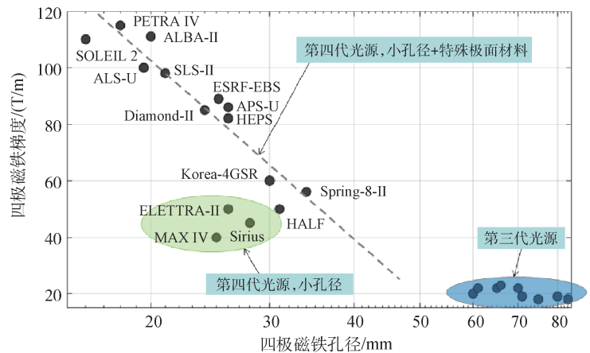
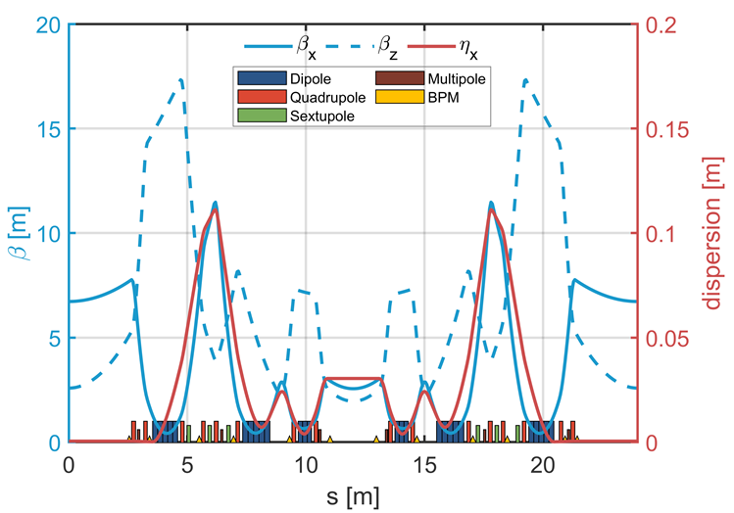
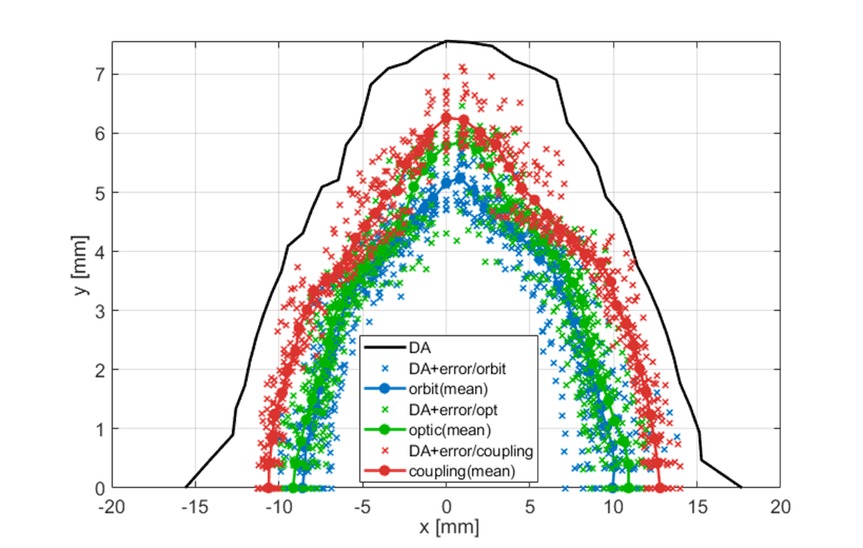
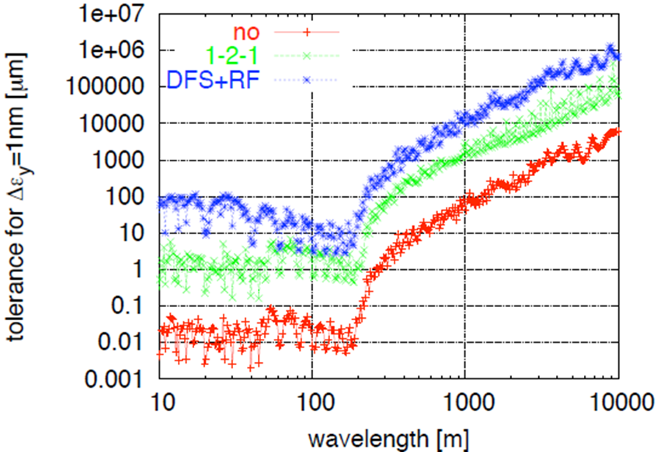
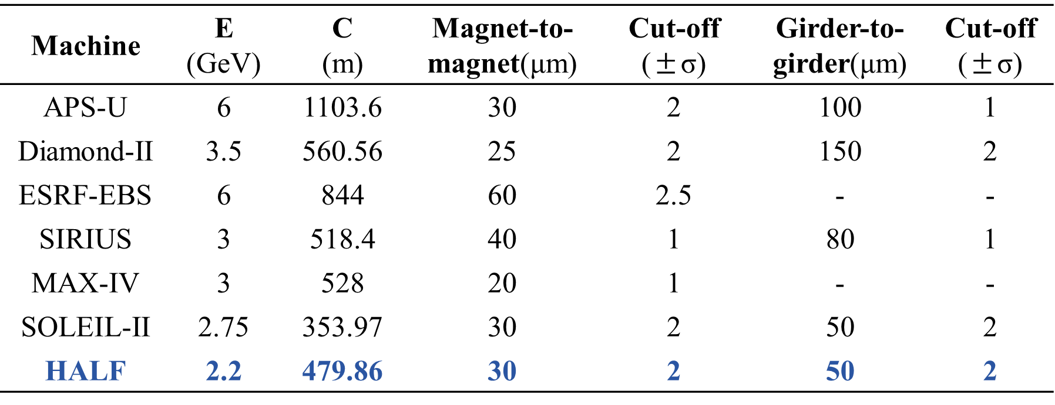
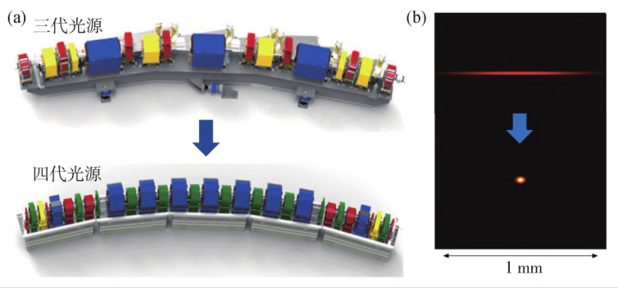
Background
Evolution of Emittance and Brightness
Orbital/Optical Effects
4

Slide 5
02
Geometric Modal Representation

Slide 6
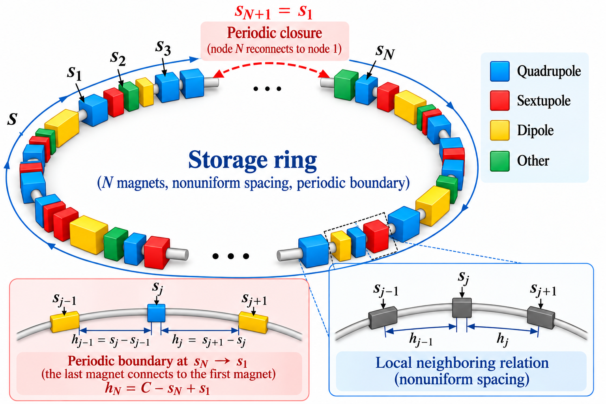
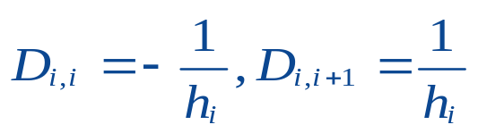



From Discrete Magnet Layout to Geometric Modes
Neighbor-to-neighbor variation
(periodic difference)
Geometric roughness operator
Generalized eigenvalue problem
M accounts for nonuniform magnet spacing
faster variation, not larger amplitude
Eigenmodes form a spatial basis ordered from global smoothness to local variation
6

Slide 7
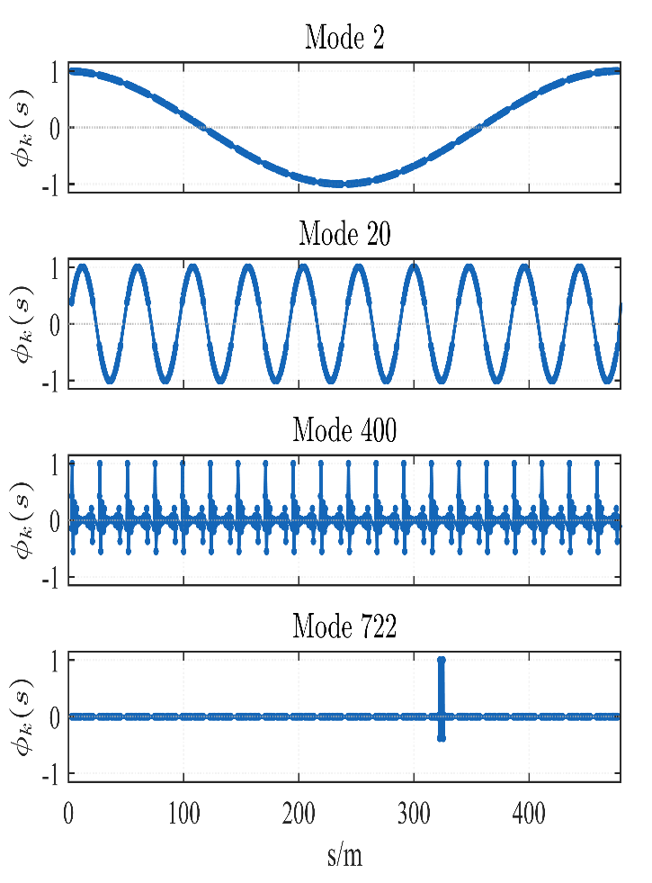
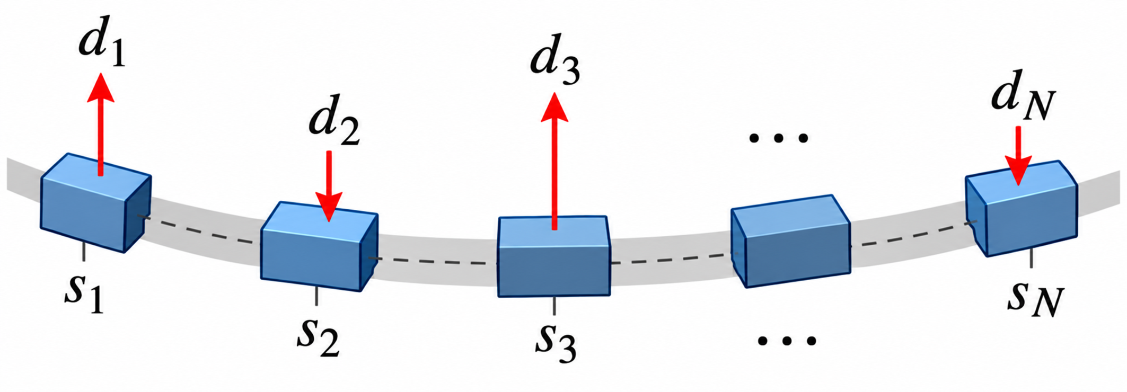
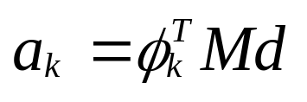

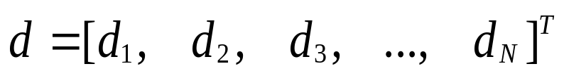
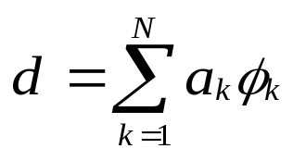
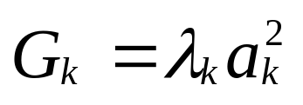
Projection of Alignment Errors onto Geometric Modes
Alignment error in physical space
Projection onto geometric modal basis
Project
(decompose)
weighted projection onto the geometric basis
M accounts for nonuniform magnet spacing
Discrete alignment deviations at magnet locations
Reconstruct:
• aₖ : excitation strength of Mode k
• λₖ : spatial variation rate of Mode k
Define:
Geometric roughness contribution
7

Slide 8
03
Geometry-to-Beam Mapping and Attribution

Slide 9
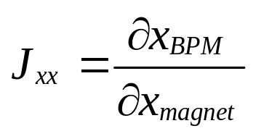
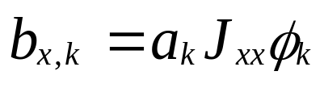
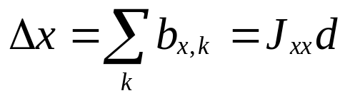
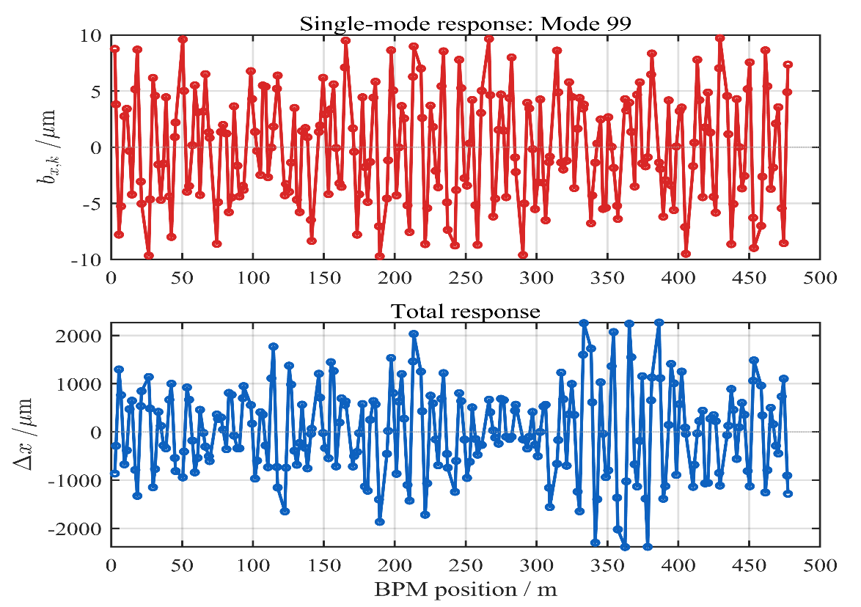
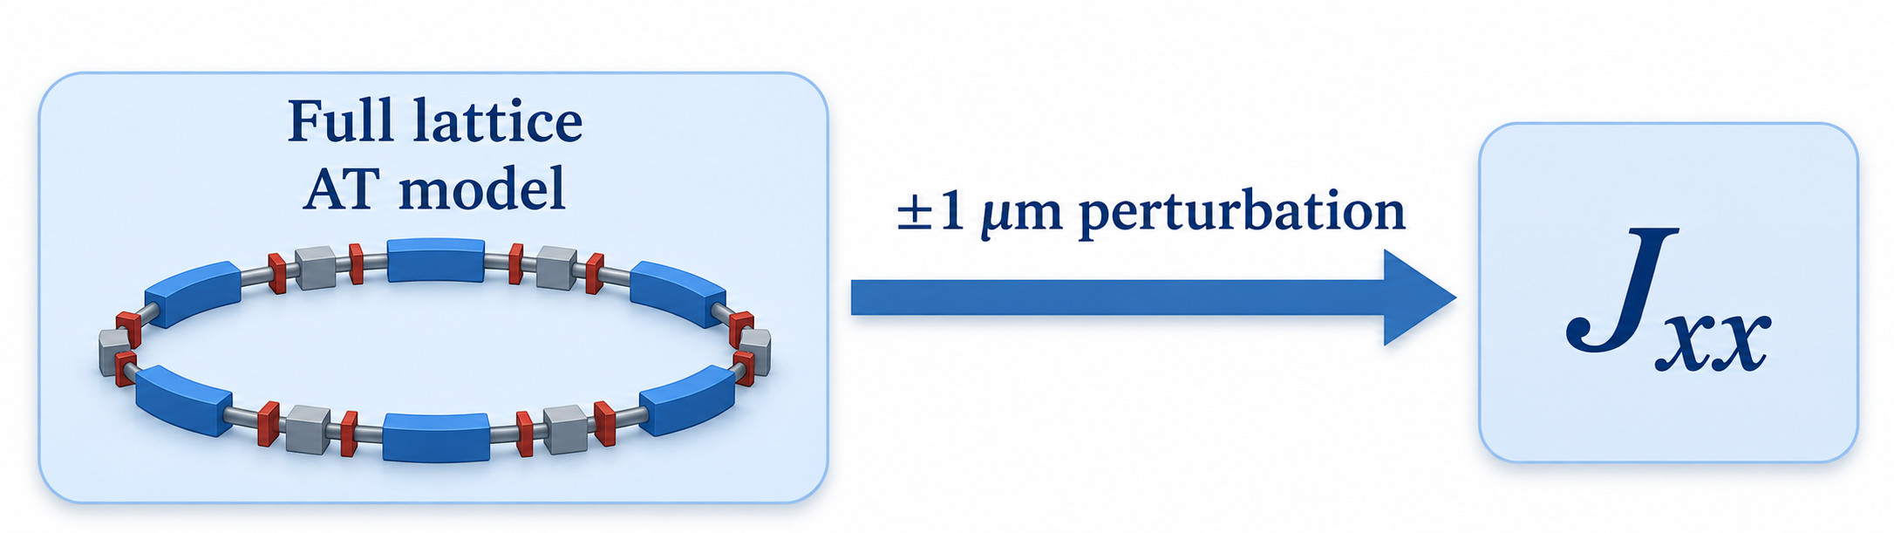


Alignment Response Operator: Bridging Geometry and Beam
Alignment response matrix
Bridge from geometry to beam
Beam space
Beam response (COD) induced by each mode
Single-mode response
Total orbit
$$x_{BPM}$$
:horizontal orbit at BPMs;
:horizontal magnet displacement
$$x_{magnet}$$
Built once from the full lattice by finite-difference perturbations(e.g. ±1 μm for each magnet).
The response matrix J is precomputed from the full lattice and then used as a fast linear mapping.
9

Slide 10
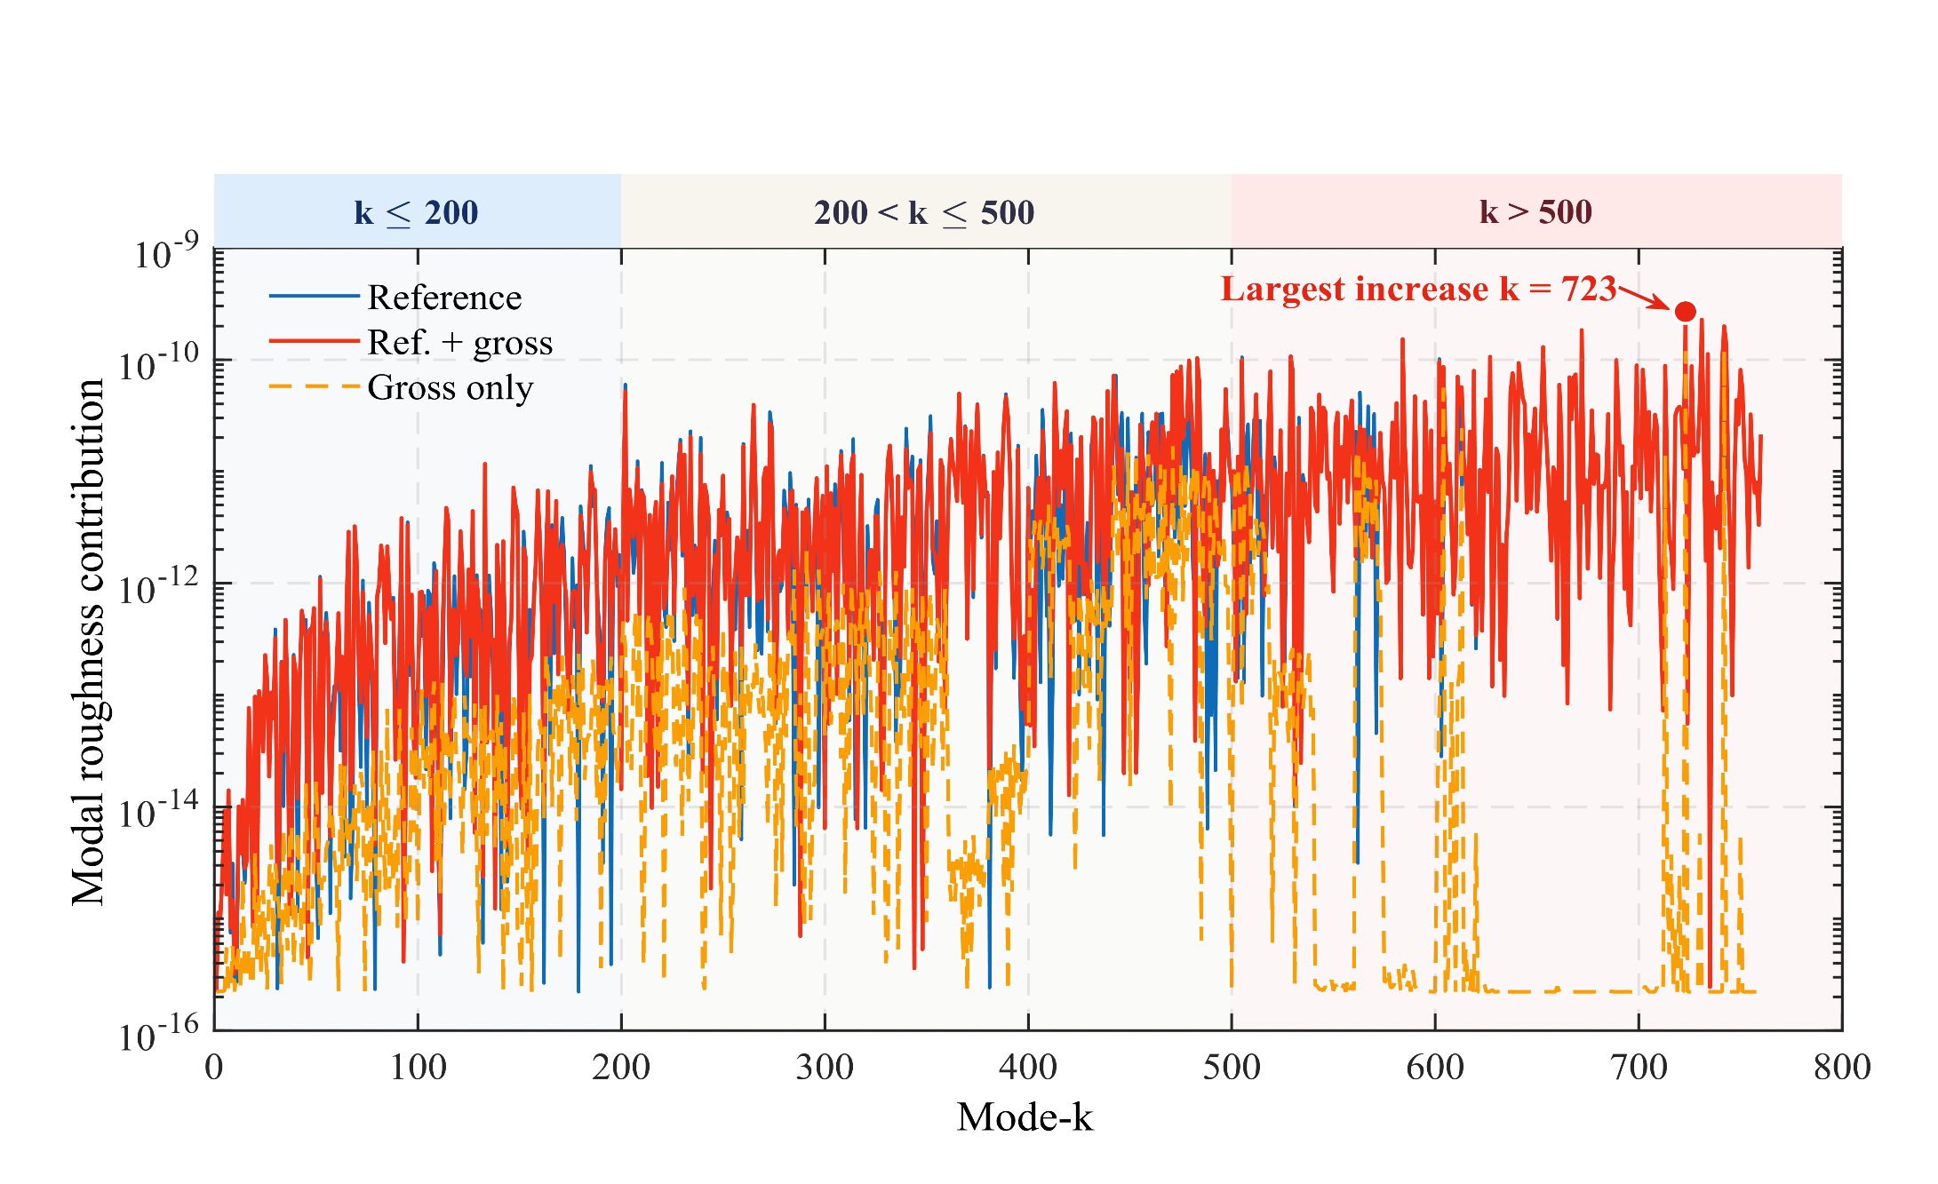
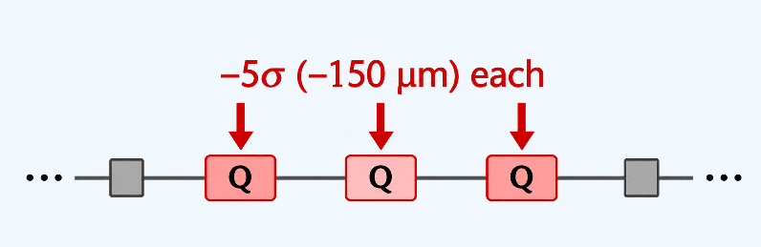


Gross-error amplification of geometric roughness
TEST CONDITION
Gross-error injection
3 Quadrupoles
x Horizontal
5σ Each magnet
150 μm Offset
Roughness metric
Spatial interpretation
Gross-error signature
Largest increase at k = 723
10

Slide 11
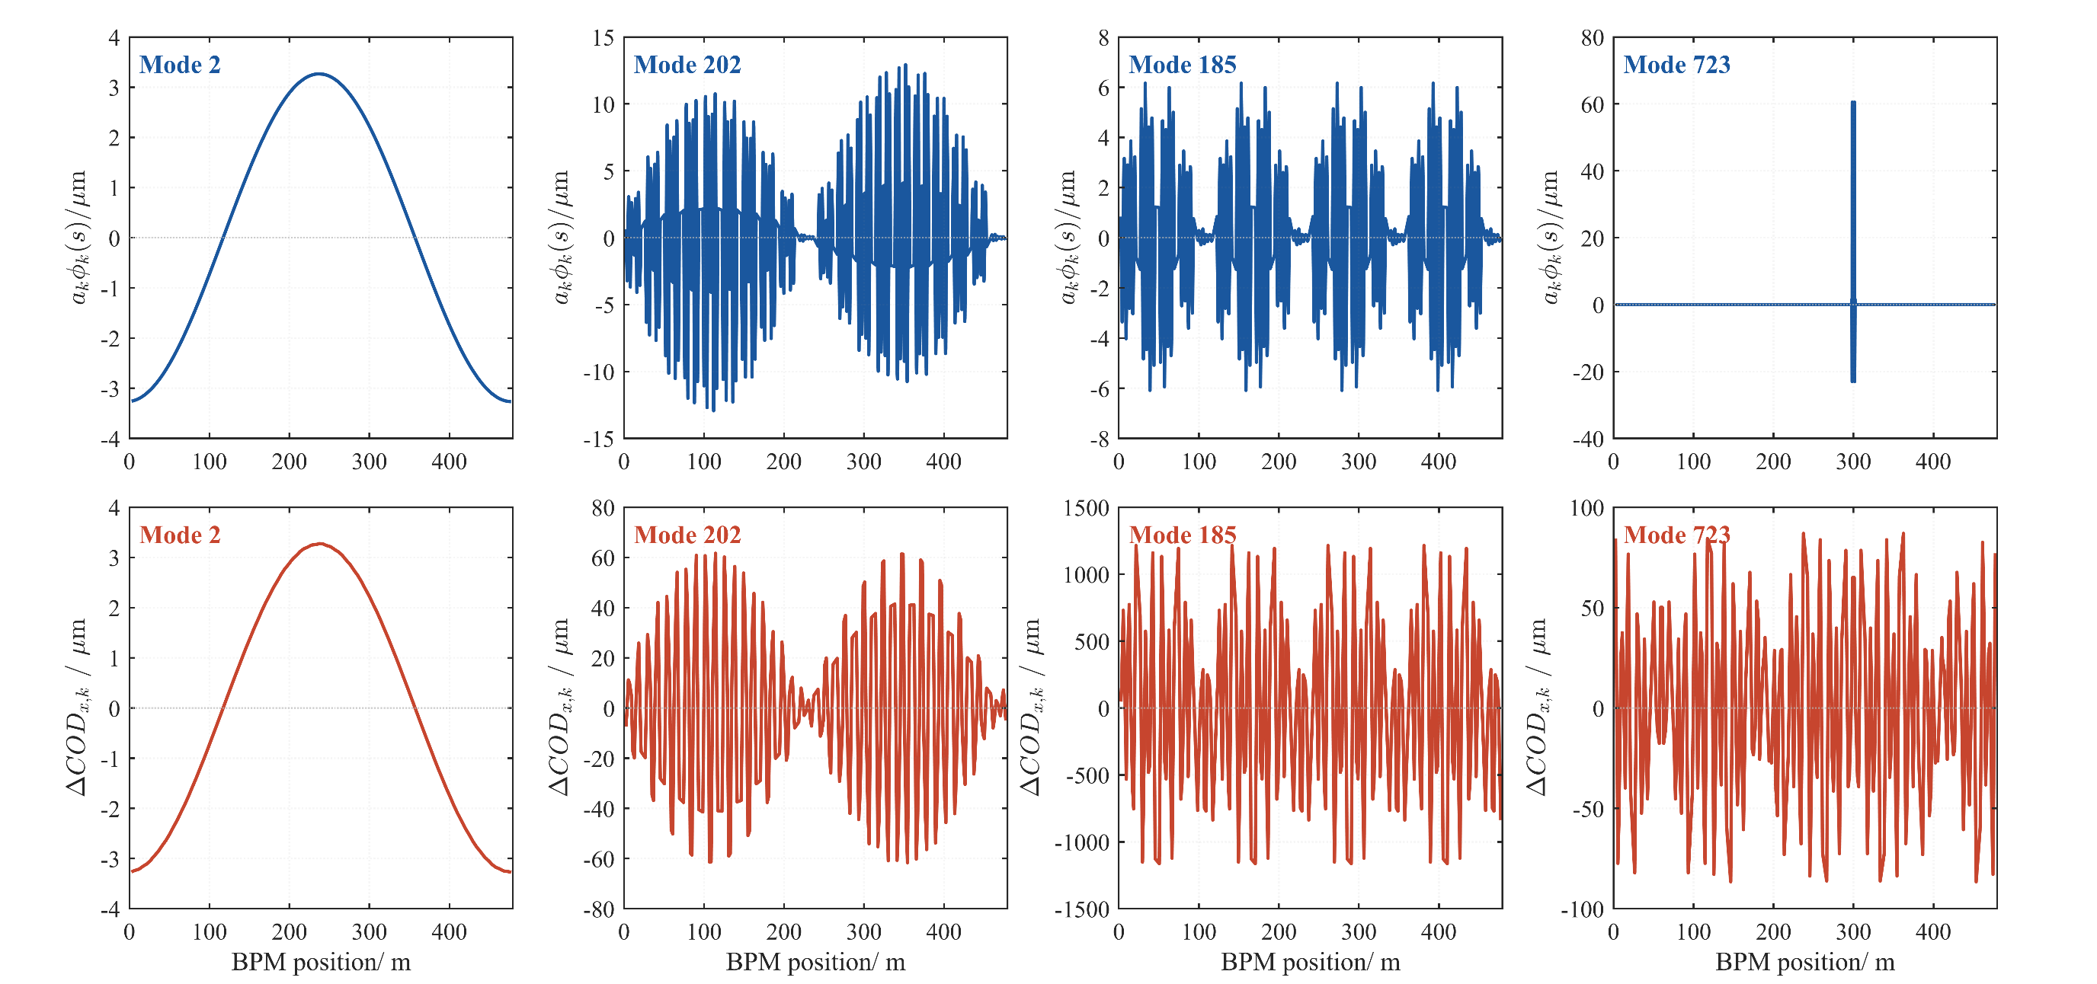
Representative geometry-to-beam modal responses
（a）
（b）
（c）
（d）
Long-wave
Large geometric amplitude
Largest beam impact
Gross-error excitation
11

Slide 12
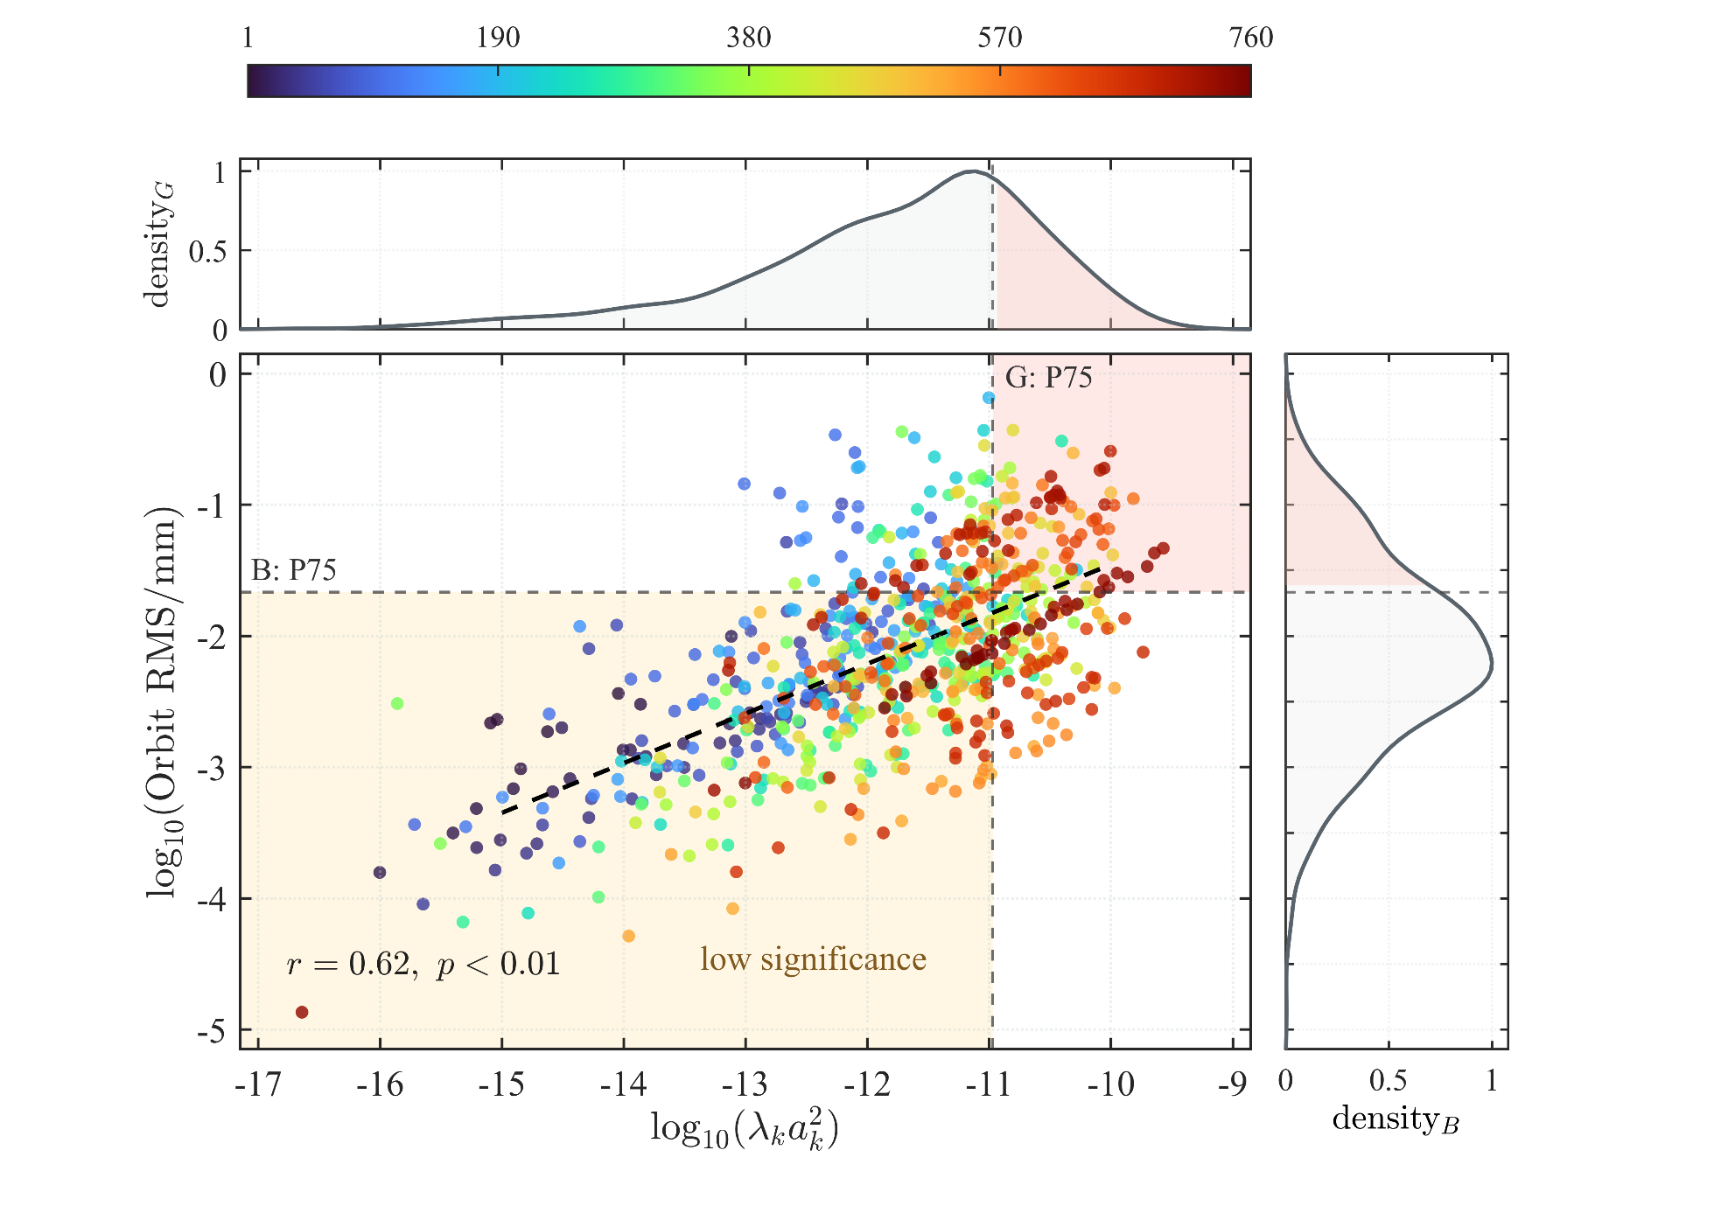
Geometry-to-Beam Mapping of Alignment Modes
Key Observations
P75 screening thresholds
G/B: P75 denote the 75th-percentile thresholds of geometric roughness and beam response, respectively.
Moderate positive correlation
Geometric roughness and beam response are significantly correlated (r=0.62, p<0.01), but with substantial scatter.
Different beam sensitivity
Modes with similar geometric roughness can produce markedly different orbit responses.
High roughness ≠ high beam impact
Some geometrically significant modes exhibit only limited beam response.
12

Slide 13
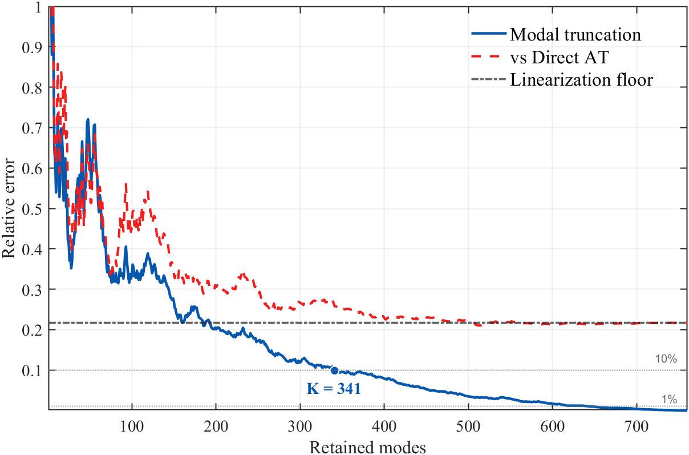
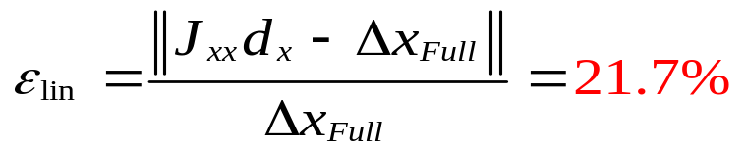
Reduced-order orbit reconstruction
341 retained modes are sufficient to reduce modal truncation to 10%
1
For the present simulated alignment case
2
The Full-AT error saturates at the 21.7% linearization floor
2
21.7% Linearization floor
(asymptotic limit of Full-AT error)
3
K=341 modes for 10% modal truncation error
Use the linear model for rapid screening and Full
AT for final validation.
3
Linear response is used for rapid screening; Full AT remains the final validation.
13

Slide 14
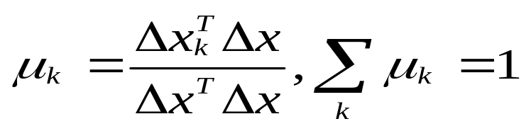
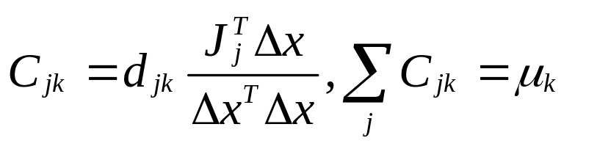
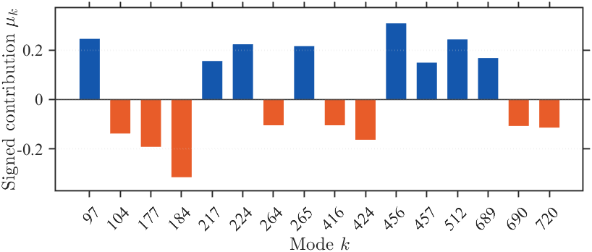
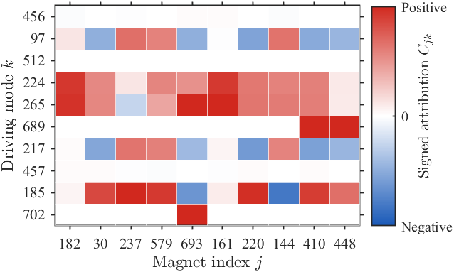

From Modal Contributions to Magnet Priorities
Signed modal beam attribution
Identify which modes drive or counteract the current orbit
Magnet-level attribution matrix
Reveal which magnets contribute to the beam-driving modes
μ_{k} >0: increase the current orbit distortion.
μ_{k} <0: counteract other modes.
$C_{jk}$:contribution of magnet j through mode k
Color: signed magnet contribution $C_{jk}$ ​
Signed attribution identifies which modes and magnets actually drive the current COD.
14

Slide 15
04
Magnet Selection and Realignment

Slide 16
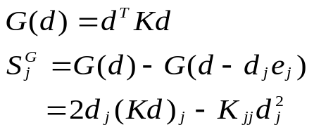
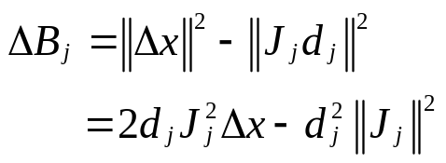
Four Magnet-Selection Strategies
Scheme A
Scheme B
Scheme C
Scheme D
Global sparse selection
Geometry-driven
Direct beam-driven
Mode-attribution driven
Existing global optimization method.
Reduce total geometric roughness
Maximize immediate COD reduction.
Trace beam-driving modes to magnets.
Two-stage MILP optimizer for solving the minimum adjustment amount
Driving modes: μₖ > 0
Sⱼᴰ = Σₖ ∈ K drive max(Cⱼₖ,0)
Use modes covering major positive μ
Accumulate positive Cⱼₖ for each magnet
Select magnets with the largest score
Select the magnet using the previous method
Used here for comparative selection
Geometry score: reduction in total roughness
Select magnets with the largest geometry score
Beam score: reduction in COD norm
Select magnets with the largest beam score
Existing method
Geometry space
Beam space
Mode → Magnet → Beam
16

Slide 17
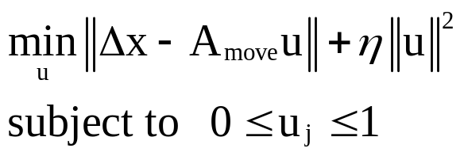
Controlled Comparison under the Same Adjustment Budget
Same adjustment budget
Same move calculation
Same evaluation framework
Each strategy adjusts the same number of magnets
All strategies use the same bounded
realignment solver.
All strategies are evaluated using the same metrics and the same lattice model.
N_{adjust} = 10
0 ≤ u_{j} ≤ 1
Linear response
Jₓₓ d
Each strategy selects exactly
10 magnets.
Selected magnets differ, move calculation is identical.
Full AT tracking
Same bounded solver for A / B / C/ D.
findorbit4
Identical mechanical selection budget.
Engineering metrics
⋯
COD RMS · Peak
Total move · Roughness
10 magnets
Only the magnet-selection principle is varied, the adjustment and evaluation procedures are kept consistent.
17

Slide 18
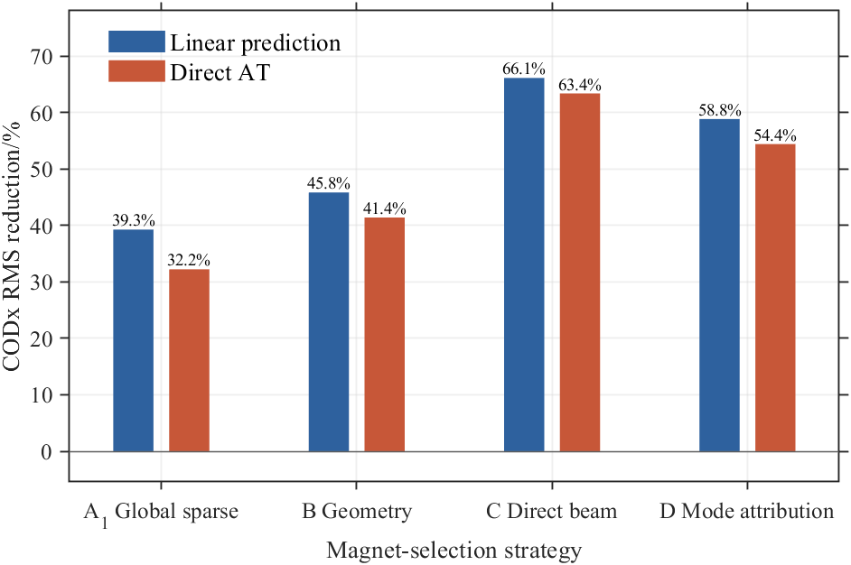
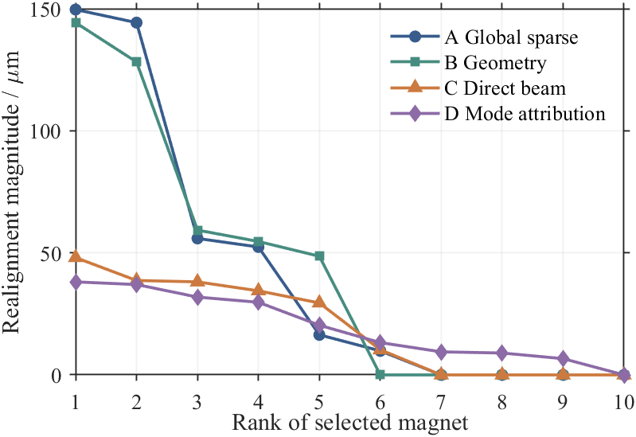
Comparative Analysis of Four Schemes
Selected magnets
COD RMS reduction
Rank | Scheme A |  | Scheme B |  | Scheme C |  | Scheme D
1 | 235 | q4 | 473 | q8 | 152 | q1 | 182 | q5
2 | 24 | q7 | 24 | q7 | 24 | q7 | 30 | q5
3 | 473 | q8 | 235 | q4 | 215 | rb1 | 237 | q5
4 | 322 | skew2 | 136 | q8 | 182 | q5 | 579 | q5
5 | 254 | lgb2 | 190 | q1 | 134 | rb2 | 693 | q5
6 | 495 | q1 | 183 | sf1 | 367 | rb1 | 161 | q5
7 | 214 | q7 | 20 | rb2 | 166 | rb1 | 220 | q5
8 | 615 | q4 | 447 | o1 | 96 | rb2 | 144 | q5
9 | 364 | q8 | 55 | q8 | 229 | q1 | 410 | q5
10 | 425 | q4 | 93 | q8 | 698 | rb1 | 448 | q5
Realignment magnitude distribution
Red entries: three injected gross-error magnets.
Schemes A and B are geometry-oriented and successfully identify the three injected gross-error magnets.
Schemes C and D are beam-oriented and deliver larger COD RMS reduction with smaller realignment magnitudes.
The schemes therefore emphasize different priorities gross-error detection versus beam-performance optimization.
18

Slide 19
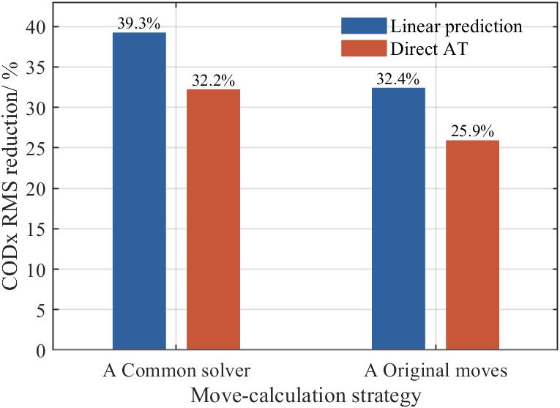

Scheme A with Two Move-Calculation Strategies
Method comparison (same Scheme-A magnet set)
A: Common solver
A: Original moves
(controlled comparison)
(smoothness + minimum move)
• Use the same 10 magnets selected by Scheme A.
• Use the same 10 magnets selected by Scheme A.
• Compute moves with the same bounded COD-minimization solver as B / C / D.
• Satisfy neighboring smoothness relation.
• Allows zero moves if a candidate does not reduce COD.
• Minimize the total prescribed adjustment amount.
Objective:
Objective:
Two-stage MILP
subject to smoothness constraints
For the same Scheme-A magnet set, COD reduction depends noticeably on
how the realignment magnitudes are calculated.
19

Slide 20
05
Conclusions

Slide 21
Conclusions
Geometry-to-beam connection
A periodic modal representation provides a scale-aware description of discrete alignment errors and enables their mapping to COD response.
Geometry ≠ beam impact
Geometrically significant modes do not necessarily produce large COD because lattice sensitivity and modal interaction also matter.
Different correction priorities
Geometry-oriented and beam-oriented selection strategies emphasize different magnets and different correction objectives.
21

Slide 22
THANKS!

