Slide 1


1
IWAA | International Workshop on Accelerator Alignment
October 5-9 2026 at KEK, Tsukuba, Japan
A hybrid ADM–IFM system
for air refractive index compensation :
Target uncertainty of 5 µm (k=1) up to 100 m
Joffray GUILLORY, Daniel TRUONG, Jean-Pierre WALLERAND
Conservatoire national des arts et métiers
Laboratoire commun de métrologie LNE-Cnam
French University
National Metrology Institute

Slide 2
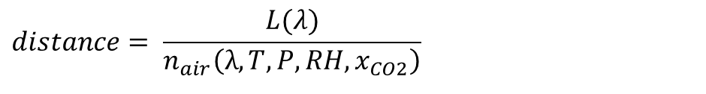
2
Principle of air refractive index compensation
  Laser trackers, Total stations: they operate at a single wavelength.
Issue: the measured distance depends strongly on the atmospheric parameters
$$distance= \frac{L(λ)}{n_{air}\left(λ,T,P,RH,x_{CO2}\right)}$$
At two wavelengths: compensation of the air refractive index with temperature and pressure
$$distance=L\left(λ_{1}\right)−\frac{n\left(λ_{1}\right)−1}{n\left(λ_{2}\right)−n\left(λ_{1}\right)}×\left(L\left(λ_{2}\right)−L\left(λ_{1}\right)\right)=\frac{K(λ_{1})L(λ_{2})−K(λ_{2})L(λ_{1})}{K(λ_{1})−K(λ_{2}) + p_{ω}\left(g(λ_{1})K(λ_{2})−g(λ_{2})K(λ_{1})\right)}$$
  Dry air
  Moist air
  partial pressure
  of water
The factor A is a constant
A = 21 for 442 nm / 1633 nm wavelengths (group index).
A = 48 for 780 nm / 1560 nm wavelengths (group index).
A = 65 for 532 nm / 1064 nm wavelengths (phase index).
Edlen
$$n−1=K\left(λ\right)×D\left(\text{T, p},x_{CO2}\right)−p_{ω}×g\left(λ\right)$$
K(λ) is the dispersion equation of the standard air
g(λ) is the dispersion equation of the water vapor

Slide 3
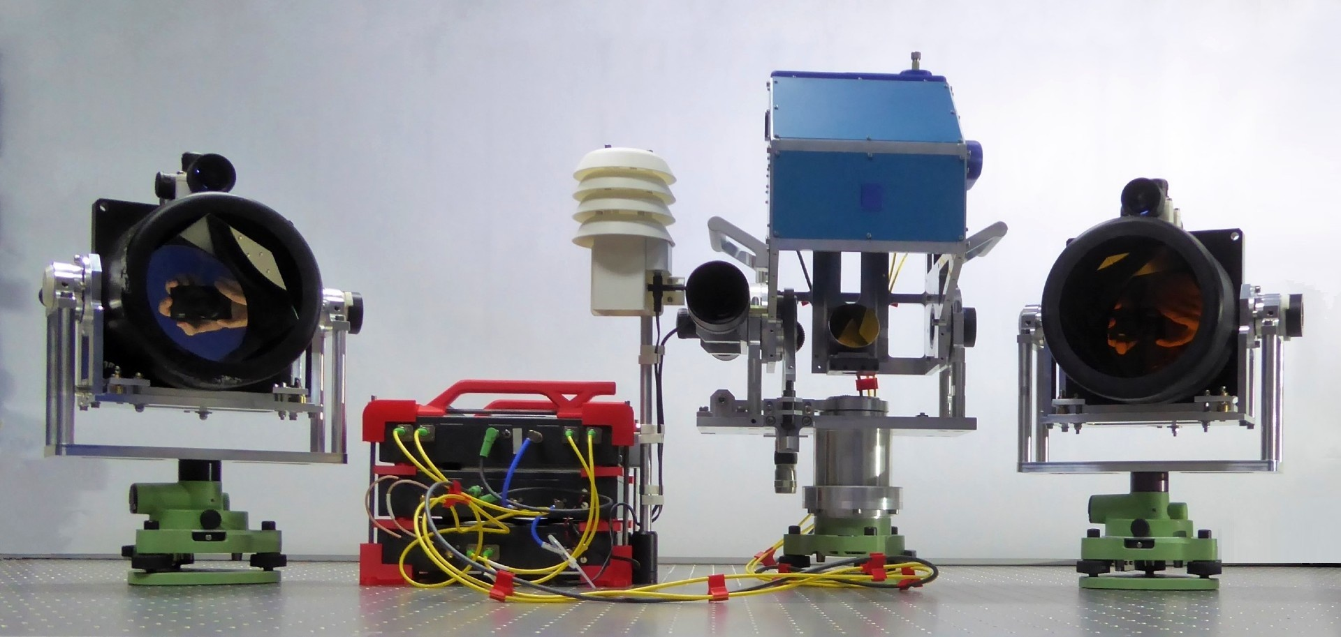
3
Arpent: a two-wavelength ADM operating at 780 nm and 1560 nm
Target, Al. hollow corner cube of 127 mm aperture
ADM and its
Weather Station
Measurement head
Target, Au. hollow corner cube of 127 mm aperture
0.4 kg
7.4 kg
10.6 kg
9.8 kg
7.4 kg

Slide 4
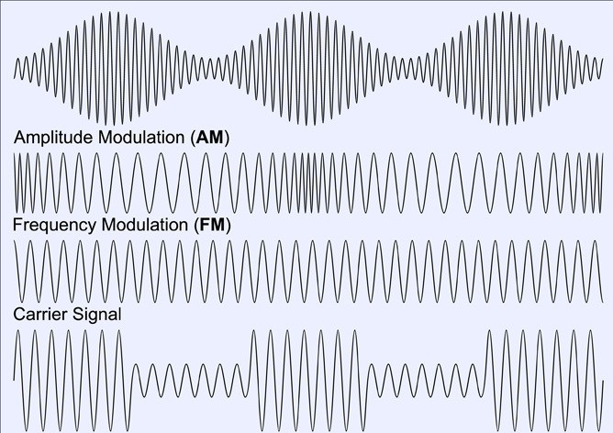
4
Arpent: a two-wavelength ADM operating at 780 nm and 1560 nm
  At each wavelength:
  The beam is emitted continuously (CW laser) and is amplitude-modulated by a radio-frequency wave at 5 GHz .
One-way
k=0
k=1
…
ADM
Target
$$A=\frac{n_{g}(λ_{1})−1}{n_{g}(λ_{2})−n_{g}\left(λ_{1}\right)}\text{≃}\text{ 48}$$
Return
φ
  The OPL is determined by measuring the phase accumulated by the radio frequency wave f_{RF} .
  This RF signal is propagated in the air by means of an optical beam of wavelength λ, i.e. at the speed of light c .
φ
$$L(λ) = \frac{1}{2}×\frac{({φ_{RF}}_{(rad)}+k⋅2π)}{2π}×\frac{c}{f_{RF}}$$

Slide 5
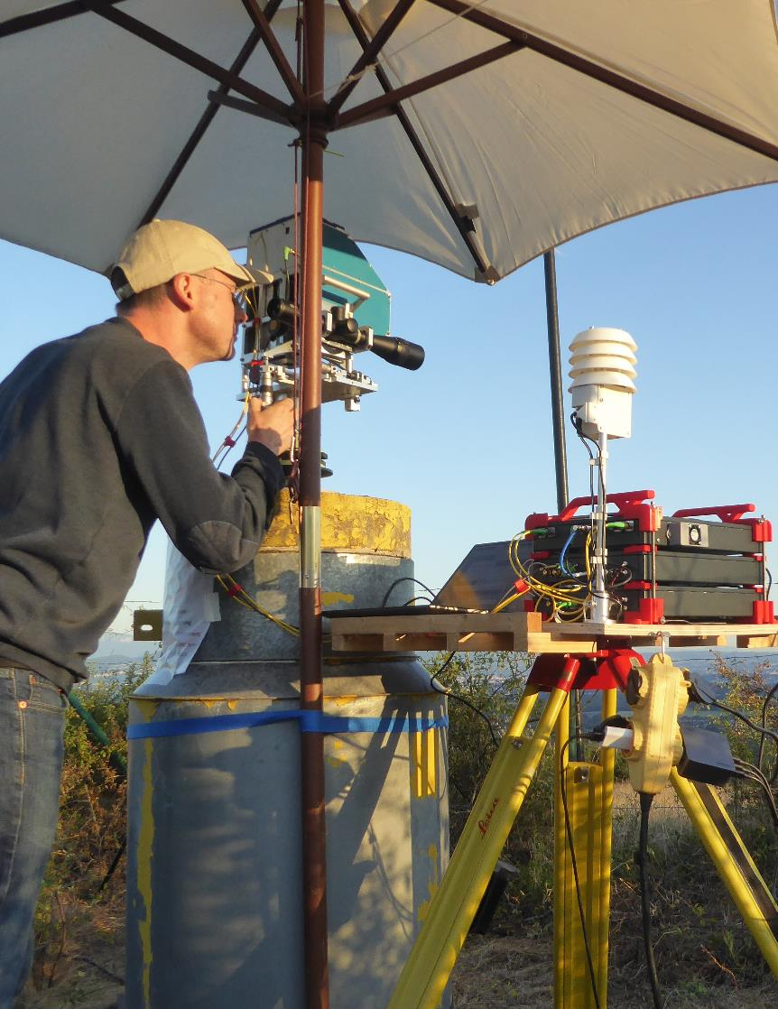
5
Conclusion from IWAA 2024 and Developments Since Then
Traceable to the International System of Units (SI) definition of the metre.
This is ensured by knowledge of the RF wave locked to a Rubidium clock.
Instrumental uncertainty between 0.3 mm and 0.7 mm (k = 1) for SNRs
from 60 dB to 50 dB. This was verified by field measurements.
Range up to 8 km.
12.3 km !
Tested on the CERN geodetic network in 2025.
Very satisfying result over kilometres,
But not good enough over short distances up to 100 m.

Slide 6
6
How to reduce the instrumental uncertainty ?

Slide 7

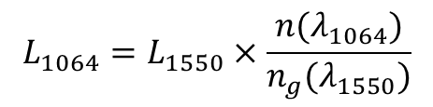
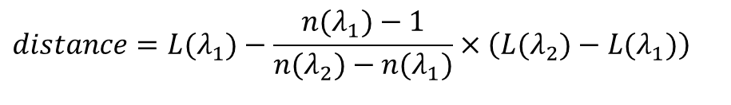


7
New approach for the air-index compensation
$$distance=L(λ_{1})−\frac{n(λ_{1})−1}{n(λ_{2})−n(λ_{1})}×\left(L(λ_{2})−L(λ_{1})\right)$$
we keep using ADM
at λ = 1.5 µm
u ~ 2 µm (k = 1)
A = 48
The physical model
(group index | 780 & 1560 nm)
difference in optical path lengths
between the two wavelengths
u = 6.7 µm (k = 1)
$$L_{1064}=L_{1550}×\frac{n(λ_{1064})}{n_{g}(λ_{1550})}$$
A = 65
(phase index | 532 & 1064 nm)
we propose to use interferometry
at 532 nm and 1064 nm
u ~ 20 nm (k = 1)
error of 10 °C ⇒ error in L₁₀₆₄ of 3 µm over 100 m
Frequency-doubled Nd:YAG laser
$$L(λ_{1})$$
fractional part
integer part
$$L(λ_{2})−L(λ_{1})$$
$$L_{1064}=\frac{λ_{1064}}{2}×\frac{φ_{1064}+2π×k_{1064}}{2π}$$
$$L_{532}−L_{1064}=\frac{λ_{532}}{2}×\frac{φ_{532}−2×φ_{1064}}{2π}+\frac{λ_{532}}{2}×\left(k_{532}−2×k_{1064}\right)$$

Slide 8
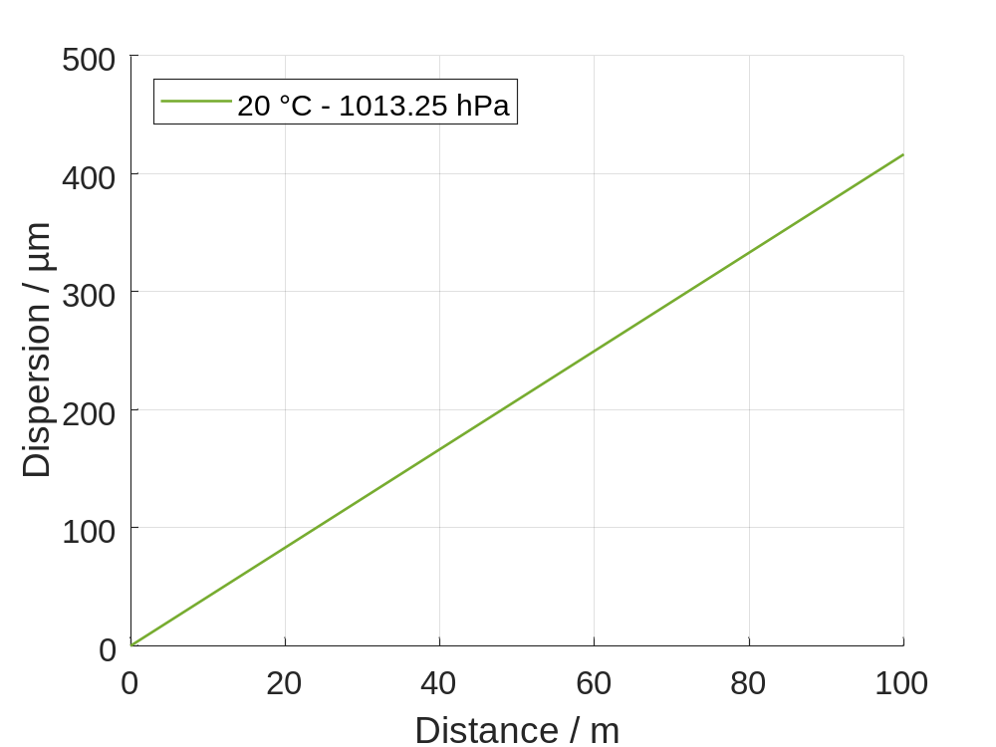
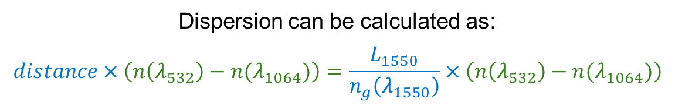


8
A hybrid ADM–IFM system… with a hard problem !
$$distance = L_{1550}×\frac{n(λ_{1064})}{n_{g}(λ_{1550})} − A×\frac{λ_{532}}{2}×\frac{φ_{532}−2×φ_{1064}}{2π} + A×\frac{λ_{532}}{2}×\left(k_{532}−2×k_{1064}\right)$$
ADM
65
IFM: fractional part
65
IFM: integer part
$L(λ_{532})−L(λ_{1064})$
The proposed approach is technically feasible
The hard problem !
Dispersion can be calculated as :
$$distance×\left(n\left(λ_{532}\right)−n(λ_{1064})\right)=\frac{L_{1550}}{n_{g}\left(λ_{1550}\right)}×\left(n\left(λ_{532}\right)−n(λ_{1064})\right)$$
4.16 µm/m
$$L(λ_{532})−L(λ_{1064})$$
Dispersion increase by 4.16 µm/m
under standard atmospheric conditions
(20 °C, 1013.25 hPa, 50%, 450 ppm)
u _{ADM} ≪ 1 mm ⇒ u _{L 532 – L 1064} ≪ 4 nm
only true if the atmospheric parameters are well known

Slide 9
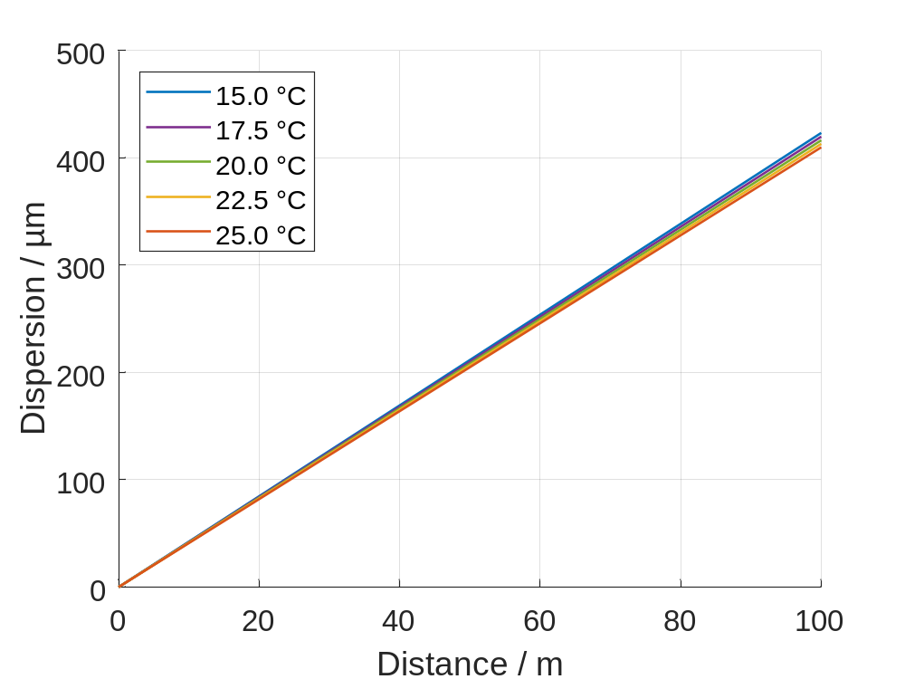

Quantification of the dispersion $L(λ_{532})−L(λ_{1064})$
9
$$distance = L_{1550}×\frac{n(λ_{1064})}{n_{g}(λ_{1550})} − A×\frac{λ_{532}}{2}×\frac{φ_{532}−2×φ_{1064}}{2π} + A×\frac{λ_{532}}{2}×\left(k_{532}−2×k_{1064}\right)$$
ADM
65
IFM: fractional part
65
IFM: integer part
$L(λ_{532})−L(λ_{1064})$
Dispersion can be calculated as :
$$distance×\left(n\left(λ_{532}\right)−n(λ_{1064})\right)=\frac{L_{1550}}{n_{g}\left(λ_{1550}\right)}×\left(n\left(λ_{532}\right)−n(λ_{1064})\right)$$
$$L(λ_{532})−L(λ_{1064})$$
Variation in the atmospheric conditions | Change in dispersion
ΔT = 1°C | 13.4 nm/m
Δp = 1 hPa | -4.1 nm/m
ΔRH = 5% | 1.3 nm/m
Δx_{CO2} = 100 ppm | 0.2 nm/m

Slide 10
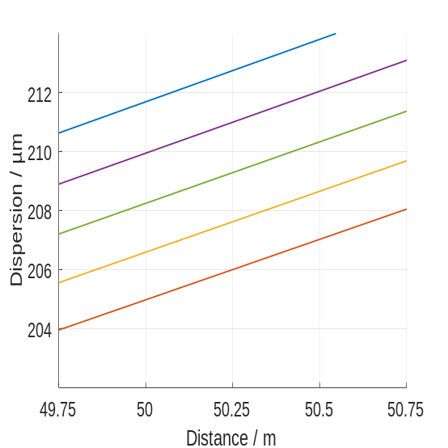
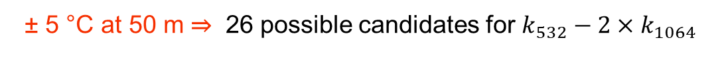
Quantification of the dispersion $L(λ_{532})−L(λ_{1064})$
10
$$distance = L_{1550}×\frac{n(λ_{1064})}{n_{g}(λ_{1550})} − A×\frac{λ_{532}}{2}×\frac{φ_{532}−2×φ_{1064}}{2π} + A×\frac{λ_{532}}{2}×\left(k_{532}−2×k_{1064}\right)$$
ADM
65
IFM: fractional part
65
IFM: integer part
$L(λ_{532})−L(λ_{1064})$
Dispersion can be calculated as :
$$distance×\left(n\left(λ_{532}\right)−n(λ_{1064})\right)=\frac{L_{1550}}{n_{g}\left(λ_{1550}\right)}×\left(n\left(λ_{532}\right)−n(λ_{1064})\right)$$
$$L(λ_{532})−L(λ_{1064})$$
± 5 °C ⇒ ± 3.4 µm
We only take the temperature T into account.
(1013.25 hPa, 50%, 450 ppm).
± 5 °C at 50 m ⇒ 26 possible candidates for $k_{532}−2×k_{1064}$
ADM Helps, but not solves the hard problem !
50 m

Slide 11
In Summary
11
$$distance = L_{1550}×\frac{n(λ_{1064})}{n_{g}(λ_{1550})} − A×\frac{λ_{532}}{2}×\frac{φ_{532}−2×φ_{1064}}{2π} + A×\frac{λ_{532}}{2}×\left(k_{532}−2×k_{1064}\right)$$
ADM
65
IFM: fractional part
65
IFM: integer part
Currently, the ADM can measure absolute distances,
while the IFM can track subsequent distance variations caused by changes in the air refractive index.
The hard problem !
We are currently implementing a third IFM wavelength to resolve the ambiguity.
Experimental setup
and
Experimental results
He-Ne laser at 633 nm

Slide 12
12
Experimental Setup

Slide 13
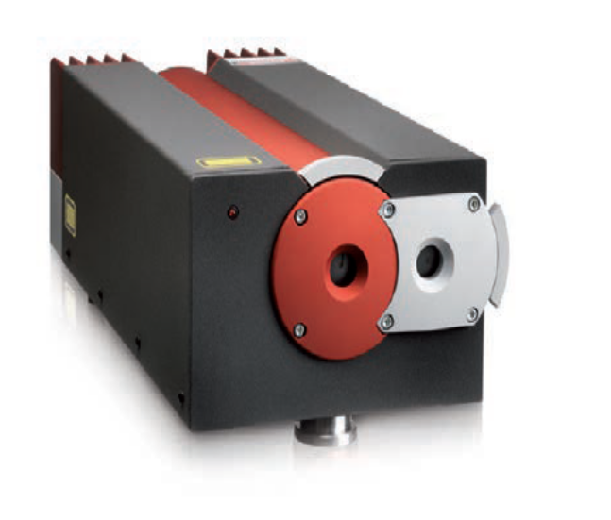
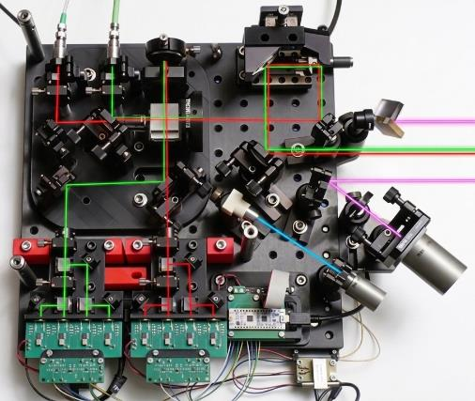
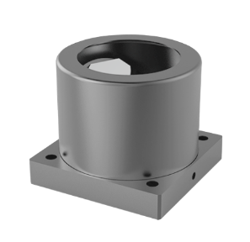



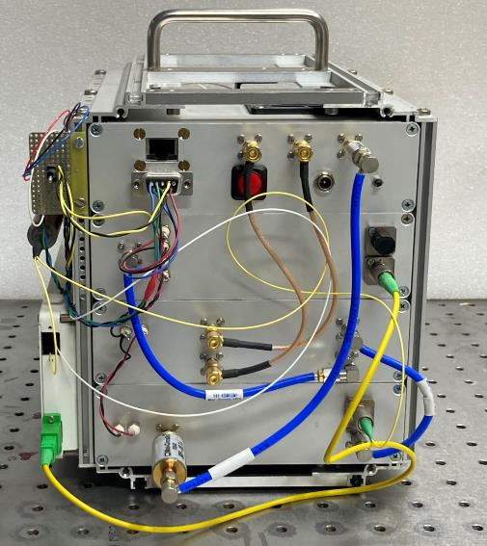
The hybrid ADM–IFM system
13
Frequency-doubled Nd:YAG laser
532 nm
1064 nm
Optical Head
Distant Target
1550 nm
The interferometric polarized beams
and the telemetric optical signal
are transmitted to an optical head by optical fibers
ADM developed in-house

Slide 14
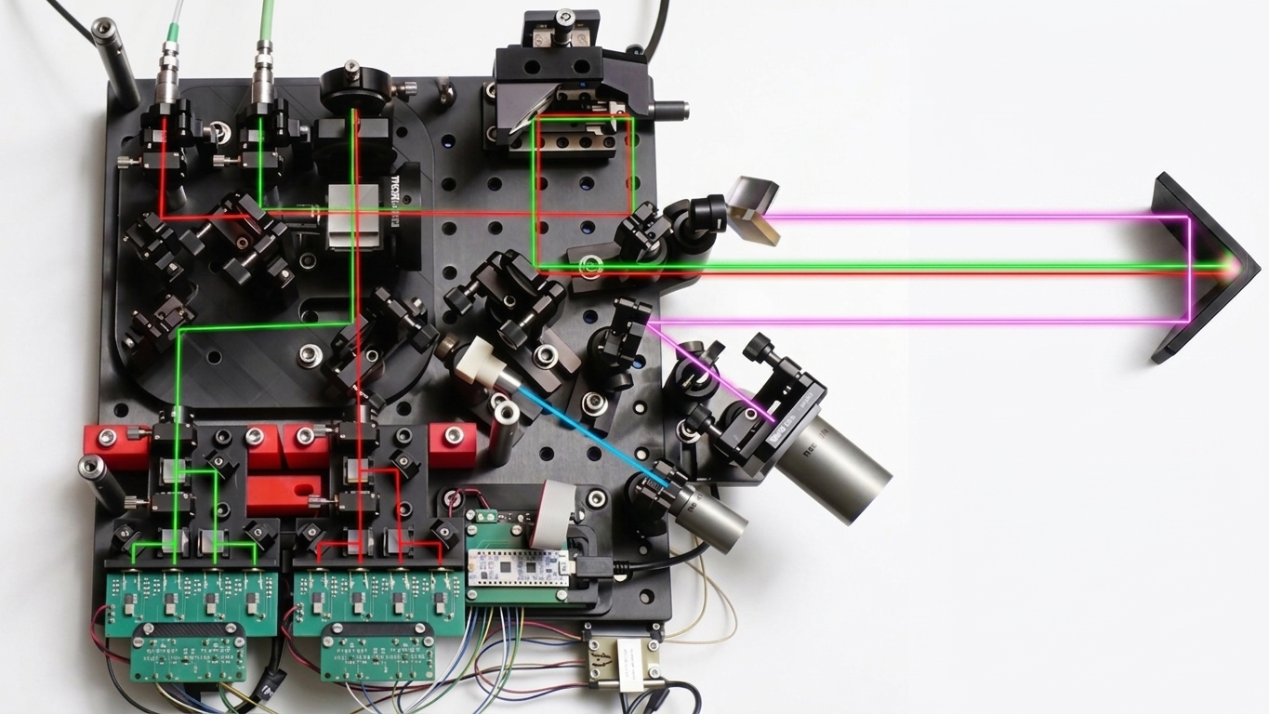
14
Focus on the optical head
IFM Ref. Target
Beam expander x5
1064 nm
532 nm
Ø 1.1 mm at 532 nm | Ø 1.4 mm at 1064 nm
λ / 4
ADM Target
Ø 5.7 mm at 532 nm | Ø 6.9 mm at 1064 nm
Double Round-Trip
Round-Trip
Dichroic Mirror
PBS
λ / 4
~ 29 mm
Dichroic Mirror
1550 nm
Distant Target
Homodyne detection in quadrature at 532 nm
Homodyne detection in quadrature at 1064 nm
Top view with corrections and a laser beams added by AI to improve readability

Slide 15
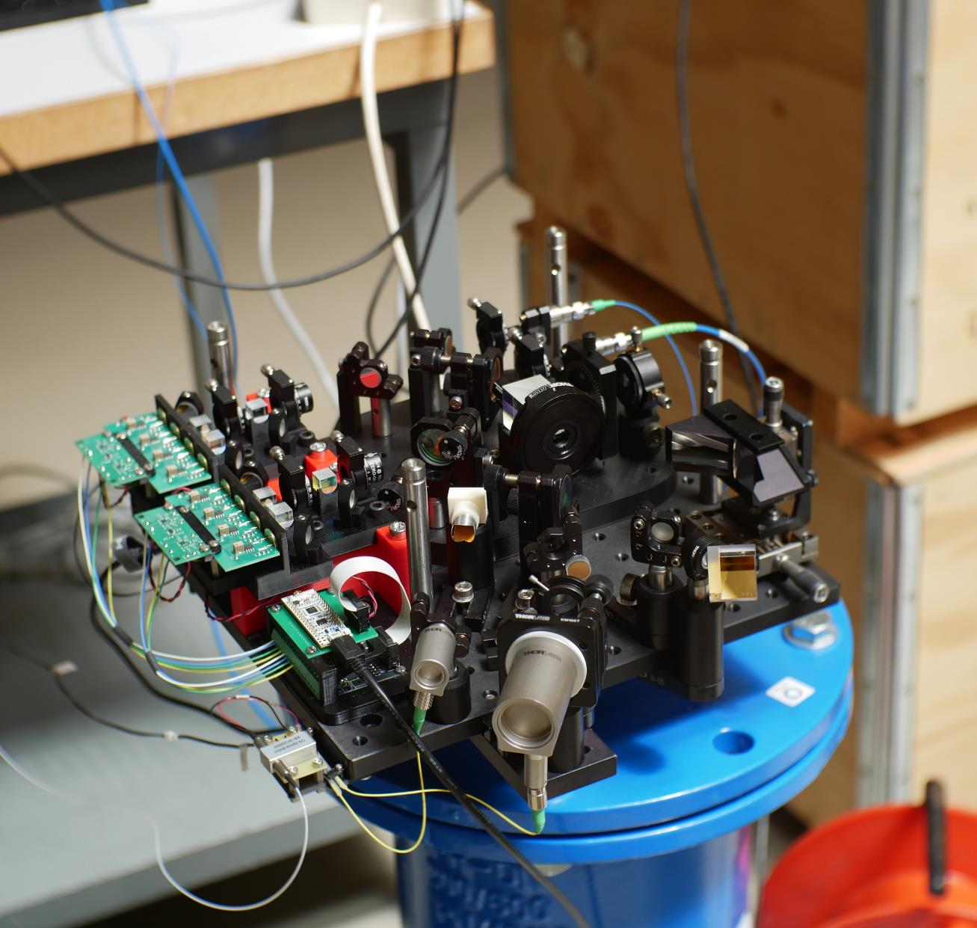
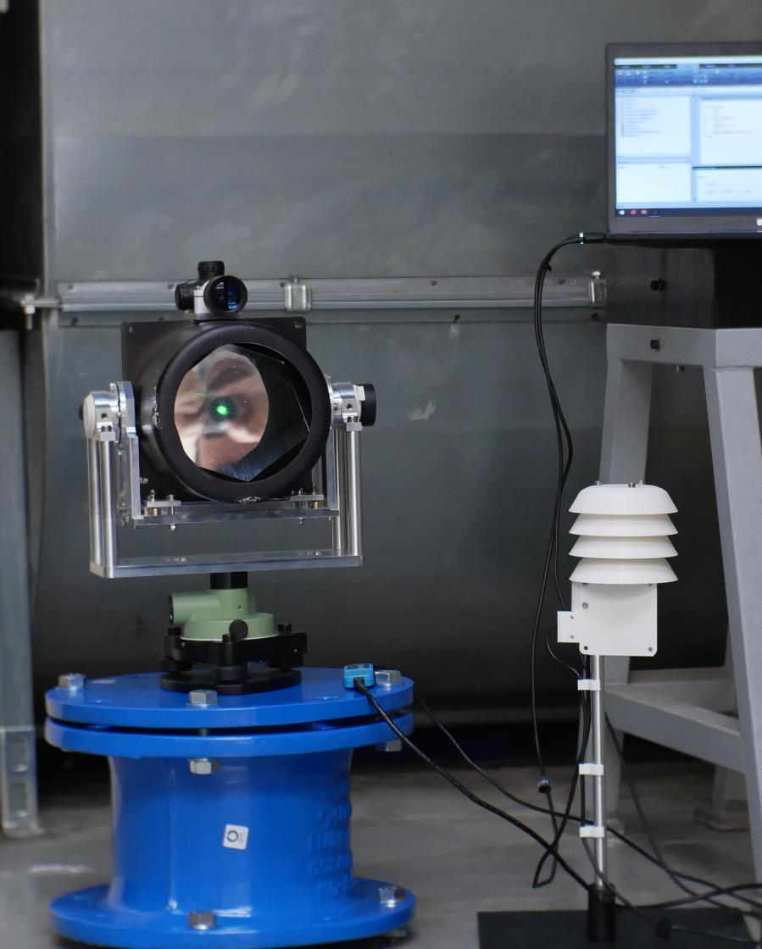
Some photographs
15
Optical Head,
35 cm × 40 cm, h = 10 cm
Target, Al. hollow corner cube of 127 mm aperture
Weather Station

Slide 16
16
Experimental Results
1. Comparison with a 3-m-long interferometric bench
2. Long-term measurement over 2 m
3. Long-term measurement over 12 m and 66 m

Slide 17
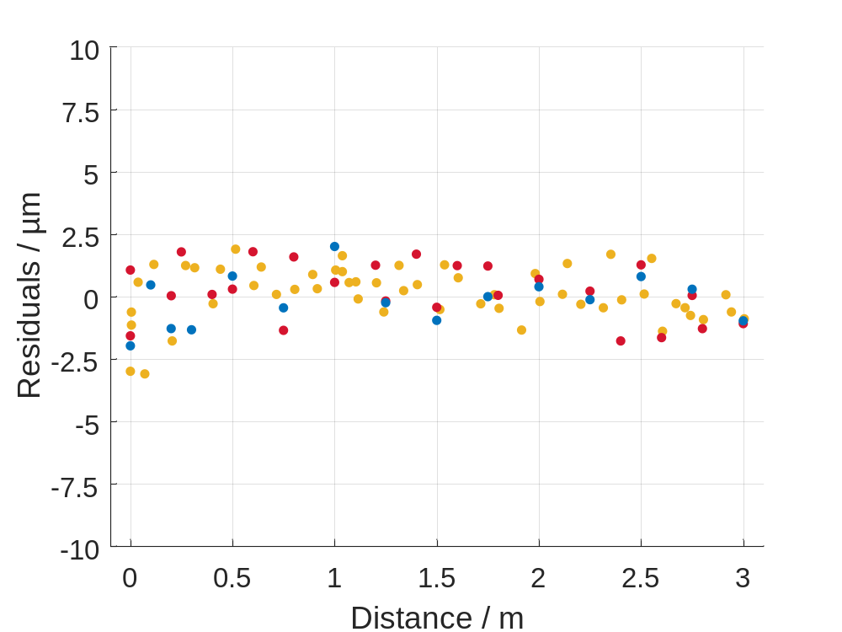
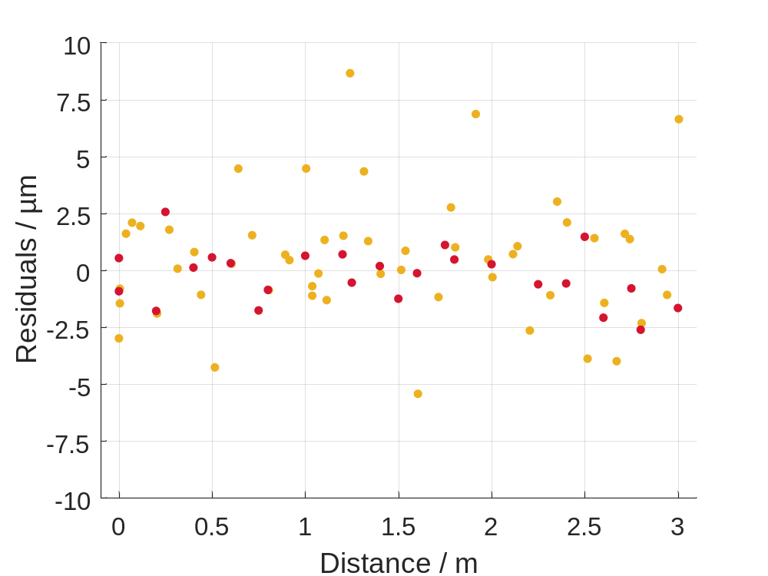
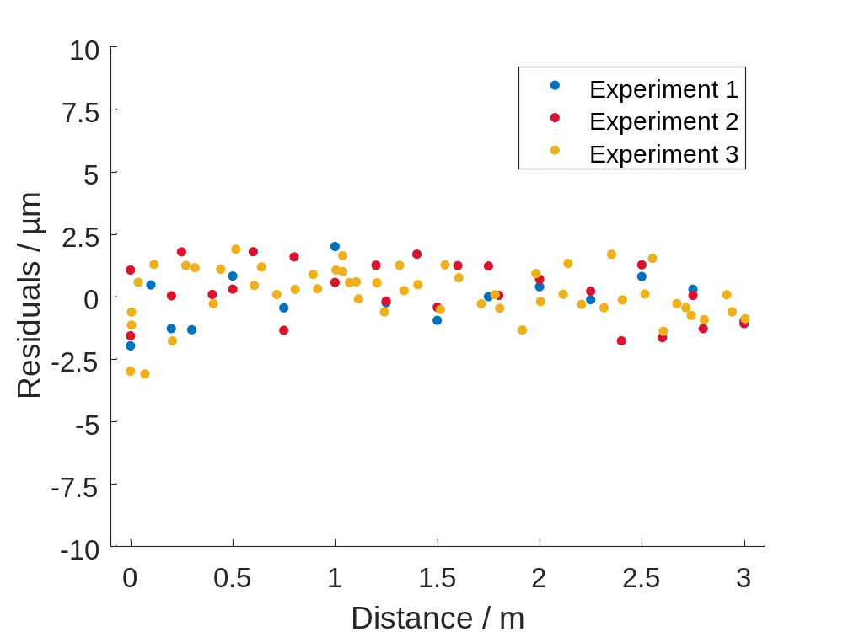
Performance of the hybrid ADM–IFM system
17
$$distance = L_{1550}×\frac{n(λ_{1064})}{n_{g}(λ_{1550})} − A×\frac{λ_{532}}{2}×\frac{φ_{532}−2×φ_{1064}}{2π} + A×\frac{λ_{532}}{2}×\left(k_{532}−2×k_{1064}\right)$$
ADM
The air-index-compensated distance
Experiment 1:
ADM measurements only
Std. Dev. = 1.0 µm, 1.2 µm and 1.1 µm
Std. Dev. = NA, 1.2 µm and 2.7 µm

Slide 18
18
Experimental Results
1. Comparison with a 3-m-long interferometric bench
2. Long-term measurement over 2 m
3. Long-term measurement over 12 m and 66 m

Slide 19
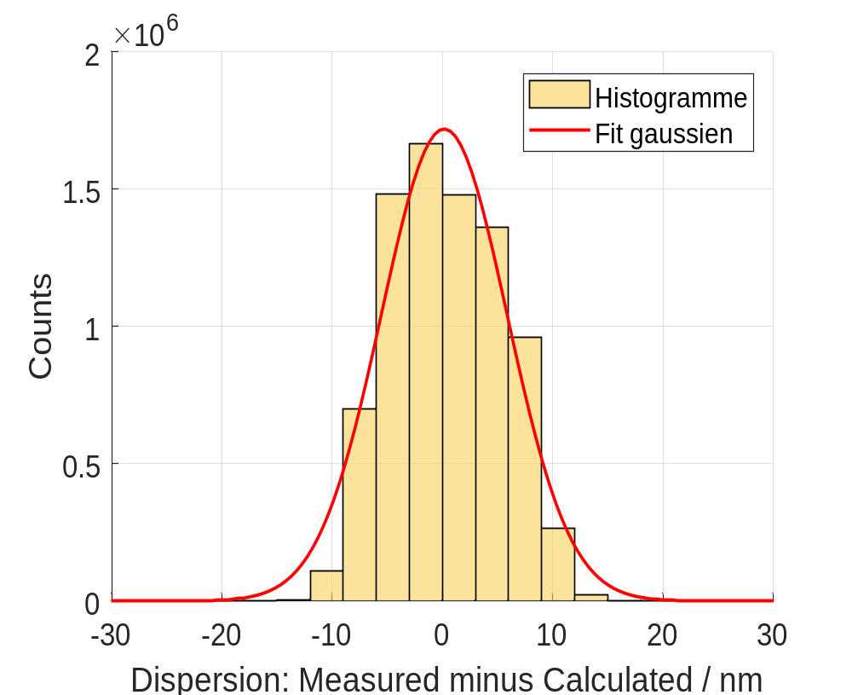
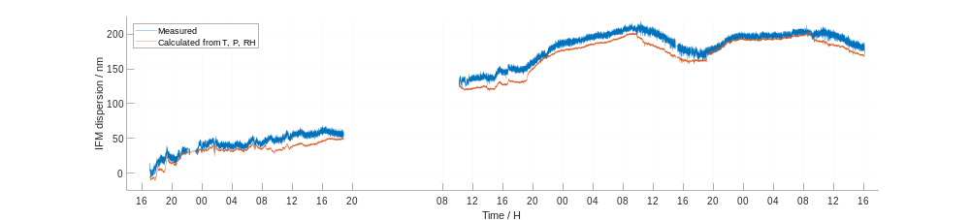

2.05 m distance measurement over 5 days: IFM
19
Setup:
The optical head and target were set up on an optical table.
A weather station was placed at the midpoint of the baseline.
T between 18.2 °C and 22.0 °C
P between 1002 hPa and 1019 hPa
RH between 47 % and 58 %
IFM Measurement:
Dispersion (fractional part) evolves as expected.
Residuals show a standard deviation of σ = 5.0 nm.
Thursday
Friday
Monday
$$L_{532}−L_{1064}$$
Tuesday
Wenesday
weekend
weather station
$$2.05 m ×\left(n_{air}\left(λ_{532},T,P,RH,x_{CO2}\right)−n_{air}\left(λ_{1064},… \right)\right)$$

Slide 20
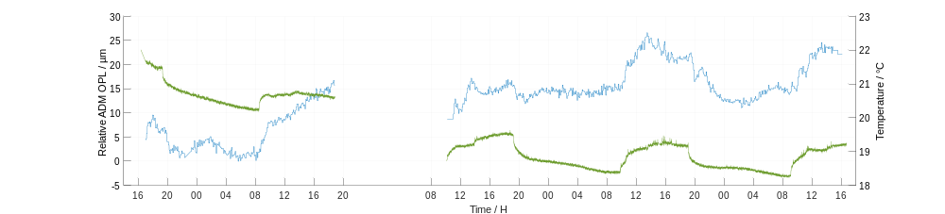
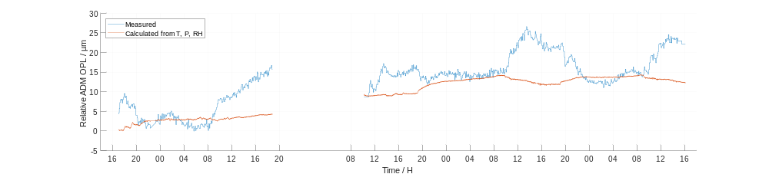



2.05 m distance measurement over 5 days: ADM
20
Expected OPL:
A fixed mechanical distance of 2.05 m,
evolving over time according to the air refractive index.
OPL Measurement:
The measured OPL evolves differently from the expected trend.
T between 18.2 °C and 22.0 °C
P between 1002 hPa and 1019 hPa
RH between 47 % and 58 %
Thermal expansion of the baseline ?
Thermally induced movement of the head or target ?
Thursday
Friday
Monday
Tuesday
Wenesday
$$L_{1550}$$
weekend
$$T_{air}$$
$$2.05 m ×n_{air}\left(λ_{1550},T,P,RH,x_{CO2}\right)$$

Slide 21
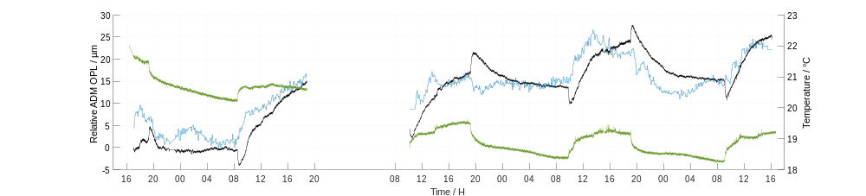
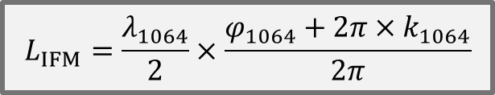
2.05 m distance measurement over 5 days: ADM
21
Expected OPL:
A fixed mechanical distance of 2.05 m,
evolving over time according to the air refractive index.
OPL Measurement:
The measured OPL evolves differently from the expected trend.
T between 18.2 °C and 22.0 °C
P between 1002 hPa and 1019 hPa
RH between 47 % and 58 %
Thermal expansion of the baseline ?
Thermally induced movement of the head or target ?
$$L_{IFM}=\frac{λ_{1064}}{2}×\frac{φ_{1064}+2π×k_{1064}}{2π}$$
Thursday
Friday
Tuesday
Wenesday
weekend

Slide 22
22
Experimental Results
1. Comparison with a 3-m-long interferometric bench
2. Long-term measurement over 2 m
3. Long-term measurement over 12 m and 66 m

Slide 23
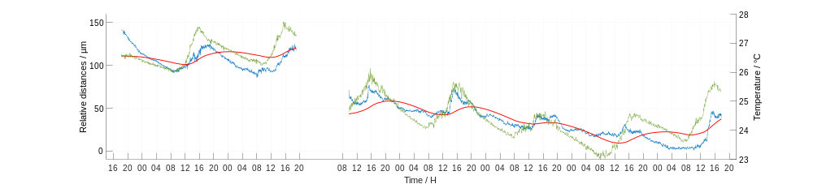

Air-index-compensated distance over 12 m and 8 days
23
Setup:
The optical head and target were set up on cast-iron pillars.
Three weather stations were distributed along the baseline.
T between 23.0 °C and 27.3 °C
P between 1006 hPa and 1022 hPa
RH between 39 % and 54 %
Wed
Thursday
Friday
Monday
Tuesday
Wenesday
Thursday
Friday
air-index-compensated distance
$$T_{air}$$
fitted model
weekend
A simple model of the thermal expansion of the concrete slab based on 3 parameters:
1. a time constant of 13 hours 45 minutes (thermal inertia of the material); 2. a thermal expansion coefficient of 2.7 µm/m/°C;
3. an offset that defines the distance of the slab at 0 °C, being ~900 µm below the initial air-index-compensated distance.

Slide 24
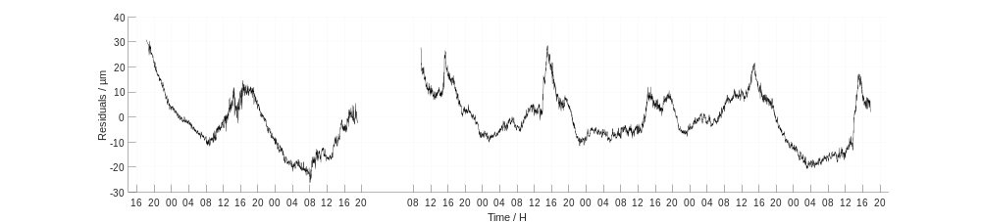
Air-index-compensated distance over 12 m and 8 days
24
The residuals after subtracting the fitted model:
distance variations between -20 µm et +30 µm
T between 23.0 °C and 27.3 °C
P between 1006 hPa and 1022 hPa
RH between 39 % and 54 %
Standard deviation of 10.4 µm
Wed
Thursday
Friday
Monday
Tuesday
Wenesday
Thursday
Friday
residuals
=
air-index-compensated distance
fitted model
weekend
The remaining variations are likely due to thermally induced movement of the optical head or the target ?

Slide 25
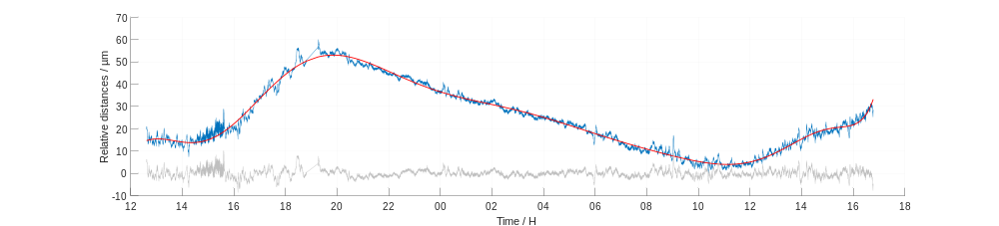
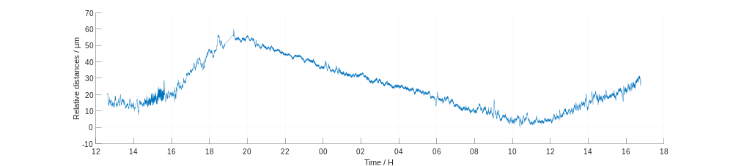
Air-index-compensated distance over 66 m and 14 hours
25
Estimation of the distance resolution over a long distance:
polynomial fit
air-index-compensated distance
residuals of 1.6 µm standard deviation

Slide 26
26
Conclusion

Slide 27





Conclusion
27
A new hybrid ADM-IFM system for air refractive index compensation
An original approach that avoids determining the absolute values of the fringe orders and ,
requiring only the difference .
The ADM, when combined with a weather station, provides a limited number of possible candidates for
Next: solve the determination of ⇒ Add a third IFM wavelength at 633 nm
Range up to 66 m experimentally tested.
Promising Results:
Short-distance measurements ⇒ uncertainty < 3 µm (k=1) for displacements up to 3 m.
Long-distance measurements ⇒ resolution < 2 µm and reliable tracking of the dispersion by IFM over several days.
Remaining Challenges:
Air-index-compensation appears effective, but distance variations due to mechanical instability / thermal expansion.
$$k_{532}$$
$$k_{1064}$$
$$k_{532}−2×k_{1064}$$
$$k_{532}−2×k_{1064}$$
$$k_{532}−2×k_{1064}$$

Slide 28
Thank you for your attention !

Slide 30
30
Bonus Slides

Slide 31
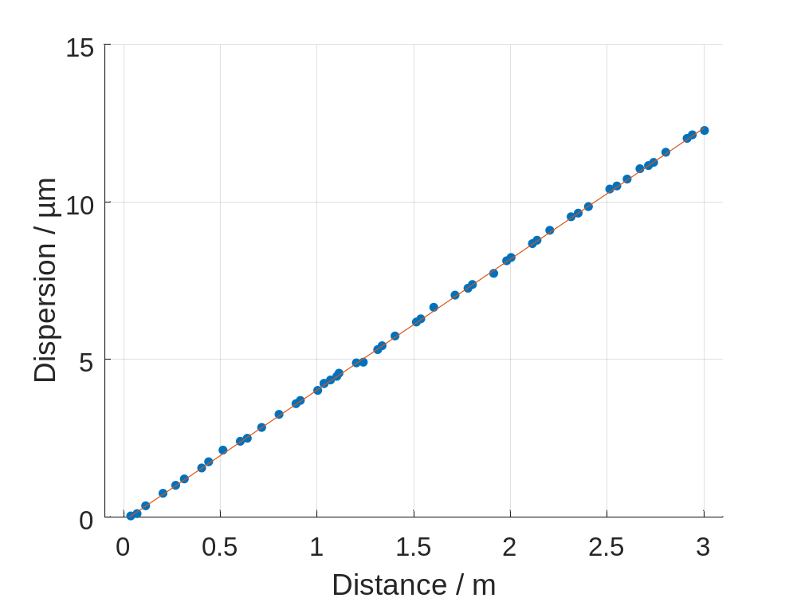
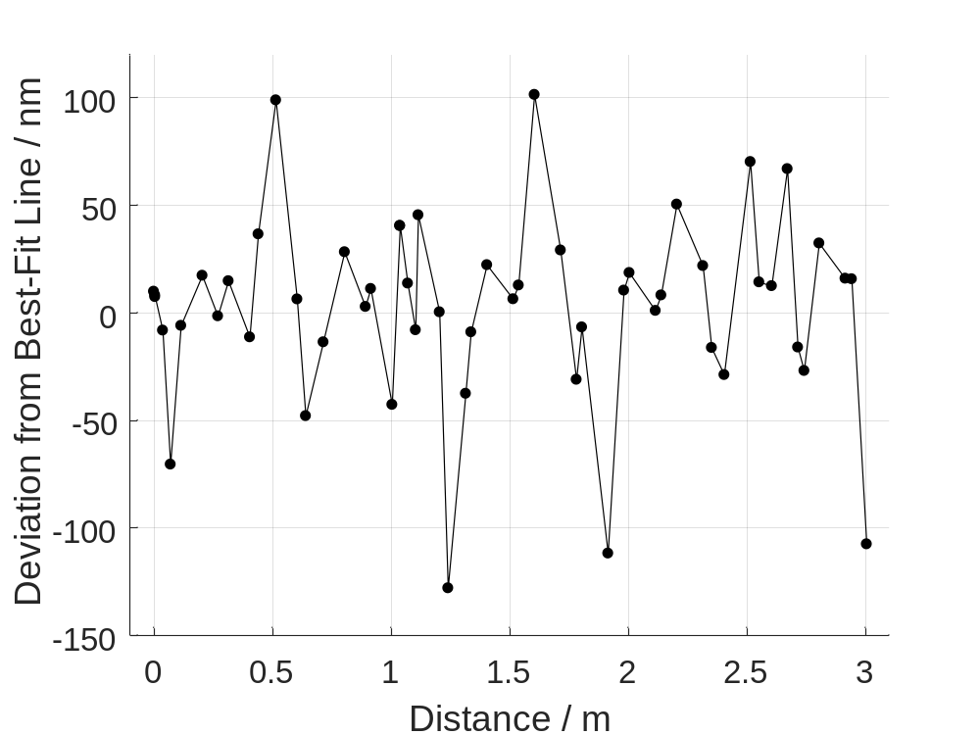
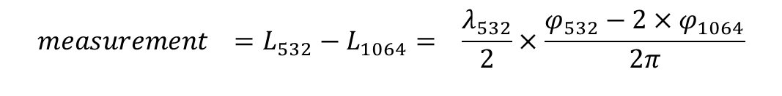
IFM performance
31
$$measurement =L_{532}−L_{1064}= \frac{λ_{532}}{2}×\frac{φ_{532}−2×φ_{1064}}{2π}$$
IFM
STD = 43 nm for all points
Slope = 4.16 µm/m
STD = 21 nm if we select only points
with IFM levels at 532 nm higher than 4x10⁶
STD = 12 nm if we select only points
with IFM levels at 532 nm higher than 6x10⁶

Slide 32
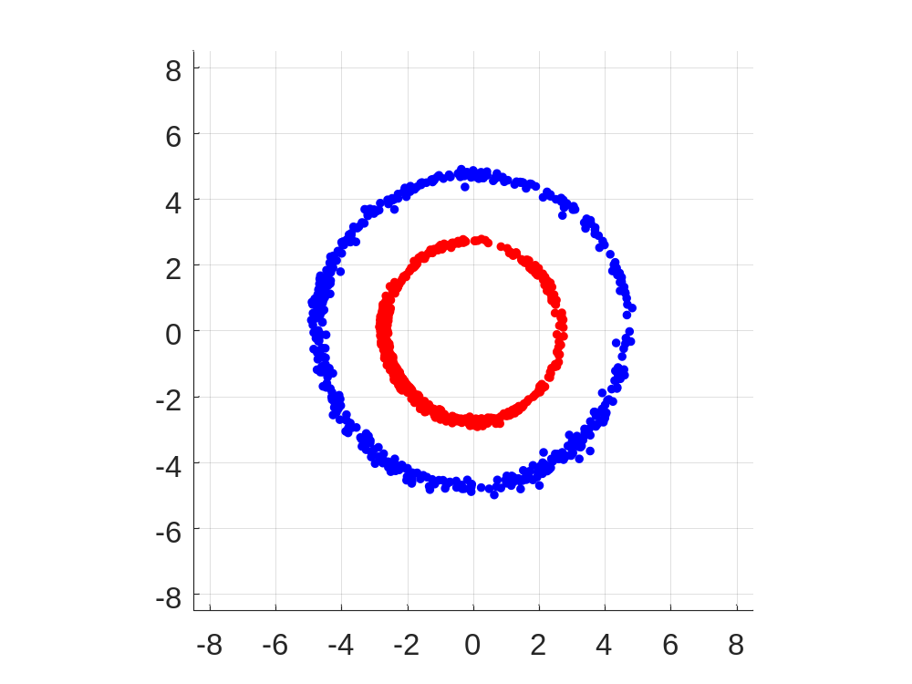
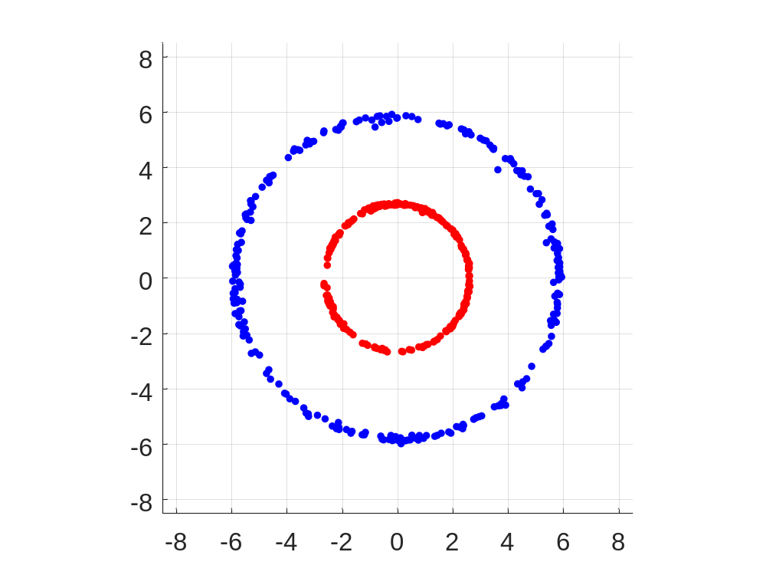



IFM: Lissajous figures
32
$$φ_{1064}$$
25.6 m
39.4 m
$$φ_{1064}$$
radius $∝P_{opt}$
The x-y plane, where each axis represents 10⁻⁶ of the ADC value from 0 to 2²³-1.
The observation time is 20 s.

Slide 33
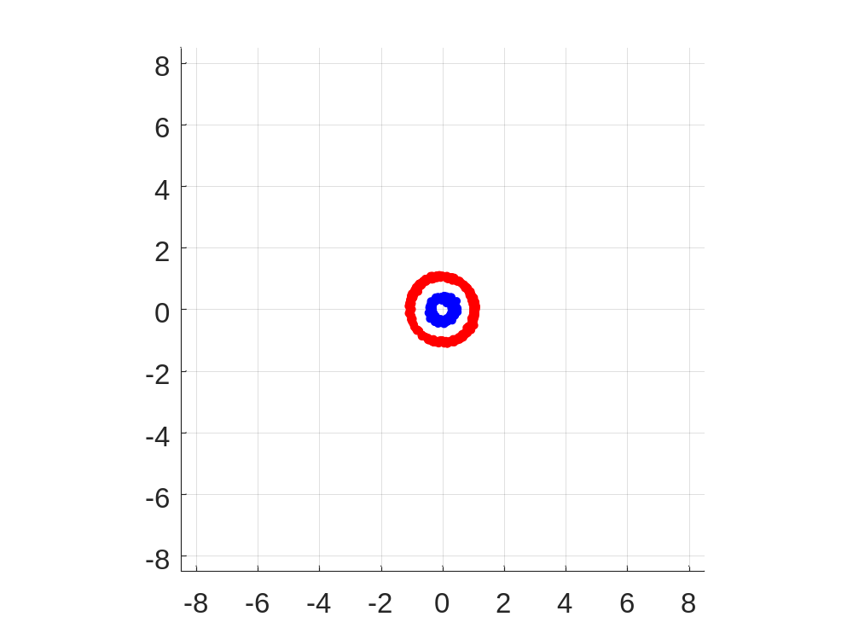
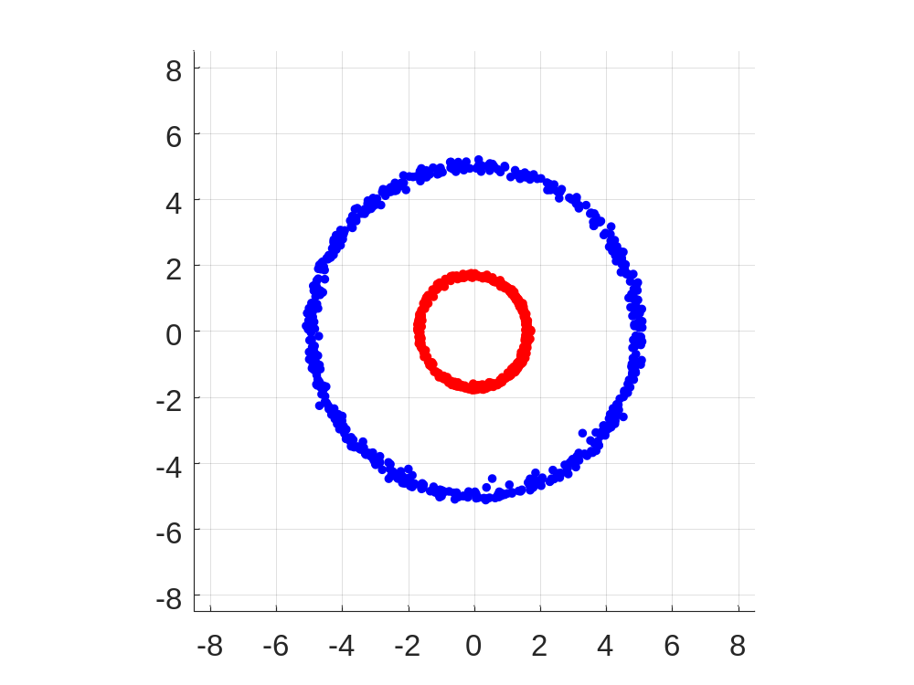
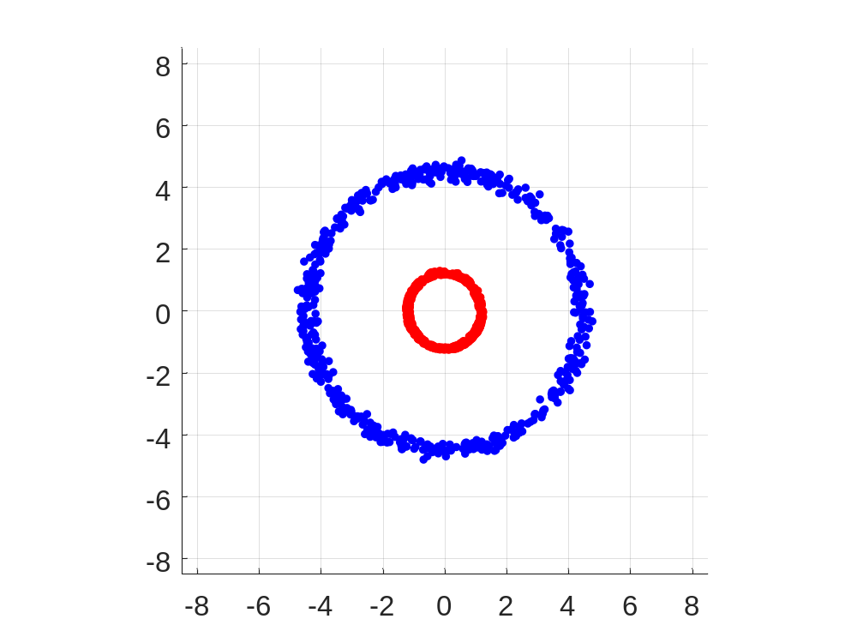
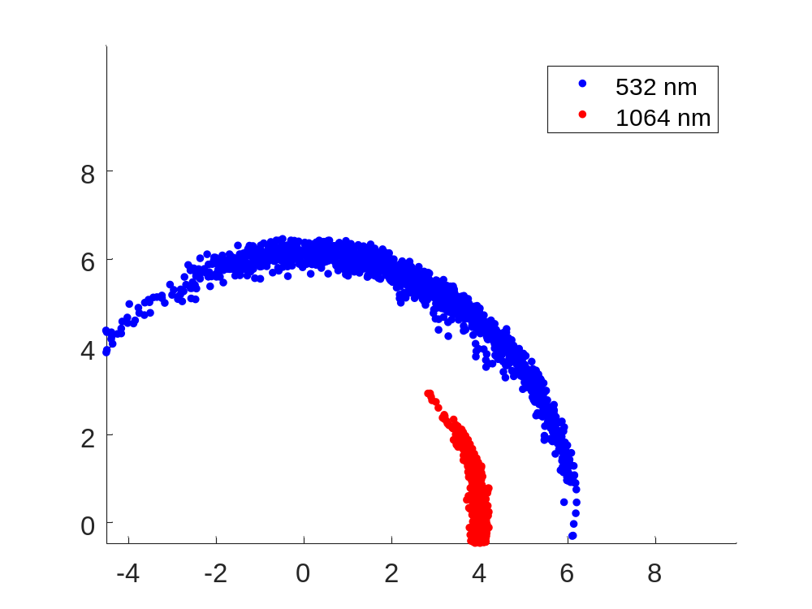
IFM: Lissajous figures
33
53.4 m
53.4 m + 1 cm
66.0 m
Level at the lower limit for good performance
Phase accuracy degraded at this level
unfavourable distance
and poor alignment
favourable distance
and good alignment

Slide 34
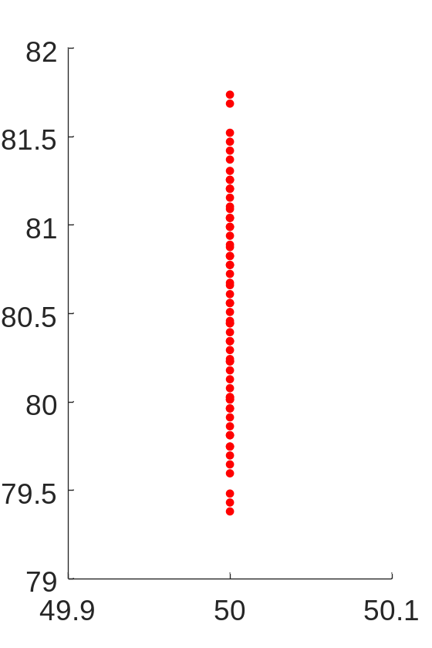
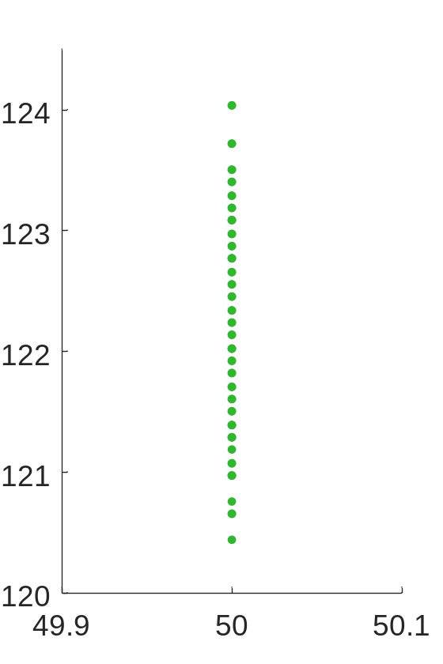
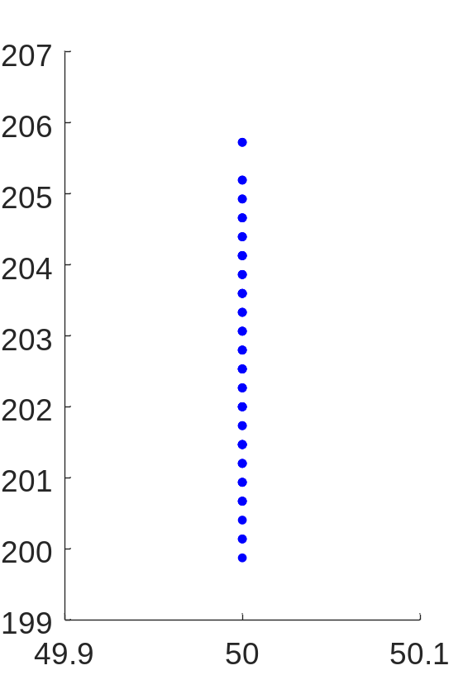
IFM: Dispersion candidates
34
Curves obtained by a simulation
532 nm – 633 nm
48 candidates
633 nm – 1064 nm
30 candidates
532 nm – 1064 nm
22 candidates
2.4 µm
3.6 µm
5.9 µm

