Slide 1
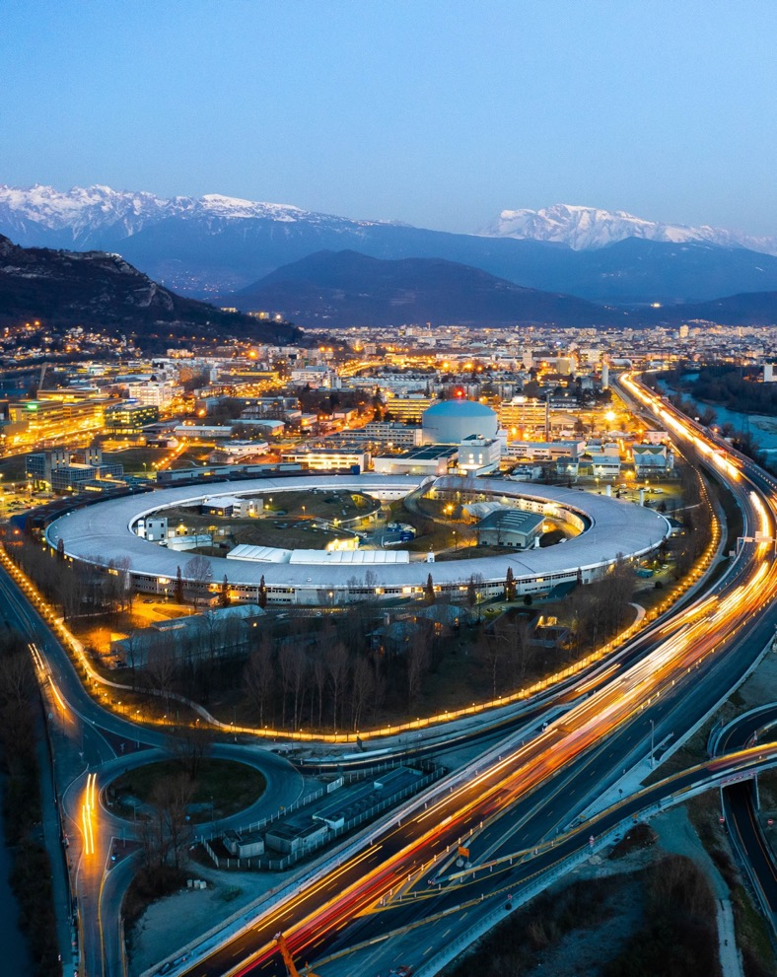

The ESRF SR Full Realignment Campaign
Results and Perspectives
Cristina Gonzalez Torres, Guillame Chamblas, David Martin, Gilles Gatta
Survey and Alignment Group, ESRF

Slide 2
Outline
Background
SR Realignment 2025-26
Future SR realignment considerations

Slide 3
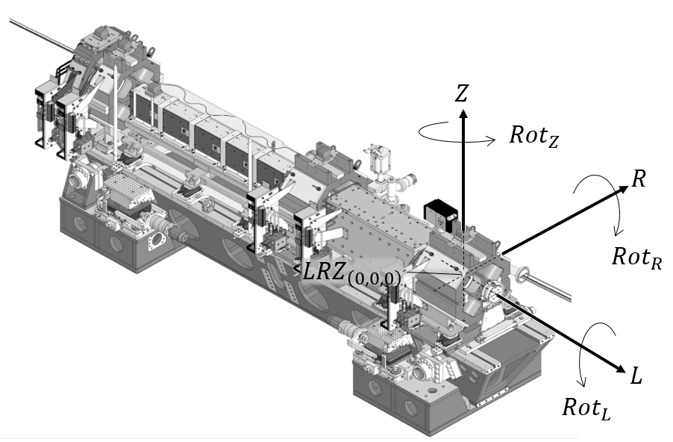



Recall the EBS Alignment Requirements
Machine | Δx [μm] | Δy [μm] | Δz [μm]
Long. Varying field dipoles | 1000 | >100 | >100
High gradient quadrupoles, Combined function dipoles | 500 | 60 | 60
Medium gradient quads | 500 | 100 | 85
Sextupoles | 500 | 70 | 50
Octupoles | 500 | 100 | 100
$R$ for $Y$ and $Z$ for $Z$
$$R$$
$$Z$$
Maximum permissible error 2.5σ

Slide 4
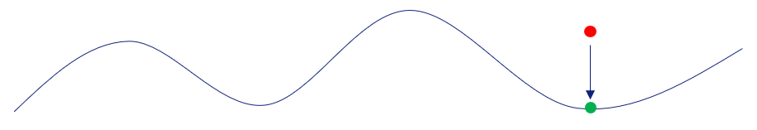
EBS Alignment - general
The EBS had defined theoretical magnet positions, but the existing beamlines prevented the machine from being installed in its theoretical position.
The EBS ID source points and straight sections were therefore constrained to be aligned with those of the old machine.
Since its original alignment in the early 1990s, the old machine had gradually moved away from its theoretical position, mainly due to site-related influences.
To avoid large movements and disturbances on the beamlines, we therefore minimise the horizontal (R) and vertical (Z) deviations of the machine magnets from a smooth reference curve.
We will explore the SR realignment, but first some background on the underlying causes
- the site related influences…

Slide 5
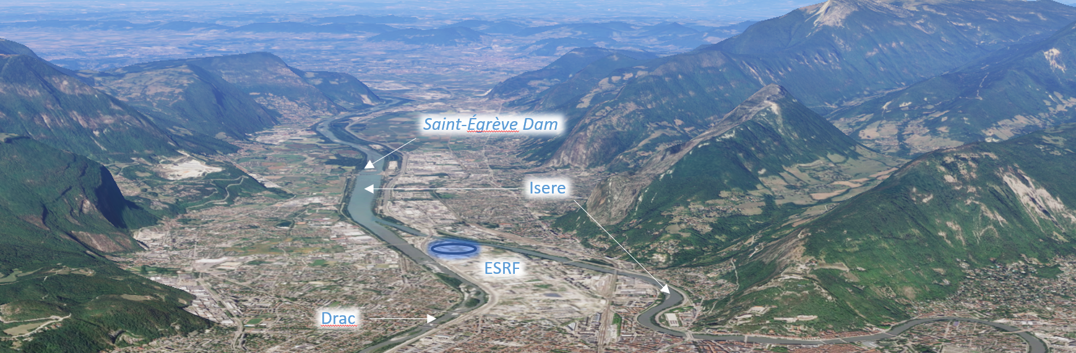
ESRF Site Characteristics
The ESRF is located:
between the Chartreuse and Vercors mountain ranges, the area is influenced by distinct geological formations.
between the Drac and Isère rivers, the site is shaped by significant geomorphological processes.
upstream of the Saint-Égrève dam, where periodic emptying alters river levels and affects groundwater conditions.
on a former glacial lake bed, with a relatively homogeneous clay substrate overlain by alluvial deposits.

Slide 6
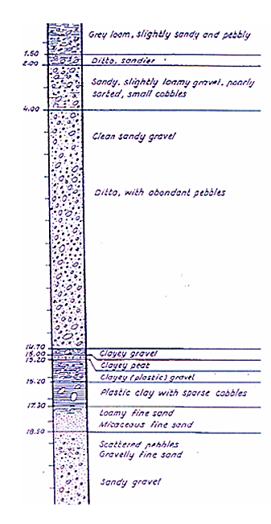
Representative stratigraphic profile Grenoble Basin to ~150 m
0 m
Recent Alluvium
0 – ~5 m: Recent Alluvium
Silty sand to sandy gravel
Locally organic (floodplain deposits)
Moderately permeable
Fluvio-glacial gravels
20 m
~5 – 20 m: Fluvio-Glacial Gravels (Würm glaciation)
Dense sandy gravels with cobbles
Poorly sorted
High permeability
Main aquifer layer
Lacustrine silts and clays
40 m
~20 – 40 m: Lacustrine Silts and Clays
Fine silts and clayey silts
Sometimes laminated (“varves”)
Low permeability
Compressible (important for settlement)
Older glaciofluvial
~40 – 80 m: Older Glaciofluvial Deposits
Alternating gravel, sand, and clay lenses
Heterogeneous structure
Variable permeability
80 m
~80 – 150+ m: Glacial Till / Morainic Deposits
Clayey matrix with embedded cobbles and boulders
Very stiff to hard
Low permeability
Glacial till
1980s bore on the ESRF site
>150 m: Bedrock
Typically limestone, marl, or conglomerates
Belongs to surrounding Alpine massifs
150 m
Bedrock

Slide 7
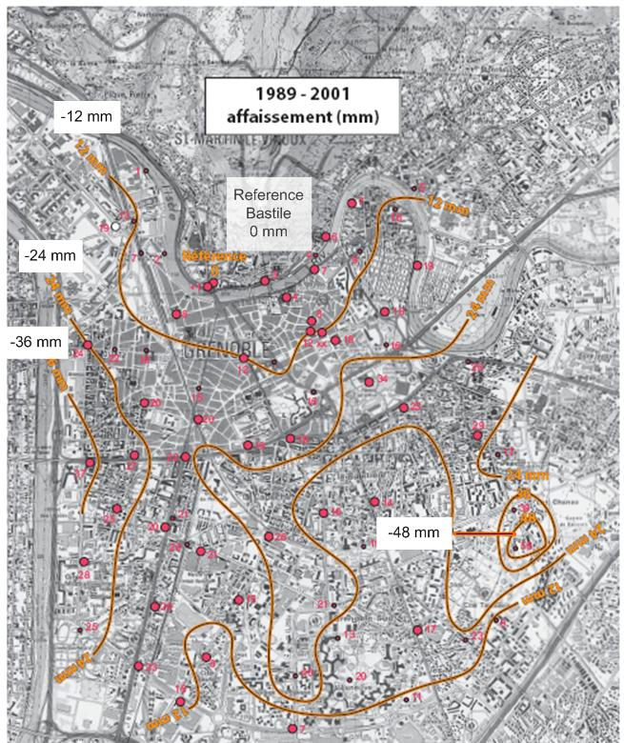
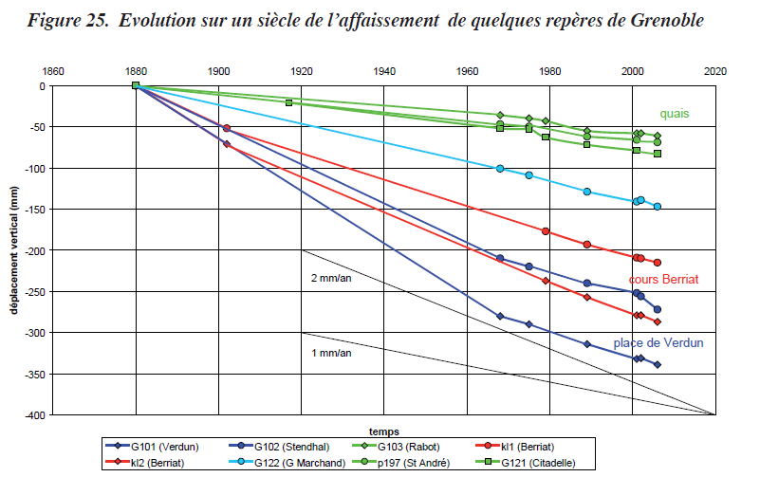
Spatial and Temporal Patterns of Subsidence in the Grenoble Basin
A 2008 study investigated subsidence in the Grenoble Basin using long-term leveling data from the IGN, covering periods from the late 19th century to the early 2000s. It shows measurable, spatially variable subsidence of about 1–3 mm/year but does not attribute it to a single definitive mechanism, suggesting that multiple geological and hydrological factors may be involved.
Ménard, G. (2008). Mesure de l’affaissement actuel de la cuvette grenobloise par comparaisons de nivellements. Rapport scientifique, Pôle Grenoblois d’Étude et de Recherche pour la Prévention des Risques Naturels, Conseil Général de l’Isère.

Slide 8
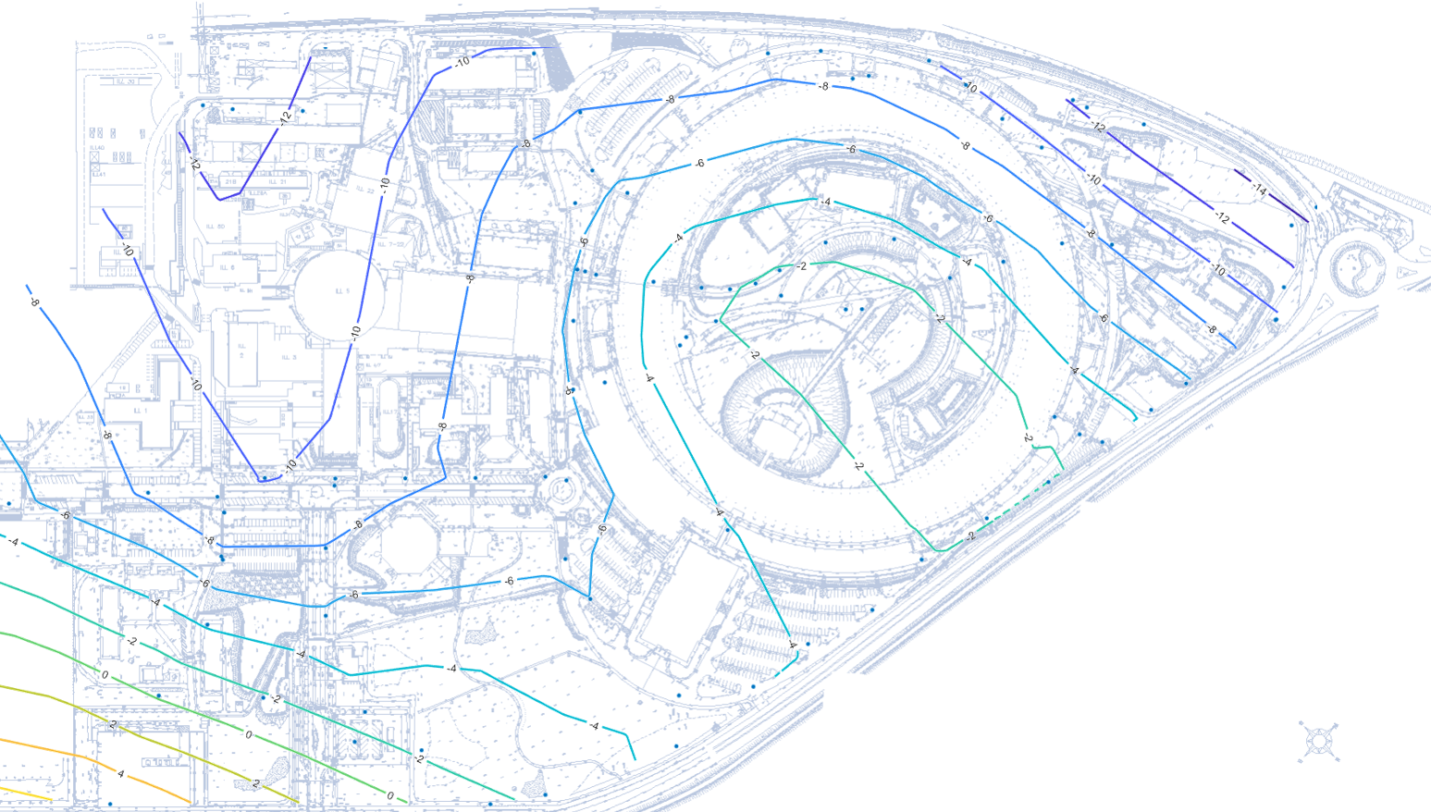
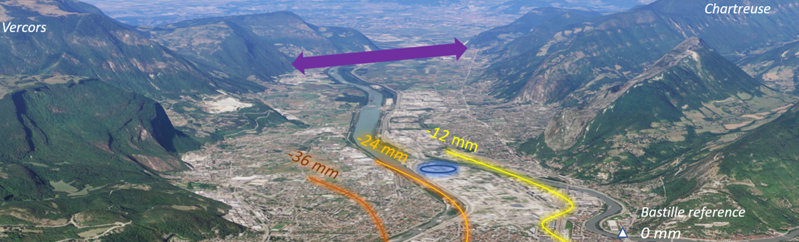
Vertical site movements – from site levelling campaigns 2015 to 2025
Chartreuse to Vercors
Change in height over 10 years between 2015 and 2025.

Slide 9
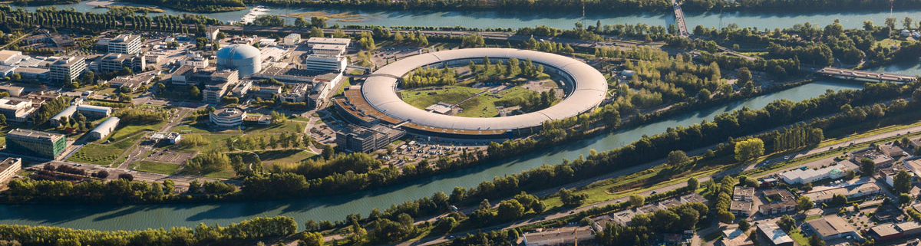
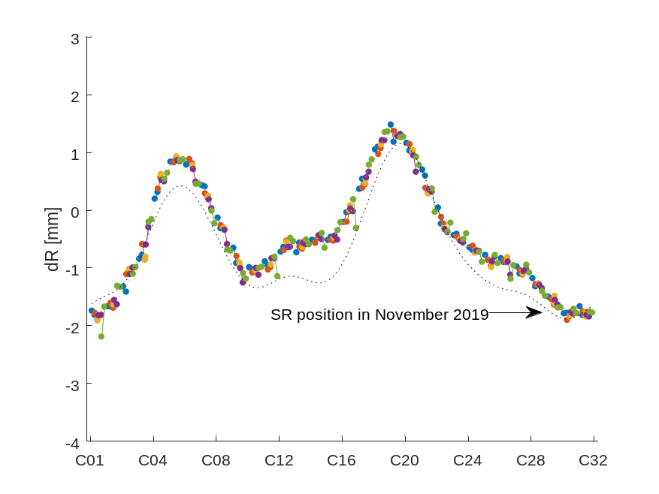
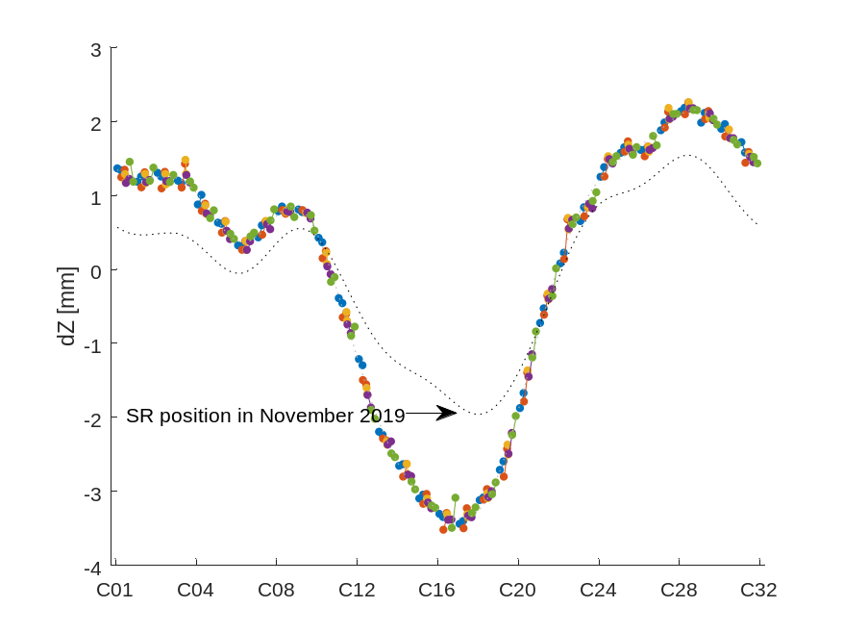

Horizontal and vertical position of the Storage Ring (SR) August 2025
$$Z$$
C08
C16
$$R$$
C01
C24
$$L$$
$$e−$$

Slide 10
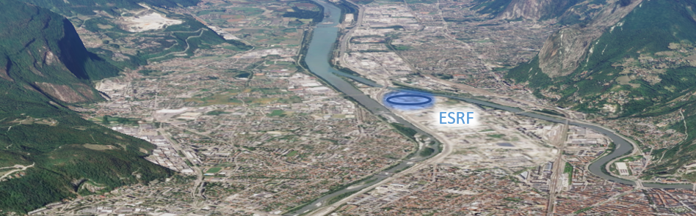
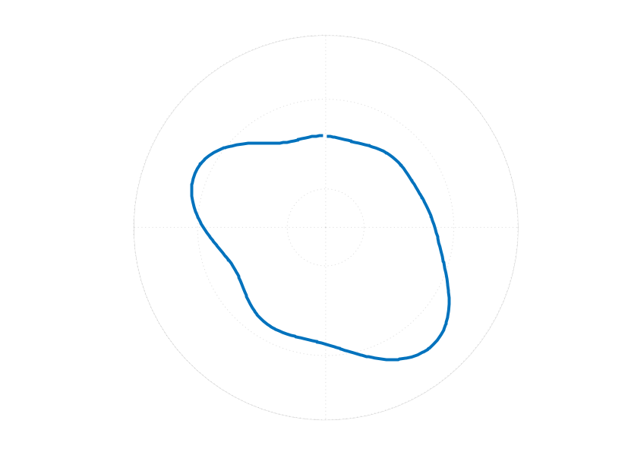
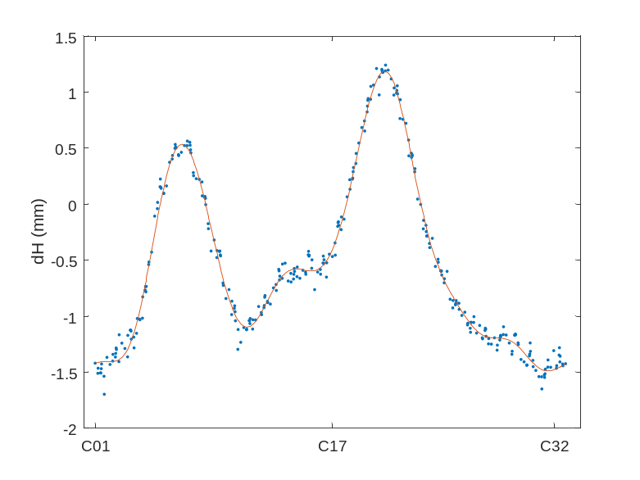
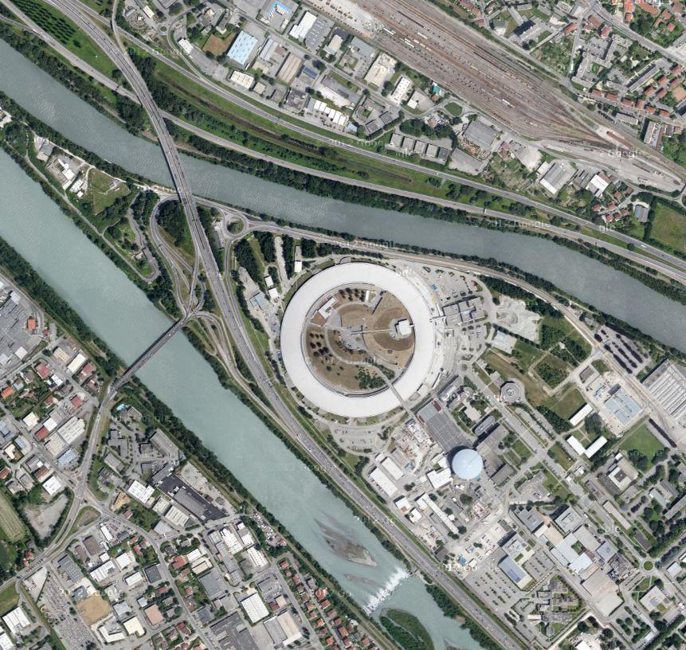
Long term horizontal machine deformation
The ESRF site, and machine are stretching along the valley and river axes…
+2.5 mm
0 mm
C20
-3.5 mm
C06
SR October 2018

Slide 11
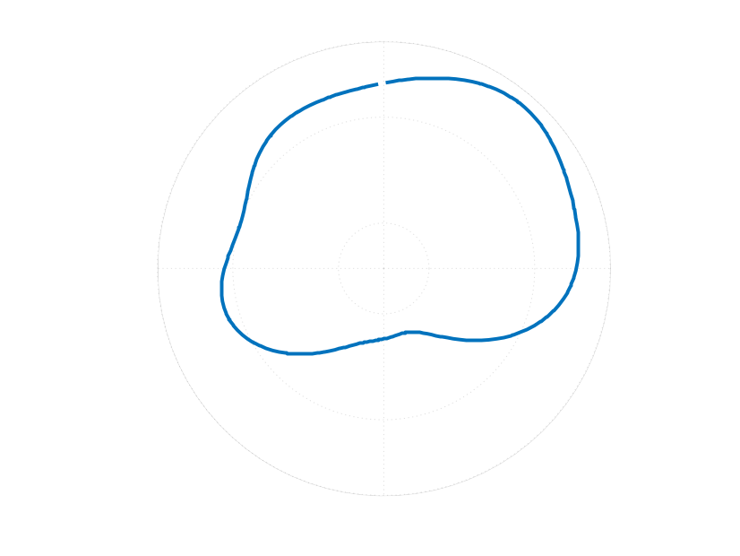
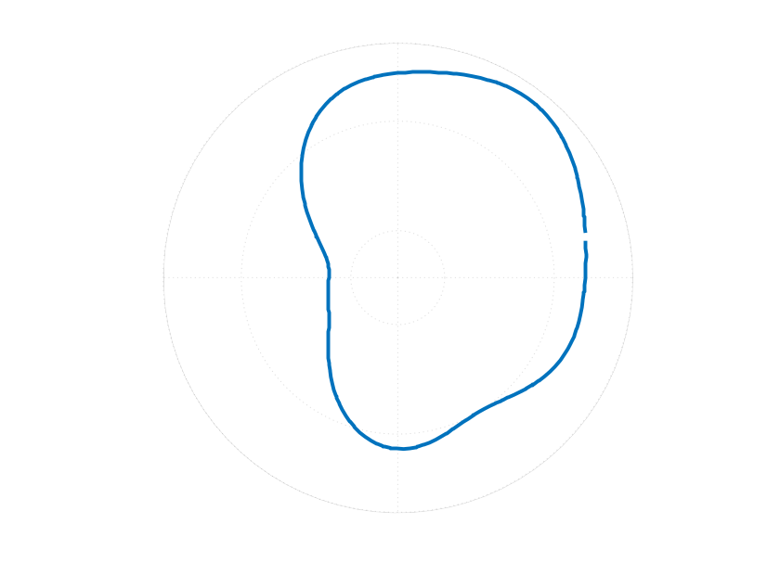
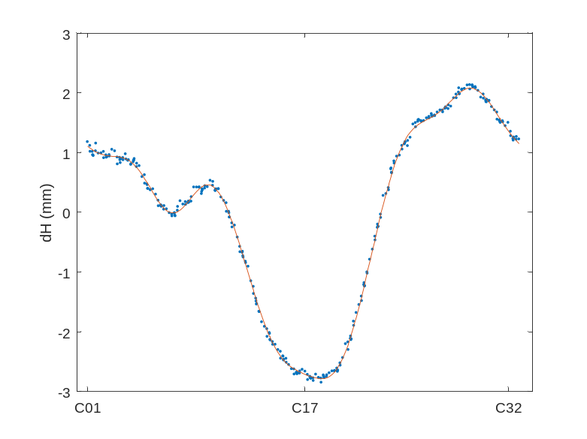
Long term Vertical Machine deformation
The ESRF site, and machine are tilting across the valley as we have already observed…
+2.5 mm
C28
0 mm
C17
-3.5 mm
SR October 2018

Slide 12
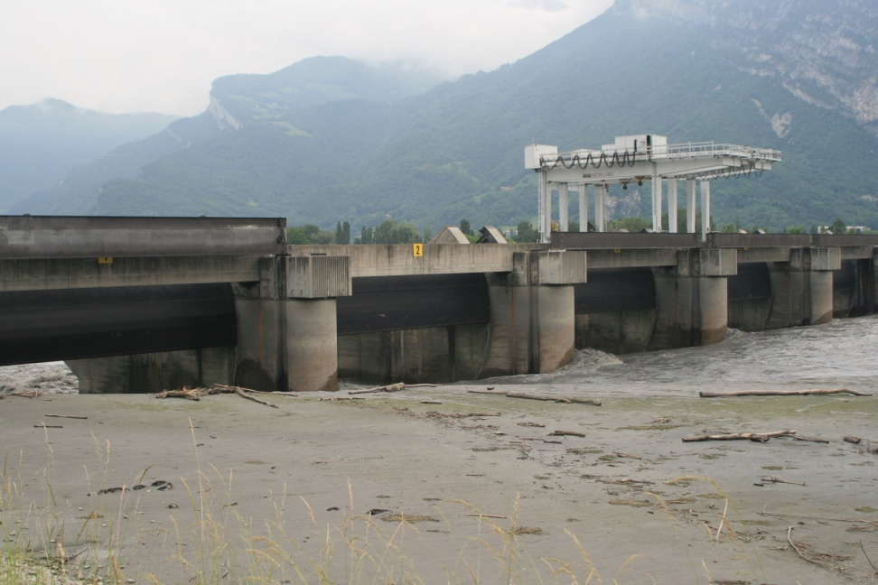
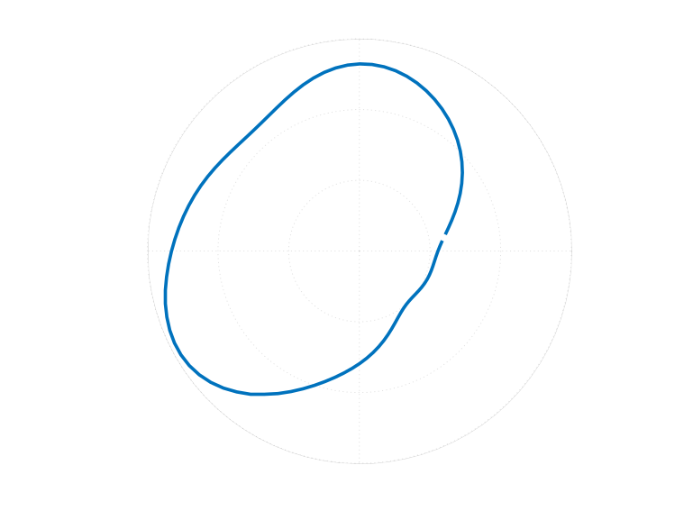
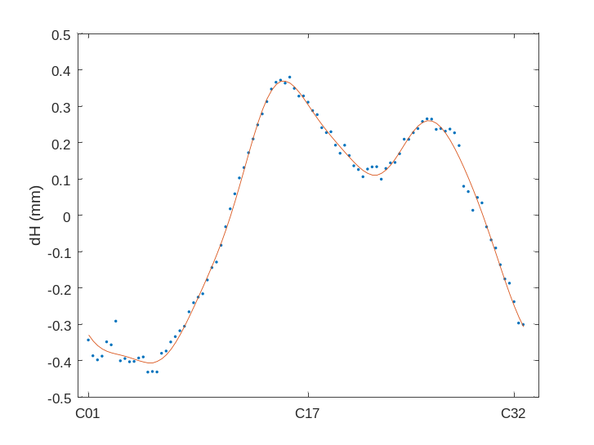
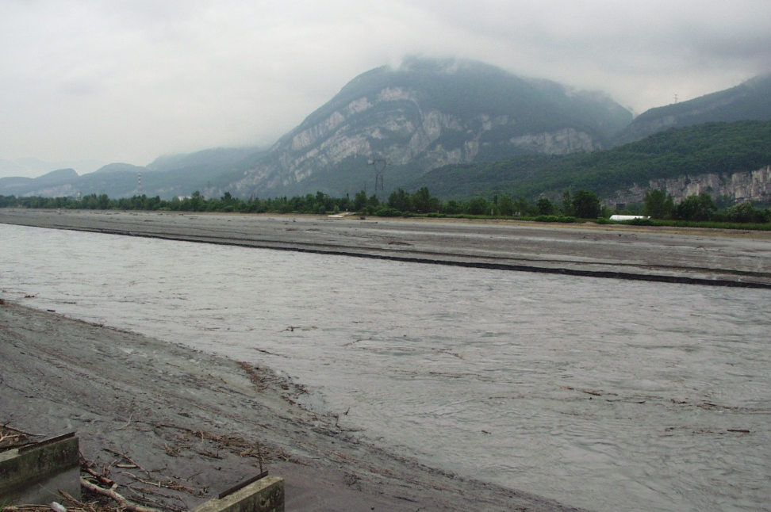
Dam flushing
The ESRF site, and machine bend up towards the adjacent rivers…
+0.4 mm
C25
0 mm
-0.4 mm
C14
Roof HLS April 2006
Roof HLS April 2006

Slide 13
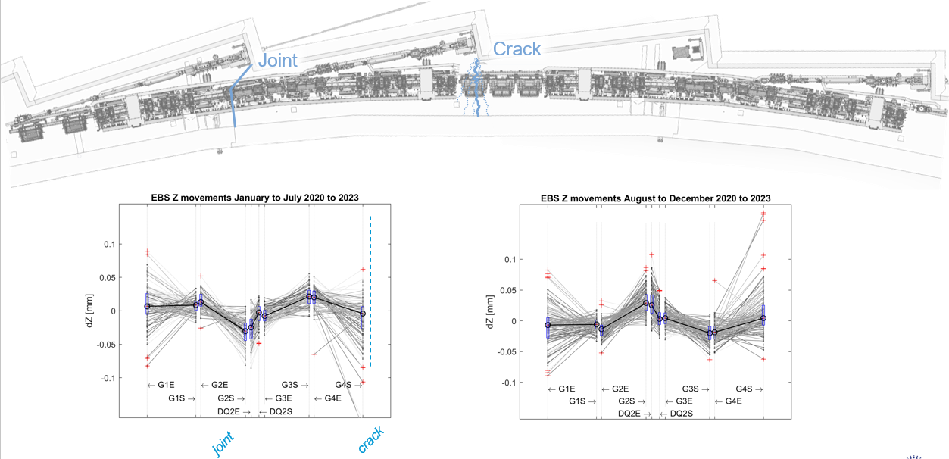
Slab bending

Slide 14
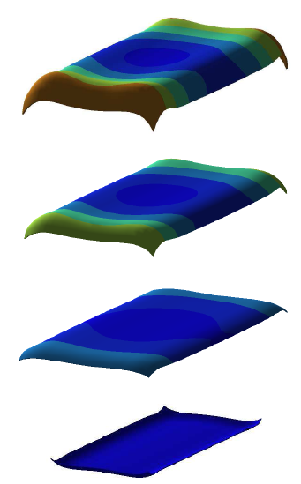
Vertical Movements at slab joints are due to slab bending
This event highlights the key movement affecting machine operation:
specifically slab bending/curling.
Slab bending arises from thermal gradient variations through the slab. Temperature varies diurnally and annually.
T=
Over the day air temperature varies
T=constant
Over one day the ground temperature doesn’t vary significantly
NECS (Numerical Engineering & Consulting Services SAS), “«Etudes de Stabilité du Golden Slab»- Comportement Thermomécanique Tenant Compte des Charges Statiques, et des Déformations Différées Dues au Séchage du Béton, Note Technique - Rapport d’Etudes Paramétriques”, N001_A143_2010_ESRF_A,26 May 2010

Slide 15
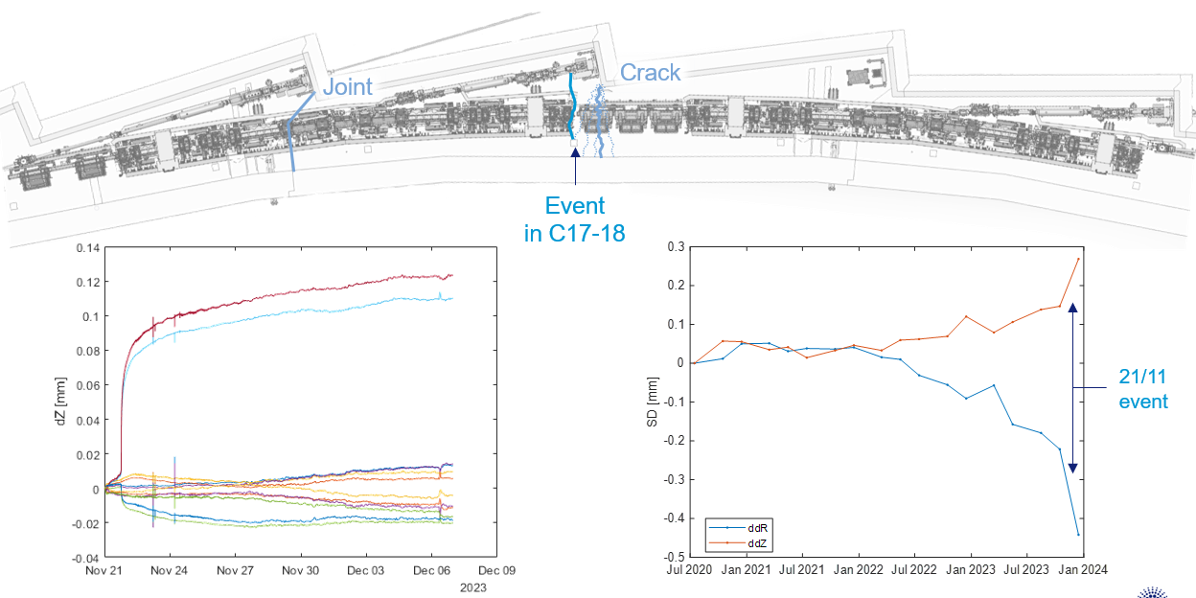
Event in the ID18 straight section on 21 November 2023 and others…

Slide 16
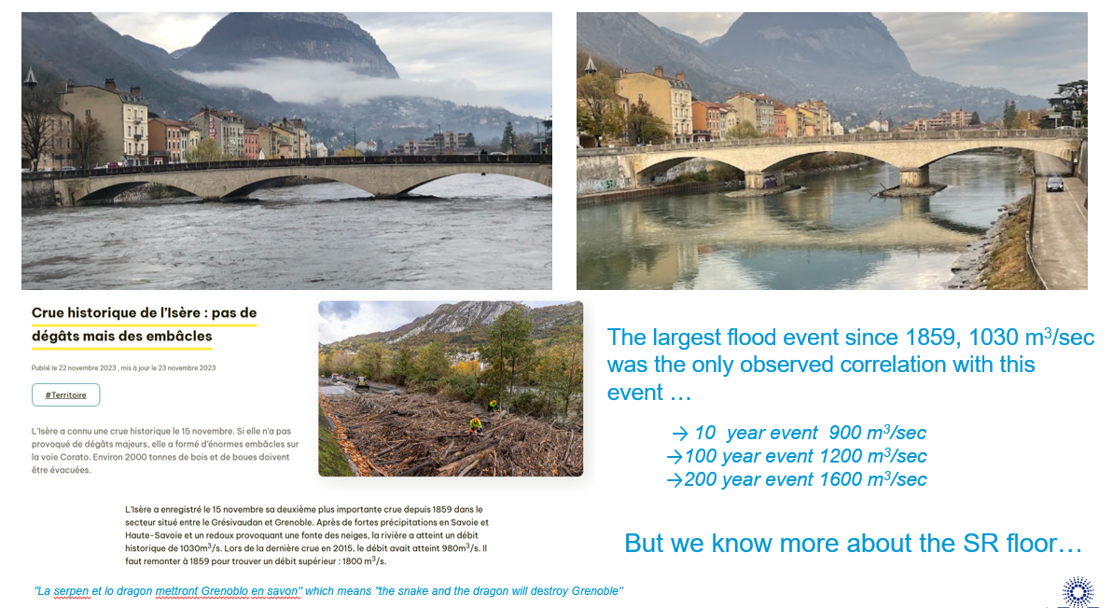
Event in the ID18 straight section on 21 November 2023

Slide 17
Problematic movements
Most of these signatures are slow, taking place over months to years and they are smooth. Their effect on machine performance is not very important.
Three however, have disturbing effects over short time periods of minutes to days. In order of importance:
1) Fast events on the EBS slabs - like what happened on 21 November 2023,
2) Slab bending due to thermal gradient variation through the slab,
3) Dam flushing.
We will come back to this, but first the SR realignment campaign…

Slide 18
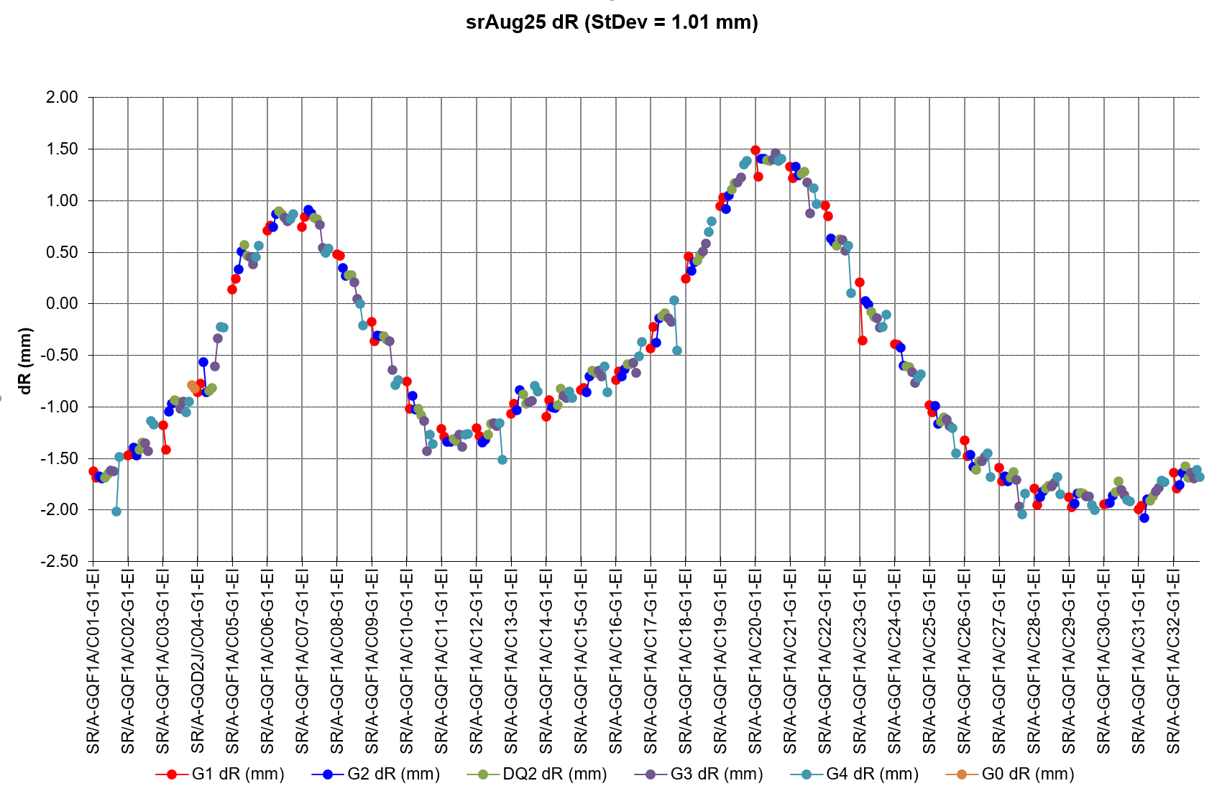
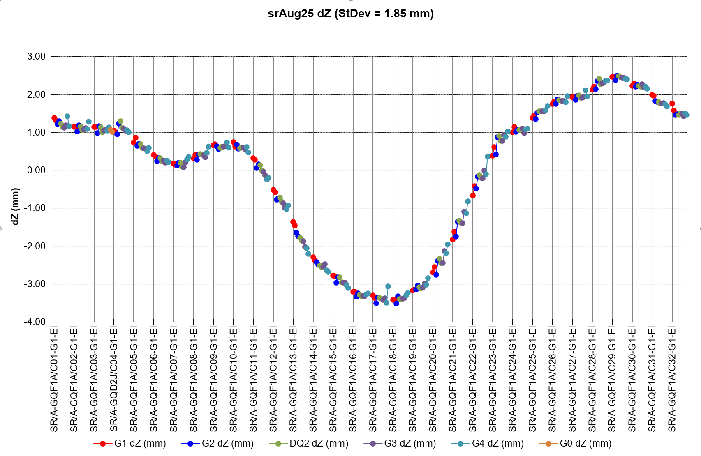
The SR Realignment - position of the machine before realignment
The absolute position of the machine is dominated by site related influences
But it is not as important as the machine smoothing

Slide 19
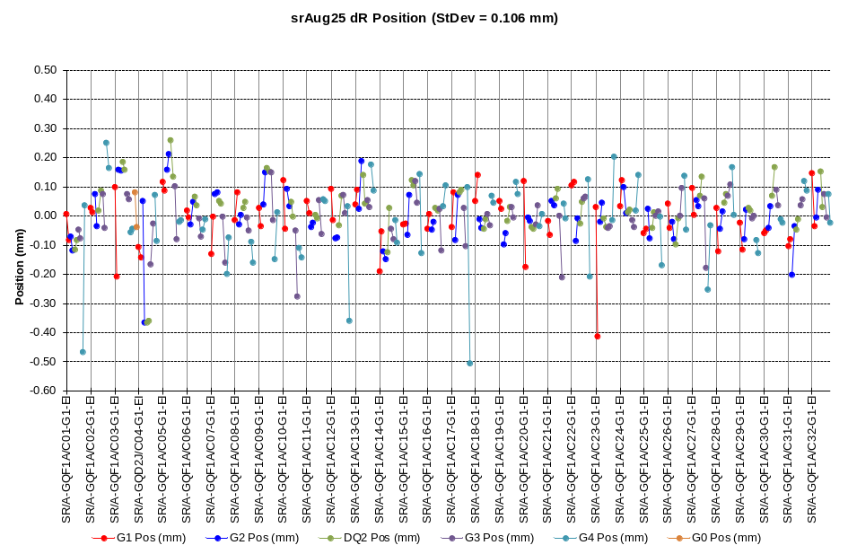
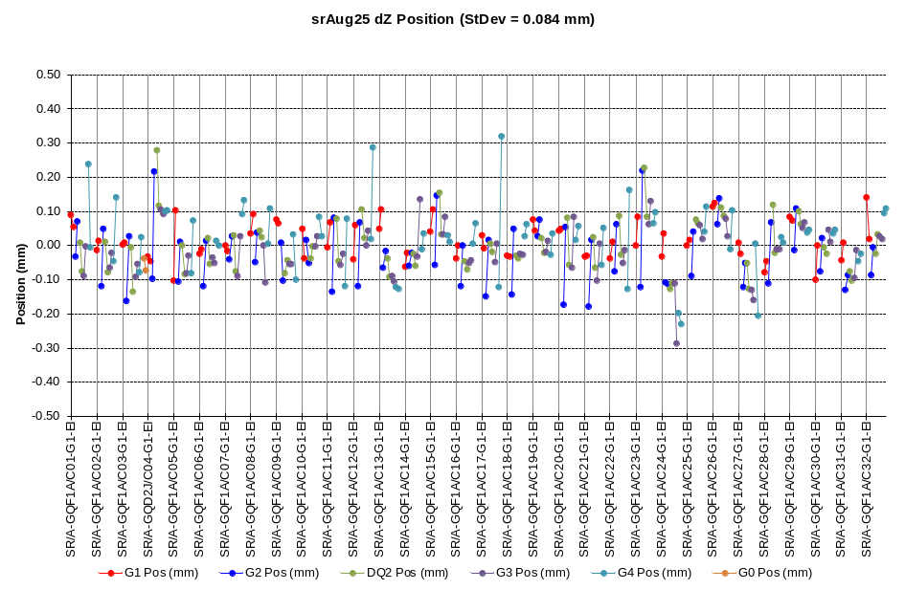
The SR Realignment – Smoothing Before Realignment
These graphs show the position of the entry and exit of adjacent girders with respect to their neighbors before the SR realignment. These smoothing errors have a strong impact on the machine performance.

Slide 20
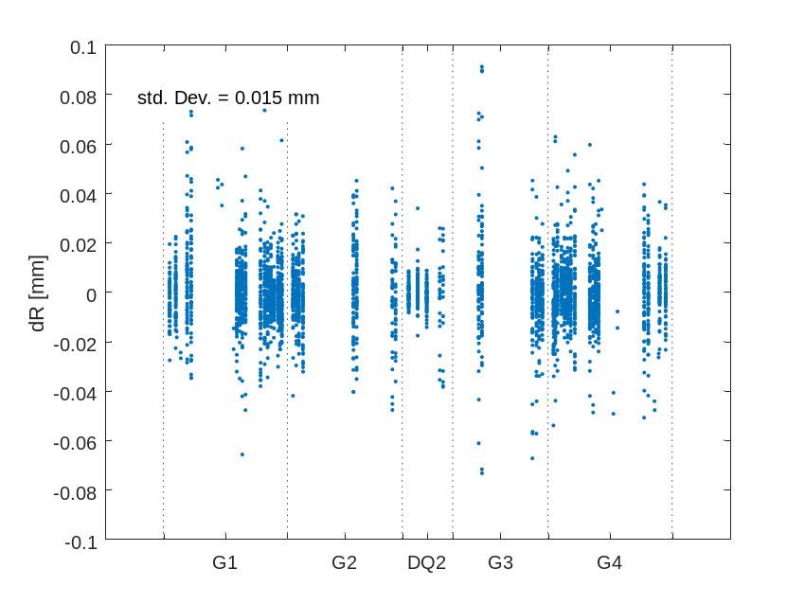
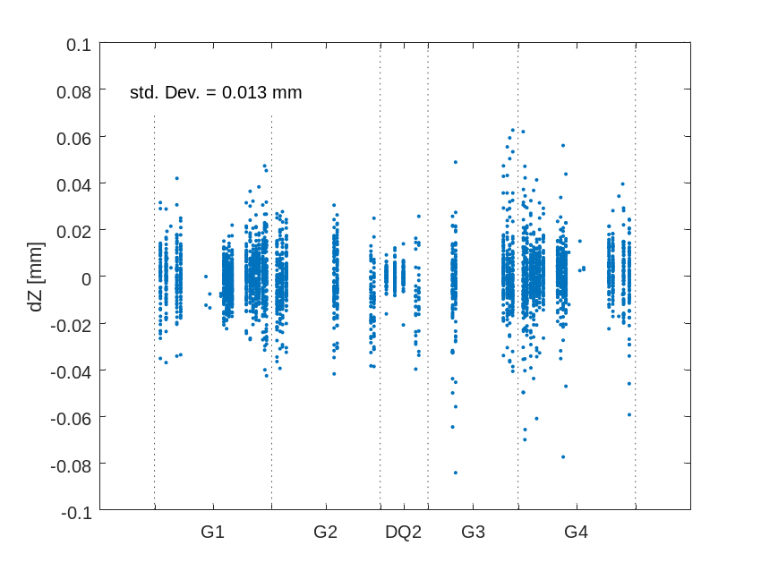
Survey of magnets on girders in 2022 i.e. R₂₀₂₂-R₂₀₁₉, and Z₂₀₂₂-Z₂₀₁₉
A survey of all of the Octupole, Quadrupole, Sextupole and DQ magnets on the girders made in 2022 showed the magnets on the girders do not move significantly.
This means errors between adjacent girders dominate alignment …

Slide 21
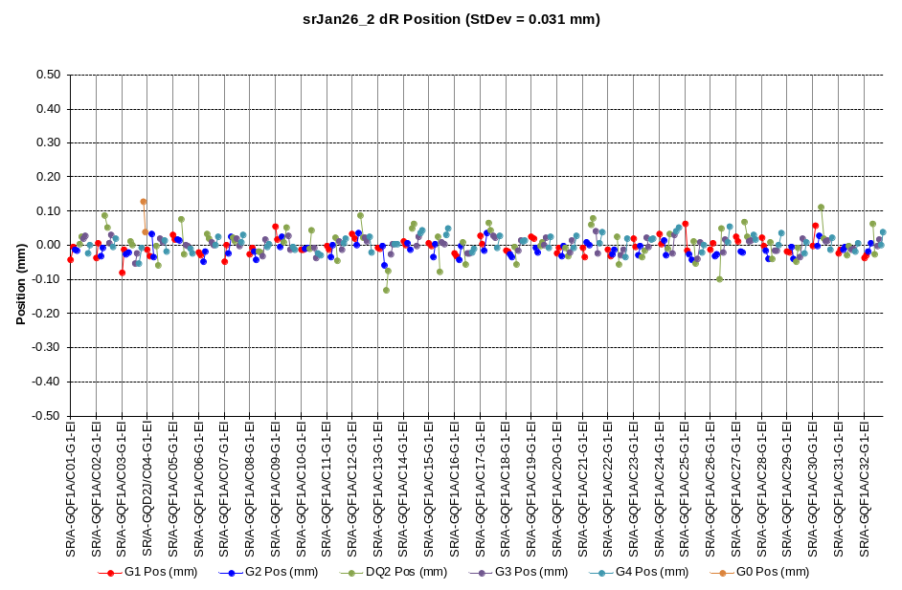
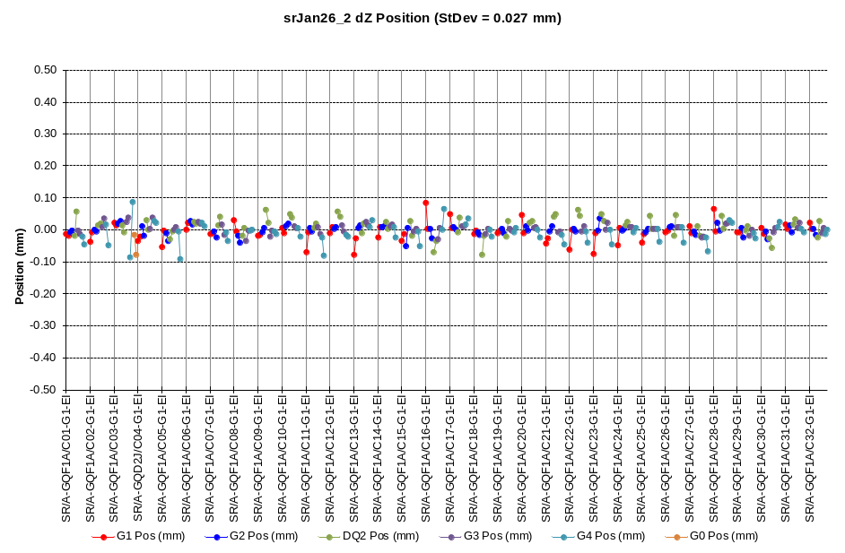
Smoothing after realignment 08 January 2026
These graphs show the position of the entry and exit of adjacent girders with respect to their neighbors immediately after the SR realignment.

Slide 22
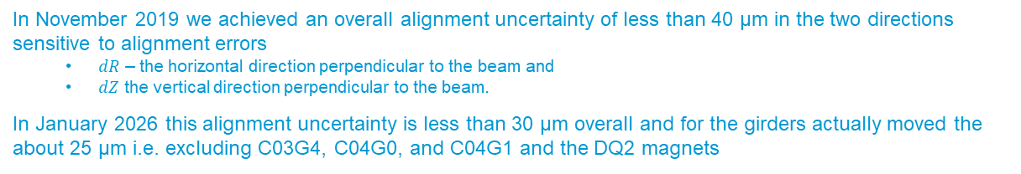
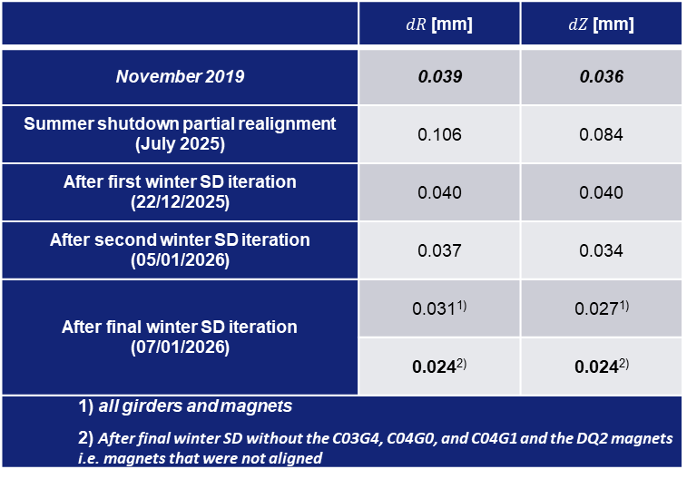
Comparison with November 2019
 | $dR$[mm] | $dZ$[mm]
November 2019 | 0.039 | 0.036
Summer shutdown partial realignment (July 2025) | 0.106 | 0.084
After first winter SD iteration (22/12/2025) | 0.040 | 0.040
After second winter SD iteration (05/01/2026) | 0.037 | 0.034
After final winter SD iteration (07/01/2026) | 0.031¹⁾ | 0.027¹⁾
 | 0.024²⁾ | 0.024²⁾
1) all girders and magnets 2) After final winter SD without the C03G4, C04G0, and C04G1 and the DQ2 magnets i.e. magnets that were not aligned
Reference November 2019
Final uncertainty achieved 2025-26
In November 2019 we achieved an overall alignment uncertainty of less than 40 µm in the two directions sensitive to alignment errors
  $dR$ – the horizontal direction perpendicular to the beam and
  $dZ$ the vertical direction perpendicular to the beam.
In January 2026 this alignment uncertainty is less than 30 µm overall and for the girders actually moved the about 25 µm i.e. excluding C03G4, C04G0, and C04G1 and the DQ2 magnets

Slide 23
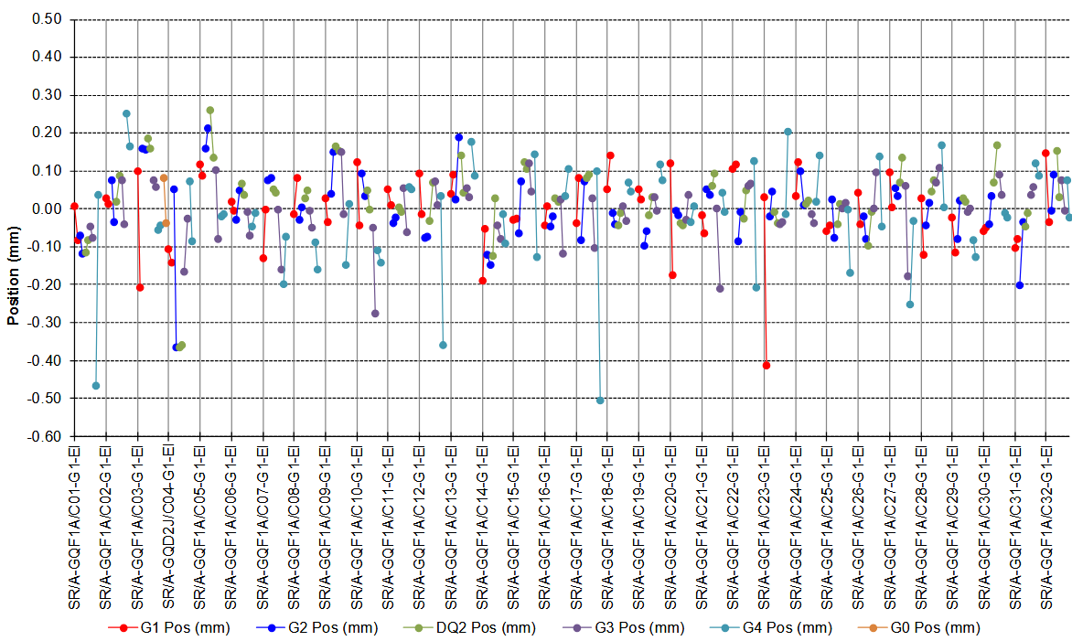
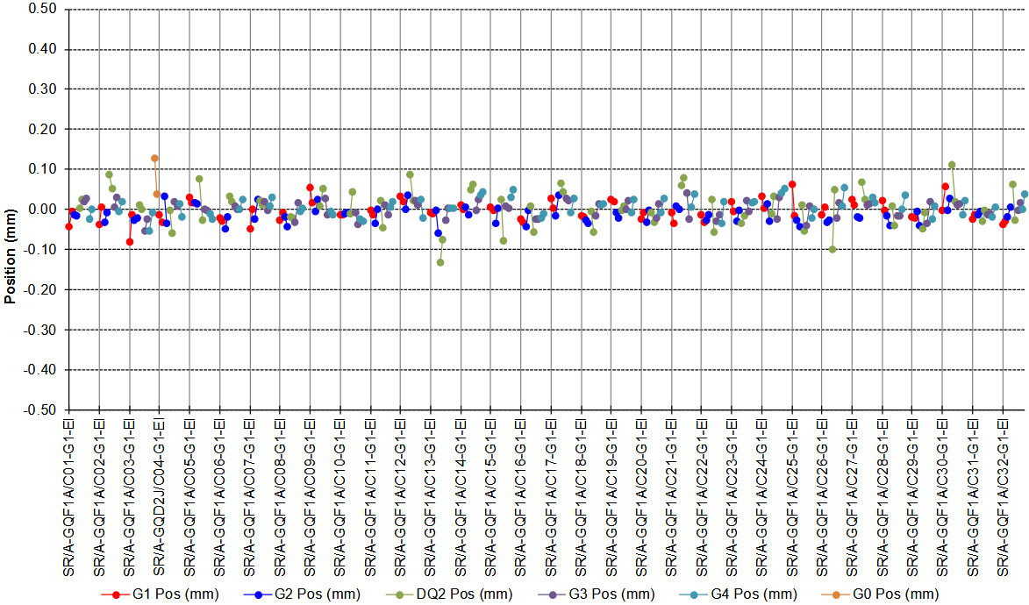
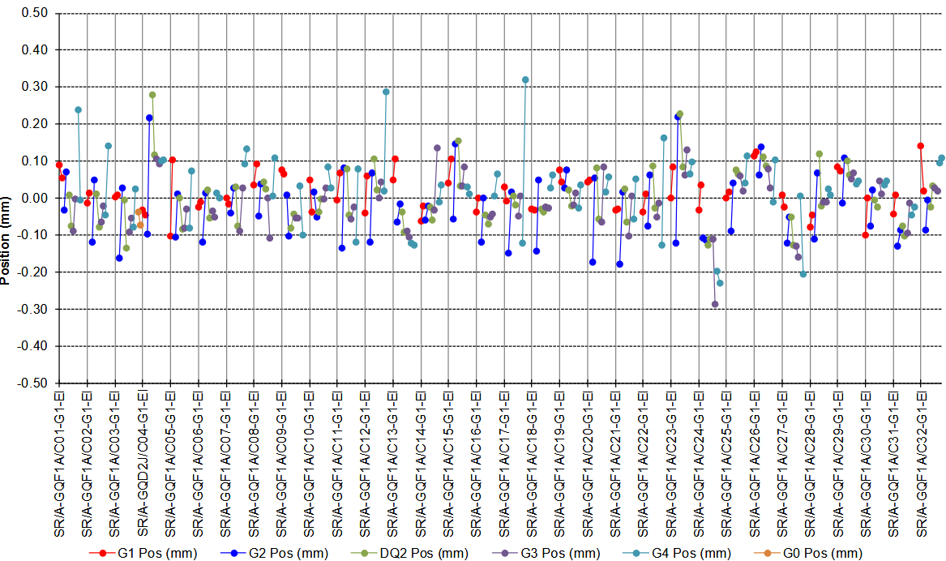
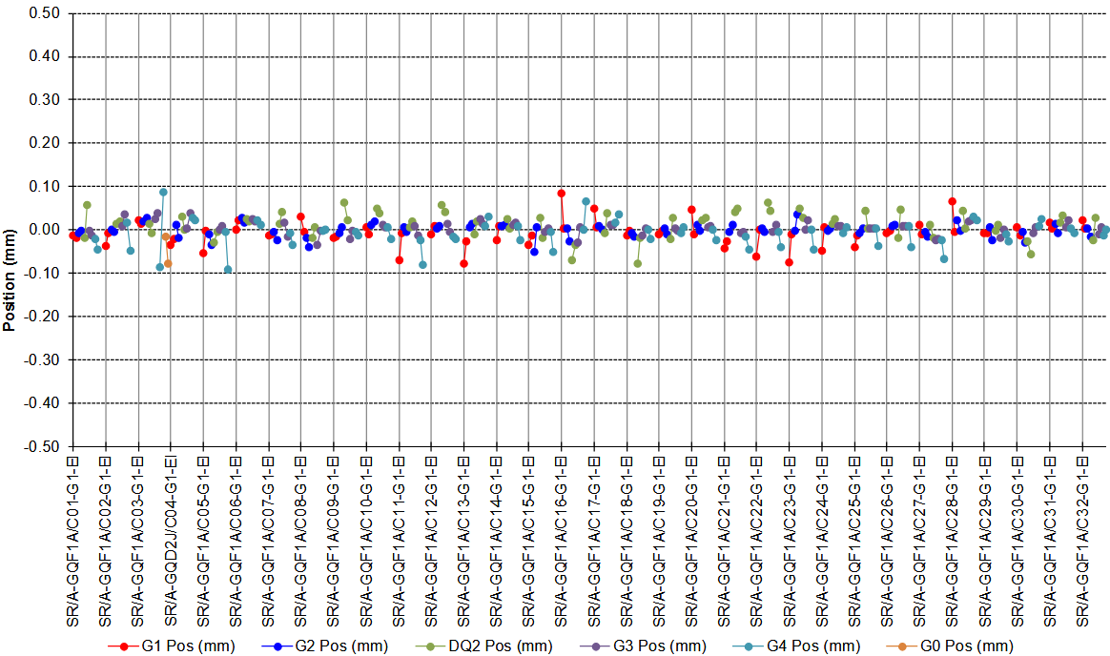
other activity – storage ring realignment in winter shutdown 2025
dR
dR
Horizontal
Before re-alignment: 102 µm rms
AFTER re-alignment 40 µm rms
dZ
dZ
Vertical
Befor re-alignment: 78 µm rms
AFTER re-alignment: 40 µm rms
 | dR (mm) | dz (mm)
November 2019 | 0.039 | 0.036
Summer shutdown partial realignment (07/25) | 0.106 | 0.084
After first winter SD iteration (22/12/2025) | 0.040 | 0.040
After second winter SD iteration (05/01/2026) | 0.037 | 0.034
After final winter SD iteration (07/01/2026) | 0.031 | 0.027
 | 0.024 | 0.024
 | Initial | After tuning
Overall ring C.O.D. | H 63𝛍m, V 57𝛍m | H 49𝛍m, V 52𝛍m
Emittances | H 180 pm, V 7 pm | H 143 pm, V < 1 pm
β-beating (fitted) | H 5%, V 12.9% | H 0.5% , V 0.5%
ΔDispersion peak | H 10 mm, V 5 mm | H 3 mm, V 3mm
Touschek L.T. @ 200mA, ε_{y}=10pm | 24 hrs | 30 hrs

Slide 24
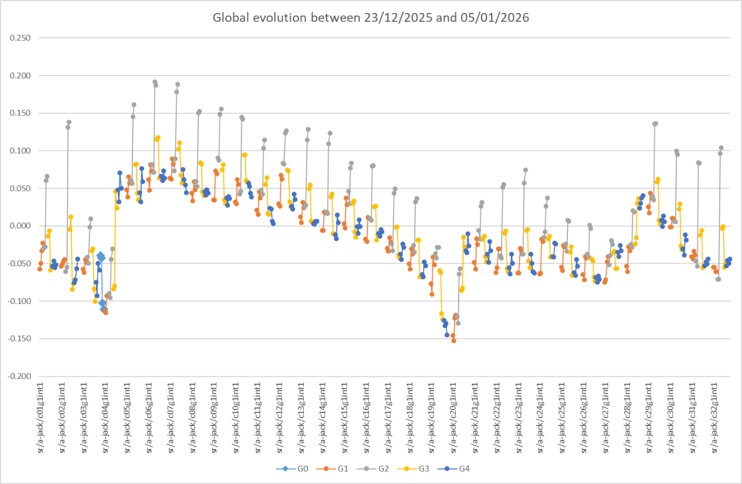
However…
On 23 December the machine was perfectly aligned in Z. However, between 23 December and 5 January there were large misalignments between the G2 and G3 girders!
This was not entirely unsurprising…
We decided to make an unplanned vertical alignment step on 5 January to compensate this unexpected movement…

Slide 25
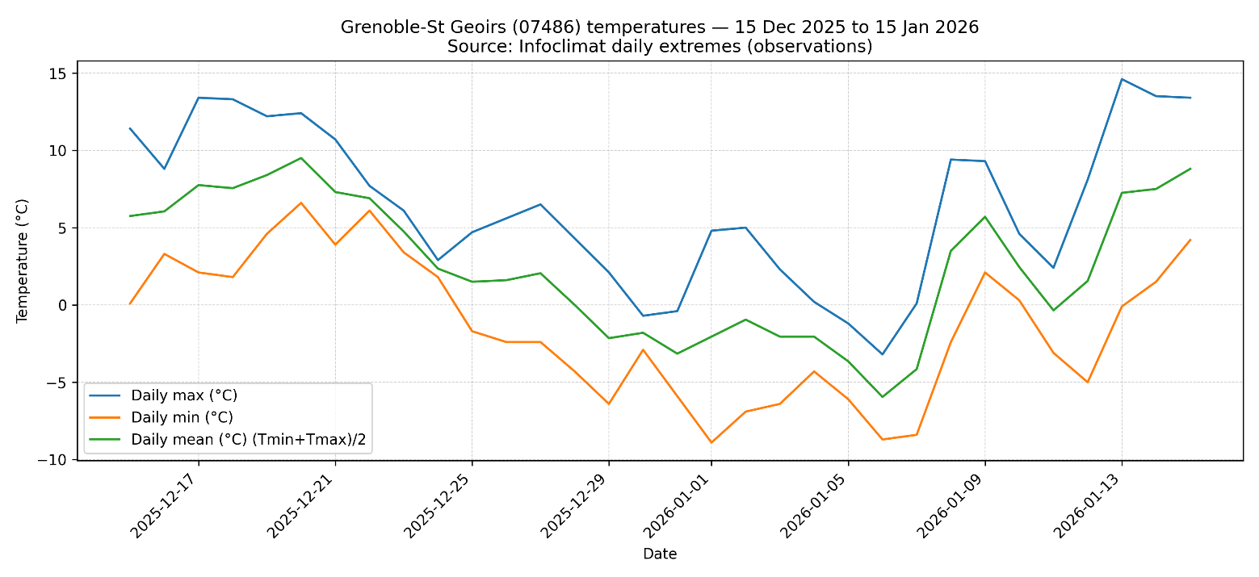
Temperature gradients Variation through the slab cause bending
23 December 2025: mean ≈ 4.8 °C
5 January 2026: mean ≈ –3.6 °C
Difference = -8.4 °C
This had a profound impact on the vertical alignment of the SR.
Recall, we mentioned slab bending earlier…
This is a perfect example of what can happen.
T=constant
Over one day the ground temperature doesn’t vary significantly
But over several days it can change dramatically

Slide 26
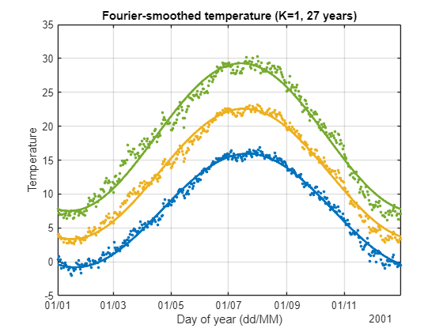
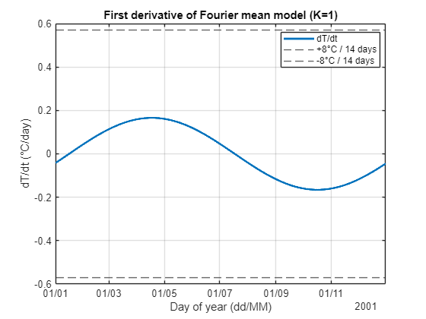
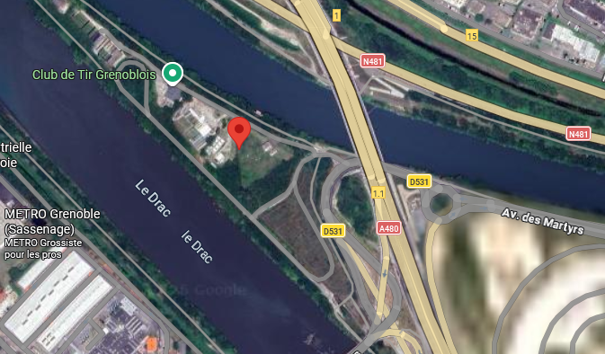
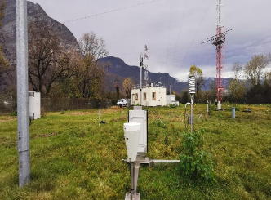
This was quite remarkable nonetheless…
Annual temperature variations at Le Versoud - CEA Radome
Temperature change of -8 °C or 0.57 °C/day over the 2025-26 Christmas period was exceptional.
On average max and min variations:
  Max dT/dt = 0.17 °C/day on 18-Apr
  Min dT/dt = -0.17 °C/day on 17-Oct

Slide 27
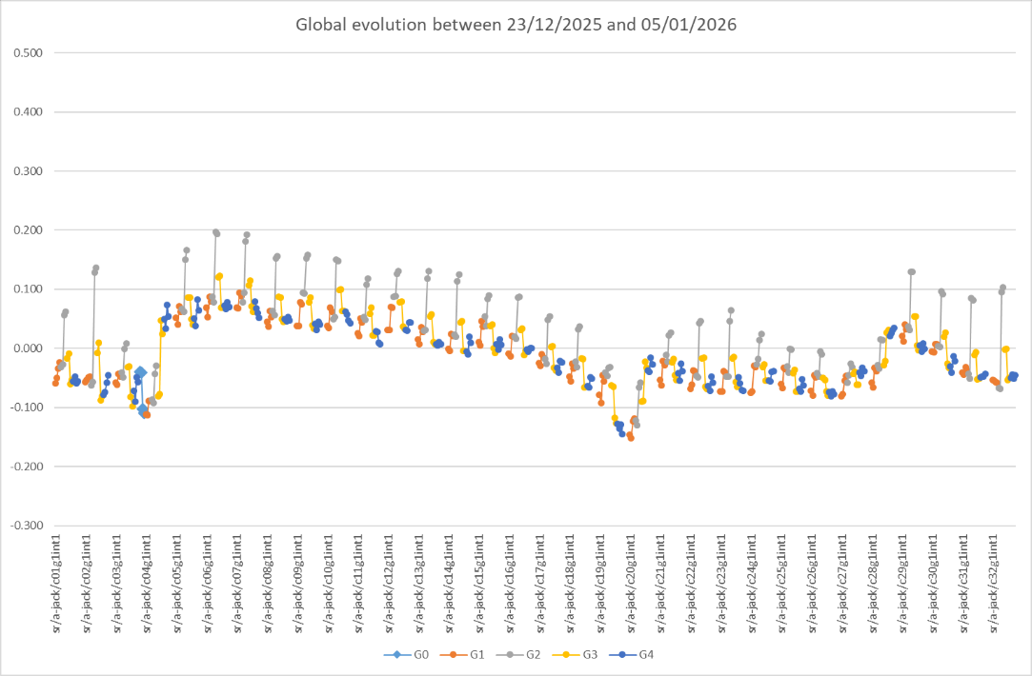
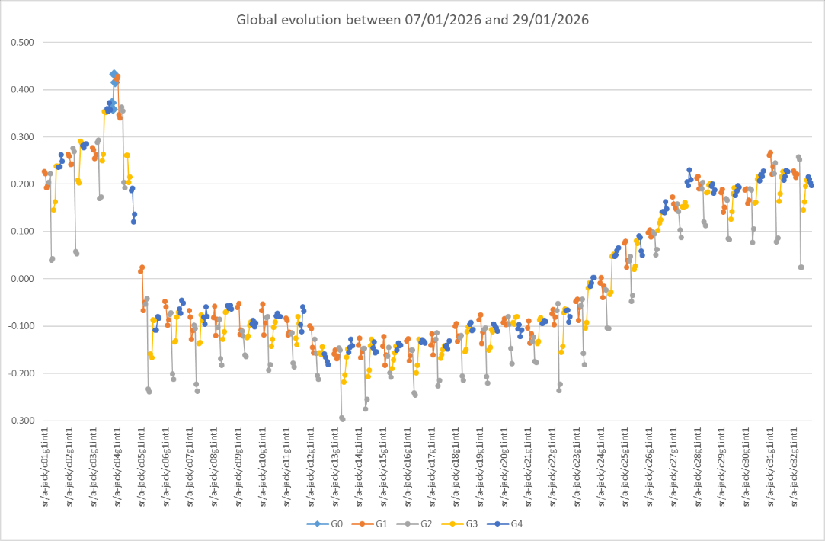
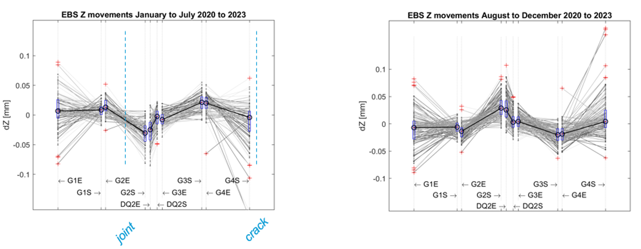
However, the situation changed Again over the next 3 weeks
There is constant movement – particularly at the slab joints.

Slide 28
Towards a long term SR alignment programme
The SR machine was not realigned between November 2019 and December 2025. Over that period, performance slowly degraded. In early 2025, a decision was made to fully realign the machine — the first complete realignment since November 2019.
Overall, we are very satisfied with the results of the realignment campaign, which has translated into enhanced machine performance.
Initially, we were concerned that the jacks might have issues because they had not been moved since November 2019. This concern proved unfounded. Aside from a few well-understood problems (fewer than 50), the jacks performed very well over several thousand movements, opening the possibility of more frequent realignment.
However, the realignment placed a heavy burden on the survey and alignment group and significantly disrupted other shutdown activities. There were also concerns about potential negative impacts on beamlines, front ends, insertion devices, and the vacuum system.
Ultimately our goal is to realign the machine while minimizing impacts on beamlines and overall machine operation, particularly during the shutdowns.…

Slide 29
February 2026 SR Realignment proposal
A proposal for long term realignment was made:
Perform vertical realignment at the start of each shutdown during the radiation check, before tunnel access. We can do this because the jack adjustment is reliable and takes less than 30 minutes. Movements will be based on the HLS.
The survey will be made as it is done now on the first afternoon of the shutdown.
Correct the largest horizontal misalignments (e.g., N selected cells) during an evening shift, outside bakeout zones, with a rapid control survey of the adjusted areas.

Slide 30



Then there was an Event in the ID23 straight section on 11/02/2026
Recall, the event in November 2023 linked to the river?
A similar event was recorded in February 2026 in the ID23 straight section

Slide 31


Realignment C21 to C25 in the May 2026 shutdown
This event led us to successfully test the proposed realignment scenario during the May 2026 shutdown…

Slide 32


No realignment was made during the summer shutdown
However, one can ask: is the February 2026 realignment proposal the right one? It is not convincing!

Slide 33

Machine smoothing January to July 2026
 | dR [µm] | ddR [µm] | dZ [µm] | ddZ [µm]
Jan 2026 | 31 (24) |  | 27 (24)
Mar 2026 | 54 | 23 | 60 | 33
May 2026 after C2-25 realignment | 56 | 2 | 67 | 7
Jul 2026 | 68 | 12 | 71 | 4
The machine alignment quality degrades quickly.
Partial realignment doesn’t have a large impact.

Slide 34


Particularly in light of another event on 3 September 2026
Events like this (Nov 2023, Feb 20-26) occur regularly. They are unpredictable both when and where they will occur.

Slide 35
Summary
Currently, we have a choice between carrying out small alignment corrections during each shutdown, or undertaking a single large-scale alignment during a longer shutdown, as was done in winter 2025/26.
Small, regular corrections will probably maintain the alignment within a relatively stable but larger and possibly growing uncertainty over the long term.
A large-scale alignment, by contrast, can achieve very good initial results, which will then gradually degrade over time.
Small corrections are less disruptive to other groups, but the resulting alignment is less satisfactory. Large-scale alignments are considerably more disruptive, but ultimately provide a cleaner and more consistent result.
In either case, the long-term evolution will be punctuated by events such as those observed at ID18, ID23 and ID31.

Slide 36
Summary
The main constraint on SR realignment today is the horizontal adjustment, which may require two or three iterations, with each iteration involving:
  one full day for the initial survey;
  one full day for manual realignment, less on the second and third iterations;
  one full day for the follow-up survey.
Vertical realignment can be completed within a few minutes using real-time HLS control.
If horizontal realignment becomes a critical operation, we should ultimately consider installing horizontal movers with real-time control to achieve a similar level of efficiency.

Slide 37

Many thanks for your attention

