Slide 1


New Beam Line Measurement Campaign at the ESRF
Cristina Gonzalez Torres
IWAA 2026 - KEK, Tsukuba, Japan
Wednesday, October 7, 2026

Slide 2
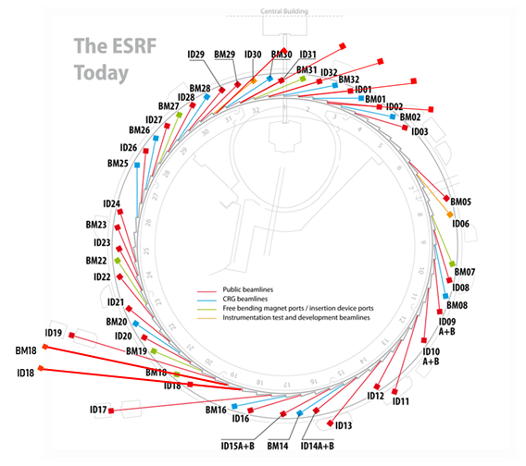
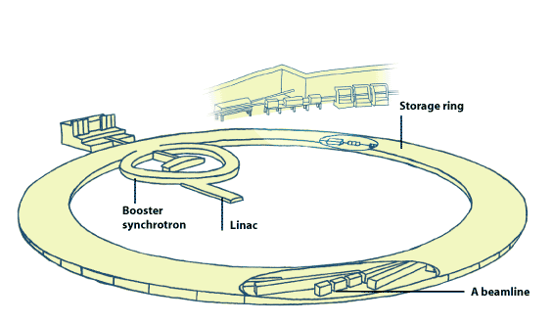
The esrf
6 GeV
34 + 12
10 000
Synchrotron
Beamlines
(public + CRG)
Scientific
visitors each year
IWAA2026| 2026/10/07 | Cristina Gonzalez Torres

Slide 3
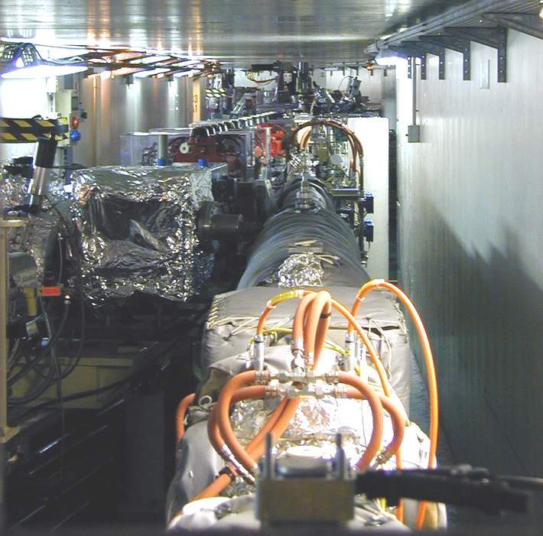

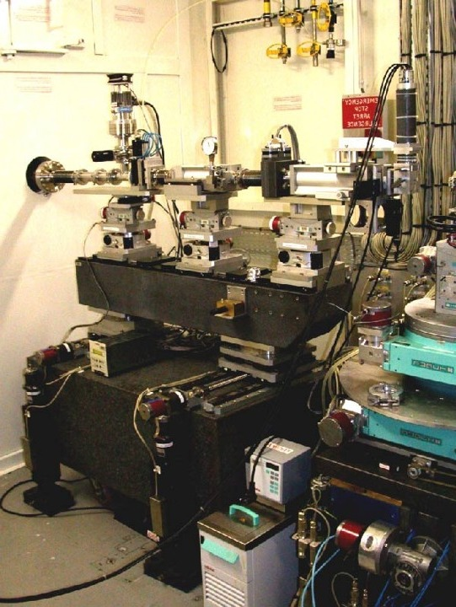

Two sides of the wall
Established monitoring | No long-term systematic time series
Mature systematic survey | Historically measurement on demand
Repeatability | No repeatability
Measurement history | …
IWAA2026| 2026/10/07 | Cristina Gonzalez Torres

Slide 4
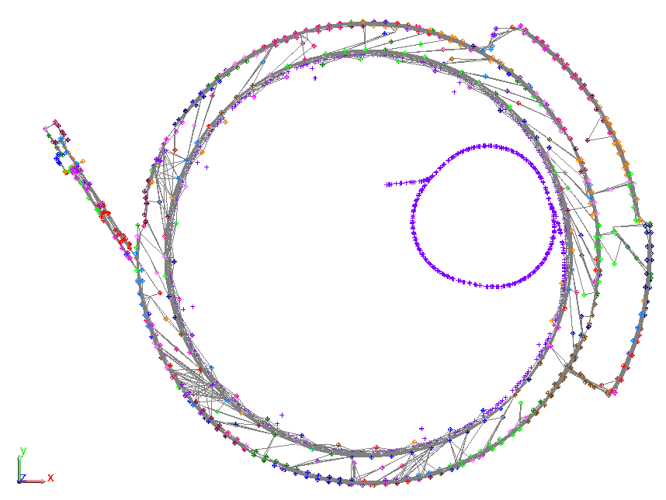



The storage ring survey
Less effort, more data — the survey has matured over three decades, five campaigns a year.
Time required
Number of observation
Observation/person
dR and dZ (μm)
A stable methodology
Regular measurements, five times a year
Our coordinate database (CDB) that contains the measured realization of the reference network at a particular moment
IWAA2026| 2026/10/07 | Cristina Gonzalez Torres

Slide 5


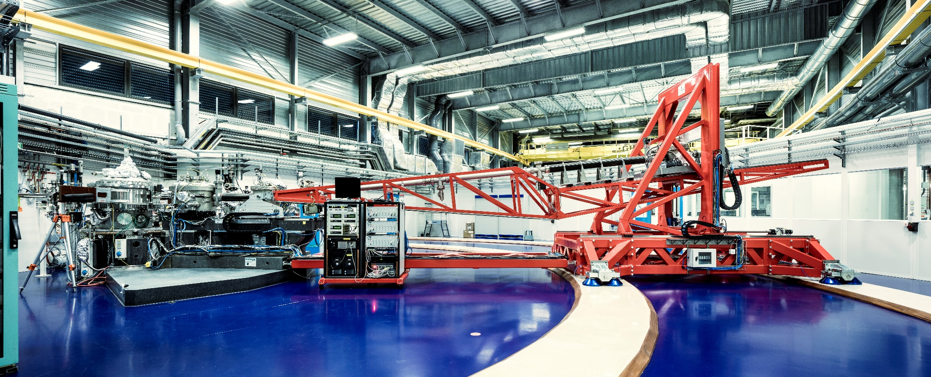
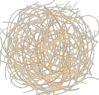
Beamlines: historically measured on demand
Operationally has worked…
Only under request….
IWAA2026| 2026/10/07 | Cristina Gonzalez Torres

Slide 6
Not a correction
No systematic problem
No beamline has currently reported a systematic alignment problem. This is not a corrective campaign, and we are not starting from the assumption that beamlines are moving.
On-demand measurement works well for the immediate task — align the element, close the intervention.
But it does not naturally build a long-term measurement history for the beamline.
WHERE IS THE ELEMENT TODAY?
How has this beamline evolved over time?
The goal of this campaign: make geometric evolution measurable.
IWAA2026| 2026/10/07 | Cristina Gonzalez Torres

Slide 7

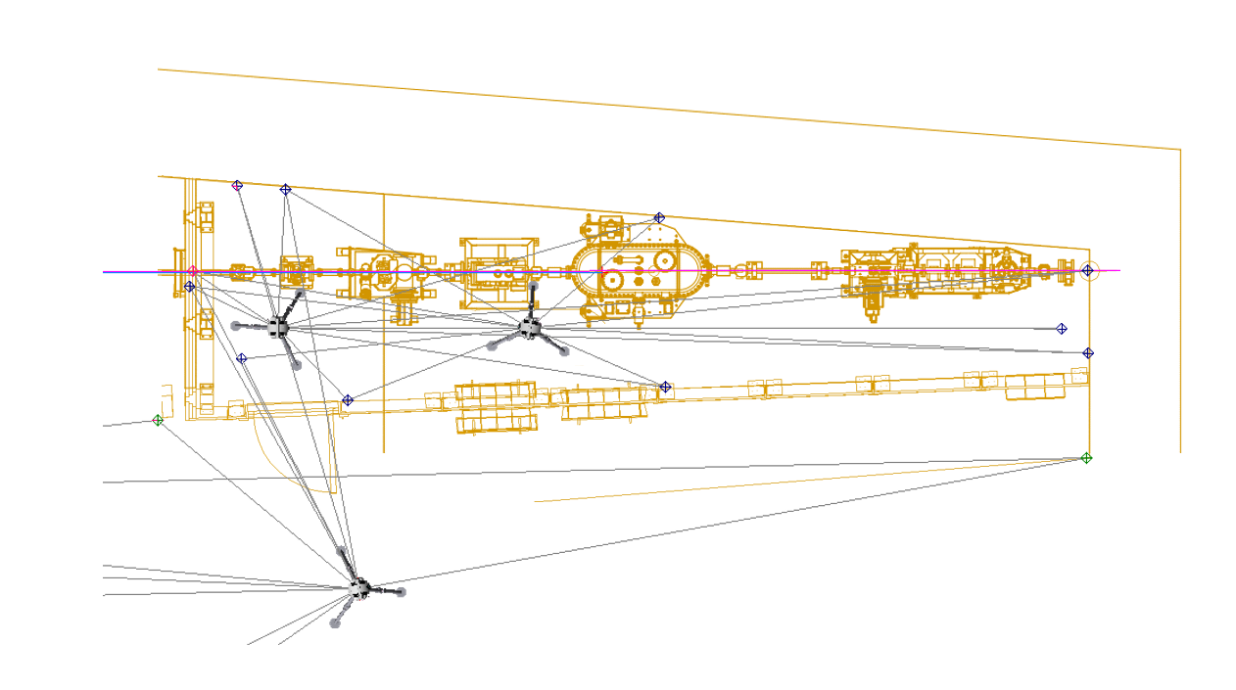
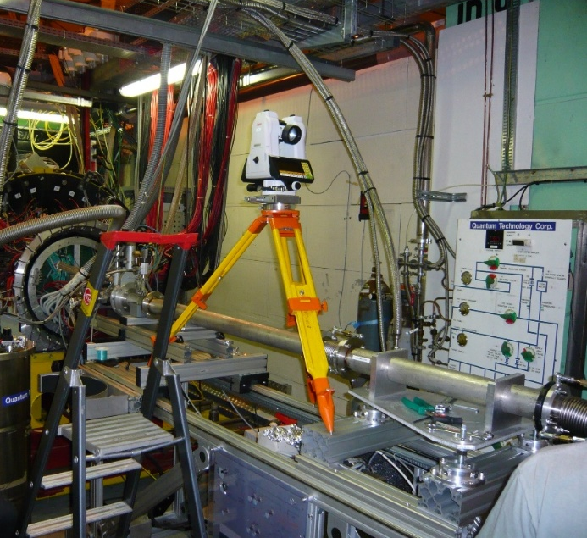
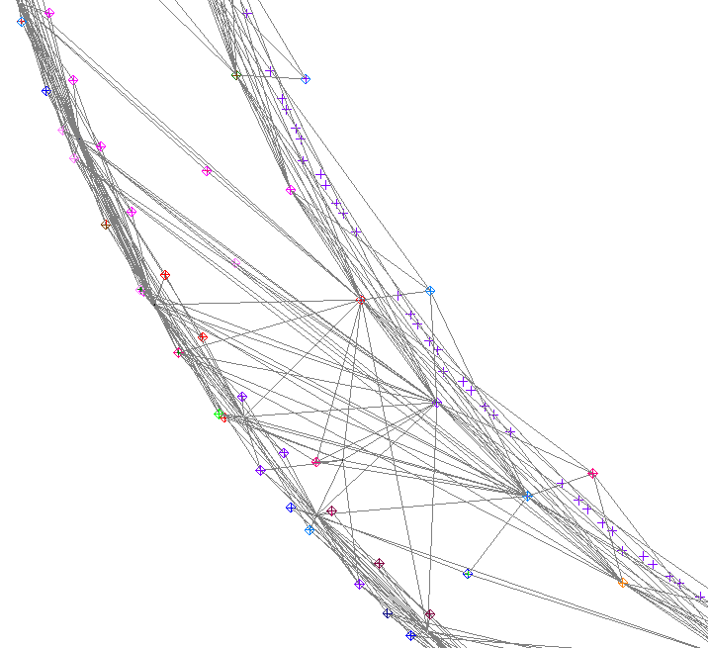

From Local sightlines to a Network
Geometrical structure
IWAA2026| 2026/10/07 | Cristina Gonzalez Torres

Slide 8
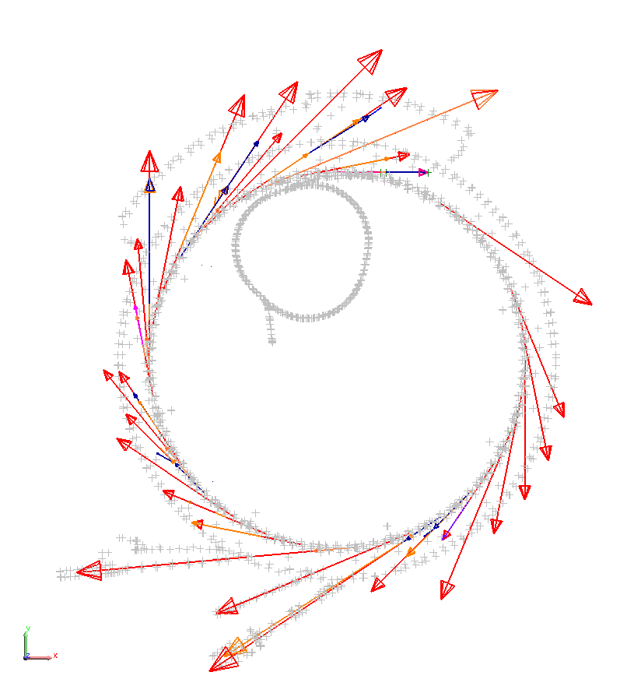
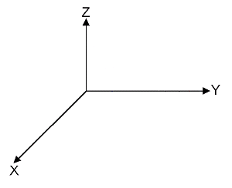

the beam lines frame
0mrad Frame
The common geometrical language of the beamline
Point Source
When we say that an element is at a certain position, or that an element has to be aligned with the beamline axis, this is the reference system we are talking about.
IWAA2026| 2026/10/07 | Cristina Gonzalez Torres

Slide 9
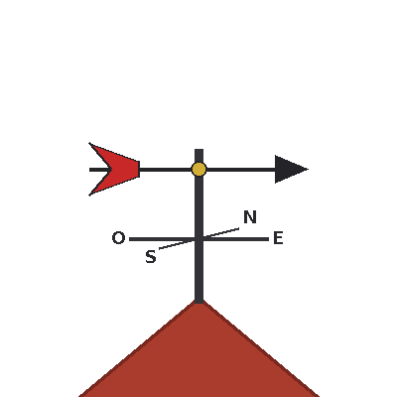
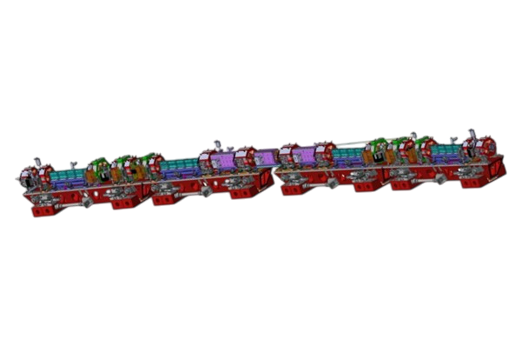
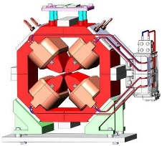
Frame construction
0mrad Frame
updated every 6 months
The nominal beamline axis is determined by the magnets position.
IWAA2026| 2026/10/07 | Cristina Gonzalez Torres

Slide 10
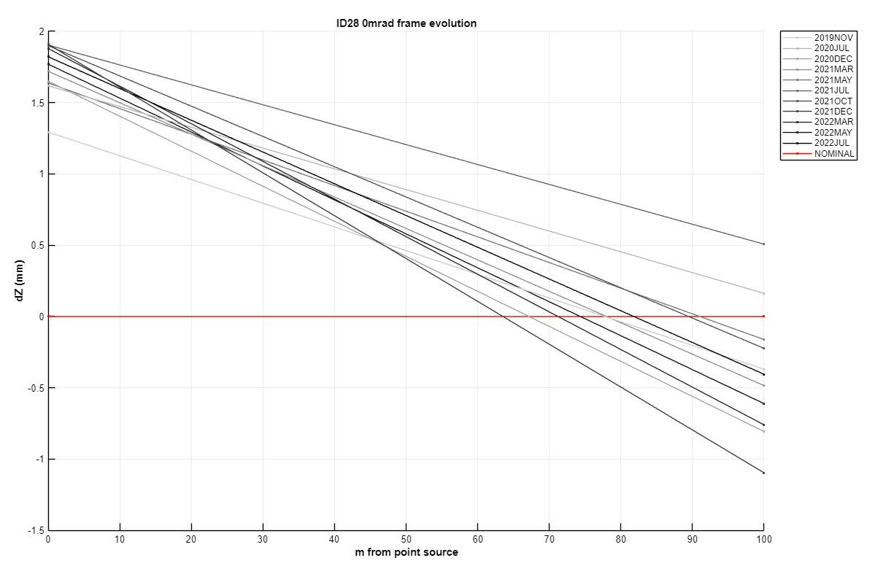
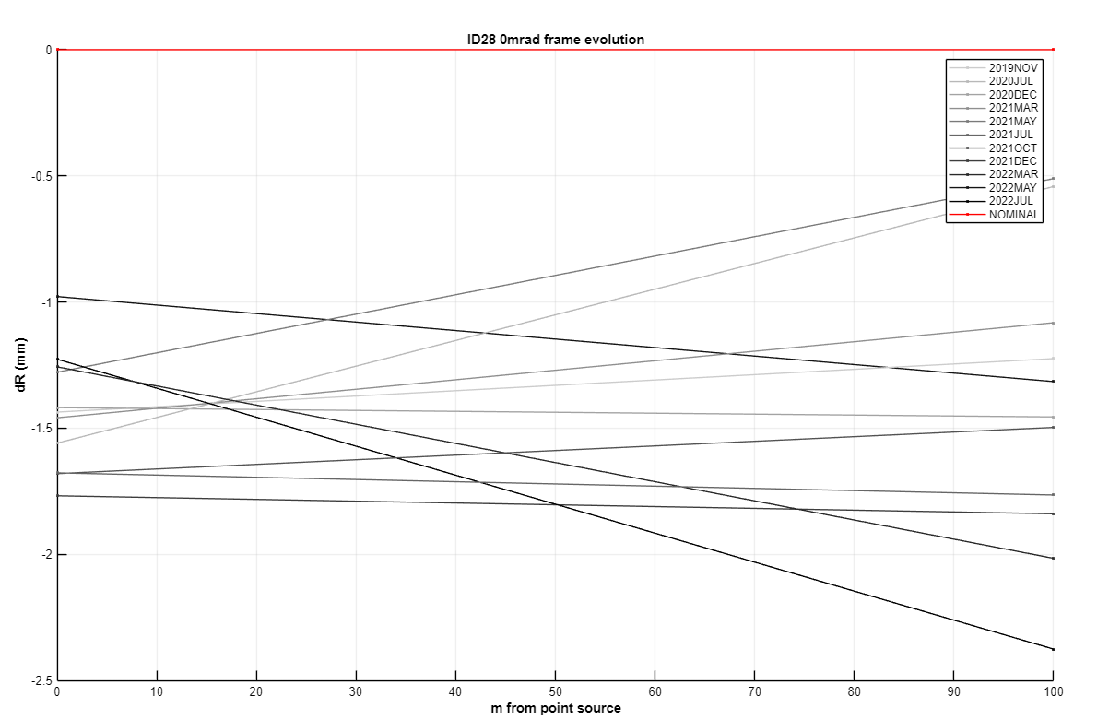
Frame evolution
The geometrical reference used to describe the beam line is not necessarily identical from one period to another
IWAA2026| 2026/10/07 | Cristina Gonzalez Torres

Slide 11
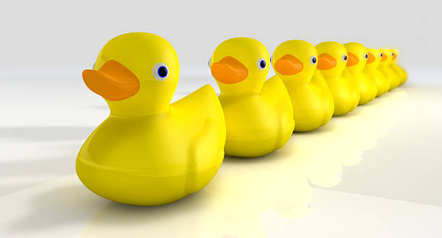
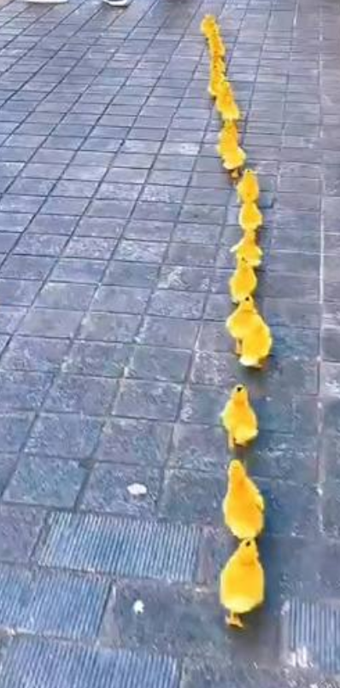
Working across Epochs
The elements are expressed in reference frames derived from different epochs
Therefore, the difference we observe can contain several contributions:
the actual evolution of the element
the evolution of the local reference network
the evolution of the global reference network
measurement uncertainty
changes associated with the way the measurement or calculation was performed
A difference between two coordinates is not automatically a displacement
IWAA2026| 2026/10/07 | Cristina Gonzalez Torres

Slide 12
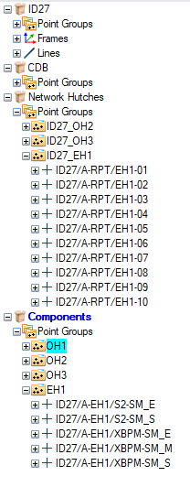

From alignment on demand to annual monitoring
ALIGNMENT ON DEMAND → ANNUAL MONITORING
The idea is to survey each beamline as a complete system
The beamline elements and the hutch reference network are measured during the same campaign
The measurements are then calculated together and related to the appropriate CDB reference
This gives us a consistent measurement epoch for that beamline.
The campaign is distributed over approximately one year
But for each individual beamline, the objective is to obtain a image of its geometry
IWAA2026| 2026/10/07 | Cristina Gonzalez Torres

Slide 13
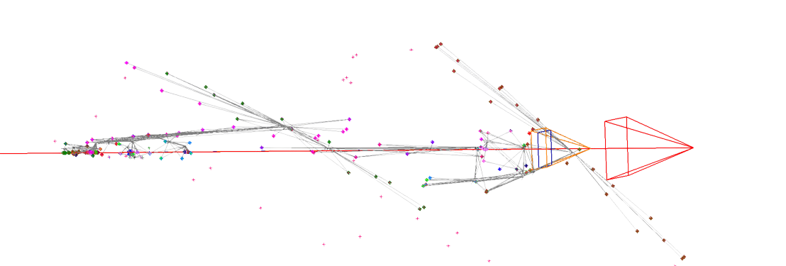
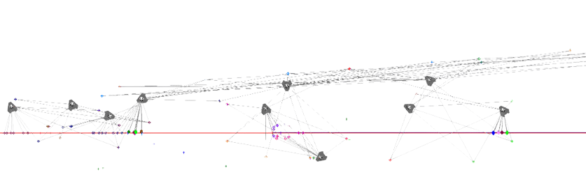
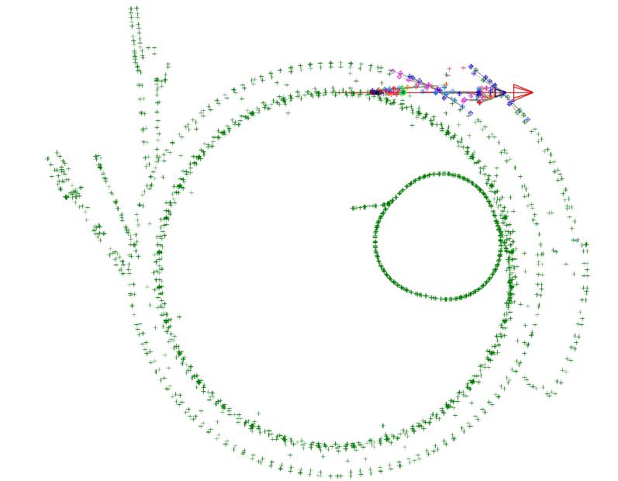
Information levels
SR / EXPH → CDB coordinates → hutch reference network → beamline elements
Three different levels of information:
Global network
Beam line networks
Beam line components
IWAA2026| 2026/10/07 | Cristina Gonzalez Torres

Slide 14
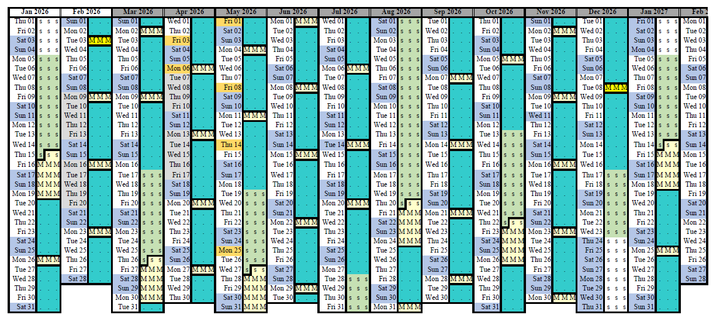


One by one along the year
46 MDT in 2026
IWAA2026| 2026/10/07 | Cristina Gonzalez Torres

Slide 15
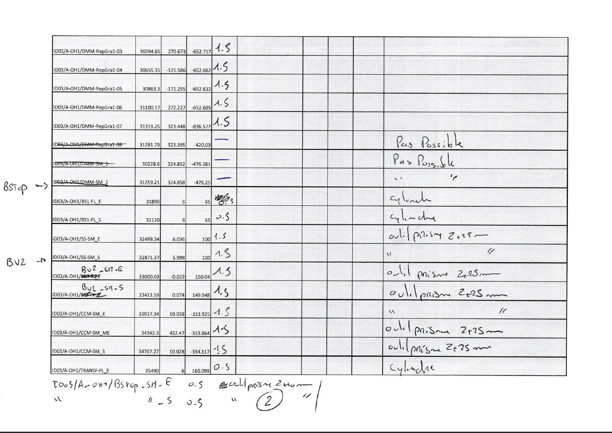




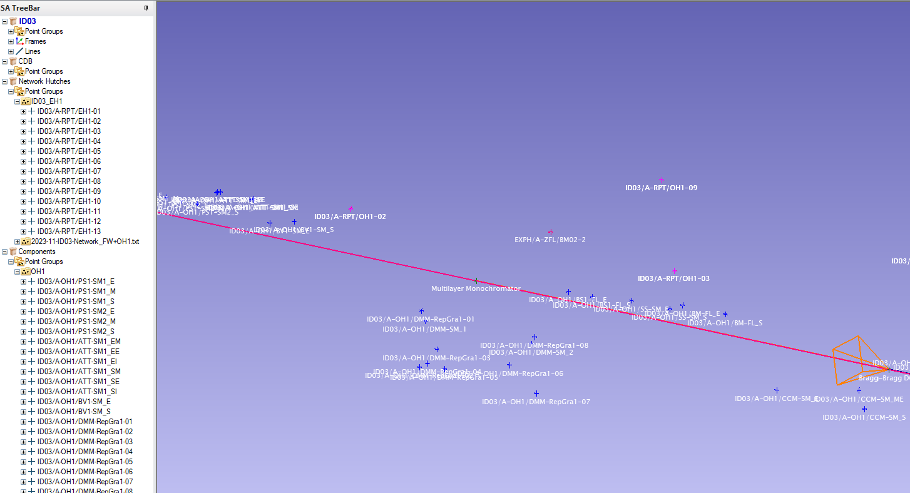
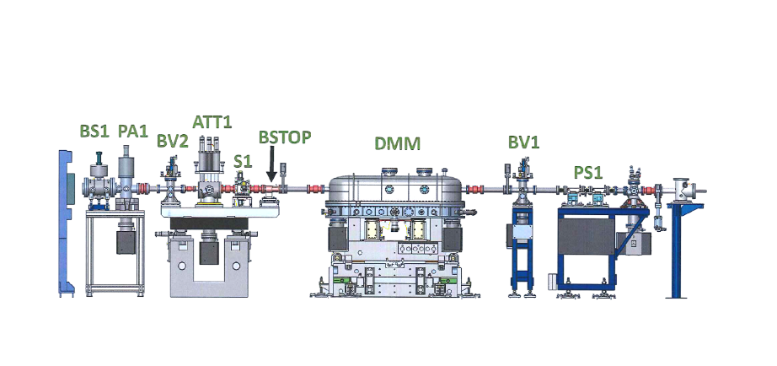


METHODOLOGY: THE MEASUREMENT SEQUENCE
For each beamline, the campaign follows a relatively simple sequence:
1
2
3
4
Prepare
Field work
Processing
Quality control
Point list
Beamline layout
Spatial Analyzer file
Measure the hutch reference network
and the beamline elements
USMN network adjustment
Bestfit to the CDB reference
Validate results
Analysis
OUTPUT
Not simply a list of measured coordinates — the campaign produces:
An updated local reference network
A complete set of beamline measurements,
associated with a defined measurement epoch
IWAA2026| 2026/10/07 | Cristina Gonzalez Torres
The European Synchrotron

Slide 16



Challenges and constraints
Diverse geometries
Long, complex paths
Raised floors, Walls isolation
Some beamlines are straightforward to survey. Others have long beam paths or complicated layouts.
The survey team may pass through several areas before reaching the points that need measuring — adding time and logistics.
Raised floors complicate instrument positioning and lines of sight between reference points and elements.
No single field configuration works everywhere — the methodology has to adapt, beamline by beamline.
IWAA2026| 2026/10/07 | Cristina Gonzalez Torres
11
The European Synchrotron

Slide 17
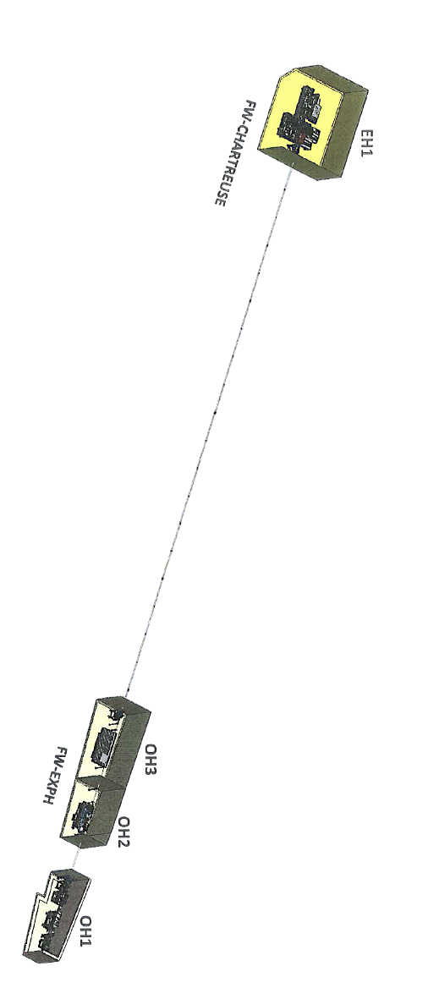
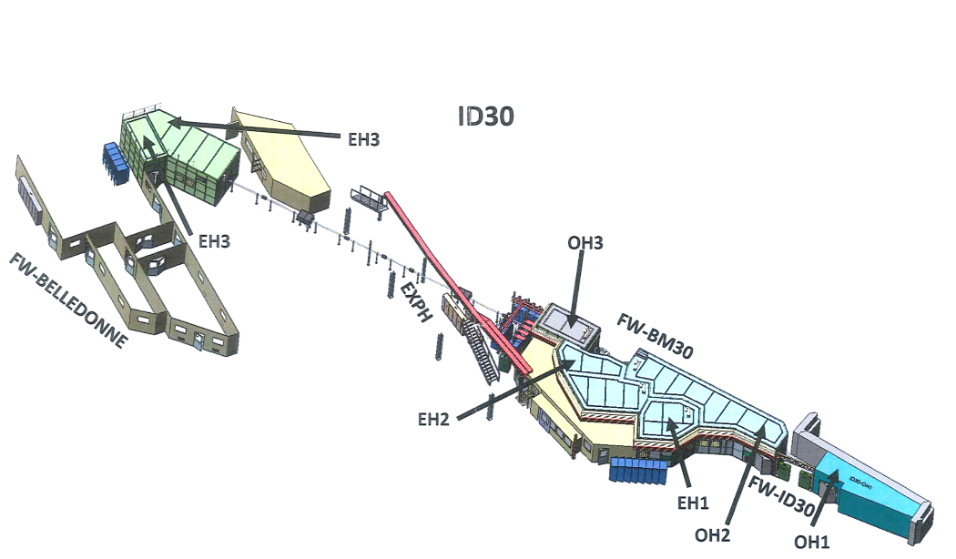
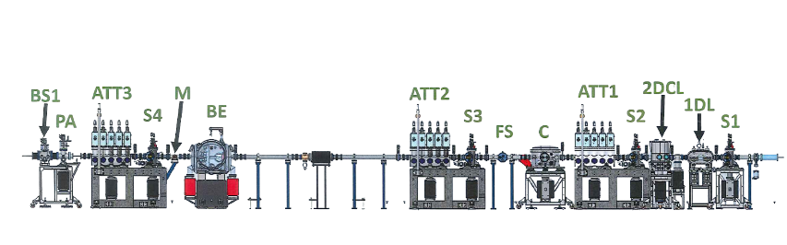
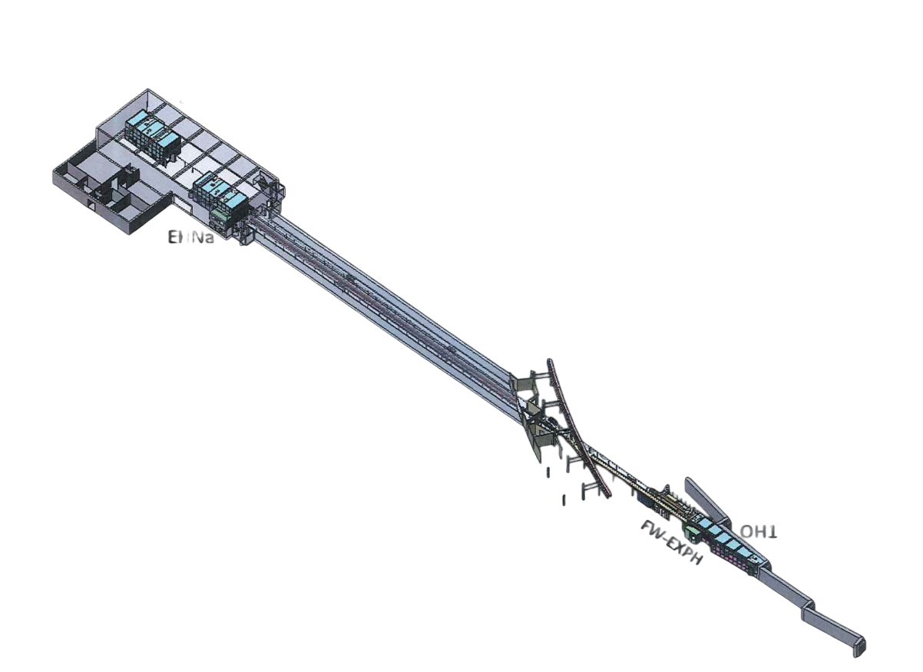
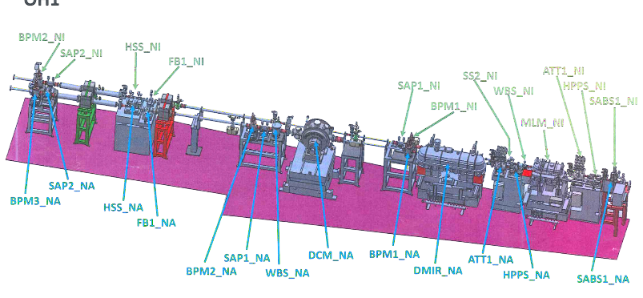
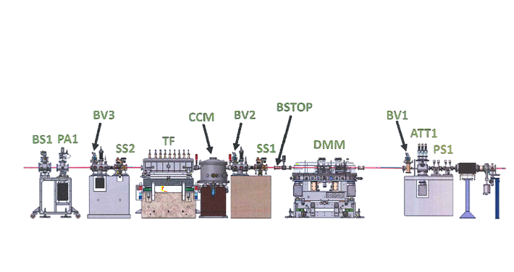
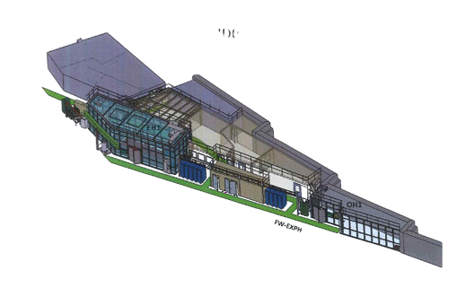
Challenges: Diversity
ID27
ID30
ID16
ID03
IWAA2026| 2026/10/07 | Cristina Gonzalez Torres

Slide 18
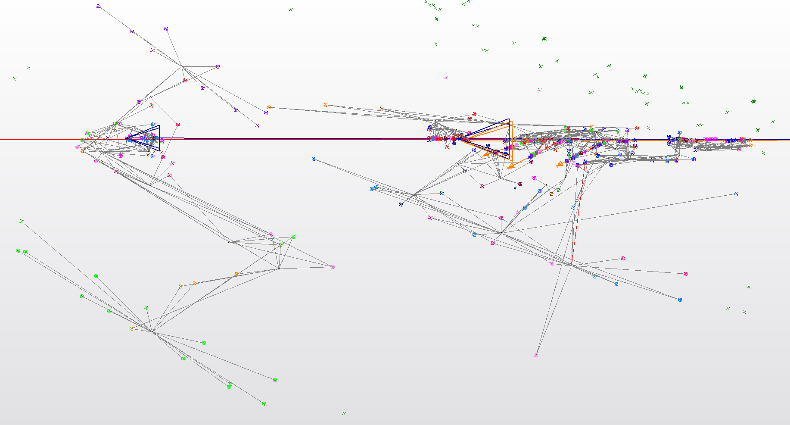
Challenges: Long and complex survey paths
Some beamlines require passing through several areas before we can reach the points we need to measure
IWAA2026| 2026/10/07 | Cristina Gonzalez Torres

Slide 19
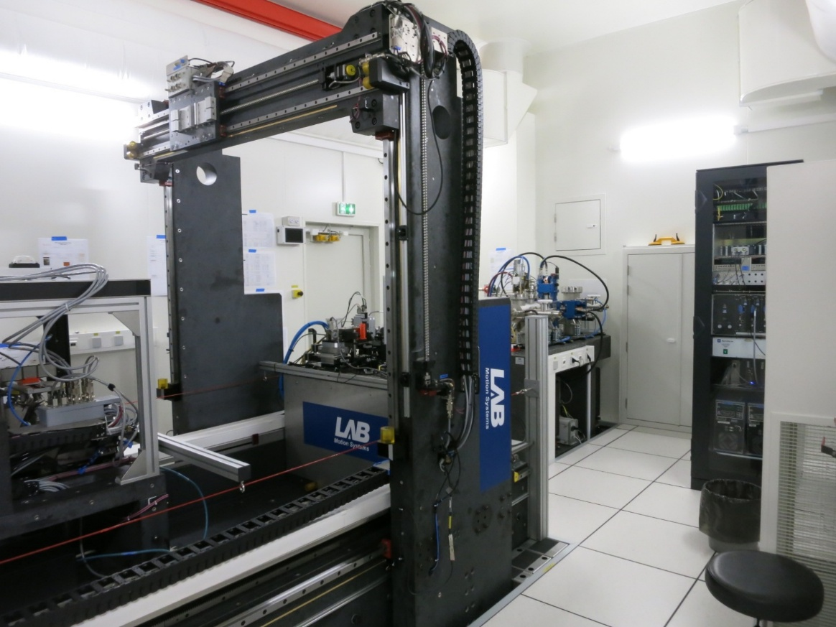
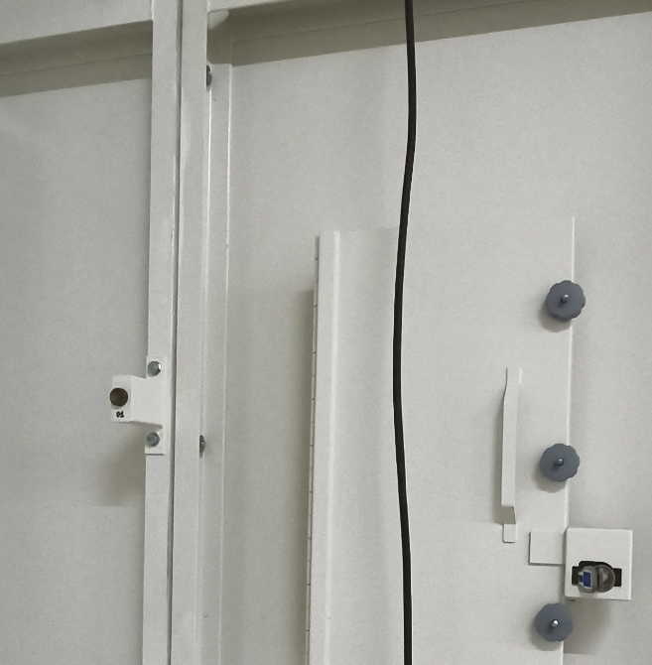
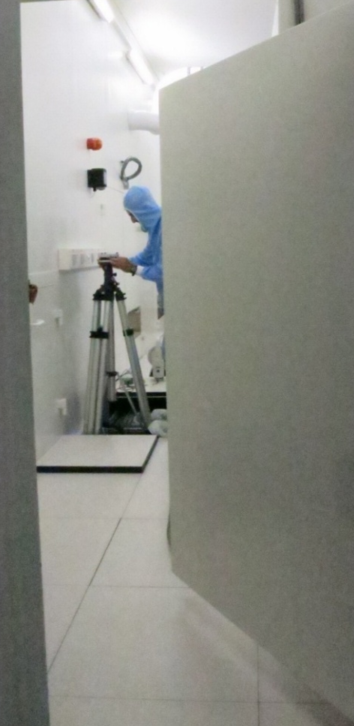
constraints: Raised floor, Isolation walls`
Raised floor
→ Time consuming
→ Conditional stations
Wall isolation :
→ Determines the network's geometry
IWAA2026| 2026/10/07 | Cristina Gonzalez Torres

Slide 20
challenges: Scheduling
WHAT HAS TO LINE UP, EVERY TIME
1
Subcontractor — the external survey company needs a free slot in their own schedule.
2
Beamline staff — have to confirm the dates don’t clash with a sample change or another intervention.
3
Safety — the access permit has to be approved.
4
ALGE (ESRF Alignment) — we need to be available ourselves, to follow up on site.
This is one of the main reasons the campaign has to be spread across the whole year.
IWAA2026| 2026/10/07 | Cristina Gonzalez Torres

Slide 21

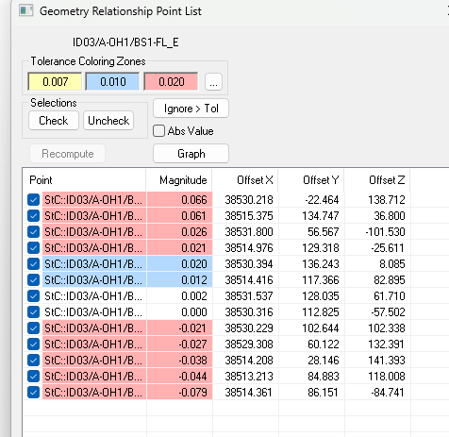
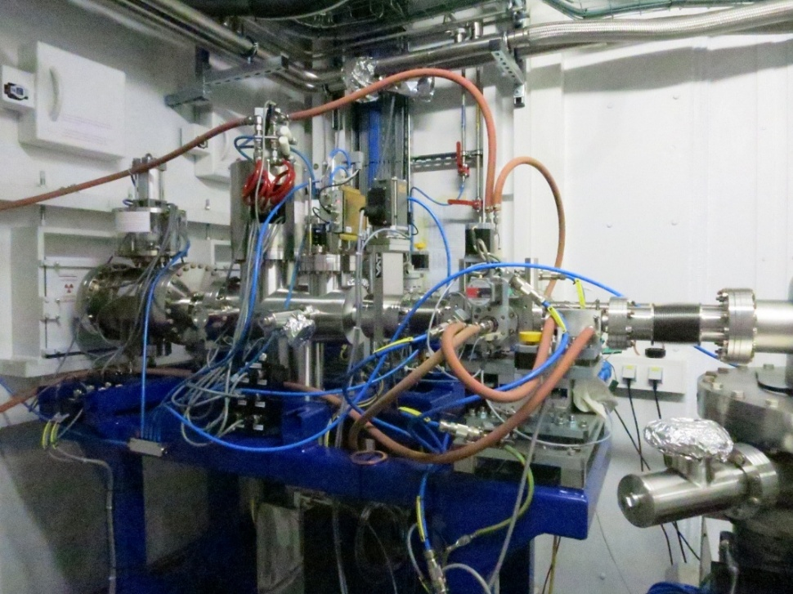
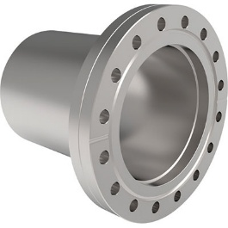
challenges: repetability
Mechanical references such as flanges aren't always measured with exactly the same geometry from one year to the next. To detect relatively small real changes, we first need to know how much of an observed difference simply comes from the measurement process itself.
Real operating conditions change between surveys too — elements move, access differs, interventions happen in between.
Good documentation and traceability are what keep the comparison meaningful.
IWAA2026| 2026/10/07 | Cristina Gonzalez Torres

Slide 22
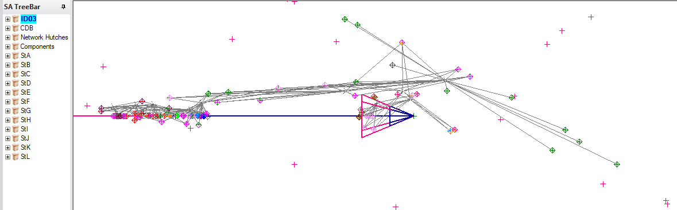
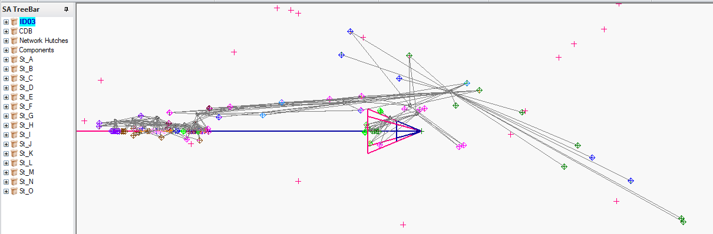
challenges: repetability
IWAA2026| 2026/10/07 | Cristina Gonzalez Torres

Slide 23
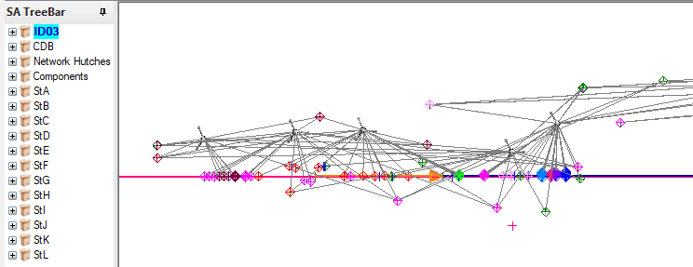
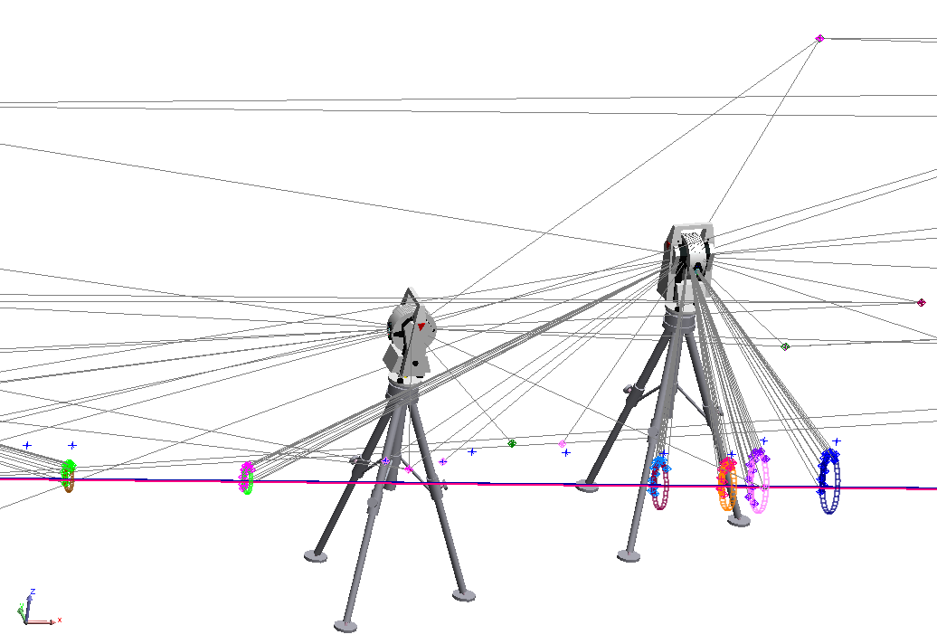
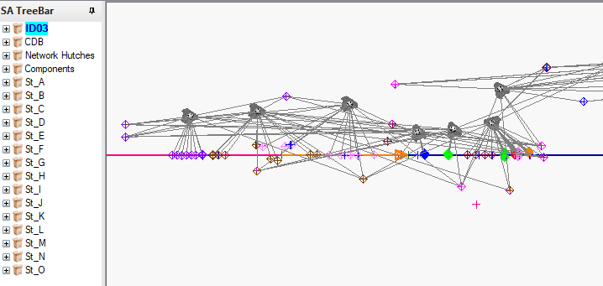
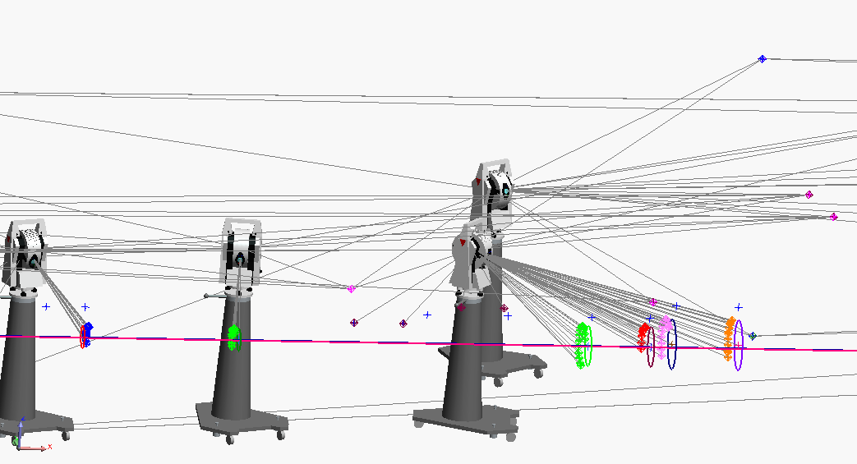
challenges: repetability
IWAA2026| 2026/10/07 | Cristina Gonzalez Torres

Slide 24
Challenges: results interpretation
0mrad202508 Frame
An observed difference is not automatically a displacement
IWAA2026| 2026/10/07 | Cristina Gonzalez Torres

Slide 25
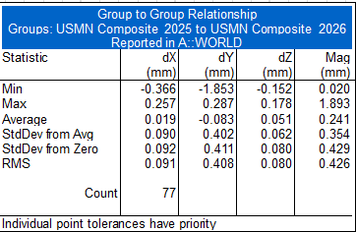
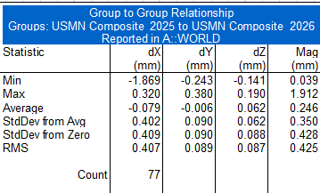
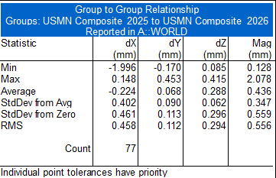
Challenges: results interpretation
Global Frame
USMN2025-USMN2026 (No CDB)
USMN2025-USMN2026 (CDB202508)
USMN2025 (CDB202508)-USMN2026 (CDB202608)
IWAA2026| 2026/10/07 | Cristina Gonzalez Torres

Slide 26

Two benefits of the campaign
TWO BENEFITS
STILL TO IMPROVE
Immediate
Coverage — More complete year-to-year datasets
Updated beamline reference networks, ready for the next alignment intervention.
Repeatability — Quantify the repeatability of the full measurement process
Scheduling — Easier to integrate into ESRF planning
Long term
A time series of beamline geometry — the basis for studying normal evolution, systematic effects, and genuinely significant changes.
QC & traceability — Stronger validation and documentation
Single point of failure — Reduce dependency on one coordinator
IWAA2026| 2026/10/07 | Cristina Gonzalez Torres

Slide 27
Conclusion
From alignment on demand to measurable beamline evolution
A complete picture, repeated every year
We started with beamlines measured mainly on demand — one intervention at a time.
The new campaign surveys each beamline as a whole: the reference network and the beamline elements are measured together, in the same visit, and tied to one clearly defined measurement epoch.
Repeated year after year, those individual snapshots progressively build a real time series — turning beamline geometry from something we check into something we can measure and interpret over time.
The goal is not simply to survey beamlines every year.
The goal is to make their geometric evolution measurable and interpretable.
IWAA2026| 2026/10/07 | Cristina Gonzalez Torres

Slide 28


THANKS FOR YOUR ATTENTION

