Slide 1


Survey & Alignment Group software :
current developments and perspectives
Guillaume Chamblas
IWAA 2026 – KEK, Tsukuba, Japan
Wednesday, October 7, 2026

Slide 2

SURVEY

Slide 3
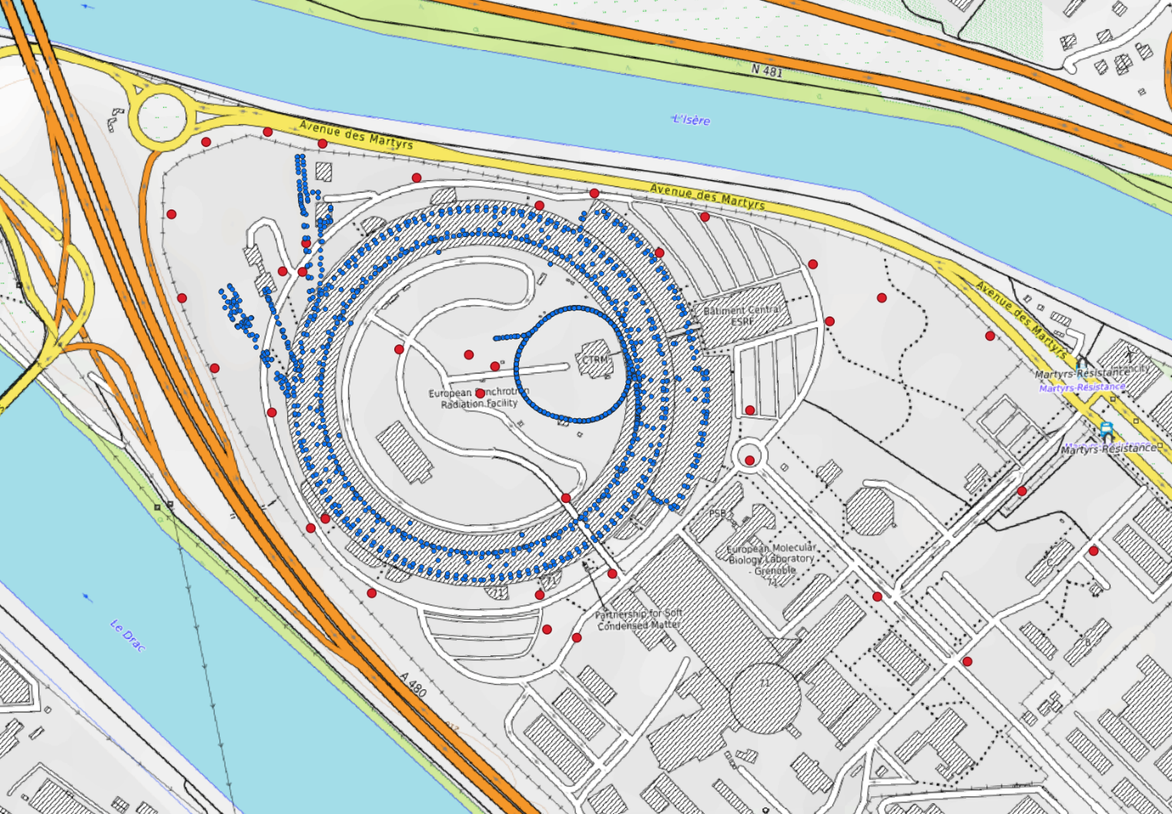
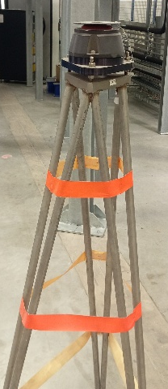
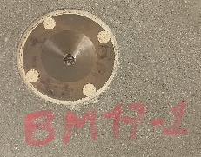
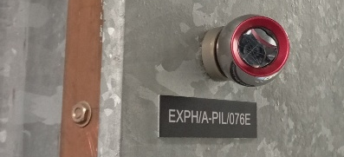
SOFTWARE - SURVEY
ESRF NETWORK
* primary network
Survey & Alignment Group has a primary network of reference points for the alignment tasks.
These points are of different types:
For the outside :
  Concrete pillars
For inside facilities :
  Glued points
  Survey monuments
  Tripod
  Magnet fiducials
  Conical fiducials cast into the slabs
Page 3

Slide 4
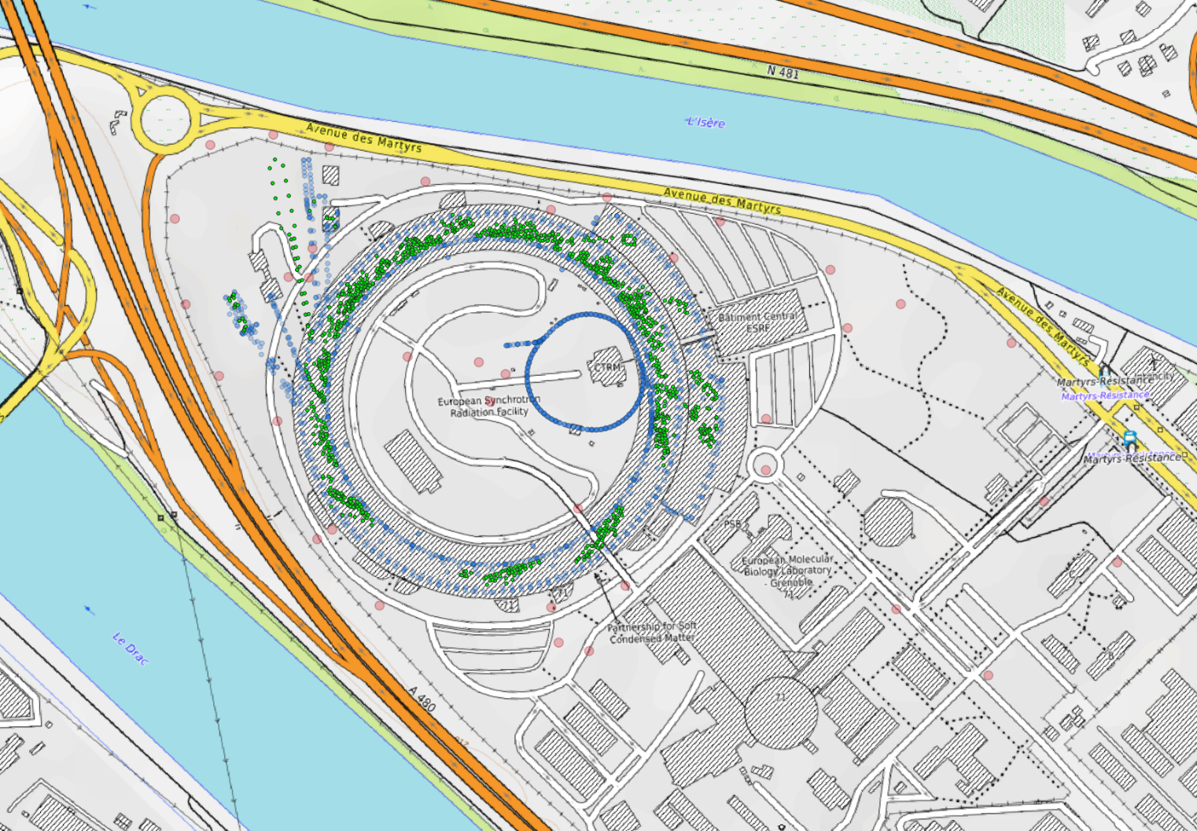
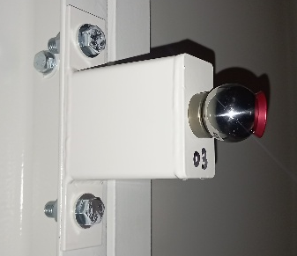
SOFTWARE - SURVEY
ESRF NETWORK
* secondary network
Survey & Alignment Group has a secondary network of reference points for the alignment tasks in the ESRF beamlines.
(located in optical and experimental hutches)
These reference points are only
glued points inside of the hutches.
The survey of these points is done during the Machine Dedicated Time (MDT) period with a variable frequency as shown in Cristina’s presentation.
Their coordinates are calculated from the primary network.
Page 4

Slide 5
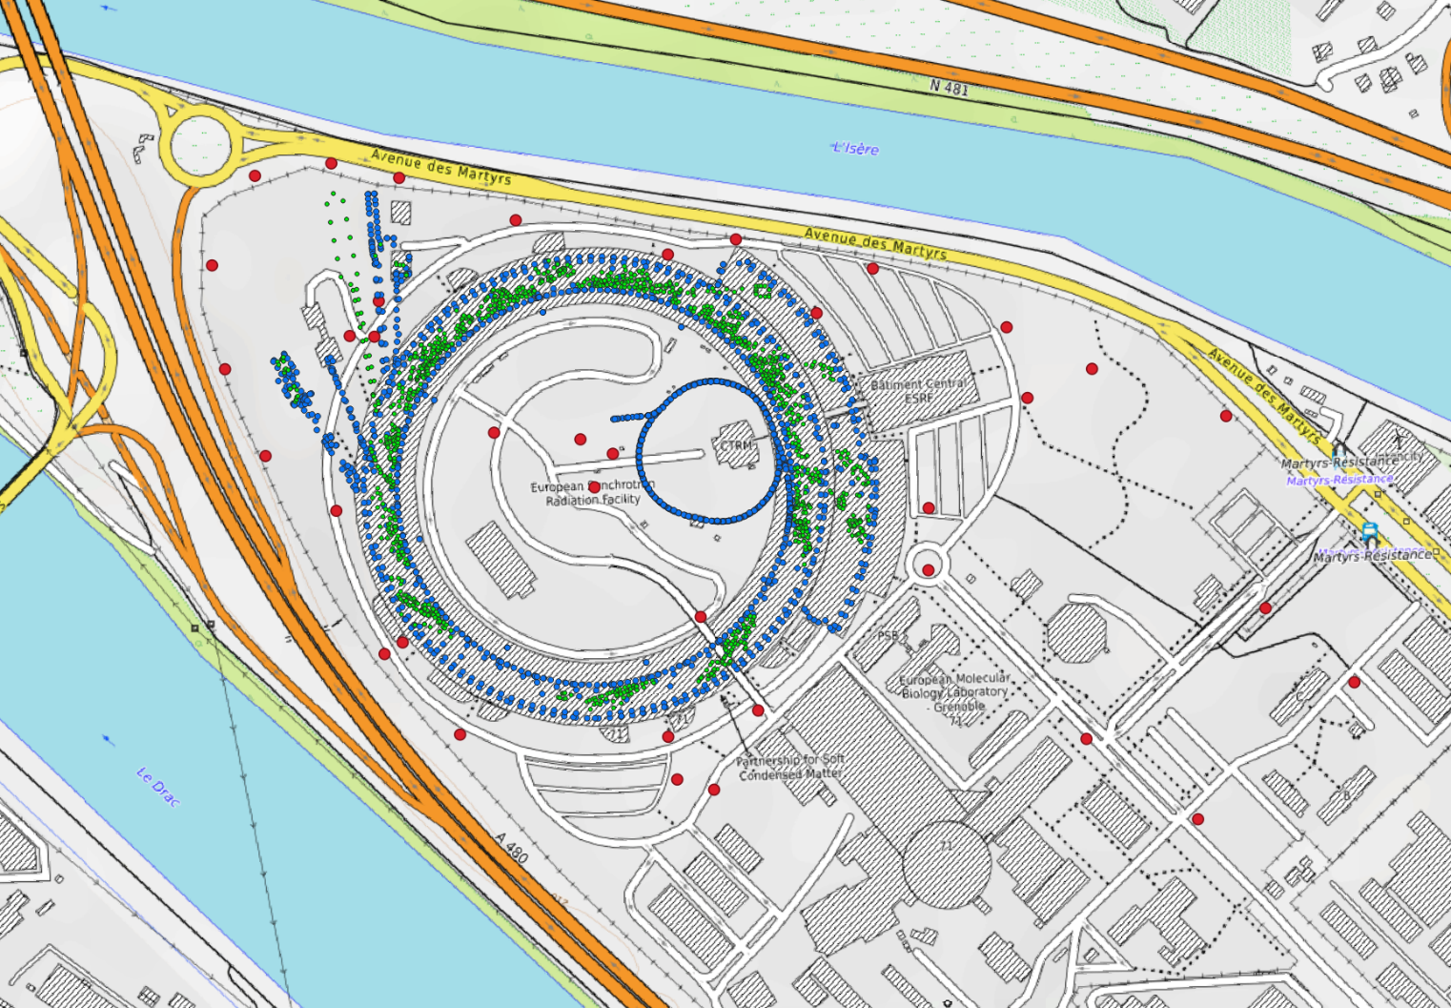
SOFTWARE - SURVEY
ESRF NETWORK
* primary + secondary networks
The primary network has 2148 points :
2108 points >> inside facilities
40 points >> outside concrete pillars
The secondary network has 1780 points.
There are about 4000 network points. This count increase with the installation of new beamlines.
All measurements are done with Laser Trackers Leica AT403 and digital levels Trimble DiNi.
In this presentation, we will only focus on the primary network, because its survey is systematically.
Page 5

Slide 6
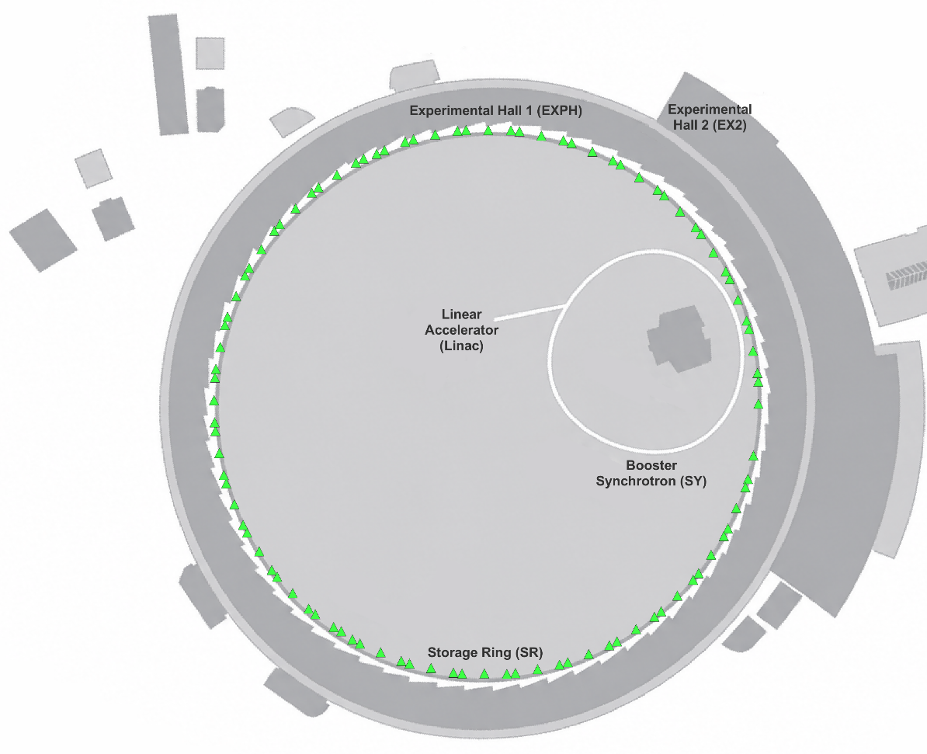
SOFTWARE - SURVEY
SHORT SHUTDOWN SURVEY
SR-SSD survey three times a year 196 stations >>> 3214 measurements Hz V d
The survey of the Storage Ring is done during every short shutdown to:
- study the accelerator's alignment smoothing
The survey consists of measuring about 200 laser tracker stations .
The available planning slot to avoid coworking is quite tight. We have an 8-hours slot to complete the full survey.
Page 6

Slide 7
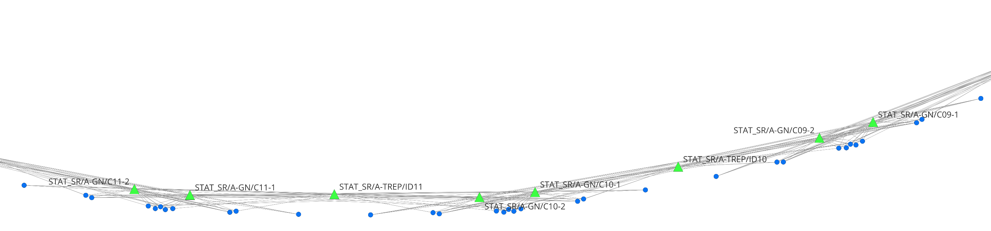
SOFTWARE - SURVEY
SHORT SHUTDOWN SURVEY
SR-SSD survey three times a year 196 stations >>> 3214 measurements Hz V d
The survey of the Storage Ring is done during every short shutdown to:
- study the accelerator's alignment smoothing
The survey consists of measuring about 200 laser tracker stations .
The available planning slot to avoid coworking is quite tight. We have an 8-hours slot to complete the full survey.
Page 7

Slide 8
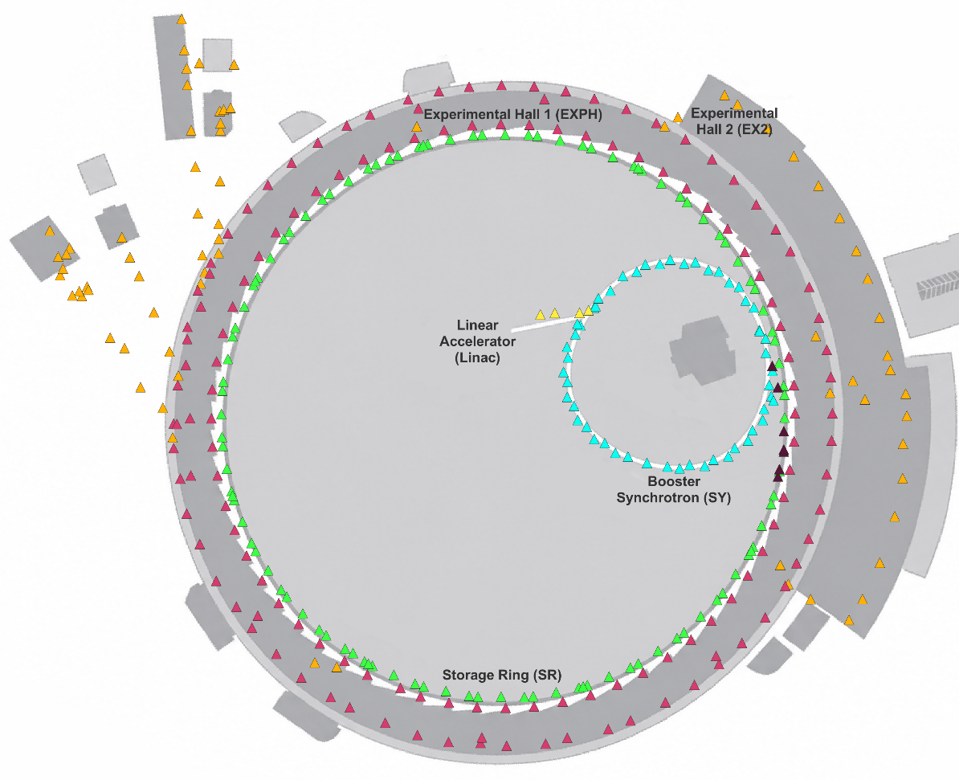
SOFTWARE - SURVEY
LONG SHUTDOWN SURVEY
SR-LSD survey + TL1 / Booster / TL2 / EXP survey two times a year 513 stations >>> 9304 measurements Hz V d
The survey of the whole facilities network is done during every long shutdown to:
study the accelerator's alignment smoothing
update the coordinates network (CDB)
The survey consists of measuring more than 500 laser tracker stations.
This survey is done for about a week.
Page 8

Slide 9
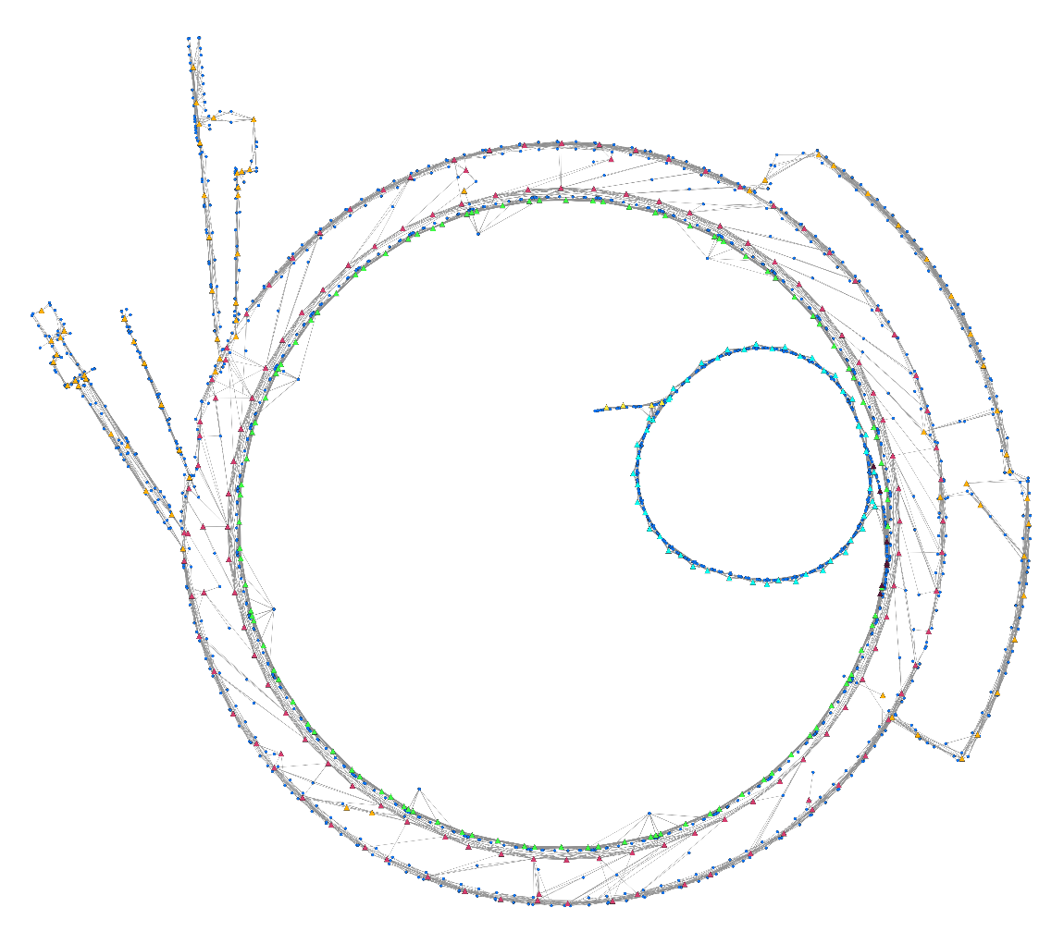
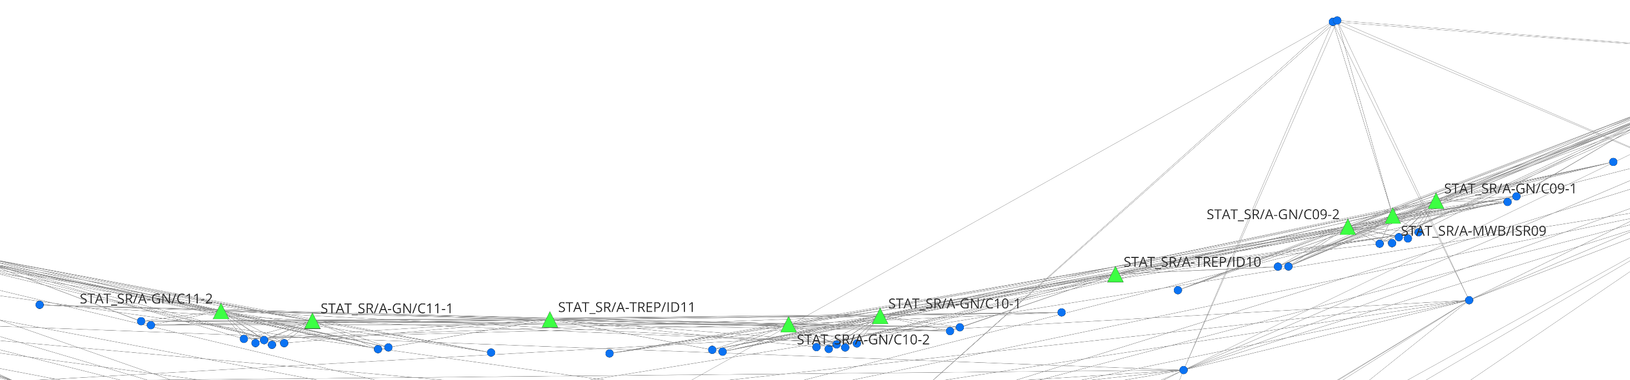
SOFTWARE - SURVEY
LONG SHUTDOWN SURVEY
SR-LSD survey + TL1 / Booster / TL2 / EXP survey two times a year 513 stations >>> 9304 measurements Hz V d
The updating of all network points is calculated from the coordinates of the machine magnets.
The link between the machine and the rest of the network is done by six pointing windows located all along the SR tunnel.

Slide 10
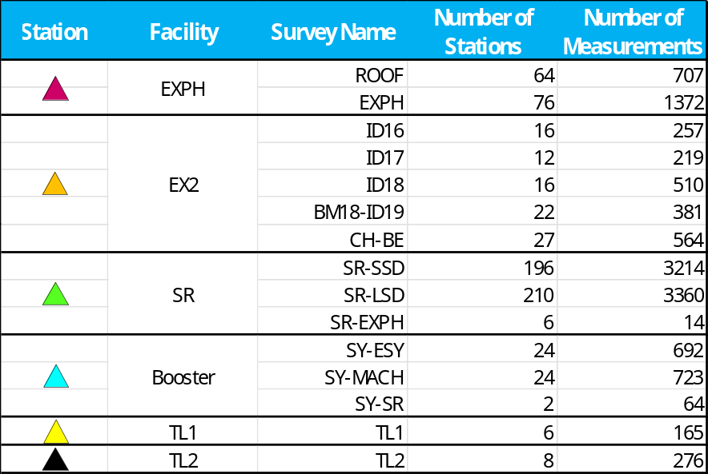
SOFTWARE - SURVEY
ANNUAL STATISTICS
Finally these surveys involve the acquisition and the management of 1614 stations and 28250 measurements per year.
They are measured during a time slot of about three weeks per year.
Page 10

Slide 11

SOFTWARE - SURVEY
SURVEY CONSTRAINTS
These surveys have several constraints :
A large number of measurements must be done with a limited timeframe
The measurements must be done frequently, up to five times a year for the Storage Ring
A part of the surveys is done by external staff who may not be fully familiar with them
Page 11

Slide 12

SOFTWARE - SURVEY
SURVEY CONSTRAINTS
These surveys have several constraints :
A large number of measurements must be done with a limited timeframe
The measurements must be done frequently, up to five times a year for the Storage Ring
A part of the surveys is done by external staff who may not be fully familiar with them
Early on, the S&A Group developed a software to automate these surveys with three aims :
Minimize the survey time with automatic pointing and measurement launching
Prevent the naming errors of measured points
Have the simplest possible software
Page 12

Slide 13
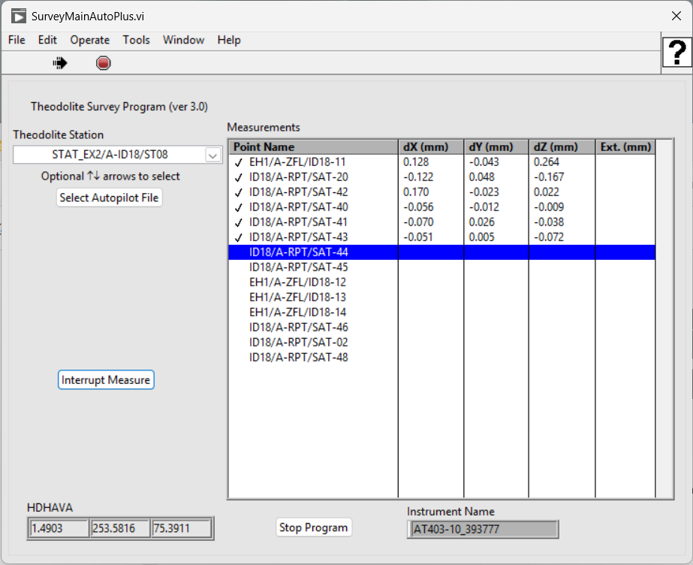
SOFTWARE - SURVEY
THEODOLITE SURVEY
The software TheodoliteSurvey was created by David Martin and Gilles Gatta to achieve these expectations.
The code has been developed for dozens of years.
At the beginning it was used to pilot TDA5005 theodolites.
Now with LMF.Tracker.Connection.dll library the software can pilot AT40x Laser Trackers.
Page 13

Slide 14
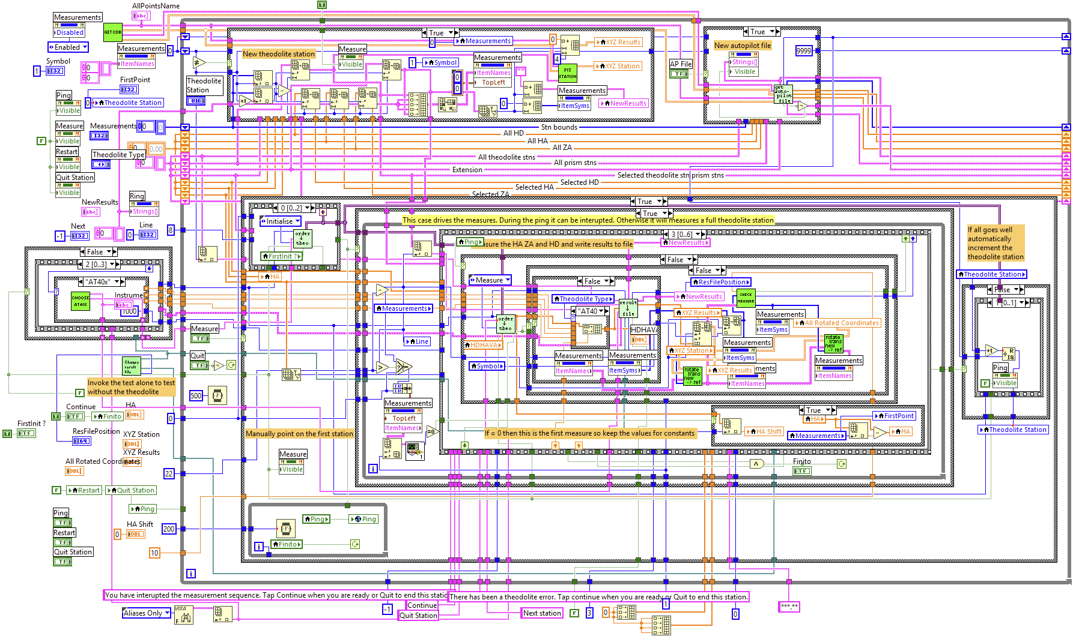
SOFTWARE - SURVEY
THEODOLITE SURVEY
The software TheodoliteSurvey was created by David Martin and Gilles Gatta to achieve these expectations.
The code has been developed for dozens of years.
At the beginning it was used to pilot TDA5005 theodolites.
Now with LMF.Tracker.Connection.dll library the software can pilot AT40x Laser Trackers.
The used code is Labview.
Page 14

Slide 15


SOFTWARE - SURVEY
CODE LIMITATION
However use of Labview could be an issue in future years:
Few people have skills in Labview coding.
Recruiting staff is already difficult. Finding people who also have these specific skills could make it even more difficult. The long-term maintenance of the software could be compromised.
The use of commercial licensed digital tools is increasingly under discussion at ESRF.
Rising licensing costs in recent years have led staff management to encourage open-source solutions.
Page 15

Slide 16



SOFTWARE - SURVEY
CODE LIMITATION
However use of Labview could be an issue in future years:
Few people have skills in Labview coding.
Recruiting staff is already difficult. Finding people who also have these specific skills could make it even more difficult. The long-term maintenance of the software could be compromised.
The use of commercial licensed digital tools is increasingly under discussion at ESRF.
Rising licensing costs in recent years have led staff management to encourage open-source solutions.
S&A Group decided to use python code for the future of this software.
Page 16

Slide 17
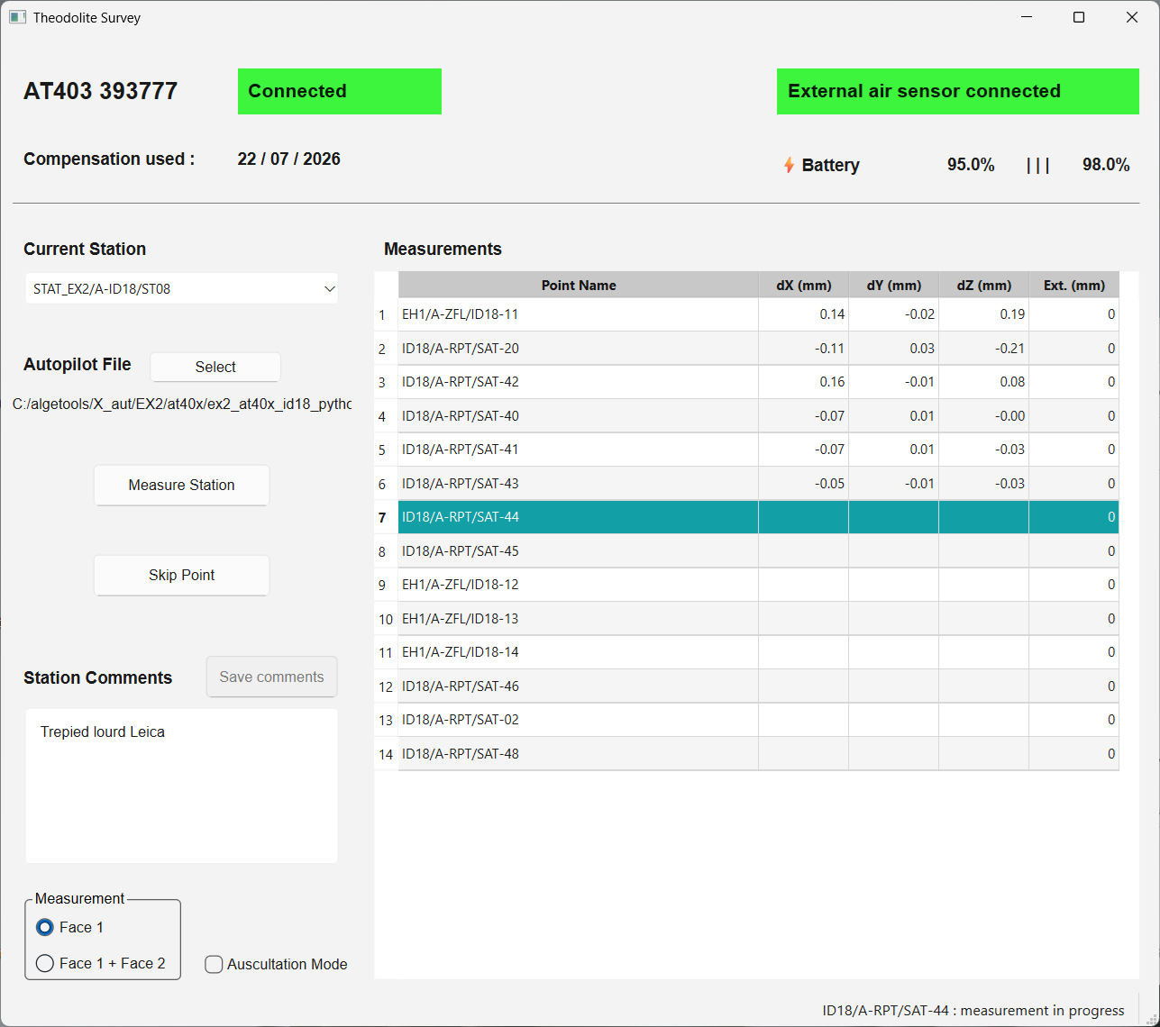
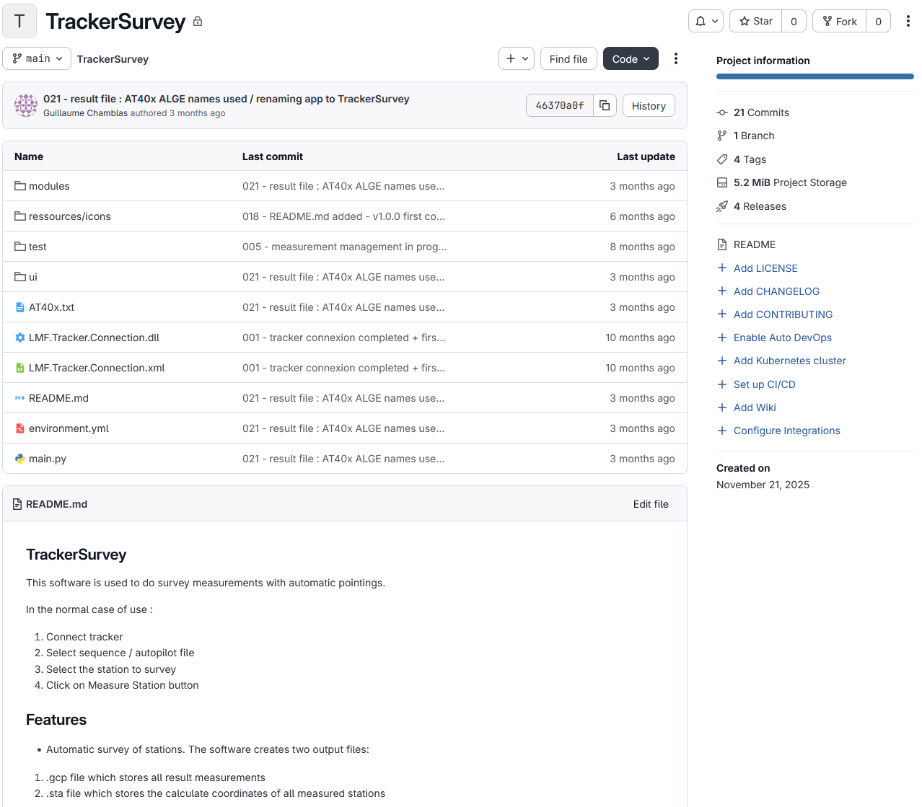
SOFTWARE - SURVEY
CODING TO PYTHON
The python coding is now complete, and this version is fully operational.
Page 17

Slide 18
CALCULATION

Slide 19
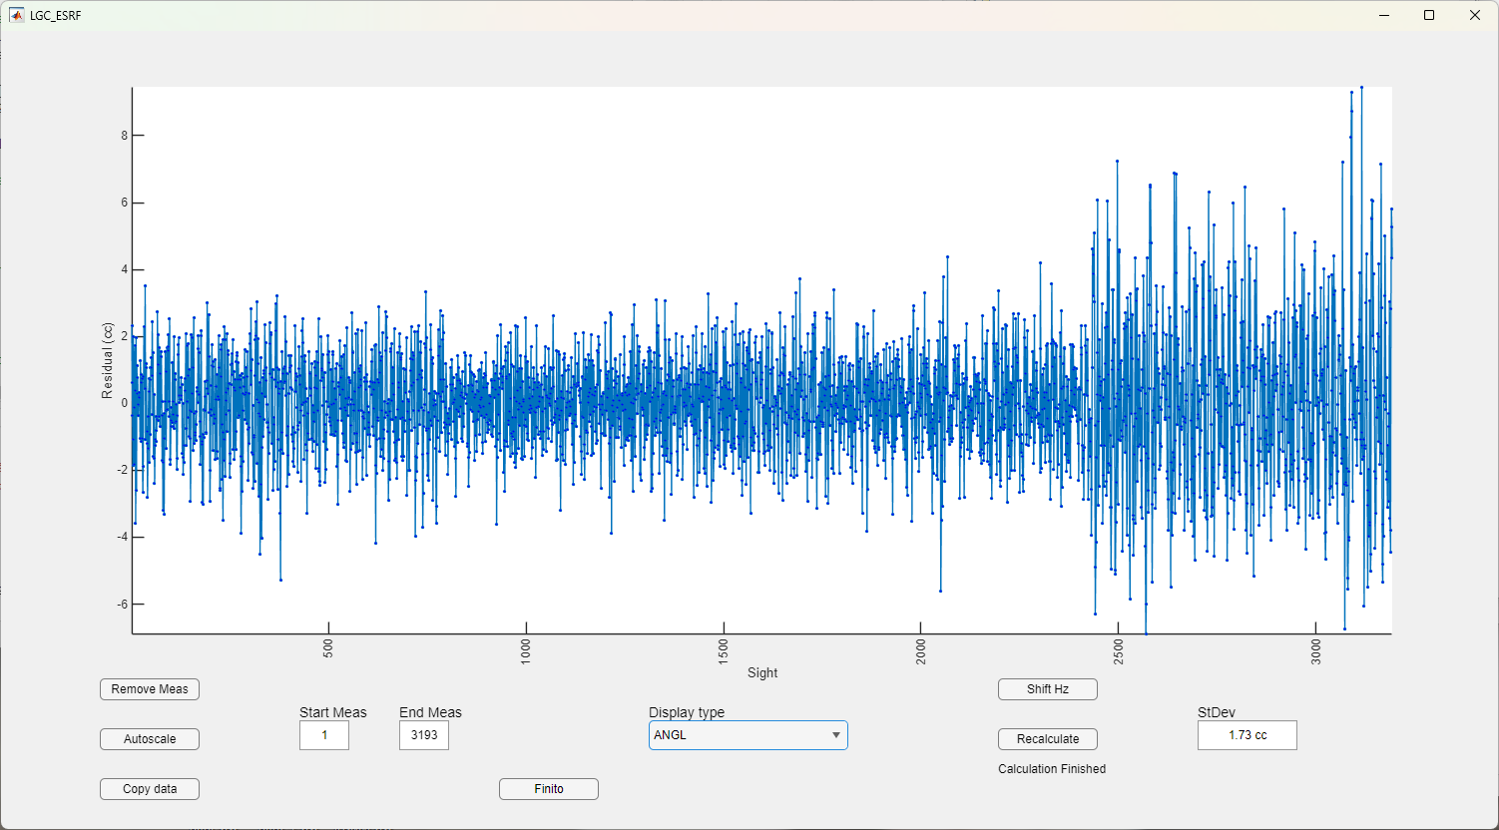



SOFTWARE - CALCULATION
CURRENT PROCESS
Thanks to the previous survey software, data are pre-formated for this calculation step.
The calculation process currently consists of successive steps to prepare data for LGC software and get calculated coordinates of network.
These steps are individual and done with :
Excel macros for data management
Matlab scripts running
These steps are not managed by a single piece of software but
insteady they are run individually.
Matlab app developed by Gilles Gatta to visualize LGC residuals and select associated observations
Page 19

Slide 20
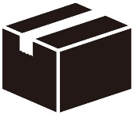
SOFTWARE - CALCULATION
CURRENT PROCESS LIMITATION
For the future of calculation management, the constraints are the same as for the survey software.
Excel and Matlab have the same issues about licensing costs.
The software development for this calculation task is currently at the project study stage.
Page 20

Slide 21
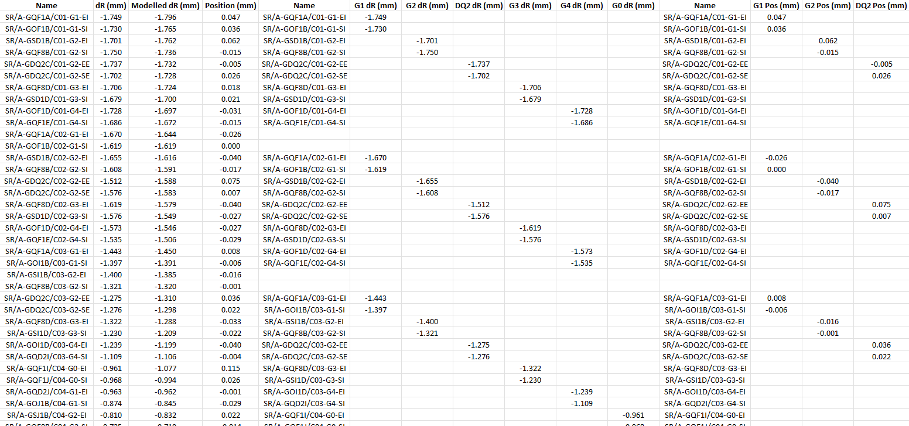

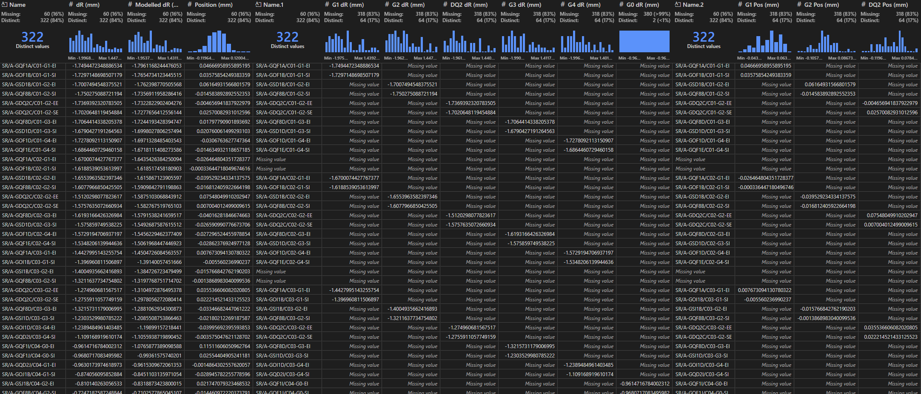
SOFTWARE - CALCULATION
PERSPECTIVES
1) Data management
For the future the initial idea is to move away from Excel and Matlab by developing python code able to do the same processing.
The data management which is currently done by Excel would instead be managed using pandas DataFrames.
Page 21

Slide 22
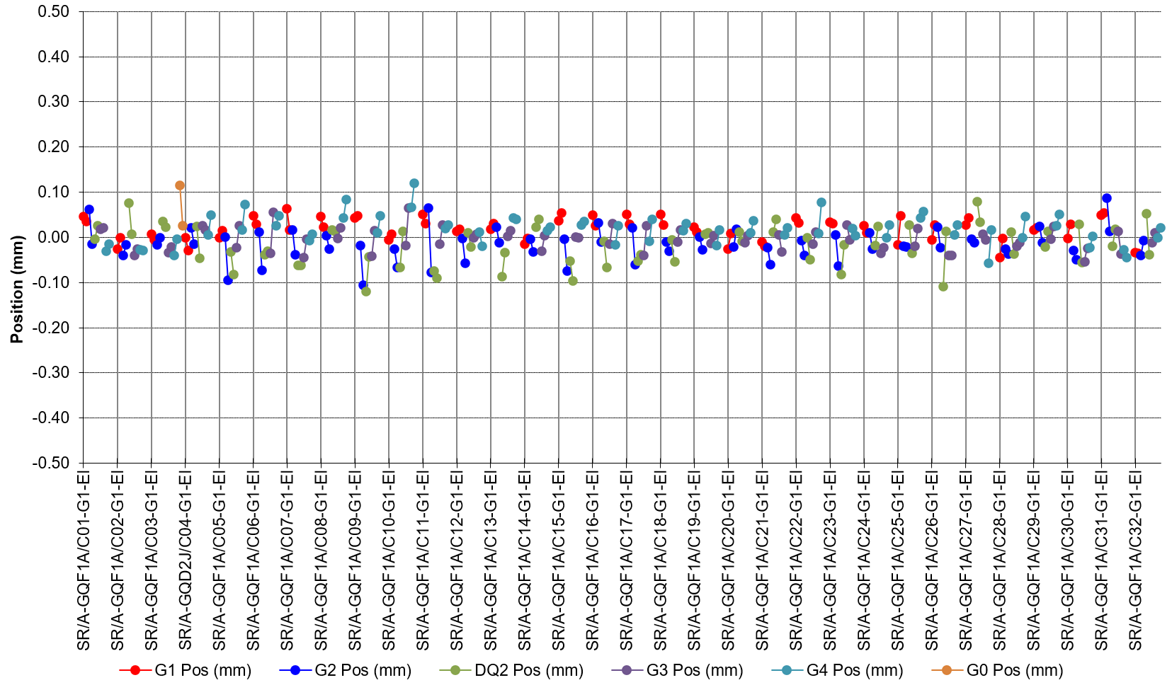
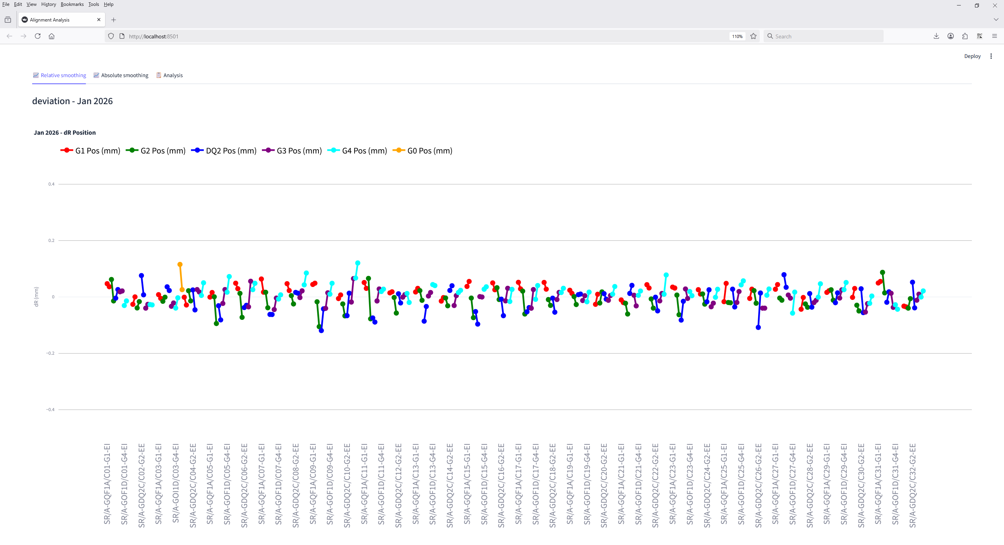

SOFTWARE - CALCULATION
PERSPECTIVES
1) Data management
For the future the initial idea is to move away from Excel and Matlab by developing python code able to do the same processing.
The data management which is currently done by Excel would instead be managed using pandas DataFrames.
2) Plotting
The plotting of smoothing curves currently done with Excel graphs, would be done by dynamic graphs generated with Streamlit technology.
Page 22

Slide 23
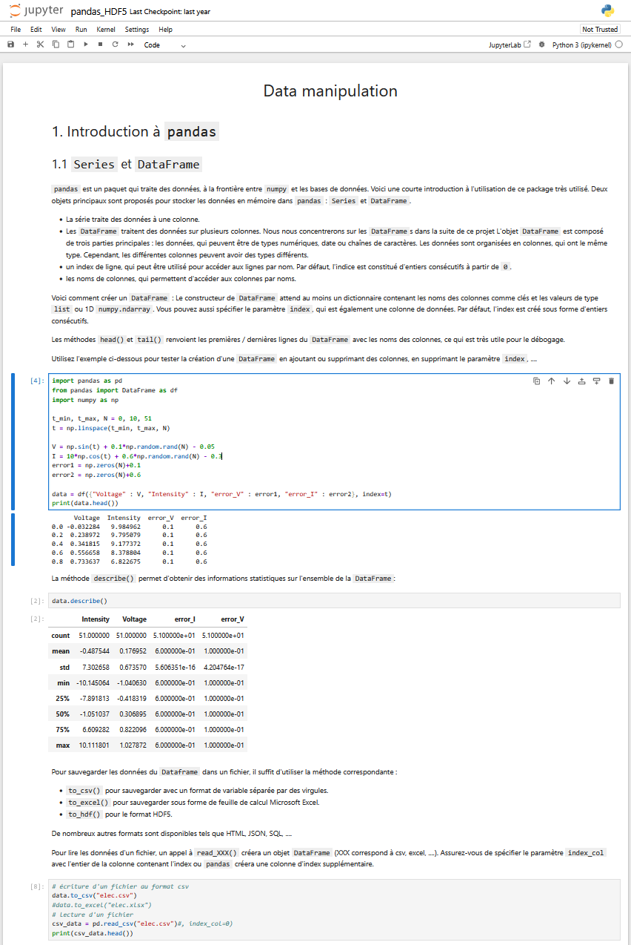

SOFTWARE - CALCULATION
PERSPECTIVES
1) Data management
For the future the initial idea is to move away from Excel and Matlab by developing python code able to do the same processing.
The data management which is currently done by Excel would instead be managed using pandas DataFrames.
2) Plotting
The plotting of smoothing curves currently done with Excel graphs, would be done by dynamic graphs generated with Streamlit technology.
3) Notebook of processing
In the longer term, the integration of the python code into a Jupyter notebook would be planned.
It would join all code running into a single file and add documentation to explain each calculation step.

Slide 24
FRAMES

Slide 25
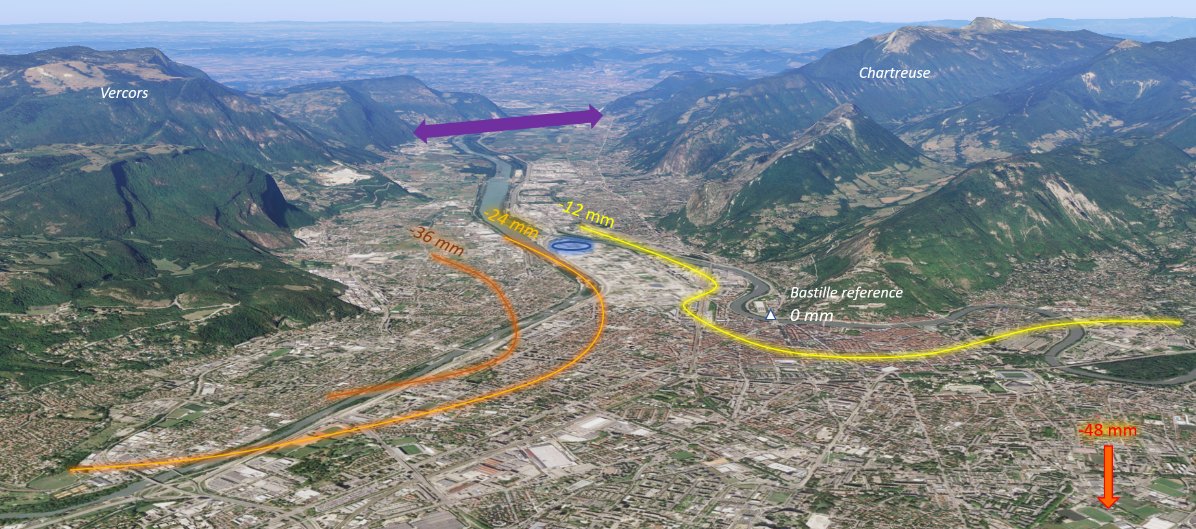
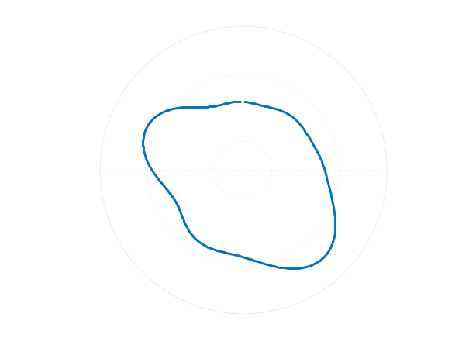

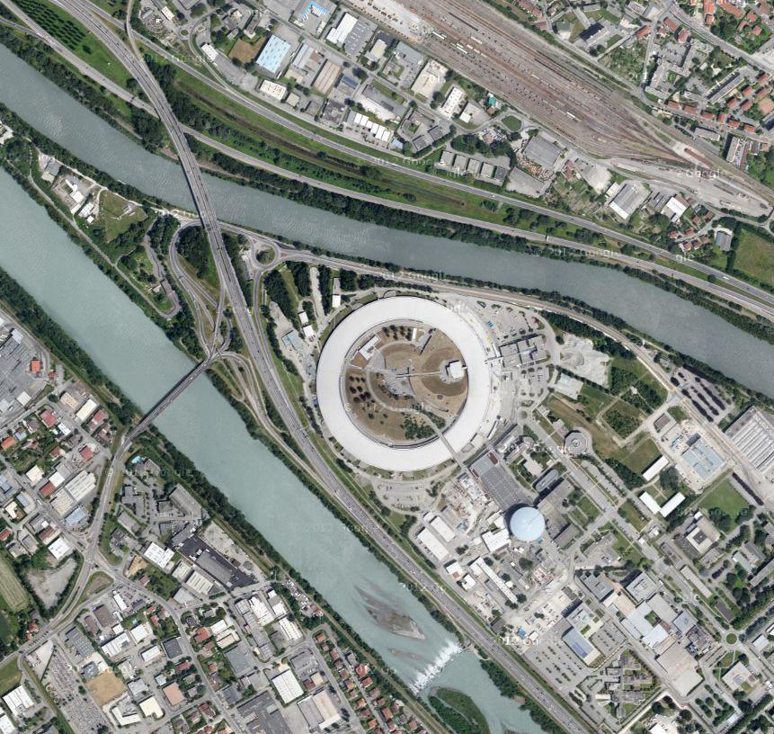
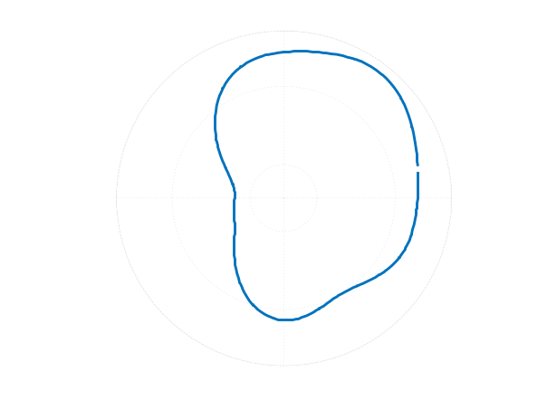

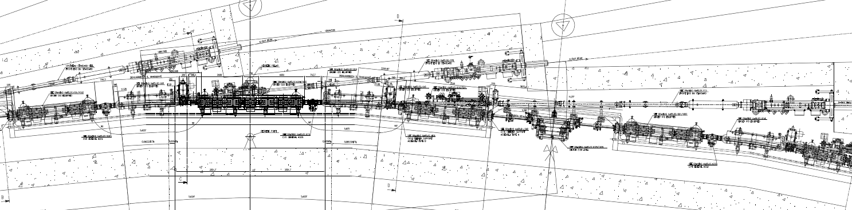
SOFTWARE - FRAMES
GROUND MOVEMENT
As explained in the previous presentation about SR realignment, the ESRF location is a non-stable site due to ground movement.
These movements modify the geometry of the machine which modifies the beam trajectory of each beamline.
Movements 1989 to 2001*
* Mesure de l’affaissement actuel de la cuvette grenobloise par comparaisons de nivellements, Menard G., Pôle Grenoblois Risques Naturels
+2.5 mm
+2.5 mm
+0.4 mm
0 mm
0 mm
0 mm
-3.5 mm
-3.5 mm
-0.4 mm
C17
C01
C01
C01
C17
C17
Horizontal deformation
Vertical deformation
Vertical deformation
Dam purging
Slab Joint
Crack
Page 25

Slide 26
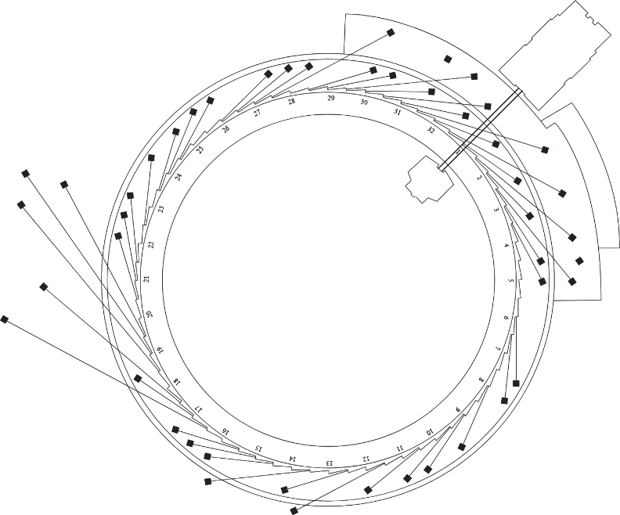
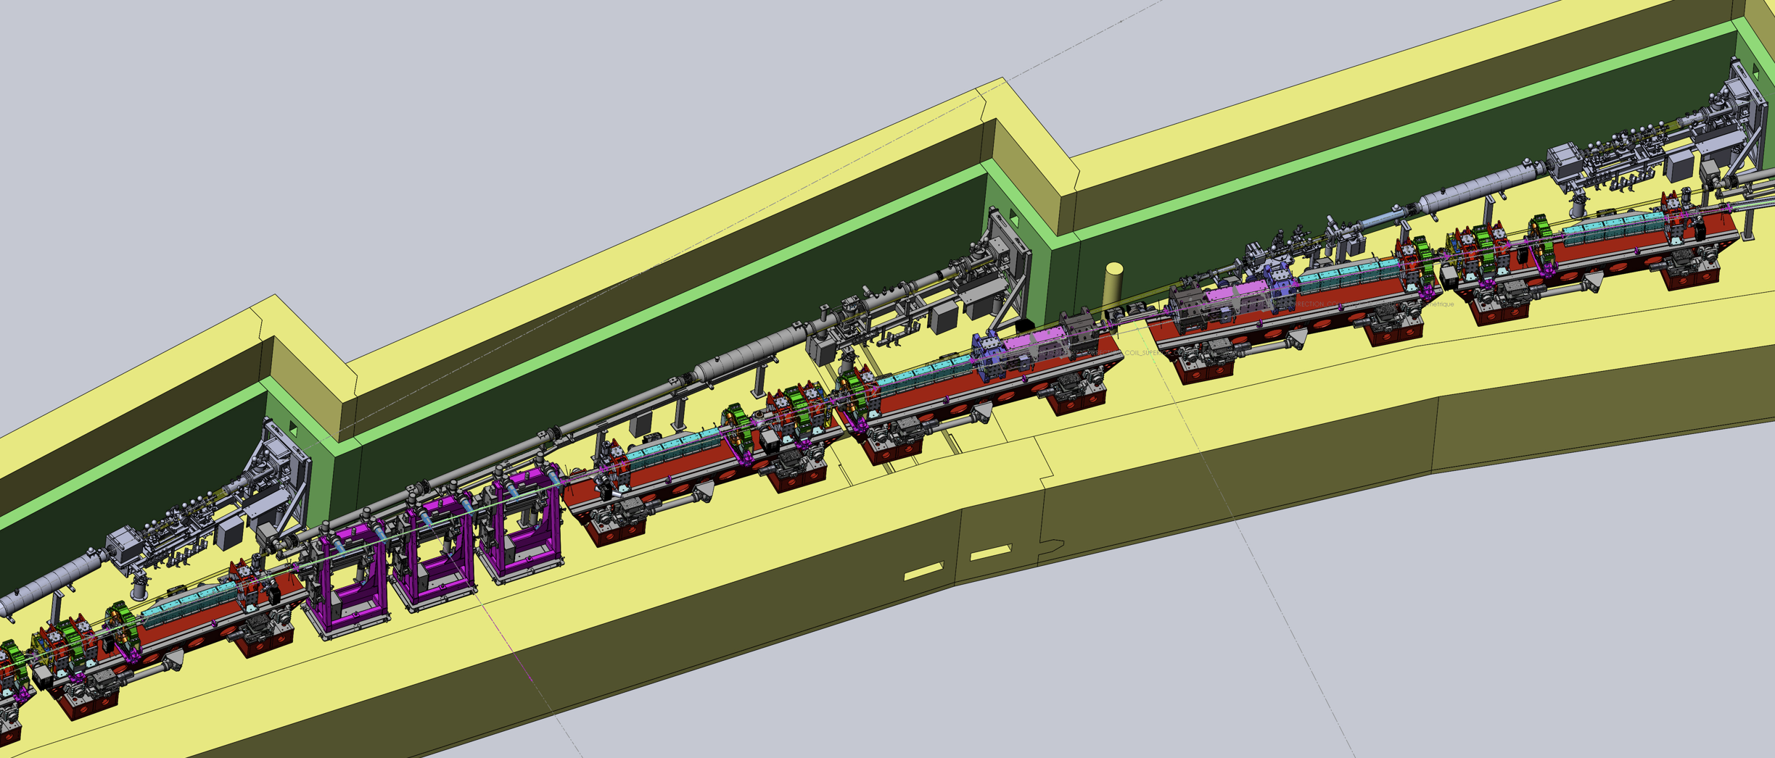
SOFTWARE - FRAMES
0mrad FRAME DEFINITION
We will focus on the ID type beamlines.
An IDxx 0mrad frame is defined by :
The segment defined by the magnetic centers of the last G4 quadrupole and the first G1 quadrupole defines the X-axis
The midpoint of this segment defines the Origin
ID16
X
Y
Quad magnetic centers
IDxx 0mrad frame
Girder 4
Girder 3
Y
Girder 2
X
Girder 1
Straight Section
Page 26
Girder 4
Midpoint = Source Point

Slide 27
SOFTWARE - FRAMES
0mrad FRAME DEFINITION
We will focus on the ID type beamlines.
An IDxx 0mrad frame is defined by :
The segment defined by the magnetic centers of the last G4 quadrupole and the first G1 quadrupole defines the X-axis
The midpoint of this segment defines the Origin
This segment of magnetic centers measures 5.7m.
However the longest beamlines measure 180m.
A misalignment of ± 0.1mm of this segment results in a deviation of about 6mm at 180m.
It was necessary to use non-static frames updated with the most recent SR survey to align on the beamlines
ID16
X
Y
Quad magnetic centers
IDxx 0mrad frame
Girder 4
Girder 3
Y
Girder 2
X
Girder 1
Straight Section
Page 27
Girder 4
Midpoint = Source Point

Slide 28
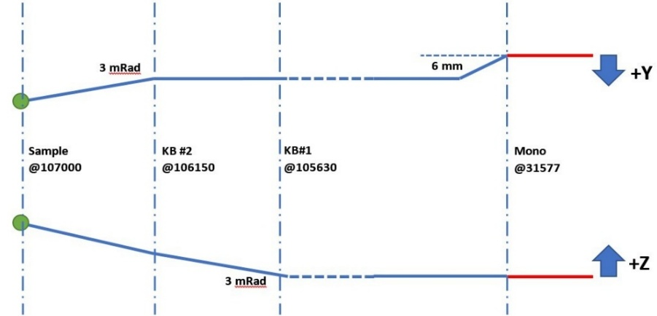
SOFTWARE - FRAMES
Beam direction
BEAMLINE FRAMES
0mrad
ESRF has close to 50 beamlines.
For some beamlines, the beam is split into several branches by angular deflections or offsets. Each branch has its own frame.
So beamlines may have multiple frames. We must manage 130 beamline frames.
Studied sample
Point source
Studied sample
0mrad
Beamlines | Frames count |  | Beamlines | Frames count
ID01 | 2 |  | BM01 | 2
ID02 | 3 |  | BM02 | 3
ID03 | 3 |  | BM05 | 3
ID06 | 1 |  | BM07 | 2
ID09 | 1 |  | BM08 | 2
ID10-COH / ID10-SURF | 1 |  | BM16 | 2
ID11 | 1 |  | BM18 | 2
ID12 | 1 |  | BM20 | 4
ID13 | 1 |  | BM23 | 4
ID14 | 2 |  | BM25 | 2
ID15A / ID15B | 4 |  | BM26 | 2
ID16A / ID16B | 6 |  | BM28 | 4
ID17 | 1 |  | BM29 | 2
ID19 | 1 |  | BM30 | 2
ID20 | 8 |  | BM31 | 2
ID21 | 4 |  | BM32 | 5
ID22 | 1
ID23-1 / ID23-2 | 9
ID24-DCM / ID24-ED | 5
ID26 | 3
ID27 | 4
ID28 | 1
ID29 | 4
ID30A-1 / ID30A-3 / ID30B | 10
ID31 | 1
ID32 | 9
ID - Total | 87 |  | BM - Total | 43
Page 28

Slide 29
SOFTWARE - FRAMES
Beam direction
BEAMLINE FRAMES
0mrad
ESRF has close to 50 beamlines.
For some beamlines, the beam is split into several branches by angular deflections or offsets. Each branch has its own frame.
So beamlines may have multiple frames. We must manage 130 beamline frames.
S&A Group needed to develop a software to update all these frames
Studied sample
Point source
Studied sample
0mrad
Beamlines | Frames count |  | Beamlines | Frames count
ID01 | 2 |  | BM01 | 2
ID02 | 3 |  | BM02 | 3
ID03 | 3 |  | BM05 | 3
ID06 | 1 |  | BM07 | 2
ID09 | 1 |  | BM08 | 2
ID10-COH / ID10-SURF | 1 |  | BM16 | 2
ID11 | 1 |  | BM18 | 2
ID12 | 1 |  | BM20 | 4
ID13 | 1 |  | BM23 | 4
ID14 | 2 |  | BM25 | 2
ID15A / ID15B | 4 |  | BM26 | 2
ID16A / ID16B | 6 |  | BM28 | 4
ID17 | 1 |  | BM29 | 2
ID19 | 1 |  | BM30 | 2
ID20 | 8 |  | BM31 | 2
ID21 | 4 |  | BM32 | 5
ID22 | 1
ID23-1 / ID23-2 | 9
ID24-DCM / ID24-ED | 5
ID26 | 3
ID27 | 4
ID28 | 1
ID29 | 4
ID30A-1 / ID30A-3 / ID30B | 10
ID31 | 1
ID32 | 9
ID - Total | 87 |  | BM - Total | 43
Page 29

Slide 30
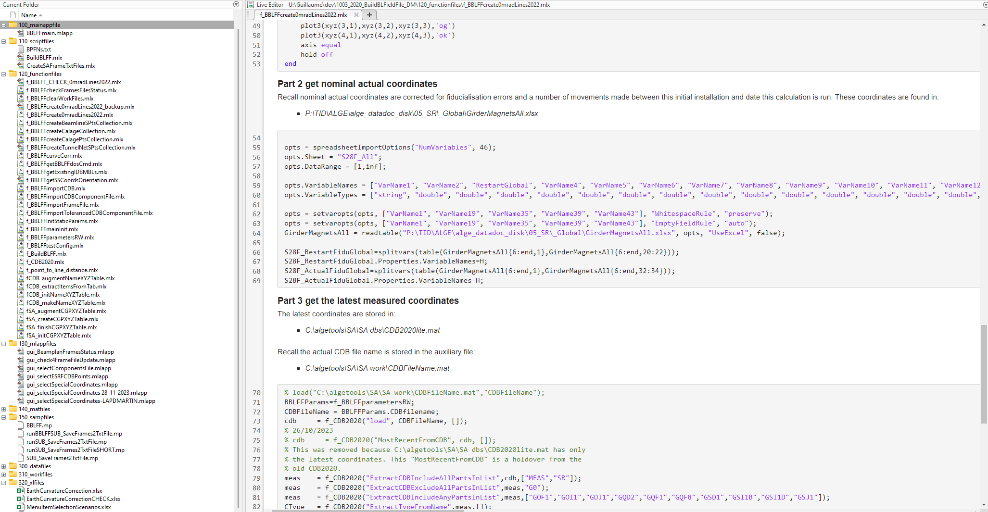
SOFTWARE - FRAMES
BBLFF
David developed a software called BBLFF that calculates beamline frames based on the latest coordinates of the SR magnets.
The used code for this software is Matlab.
Page 30

Slide 31
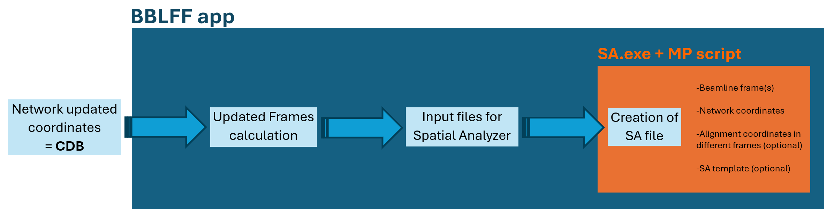
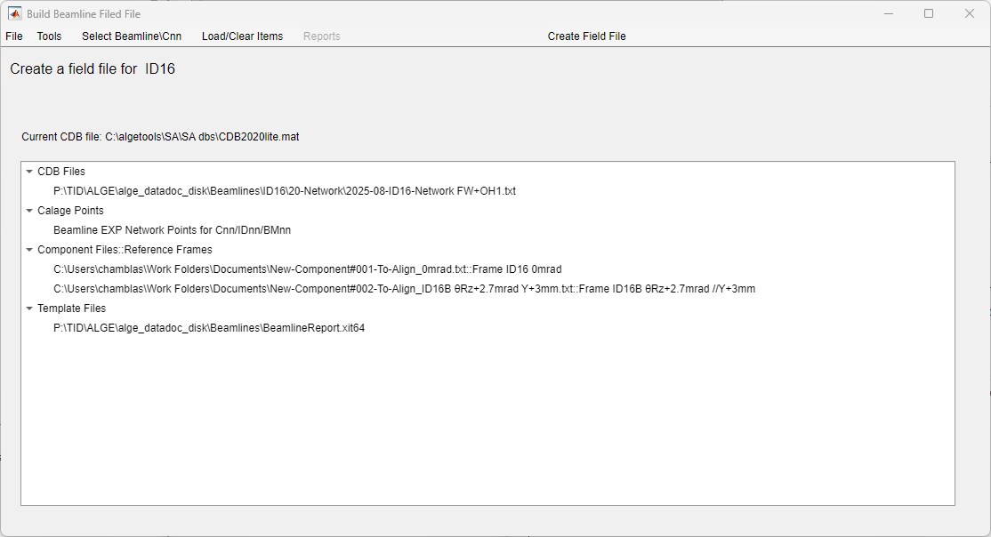
SOFTWARE - FRAMES
BBLFF
David developed a software called BBLFF that calculates beamline frames based on the latest coordinates of the SR magnets.
The used code for this software is Matlab.
This software creates then the frame definition files that are imported into Spatial Analyzer by running an MP script.
This SA file with last updated network and frames is a common framework for field teams.
This prevents human errors.
network
Alignment coordinates
SA template
Page 31

Slide 32
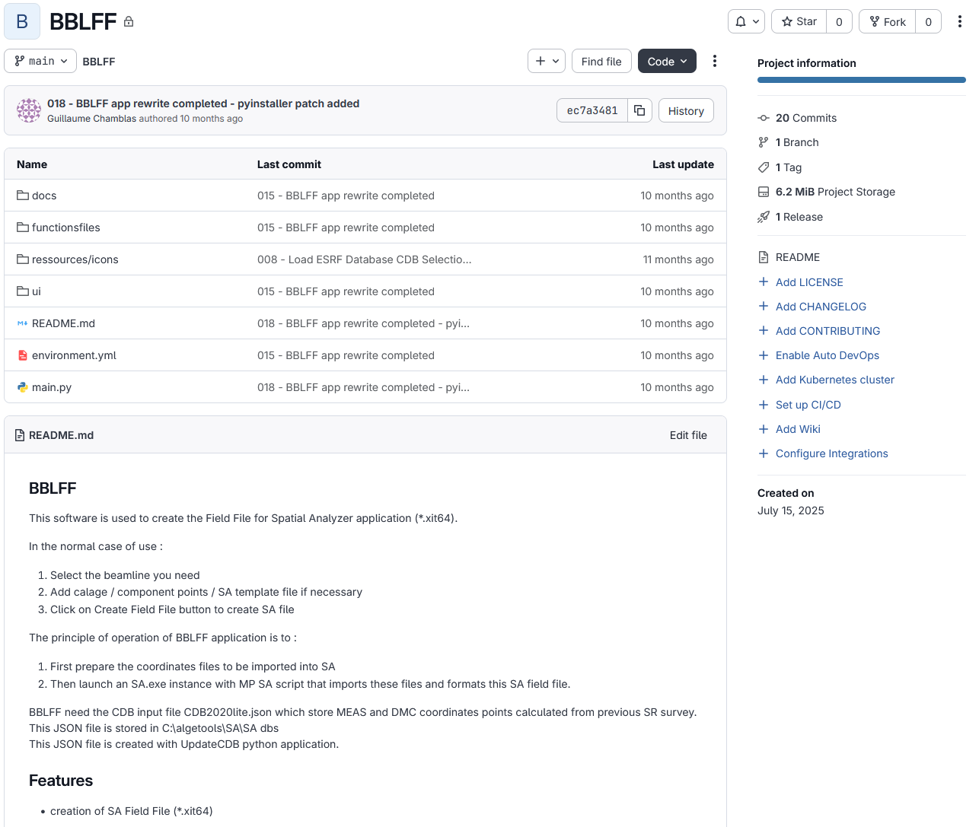
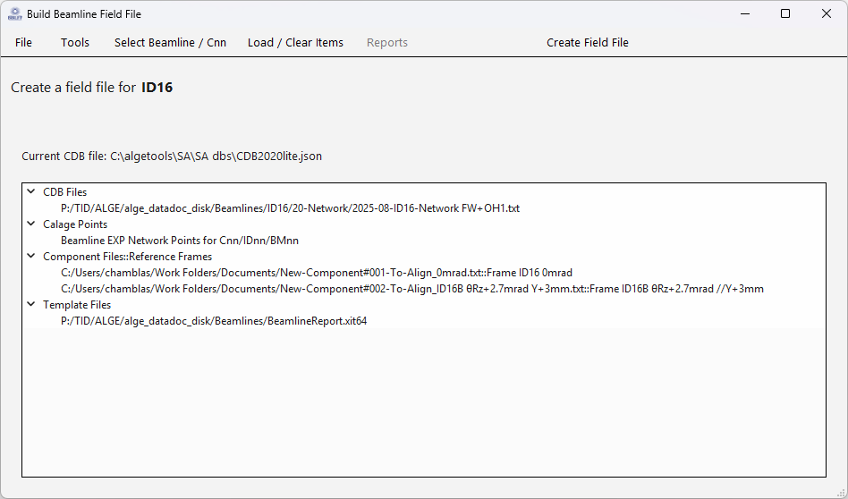
SOFTWARE - FRAMES
CODING TO PYTHON
For the same reasons of maintenance and cost, S&A Group decided to use python code for the future of this software.
The python coding is now complete, and this version is fully operational.
Page 32

Slide 33


SOFTWARE - FRAMES
PERSPECTIVES
1) Time interpolated frames
The reference frames are updated only every six months, as the general survey is done twice a year.
Consequently, for an alignment work scheduled shortly before a network update, the frame may be outdated.
The idea would be to use SR survey archives to model accelerator annual movement and interpolate a frame calculation based on the date of the alignment.
Page 33

Slide 34

SOFTWARE - FRAMES
PERSPECTIVES
1) Time interpolated frames
The reference frames are updated only every six months, as the general survey is done twice a year.
Consequently, for an alignment work scheduled shortly before a network update, the frame may be outdated.
The idea would be to use SR survey archives to model accelerator annual movement and interpolate a frame calculation based on the date of the alignment.
2) Modeling beam trajectory
During a realignment process of SR Girders as shown in the previous presentation, a major concern for beamline physicians is the impact on the new beam trajectory.
The idea would be to integrate modeling of the new trajectory based on different realignment scenarios.
Page 34

Slide 35


THANKS FOR YOUR ATTENTION

