Slide 1

Beyond existing specification tools
How to specify on a drawing an alignment specification using ISO GPS situation features
Dr Bertrand Nicquevert, CERN, EN department, Geneva, Switzerland
with the contribution of Fabien Rey, ESS, Lund, Sweden

Slide 2
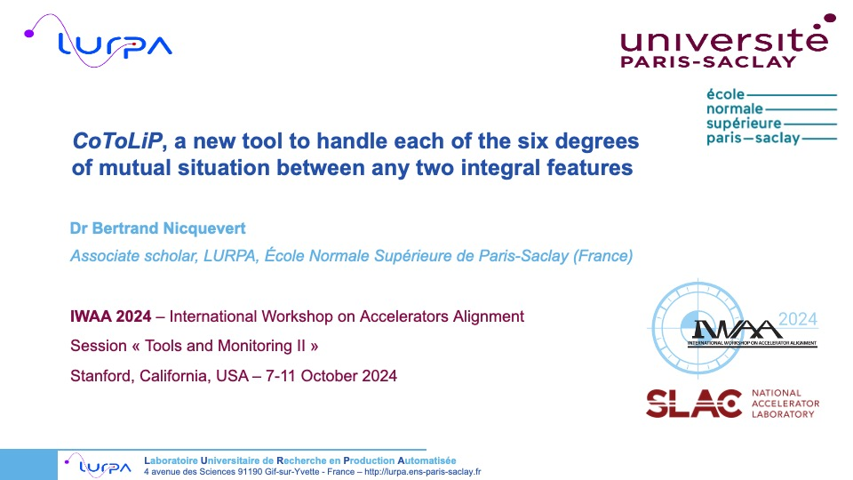
This talk is a follow-up of an IWAA 2024 (SLAC) talk

Slide 3
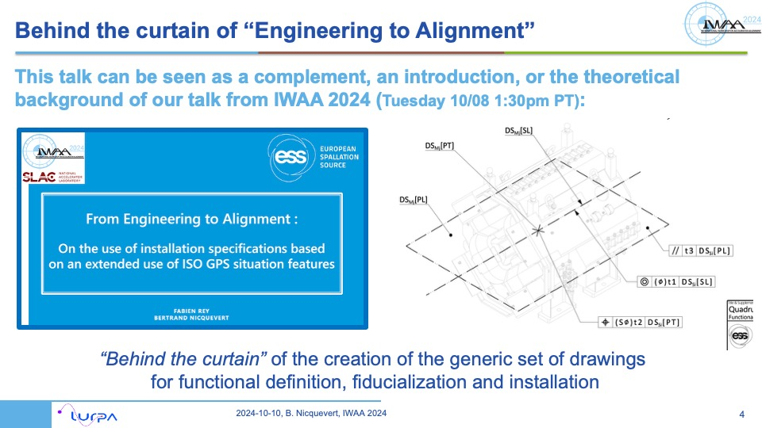
… making reference to another IWAA 2024 talk by F. Rey

Slide 4
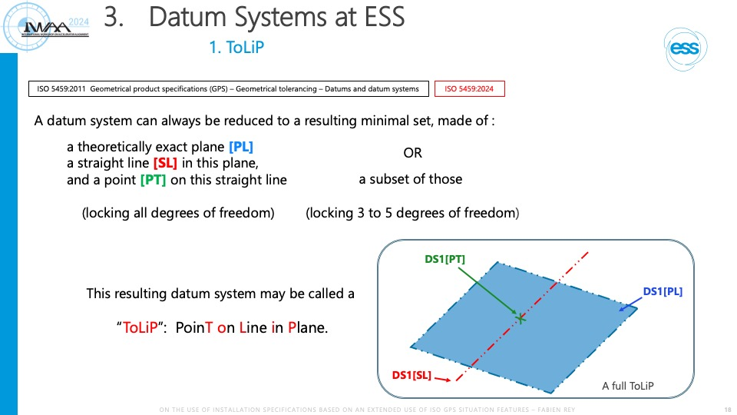
… where the “ToLiP” was used for installation drawings

Slide 5
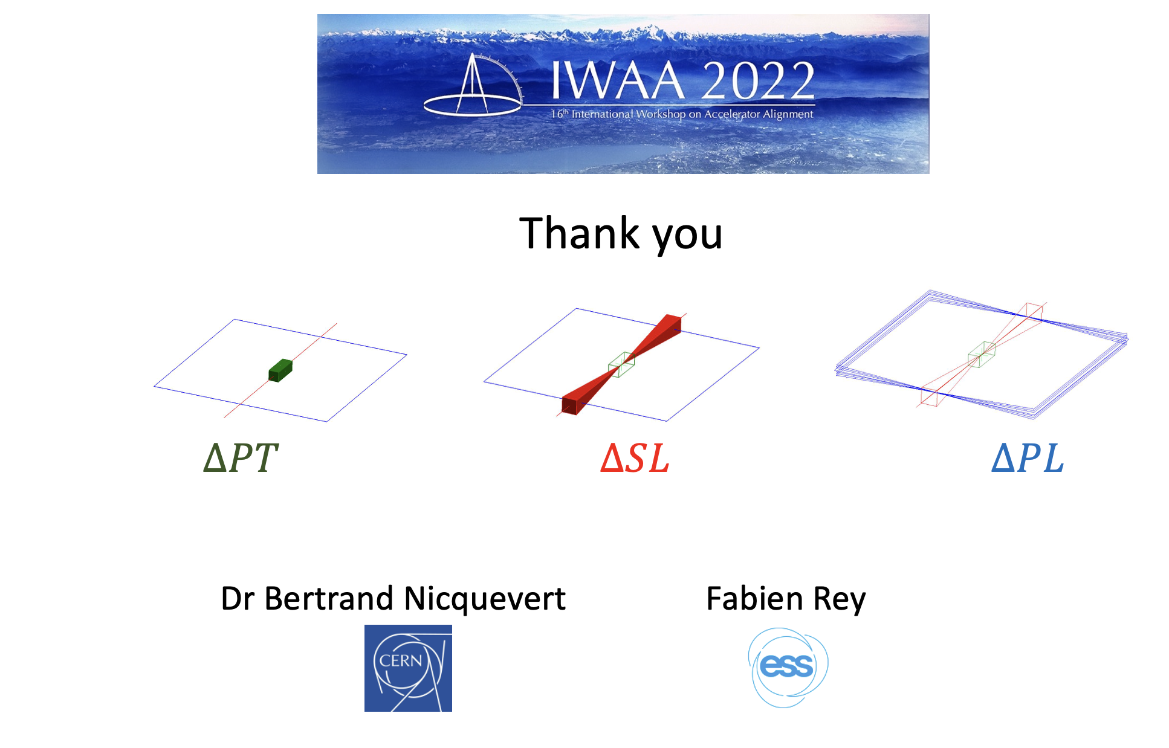
… itself following up his IWAA 2022 (Ferney) talk, whose provisional conclusion yielded to the following representation of “tolerances”:
Today’s talk is an update on these “tolerances”, and on the specifications that may capture them in a TPD*
TPD: Technical Product Documentation
= a drawing, or an annotated 3D model
A contribution to a solid definition of the “alignment requirements”

Slide 6
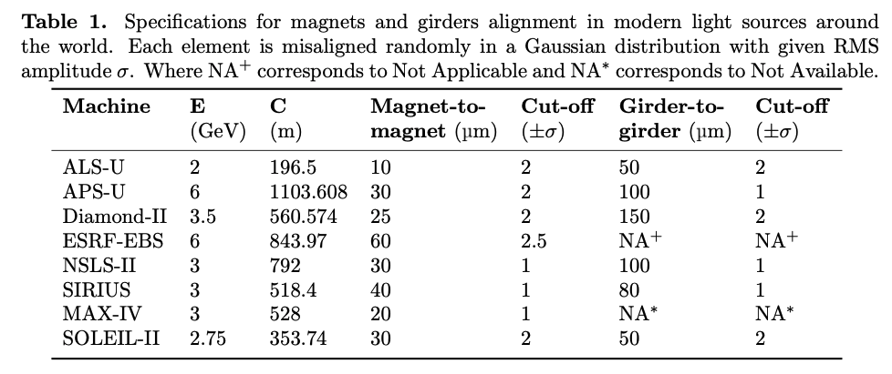
Table tolerances: on the value of which characteristic?
Typical example of alignment specification
“Magnet-to-magnet”? A magnet is not just a point, is it?
And what is this thing called “girder to girder”?

Slide 7
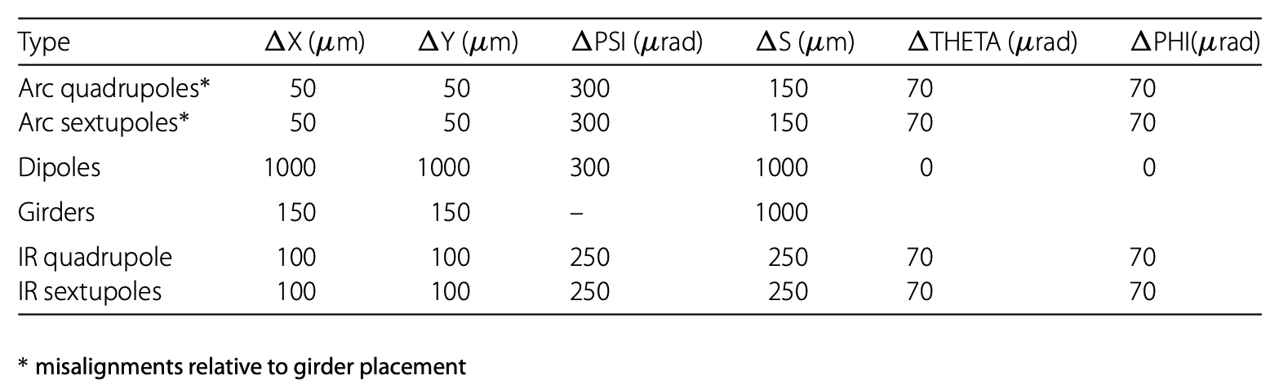
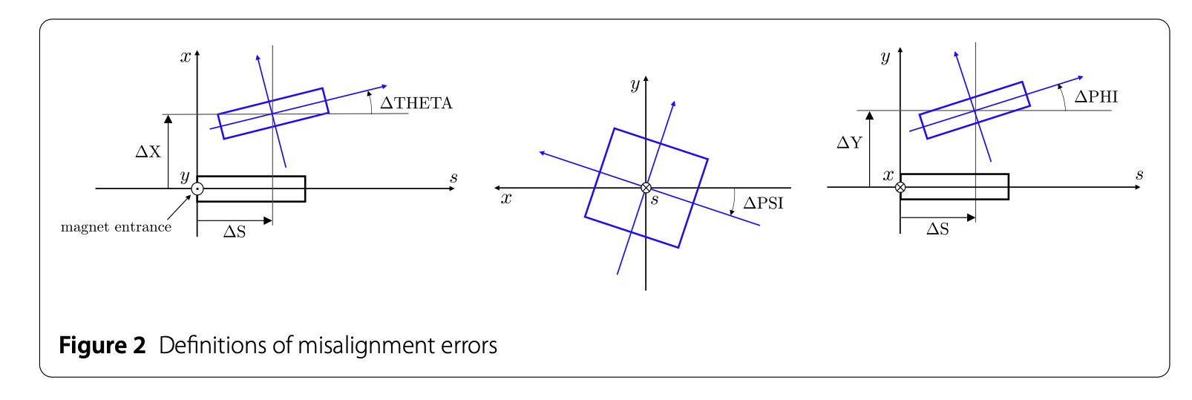
Angular specifications: a more illustrated case
Charles et al. EPJ Techniques and Instrumentation (2023) 10:8
https://doi.org/10.1140/epjti/s40485-023-00096-3

Slide 8
Is everything explicitly defined?
What is the toleranced feature? Is it a center? Or also an axis? Or even a plane? Or all?
Defined how?
  By its geometrical surfaces? by its functional situation features? (e.g. for a magnet, by the magnetic axis after fiducialization)
What are the characteristics on which these conditions apply
  Based on the actual (measured) value of what? What is meant by “girder placement”?
Accessorily, how is roll angle defined, and what is the order of composition of rotations?
  Undetermined, and only depending on the nominal axes (by projection)?
  Or with an order? Phi - theta - psi? Phi Psi theta? Theta Psi phi? … (6 possibilities)
And how to indicate these specification univocally on a drawing?
This, with the aim to bridge the various communities: the user’s requirement, the functional specification, the assembly instruction (alignment requirements), the verification specification (survey), and also the machining, the fiducialization…

Slide 9
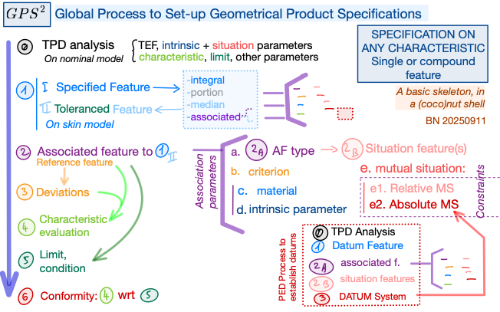
An overall “specification process” was developed for ISO
GPS^2: Global Process to Set-Up Geometrical Product Specifications
0. nominal specified features
nominal toleranced features (when ≠)
situation features of all these features
real specified features
real toleranced features
situation features of all these features
Associated theoretically exact features -> reference feature
3. Deviations between 1 and 2
4. Characteristic established on 3.
5. Limit condition on 4.
GPS^2 model considers all kinds of specifications
For illustration only - Extents far beyond the scope of today’s talk…
… and far beyond our (alignment) needs!

Slide 10
Focussing on a “situation specification” in ISO GPS system
Probably equivalent to the so-called “frame requirement”
Situation specification (ISO 17450-1)
With respect to a feature of defined target situation (= with some or all distances and angles fixed by TEDs, Theoretically Exact Dimensions) with respect to a datum system, the characteristic based on the deviations of the real feature shall not be greater than predefined agreed values: the tolerances
Situation features (ISO 17450-1 – definition, ISO 20223 – representation): as generalization of the “axis” of a cylinder, situation features are of type plane, straight line and points, preferably regrouped into a minimum set of situation features (MiSSiF) made of at most one plane, at most one straight line and at most one point, with the ToLiP condition “point on line in plane”
Situation of a feature (ISO 25378): the situation of any feature is defined by the situation of its situation features. => Degrees of freedom of a feature = those of its situation features
Complete situation specification: where ALL degrees of freedom (all distances and angles) of the nominal toleranced feature are constrained with respect to a datum system

Slide 11
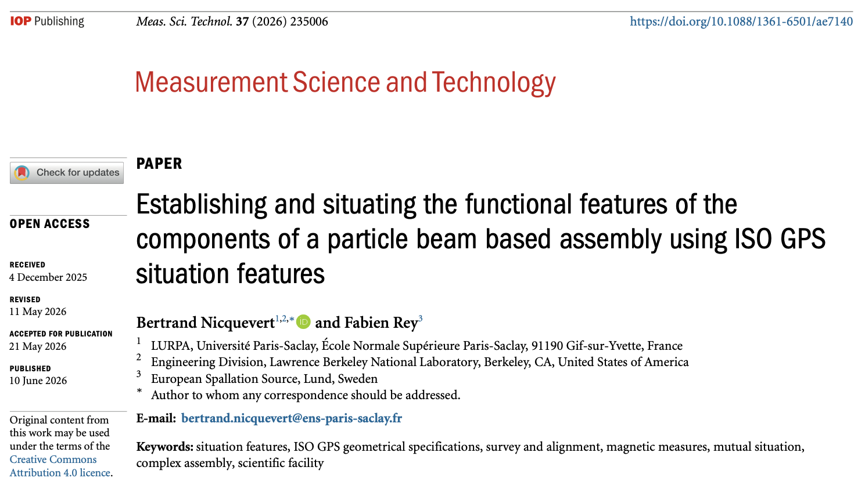
Supporting paper of our IWAA 2024 talk published in June!

Slide 12
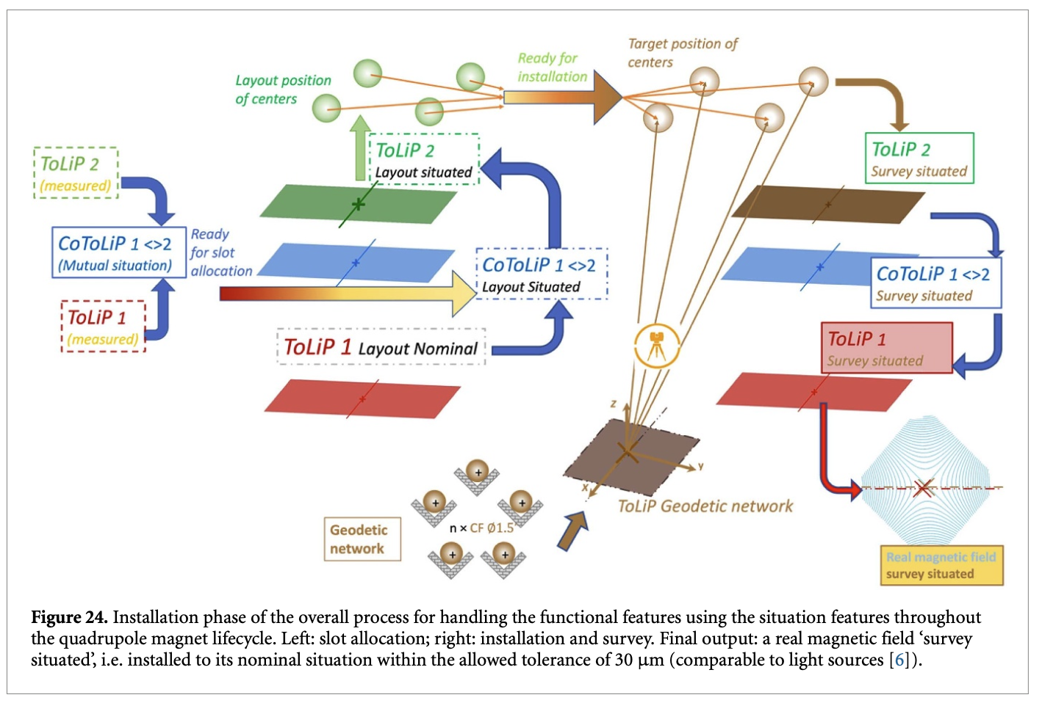
Overall process of a complete situation specification
A complex, but not complicate process!
It deals altogether with:
the situation features of
  Nominal features;
  Real features;
of both:
  The device itself;
  Its functional features;
  Its measured or surveyed features;
during various sequential phases:
  Fiducialization;
  Specification;
  Survey;
  Alignment;
  (and manufacturing, not shown here)

Slide 13
Four global steps
x
Fiducialization: establishment of “real” situation features
x
Verification: survey of the real situation of the situation features
x
Specification of the nominal situation of the situation features
Alignment of the real situation of the situation features with respect to their nominal situation

Slide 14
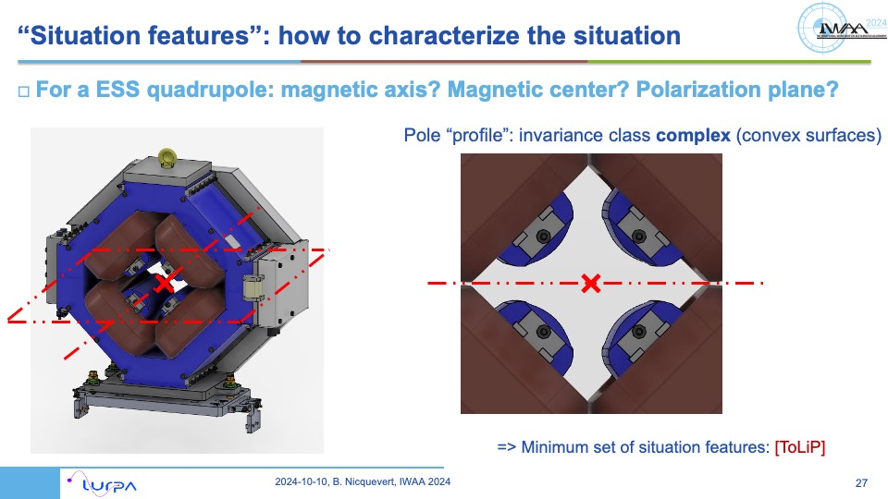
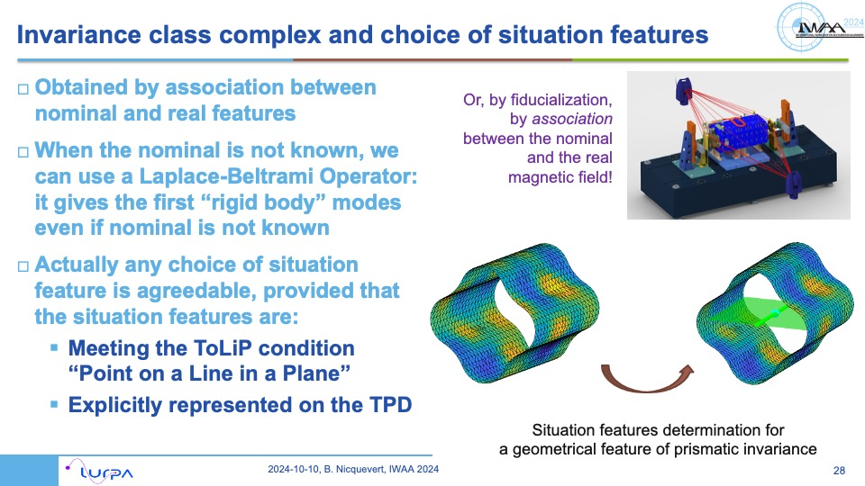
First step: establishment of situation features
(not the main topic for today: see IWAA 2024)
Nominal situation features: as represented in the TPD
“Real” situation features: ideal features, established by an association with the real features

Slide 15
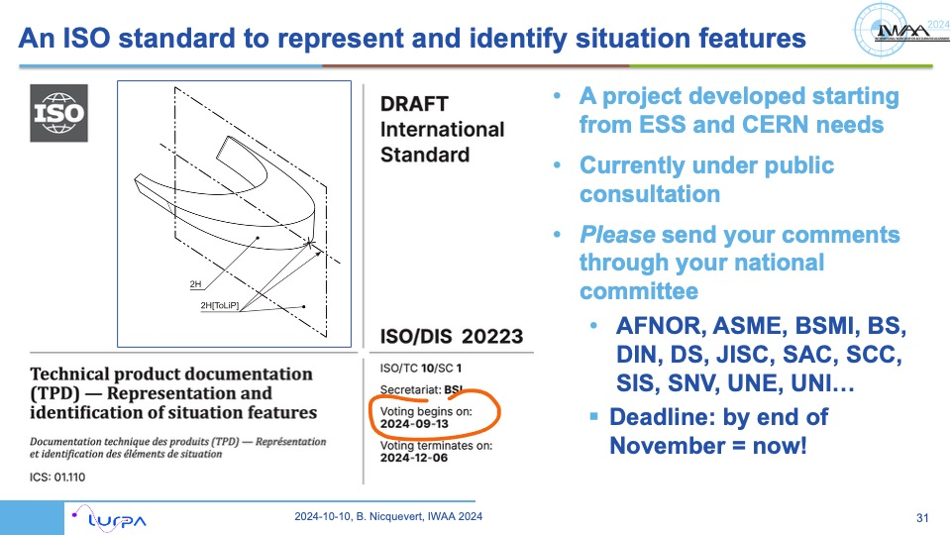
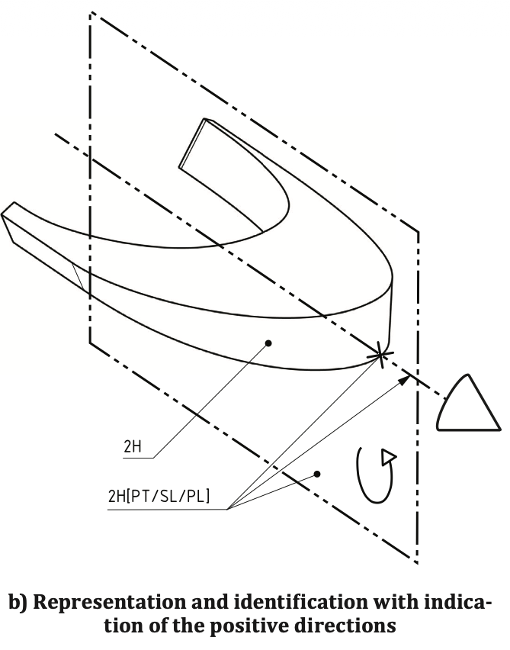
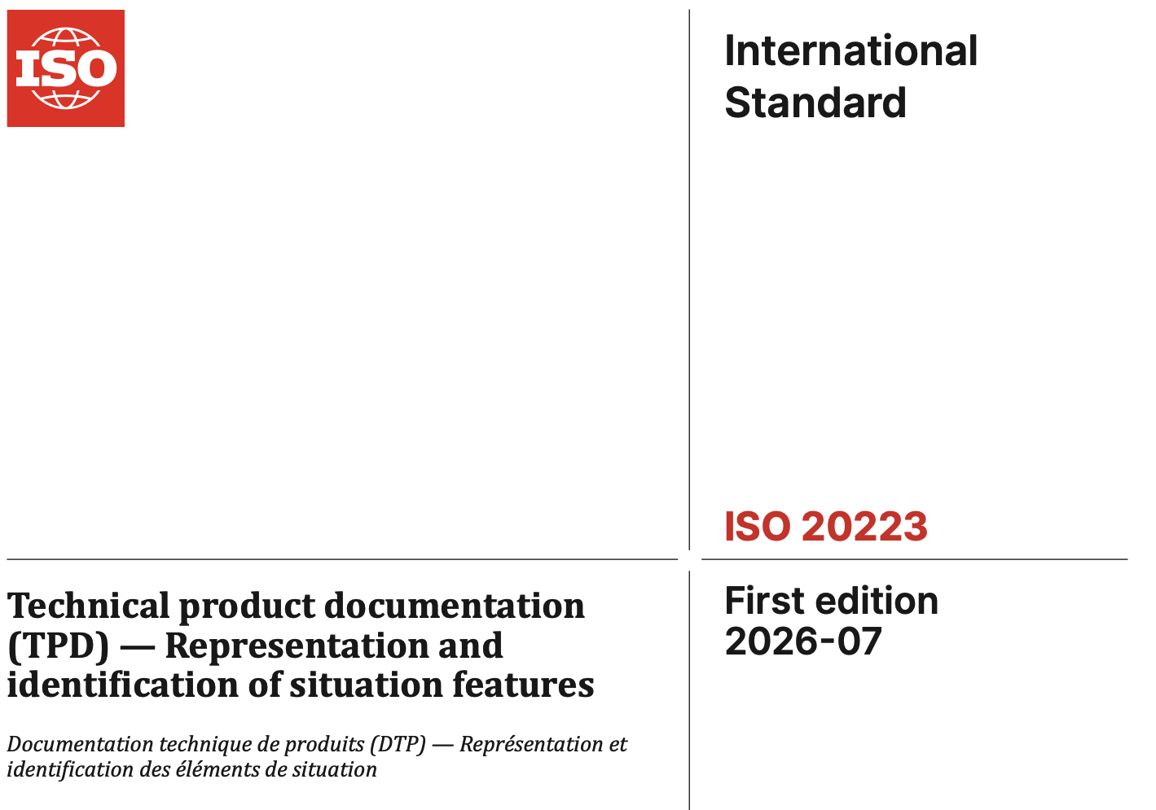
Nominal situation features: ISO 20223 published in July!
Provides (hopefully) all tools to represent the nominal situation features

Slide 16
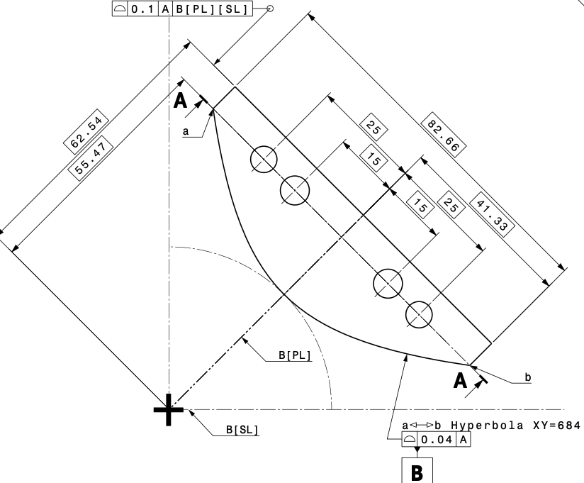
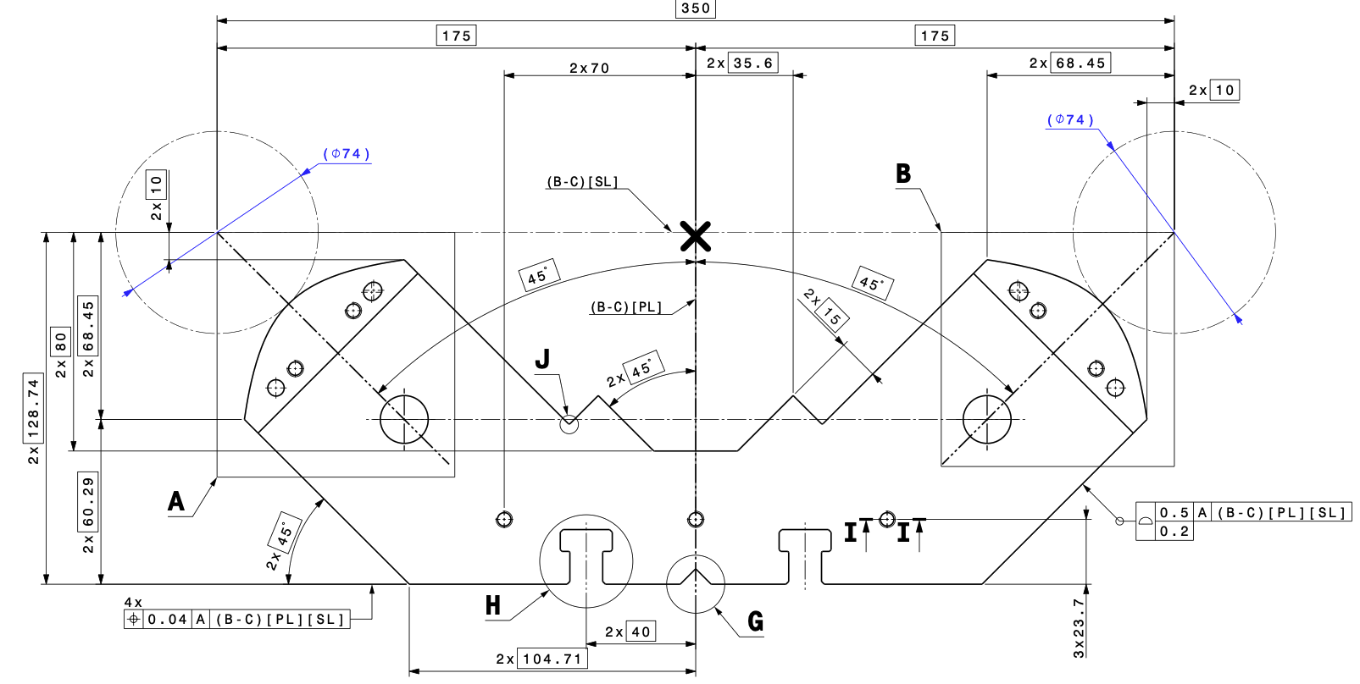
Example of an explicit indication of situation features: the prototype of FCC-ee quadrupoles
For a collection of two poles
For one hyperbolic pole

Slide 17
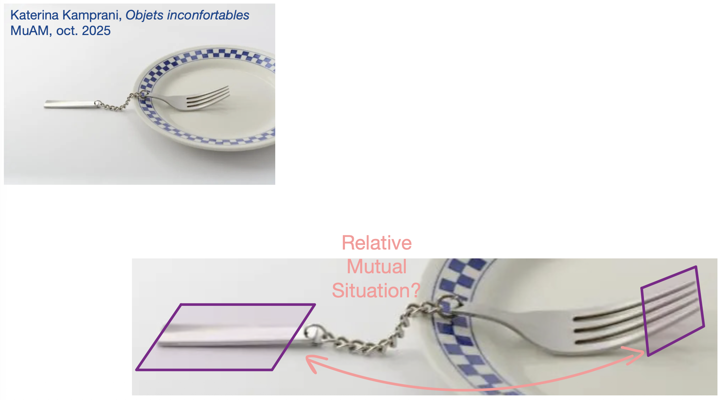
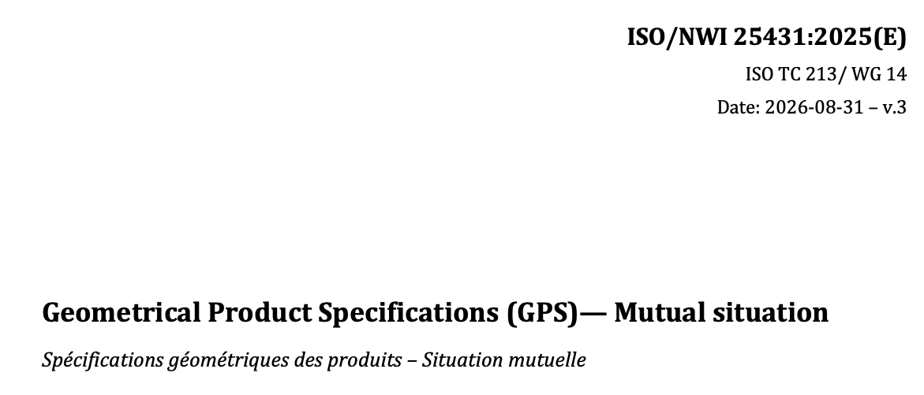
Mutual situation: a key topic
NWI = New Work Item
This a new ISO standard on the topic, currently under (very first stage of) preparation
Expectation for today: capture the needs of IWAA community, to provide in this ISO 25431 the tools we are in need for

Slide 18
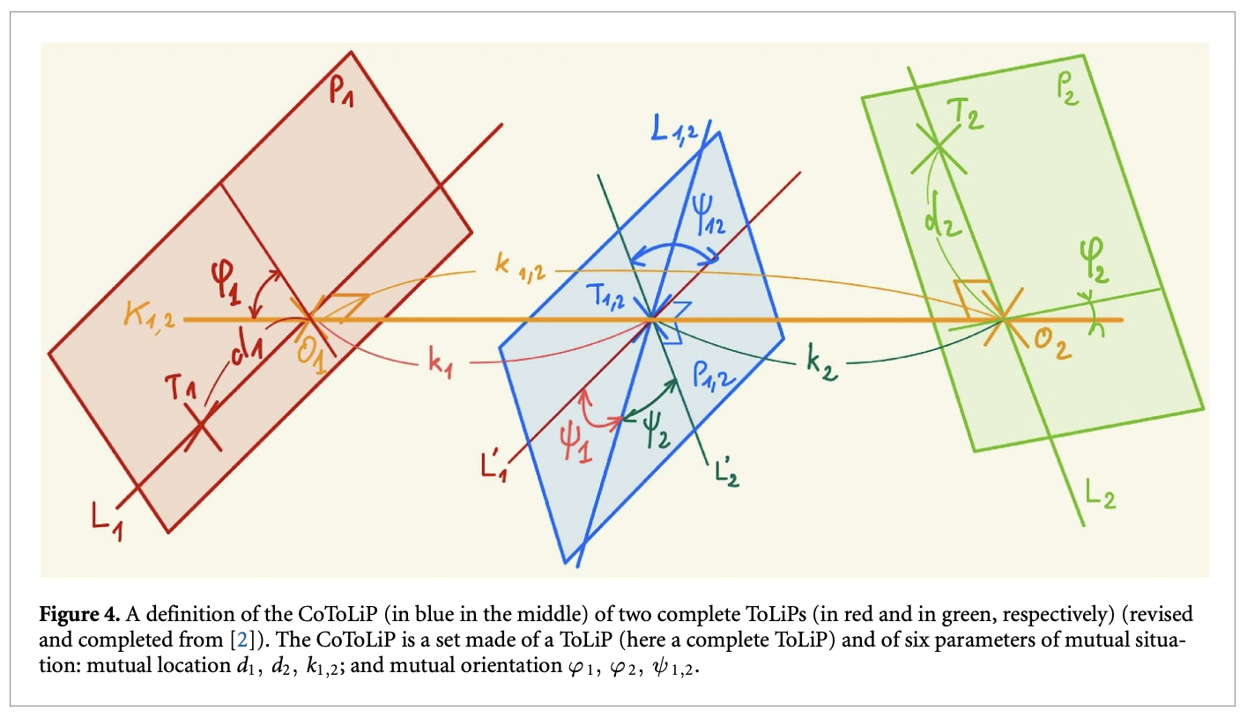
CoToLiP, a tool proposed to parametrize the mutual situation
Can serve to parametrize the mutual situation of any pair of ToLiPs (minimum sets of situation features)
Complete ToLiPs, with all three types
ToLiPs with remaining internal mobilities (degrees of freedoms)
Two ToLiPs of ideal features
Two ToLiPs of real features
Or real vs ideal
First published in a simpler form @IPAC 2023

Slide 19
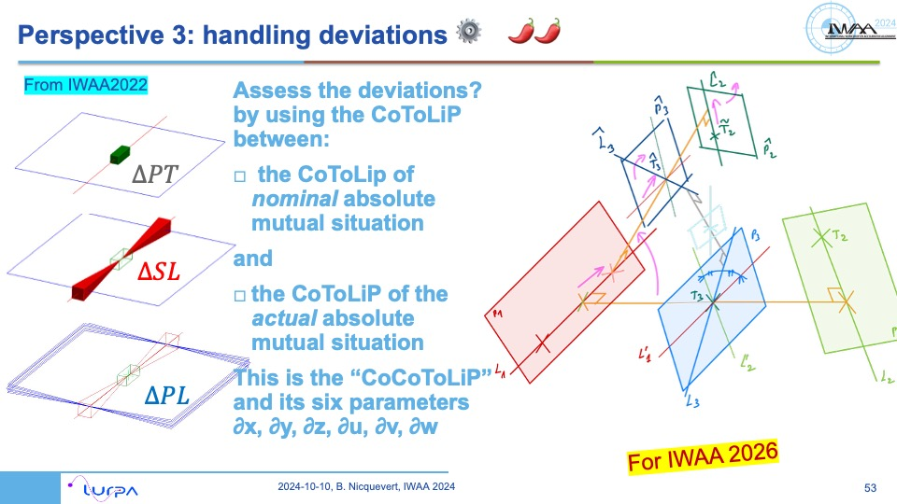
Handling deviations?
In 2024, the results of our research were not yet converging
Where are we with this topic in 2026?

Slide 20
CoCoToLiP? Handling deviations of a CoToLiP
Aim: evaluation of the deviation between nominal and real situations
Let us define, for our case:
ToLiP0 = ToLiP of a resulting datum system
ToLiP1 = ToLiP of the specified feature (functional features)
Nominal situation of ToLiP1: represented by a CoToLiP 1, 0 between this ToLiP1 and ToLiP0
ToLiP2 = ToLiP of the same specified feature with deviations
Actual situation of ToLiP2: represented by a CoToLiP 2, 0 between this ToLiP2 and ToLiP0
“CoCoToLiP” represents the “variation”, or “deviation” of the initial CoToLiP 1, 0
CoCoToLiP is also… a CoToLiP!
  This is CoToLiP 2,1 representing the deviations between the nominal specified CoToLiP1,0 and the actual measured/surveyed CoToLiP 2, 0
Target for alignment: make CoCoToLiP = 0: “cancel deviations”, both in translation and in rotation
There are so many ToLiPs and CoToLiPs involved that this is hard to catch them all !

Slide 21
CoToLiP 2, 0
CoToLiP 2,1
= CoCoToLiP
CoToLiP 1, 0
…with small angles and distances
CoCoToLiP
CoToLiPs
A fractal perspective! Self-similarity at every scale

Slide 22
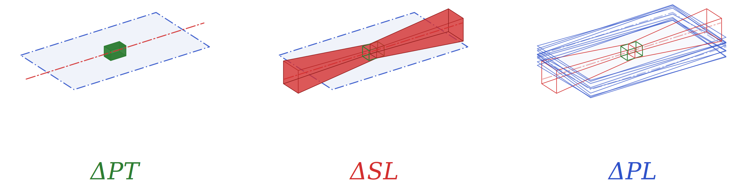
First attempt (IWAA 2022) of a “CoCoToLiP” representation
The three translations were represented by the three translational mobilities of the point [PT]
The two rotational mobilities of the straight line [SL] around the point [PT] were representing two of the three rotations
The rotational mobility of the plane [PL] around the straight line [SL] was representing the last of the three rotations

Slide 23
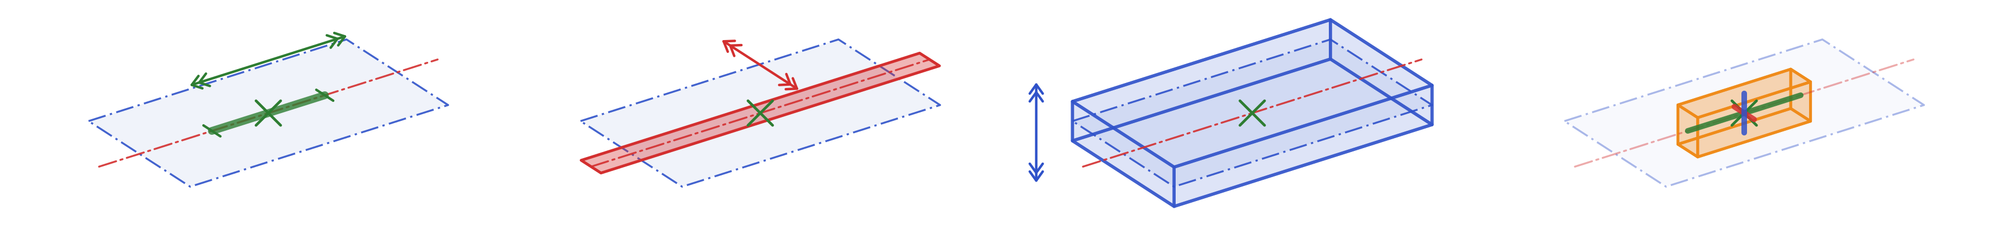
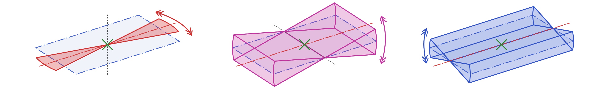
Second variant (today’s IWAA 2026), using ISO 20223 annex B
Adding them all up:
Translations
sliding [PT] along [SL]
sToL
sweeping [SL] in [PL]
sLiP
shifting [PL]
sP
swimming [PT]
(composition of the three translations)
Would be the same for any point
Nota: denominations are not yet standardized!
Follow the development of ISO/NWI 25341
Rotations
rotating [SL] in [PL]
around [PT]
rLiP%T
angle “L”
rocking plane [SL]/[PL]
around a line passing by [PT] perpendicular to [SL]
R(L,P)%T
angle “LP”
revolving [PL] around [SL]
rP%L
Angle “P”
How to add all this up?
Not the same result for any point!
L, P, LP: provisional notations

Slide 24
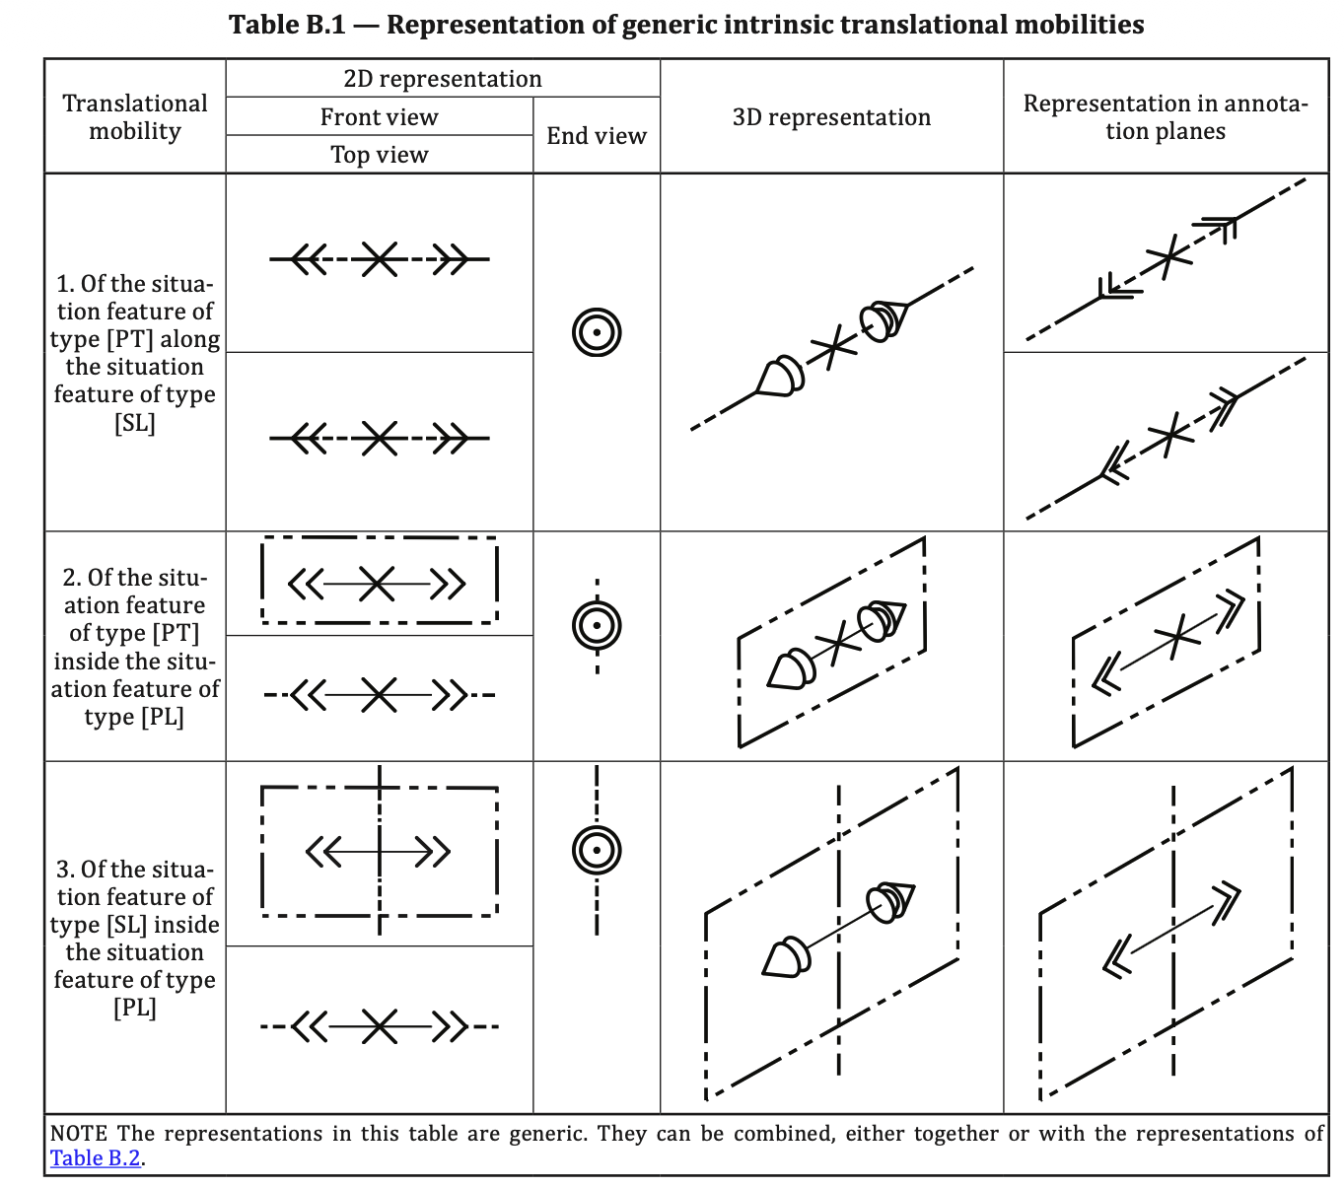
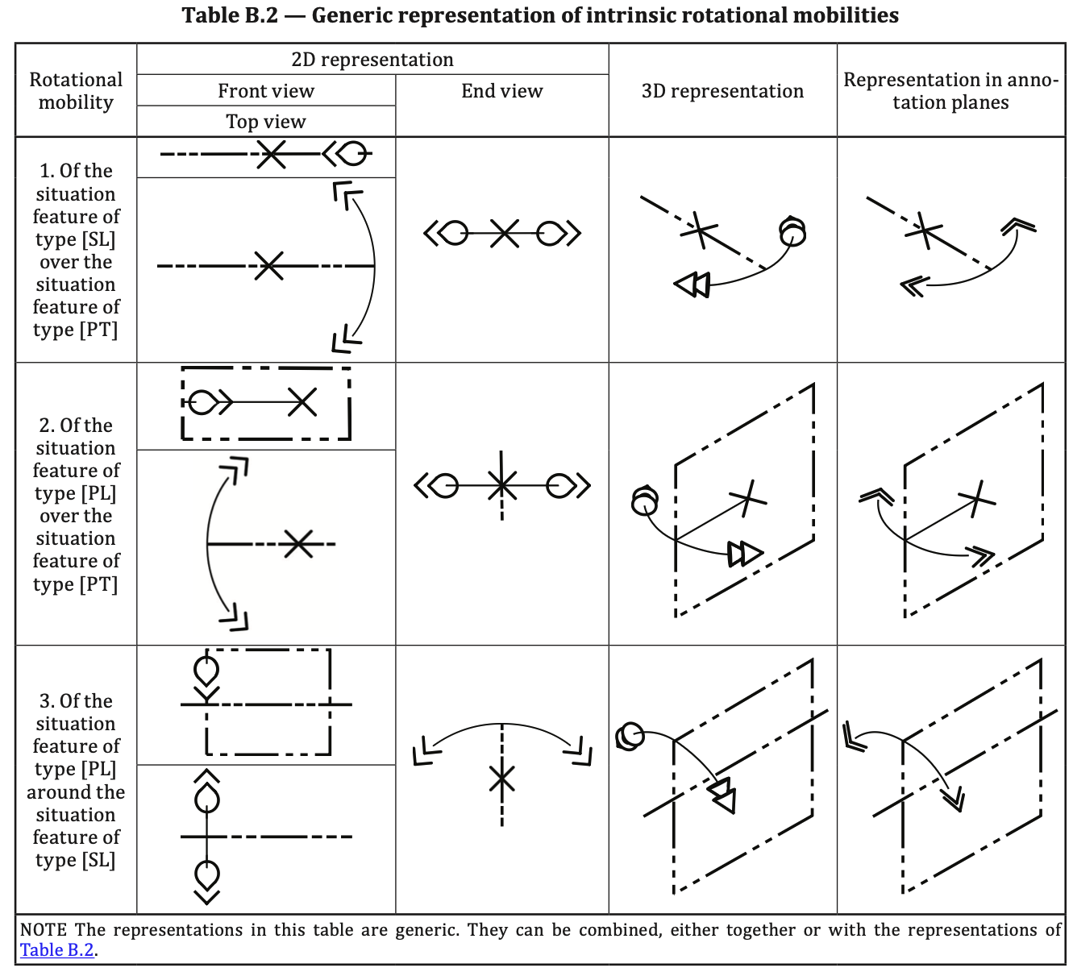
Based on indication of degrees of freedom of any MiSSiF*
* MiSSiF: Minimum Set of Situation Features; can be complete or not
ISO 20223:2026

Slide 25
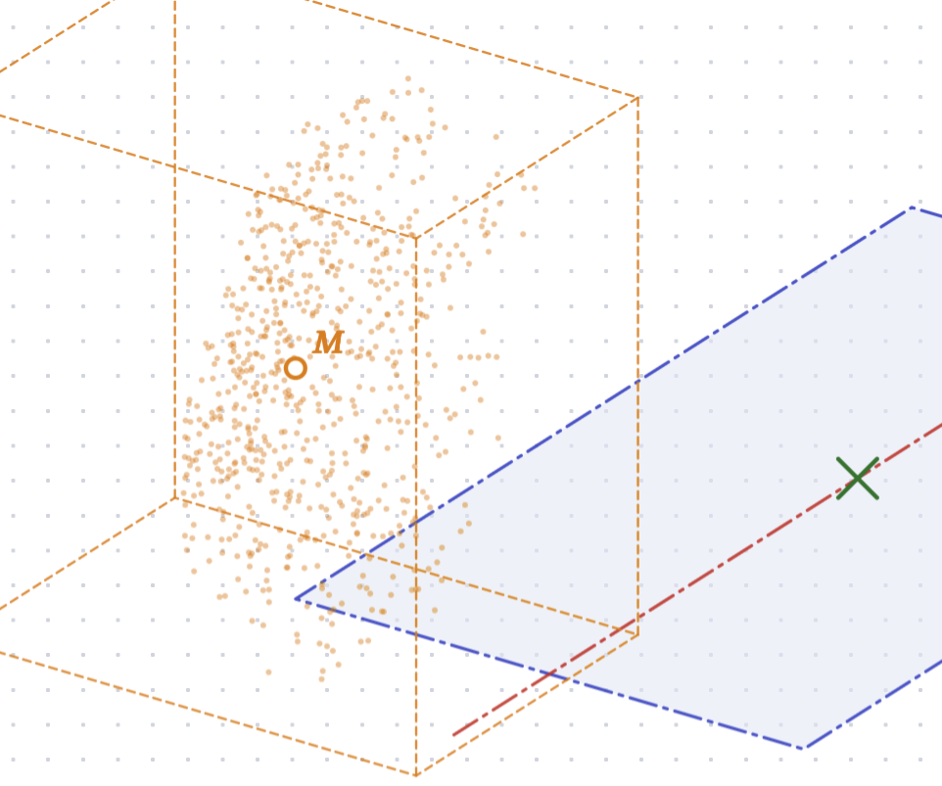
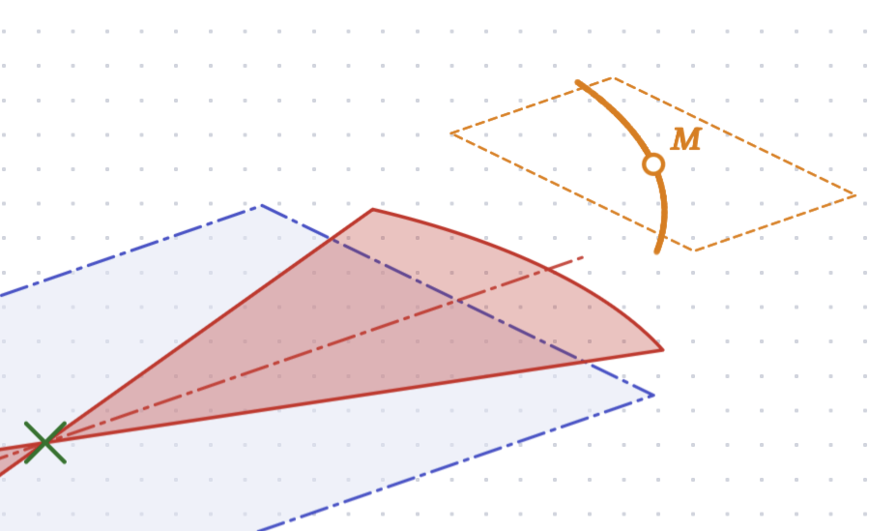
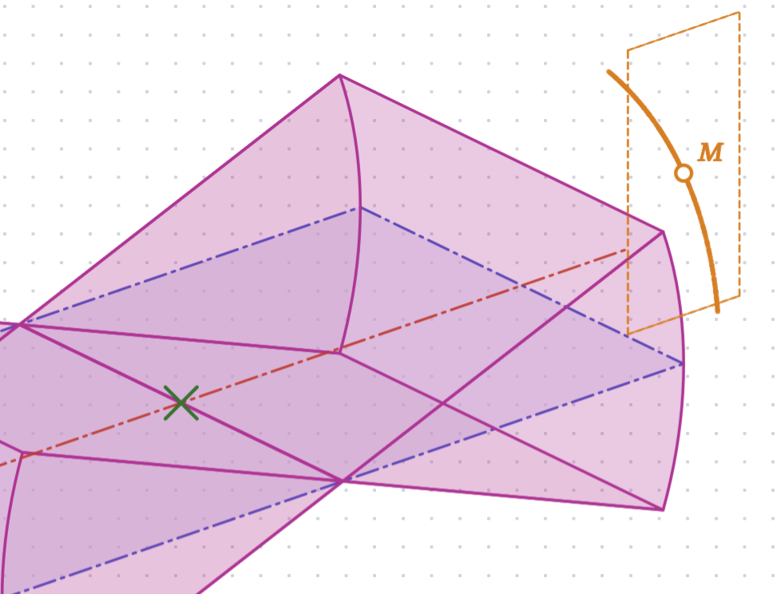
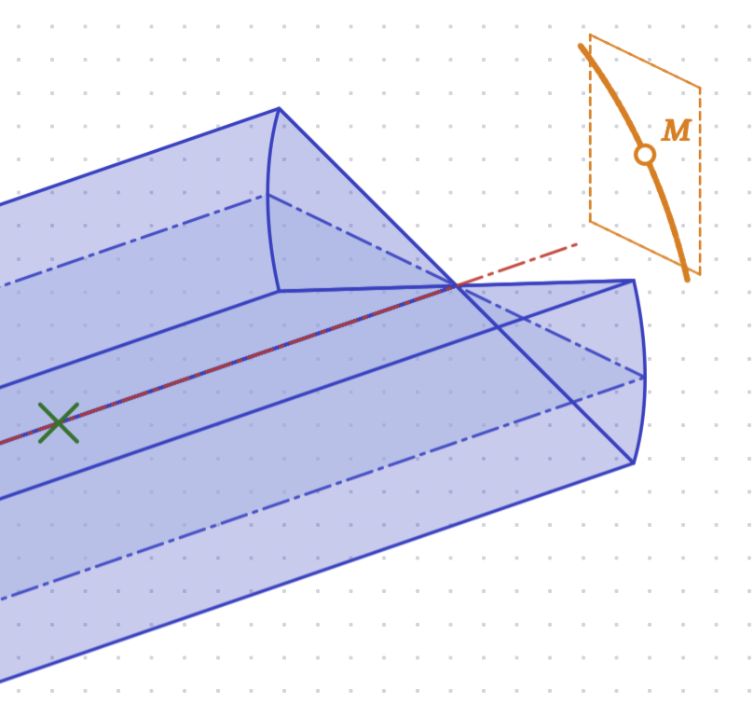
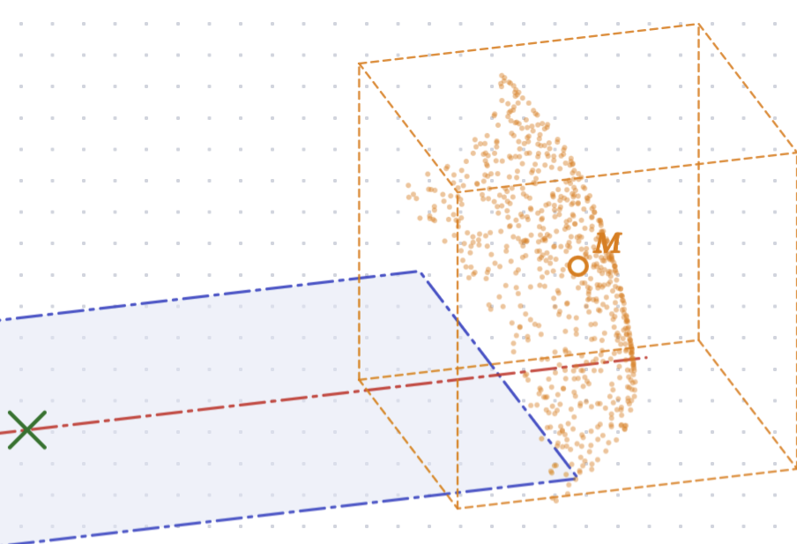
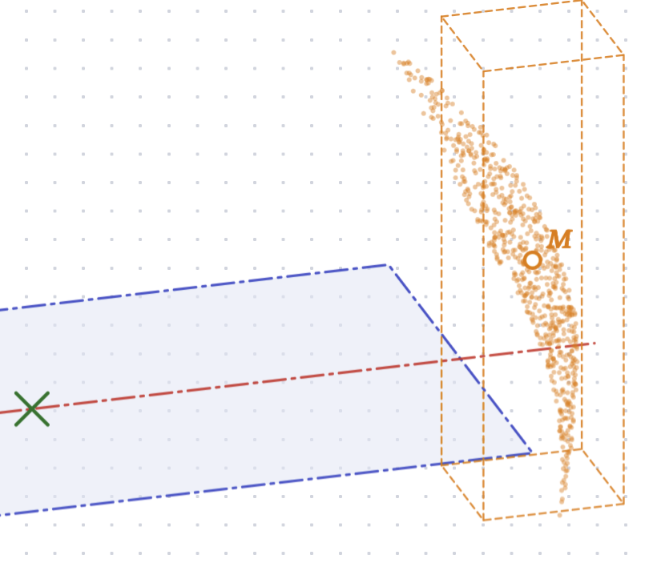
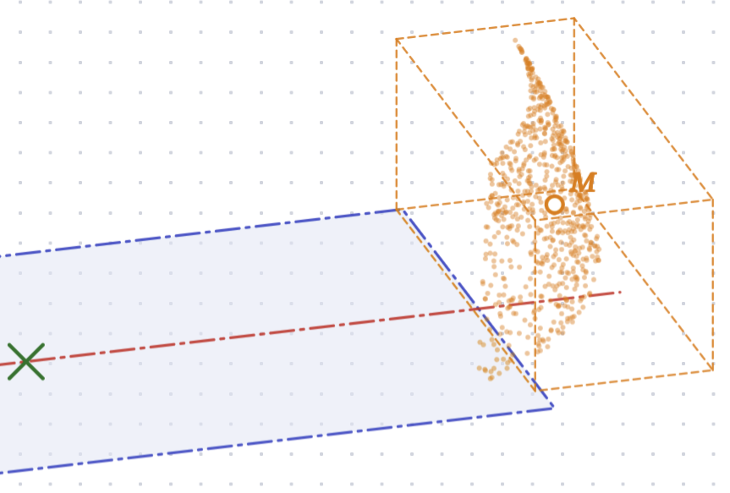
Visualization of the combination of mobilities at any point
Influence of the variation of the angles on the position of the point M
Angle “L”
Angle “LP”
Angle “P”
All angles “L”, “LP” and “P”
When these mobilities are uncertainties on the value of each angle, their total contribution on the final position of any point M is here visualized
(Nota: adding up translations is trivial – they are not represented here)
Both angles “L” and “LP”
Both angles “LP” and “P”
Both angles “L” and “P”

Slide 26
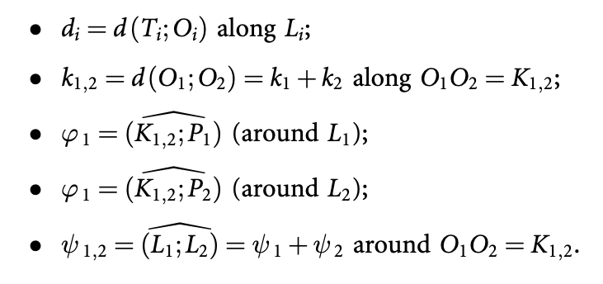
CoToLiPian angles (angular parameters of a CoToLiP)
Definition of the linear and angular parameters
Equivalent to Euler angles of type x – z’ – x’’
(or x1 – z2 – x3)

Slide 27
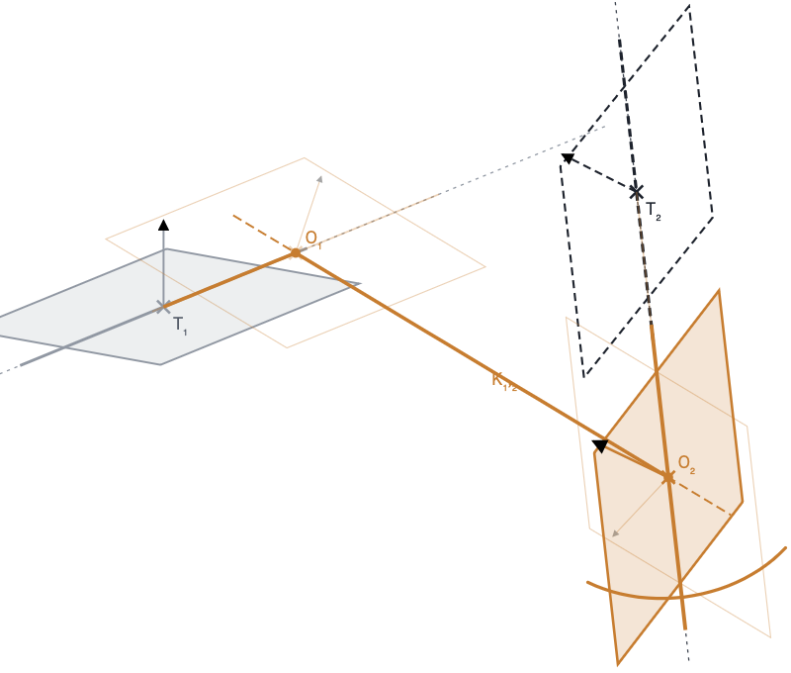
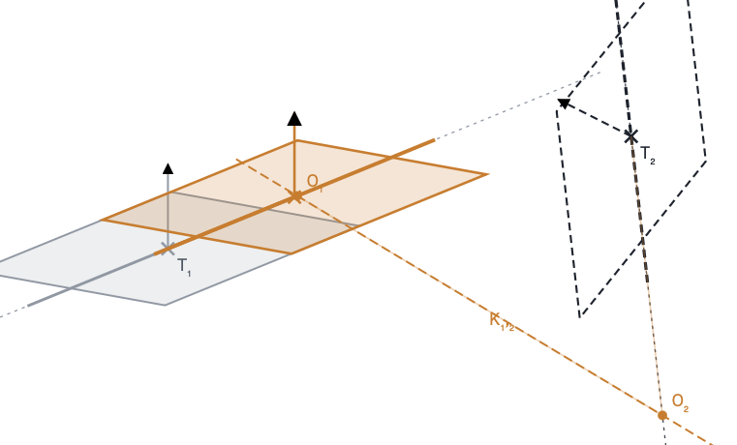
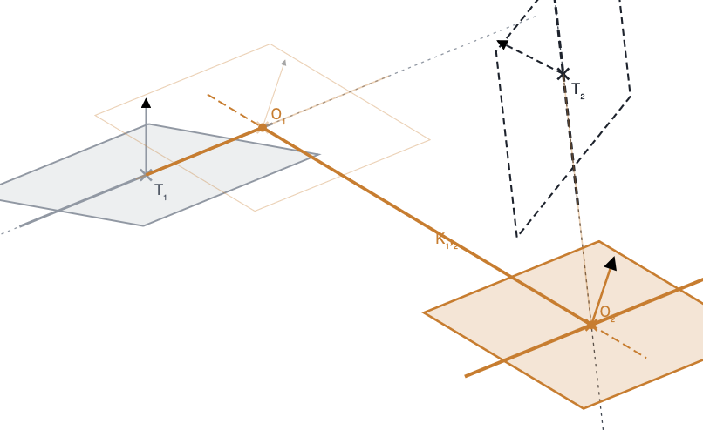
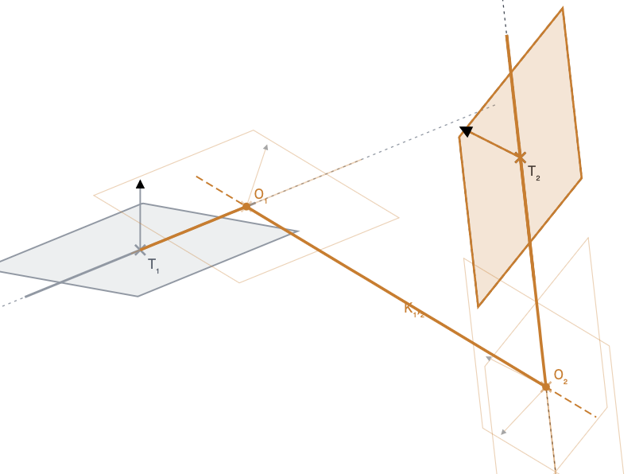
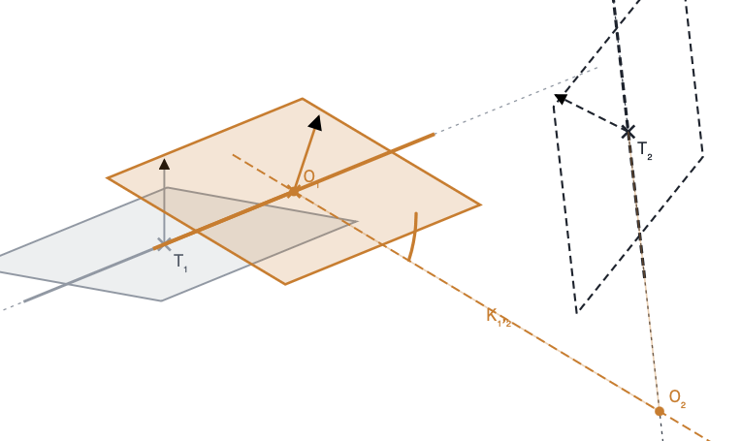
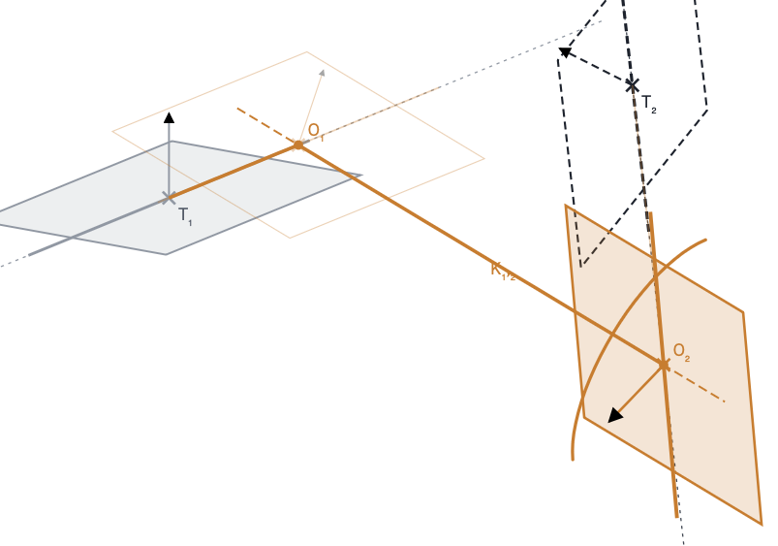
CoToLiPian transformation steps
L2
L1
O1
d1,2
K1,2
O1
O2
P1
T1
K1,2
Phi2 = â (K1,2; P2) around L2
d1,2 = d (O1; O2) along K1,2
O2
d1 = d (T1; O1) along L1
Angle type “P”
Phi2
L2
L1
L1
O1
L2
T2
P1
T1
Phi1
K1,2
Psi1,2
K1,2
Psi1,2 = â (L1; L2) around K1,2
Phi1 = â (P1; K1,2) around L1
Angle type “L”
O2
Angle type “P”
O2
d2 = d (O2; T2) along L2
L’1
L1,2

Slide 28
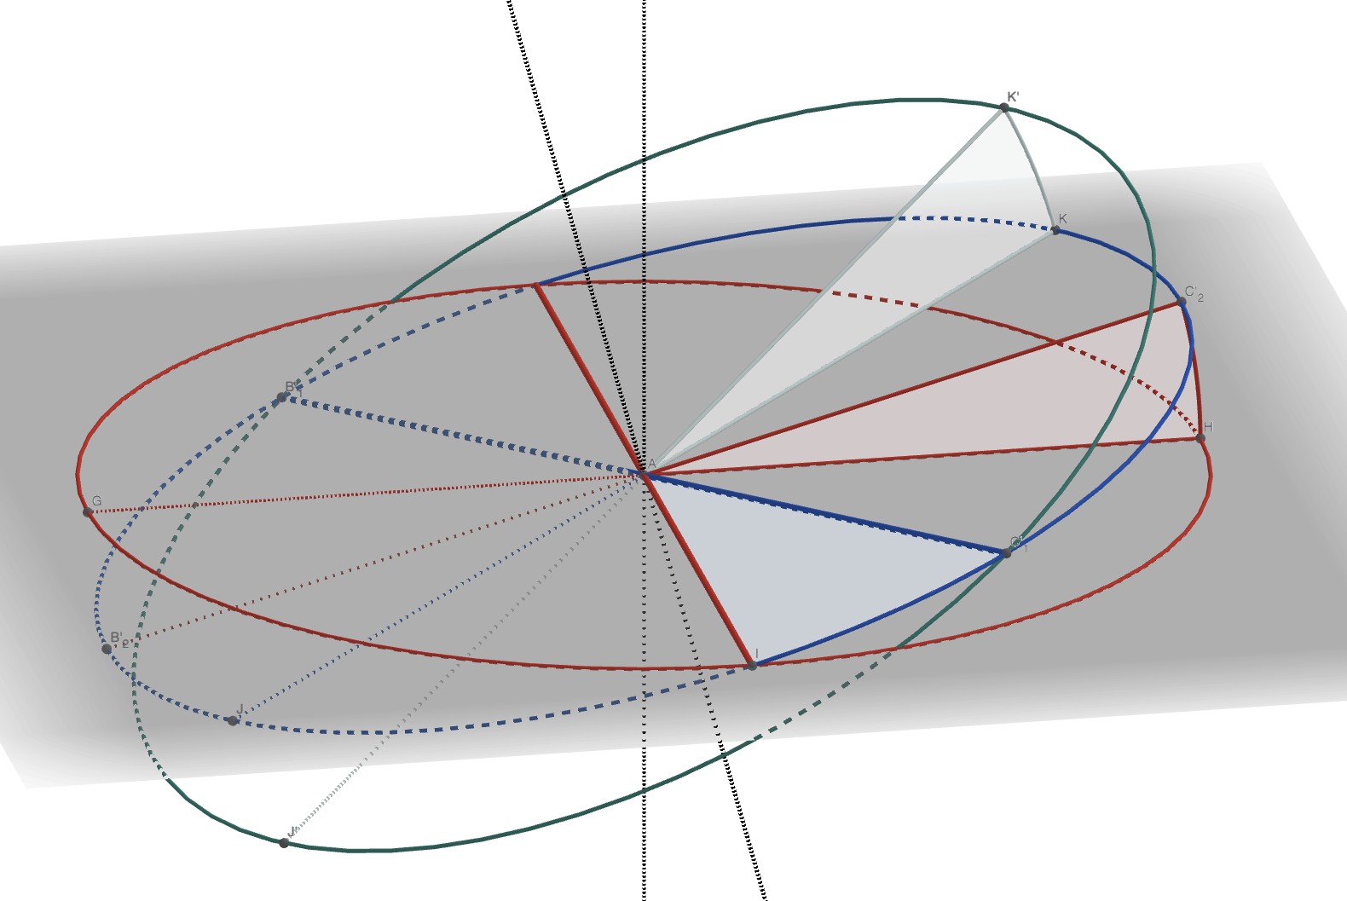
Focus on the angular parameters (after translations)
P2
Phi2
P1,2
L1
CoToLiPian angles
Phi1
Psi1,2
Phi2
Phi1
P1
L1,2
L2
In the figure, T1 and T2 are translated onto T1,2
Psi1,2
Actually, and this is a great asset: each angle is considered around their correct Ti
Phi1 around T1
Psi1,2 around T1,2
Phi2 around T2

Slide 29
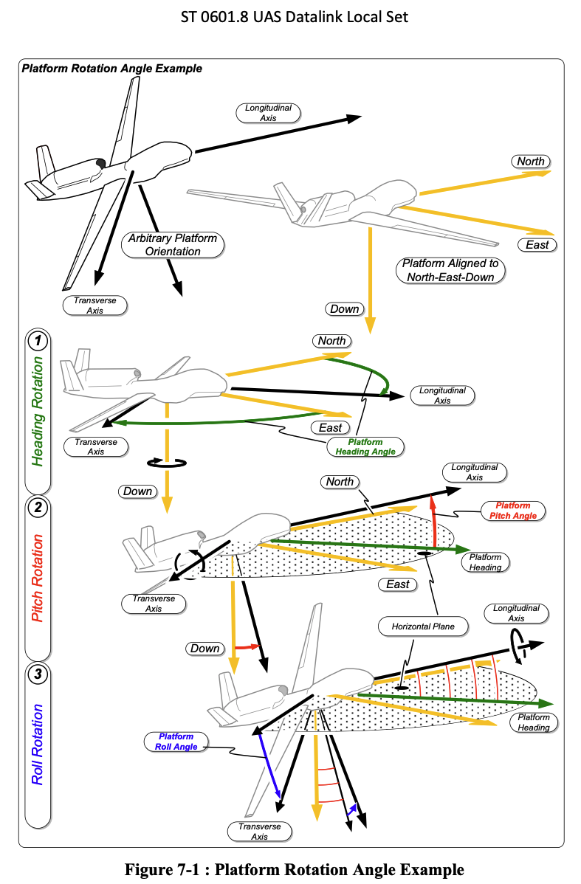

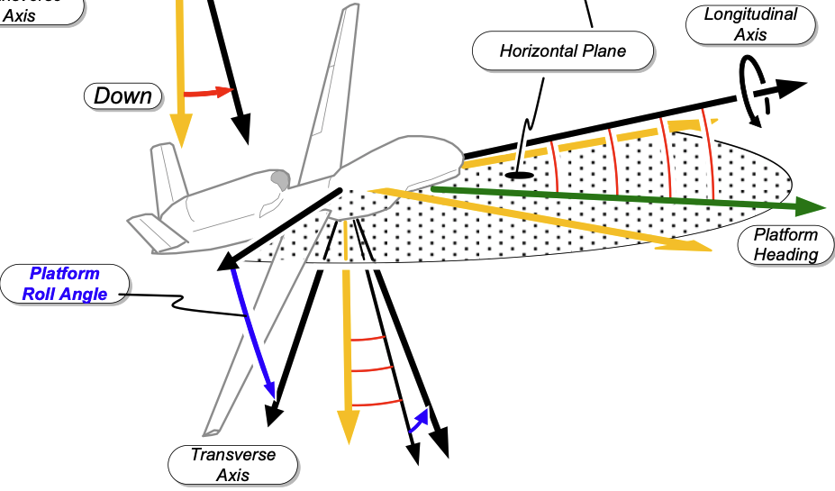
Comparing with classical yaw / pitch / roll angles
Aka “Tait-Bryant” angles of type z – y’ – x’’
Focus on the roll angle
Is it the same as PSI?
No exactly! Not defined around the same axis
Depending on the choice of the (most of the time not explicit) convention, the roll angle can differ.
This adds up to the uncertainty of specification

Slide 30
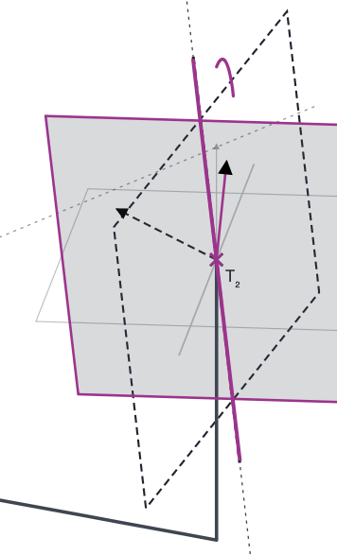
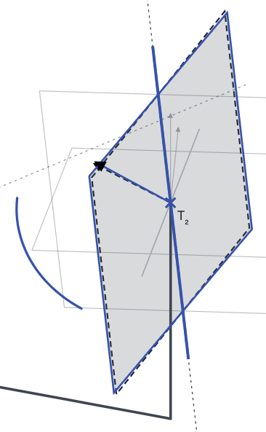
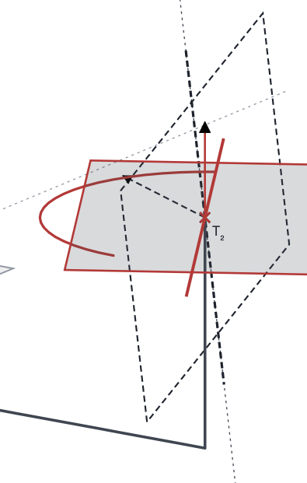
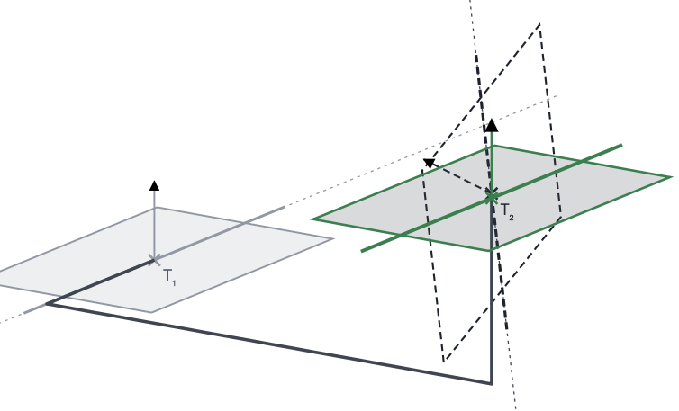
Classical yaw / pitch / roll angles
Tait-Bryan transformation steps applied to a ToLiP
Three translations along directions perpendicular 2 by 2
Yaw
(in P1)
Pitch
(around a line perpendicular to L2)
Roll
(around L3)

Slide 31
Comparison of “yaw / pitch / roll” vs CoToLiPian angles
0. Initial state
1. Rotation of type “L”
2. Rotation of type “LP”
3. Rotation of type “P”
T1 L1 P1
axis ⊥ P1 at B → T1 L2 P1
axis ⊥ L2 in P1 → T1 L3 P2
axis L3 → T1 L3 P3
axis
axis
P3
yaw / pitch / roll
P1
P1
P = 30°
P2
T1
L2
P1
L3
T1
B = T1
B = T1
L1
L1
L = 35°
L2
LP = 25°
P2
L3 = axis
Tait–Bryan z-y’-x’’ sequence {L; LP; P} around T1
From the red ToLiP to the green ToLiP, by two equivalent routes (only angles considered)
0. Initial state
1. Rotation of type “P”
2. Rotation of type “L”
3. Rotation of type “P”
ToLiP1: T1 L1 P1
axis L1 = L2 → T1 L2 P2
axis ⊥ P2 at B → T1 L3 P2
axis L3 → T1 L3 P3
P = 35°
axis
P3
P2
L2
CoToLiP
M (bisecting)
P = 25°
B = T1
B = T1
B = T1
B = T1
P1
L3
L3 = axis
L1
P1
L = 30°
P2
L1 = L2
= axis
CoToLiP sequence {P; L; P} around T1
P2

Slide 32
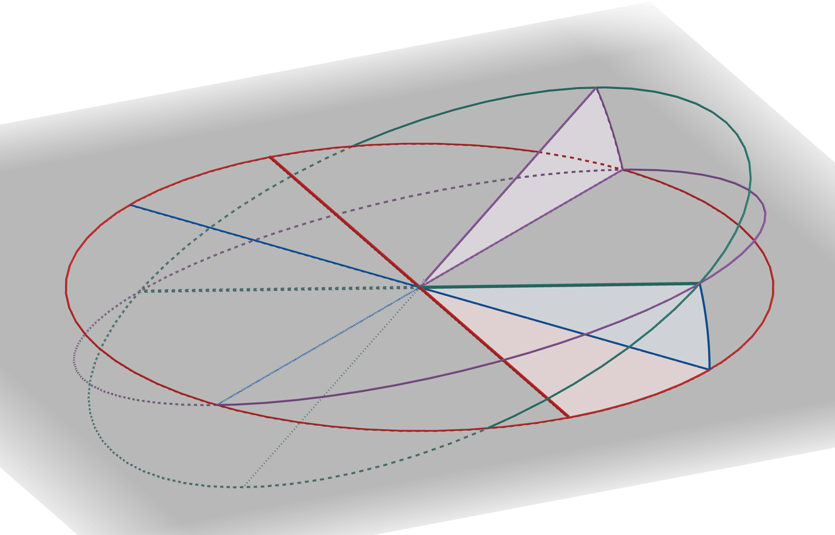
Different routes yielding to the same ToLiP transformation
CoToLiPian angles
Phi1
Psi1,2
Psi2
Yaw pitch roll angles
Yaw
Pitch
Roll
In most cases, discrepancy between the two routes is < 10^{–11}

Slide 33
The CoToLiP, a convention for mutual situation parameters?
Aim (for ISO/NWI 25431)
Standardize the CoToLiP and its mutual situation parameters as a default operator
It will always be possible to define explicitly other operators
Advantages
CoToLiP is symmetrical
The cotolipian parameters can be signed (absolute mutual situation) or unsigned (relative mutual situation)
CoToLiP is a commutative operator: CoToLiP (ToLiP1, ToLiP2) = CoToLiP (ToLiP2, ToLiP1)
The angular parameters do not depend on the order of the sequence of rotations
The parameters are grouped into three “motors*”.
  *A motor (in projective algebra) is a combination of a translation and a rotation with the same axis

Slide 34
CoToLiPian “motors”
Phi2 = a (K1,2; P2) around L1
d1 = d (T1; O1) along L1
d1,2 = d (O1; O2) along K1,2
Phi1 = a (P1; K1,2) around L1
Psi1,2 = a (L1; L2) around K1,2
d2 = d (O2; T2) along L2
First “motor”
Second “motor”
Third “motor”

Slide 35
Determining a CoToLiP from real data (1/2)
Input before characterisation by a CoToLiP:
1. ToLiP1, the nominal situation of ToLiP
2. A set of measured points on the feature 2* whose situation is represented by the yet non-established ToLiP2
Operations:
*From the set of measured points, establish ToLiP2 by an association (e.g. with Spatial Analyser)
*Establish the common perpendicular K1,2 between L1 and L2, and determine the distances d1, d2, and d1,2
In the figure, T1 and T2 are translated onto T1,2
Angle (L1, L2) -> Psi1,2, the bisecting line is L1,2
The plane containing L1 and L2 is P1,2
Project the perpendicular to L1 in P1,2 onto P1 –> Phi1
Project the perpendicular to L2 in P1,2 onto P2 –> Phi2
P2
Phi2
P1,2
*: operations not represented
L1
P1
Phi1
L2
Psi1,2
L1,2
}
{T1,2; L1,2; P1,2} = ToLiP1,2
d1, d2, and d1,2
Phi1, Phi2 and Psi1,2
Absolute mutual situation parameters of ToLiP2 with respect to ToLiP1
Output:

Slide 36
How to specify situation characteristics
When
ToLiP1 (red) is the nominal ToLiP of the situation of our device,
ToLiP2 (green) is established from the measured data,
then CoToLiP 2,1 is our researched “CoCoToLiP”
  How to specify the limit conditions on the CoCoToLiP?
  Initial (traditional) track: a table with ±n rms limit condition values: but how to deal with the implicit undefined or possibly inconsistent parameters?
  First variant (IWAA 2022 and 2024, and MST paper): proceed by analogy with existing ISO GPS tools on the axis of an associated cylinder, and define a tolerance zone;
  Second variant (IWAA 2026): direct tolerancing of mutual situation parameters – and actually, back to the first track, without the implicit! ✅

Slide 37
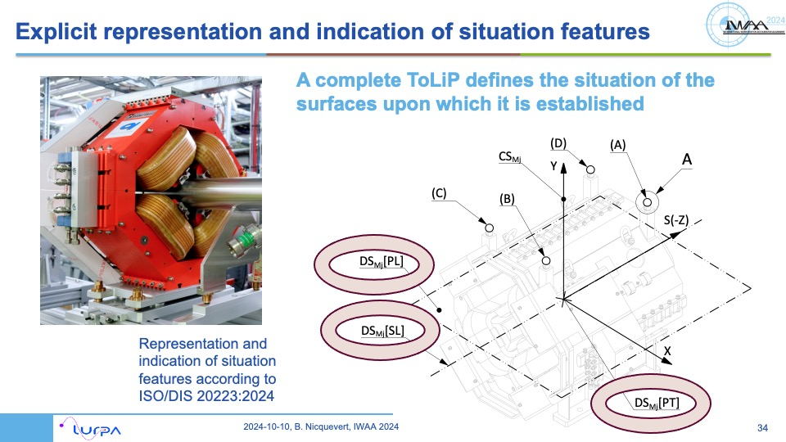
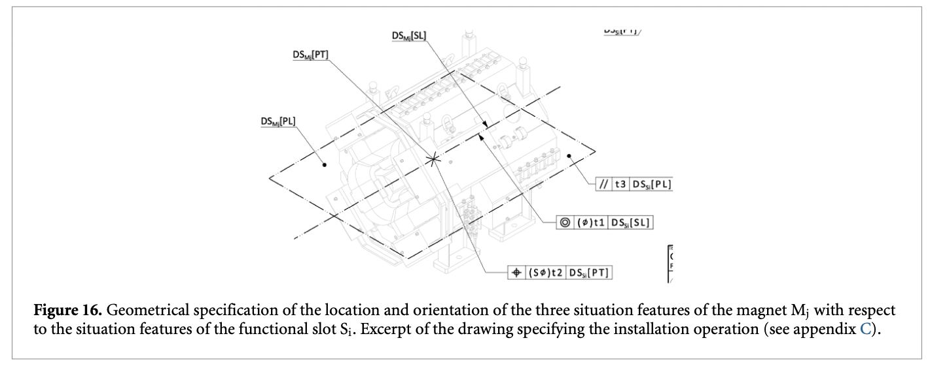
Situation specification of a situation feature, first variant 1/2
Idea: there are tools in ISO 1101 (or ASME Y14.5) to specify the orientation or position of the axis of an associated cylinder, or an associated plane or mid-plane of an associated biplane.
Ex. Ⓧ, Ⓝ and Ⓣ modifiers (ISO 1101, 8.2.2.2)
What about extending their use to any type of situation feature?
(once solved the issue of their extent, that is by default infinite)

Slide 38

Situation specification of a situation feature, first variant 2/2
Exemplified here for the case of the truncated situation feature of an associated feature (minimum circumscribed) to a specified feature nominally cylindrical.
The theoretically exact feature (the straight line 2) is constrained to be situated with respect to the datum system DS
(situation not fully exemplified here, e.g. // DS[PL] at a given distance from DS[PT] in a direction defined by DS[SL])

Slide 39

Situation specification of a situation feature, second variant
Simpler and more direct way of tolerancing
Nota: the symbology is not yet standardized!
Follow the development of ISO/NWI 25341
This situation specification variant would assign an explicit and univocal meaning to our ±t rms Tables
Nota: the “parameter specification element Q” defined in ISO 1101:2017, 8.2.2.3.2, may be used to refer to a 1 sigma value of the quadratic deviation

Slide 40
Comparison between the three variants, for a magnet “axis”
FUN (functional) specification
Step of the GPS^2 process | ± rms Table | Variant “tolerance zone” | Variant “mutual situation parameters”
0. Nominal specified features | Implicitly, magnetic axis | Situation feature [SL] of the magnetic ToLiP | Situation feature [SL] of the magnetic ToLiP
Real specified features | Measured magnetic axis | [SL]1 associated to the measured magnetic axis, extent limited | [SL]1 associated to the measured magnetic axis
2. Associated feature | A straight line at the exact situation? | [SL]2 situated at theoretically exact situation | [SL]2 situated at theoretically exact situation
3. deviations 1 vs 2 | ? | Local deviations between the points of the two [SL] | Defines a global deviation and this is NEW
4. Characteristic on 3. | ? | Doubled maximum deviation | Mutual situation parameters SL1 vs SL2
5. Limit condition on 4. | The values in the Table | A tolerance zone | The adapted values in the Table!

Slide 41


And the MuToLip?
Provides a very convenient “average” CoToLiP
Very useful for multiple devices when the “roll angle” is not uniquely defined (twin aperture magnets of FCC-ee) or not even functional (e.g. LBNL ALS-U rafts)
“Provide a physicist’s defined axis of the girder”
Jana Barker, IWAA 2026, 2026-10-06

Slide 42

CoToLiP and MuToLiP algorithms
… Falls down beyond today’s scope (and time)
As a consequence:
“to be continued”
For IWAA 2028!
Where are we in 2026?
Complete algorithms are now ready, and under test, for:
CoToLiP n=2
MuToLiP n>2
With a far simpler perspective, using the CoToLiPian angles in a cleverer way…
And taking into account all limit cases!

Slide 43

Other usages of CoToLiP: installation in the tunnel
Handling and unloading during installation is already a kind of first alignment!
Aiming at a submillimetric range of accuracy
From LHC transfer table (2003) …

Slide 44


Toward the future
© courtesy G. Villiger, CERN EN/THE, June 2026
1532 mm
750 mm
1050 mm
1300 mm
630 mm
… to FCC automatised installation (2038?)
2500 mm

Slide 45
References
On top of the three IWAA presentations mentioned in the body of this presentation:
Nicquevert, B., Rey, F. “Handling the Functional Features of Accelerator Components Using ISO GPS Situation Features”. J. Phys.: Conf. Ser. 2687 072028 (2024). https://doi:10.1088/1742-6596/2687/7/072028
Nicquevert Bertrand, Rey Fabien. “Handling the Functional Features of Accelerator Components Using ISO GPS Situation Features.” In Proceedings of IPAC’23, Venice, Italy, 2023. https://inspirehep.net/files/393f09317f81cd244bdbf0ee18c1c29d
Qie, Y., Nicquevert, B., Anwer, N. “Functional specification of complex assemblies using projective geometric algebra”. CIRP Annals, vol. 73, 1, pp. 105-108 (2024). https://doi.org/10.1016/j.cirp.2024.04.059
Nicquevert Bertrand, “For a Global Process to Set a Geometrical Product Specification [GPS^2]: a R&D Roadmap Toward an Extensive and Extended Use of Situation features in ISO Geometrical Product Specification (GPS) Standards”, ADM2024 International Conference, Palermo, Italy, Sep 2024. Springer, pp. 488–495, 2025. https://doi.org/10.1007/978-3-031-76597-1_51
ISO 20223:2026, Representation and identification of situation features

Slide 46
Acknowledgments
A special thank to my “sparring partner” Fabien Rey / ESS, for numerous discussions on the development of the concepts presented in this talk, and for his key contribution to many illustrations
Many thanks to CERN, in particular for J.-P. Burnet (CERN FCC studies), and to S. Atieh, I. Ruehl and D. Lafarge (CERN EN dept) to support my participation to IWAA
Thanks to I. Garcia-Aguirrebeitia Sanchez (CERN TE/MSC) and G. Villiger (CERN EN/THE) for their contributions. A lot of working ahead, working on how to use CoToLiP for the design of the FCC-ee quadrupoles, their installation, and many coming new topics
Thanks also to A. Bertarelli and T. Capelli (CERN EN/MME), and colleagues from ISO TC213 and in industry, for providing me cases to support the needs to still improve our ISO GPS standards
And many thanks to Hélène, Dirk and many others (CERN BE/GM) to open the door for new perspectives in dealing with the « geodetic common framework » to be used at multiscale levels.

