Slide 1



Forty Years of Accelerator Alignment at Duke University Free Electron Laser Laboratory
(DFELL)
IWAA 2026
Tsukuba, Japan
Mark Emamian IWAA 2026 8 October 2026

Slide 2

Chronology and a Brief History
Storage Ring Based Free Electron Laser Lab at Stanford University was conceived
Planning for magnet design and alignment started
Some of the Dipoles & Quadrupoles plus the girders were fabricated and installed
Magnets, girders, Linac accelerators plus all lab equipment were moved to Duke University
More equipment and some of the technical and scientific staff moved to Duke University
Planning for construction of a building for the lab at Duke was started
Construction of the 5100 square meter Duke Free Electron Laser Lab (DFELL) was completed
Mark Emamian IWAA 2026 8 October 2026

Slide 3
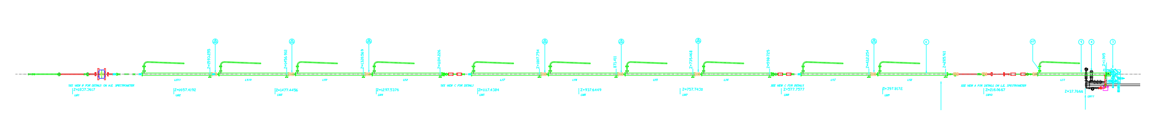
Optical instruments and alignment tools used to accomplish the task of alignment:
a. Brunson 76-RH Telescopic transit square, used to align components in a vertical plane.
Brunson 376-RHN Universal transit square
Wild precision sight level model N3, used to sight in horizontal plane and set elevations of components.
Wild precision optical plummet model NL, used for nadir pluming.
Brunson 803 invar scale extension kit, to measure distances of less than 7 meters.
Mark Emamian IWAA 2026 8 October 2026

Slide 4
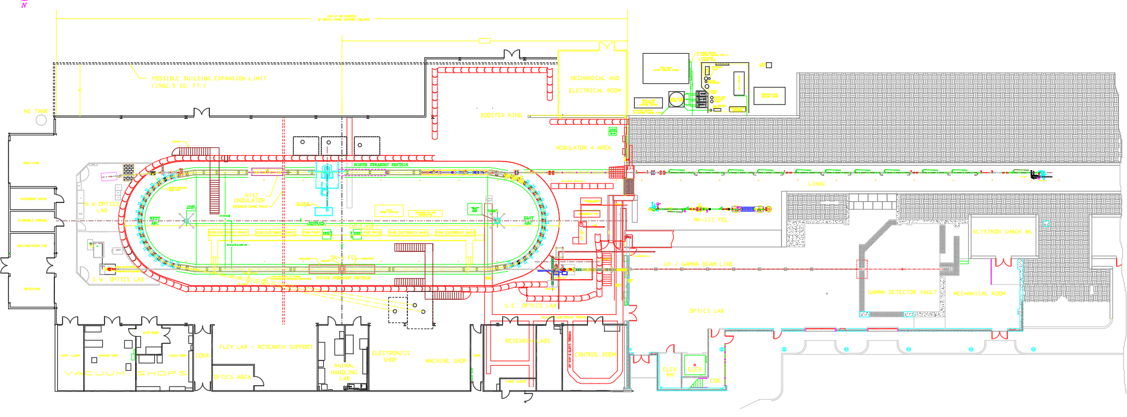
To satisfy the extraordinary stability requirements for research in the UV and γ-ray, the main storage ring’s 1 meter thick slab is supported on a matrix of 32 closely spaced caissons extended to the underlying bedrock.
The rest of the facility including the cavity mirrors are installed on separate slabs with their thickness ranging from 12 to 32 cm.
Mark Emamian IWAA 2026 8 October 2026

Slide 5
Realignment of Duke Free Electron Laser Storage Ring
2001
In the fall of 2001, both East and West arc sections of the storage ring at the Duke Free Electron Laser (FEL) laboratory went under a major upgrade. This upgrade was necessary in order to improve the power supplies and water-cooling capabilities in the arc quadrupole magnets, and also to improve the vacuum systems in the arc sections.
Mark Emamian IWAA 2026 8 October 2026

Slide 6
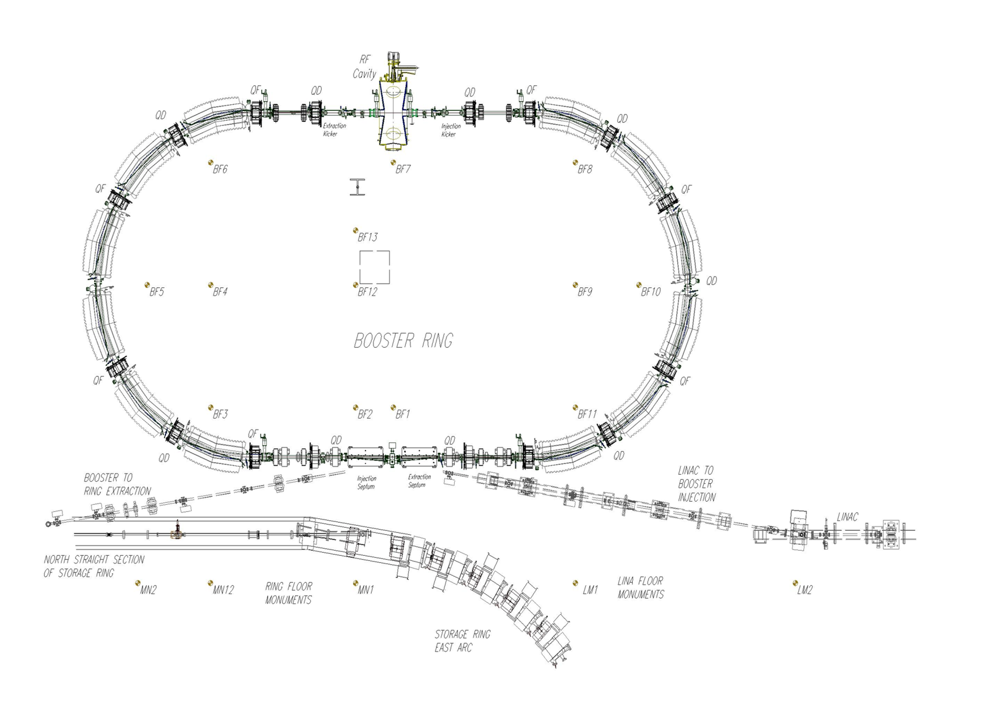
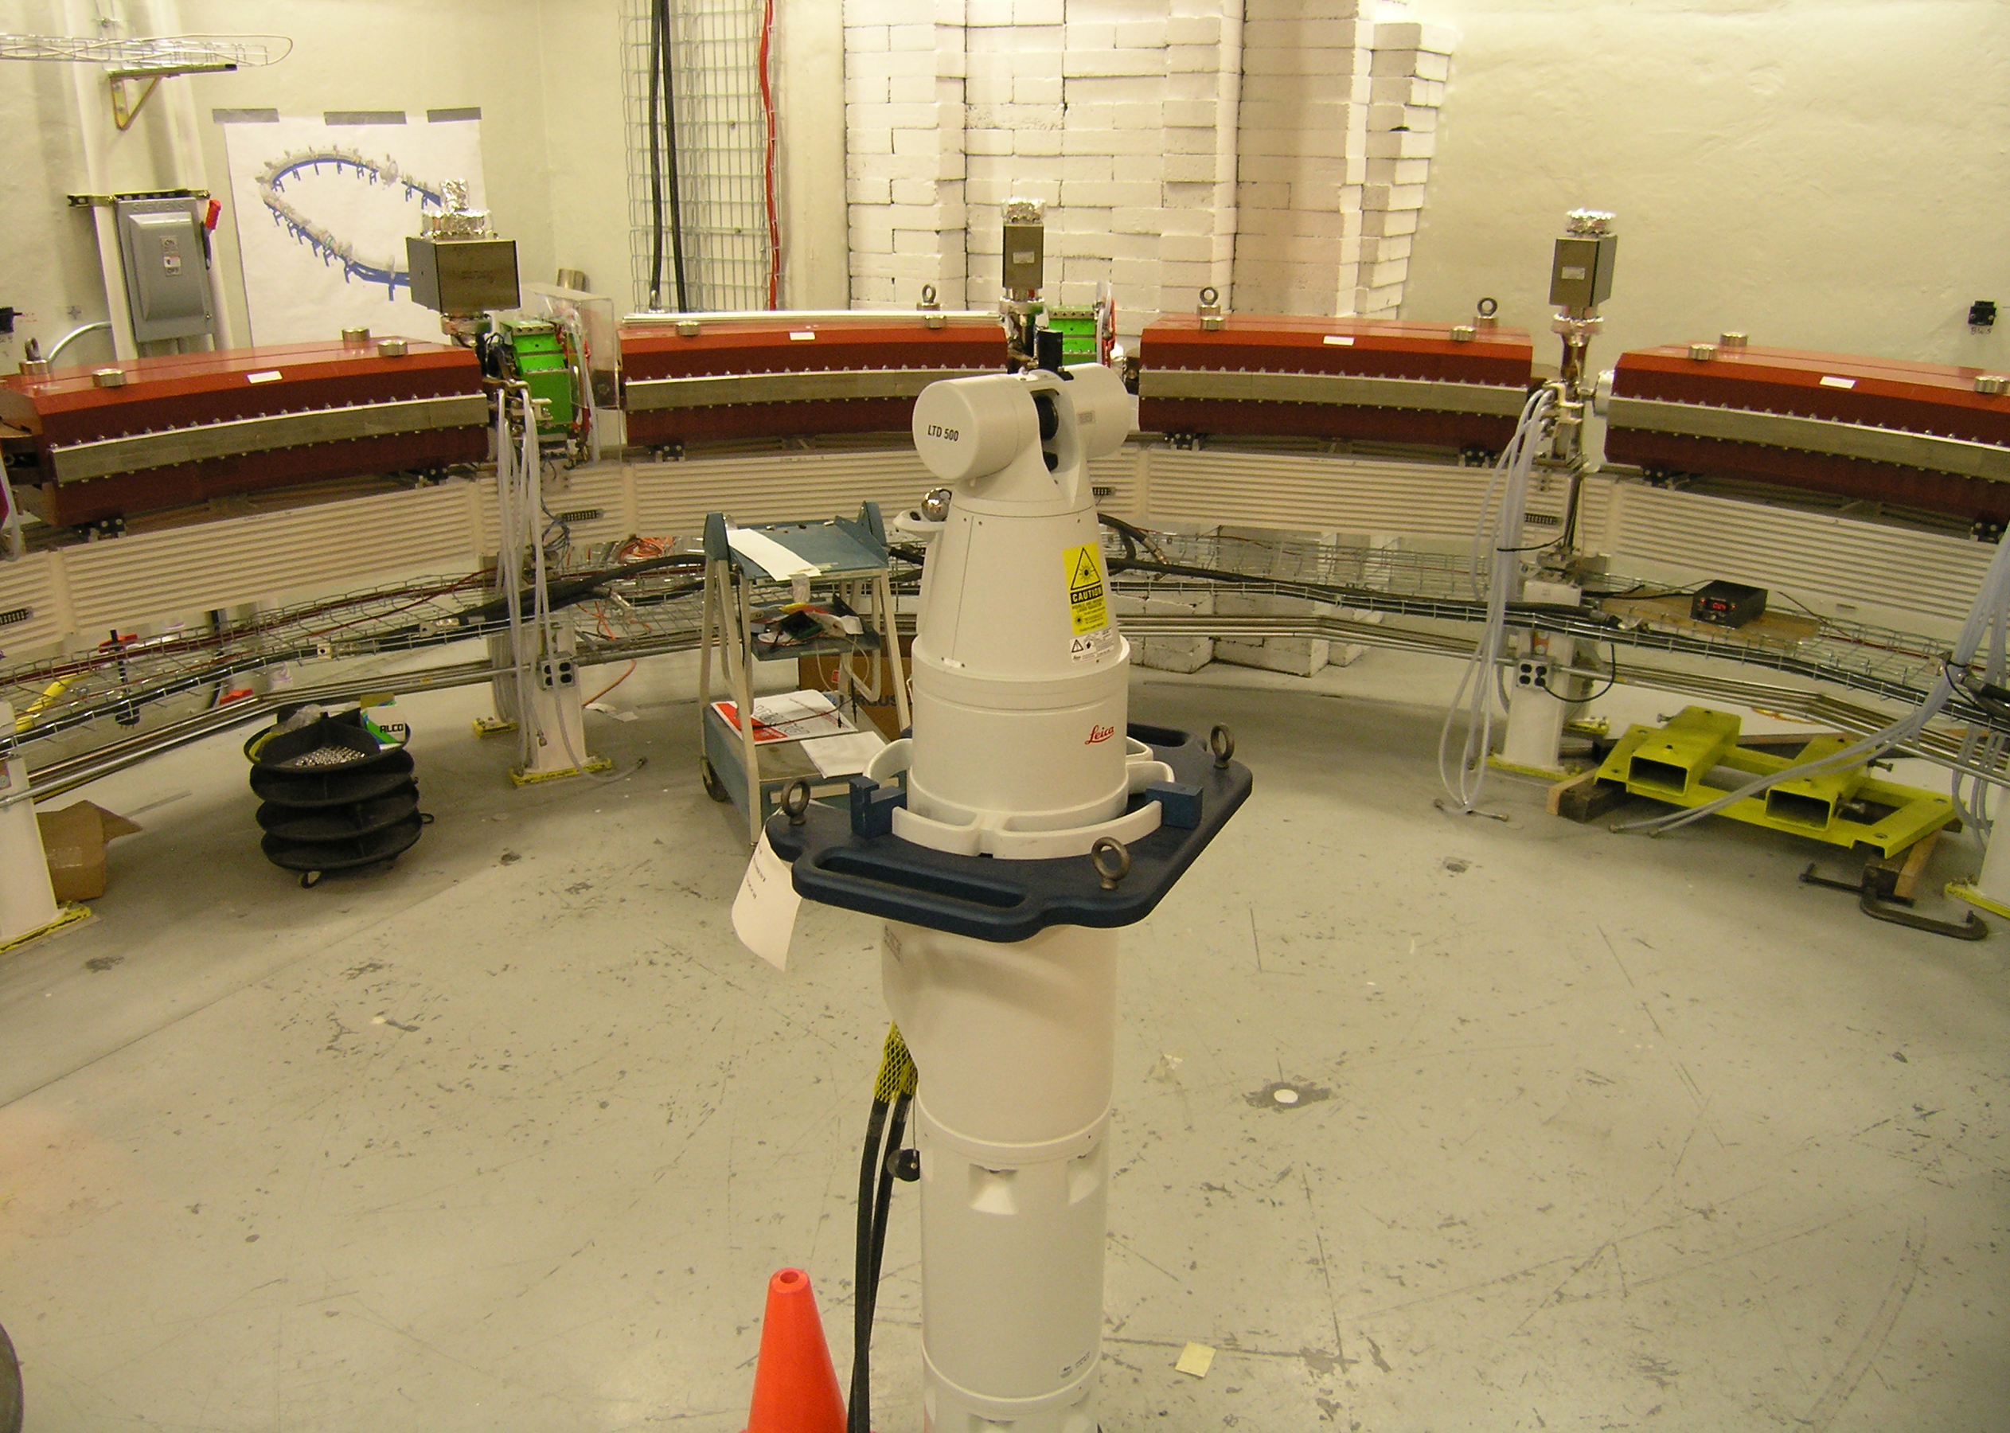

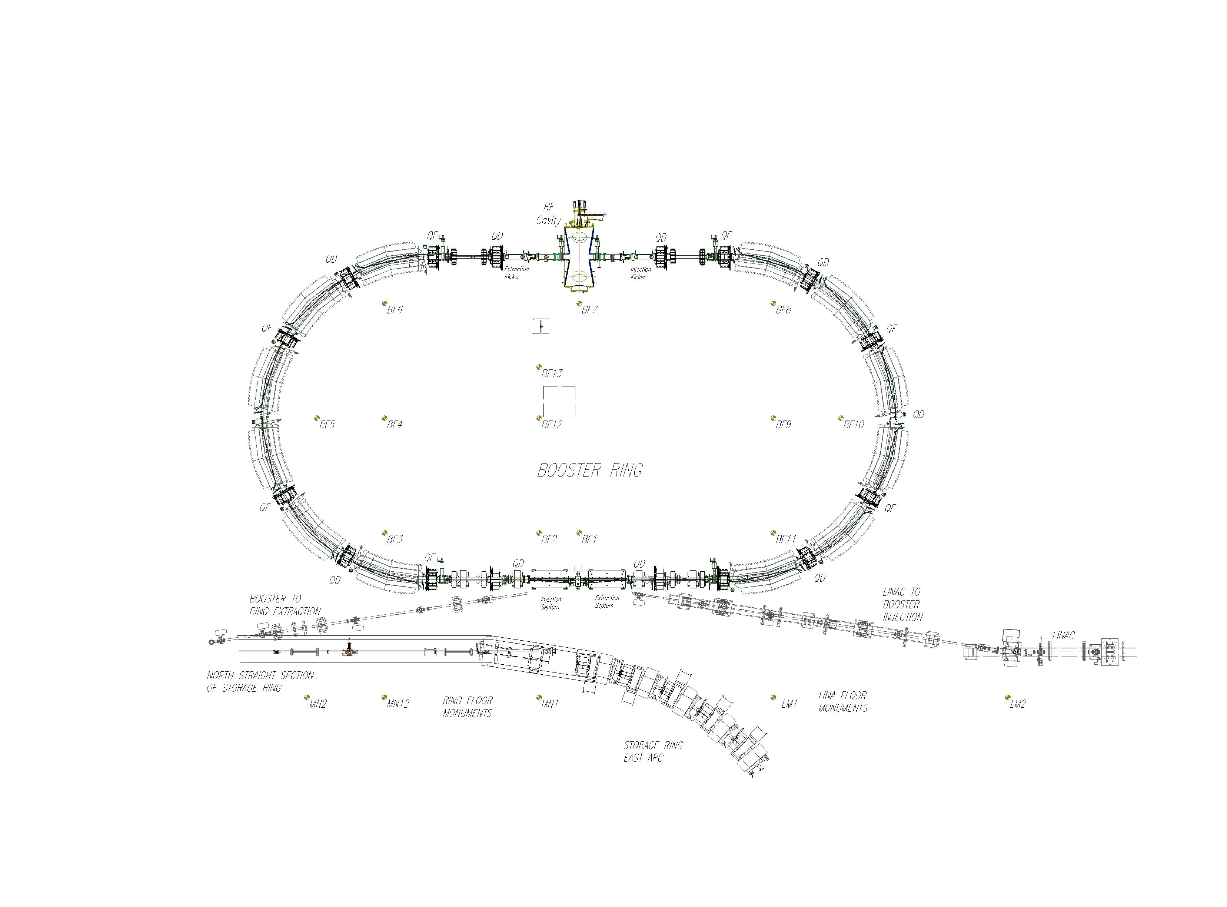
Booster Ring Installation
2006
Used Laser Tracker LTD500
31.9 m circumference machine
12 dipole magnets;
8 Focusing (QF) and 8 Defocusing (QD) quadrupoles
8 Sextupoles and 8t horizontal and vertical trim Dipoles
One178.55 MHz RF cavity for ramping electron bunches to 1.2 GeV
One injection and one extraction septum magnet; two kicker magnets
Each arc in the booster ring consists of 6 magnet clusters which are supported by individual extruded aluminum strong backs.
Beam energy ramping from 0.27 GeV to 1.2 GeV is accomplished in 0.6 second at 1.3 second of repetition rate.
Mark Emamian IWAA 2026 8 October 2026

Slide 7
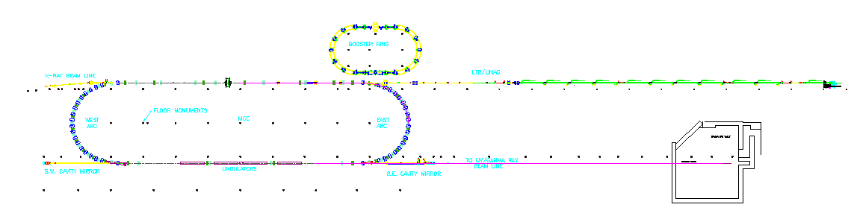
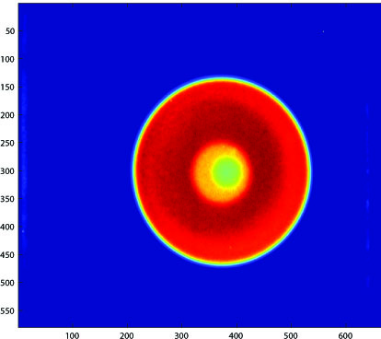
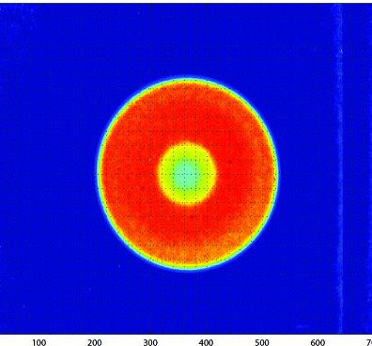
Beam Based Alignment of HIGS Targets at DFELL
2010
DFELL Storage Ring / HIGS Floor Monuments Layout
Gamma Ray BGO Imaging System progress Report
In order to rapidly and precisely image and align objects and other experimental targets which are placed in the path of gamma rays, a gamma ray imaging system was designed. Major components of this system consist of a scintillation crystal plate, Bismuth Germanium Oxide or BGO which converts gamma rays to visible lights, and a CCD based camera to capture the lights. The spatial resolution of this BGO system is in the order of 0.5 mm.
Mark Emamian IWAA 2026 8 October 2026

Slide 8
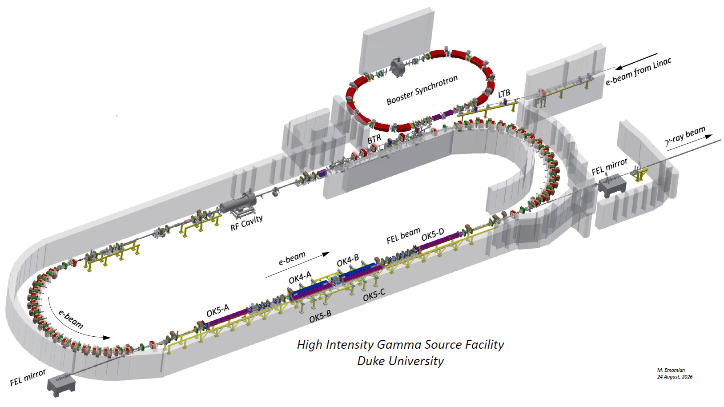
Switch Yard Installation in 2012
Installation of a long kinematic mounting track which is capable of holding a pair of Helical undulators (Optical Klystron 5, OK5) and a pair of planar undulators (Optical Klystron 4, OK4 ). Track can move to switch from planar to helical polarity on demand with a relative ease and minimum amount of time.
Mark Emamian IWAA 2026 8 October 2026

Slide 9
Thank You!
Mark Emamian IWAA 2026 8 October 2026

