Slide 1



SOLEIL II alignment: a metrological approach to meeting tolerances with confidence
Y. Delalande¹, S. Ducourtieux¹, A. Lestrade¹, M. Sebdaoui¹, B. Leluan¹, C. Bourgoin¹, Y. Denis¹, D. Jourdain¹, J. Guillory², S. Durand³
¹Synchrotron SOLEIL
²Laboratoire Commun de Métrologie LNE (Cnam/LCM - EA 2367)
³Laboratoire Geomatique et Foncier (Cnam/GeF - UR 4630)

Slide 2
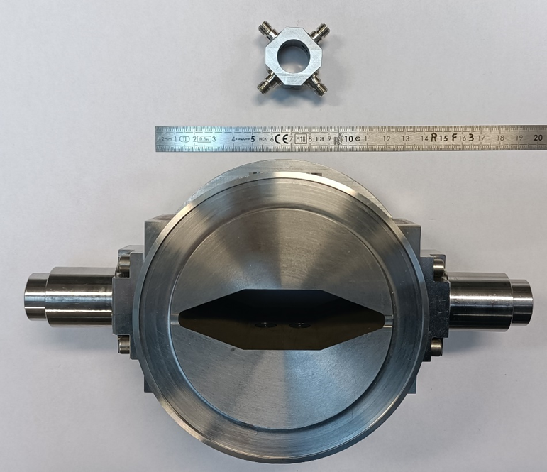
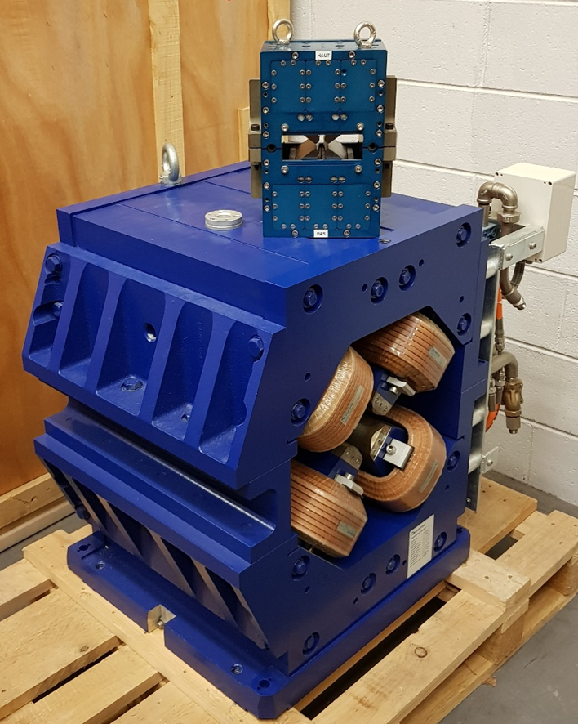
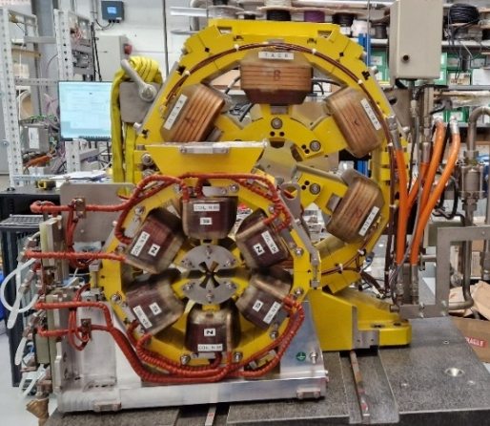
SOLEIL II project
Shutdown
2020
2021
2022
2023
2024
2025
2026
2027
2028
2029
2030
2031
2032
2033
2034
2035
CDR
(Conceptual Design Report)
TDR
(Technical Design Report)
STAGE 1:
CONSTRUCTION
STAGE 2:
TOWARDS FULL PERFORMANCE
Shutdown and dismantling of the existing machine
Commissioning of the new booster and storage ring
Adaptation and restart of the beamlines
Information System Overhaul
Modernization of the support labs
R&D program on instrumentation
Complete Modernization of the beamlines
Full performance of the accelerators
Modernization of the support labs
R&D program on instrumentation
Evolution towards innovative analysis techniques
SOLEIL
LINAC energy: 110 MeV
Booster: 0.1 - 2.75 GeV
SR circumference: 354.10 m
SR energy: 2.75 GeV
SR emittance: 3900 pm.rad
317 electromagnets
56 girders
29 beamlines
SOLEIL II
LINAC energy: 150 MeV
Booster: 0.15 - 2.75 GeV
SR circumference: 353.98 m
SR energy: 2.75 GeV
SR emittance: 90 pm.rad
1300 permanent/electro-magnets
86 girders
29 beamlines
BPM vacuum chamber SOLEIL/SOLEIL II
Sextupole SOLEIL/SOLEIL II
Quadrupole SOLEIL/SOLEIL II

Slide 3
SOLEIL II project
Shutdown
2020
2021
2022
2023
2024
2025
2026
2027
2028
2029
2030
2031
2032
2033
2034
2035
CDR
(Conceptual Design Report)
TDR
(Technical Design Report)
STAGE 1:
CONSTRUCTION
STAGE 2:
TOWARDS FULL PERFORMANCE
Shutdown and dismantling of the existing machine
Commissioning of the new booster and storage ring
Adaptation and restart of the beamlines
Information System Overhaul
Modernization of the support labs
R&D program on instrumentation
Complete Modernization of the beamlines
Full performance of the accelerators
Modernization of the support labs
R&D program on instrumentation
Evolution towards innovative analysis techniques
New lattice very compact and very sensitive to misalignment => tight alignment tolerances
SOLEIL
LINAC energy: 110 MeV
Booster: 0.1 - 2.75 GeV
SR circumference: 354.10 m
SR energy: 2.75 GeV
SR emittance: 3900 pm.rad
317 electromagnets
56 girders
29 beamlines
SOLEIL II
LINAC energy: 150 MeV
Booster: 0.15 - 2.75 GeV
SR circumference: 353.98 m
SR energy: 2.75 GeV
SR emittance: 90 pm.rad
1300 permanent/electro-magnets
86 girders
29 beamlines
BPM vacuum chamber SOLEIL/SOLEIL II
Sextupole SOLEIL/SOLEIL II
Quadrupole SOLEIL/SOLEIL II

Slide 4
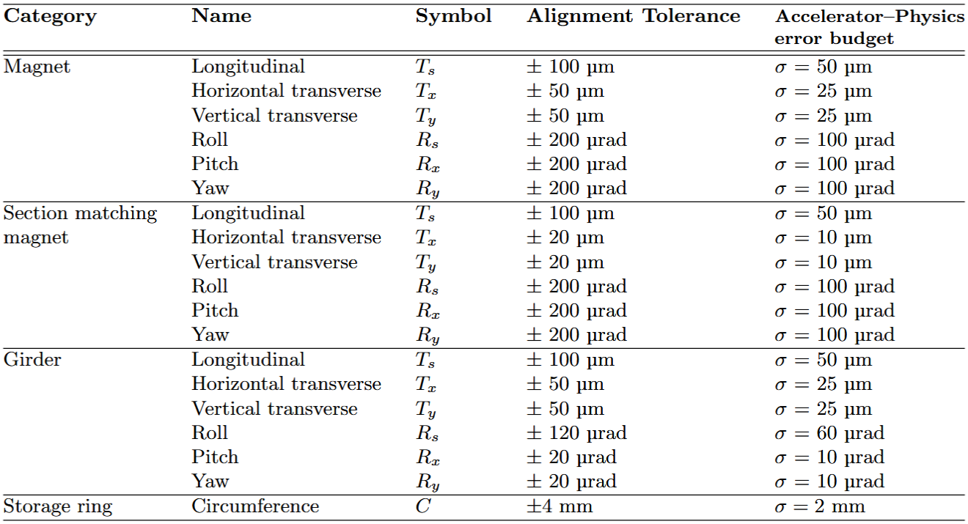
Main alignment requirements for SOLEIL II
Install the new storage ring in the existing tunnel while keeping the source points of the 15 preserved beamlines at their current position (+/- 0.5 mm)
Meet the alignment tolerances set by the accelerator physicists to reduce critical discontinuities along the beam path and guarantee the expected electron beam performance
y
x
s
Beam
Errors simulated by accelerator physicists (normal distribution truncated at +/- 2σ)
Alignment tolerances defined as +/- 2σ of the simulated error, for consistency
Ultra-low-emittance lattice with strong, densely packed magnets: a few tens of µm of misalignment degrades the beam
Permanent-magnet quadrupoles cannot be tuned, hence tight longitudinal and circumference tolerances

Slide 5
Main alignment requirements for SOLEIL II
Install the new storage ring in the existing tunnel while keeping the source points of the 15 preserved beamlines at their current position (+/- 0.5 mm)
Meet the alignment tolerances set by the accelerator physicists to reduce critical discontinuities along the beam path and guarantee the expected electron beam performance
y
x
How can we guarantee that these requirements will be met with sufficient confidence?
s
Beam
Errors simulated by accelerator physicists (normal distribution truncated at +/- 2σ)
Alignment tolerances defined as +/- 2σ of the simulated error, for consistency
Ultra-low-emittance lattice with strong, densely packed magnets: a few tens of µm of misalignment degrades the beam
Permanent-magnet quadrupoles cannot be tuned, hence tight longitudinal and circumference tolerances

Slide 6
Metrological approach for SOLEIL II
Future contribution
A metrological approach is a quality assurance approach aimed to ensure the reliability of a single measurement or a measurement strategy. It involves analysing, quantifying and controlling uncertainty throughout the measurement process, to deliver results that are traceable to the SI as far as possible, documented, repeatable and compliant with the specified requirements.
At SOLEIL, this approach led to a few key questions:
  What exactly do the alignment errors simulated by the physicists represent, and do they reflect the actual alignment process?
  What exactly is a tolerance, and how do we decide whether it is met?
  Are the alignment tolerances achievable with our measurement chain?
This approach goes beyond pure alignment and requires close collaboration with accelerator physicists, mechanical engineers, and magnet experts.
Requirements
& discussions
Optimisations
& improvements
Tolerance
definition
Modelling and
simulations
Conformity
assessment
Metrological approach
Uncertainty
budget
R&D
Measurements
& comparisons
Calibrations
& Traceability

Slide 7
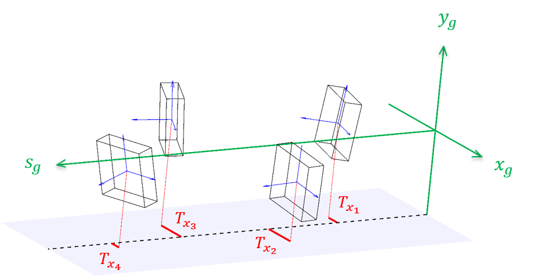
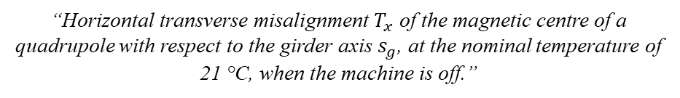
Measurand definition
Measurand = quantity intended to be measured
  Requires a precise definition to avoid any ambiguity regarding what is to be measured
  Must match exactly the quantity to which the tolerance applies: physicists and aligners must be talking about the same thing
What is it exactly?
Example of poorly defined measurand:
Example of a measurand defined at SOLEIL:
“Horizontal transverse misalignment $T_{x}$ of the magnetic centre of a quadrupole with respect to the girder axis $s_{g}$, at the nominal temperature of 21 °C, when the machine is off.”
“Relative deviation between magnets”
Under which conditions?
In which frame?
Between what?
In which direction?
Which magnets?

Slide 8
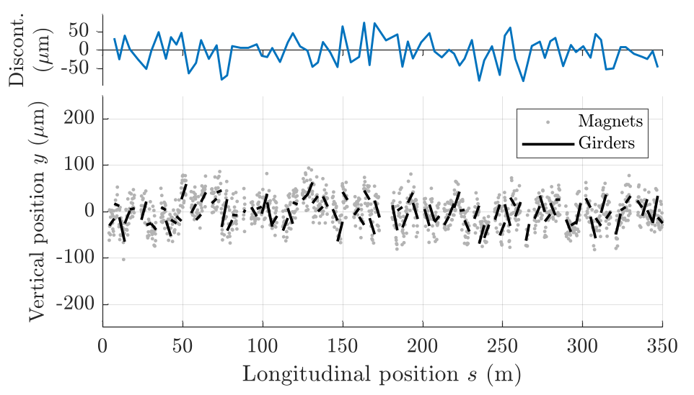
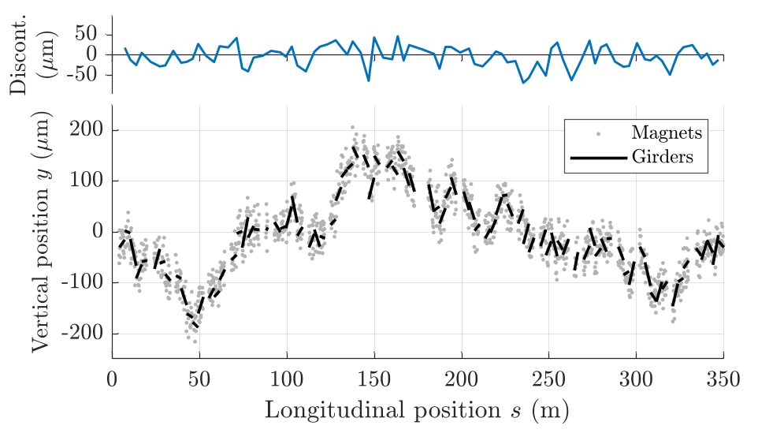
Towards a more realistic alignment error model
Tolerances are derived from Monte Carlo beam simulations, in which alignment errors are applied in successive layers: magnets on their girder, then girders in the tunnel
Initial model: independent girders
New model: correlated girders
Same input for both models: σ = 25 µm in translation, 10 µrad in rotation
Each girder drawn independently:
Girder-to-girder discontinuity: σ = 37 µm, max = 149 µm
Each girder positioned relative to the previous one, as done with the laser tracker, with ring closure:
Girder-to-girder discontinuity: σ = 26 µm, max = 85 µm
Better and more realistic simulated beam performance, avoiding further tightening of alignment tolerances

Slide 9
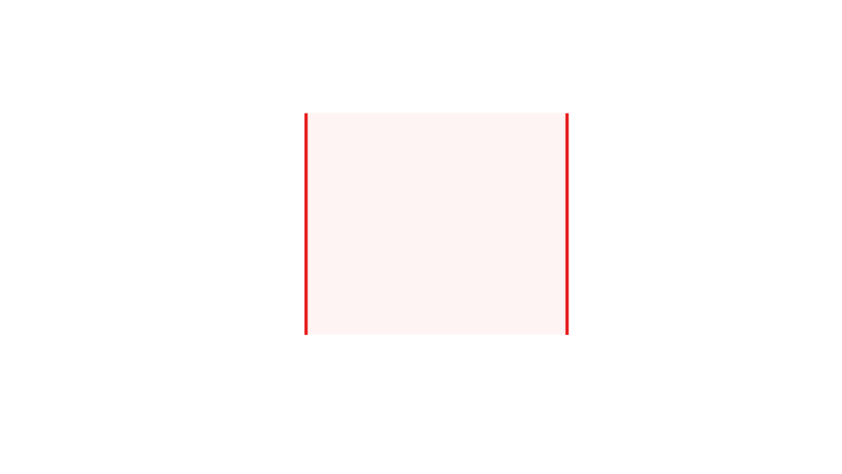
Conformity: are the tolerances met?
Tolerance = interval of permissible values for a measurand to meet specified requirements.
At SOLEIL: +/- 2σ of the error simulated by the physicists
Probability
Tolerances
Magnet position
Theoretical position

Slide 10
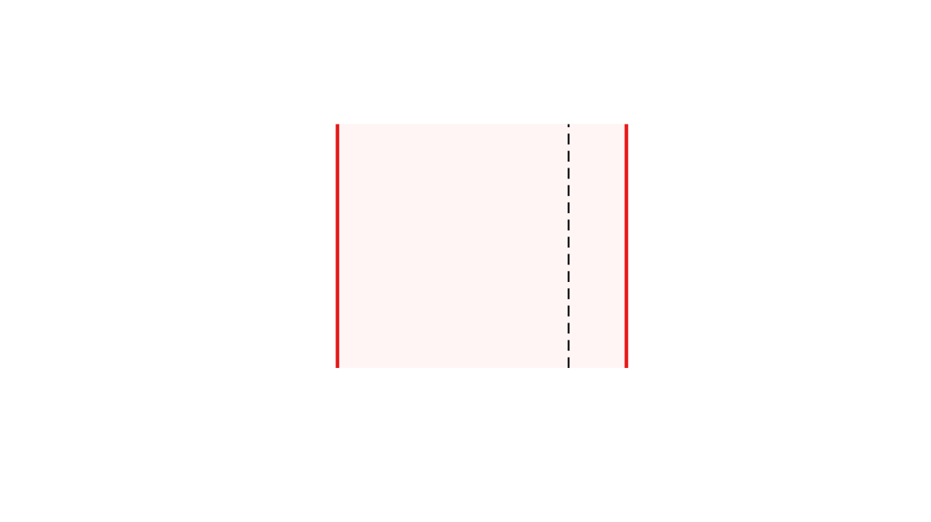
Conformity: are the tolerances met?
Tolerance = interval of permissible values for a measurand to meet specified requirements.
At SOLEIL: +/- 2σ of the error simulated by the physicists
Probability
Conform
Tolerances
Magnet position
Theoretical position
Measured position

Slide 11

Conformity: are the tolerances met?
Tolerance = interval of permissible values for a measurand to meet specified requirements.
At SOLEIL: +/- 2σ of the error simulated by the physicists
Probability
Not conform
Tolerances
Magnet position
Theoretical position
Measured position

Slide 12
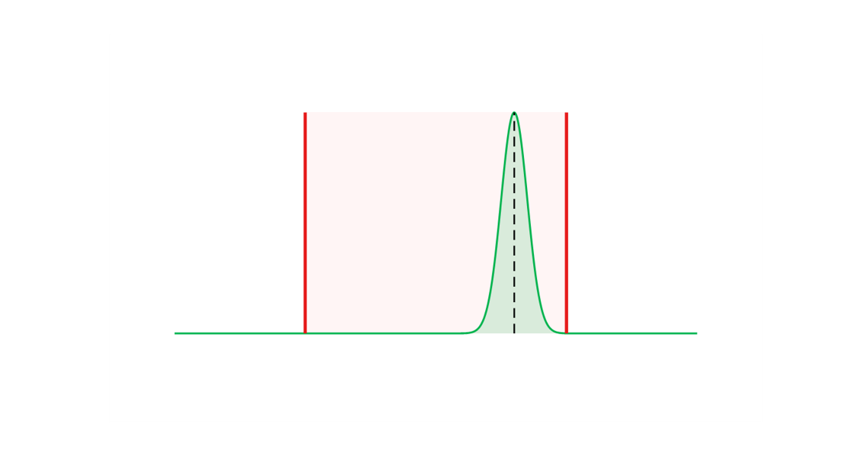
Conformity: are the tolerances met?
Tolerance = interval of permissible values for a measurand to meet specified requirements.
At SOLEIL: +/- 2σ of the error simulated by the physicists
A measured value inside the tolerance not guarantee that the true value is: measurand uncertainty must be considered
Probability
Conform at better than 99.9 %
Tolerances
Magnet position
Theoretical position
Measured position

Slide 13
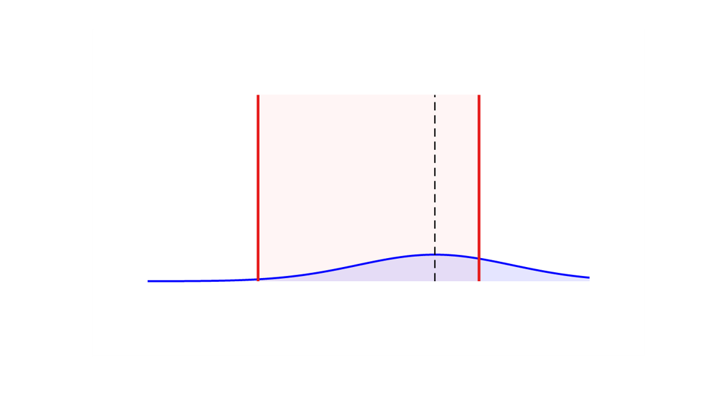
Conformity: are the tolerances met?
Tolerance = interval of permissible values for a measurand to meet specified requirements.
At SOLEIL: +/- 2σ of the error simulated by the physicists
A measured value inside the tolerance not guarantee that the true value is: measurand uncertainty must be considered
Probability
Conform at 70 %
Tolerances
Magnet position
Theoretical position
Measured position

Slide 14
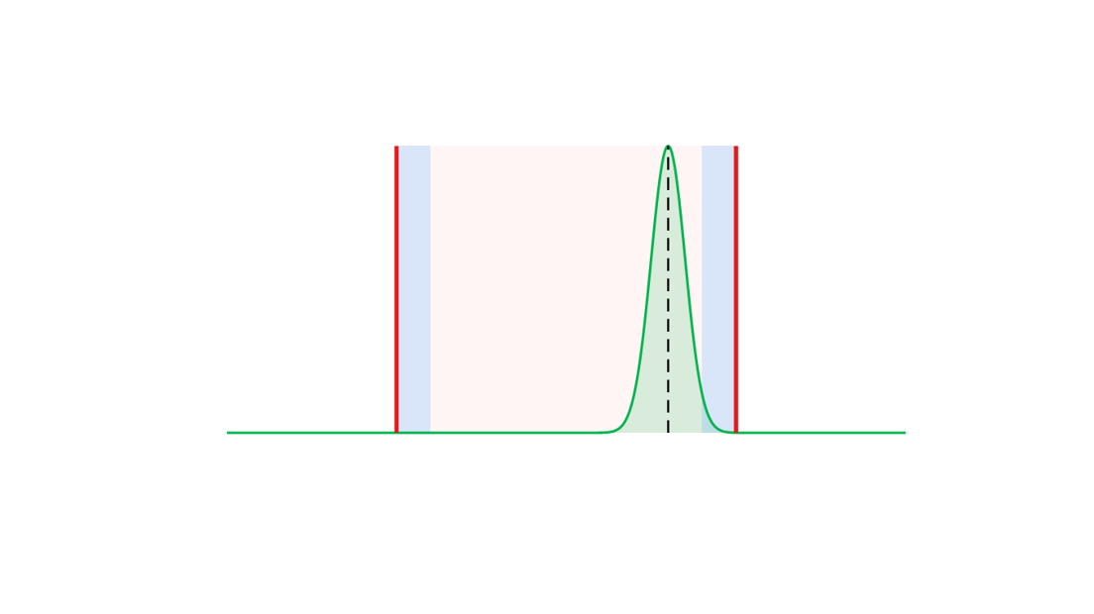
Conformity: are the tolerances met?
Tolerance = interval of permissible values for a measurand to meet specified requirements.
At SOLEIL: +/- 2σ of the error simulated by the physicists
A measured value inside the tolerance not guarantee that the true value is: measurand uncertainty must be considered
Conformity criterion (JCGM 106): the tolerance is reduced by guard bands of 2u, defining an acceptance interval that ensures a conformity probability of at least 95 %.
Acceptance interval
Probability
Conform at better than 95 %
2u
2u
Tolerances
Magnet position
Theoretical position
Measured position

Slide 15
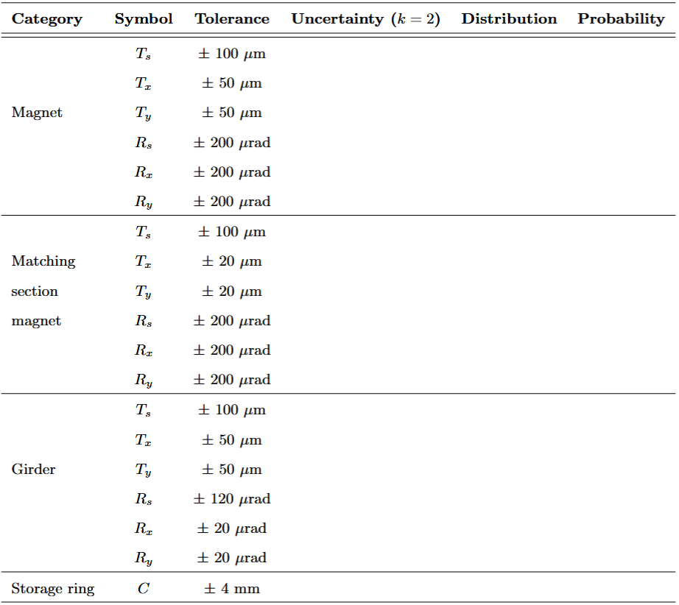
Are the tolerances achievable?
The uncertainty on the final measurand results from the whole alignment chain, not from a single measurement
Only a global uncertainty budget tells us, before construction, whether the tolerances can be met and where to improve
Magnetic characterisation
Stretched wire, laser tracker, inclinometer
?
U = ?
Fiducialisation
Keyence sensors, CMM, laser tracker
U = ?
Magnet alignment on girder
Laser tracker, inclinometer, gauges
U = ?
Girder alignment in tunnel
Laser tracker, motorization, gauges
U = ?
Survey
Laser tracker, adjustment software
U = ?

Slide 16
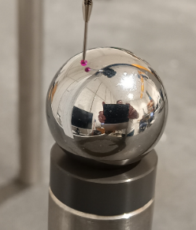
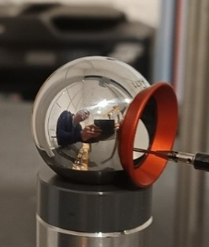
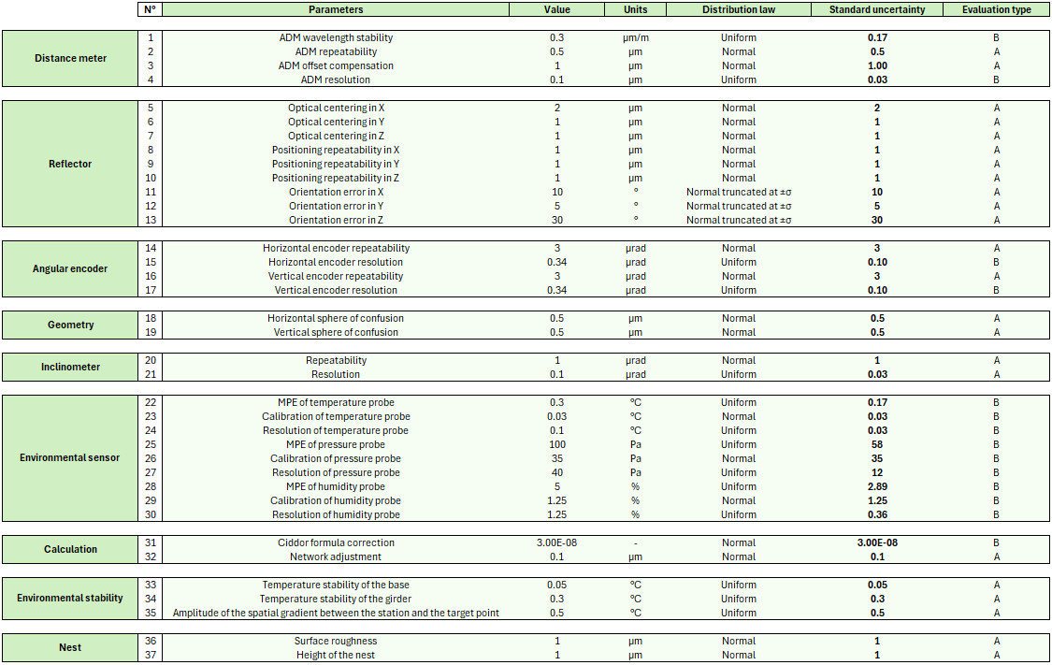
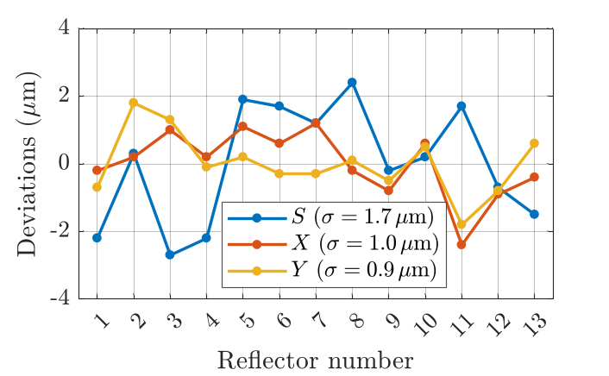
Laser tracker uncertainty budget
The laser tracker is used at every alignment step: a dedicated uncertainty budget was built for this instrument alone
Five years of R&D, experimental characterisation, standardised protocols and periodic calibration have provided in-depth knowledge of the laser tracker
Example: Reflector centring error
Identification
Quantification
Propagation
1) Mechanical centre: reference sphere probed in the same nest
2) Optical centre: intersection of the three mirror planes probed
Centring error = vector from mechanical centre to optical centre
Validation: laser tracker vs CMM on 13 reflectors:

Slide 17
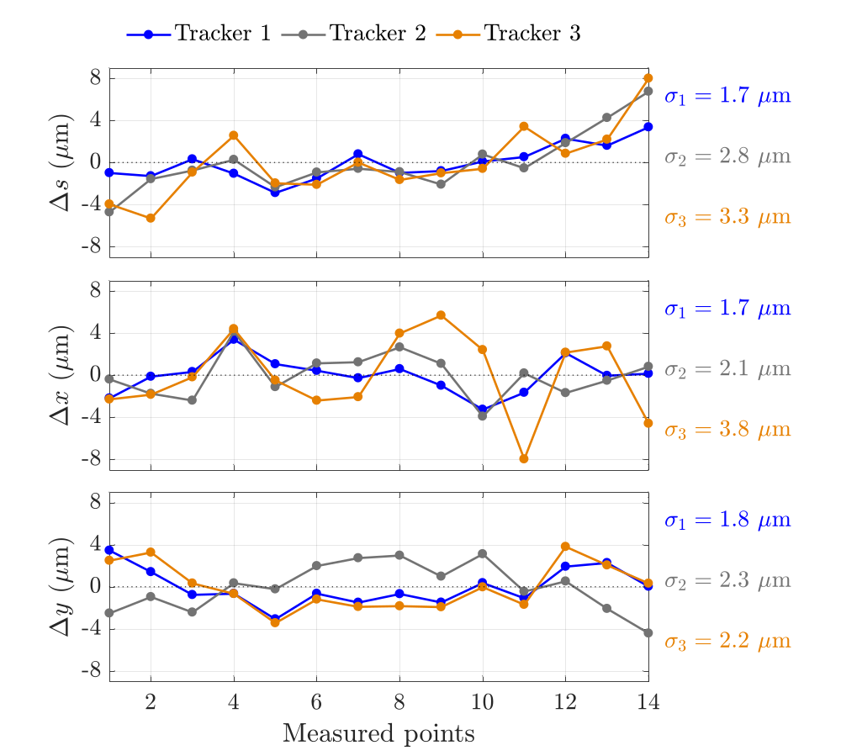
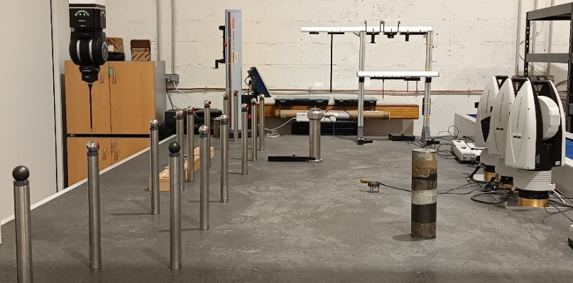
Laser tracker uncertainty budget
Trueness is rarely assessed: without a stable, well-known reference shape, the main option is comparison with an instrument of equal or better uncertainty
y
14 points
s
3 laser trackers
x
Reference: calibrated CMM (LK Altera M, MPE 4.0 µm + L/350)
Set-up: 14 reflectors along a 3 m line, measured simultaneously by all instruments
Conditions: 21 +/- 0.1 °C, 30 measurement series for each instrument
Repeatability: σ < 1 µm for the CMM, σ < 2 µm for each laser tracker
Analysis: mean shapes compared in the 3 directions
Realistic laser tracker uncertainty: 4 µm (k = 1) over a 3 m girder, measured from 1.5 m

Slide 18
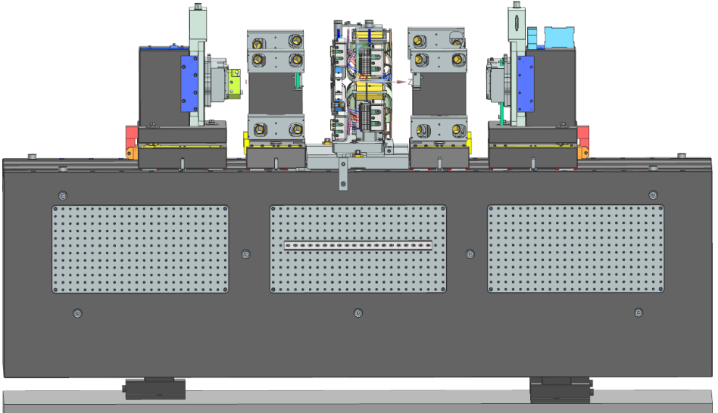
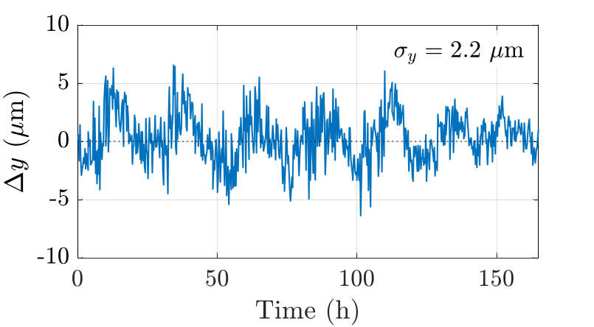
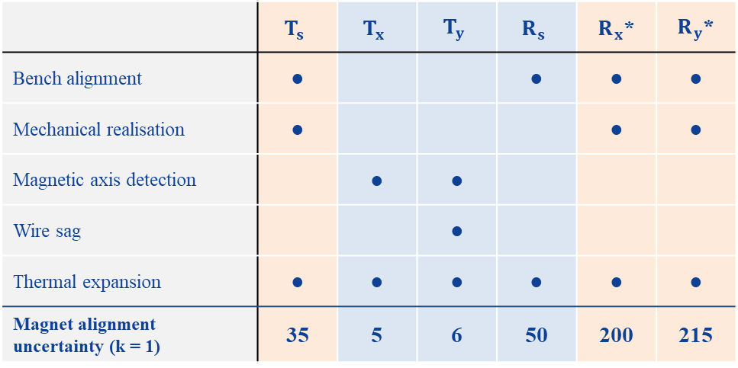
Magnetic characterisation
Objective: define each magnet’s own reference frame (6 DOF) from its magnetic properties
Method: a stretched wire locates the magnetic axis and plane, and the magnet is shimmed to the bench frame
y
x
Identification
Quantification
Propagation
s
 | $$T_{s}$$ | $$T_{x}$$ | $$T_{y}$$ | $$R_{s}$$ | $R_{x}$* | $R_{y}$*
Bench alignment | ● |  |  | ● | ● | ●
Mechanical realisation | ● |  |  |  | ● | ●
Magnetic axis detection |  | ● | ●
Wire sag |  |  | ●
Thermal expansion | ● | ● | ● | ● | ● | ●
Magnet alignment uncertainty (k = 1) | 35 | 5 | 6 | 50 | 200 | 215
Vertical magnetic axis repeatability over 160 h
µm
µm
µm
µrad
µrad
µrad
Magnetic DOF (measured)
Mechanical DOF (set by realisation)
*Values for a magnet with a pole length of 150 mm and a pin spacing of 340 mm on the girder

Slide 19

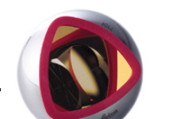
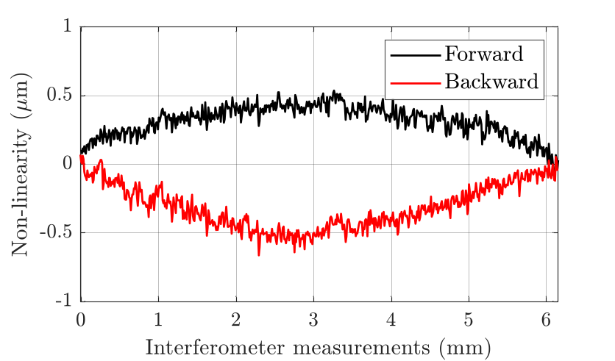
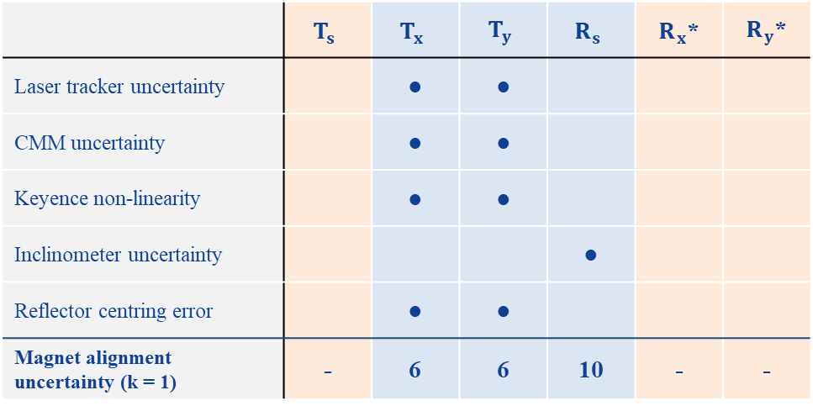
Fiducialisation
Objective: link the magnetic reference frame to mechanical references
Method: the wire position is transferred to the fiducials via optical sensors and a laser tracker
Fiducialisation
Laser tracker measurements
Identification
Quantification
Propagation
CMM measurements
 | $$T_{s}$$ | $$T_{x}$$ | $$T_{y}$$ | $$R_{s}$$ | $R_{x}$* | $R_{y}$*
Laser tracker uncertainty |  | ● | ●
CMM uncertainty |  | ● | ●
Keyence non-linearity |  | ● | ●
Inclinometer uncertainty |  |  |  | ●
Reflector centring error |  | ● | ●
Magnet alignment uncertainty (k = 1) | - | 6 | 6 | 10 | - | -
Magnetic axis
Keyence axis
Keyence measurements
Keyence non-linearity over a 6 mm displacement
µm
µm
µm
µrad
µrad
µrad
Magnetic DOF (measured)
Mechanical DOF (set by realisation)
*Values for a magnet with a pole length of 150 mm and a pin spacing of 340 mm on the girder

Slide 20
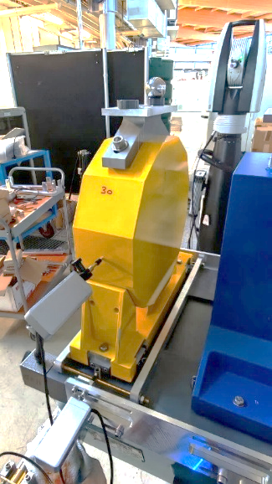
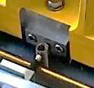
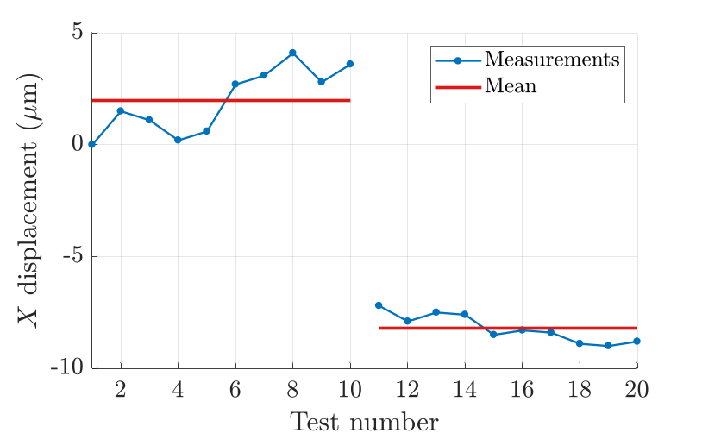
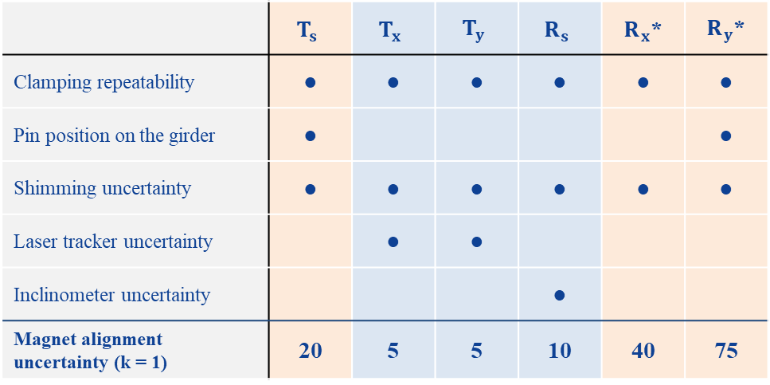
Magnet alignment on girder
Objective: position each magnet’s reference frame within the girder reference frame
Method: magnets are clamped against pins, measured with a laser tracker and inclinometer, and shimmed if needed
Identification
Quantification
Propagation
Laser tracker to check the position
 | $$T_{s}$$ | $$T_{x}$$ | $$T_{y}$$ | $$R_{s}$$ | $R_{x}$* | $R_{y}$*
Clamping repeatability | ● | ● | ● | ● | ● | ●
Pin position on the girder | ● |  |  |  |  | ●
Shimming uncertainty | ● | ● | ● | ● | ● | ●
Laser tracker uncertainty |  | ● | ●
Inclinometer uncertainty |  |  |  | ●
Magnet alignment uncertainty (k = 1) | 20 | 5 | 5 | 10 | 40 | 75
Clamping tool
Length gauge to check the X pin displacement
Clamping repeatability before and after a 10 µm shimming
µm
µm
µm
µrad
µrad
µrad
Before shimming
10.2 µm
Magnetic DOF (measured)
Mechanical DOF (set by realisation)
After shimming
*Values for a magnet with a pole length of 150 mm and a pin spacing of 340 mm on the girder

Slide 21
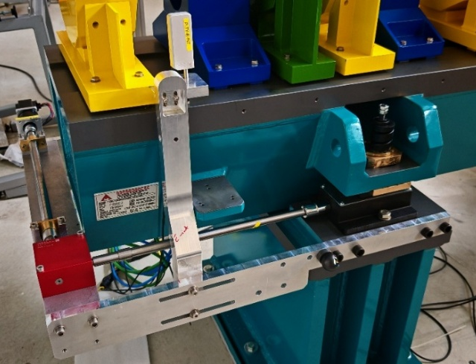
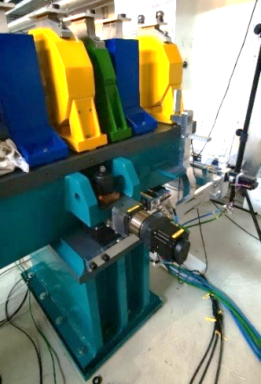
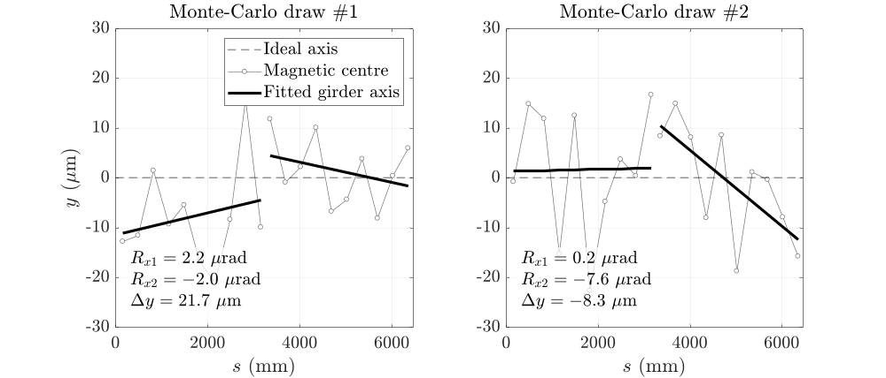
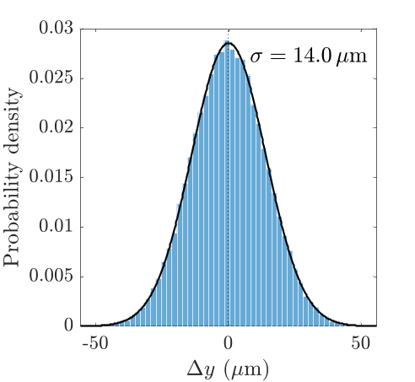
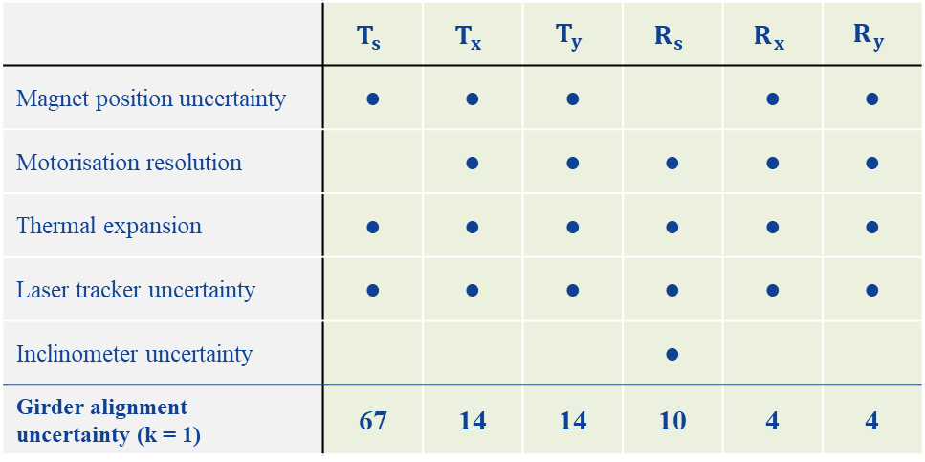
Girder alignment in the tunnel
Objective: set the girders at their nominal positions and minimise inter-girder discontinuities
Method: girders installed two by two, measured in the network frame, and finely alignment with motorisation
Identification
Quantification
Propagation
 | $$T_{s}$$ | $$T_{x}$$ | $$T_{y}$$ | $$R_{s}$$ | $$R_{x}$$ | $$R_{y}$$
Magnet position uncertainty | ● | ● | ● |  | ● | ●
Motorisation resolution |  | ● | ● | ● | ● | ●
Thermal expansion | ● | ● | ● | ● | ● | ●
Laser tracker uncertainty | ● | ● | ● | ● | ● | ●
Inclinometer uncertainty |  |  |  | ●
Girder alignment uncertainty (k = 1) | 67 | 14 | 14 | 10 | 4 | 4
Monte Carlo simulation of the inter-girder discontinuity
100 000 draws
µm
µm
µm
µrad
µrad
µrad
Translations: discontinuity between consecutive girders
Rotations: girder orientation relative to nominal

Slide 22
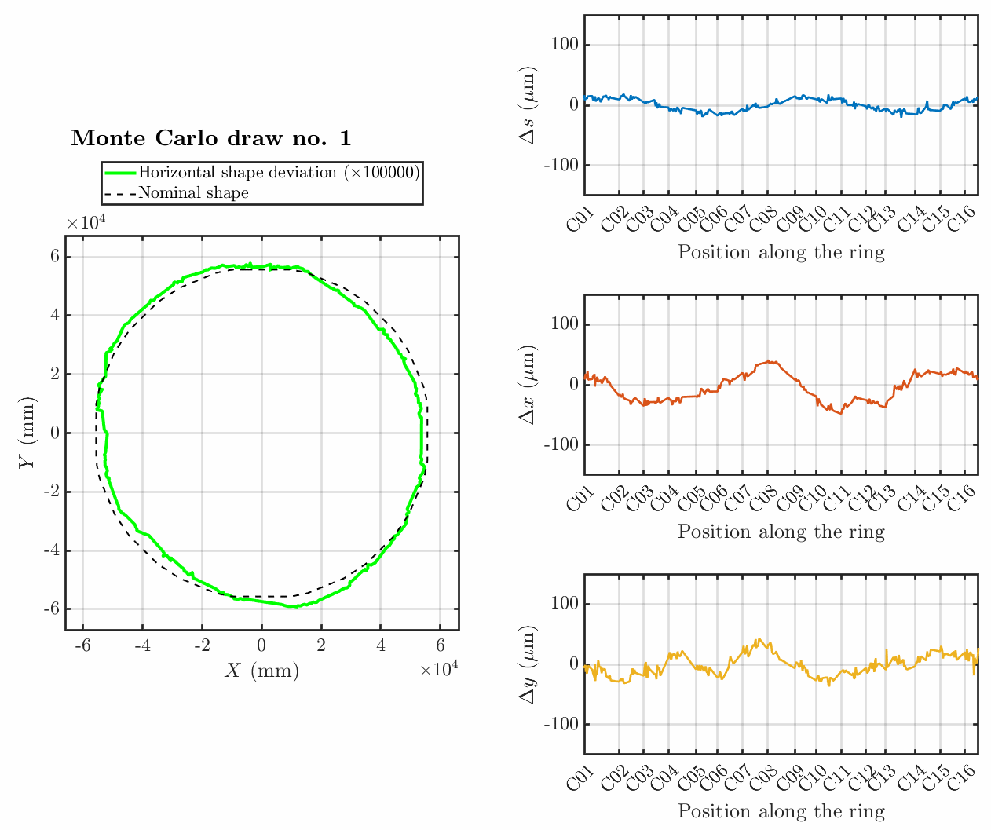
Survey: simulation model
The survey determines the final position of every component and decides on conformity
Survey uncertainty is hard to evaluate: thousands of observations combined through a network adjustment
A Monte Carlo simulation model was therefore developed
Survey configuration
Stations, points, observations, environment
Laser tracker budget
Error distributions
Simulated observations
Randomly drawn errors
Network adjustment
Soleil6D
Monte Carlo (N drawn)
Uncertainty on indicators
Global shape, circumference, inter-girder, intra-girder, etc.
The model must be verified experimentally

Slide 23
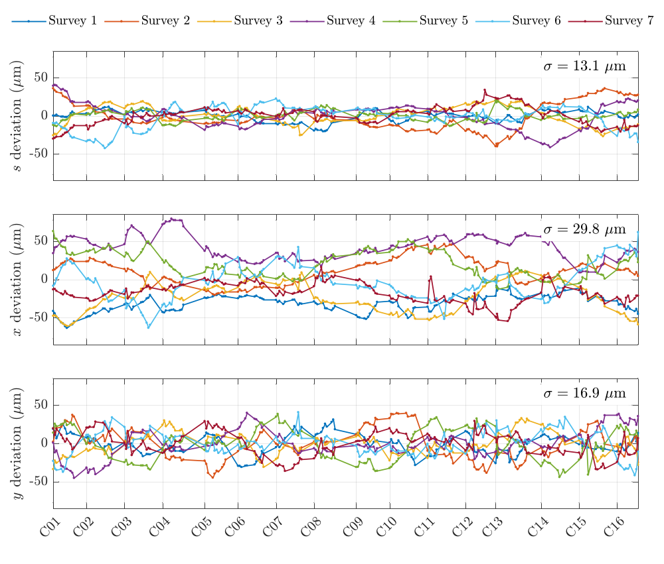
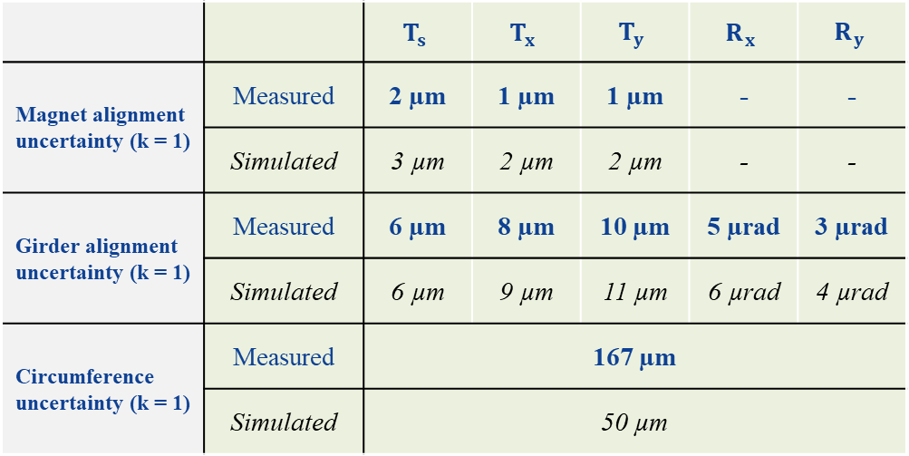
Survey: repeatability campaign
7 surveys of the storage ring in 3 weeks (4 laser trackers, 462 stations, 35290 measurements)
 |  | $$T_{s}$$ | $$T_{x}$$ | $$T_{y}$$ | $$R_{x}$$ | $$R_{y}$$
Magnet alignment uncertainty (k = 1) | Measured | 2 µm | 1 µm | 1 µm | - | -
 | Simulated | 3 µm | 2 µm | 2 µm | - | -
Girder alignment uncertainty (k = 1) | Measured | 6 µm | 8 µm | 10 µm | 5 µrad | 3 µrad
 | Simulated | 6 µm | 9 µm | 11 µm | 6 µrad | 4 µrad
Circumference uncertainty (k = 1) | Measured | 167 µm
 | Simulated | 50 µm
Overall shape of the storage ring controlled to within +/- 80 µm during a survey
Model validated on local indicators, circumference gap likely due to machine movements

Slide 24
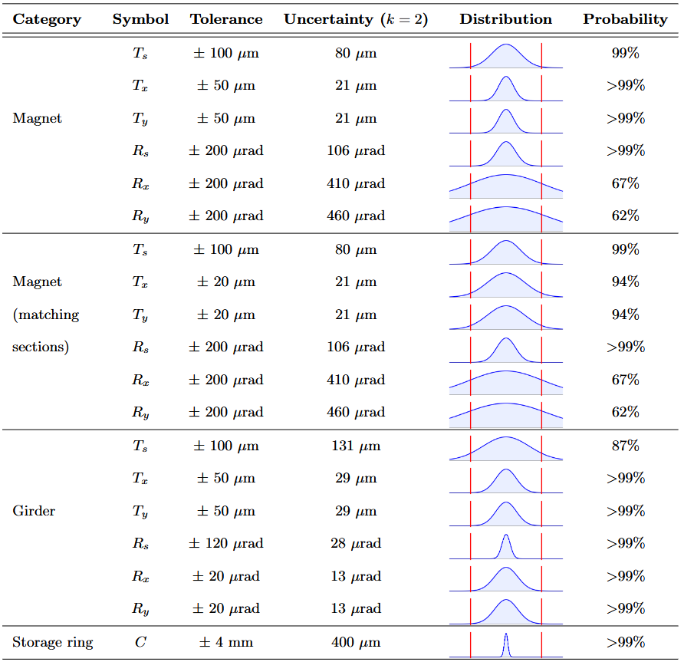
Final uncertainty estimation
Step uncertainties combined over the whole chain
Expanded uncertainty (k = 2) compared with each tolerance: probability of conformity, assuming no systematic bias (centred distributions)
Conformity guaranteed (> 95 %) for most measurands
Issues with Rx and Ry orientations of magnets
Ongoing discussion with the accelerator physicists: angular tolerances proportional to magnet length
  Alignment : tolerances matched to what can be achieved
  Beam: tighter tolerances on long magnets (dipoles), which have the largest impact on beam dynamics
Current estimate, to be updated as the alignment process and the uncertainty budgets evolve

Slide 25
Conclusion and perspectives
Conclusion:
For a process as complex as the alignment of a fourth-generation synchrotron, the metrological approach proved rich and useful:
  clear definition of measurands, tolerances and decision rules
  questioning of every step of the process
  characterisation and optimisation of instruments and measurement processes
Building a complete uncertainty budget across the whole chain gives a global view that no single step provides
Results are very encouraging and confirm that the SOLEIL II alignment tolerances can be met
Perspectives:
Characterisation of machine movements, to better account for them during alignment
Magnetic characterisation and fiducialisation benches under construction, installation planed for august of 2027
Tolerances can’t be met without a good control of uncertainties

Slide 26
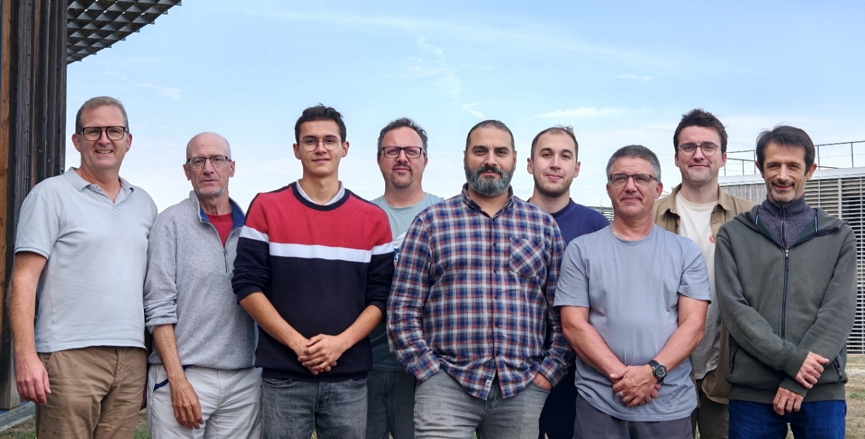
Acknowledgements
Many thanks to all my colleagues at SOLEIL and more specifically those in the Alignment and Metrology Group:
Sebastien DUCOURTIEUX
Alain LESTRADE (technic advisor 20%)
Mourad SEBDAOUI
Bruno LELUAN
Cedric BOURGOIN
Yann DENIS
David JOURDAIN (CDD)
Vincent GIGOT (trainee)
Special thanks to my thesis supervisor, Stéphane Durand, and my advisor, Joffray Guillory

Slide 27
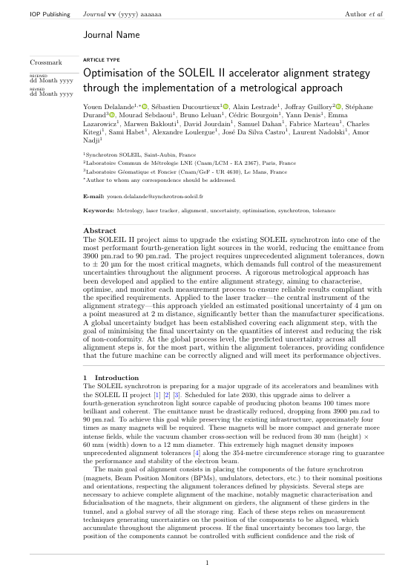
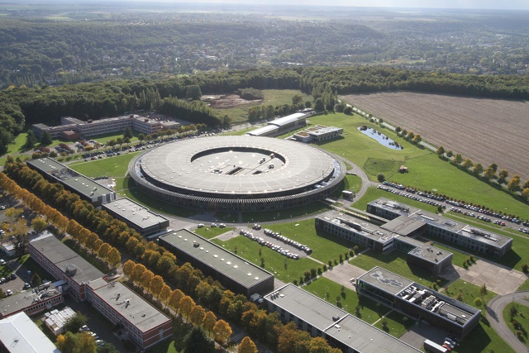
Discussion
Submitted to MST and under review
Y. Delalande et al., "Optimisation of the SOLEIL II accelerator alignment strategy through the implementation of a metrological approach", under review in Meas. Sci. Technol.

