Slide 1



SOLEIL II alignment: a metrological approach to meet tolerances with confidence
Y. Delalande¹, S. Ducourtieux¹, A. Lestrade¹, M. Sebdaoui¹, B. Leluan¹, C. Bourgoin¹, Y. Denis¹, D. Jourdain¹, J. Guillory², S. Durand³
¹Synchrotron SOLEIL
²Laboratoire Commun de Métrologie LNE
³Laboratoire Geomatique et Foncier

Slide 2
Outline
SOLEIL II project and alignment requirements
The metrological approach and its three key questions
  Measurand definition and alignment error model
  Tolerances and conformity assessment
  Uncertainty budget: laser tracker, alignment steps, survey, final estimate
Conclusion and perspectives
An overview of the approach, not a detailed description of each step

Slide 3
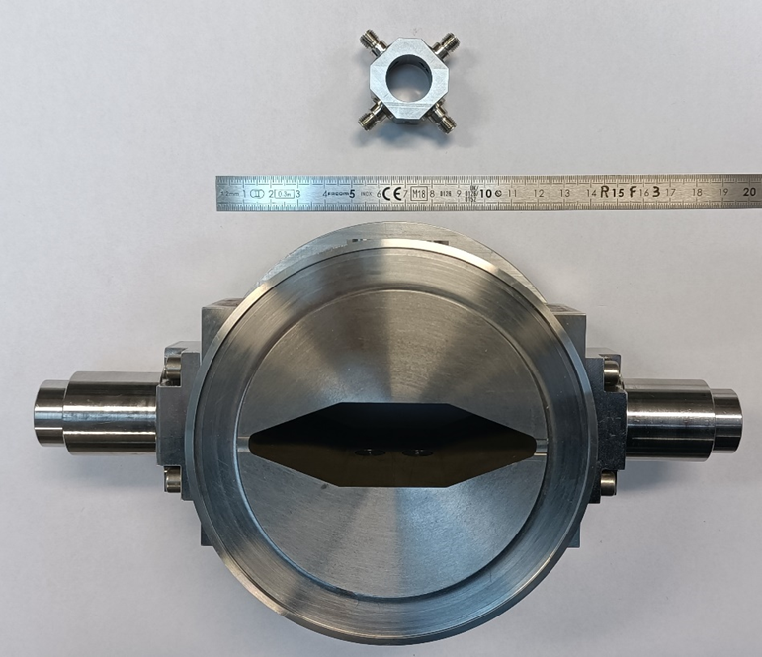
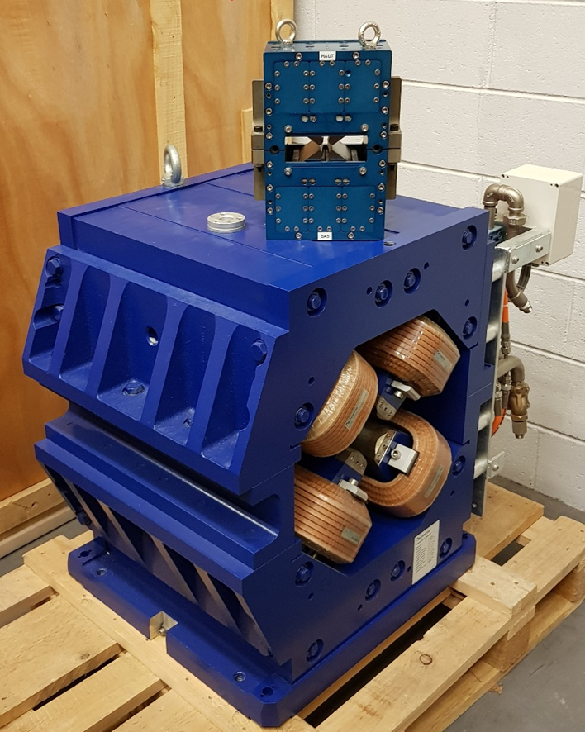
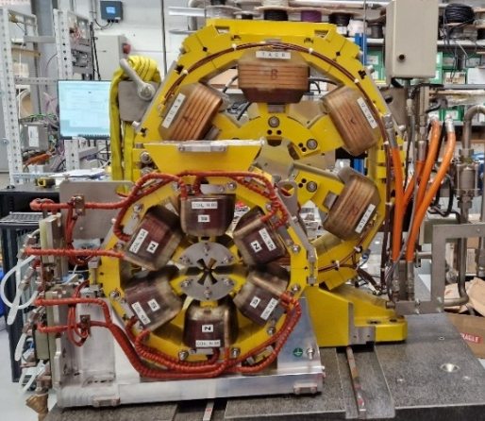
SOLEIL II project
Shutdown
2020
2021
2022
2023
2024
2025
2026
2027
2028
2029
2030
2031
2032
2033
2034
2035
CDR
(Conceptual Design Report)
TDR
(Technical Design Report)
STAGE 1:
CONSTRUCTION
STAGE 2:
TOWARDS FULL PERFORMANCE
Shutdown and dismantling of the existing machine
Commissioning of the new booster and storage ring
Adaptation and restart of the beamlines
Information System Overhaul
Modernization of the support labs
R&D program on instrumentation
Complete Modernization of the beamlines
Full performance of the accelerators
Modernization of the support labs
R&D program on instrumentation
Evolution towards innovative analysis techniques
SOLEIL
LINAC energy: 110 MeV
Booster: 0.1 - 2.75 GeV
SR circumference: 354.10 m
SR energy: 2.75 GeV
SR emittance: 3900 pm.rad
317 electromagnets
56 girders
29 beamlines
SOLEIL II
LINAC energy: 150 MeV
Booster: 0.15 - 2.75 GeV
SR circumference: 353.98 m
SR energy: 2.75 GeV
SR emittance: 90 pm.rad
1300 permanent/electro-magnets
86 girders
29 beamlines
BPM vacuum chamber SOLEIL/SOLEIL II
Sextupole SOLEIL/SOLEIL II
Quadrupole SOLEIL/SOLEIL II

Slide 4
SOLEIL II project
Shutdown
2020
2021
2022
2023
2024
2025
2026
2027
2028
2029
2030
2031
2032
2033
2034
2035
CDR
(Conceptual Design Report)
TDR
(Technical Design Report)
STAGE 1:
CONSTRUCTION
STAGE 2:
TOWARDS FULL PERFORMANCE
Shutdown and dismantling of the existing machine
Commissioning of the new booster and storage ring
Adaptation and restart of the beamlines
Information System Overhaul
Modernization of the support labs
R&D program on instrumentation
Complete Modernization of the beamlines
Full performance of the accelerators
Modernization of the support labs
R&D program on instrumentation
Evolution towards innovative analysis techniques
Very compact lattice, highly sensitive to misalignment => tight alignment tolerances
SOLEIL
LINAC energy: 110 MeV
Booster: 0.1 - 2.75 GeV
SR circumference: 354.10 m
SR energy: 2.75 GeV
SR emittance: 3900 pm.rad
317 electromagnets
56 girders
29 beamlines
SOLEIL II
LINAC energy: 150 MeV
Booster: 0.15 - 2.75 GeV
SR circumference: 353.98 m
SR energy: 2.75 GeV
SR emittance: 90 pm.rad
1300 permanent/electro-magnets
86 girders
29 beamlines
BPM vacuum chamber SOLEIL/SOLEIL II
Sextupole SOLEIL/SOLEIL II
Quadrupole SOLEIL/SOLEIL II

Slide 5
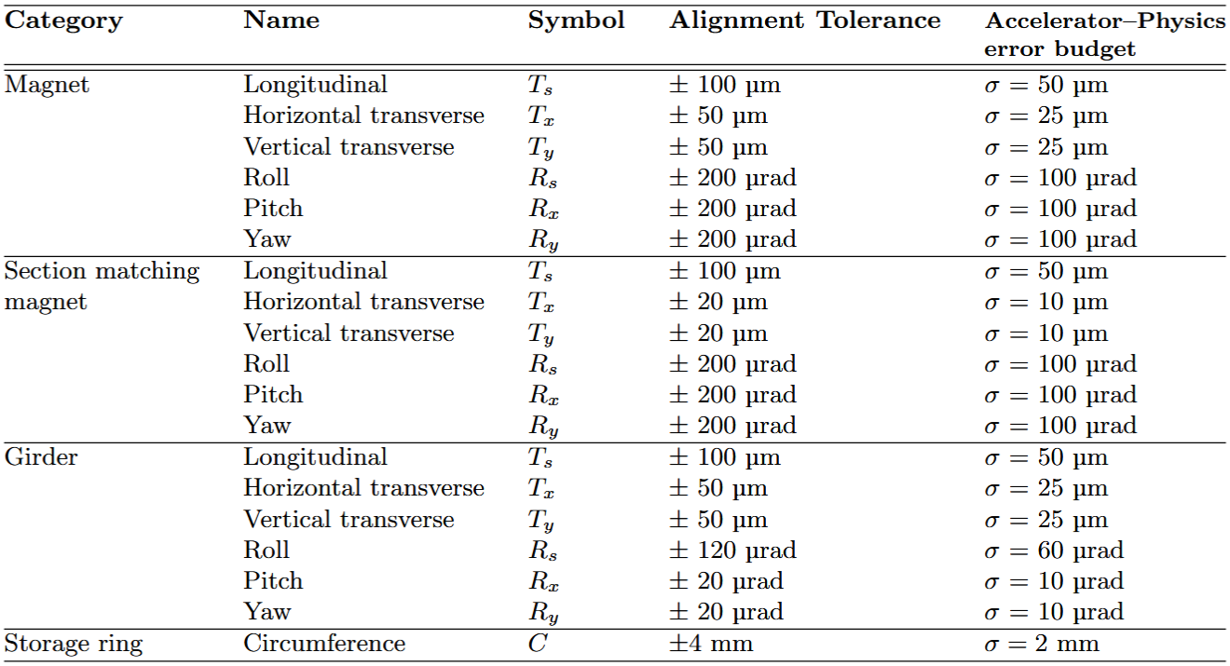
Main alignment requirements for SOLEIL II
Install the new storage ring in the existing tunnel while keeping the source points of the 15 preserved beamlines at their current position (+/- 0.5 mm)
Meet the alignment tolerances set by the accelerator physicists to reduce critical discontinuities along the beam path and guarantee the expected electron beam performance
y
x
s
Beam
Errors simulated by accelerator physicists (normal distribution truncated at 2σ)
Alignment tolerances defined as +/- 2σ of the simulated error, for consistency
Ultra-low-emittance lattice with strong, densely packed magnets: a few tens of µm of misalignment degrades the beam
Permanent-magnet quadrupoles cannot be tuned, hence tight longitudinal and circumference tolerances

Slide 6
Main alignment requirements for SOLEIL II
Install the new storage ring in the existing tunnel while keeping the source points of the 15 preserved beamlines at their current position (+/- 0.5 mm)
Meet the alignment tolerances set by the accelerator physicists to reduce critical discontinuities along the beam path and guarantee the expected electron beam performance
y
x
How can we guarantee that these requirements will be met with sufficient confidence?
s
Beam
Errors simulated by accelerator physicists (normal distribution truncated at 2σ)
Alignment tolerances defined as +/- 2σ of the simulated error, for consistency
Ultra-low-emittance lattice with strong, densely packed magnets: a few tens of µm of misalignment degrades the beam
Permanent-magnet quadrupoles cannot be tuned, hence tight longitudinal and circumference tolerances

Slide 7
Metrological approach for SOLEIL II
Future contribution
A metrological approach is a quality assurance approach aimed to ensuring the reliability of a single measurement or a measurement strategy. It involves analysing, quantifying and controlling uncertainty throughout the measurement process, to deliver results that are traceable to the SI as far as possible, documented, repeatable and compliant with the specified requirements.
At SOLEIL, this approach led to a few key questions:
  What exactly do the alignment errors simulated by the physicists represent, and do they reflect the actual alignment process?
  What exactly is a tolerance, and how do we decide whether it is met?
  Are the alignment tolerances achievable with our measurement chain?
Requirements
& discussions
Optimisations
& improvements
Tolerance
definition
Modelling and
simulations
Conformity
assessment
Metrological approach
Uncertainty
budget
R&D
Measurements
& comparisons
Calibrations
& Traceability

Slide 8
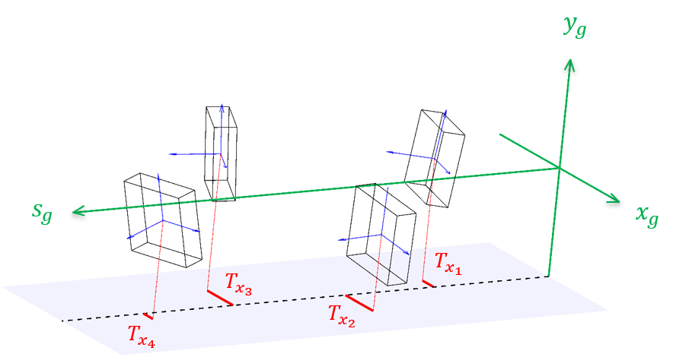
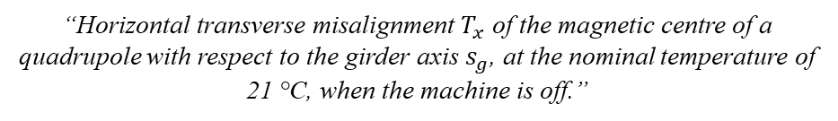
Measurand definition
Measurand = quantity intended to be measured (VIM)
  Requires a precise definition to avoid any ambiguity regarding what is to be measured
  Must match exactly the quantity used in physicist simulations: physicists and aligners must be talking about the same thing
What is it exactly?
Example of poorly defined measurand:
Example of a measurand defined at SOLEIL:
“Horizontal transverse misalignment $T_{x}$ of the magnetic centre of a quadrupole with respect to the girder axis $s_{g}$, at the nominal temperature of 21 °C, when the machine is off.”
“Relative deviation between magnets”
Under which conditions?
In which frame?
Between what?
In which direction?
Which magnets?

Slide 9
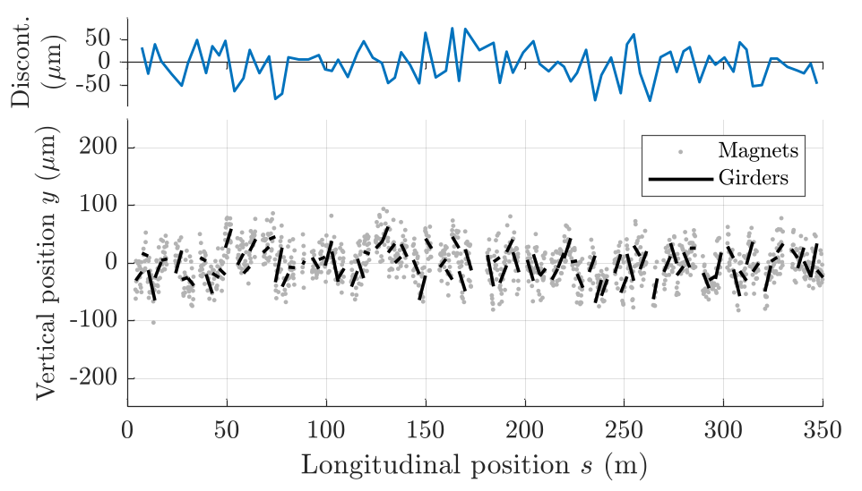
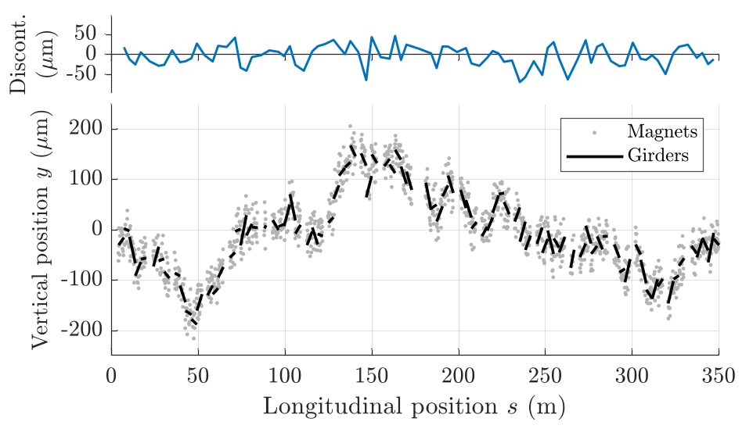
Towards a more realistic alignment error model
Tolerances are derived from Monte Carlo beam simulations, in which alignment errors are applied in successive layers: magnets on their girder, then girders in the tunnel
Initial model: independent girders
New model: correlated girders
Same input for both models: σ = 25 µm in translation, 10 µrad in rotation
Each girder drawn independently:
Girder-to-girder discontinuity: σ = 37 µm, max = 149 µm
Each girder positioned relative to the previous one, as done with the laser tracker, with ring closure:
Girder-to-girder discontinuity: σ = 26 µm, max = 85 µm
More realistic and beneficial for both sides: better simulated beam performance for physicists and no further tightening of tolerances for aligners

Slide 10
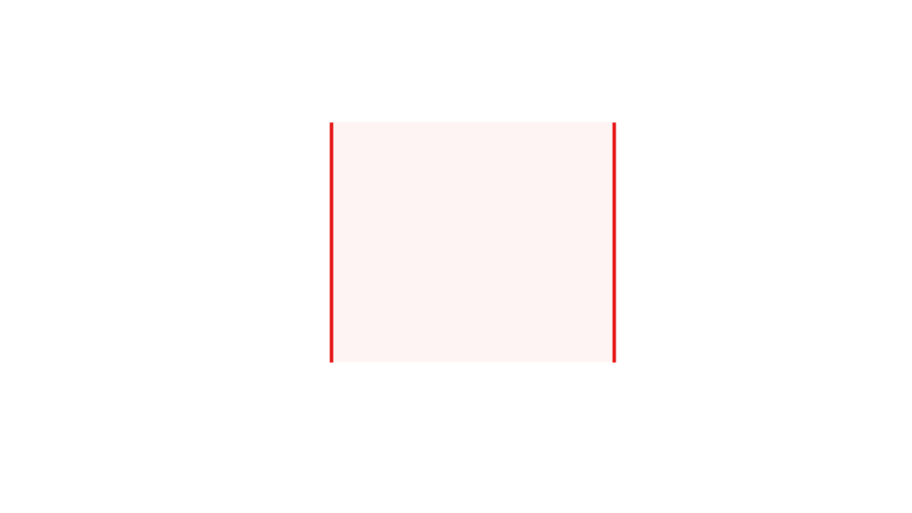
Conformity: are the tolerances met?
Tolerance = interval of permissible values for a measurand to meet specified requirements.
At SOLEIL: +/- 2σ of the error simulated by the physicists
Probability
Tolerances
Magnet position
Theoretical position

Slide 11
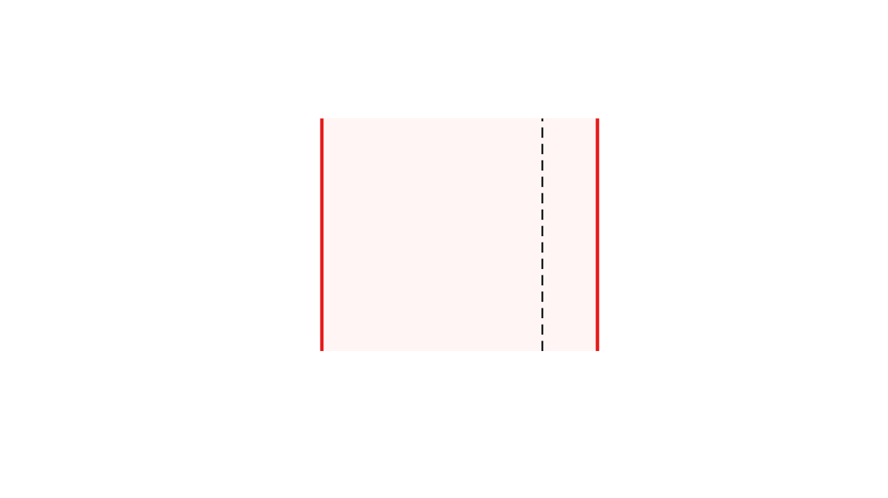
Conformity: are the tolerances met?
Tolerance = interval of permissible values for a measurand to meet specified requirements.
At SOLEIL: +/- 2σ of the error simulated by the physicists
Probability
Conforming
Tolerances
Magnet position
Theoretical position
Measured position

Slide 12

Conformity: are the tolerances met?
Tolerance = interval of permissible values for a measurand to meet specified requirements.
At SOLEIL: +/- 2σ of the error simulated by the physicists
Probability
Non-conforming
Tolerances
Magnet position
Theoretical position
Measured position

Slide 13
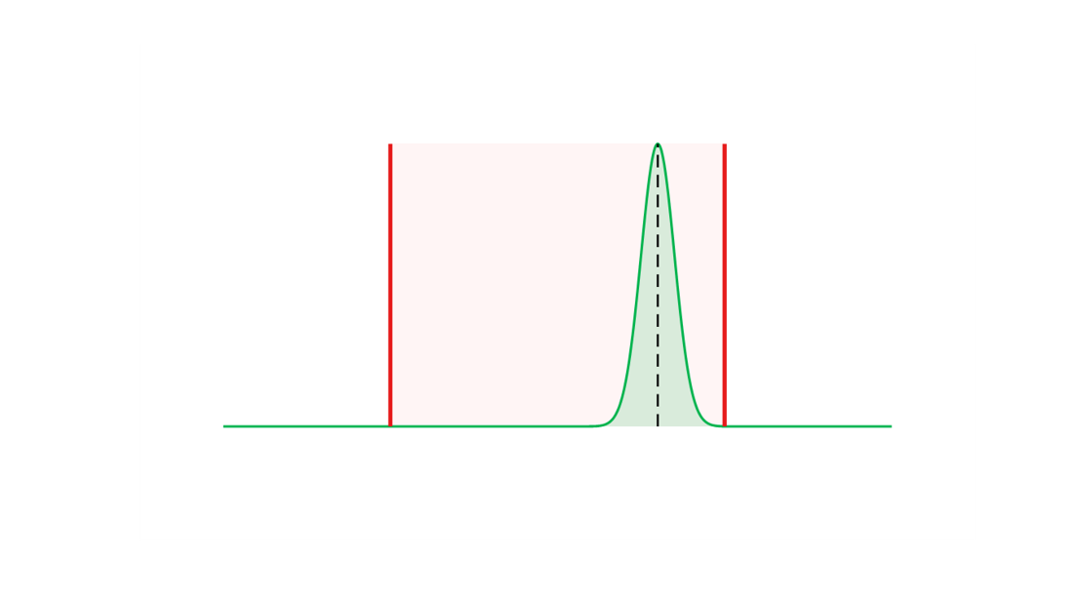
Conformity: are the tolerances met?
Tolerance = interval of permissible values for a measurand to meet specified requirements.
At SOLEIL: +/- 2σ of the error simulated by the physicists
A measured value inside the tolerance does not guarantee the true value is: measurand uncertainty must be considered
Conforming with a probability better than 99.9 %
Probability
Tolerances
Magnet position
Theoretical position
Measured position

Slide 14
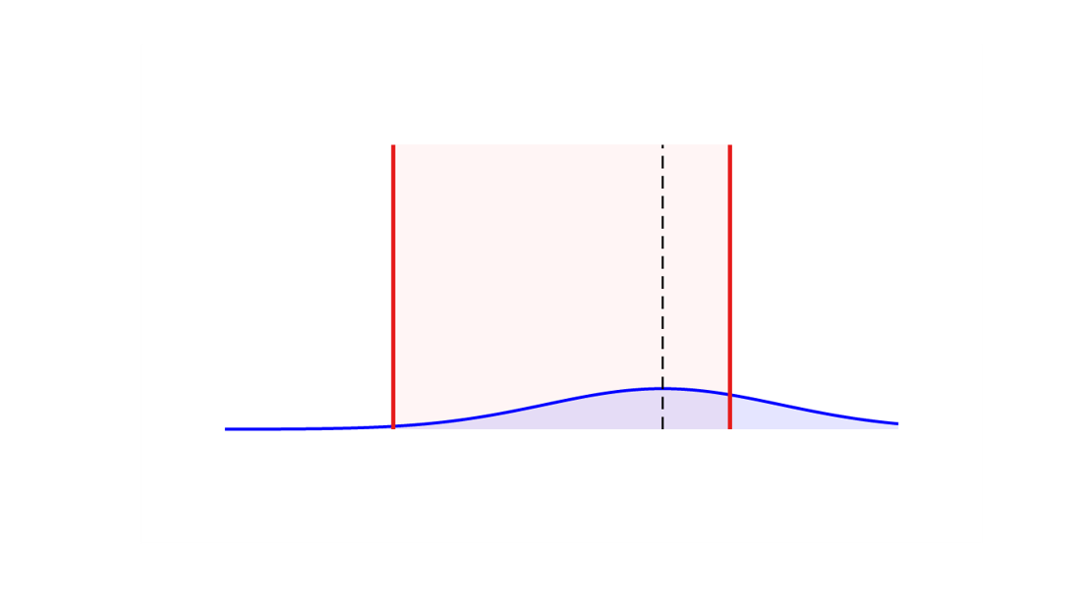
Conformity: are the tolerances met?
Tolerance = interval of permissible values for a measurand to meet specified requirements.
At SOLEIL: +/- 2σ of the error simulated by the physicists
A measured value inside the tolerance does not guarantee the true value is: measurand uncertainty must be considered
Conforming with a probability around 70 %
Probability
Tolerances
Magnet position
Theoretical position
Measured position

Slide 15
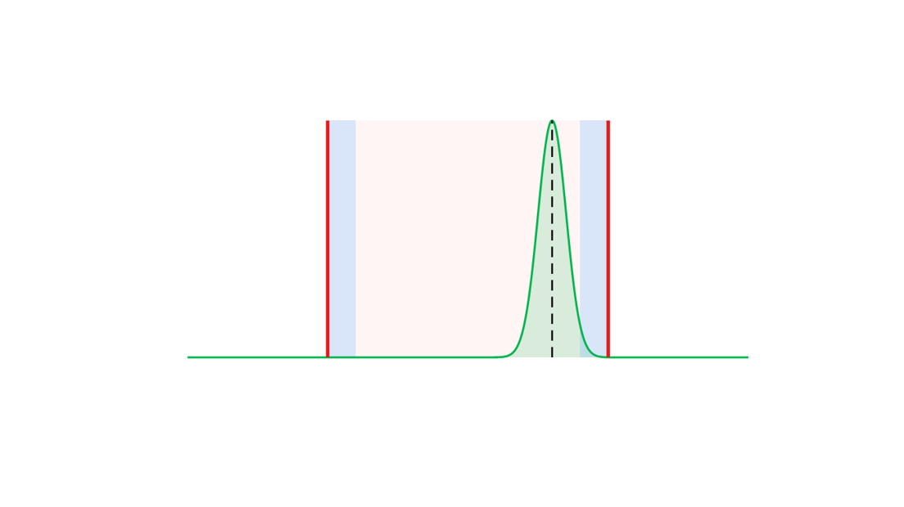
Conformity: are the tolerances met?
Tolerance = interval of permissible values for a measurand to meet specified requirements.
At SOLEIL: +/- 2σ of the error simulated by the physicists
A measured value inside the tolerance does not guarantee the true value is: measurand uncertainty must be considered
Conformity criterion (JCGM 106): the tolerance is reduced by guard bands of 2u, defining an acceptance interval that ensures a conformity probability of at least 95 %.
Conforming with a probability better than 95 %
Acceptance interval
Probability
2u
2u
Tolerances
Magnet position
Theoretical position
Measured position

Slide 16
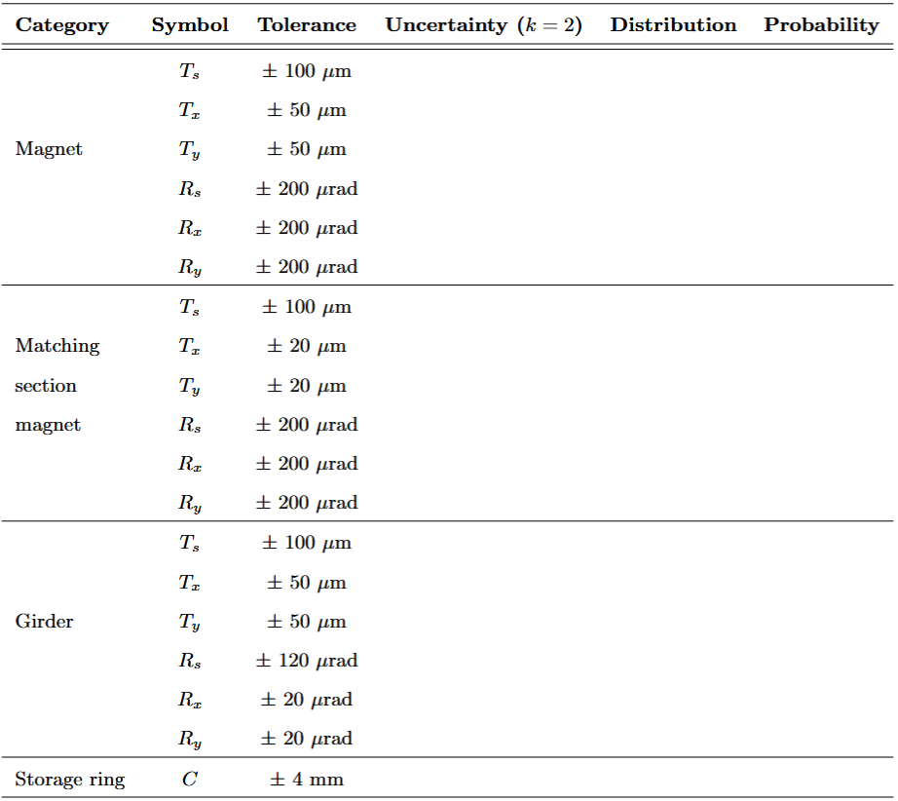
Are the tolerances achievable?
Global uncertainty budget of the alignment strategy to estimate the uncertainty of each measurand
The uncertainty on the final measurand results from the whole alignment chain, not from a single measurement
Magnetic characterisation
Stretched wire, laser tracker, inclinometer
?
U = ?
Fiducialisation
Keyence sensors, CMM, laser tracker
U = ?
Magnet alignment on girder
Laser tracker, inclinometer, gauges
U = ?
Girder alignment in tunnel
Laser tracker, motorisation, gauges
U = ?
Survey
Laser tracker, adjustment software
U = ?

Slide 17
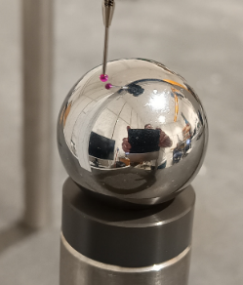
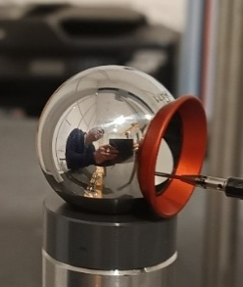
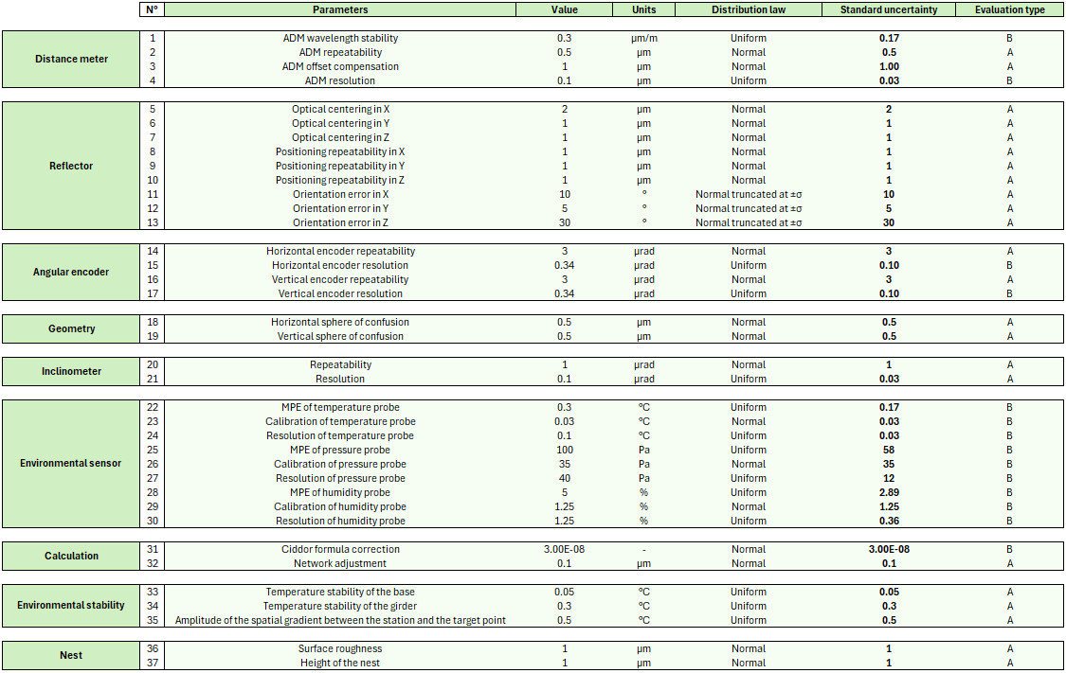
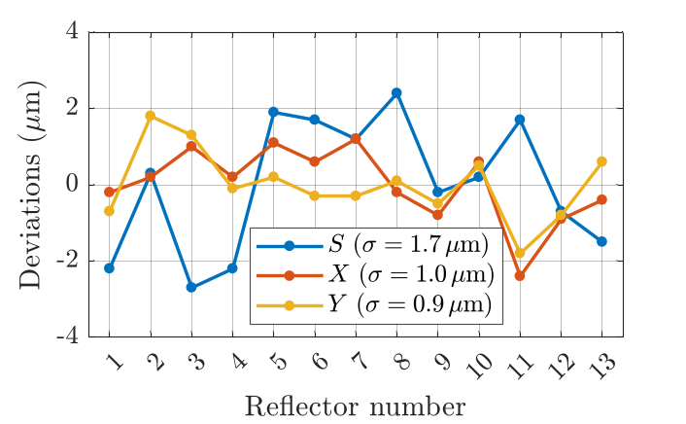
Laser tracker uncertainty budget
The laser tracker is used at every alignment step: a dedicated uncertainty budget was built for this instrument alone
Five years of R&D: more than 30 uncertainty contributions identified and quantified, through experimental characterisation, protocols and calibration
Example: Reflector centring error
Identification
Quantification
Propagation
1) Mechanical centre: reference sphere probed in the same nest
2) Optical centre: intersection of the three mirror planes probed
Centring error = vector from mechanical centre to optical centre
Validation: laser tracker vs CMM on 13 reflectors:

Slide 18
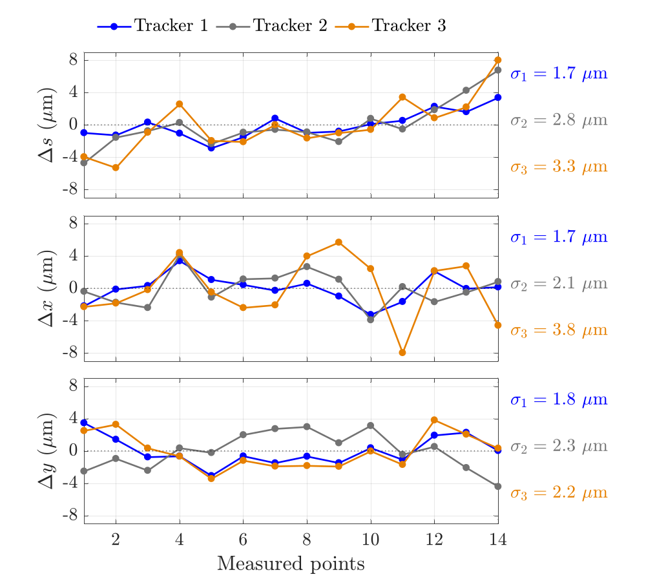
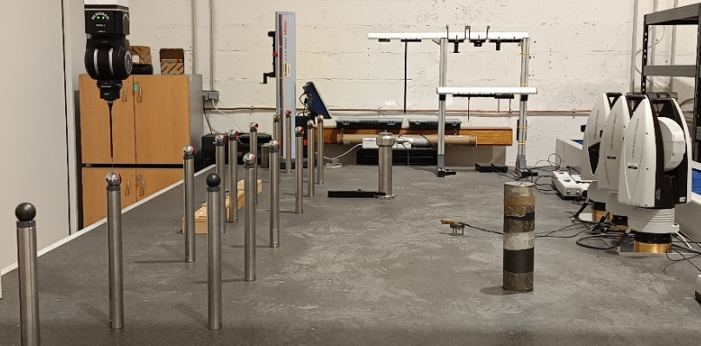
Laser tracker uncertainty budget
Experimental verification of the laser tracker uncertainty budget on a typical girder-like shape, by comparison with a reference instrument (CMM)
y
14 points
s
3 laser trackers
x
Reference: calibrated CMM (LK Altera M, MPE 4.0 µm + L/350)
Set-up: 14 reflectors along a 3 m line, measured simultaneously by all instruments
Conditions: 21 +/- 0.1 °C, 30 measurement series for each instrument
Repeatability: σ < 1 µm for the CMM, σ < 2 µm for each laser tracker
Analysis: mean shapes compared in the 3 directions
Realistic laser tracker uncertainty estimated: 4 µm (k = 1) over a 3 m girder, measured from 1.5 m in a controlled environment

Slide 19
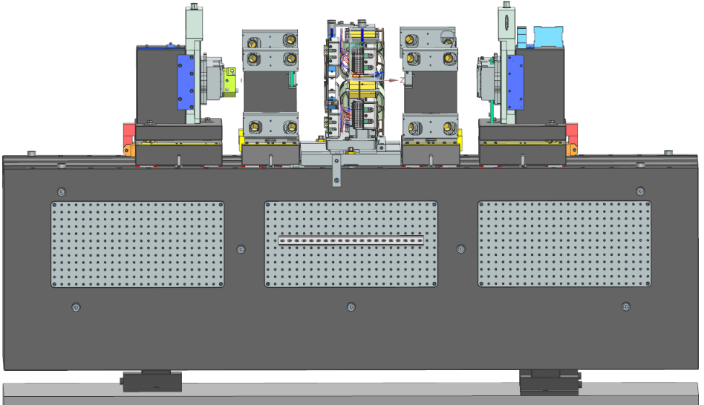
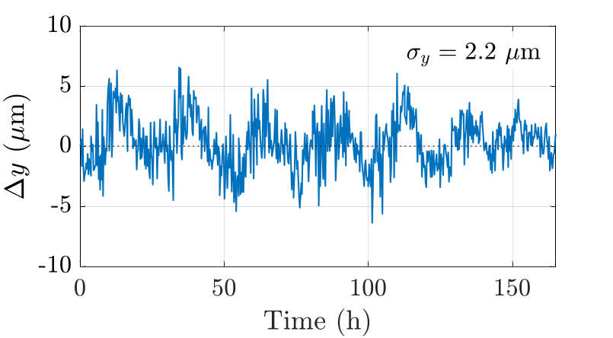
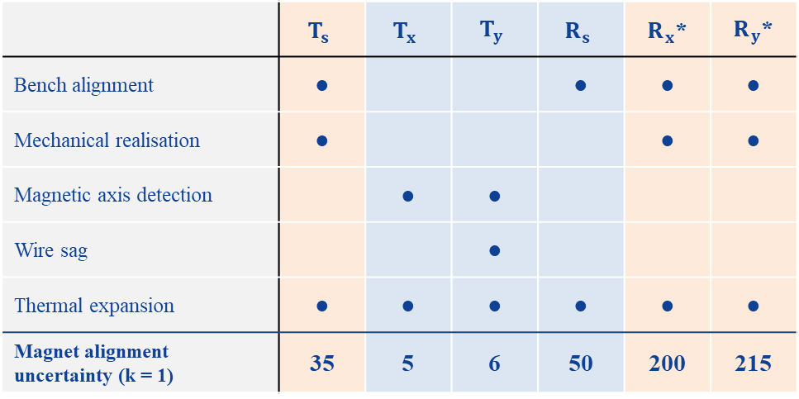
Magnetic characterisation
Objective: define each magnet’s own reference frame (6 DOF) from its magnetic properties
Method: a stretched wire locates the magnetic axis and plane, and the magnet is shimmed to the bench frame
y
x
Identification
Quantification
Propagation
s
 | $$T_{s}$$ | $$T_{x}$$ | $$T_{y}$$ | $$R_{s}$$ | $R_{x}$* | $R_{y}$*
Bench alignment | ● |  |  | ● | ● | ●
Mechanical realisation | ● |  |  |  | ● | ●
Magnetic axis detection |  | ● | ●
Wire sag |  |  | ●
Thermal expansion | ● | ● | ● | ● | ● | ●
Magnet alignment uncertainty (k = 1) | 35 | 5 | 6 | 50 | 200 | 215
Vertical magnetic axis repeatability over 160 h
µm
µm
µm
µrad
µrad
µrad
Magnetic DOF (measured)
Mechanical DOF (set by realisation)
*Values for a magnet with a pole length of 150 mm and a pin spacing of 340 mm on the girder

Slide 20

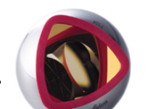
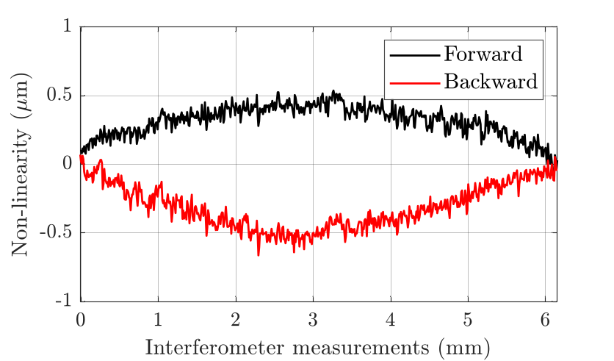
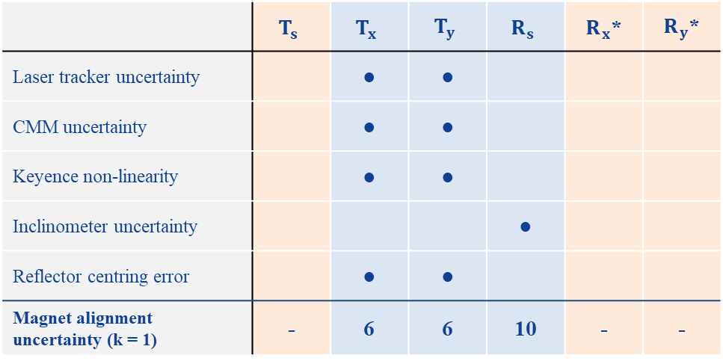
Fiducialisation
Objective: link the magnetic reference frame to mechanical references
Method: the wire position is transferred to the fiducials via optical sensors and a laser tracker
Fiducialisation
Laser tracker measurements
Identification
Quantification
Propagation
CMM measurements
 | $$T_{s}$$ | $$T_{x}$$ | $$T_{y}$$ | $$R_{s}$$ | $R_{x}$* | $R_{y}$*
Laser tracker uncertainty |  | ● | ●
CMM uncertainty |  | ● | ●
Keyence non-linearity |  | ● | ●
Inclinometer uncertainty |  |  |  | ●
Reflector centring error |  | ● | ●
Magnet alignment uncertainty (k = 1) | - | 6 | 6 | 10 | - | -
Magnetic axis
Keyence axis
Keyence measurements
Keyence non-linearity over a 6 mm displacement
µm
µm
µm
µrad
µrad
µrad
Magnetic DOF (measured)
Mechanical DOF (set by realisation)
*Values for a magnet with a pole length of 150 mm and a pin spacing of 340 mm on the girder

Slide 21
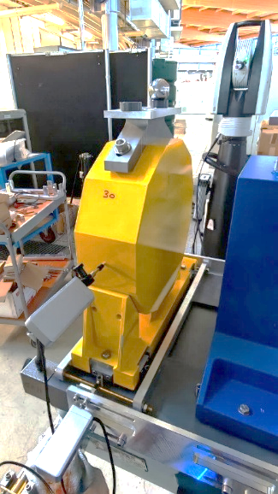
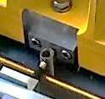
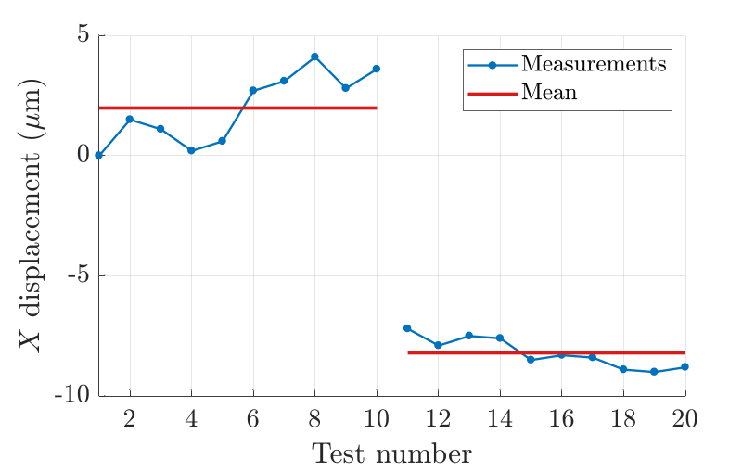
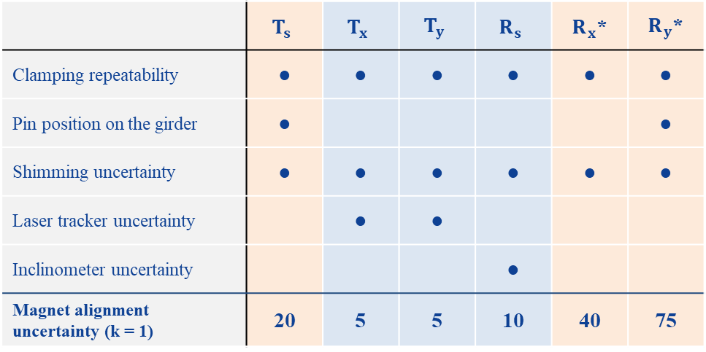
Magnet alignment on girder
Objective: position each magnet’s reference frame within the girder reference frame
Method: magnets are clamped against pins, measured with a laser tracker and inclinometer, and shimmed if needed
Identification
Quantification
Propagation
Laser tracker to check the position
 | $$T_{s}$$ | $$T_{x}$$ | $$T_{y}$$ | $$R_{s}$$ | $R_{x}$* | $R_{y}$*
Clamping repeatability | ● | ● | ● | ● | ● | ●
Pin position on the girder | ● |  |  |  |  | ●
Shimming uncertainty | ● | ● | ● | ● | ● | ●
Laser tracker uncertainty |  | ● | ●
Inclinometer uncertainty |  |  |  | ●
Magnet alignment uncertainty (k = 1) | 20 | 5 | 5 | 10 | 40 | 75
Clamping tool
Length gauge to check the X pin displacement
10 µm shimming with laser marking and cutting machine
µm
µm
µm
µrad
µrad
µrad
Before shimming
10.2 µm
Magnetic DOF (measured)
Mechanical DOF (set by realisation)
After shimming
*Values for a magnet with a pole length of 150 mm and a pin spacing of 340 mm on the girder

Slide 22
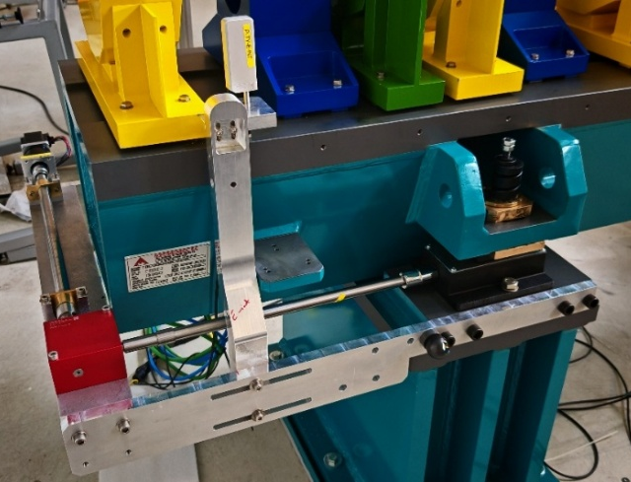
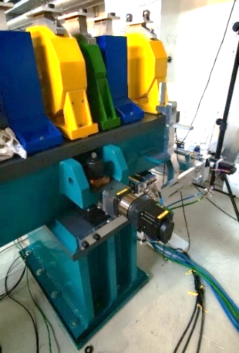
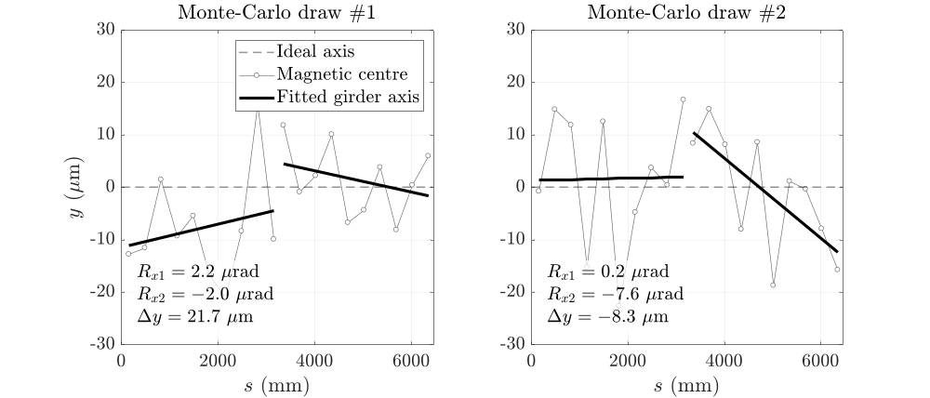
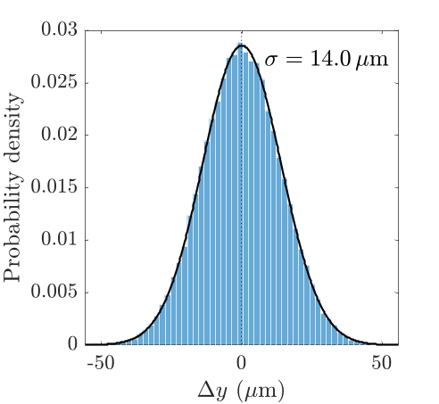
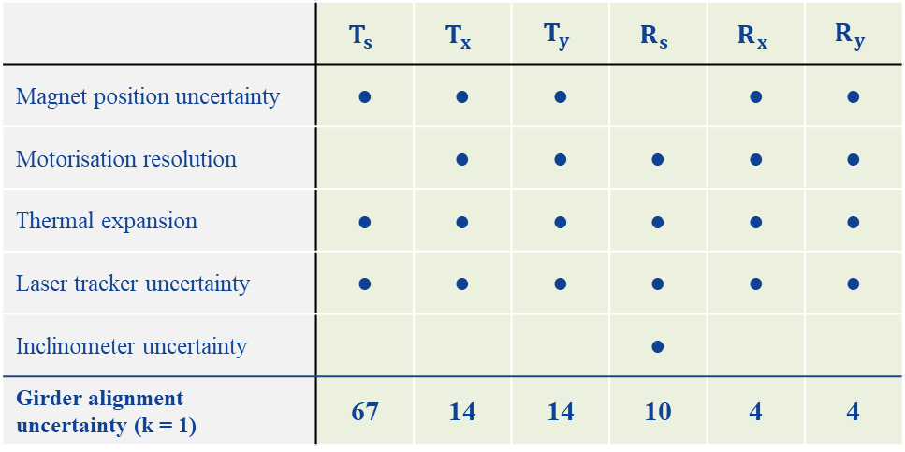
Girder alignment in the tunnel
Objective: set the girders at their nominal positions and minimise inter-girder discontinuities
Method: girders installed two by two, measured in the network frame, and finely aligned with motorisation
Identification
Quantification
Propagation
 | $$T_{s}$$ | $$T_{x}$$ | $$T_{y}$$ | $$R_{s}$$ | $$R_{x}$$ | $$R_{y}$$
Magnet position uncertainty | ● | ● | ● |  | ● | ●
Motorisation resolution |  | ● | ● | ● | ● | ●
Thermal expansion | ● | ● | ● | ● | ● | ●
Laser tracker uncertainty | ● | ● | ● | ● | ● | ●
Inclinometer uncertainty |  |  |  | ●
Girder alignment uncertainty (k = 1) | 67 | 14 | 14 | 10 | 4 | 4
Monte Carlo simulation of the inter-girder discontinuity
100 000 draws
µm
µm
µm
µrad
µrad
µrad
Translations: discontinuity between consecutive girders
Rotations: girder orientation relative to nominal

Slide 23
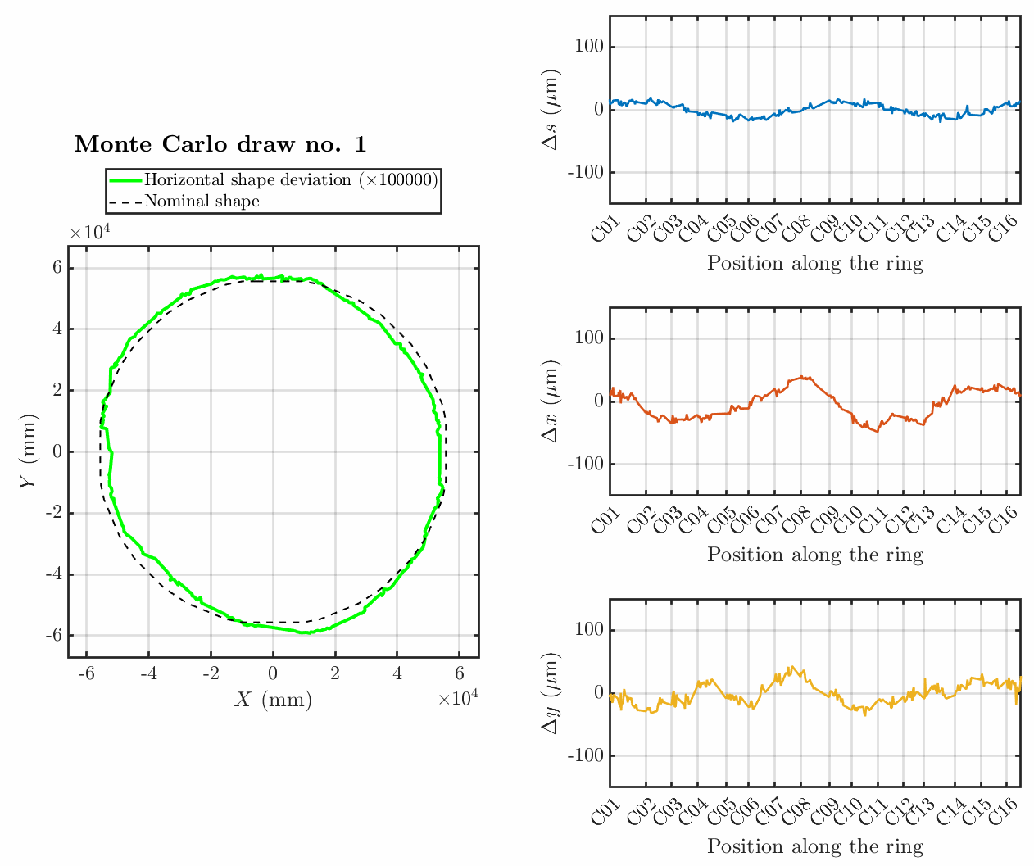
Survey: simulation model
The survey determines the final position of every component and decides on conformity
Survey uncertainty affects every measurand and is hard to evaluate
A Monte Carlo simulation model was therefore developed
Survey configuration
Stations, points, observations, environment
Laser tracker budget
Error distributions
Simulated observations
Randomly drawn errors
Network adjustment
Soleil6D
Monte Carlo (N drawn)
Uncertainty on indicators
Global shape, circumference, inter-girder, intra-girder, etc.
The simulations must be verified experimentally

Slide 24
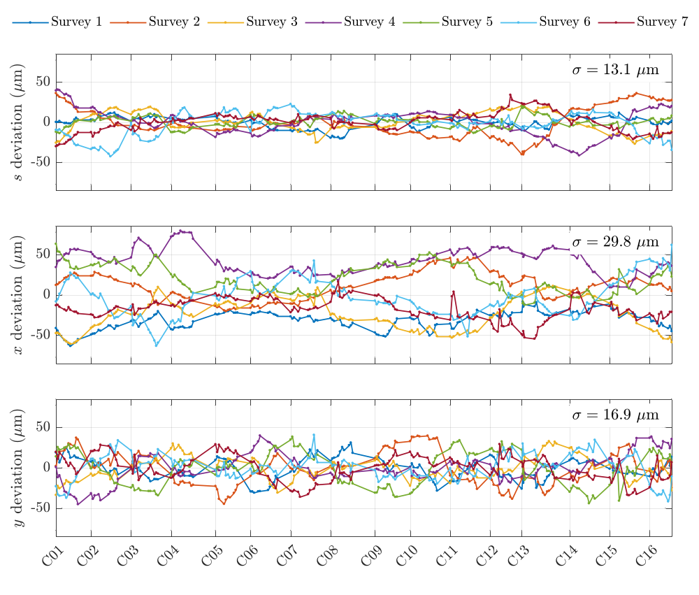
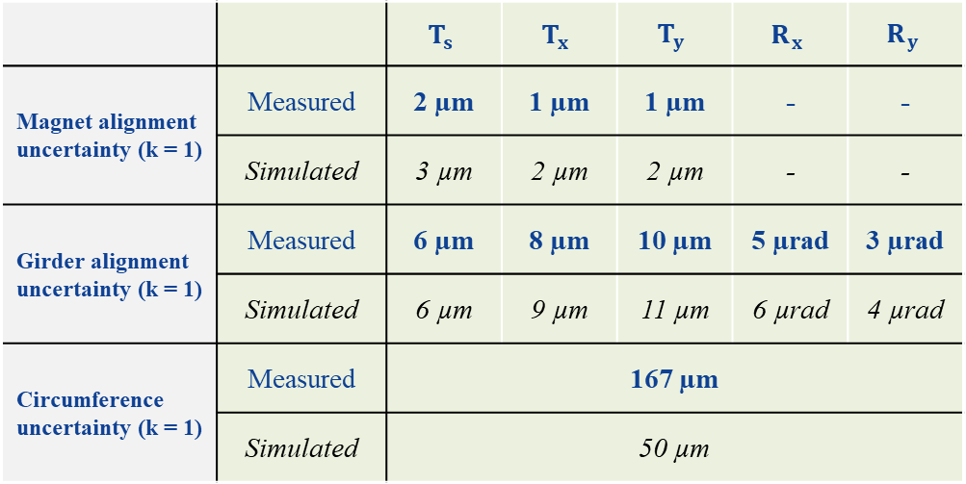
Survey: repeatability campaign
7 surveys of the storage ring in 3 weeks (4 laser trackers, 462 stations, 35290 measurements)
 |  | $$T_{s}$$ | $$T_{x}$$ | $$T_{y}$$ | $$R_{x}$$ | $$R_{y}$$
Magnet alignment uncertainty (k = 1) | Measured | 2 µm | 1 µm | 1 µm | - | -
 | Simulated | 3 µm | 2 µm | 2 µm | - | -
Girder alignment uncertainty (k = 1) | Measured | 6 µm | 8 µm | 10 µm | 5 µrad | 3 µrad
 | Simulated | 6 µm | 9 µm | 11 µm | 6 µrad | 4 µrad
Circumference uncertainty (k = 1) | Measured | 167 µm
 | Simulated | 50 µm
Overall shape of the storage ring controlled to within +/- 80 µm during a survey
Simulations validated on local indicators, circumference gap likely due to machine movements

Slide 25
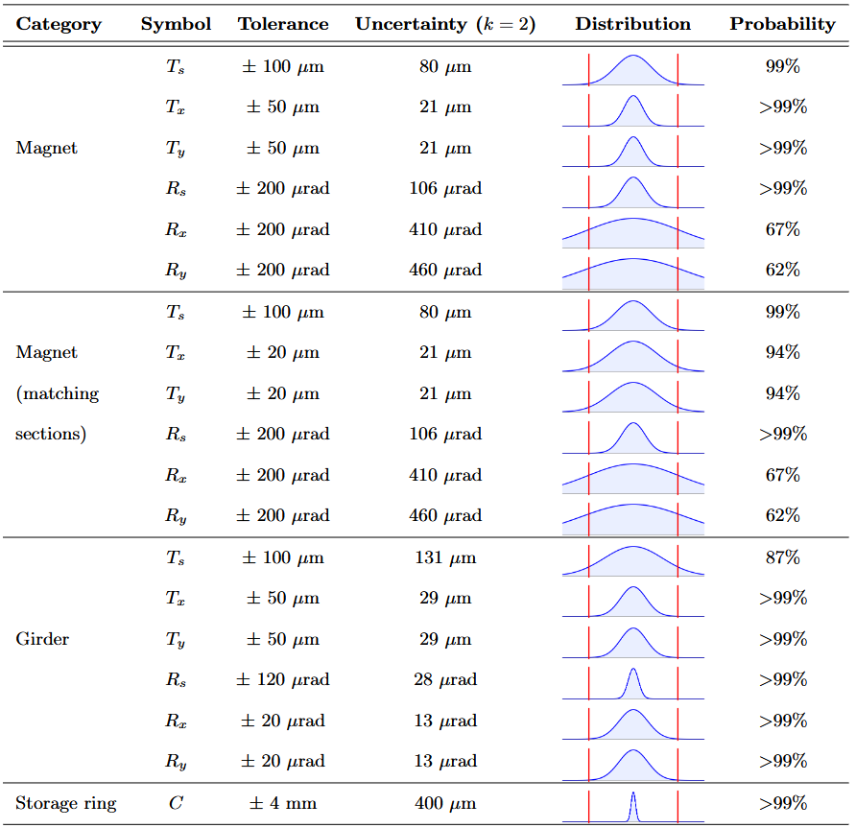
Final uncertainty estimation
Step uncertainties combined over the whole chain
Expanded uncertainty (k = 2) compared with each tolerance: probability of conformity, assuming no systematic bias (centred distributions)
Conformity guaranteed (> 95 %) for most measurands
  Transverse magnet alignment still to be improved
  Main issue: magnet pitch and yaw (Rx and Ry)
Ongoing discussion with the accelerator physicists: angular tolerances proportional to magnet length
  Alignment: tolerances matched to what can be achieved
  Beam: tighter tolerances on long magnets (dipoles), which have the largest impact on beam dynamics
Current estimate, to be updated as the alignment process and the uncertainty budgets evolve

Slide 26
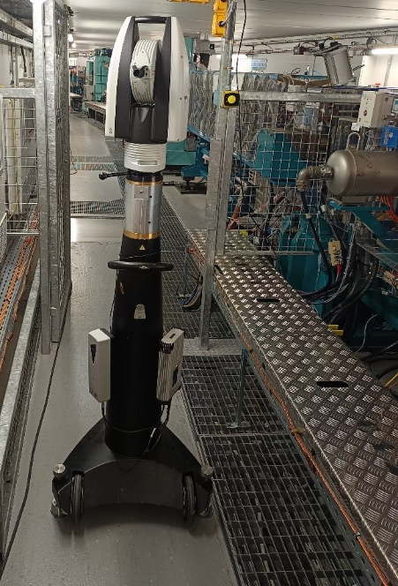
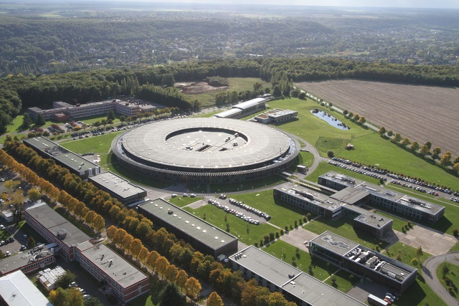
Conclusion and perspectives
Conclusion:
For a process as complex as the alignment of a fourth-generation light source, the metrological approach is essential: it aims to take everything into account and quantify it, to give us the best chance of conformity
It gave us a better understanding of what the physicists actually require:
  precise definition of measurands and a more realistic alignment error model
  clear decision rules for conformity, with guard bands
  a realistic estimation of the uncertainty budget across the whole alignment chain
A long process, never really finished: results are encouraging, critical cases are identified, and optimisations are under way to improve them
Perspectives:
Characterisation of machine movements, to better account for them during alignment
Magnetic characterisation and fiducialisation benches under construction, installation planned for august of 2027

Slide 27
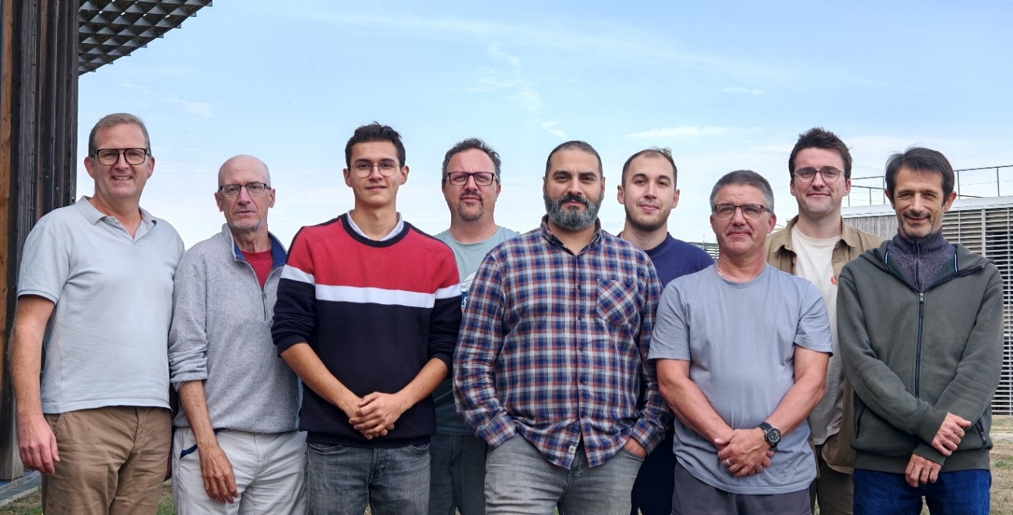
Acknowledgements
Many thanks to all my colleagues at SOLEIL and more specifically those in the Alignment and Metrology Group:
Sebastien DUCOURTIEUX
Alain LESTRADE (technic advisor 25%)
Mourad SEBDAOUI
Bruno LELUAN
Cedric BOURGOIN
Yann DENIS
David JOURDAIN (CDD)
Vincent GIGOT (trainee)
Special thanks to my thesis supervisor, Stéphane Durand, and my advisor, Joffray Guillory

Slide 28
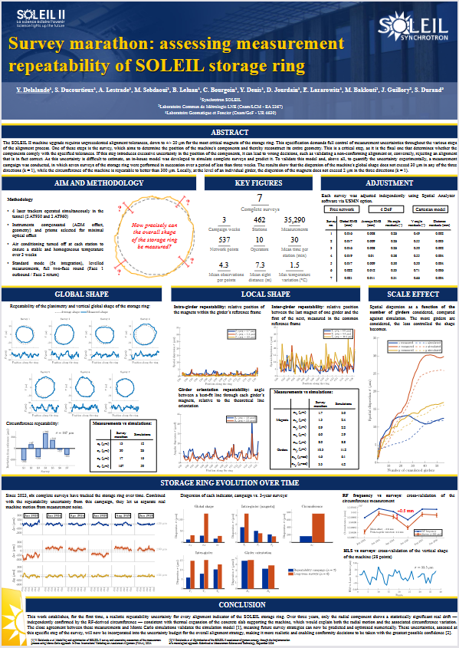
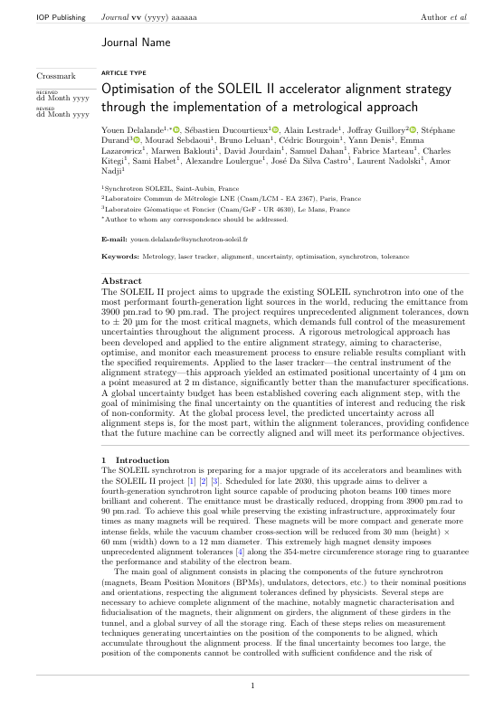
Poster and ongoing peer review paper
Submitted to MST and under review
Poster for IWAA 2026
Y. Delalande et al., "Optimisation of the SOLEIL II accelerator alignment strategy through the implementation of a metrological approach", under review in Meas. Sci. Technol.

Slide 29
Thank you!

Slide 30
Backup
Conformity of the horizontal transverse position Tx of the magnetic centres of the magnets on a girder
  Which magnets meet the tolerances and are conforming according to JCGM 106 (probability above 95 %) ?
GIRDER
Magnet
x
s
Measured magnetic center and associated uncertainty (10 µm at k = 2)

Slide 31
Backup
Conformity of the horizontal transverse position Tx of the magnetic centres of the magnets on a girder
  Which magnets meet the tolerances and are conforming according to JCGM 106 (probability above 95 %) ?
GIRDER
Magnet
x
s
Measured magnetic center and associated uncertainty (10 µm at k = 2)
Theoretical axis of the beam

Slide 32
Backup
Conformity of the horizontal transverse position Tx of the magnetic centres of the magnets on a girder
  Which magnets meet the tolerances and are conforming according to JCGM 106 (probability above 95 %) ?
GIRDER
Magnet
x
40 µm
s
Measured magnetic center and associated uncertainty (10 µm at k = 2)
Theoretical axis of the beam
Specified tolerance for Tx (+/- 20 µm)

Slide 33
Backup
Conformity of the horizontal transverse position Tx of the magnetic centres of the magnets on a girder
  Which magnets meet the tolerances and are conforming according to JCGM 106 (probability above 95 %) ?
GIRDER
Magnet
x
40 µm
s
20 µm
Measured magnetic center and associated uncertainty (10 µm at k = 2)
Theoretical axis of the beam
Specified tolerance for Tx (+/- 20 µm)
Acceptance limit (+/- 10 µm)

Slide 34
Backup
Conformity of the horizontal transverse position Tx of the magnetic centres of the magnets on a girder
  Which magnets meet the tolerances and are conforming according to JCGM 106 (probability above 95 %) ?
Within the acceptance limit (not to be realigned)
Outside the tolerances (to be realigned)
Outside the acceptance limit (to be realigned)
GIRDER
Magnet
x
40 µm
s
20 µm
Measured magnetic center and associated uncertainty (10 µm at k = 2)
Theoretical axis of the beam
Specified tolerance for Tx (+/- 20 µm)
Acceptance limit (+/- 10 µm)

Slide 35
Backup
Conformity of the horizontal transverse position Tx of the magnetic centres of the magnets on a girder
  Which magnets meet the tolerances and are conforming according to JCGM 106 (probability above 95 %) ?
Within the acceptance limit (not to be realigned)
Outside the tolerances (to be realigned)
Outside the acceptance limit (to be realigned)
The smaller the measurand uncertainty, the easier it is to decide on conformity
GIRDER
Magnet
x
40 µm
s
20 µm
Measured magnetic center and associated uncertainty (10 µm at k = 2)
Theoretical axis of the beam
Specified tolerance for Tx (+/- 20 µm)
Acceptance limit (+/- 10 µm)

Slide 36
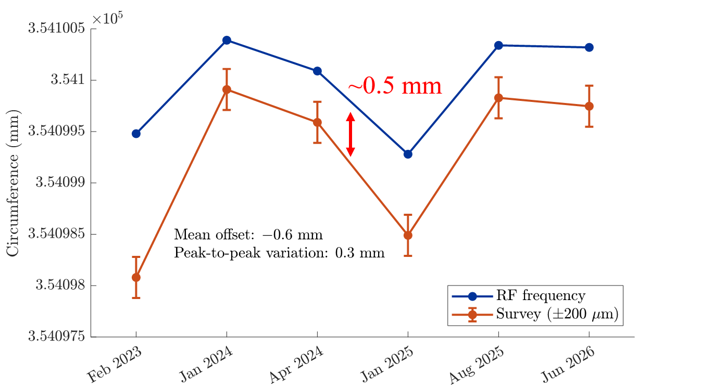
Backup

Slide 37
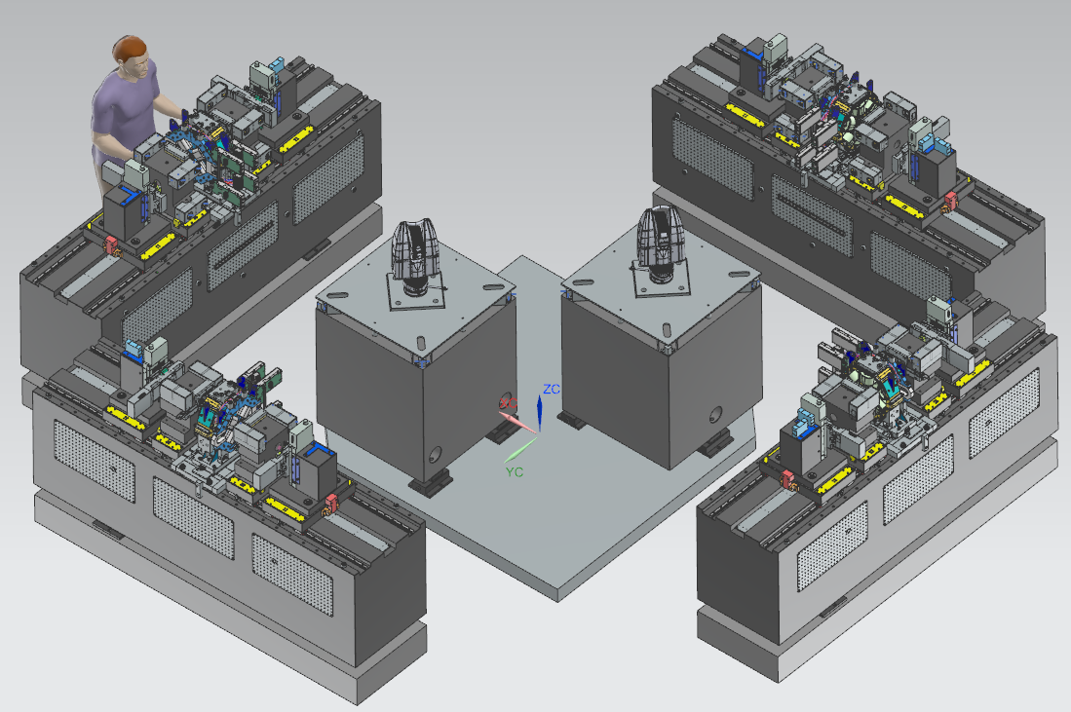
Backup
T5 building will be equipped with 4 benches and 2 laser trackers to support the characterization and fiducialization rate of the magnets:
  1 doublet/day/bench,
  2 quadrupoles, reverse bend /day/bench,
  1 dipole/2 days/bench)
Benches will be more compact and fully automated for measurements.
The air surrounding the benches will be controlled at a temperature of 21°C ± 0.25°C to improve the overall stability of the measurements, and with low airflow (< 0.15 m/s) to reduce air turbulence that perturbs laser tracker measurements.
Aluminum will be replaced by granite when possible:
Coefficient of thermal expansion 4 times lower than aluminum (goes from 24 µm/K/m to only 6.2 µm/K/m).
Granite will offer a much better thermal inertia.
5 m x 5 m
granite

Slide 38
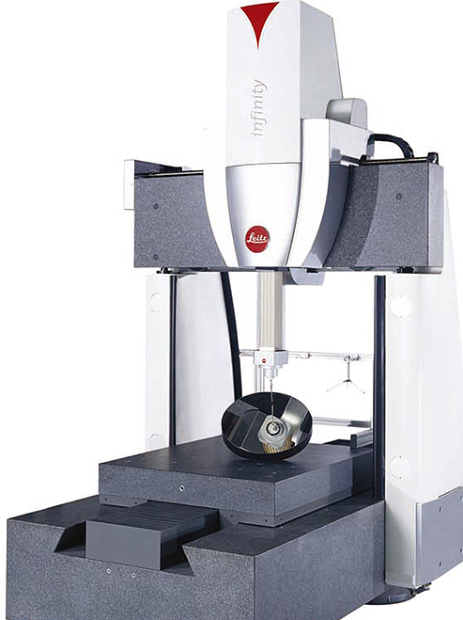

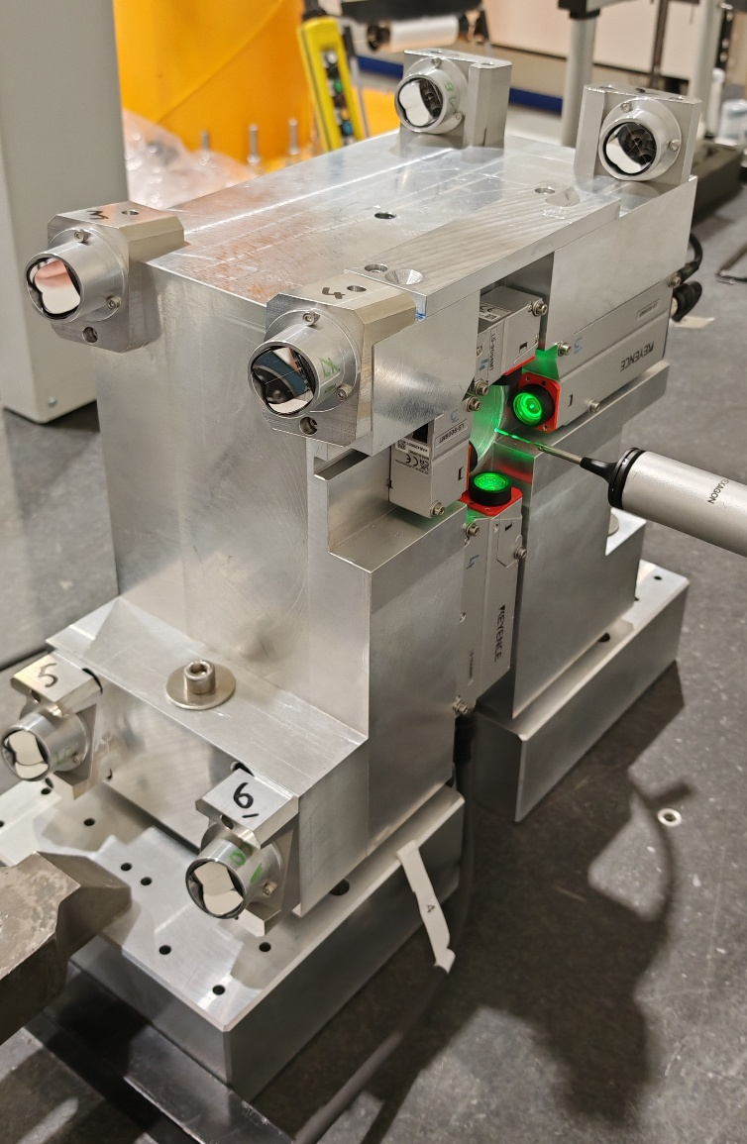
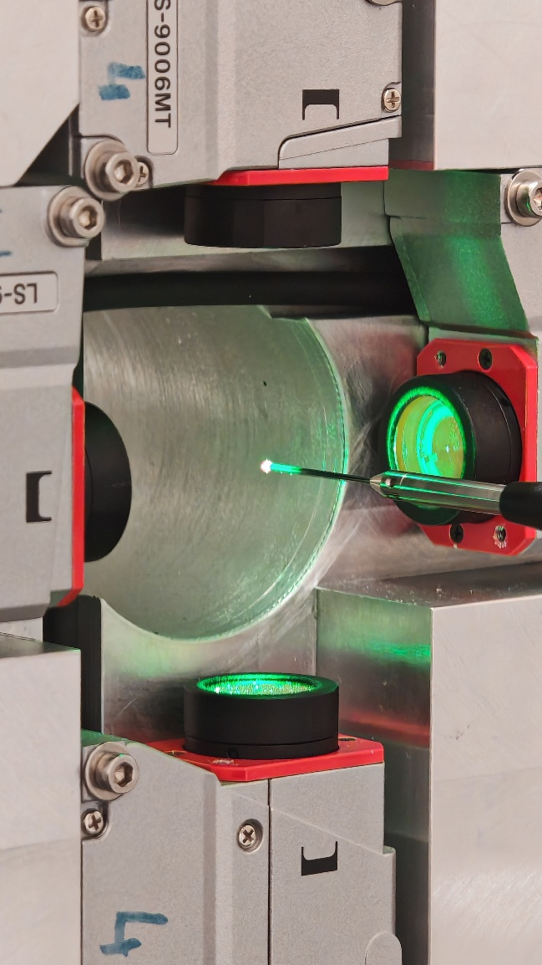
Backup
Fiducialization of the Keyence sensor system under a CMM
Aim: detect the offsets between the sensors and the fixed prisms (the zero positions)
Measurement subcontracted to CETIM:
CMM: Leitz Infinity 2.4m x 1.2m x 1m.
5 repeated measurements for CMM.
100 repeated measurements for tracker
Proposed expanded uncertainty for our measurement: 2 µm (k=2).
Determination of the Keyence sensor zero with an uncertainty of 1 µm (σ).
Deviation between all measurements = 1 µm (σ)
CMM probe with 1 or 3 mm sapphire spheres

