Slide 1
A start-to-end optimization of the ILC E-driven positron source by machine learning
Y. Sasaki, M. Kuriki, T. Takahashi, Z. Liptak (Hiroshima U.)
Y. Enomoto, T. Omori, M. Fukuda, Y. Morikawa,
K. Yokoya, J. Urakawa (KEK)

Slide 2
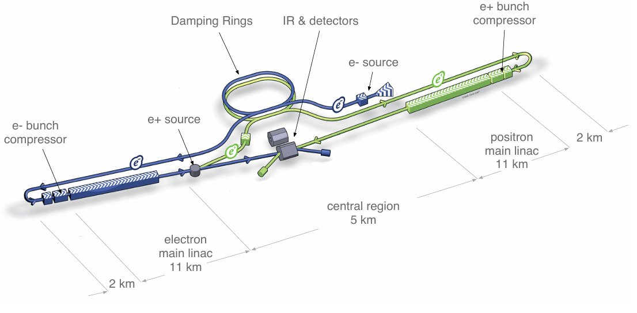
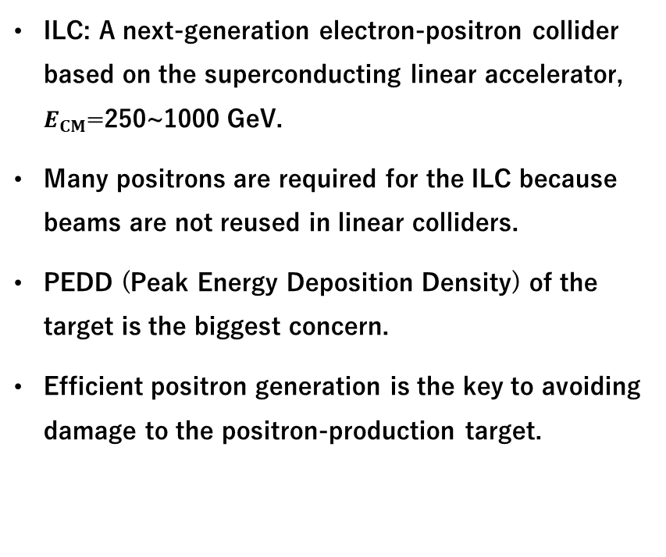
International Linear Collider
ILC: A next-generation electron-positron collider based on the superconducting linear accelerator, $E_{CM}$=250~1000 GeV.
Many positrons are required for the ILC because beams are not reused in linear colliders.
PEDD (Peak Energy Deposition Density) of the target is the biggest concern.
Efficient positron generation is the key to avoiding damage to the positron-production target.
Schematic layout of the ILC
Behnke et al., “The International Linear Collider Technical Design Report- Volume 1: Executive Summary.”
WRe target
positrons
3 GeV electrons

Slide 3
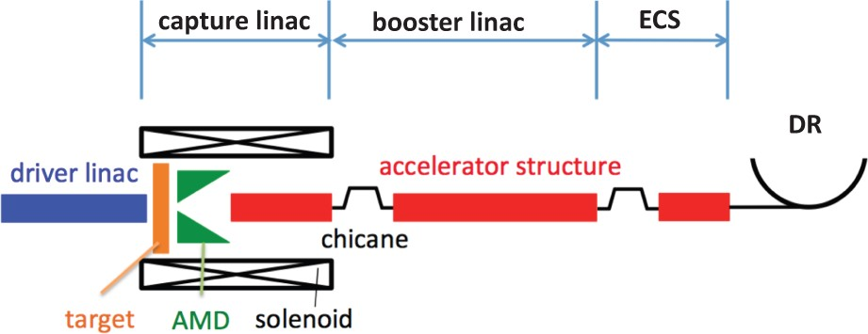
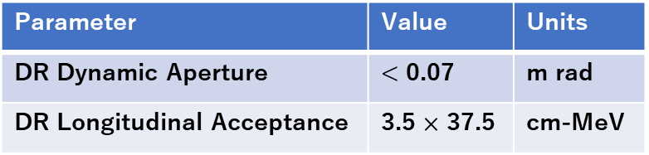
ILC Electron-driven positron source
Electrons and positrons are captured by the capture linac.
The electrons are separated from the positrons by bending magnets.
Positrons are accelerated to an energy of 5 GeV.
The ECS compresses the energy of the positrons.
The positron generation efficiency is evaluated as the number of positrons in the damping ring acceptance.
Schematic layout of the ILC electron-driven positron source
Seimiya et al., “Positron Capture Simulation for the ILC Electron-Driven Positron Source.”
Parameter | Value | Units
DR Dynamic Aperture | < 0.07 | m rad
DR Longitudinal Acceptance | 3.5 $×$ 37.5 | cm-MeV

Slide 4
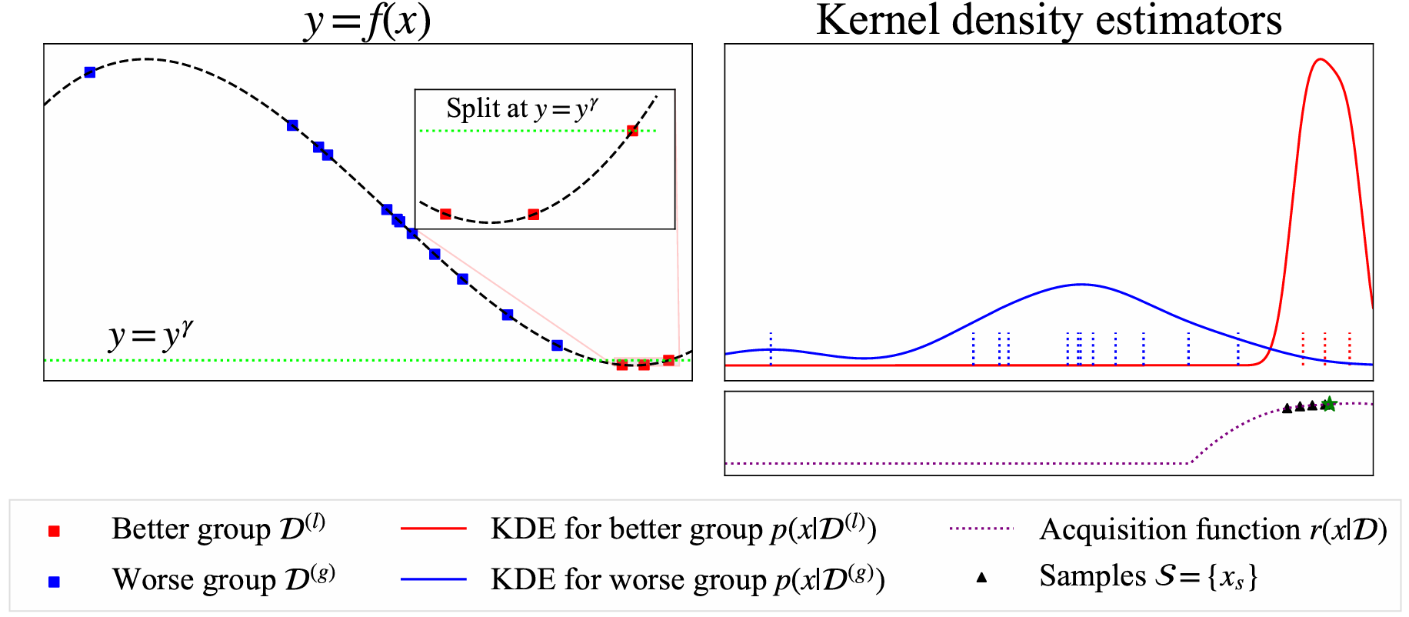
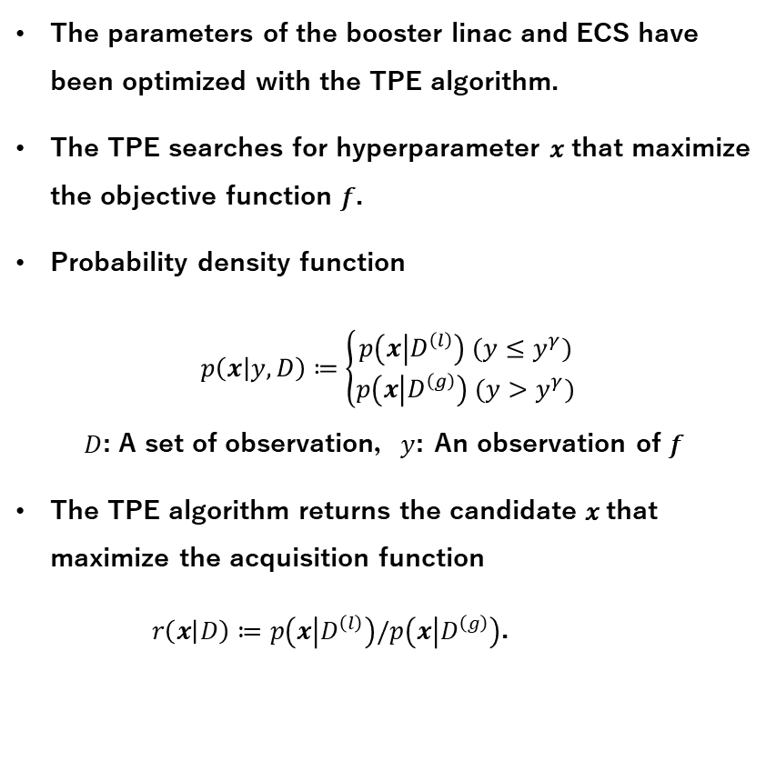
Tree-structured Parzen Estimator
The parameters of the booster linac and ECS have been optimized with the TPE algorithm.
The TPE searches for hyperparameter 𝑥 that maximize the objective function 𝑓.
Probability density function
$$p\left(x | y, D\right)≔\left\{\begin{aligned}p\left(x | D^{\left(l\right)}\right) (y≤y^{γ}) \\ p\left(x | D^{\left(g\right)}\right) (y>y^{γ})\end{aligned}\right.$$
$D$: A set of observation，$y$: An observation of 𝑓
The TPE algorithm returns the candidate 𝑥 that maximize the acquisition function
$r\left(x | D\right)≔p\left(x | D^{\left(l\right)}\right)/p\left(x | D^{\left(g\right)}\right)$.
Objective function
Acquisition function
Watanabe, “Tree-Structured Parzen Estimator.”

Slide 5
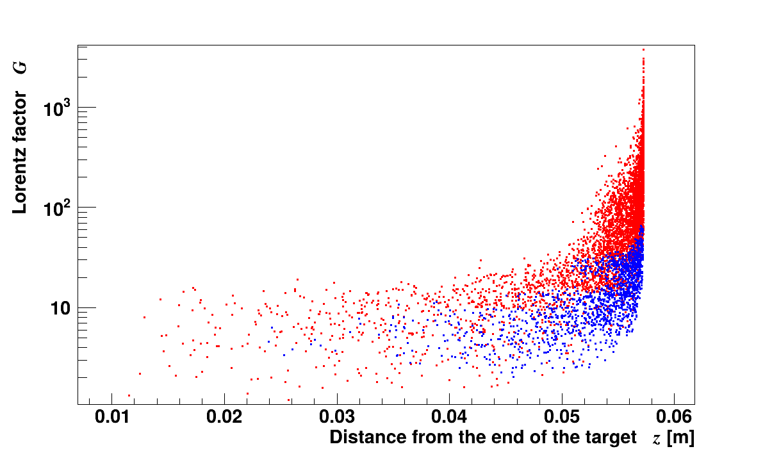
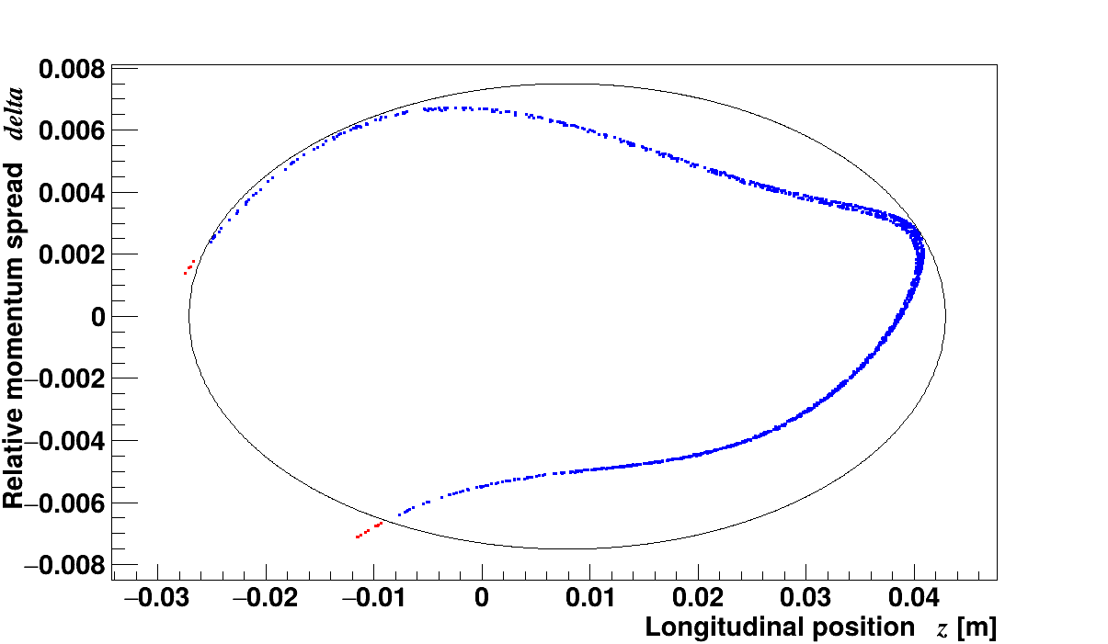
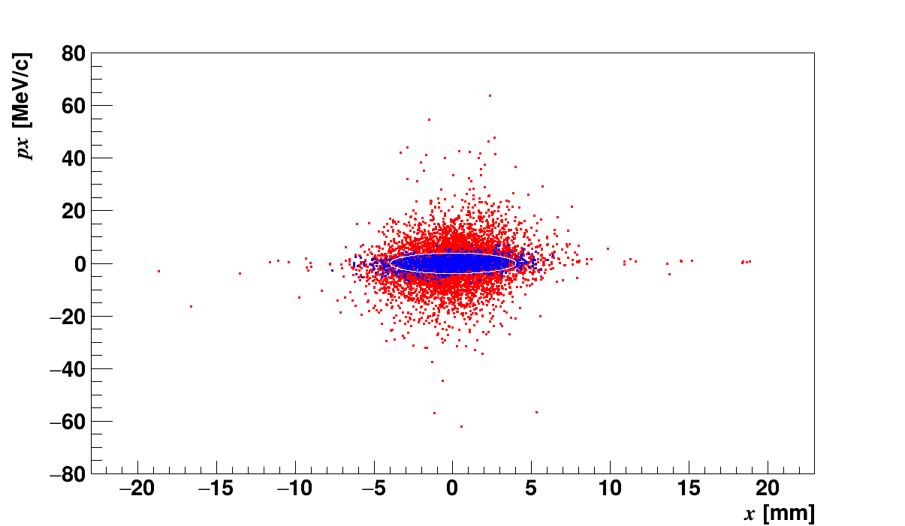
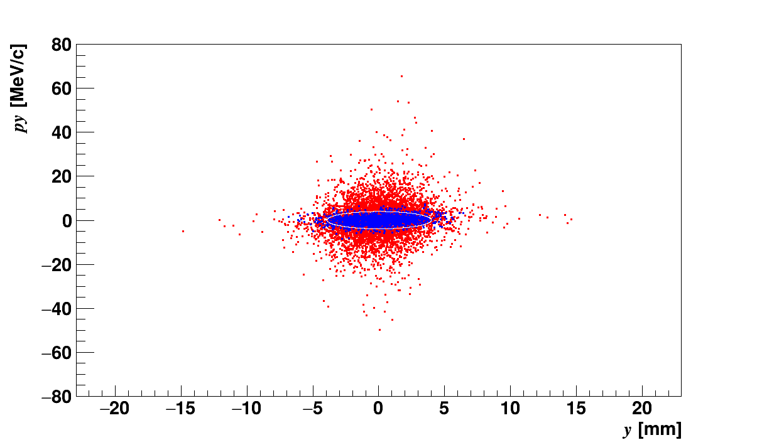


Methods
We try a precise optimization of drive beam and target parameters with Geant4.
We set the acceptance at the end of the target by tracing the particles that fit within the DR acceptance backwards.
Evaluation of the number of positrons in the provisional acceptance for various combinations of drive beam energy and target thickness.
Evaluation of the peak energy deposition density.
The longitudinal phase space distribution after the target
After the ECS.
Backward trace
DR acceptance
$$x$$
$$y$$
●：All positrons
●：Accepted positrons

Slide 6
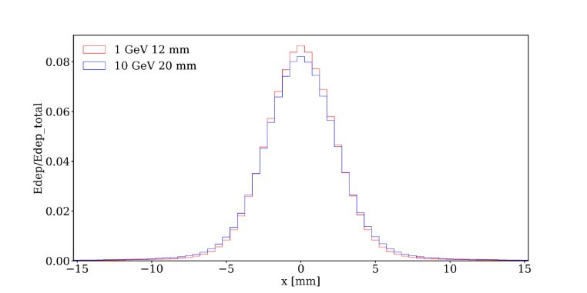
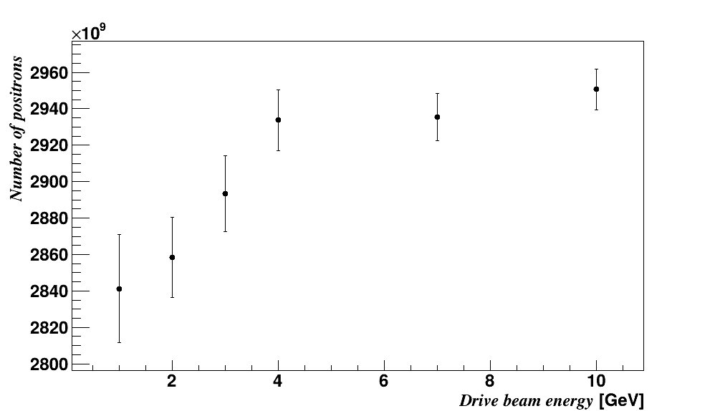
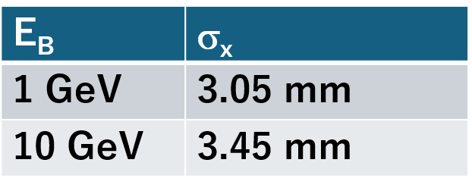
Results & Discussion
The number of positrons normalized by the energy density of the target
$x$distribution of the energy deposition
@ the target depth that maximizes the PEDD
4%
The positrons are scattered for higher drive beam energy. This is because the optimum target thickness is thicker for higher drive beam energy.
The positron yield normalized by the energy density is higher for higher drive beam energy.

Slide 7
Conclusions & Future work
The ILC is an electron-positron collider with a center of mass energy of 250 GeV to 1 TeV.
Many positrons are required compared to ring colliders because beams are not reused.​
The ILC E-driven positron source should be designed to avoid damage to the positron-production target.
We evaluated the number of positrons in the provisional acceptance of the end of the target.
The positron yield normalized by the energy density is higher for higher drive beam energy.
Future work
Start-to-end optimization by machine learning.

