Slide 1


Research on radiation generation
from compact synchrotron radiation sources
Runa Murayama
Hiroshima Univ
Notes:
My name is Runa Murayama.
I am from Hiroshima University.
I will talk about Research on radiation generation from compact synchrotron radiation source.

Slide 2
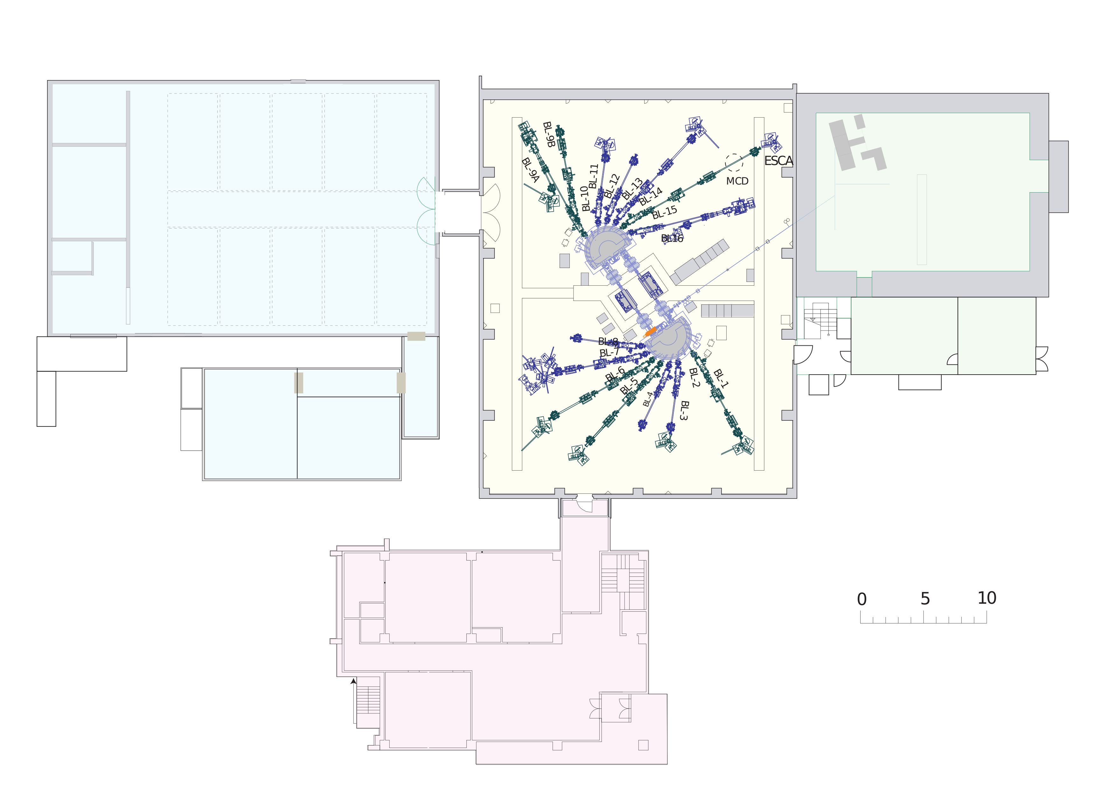
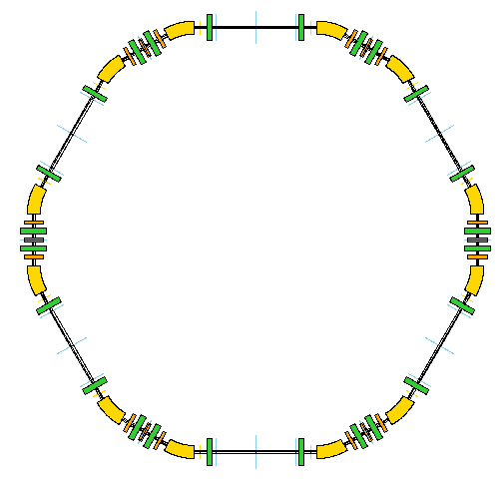
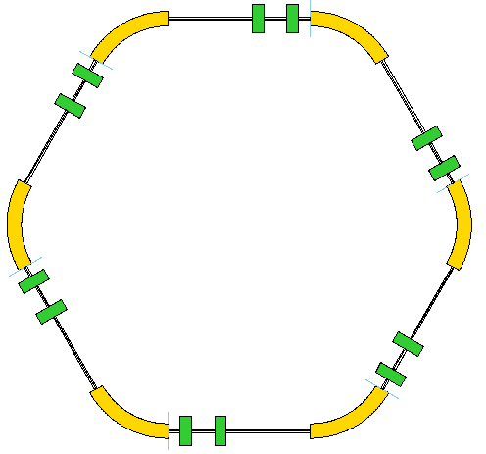
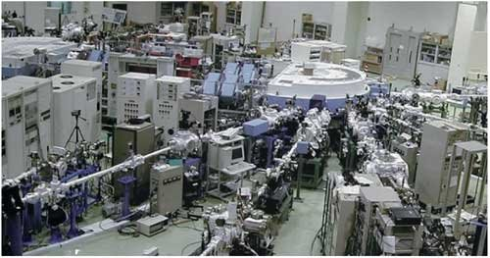
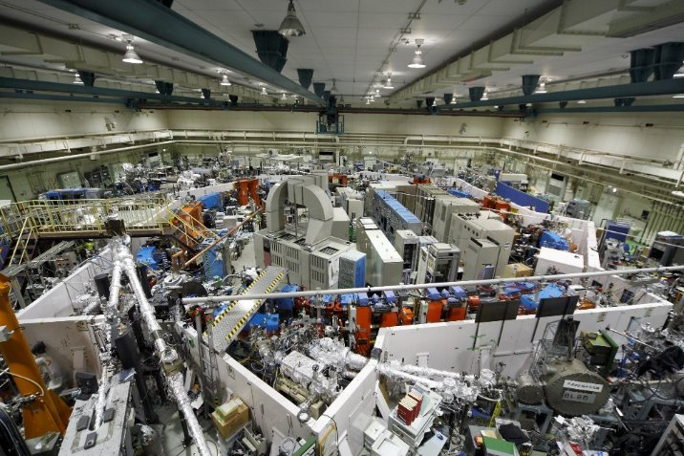
Background
HiSOR
HiSOR-II
150MeV Microtron
150MeV Beam Transport Line
150MeV Microtron
700MeV Storage Ring
150MeV Beam Transport Line
600MeV Storage Ring
600MeV Beam Transport Line
600MeV Booster Synchrotron
Change
accelerator
structure
Shielding
walls
similar to
UVSOR structure
UVSOR-III
The storage ring is surrounded by shielding walls.
Extended Experimental Hall
Present HiSOR
Yokes of 180deg bending magnets work as radiation shielding.
HiSOR-II will be like this?
Notes:
HiSOR is a compact synchrotron radiation source in Hiroshima University. It was constructed about 30 years ago. Now, We have a future plan called HiSOR-II. HiSOR has no radiation shielding wall. Because radiation is shielded by iron yoke of the two H-shaped big bending magnets. But Bending magnets of HiSOR-II are small and C-shaped. In addition, we plan to introduce top-up operation. Therefore, we need to construct shielding wall around the HiSOR-II ring like UVSOR.

Slide 3
Motivation
HiSOR
HiSOR-II
Change
accelerator
structure
150MeV Microtron
150MeV Beam Transport Line
150MeV Microtron
We want to realize HiSOR-Ⅱ
with low cost as possible!
The radiation shielding should be
cost-effective, too!
700MeV Storage Ring
150MeV Beam Transport Line
600MeV Storage Ring
600MeV Beam Transport Line
600MeV Booster Synchrotron
Shielding
walls
similar to
UVSOR structure
UVSOR-III
The storage ring is surrounded by shielding walls.
Extended Experimental Hall
Present HiSOR
Yokes of 180deg bending magnets work as radiation shielding.
HiSOR-II will be like this?
Notes:
We want to realize HiSOR-Ⅱ with low cost as possible. The radiation shielding should be cost-effective,too.

Slide 4
Goal
HiSOR
HiSOR-II
Change
accelerator
structure
150MeV Microtron
150MeV Beam Transport Line
150MeV Microtron
To develop cost-effective radiation shielding,
we first examine how radiation is generated and propagated by using the simulation code PHITS.
700MeV Storage Ring
150MeV Beam Transport Line
600MeV Storage Ring
600MeV Beam Transport Line
600MeV Booster Synchrotron
Shielding
walls
similar to
UVSOR structure
UVSOR-III
The storage ring is surrounded by shielding walls.
Extended Experimental Hall
Present HiSOR
Yokes of 180deg bending magnets work as radiation shielding.
HiSOR-II will be like this?
Notes:
To develop cos-effective radiation shielding, we first examine how radiation is generated and propagated by using the simulation code PHITS.

Slide 5
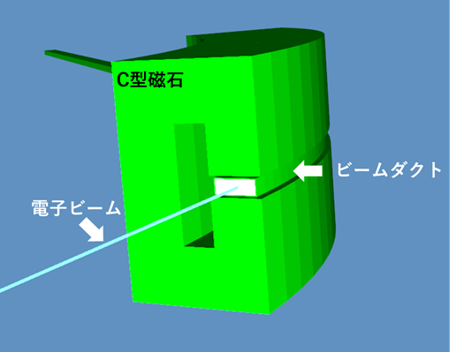
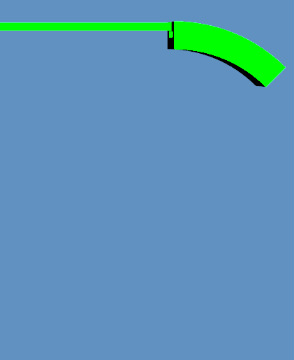










Simulation Model
Simulation Model
Residual
Gas (CO)
$$y$$
Drift Space
Fe
Electron Beam
（750MeV）
Bending Magnet
Bean
duct
$$x$$
$$x$$
Electron
beam
$$z$$
$$z$$
$$ρ=2.2[m]$$
40[cm]
$$y$$
3.9[cm]
$$x$$
I created a simple simulation model based on UVSOR.
It has a straight section and a bending magnet.
The beam duct is made of stainless steel.
The magnet is made of iron.
All other parts are vacuum.
63.6[cm]
11[cm]
Fe
Notes:
I created a simulation model. This isle based on UVSOR. Because HiSOR-Ⅱ will have similar structure as UVSOR. This model has a one straight section and a one bending magnet. The magnet is made of iron. The beam pipe is made of stainless steal. All other parts are vacuum.
The amount of residual gas is increased more than normal so that collisions with the residual gas occur more frequently.
When 10electron put in duct, three electron collisions gas.

Slide 6
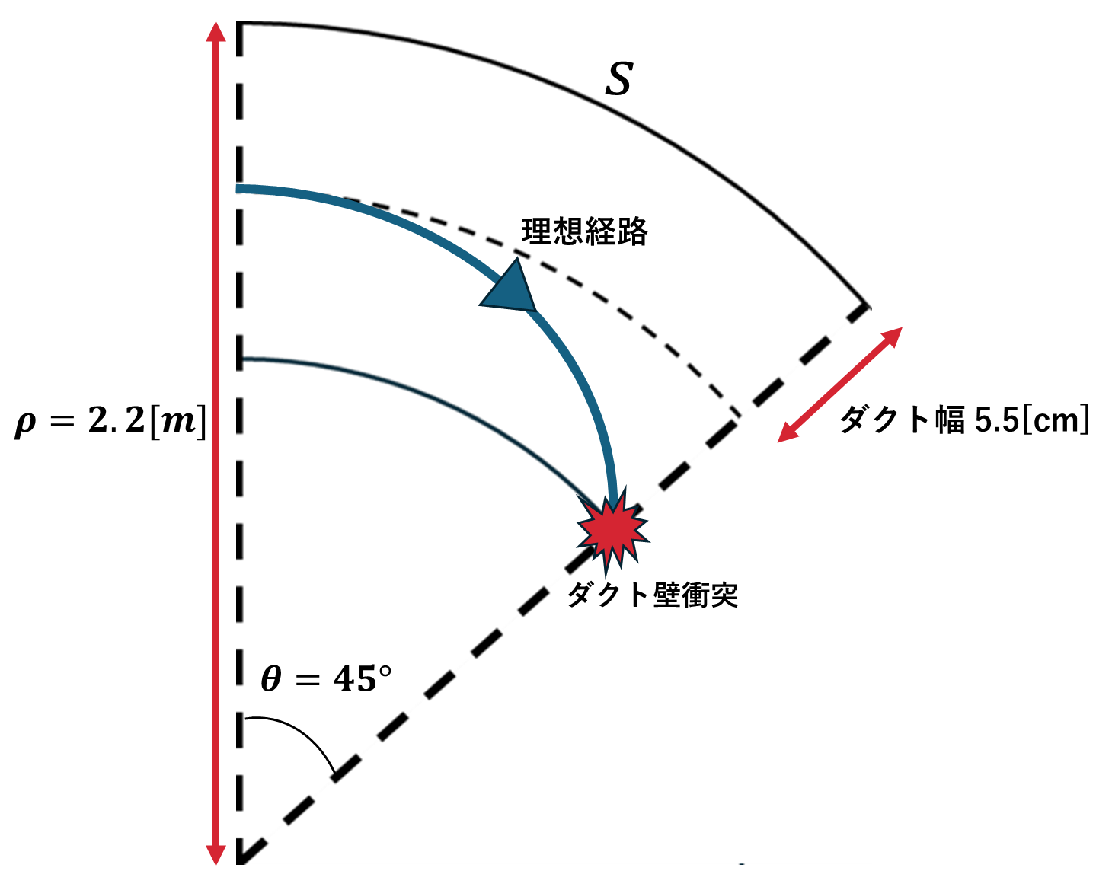



Beam Loss Mechanism
In this study, we only consider residual gas scattering.
We put CO as the residual gas in the straight section.
Bremsstrahlung
Rutherford Scattering
$$∆y=19[mm]$$
$$θ$$
$$l=2.2π$$
Electrons scattered by an angle larger than a critical value are lost and generate radiation.
Electrons losing energy higher than a critical value
are lost and generate radiation.
Notes:
In this study, we only consider residual gas scattering. We put CO as the residual gas in the straight section. We consider two major processes.
Left picture is Bremsstrahlung. Electrons lose energy through reactions with gases. In magnet field, If an electron loses energy more than 64[eV], electron hits the duct and generate radiation.
Right picture is Rutherford Scattering. Electron change its direction through reactions with gases. If the electron angle changes by less than 2.2 [mrad], the electron will not collide with the duct.

Slide 7
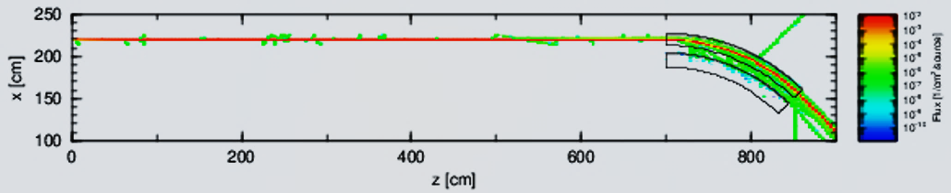
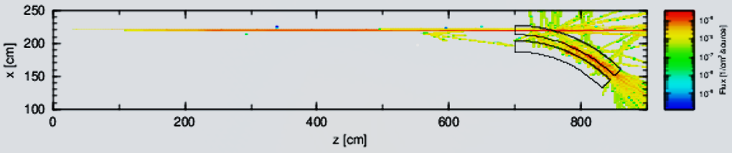
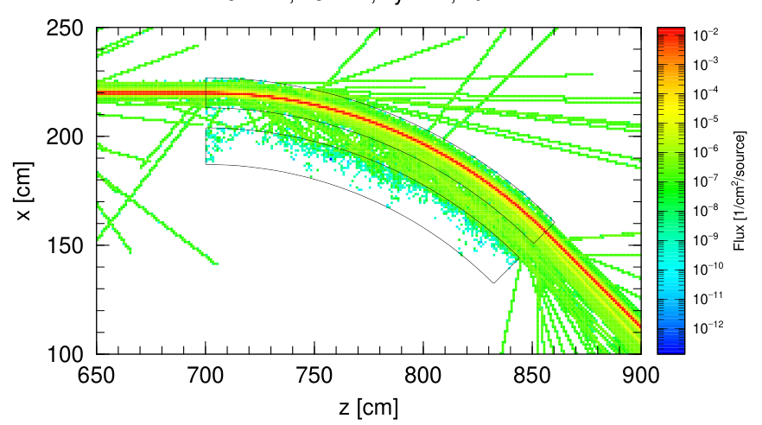
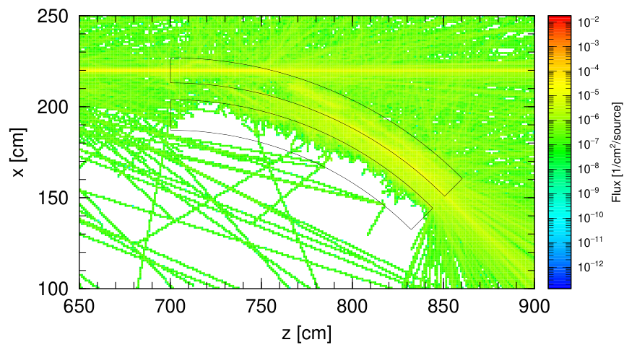


Simulation Result
Electron fluence
Gamma-ray fluence
Interaction with residual gases
In ${10}^{4}$ electron
In ${10}^{4}$ electron
In ${10}^{5}$ electron
In ${10}^{5}$ electron
Notes:
This is the result. This one is Electron fluence. Red color line is electron beam.
Others are electrons losing energy or generated as radiation.

Slide 8
Simulation Result
Electron fluence
Gamma-ray fluence
Interaction with residual gases
In ${10}^{4}$ electron
In ${10}^{4}$ electron
Bremsstrahlung gamma-rays
In ${10}^{5}$ electron
In ${10}^{5}$ electron
Notes:
This one is Gamma-ray fluence.
We can see bremsstrahlung gamma-rays.

Slide 9
Simulation Result
Electron fluence
Gamma-ray fluence
Interaction with residual gases
In ${10}^{4}$ electron
In ${10}^{4}$ electron
Intense radiation along the beam orbit
In ${10}^{5}$ electron
In ${10}^{5}$ electron
Notes:
We can see intense radiation along the beam orbit.

Slide 10
Simulation Result
Electron fluence
Gamma-ray fluence
Interaction with residual gases
In ${10}^{4}$ electron
In ${10}^{4}$ electron
Shielding effect of magnet yoke
In ${10}^{5}$ electron
In ${10}^{5}$ electron
Notes:
The inner square is the magnet's yoke section.
We can see shielding effect of the magnet yoke.

Slide 11

Summary & Prospects
[Summary]
We made PHITS simulation
for a simple storage ring model.
We consider the residual gas scattering only.
We found that intense radiation is concentrated along the straight line and around the beam orbit at the exit of
the bending magnet.
※１
※2
γ
In ${10}^{5}$ electron
[Prospects]
- We include quadrupole magnets in the simulation.
- We place a shielding blocks around the straight line and at the exit of the bending magnet.
- We treat other beam loss processes such as Touschek scattering.
Notes:
We made PHITS simulation for a simple storage ring model.
We consider the residual gas scattering only. We found that intense radiation is the straight line and around the beam orbit at the exit of the bending magnet.
I want to do next ,
-We include quadrupole magnets in the simulation.
-We place a shielding blocks around the straight line and at the exit of the bending magnet.
- We treat other beam loss processes such as Touschek scattering.

