Slide 1
Absolute value of transition probability: derivations and applications
Kenzo Ishikawa, Hokkaido University

Slide 2
Contents
[1]. Principle of quantum mechanics.
[2]. Transition probability of wave packets.
[3]. Rayleigh scattering of solar lights with molecule in
the atmosphere “ Blue sky and albedo”.
[4]. Summary
* Solar corona heating: neutrino radiative decays
  in magnetized plasma.
* Short distance neutrino spectrum in pion decays.
* Resonance decay at threshold. Other QED processes.

Slide 3
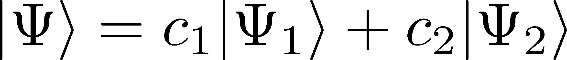
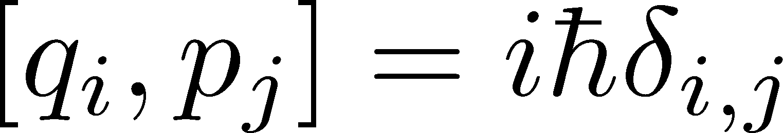
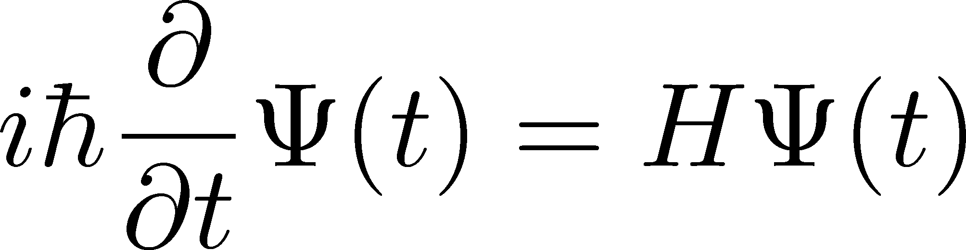
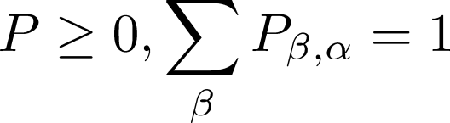
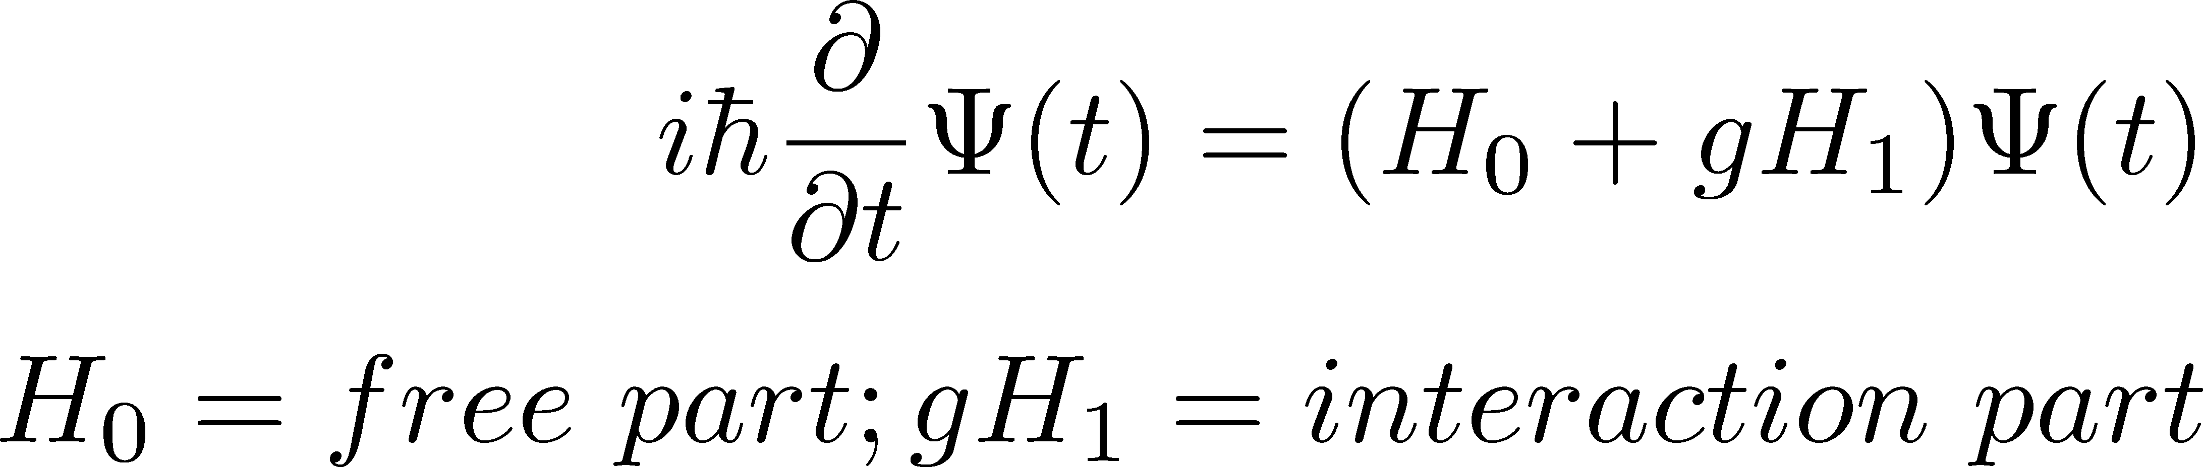
[1].
Principles of the quantum mechanics
(1) Superposition principle
(2) Commutation relations
(3) Schrödinger equation
(4) Probability principle
Normalized wavefunctions
Schrödinger equation of interacting system
Transition probability bridges natural phenomena with microscopic law. （Planck, Einstein, Bohr, －）

Slide 4
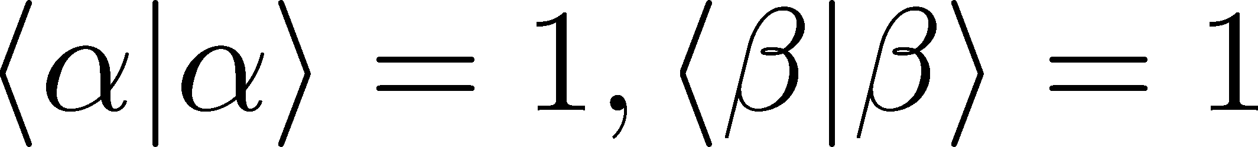
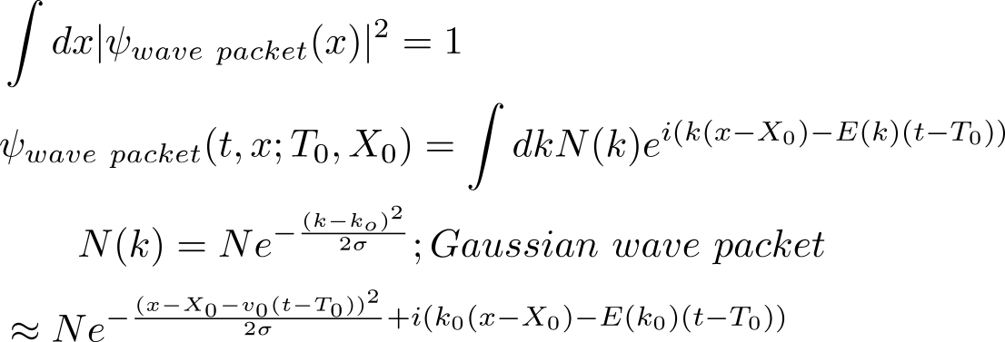
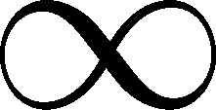


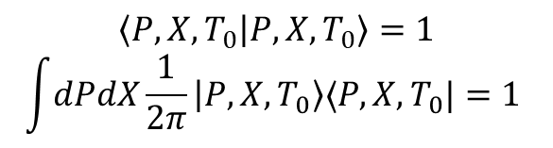
[2-1] Normalized states (wave packets)
$$\left\langle P,X,T_{0} | P,X,T_{0}\right\rangle =1$$
$$\int{dPdX}\frac{1}{2π}\left|P,X,T_{0}\right\rangle ⟨P,X,T_{0}|=1$$
Gaussian wave packets
K.I and T. Shimomura, PTP (2005)
$$t$$
Wave packet size
$$x$$
K.I and K.Oda, PTEP (2018)

Slide 5
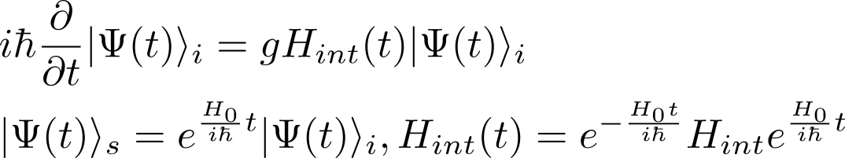
Transition of normalized states with an interaction
Transition amplitude
Construct the initial and final states with wave packets, and compute the amplitude with Dyson formula.
KI and Y. Tobita, (2013,2014), KI, T.Tajima, and Y.Tobita (2015).
KI and K. Oda(2018), KI,K.Nishiwaki,K.Oda(’20,’23) ,KI,Jinnouci,Nishiwaki,Oda(’23)
On wave packets: KI(2024), KI and Y.Nishio(2024), KI and O.Jinnouchi(in preparation)

Slide 6
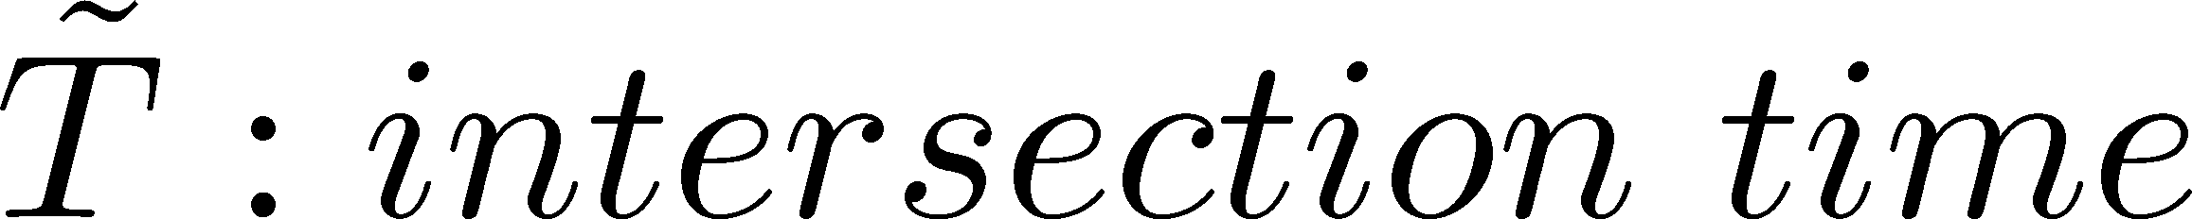
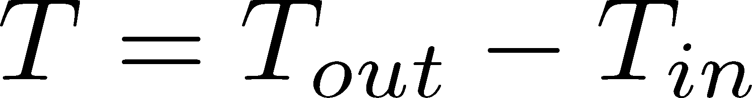
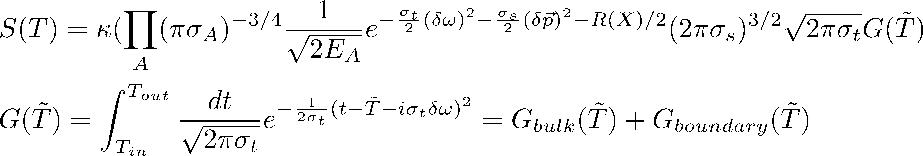
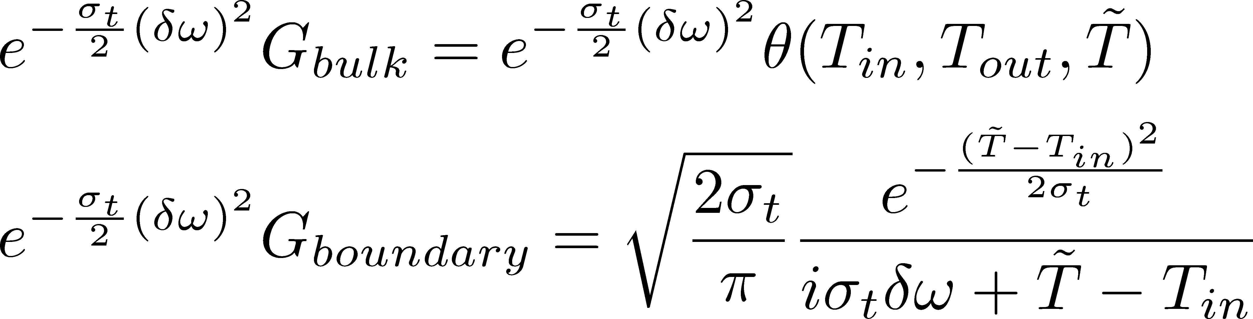

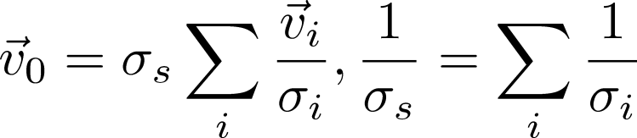
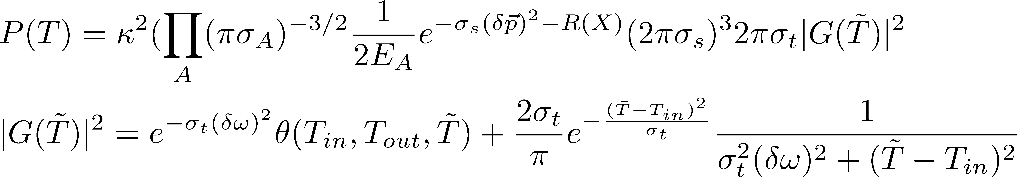
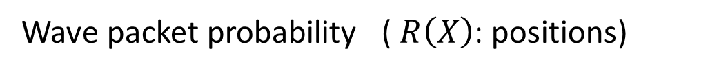
[2-2] Wave packet amplitude
----(A)
---(B)
Wave packet probability ( $R\left(X\right)$: positions)
1st class quantity
2nd class quantity

Slide 7
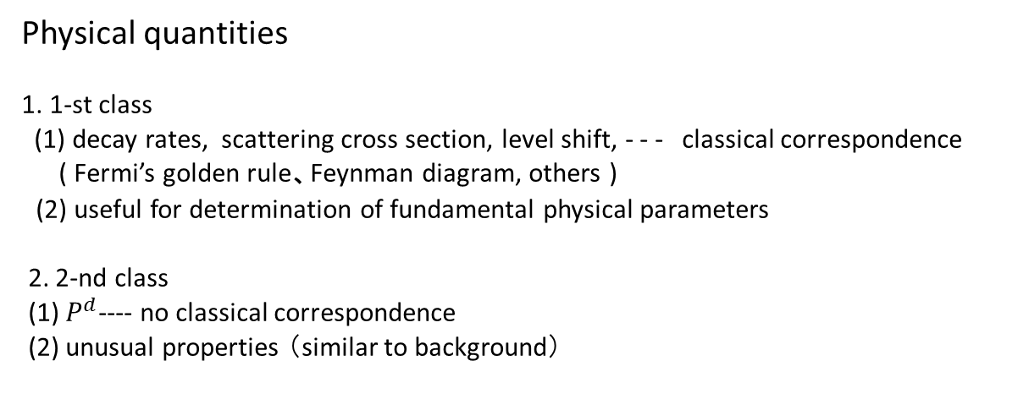
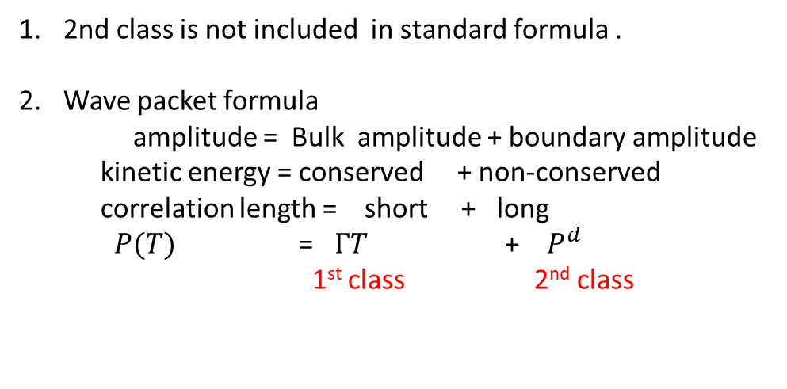
[2-3] Absolute value of transition probability is composed of 1st and 2nd classes.
2nd class is not included in standard formula .
Wave packet formula
amplitude = Bulk amplitude + boundary amplitude
kinetic energy = conserved + non-conserved
correlation length = short + long
$P(T)$ = $ΓT$ + $P^{d}$
1st class 2nd class
Physical quantities
1. 1-st class
(1) decay rates, scattering cross section, level shift, - - - classical correspondence
( Fermi’s golden rule、Feynman diagram, others )
(2) useful for determination of fundamental physical parameters
2. 2-nd class
(1) $P^{d}$---- no classical correspondence
(2) unusual properties （similar to background）

Slide 8
[3]. Applications of the absolute transition probability
(3-1) Rayleigh Scattering of the solar light (on blue sky, albedo)
(3-2) Heating of solar corona by neutrino electroweak Hall effect
(electroweak interaction) (K.I and Y.Tobita)
(3-3) Short distance neutrino in pion decay (weak decay ;K.I and Y.Tobita)
(3-4) Resonance decay at threshold energy, V --> PP (strong decay ).
QED processes.(Jinnouchi, Sakurai, Sloan, Takesada, Oda, Nishiwaki, -)

Slide 9
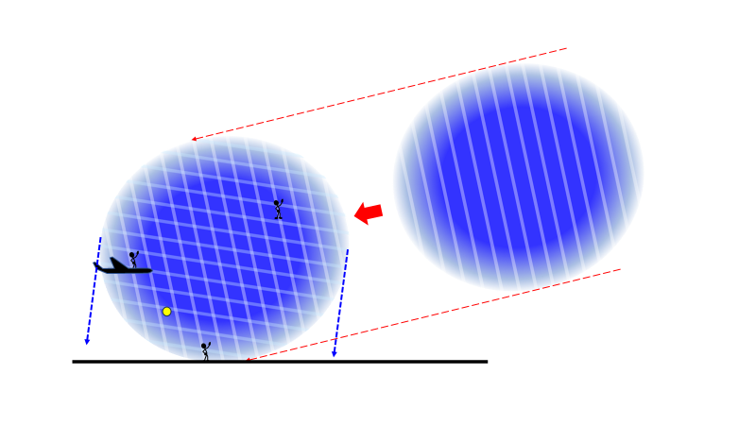
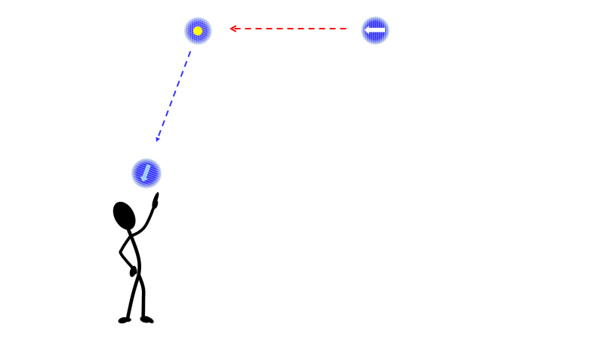
[3] Rayleigh scattering of sun light with a molecule in the
atmosphere.
Why is the sky blue？
Small wave packet, R=10cm
Large wave packet , R=50-100km

Slide 10
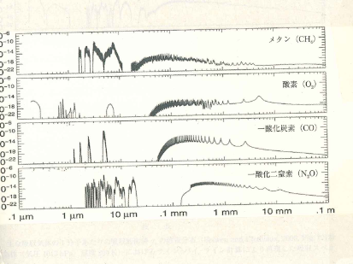
Why is this relevant to the probability of Rayleigh scattering ?
No absorption !
Bohren and Clothiaux(2006)

Slide 11

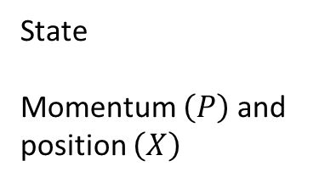

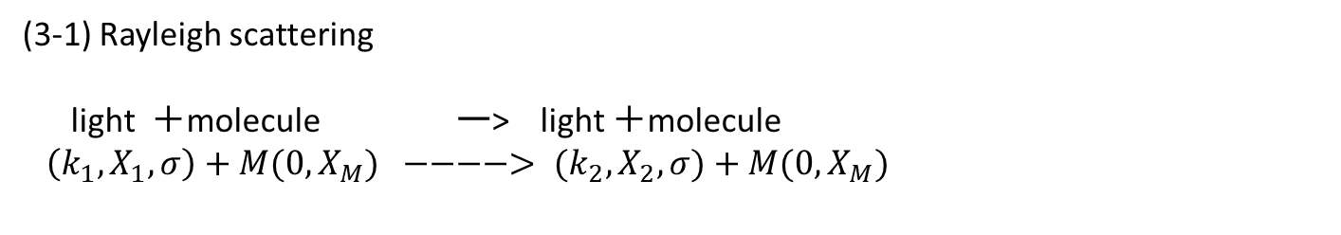

(3-1) Rayleigh scattering
light ＋molecule ー> light ＋molecule
$（k_{1},X_{1}, σ）+M(0, X_{M}) −−−−> (k_{2},X_{2}, σ)+M(0,X_{M})$
$\left|0, X_{M},T_{2}\right\rangle$
$$\left|K_{2}, X_{2},T_{2}, σ\right\rangle$$
State
Momentum $\left(P\right)$ and position $\left(X\right)$
$$|0, X_{M},T_{1}⟩$$
$$|K_{1}, X_{1},T_{1}, σ⟩$$

Slide 12
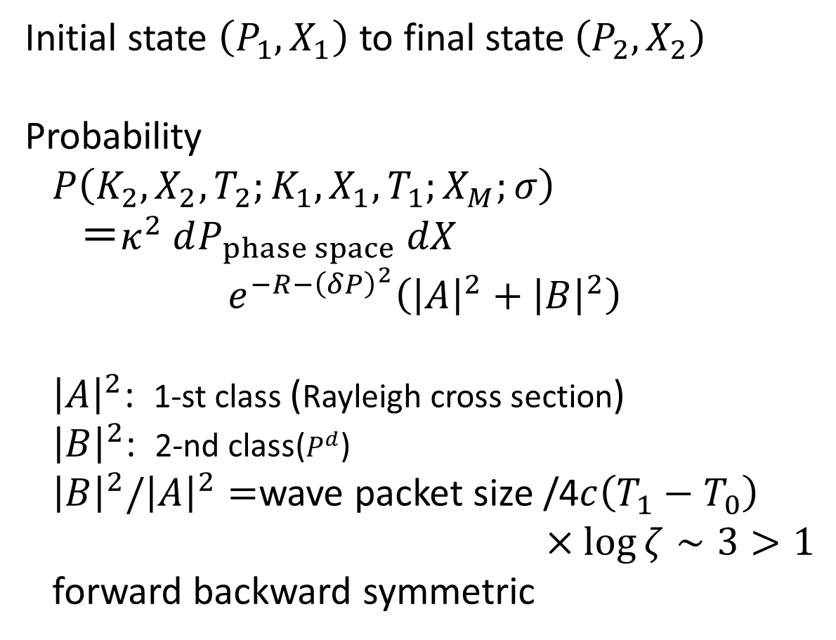
Initial state $（P_{1},X_{1}）$ to final state$\left(P_{2},X_{2}\right)$
Probability
$P\left(K_{2},X_{2},T_{2};K_{1},X_{1},T_{1};X_{M};σ\right)$
$＝κ^{2} dP_{phase space} dX$
$$e^{−R−{\left(δP\right)}^{2}}\left({\left|A\right|}^{2}+{\left|B\right|}^{2}\right)$$
${\left|A\right|}^{2}$: 1-st class (Rayleigh cross section)
${\left|B\right|}^{2}$: 2-nd class($P^{d}$)
${\left|B\right|}^{2}/{\left|A\right|}^{2}=$wave packet size /4$c\left(T_{1}−T_{0}\right)$
$×\log{ζ}∼3>1$
forward backward symmetric

Slide 13
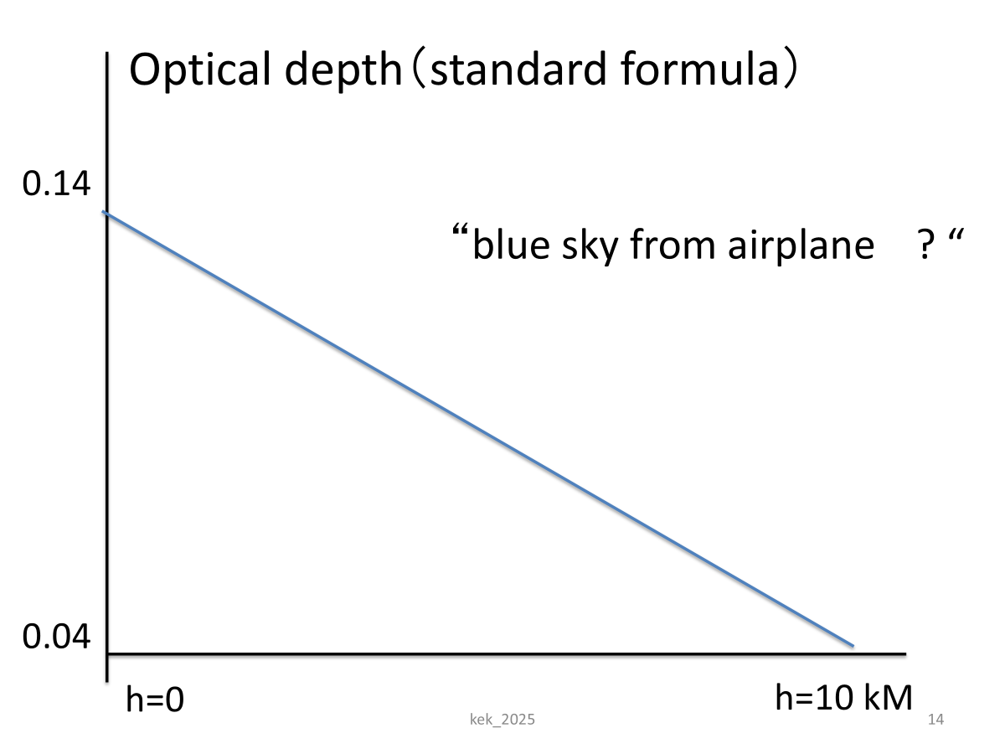
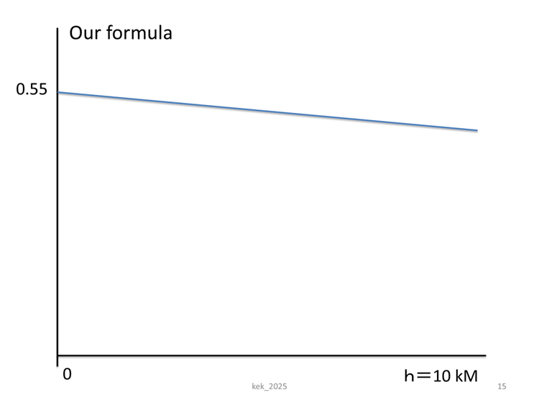
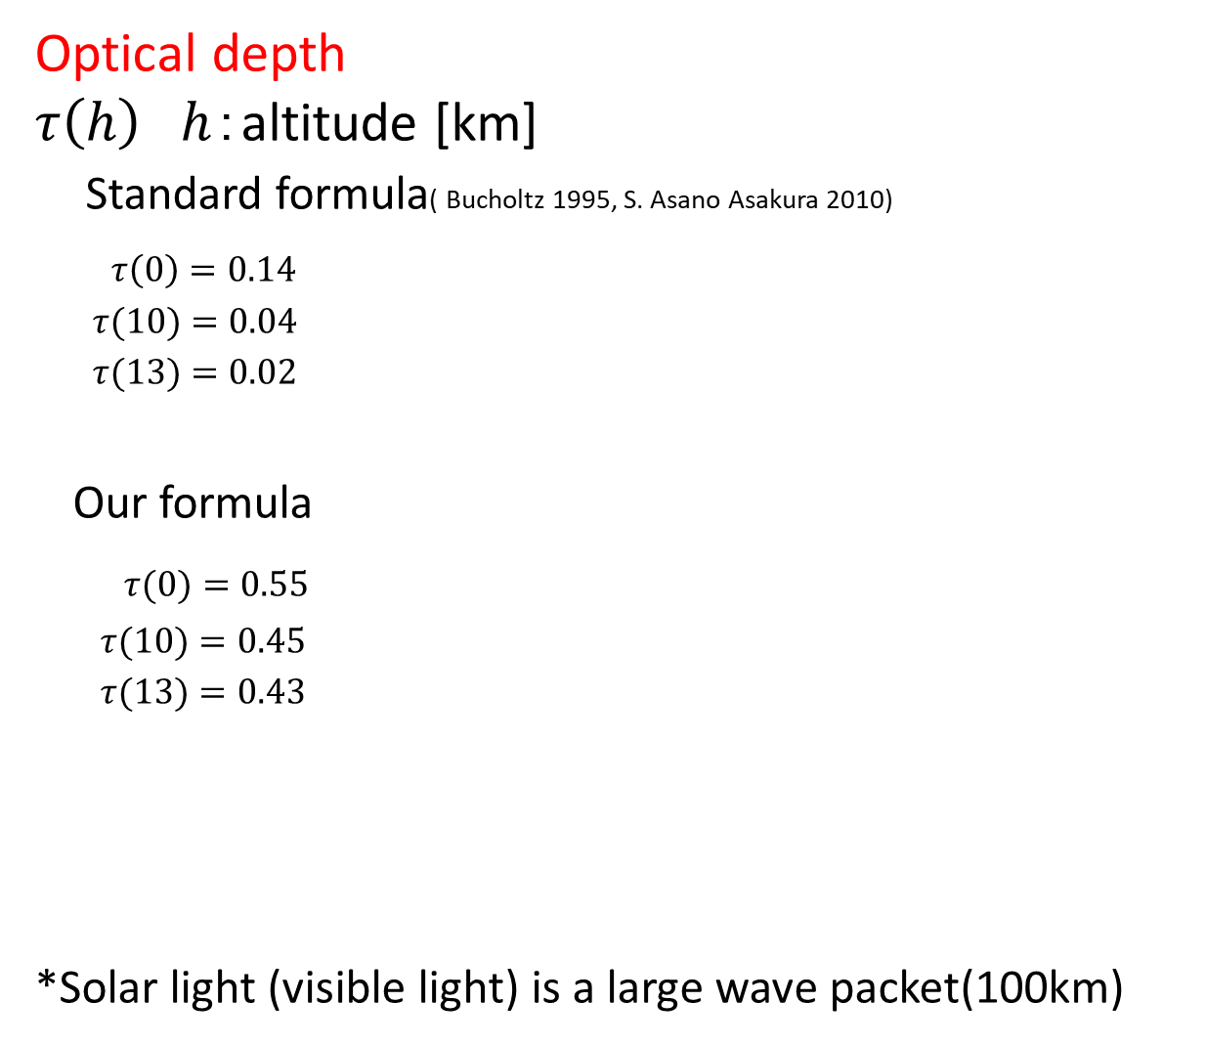
Optical depth
$τ\left(h\right)$ $h$：altitude [km]
Standard formula( Bucholtz 1995, S. Asano Asakura 2010)
$τ\left(0\right)=0.14$
$τ(10)=0.04$
$τ(13)=0.02$
Our formula
$τ(0)=0.55$
$τ(10)=0.45$
$τ(13)=0.43$
*Solar light (visible light) is a large wave packet(100km)

Slide 14
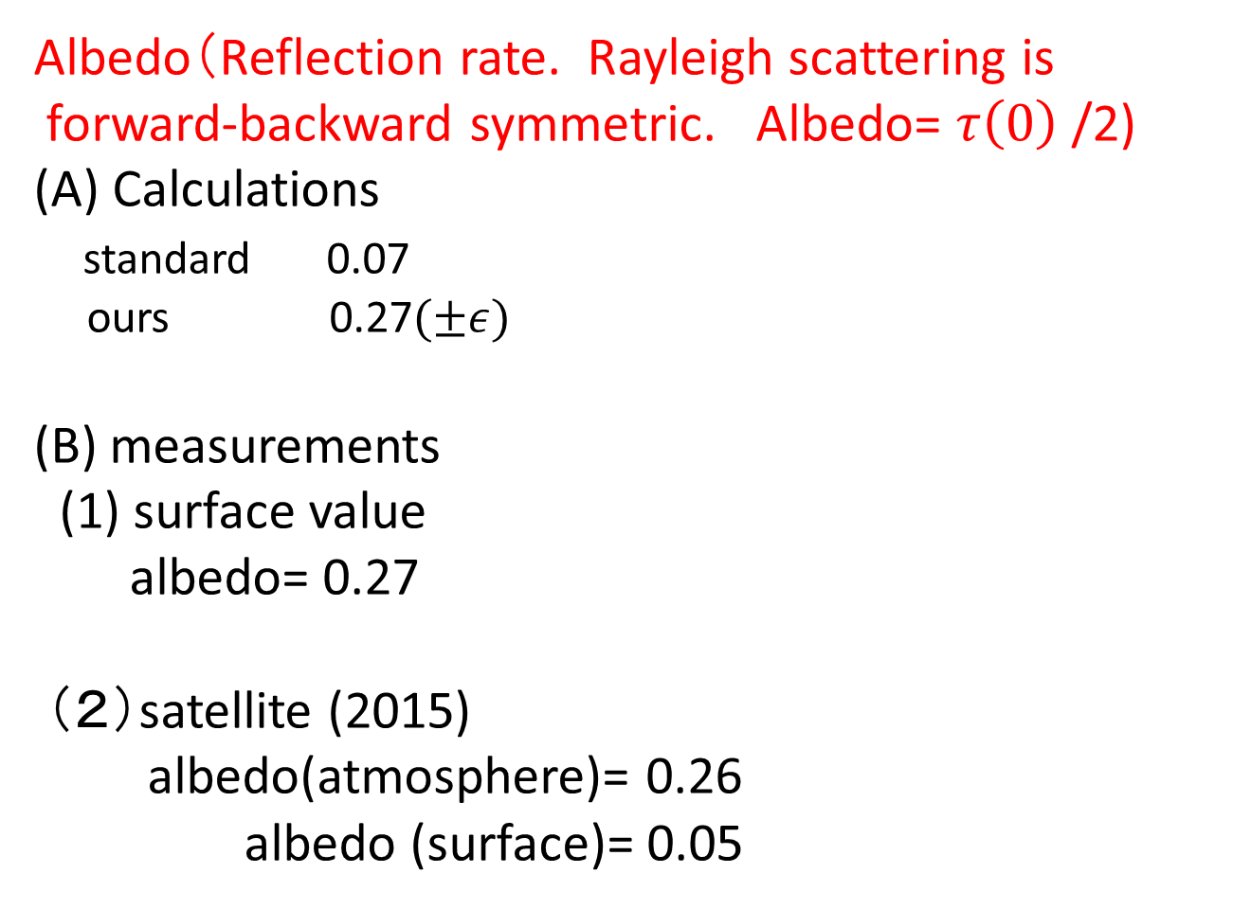
Albedo（Reflection rate. Rayleigh scattering is
forward-backward symmetric. Albedo= $τ\left(0\right)$ /2)
(A) Calculations
standard 0.07
ours 0.27$(±ε)$
(B) measurements
(1) surface value
albedo= 0.27
（２）satellite (2015)
albedo(atmosphere)= 0.26
albedo (surface)= 0.05

Slide 15
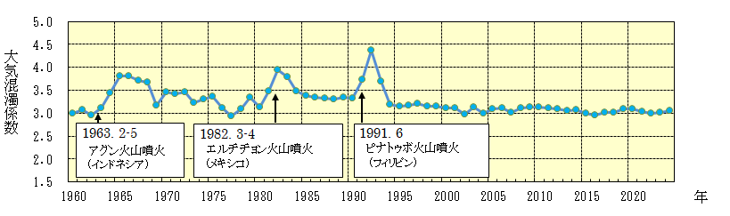

Atmospheric turbidity coefficient
(Japan Meteorological Agency, 2025.3.28)
Our theory
$$\frac{{\left|B\right|}^{2}}{{\left|A\right|}^{2}}=3$$

Slide 16
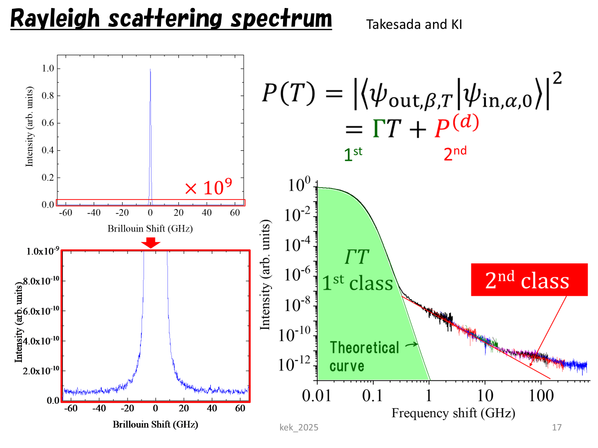
Second class transition in laboratory experiment
Rayleigh scattering with nano particle (M.Takesada-KI)

Slide 17
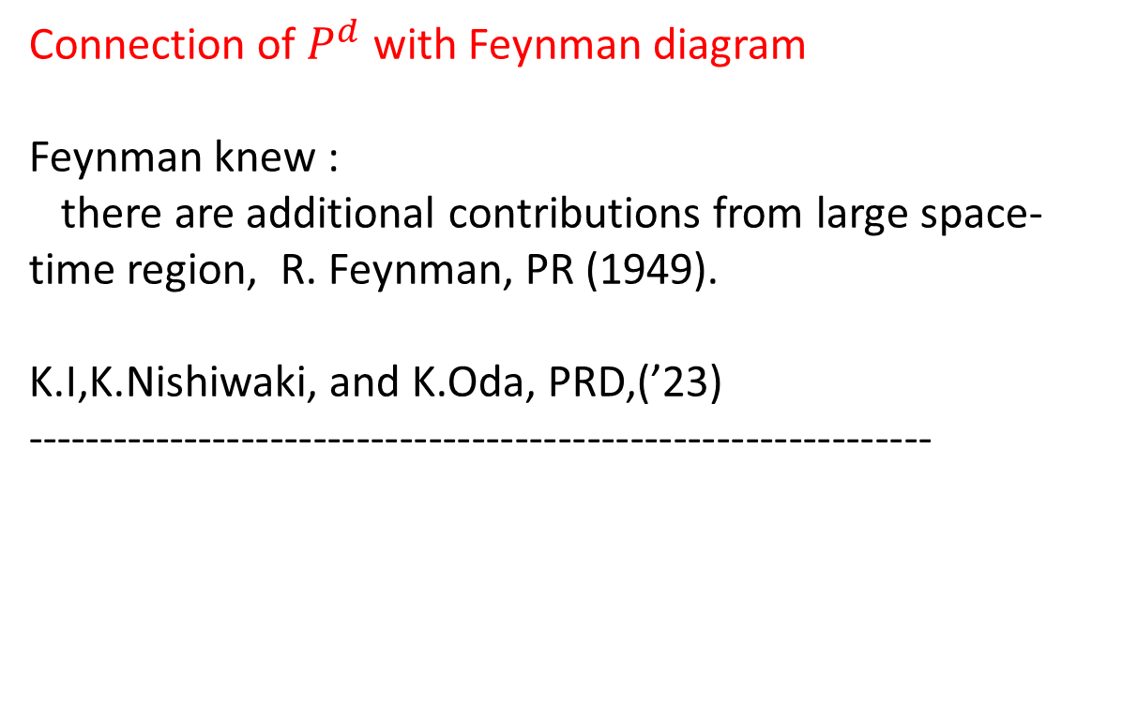
Connection of $P^{d}$ with Feynman diagram
Feynman knew :
there are additional contributions from large space-time region, R. Feynman, PR (1949).
K.I,K.Nishiwaki, and K.Oda, PRD,(’23)
---------------------------------------------------------------
Sky
Laboratory

Slide 18
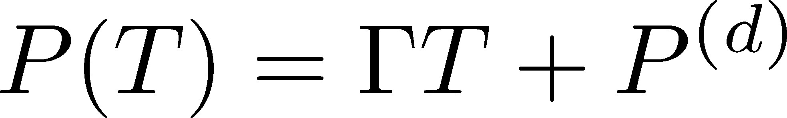
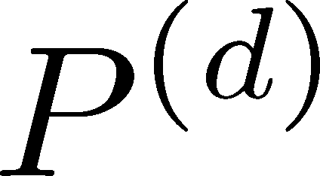
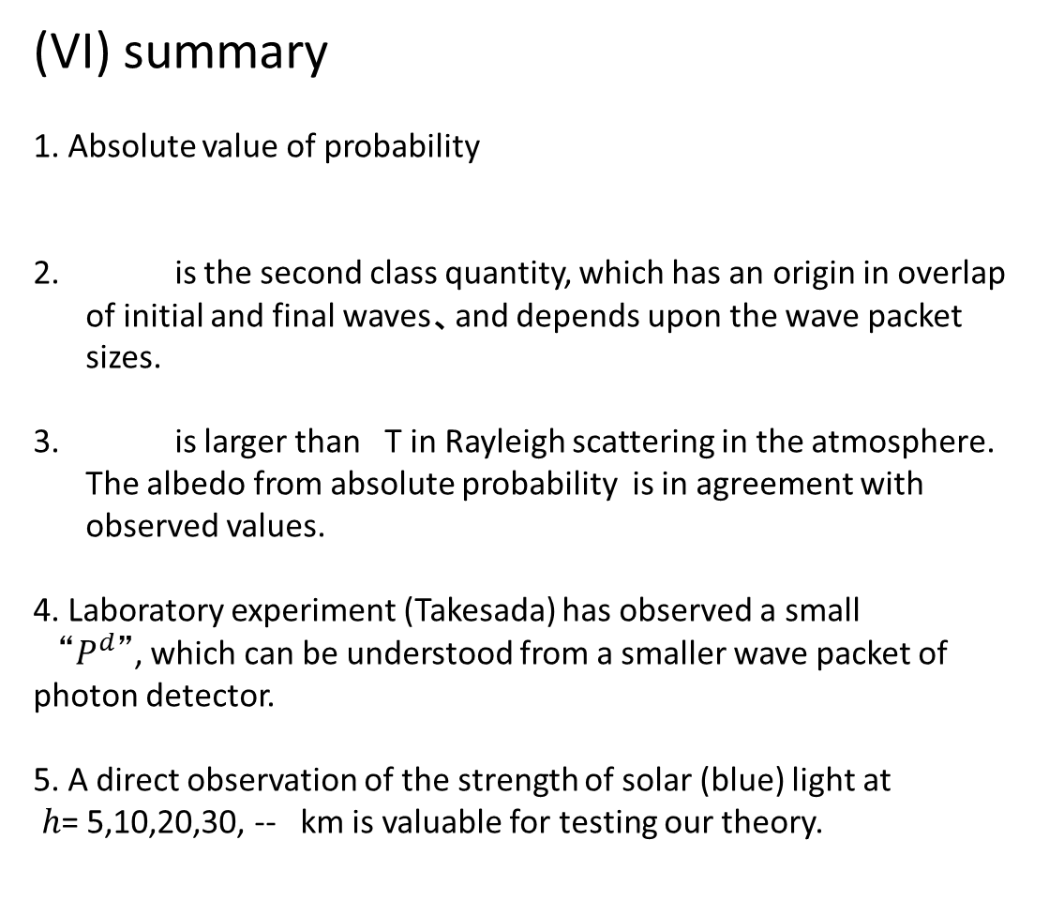

(VI) summary
1. Absolute value of probability
is the second class quantity, which has an origin in overlap of initial and final waves、and depends upon the wave packet sizes.
is larger than T in Rayleigh scattering in the atmosphere. The albedo from absolute probability is in agreement with observed values.
4. Laboratory experiment (Takesada) has observed a small
“$P^{d}$”, which can be understood from a smaller wave packet of photon detector.
5. A direct observation of the strength of solar (blue) light at
$h$= 5,10,20,30, -- km is valuable for testing our theory.
$$Г$$

Slide 19

Energy conversion at Solar corona：Inverted mass hierarchy
$$ν→ ν’+γ$$
Ishikawa-Tobita,
Ishikawa-Tobita

Slide 20
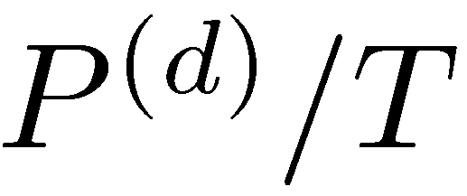
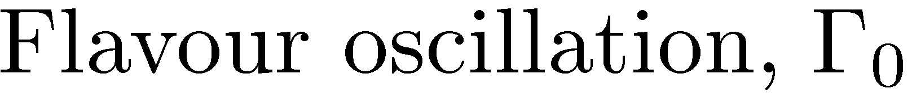
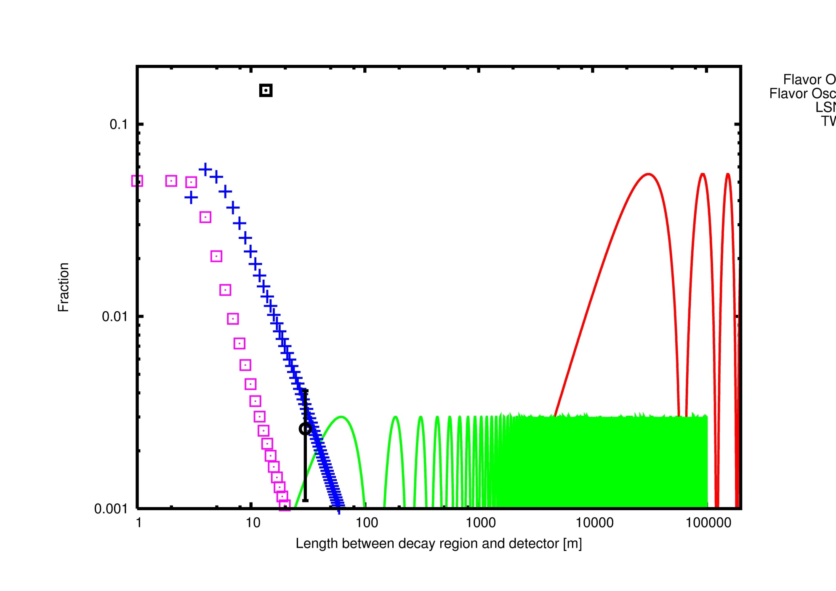

$ν_{e}$ in pion decay, $π → e+ν_{e}$
Ishikawa-Tobita,(2014)

Slide 21
Comments:
On Wave packet parameters.
1. Which equation does the wave packet satisfy ?
Free equation for scattering of isolate states.
KI, Annals of Physics, (2024); KI and Y. Nishio. Annals of Physics ,(2024)
2. Shape and size of wave packet?
Size of wave packet :
Mean free path for continuum states.
Size of wave function for bound states.
KI and O.Jinnouchi, in preparation

