Slide 1
Direct dark matter detection with liquid gas experiments
Muping Chen (QUP-KEK) QUP Workshop 04/09/2025
Based on Chen, Gelmini, and Takhistov, JCAP 12 (2021) 12, 048 [2105.08101] and Bozorgnia, Chen, Gelmini, Kamaha, and Xu, Accepted by JCAP [2408.13664]

Slide 2
Direct detection with liquid gas(Xe, Ar)
Current liquid gas experiments also detect dark matter(DM)-electron interaction

Slide 3
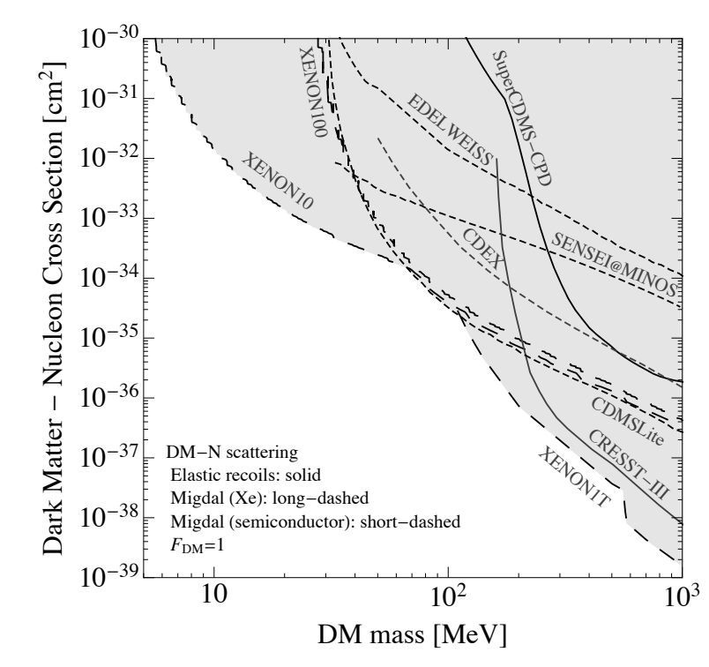
Conventional analysis
Assumed halo function
Given interaction model
Results shown in plane
Understanding implications for a particular model
Model-dependent comparisons of different results
Snowmass 2021 [2203.08297]

Slide 4
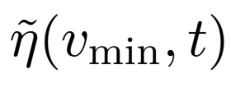
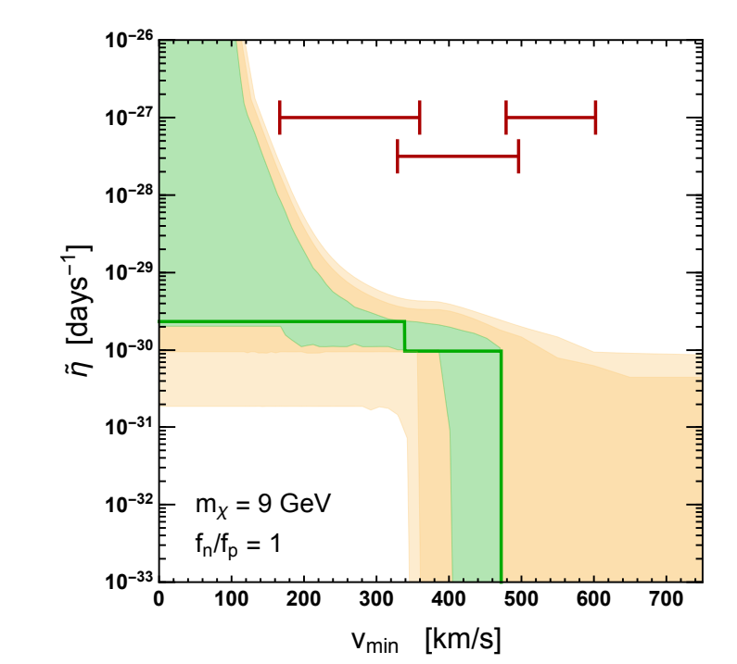
Halo-indepedent method
First developed by Fox, Liu and Weiner
Fox, Liu and Weiner, PRD 83, 103514 (2011), [1011.1915]
Reducing Astrophysical uncertainty
Compare two results in a astrophysics-independent manner
Infer local DM halo velocity distribution
Formalism for calculating developed by Gelmini et al.Gelmini et al, JCAP 12 (2017) 039 [1707.07019]

Slide 5
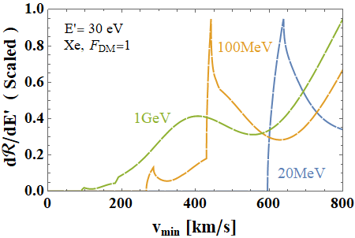
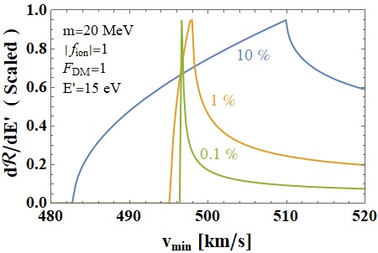
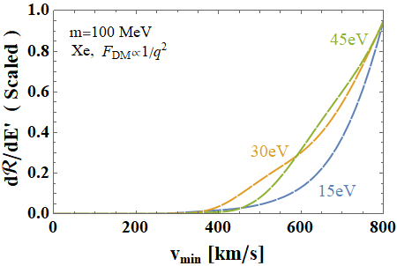
New DM-electron scattering Analysis
Graphs are rescaled, the maximum is 1.
“Window”: $v_{min}$ range in which the reponse function is significantly different from 0.
Direct detection data can give information on the local dark halo within the window.
Chen, Gelmini, and Takhistov, JCAP 12 (2021) 12, 048 [2105.08101]

Slide 6
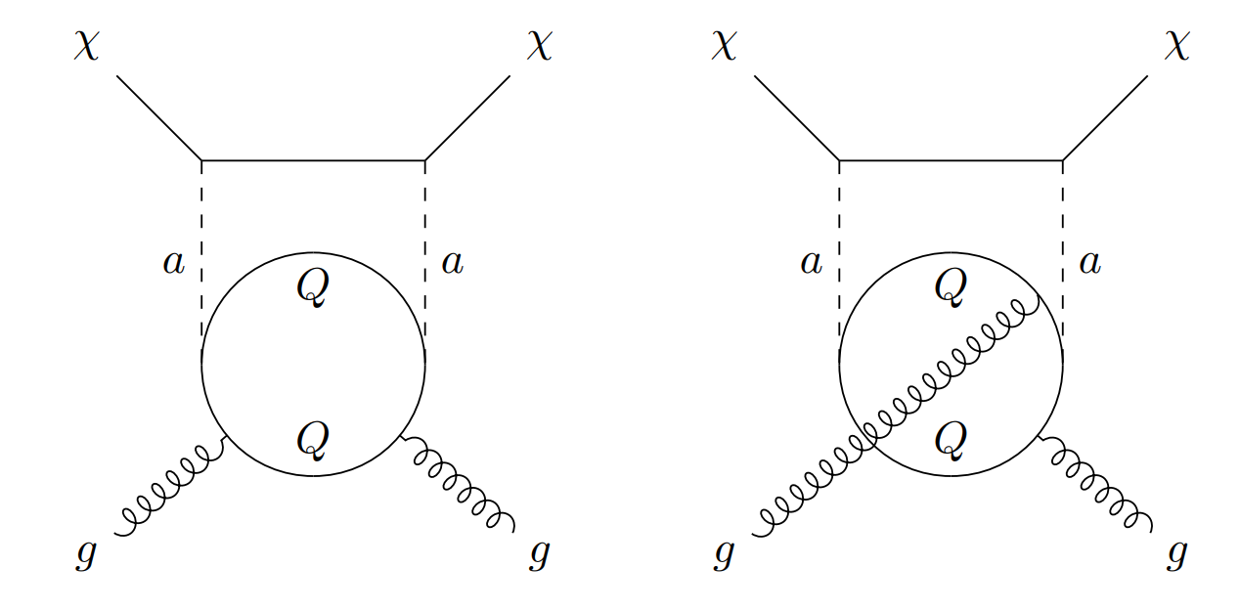
Loop-level Correction
Compare Xe and Ar detection capability due to a pseudoscalar mediator
Loop-level correction must be included
Xe: Nonzero nuclear spin, tree-level + loop-level
Ar: Zero nuclear spin, loop-level only
Ertas and Kahlhoefer, JHEP 06 (2019) 052, [1902.11070]

Slide 7
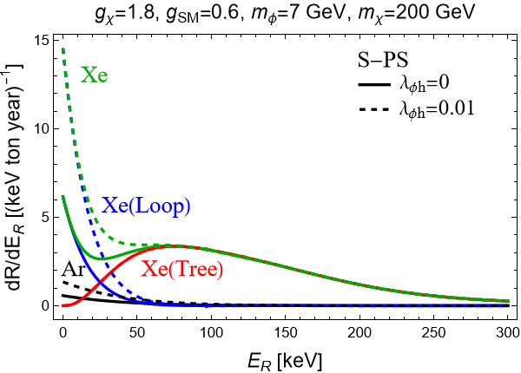
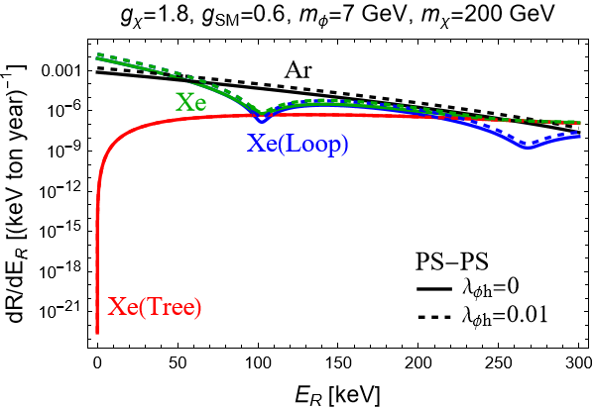
Differential rate comparison
Bozorgnia, Chen, Gelmini, Kamaha, and Xu, Accepted by JCAP [2408.13664]

Slide 8
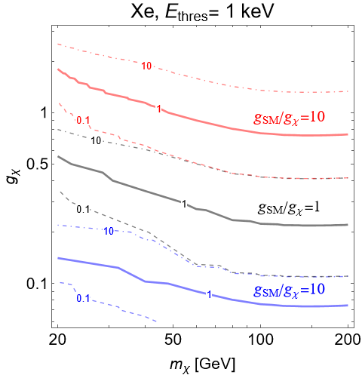
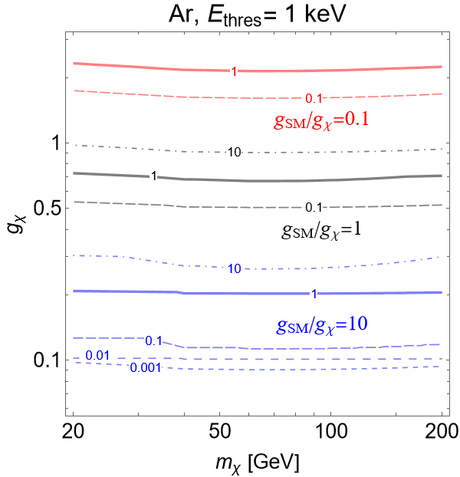
Events comparison
Bozorgnia, Chen, Gelmini, Kamaha, and Xu, Accepted by JCAP [2408.13664]

Slide 9
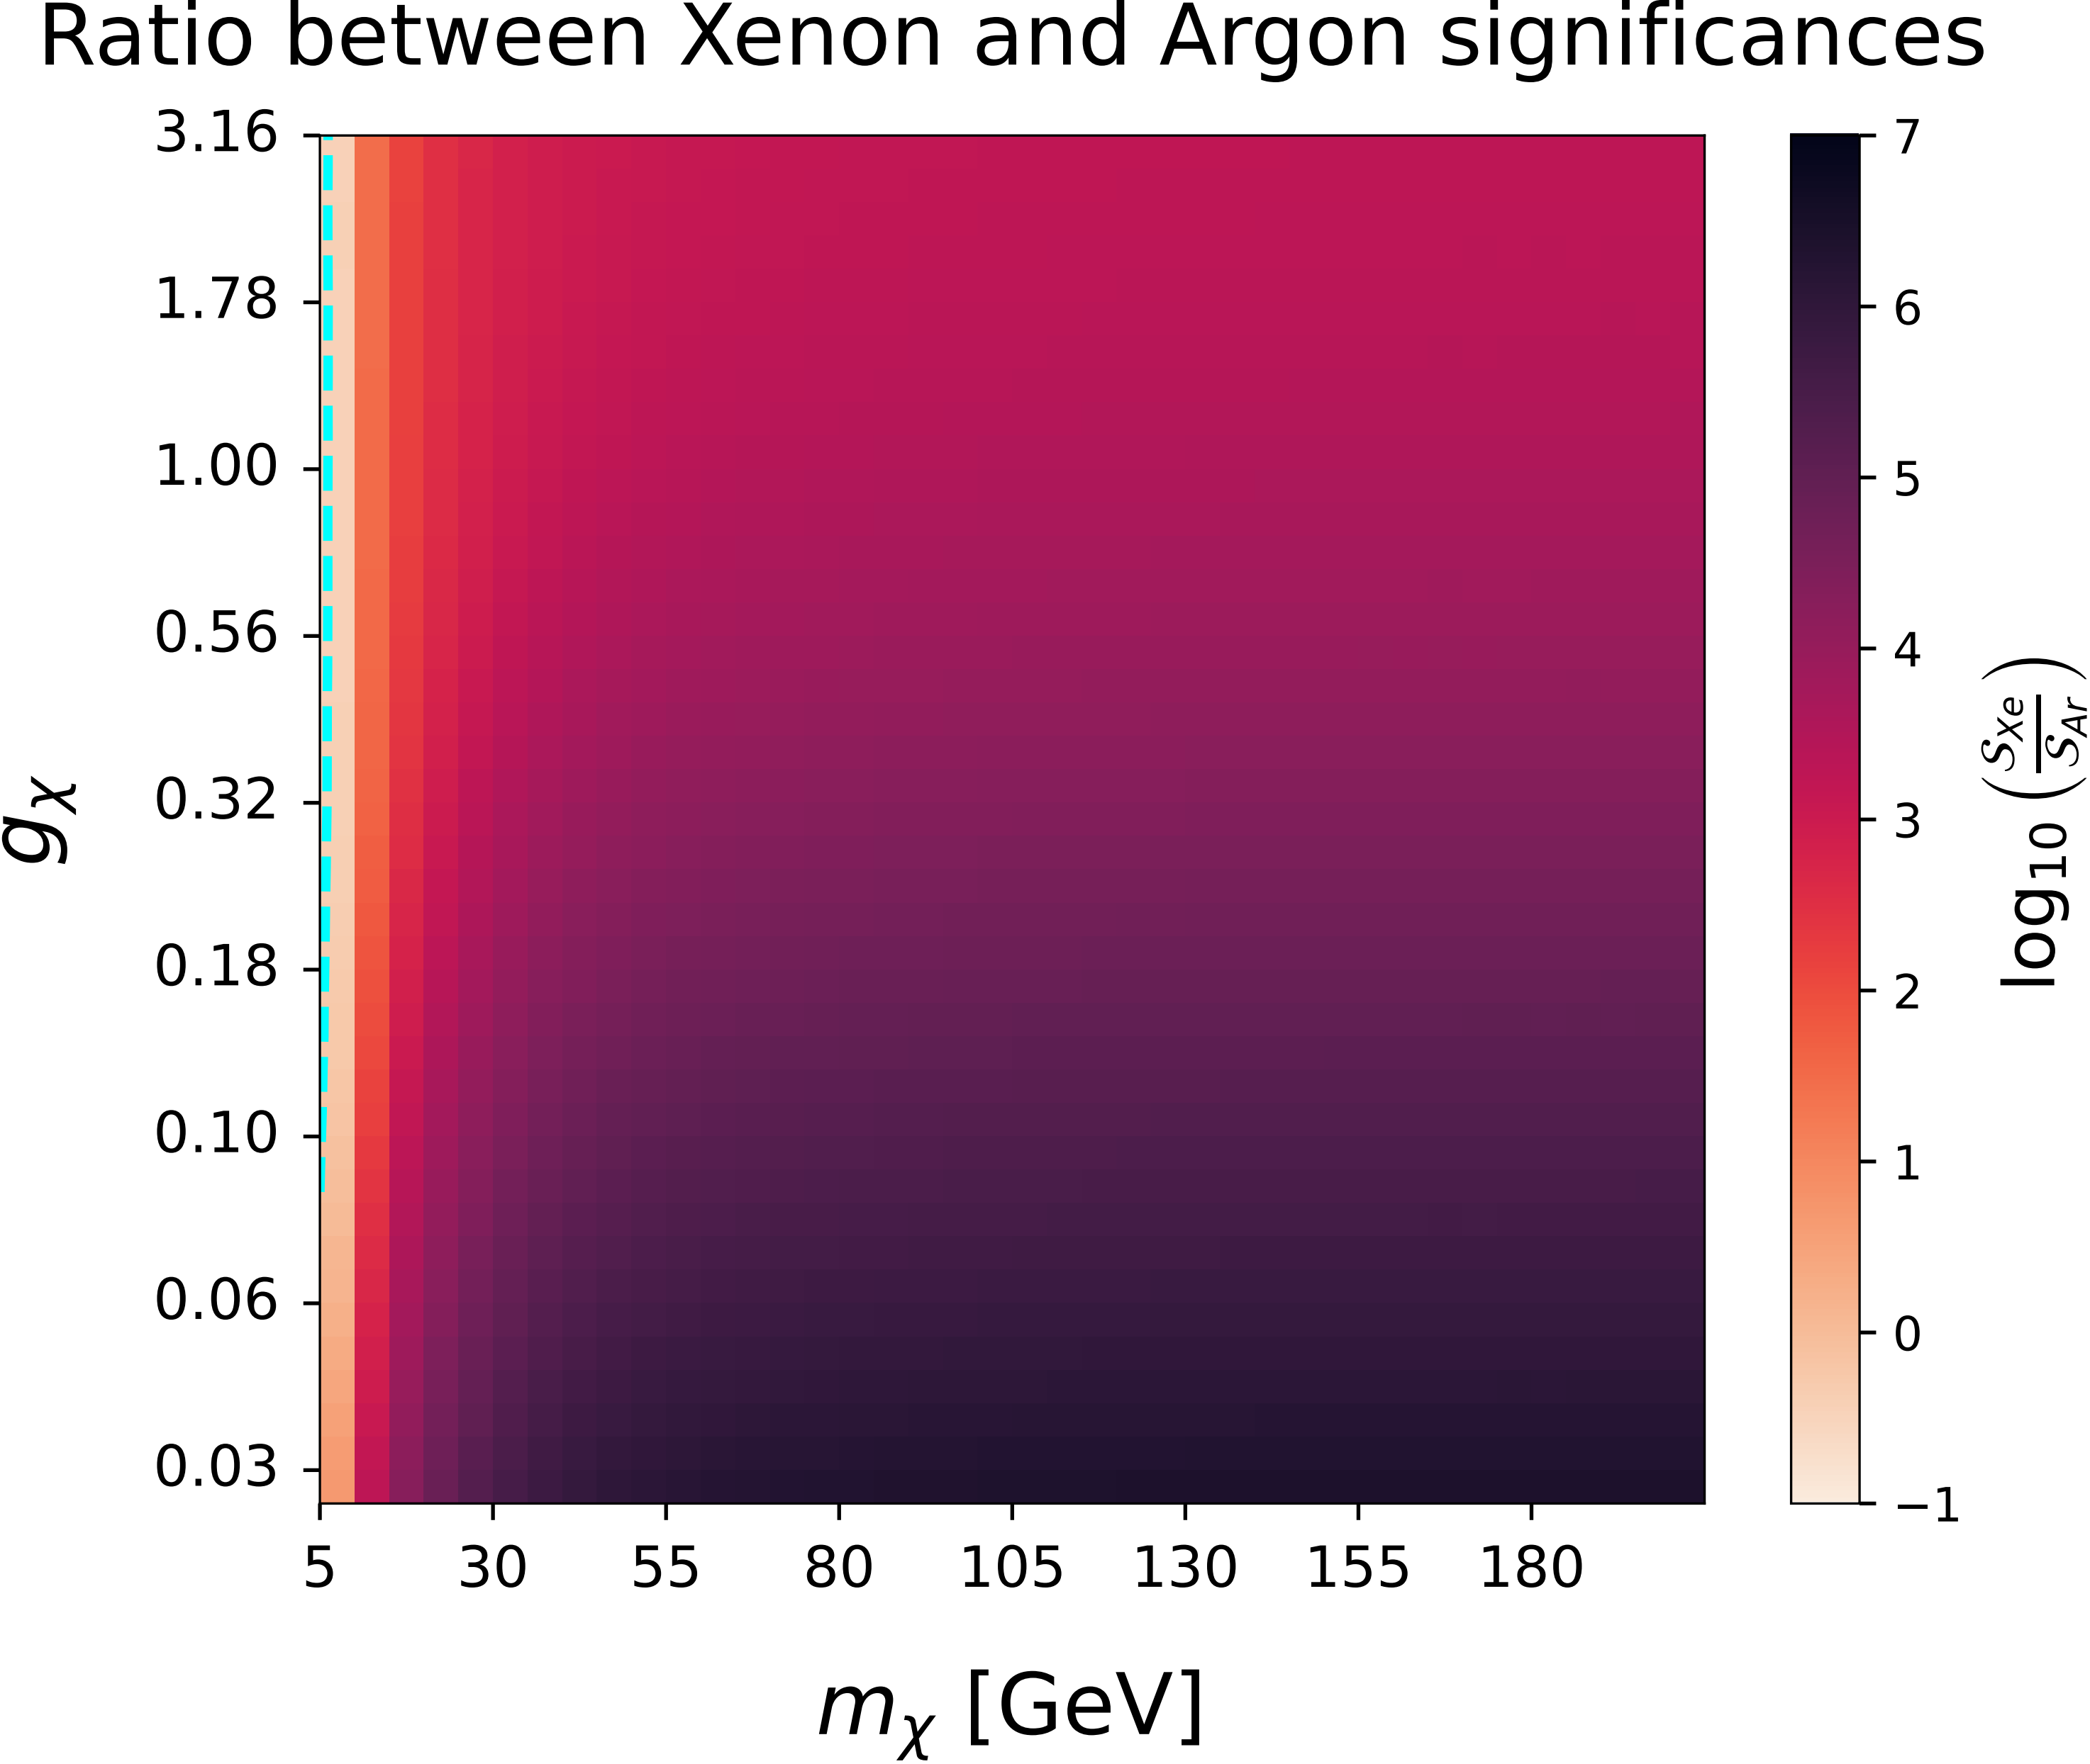
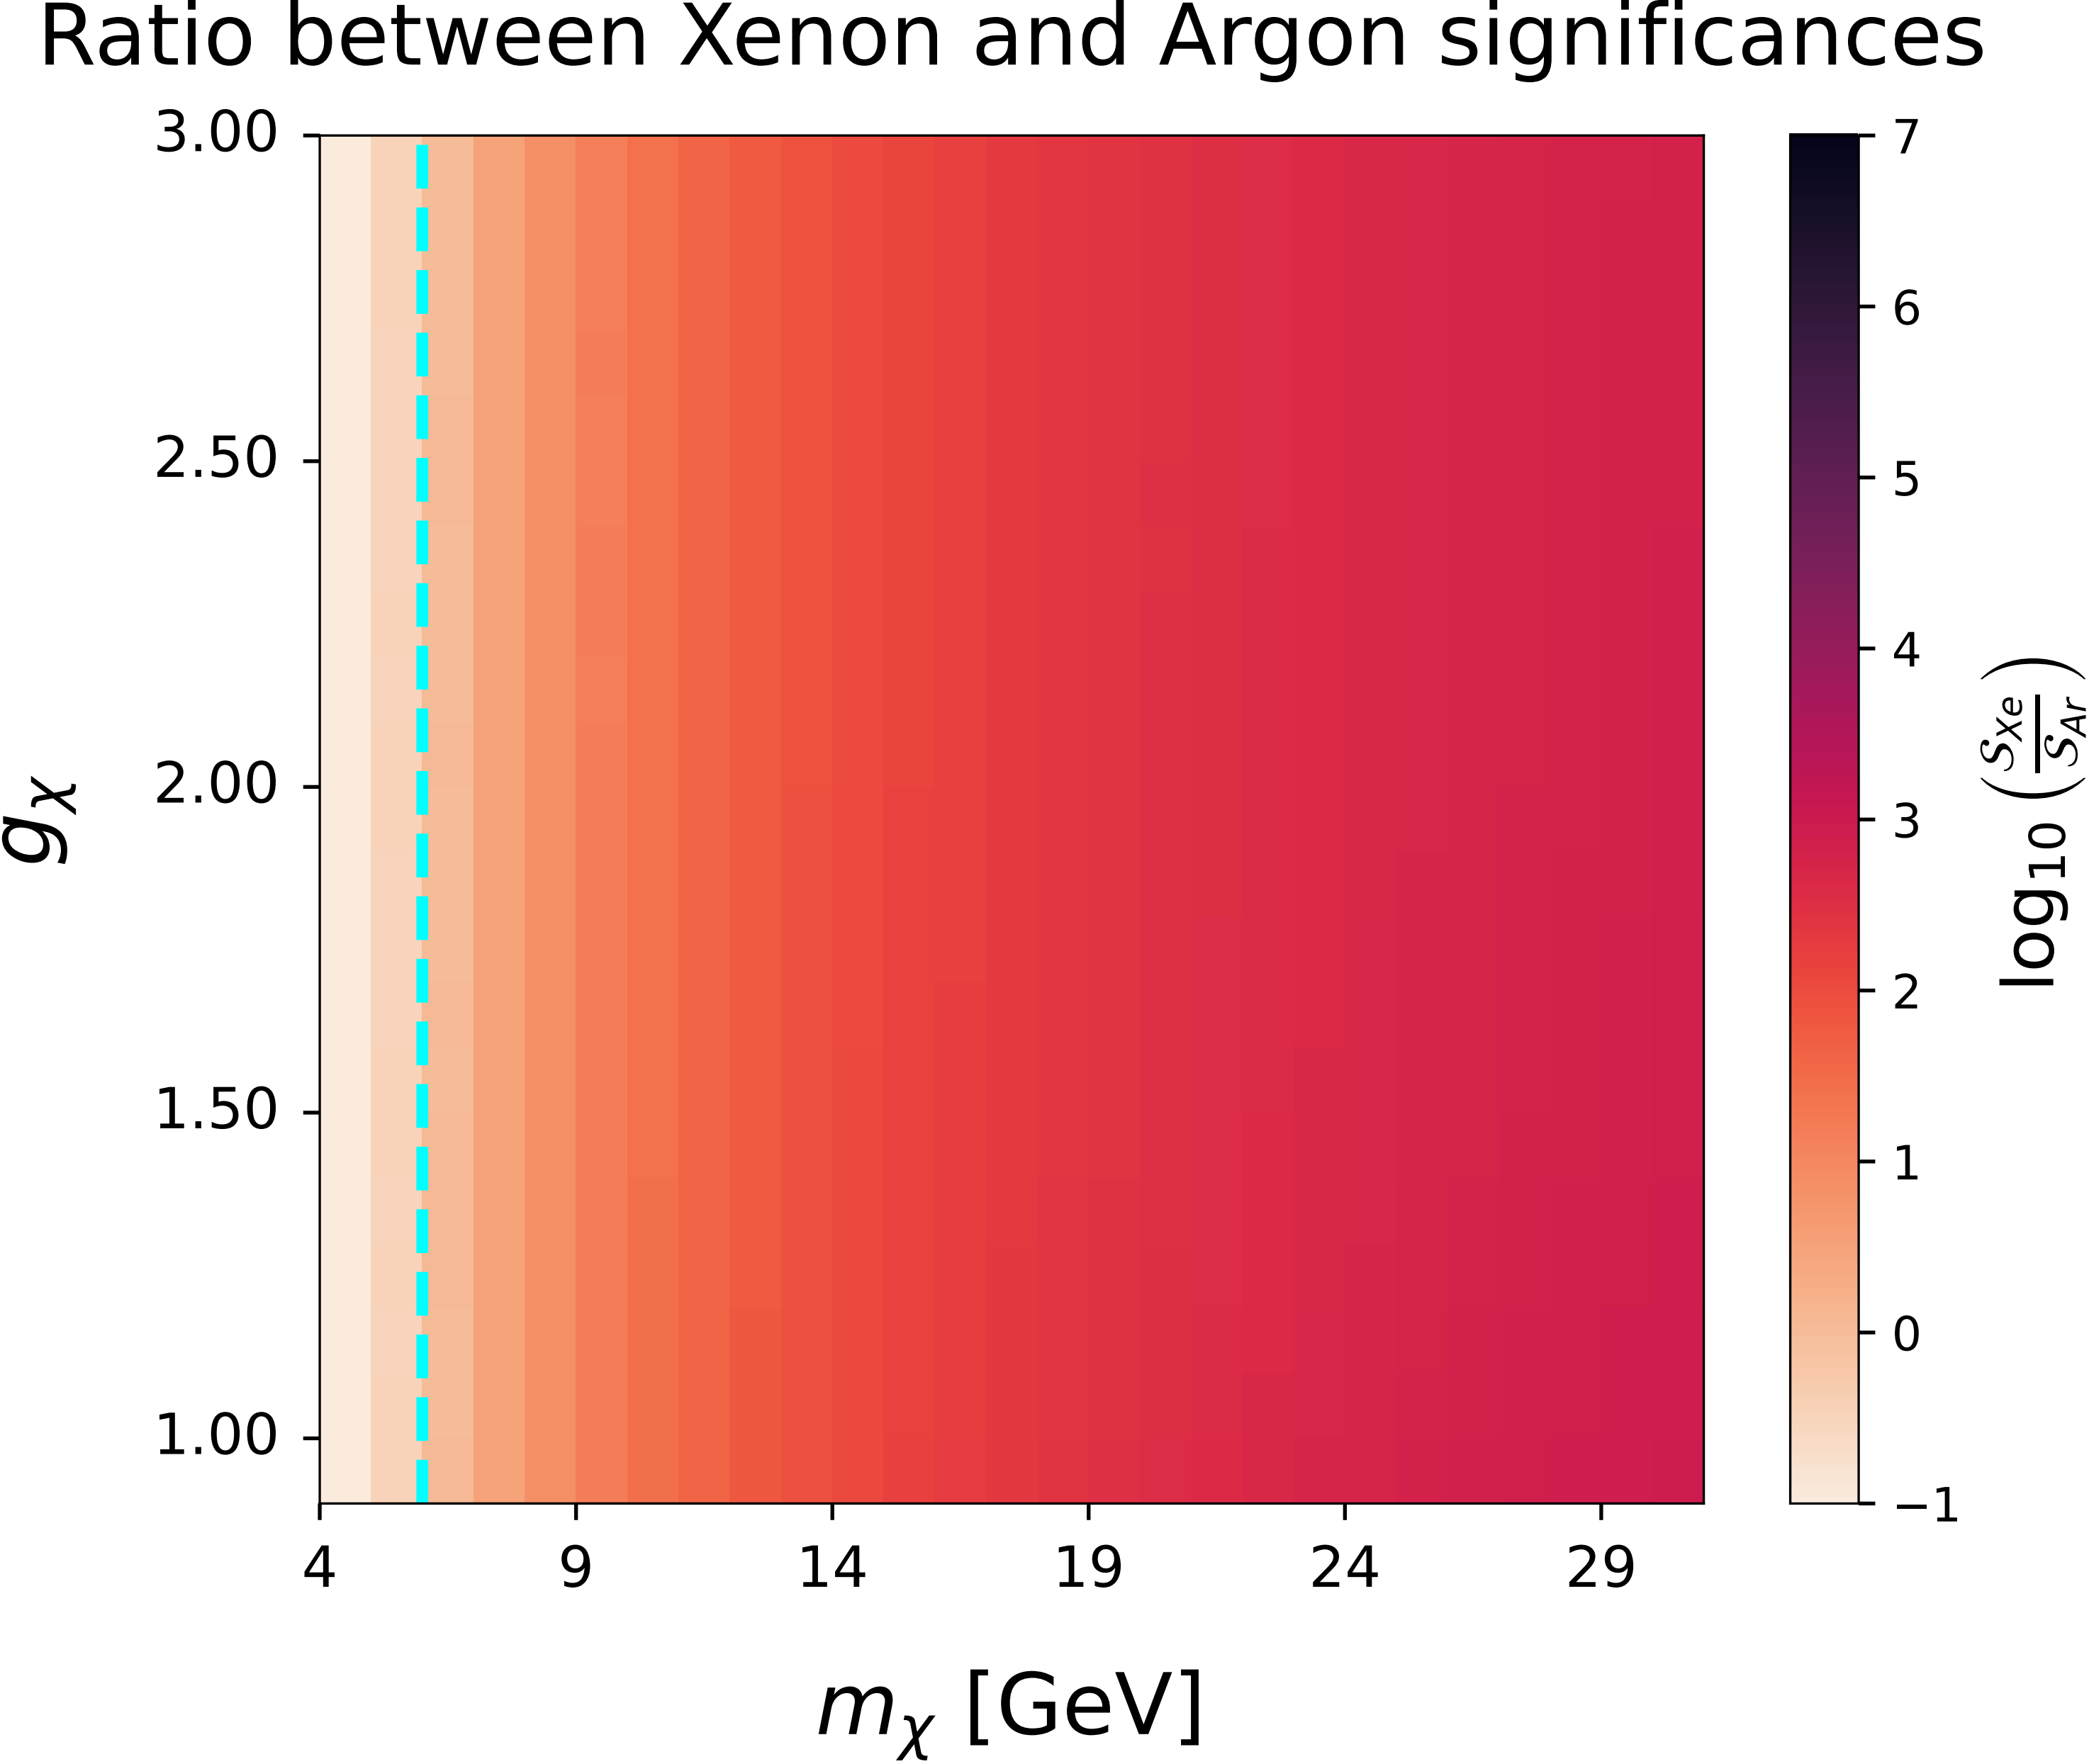
Significance comparison
DarkSide-LowMass (DS-LSM) and LUX-ZEPLIN (LZ)
DS-M: P. Agnes et al.,Phys.Rev.D 107 (2023) 11, 112006 [2209.01177] LZ: B. J. Mount et al., [1703.09144]
Bozorgnia, Chen, Gelmini, Kamaha, and Xu, Accepted by JCAP [2408.13664]

Slide 10
Summary
Halo-indepedent analysis can infer local DM halo properties and compare experimental results, free of astrophysical uncertainties.
Response function acts as a window through which direct detection data can give information on the local dark halo. Different experiments sensitive to partially overlapping velocity ranges would be needed to enable a more detailed inference of the DM distribution.
At loop-level there are spin-indepedent terms that can be detected by Ar.
Ar-based DS-LM experiment generally requires larger exposure to reach a sensitivity similar to that of the Xe-based LZ experiment. Only for a small region of parameter space ($m_{χ}\sim \text{GeV}$, $g_{χ}\sim \text{1}\text{−}\text{3}$) in which the Ar-based experiment is favored and can reach a sensitivity which is $\sim 10$ times better than the Xe-based experiment.

Slide 11
Thank you for listening

