Slide 1
J-PARC tour
Meeting place and time
The meeting place for the J-PARC tour is different from this venue.
The bus stops just a minute's walk straight ahead from the "Akamon" gate.
Please gather by around 8:50 AM.
We will depart at 9:00 AM sharp.
The bus is non-stop to J-PARC for a 2.5-hour drive. Please use the restroom before boarding.
Items to bring
Foreign visitors, please remember to bring your passport.
日本人の参加者の方は運転免許証やマイナンバーカードなど、顔写真付きのIDをご持参ください。
センター員はJ-PARCカードと放射線のバッチを忘れずに
Lunch
Lunch boxes are prepared for you in J-PARC.

Slide 2
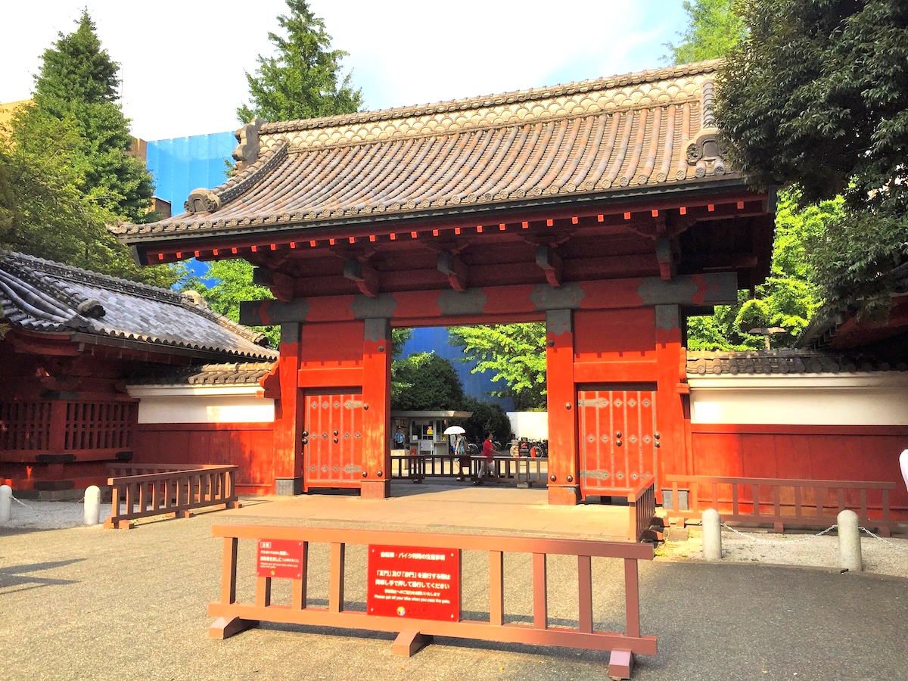
“Akamon” gate
Meeting place @8:50
Workshop venue

Slide 3
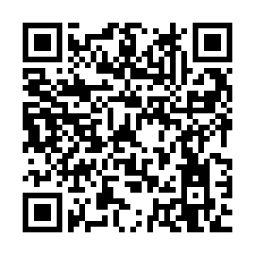

Slide 4
Group A (MLF -> Hadron)
Group B (Hadron H -> MLF)
Klauser, Christine
OGUNWALE MUSILIUDEEN ADEWALE
Maxime Lamotte
Rauber Thomas
Sanchez-Real Zielniewicz, Luz
RITT, Stefan
Heiss, Michael
Briki Issa
Janka Gianluca
von Schoeler, Katharina Susanne Eveline
Pranas Juknevicius
Kara, Oğuzhan
Lewis, Edison, Xavier
Xiao Zhao
Isenring Pascal
HUME, Timothy, David
Segner Lea
Daniel Laube
Kiselev, Daniela, Candida
Sanz-Becerra,Diego,Alejandro
Pires, Victor
Knecht, Andreas
Bartkowiak, Marek
Kirch, Klaus, Stefan
Adelmann Andreas
Filges, Jürgen Uwe
Sobbia, Raffaello
Kawamura Naritoshi
Makimura Shunsuke
MIBE Tsutomu
Yamada Masako
Onoi Masahiro
Kawagoe Hirotaka
Yamamura Shunki
Ueno Kaoru
高野 洋一
Snuverink, Jochem

