Slide 1
Short-range and tensor correlations in light
nuclei studied with antisymmetrized
molecular dynamics (TOAMD)
Mengjiao LYU (RCNP)
Masahiro ISAKA (Hosei)
Hiroshi TOKI (RCNP)
Hisashi HORIUCHI (RCNP)
Kiyomi IKEDA (RIKEN) Tadahiro SUHARA (Matsue)
Taiichi YAMADA (Kanto Gakuin)
Takayuki MYO
QNP2018 2018.11, Tsukuba

Slide 2
Outline
Variational methods for finite nuclei with bare force
Tensor-Optimized Antisymmetrized Molecular Dynamics (TOAMD)
$Φ_{TOAMD}=(1+F+F^{2}+⋯)×Φ_{AMD}$
Variational correlation function $F=\sum_{i<j}{f_{ij}}$
Power series expansion using $F$
High-Momentum AMD (HM-AMD)
High-momentum nucleon pairs as 2p-2h excitations
Combine TOAMD & HM-AMD
F

Slide 3
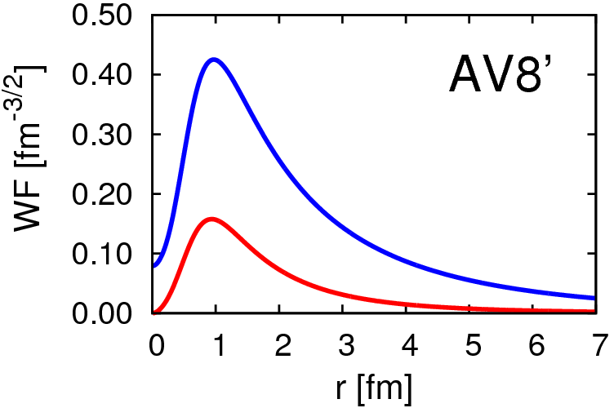
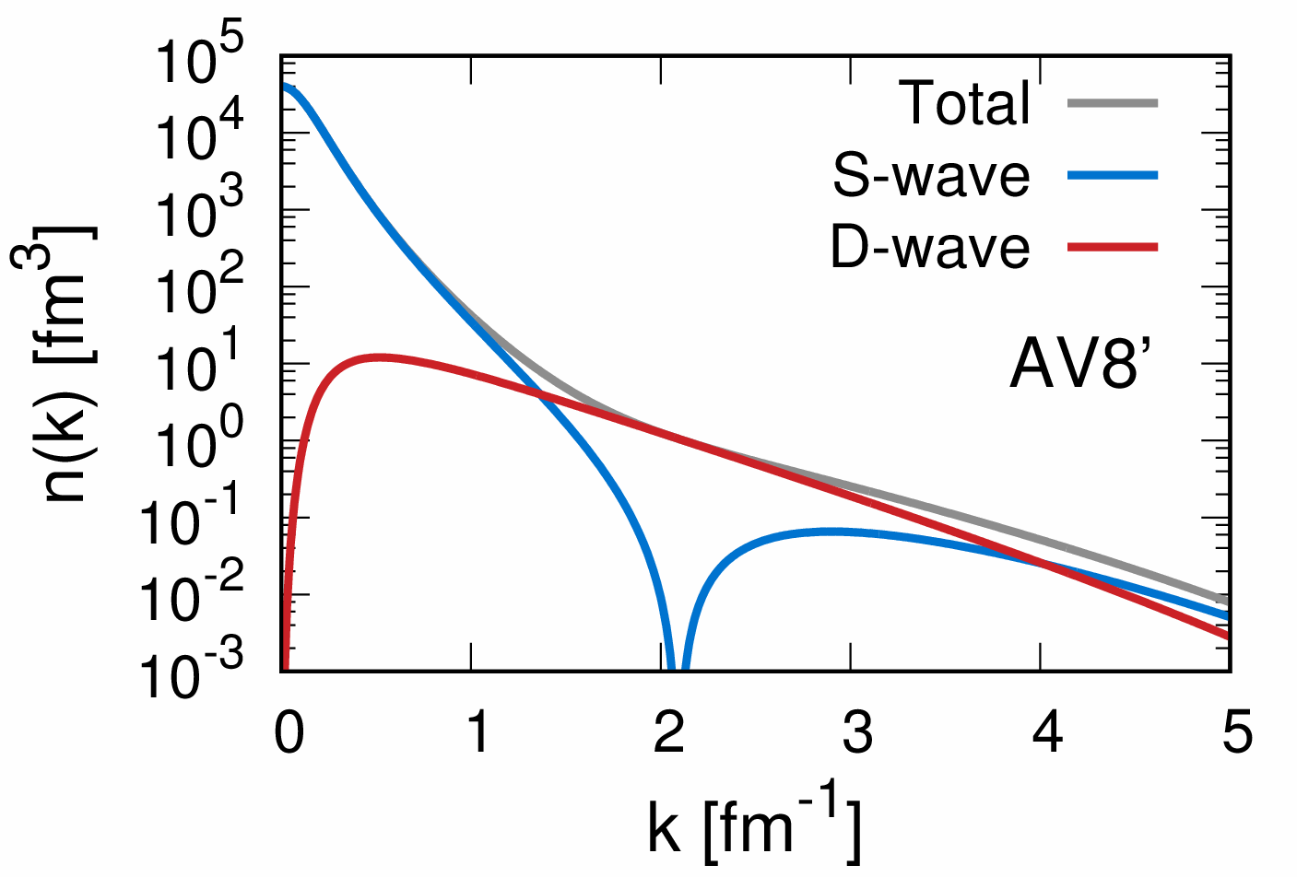
Deuteron properties & tensor force
S
Energy | -2.24 MeV
Kinetic | 19.88
Central | -4.46
Tensor | -16.64
LS | -1.02
P(L=2) | 5.77%
Radius | 1.96 fm
S 11.31
D 8.57
$$Φ(r)$$
D
SD -18.93
DD 2.29
r [fm]
S
S 2.00
D 1.22
$$\tilde{Φ}(k)$$
D
d-wave is
“spatially compact”
(high-momentum)

Slide 4
Tensor-optimized antisymmetrized molecular dynamics in nuclear physics (TOAMD)
Prog. Theor. Exp. Phys. 2015, 073D02 (38 pages)
DOI: 10.1093/ptep/ptv087
Takayuki Myo, Hiroshi Toki, Kiyomi Ikeda, Hisashi Horiuchi, and Tadahiro Suhara
Describe finite nuclei using V_{NN} , in particular, for clustering
Multiply pair-type correlation function $"F=\sum_{i<j}^{A}{f_{ij}}"$ to AMD w.f.
$F_{D}$ for D-wave transition with S₁₂ from tensor force
$F_{S}$ for Short-range repulsion in central force
A. Sugie, P. E. Hodgson and H. H. Robertson, Proc. Phys. Soc. 70A (1957) 1
S. Nagata, T. Sasakawa, T. Sawada, R. Tamagaki, PTP22 (1959) 274

Slide 5
General formulation of TOAMD
$$|\left.Φ_{TOAMD}\right\rangle =\left(1{+F}_{D}+F_{S}+F_{D}F_{S}+F_{S}F_{S}+F_{D}F_{D}+⋯\right)|\left.Φ_{AMD}\right\rangle$$
tensor
short-range
Power series expansion, but, all F are independent
tensor × short-range
Variational principle
$δE=0$ for $E=\frac{\left\langle Φ_{TOAMD} | H | Φ_{TOAMD}\right\rangle }{\left\langle Φ_{TOAMD} | Φ_{TOAMD}\right\rangle }$
Variational parameters
AMD : ν, Z_{i} (i=1,…, A)
$F_{D} :S_{12}\sum_{n}^{N_{G}}{C_{n}e^{−a_{n}{(r_{i}−r_{j})}^{2}}}$
$F_{S} : \sum_{n}^{N_{G}}{C_{n}^{′}e^{−a_{n}^{′}{(r_{i}−r_{j})}^{2}}}$
$$|\left.Φ_{AMD}\right\rangle =det\left\{φ_{1}⋯φ_{A}\right\}$$
nucleon w.f.
$$φ_{Z}(r)∝e^{−ν{(r−Z)}^{2}}χ_{σ}χ_{τ}$$
Gaussian wave packet
spin-isospin dependent
$\sum_{n}{\left(H_{m,n}−E{ N}_{m,n}\right)C_{n}}=0$
Eigenvalue problem

Slide 6
Matrix elements of correlated operator
Correlated Hamiltonian
$$\frac{\left\langle Φ_{TOAMD}^{} | H | Φ_{TOAMD}^{}\right\rangle }{\left\langle Φ_{TOAMD}^{} | Φ_{TOAMD}^{}\right\rangle }=\frac{\left\langle Φ_{AMD} | H+F^{†}H+HF+F^{†}HF+⋯ | Φ_{AMD}\right\rangle }{\left\langle Φ_{AMD} | 1+F^{†}+F+F^{†}F+⋯ | Φ_{AMD}\right\rangle }$$
Correlated Norm
Classify the connections of F, H into many-body operators using cluster expansion method
3-body
4-body
bra
F†
V
$F^{†}F=${2-body} $+⋯+${4-body}
F
ket
(2-body)²
$$𝒜$$
i j k
$$𝒜$$
i j k l
$F^{†}VF=${2-body} $+⋯+$ {6-body}
Fourier transformation of $F, V$ $$e^{−a{(r_{i}−r_{j})}^{2}}⇒e^{−k^{2}/4a}∙e^{ik⋅r_{i}}∙e^{−ik⋅r_{j}}$$
(2-body)³
relative
single particle

Slide 7
Results
PLB 769 (2017) 213
PRC 95 (2017) 044314
PRC 96 (2017) 034309 PTEP (2017) 073D01
PTEP (2017) 111D01
³H, ⁴He, (⁶He, ⁶Li)
V_{NN} : bare AV8’ with central, LS, tensor terms
7 Gaussians for $F_{D},F_{S}$ to converge the solutions.
Successively increase the correlation terms.
|$\left.Φ_{TOAMD}\right\rangle =\left(1+F_{S}{+F}_{D}+F_{S}F_{S}+F_{S}F_{D}+F_{D}F_{S}+F_{D}F_{D}\right)\text{|}\left.Φ_{AMD}\right\rangle$
Single F
Double F
AMD
F
F
F
F
F
2p-2h
3p-3h
4p-4h

Slide 8
TOAMD with Double $F$
F
F
AV8’
$$\left(1+F_{S}{+F}_{D}+F_{S}F_{S}+F_{S}F_{D}+F_{D}F_{S}+F_{D}F_{D}\right)|\left.Φ_{AMD}\right\rangle$$
S
D
SS
SD
DS
DD
F are independent
AMD
³H
Add terms successively
Reproduce the GFMC energy
Small curvature as $F^{2}$ terms increase → good convergence
$\sqrt{\left\langle r^{2}\right\rangle }=1.75 fm$
$${1+F}_{S}$$
Correlation functions

Slide 9
TOAMD with Double $F$
F
F
AV8’
$$\left(1+F_{S}{+F}_{D}+F_{S}F_{S}+F_{S}F_{D}+F_{D}F_{S}+F_{D}F_{D}\right)|\left.Φ_{AMD}\right\rangle$$
S
D
SS
SD
DS
DD
PLB769 (2017) 213
³H
Kinetic/2
F are independent
Reproduce the Hamiltonian components of ³H
Central
Tensor
Correlation functions

Slide 10
TOAMD with Double $F$
F
F
AV8’
$$\left(1+F_{S}{+F}_{D}+F_{S}F_{S}+F_{S}F_{D}+F_{D}F_{S}+F_{D}F_{D}\right)|\left.Φ_{AMD}\right\rangle$$
S
D
SS
SD
DS
DD
F are independent
AMD
⁴He
Good energy with $F^{2}$
Small curvature as $F^{2}$ terms increase → good convergence
$\sqrt{\left\langle r^{2}\right\rangle }=1.50$fm
Next order : $F^{3}$ is ongoing
$${1+F}_{S}$$
Correlation functions

Slide 11
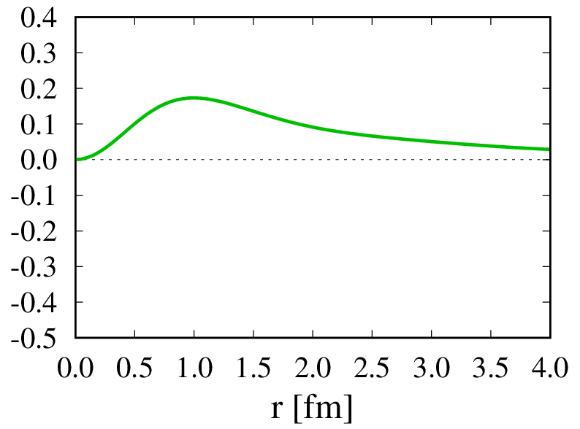
Correlation functions $F_{S}$ , $F_{D}$ in ³H
short-range${ F}_{S}(r)$
tensor $F_{D}(r)$
F_{S} ³E
r²×F_{D} ³E
Amplitude
intermediate
long
F_{S} ¹E
Negative sign in $F_{S}$ to avoid short-range repulsion in V_{NN} .
Ranges of $F_{D}, F_{S}$ are NOT short, contributing to many-body terms.

Slide 12
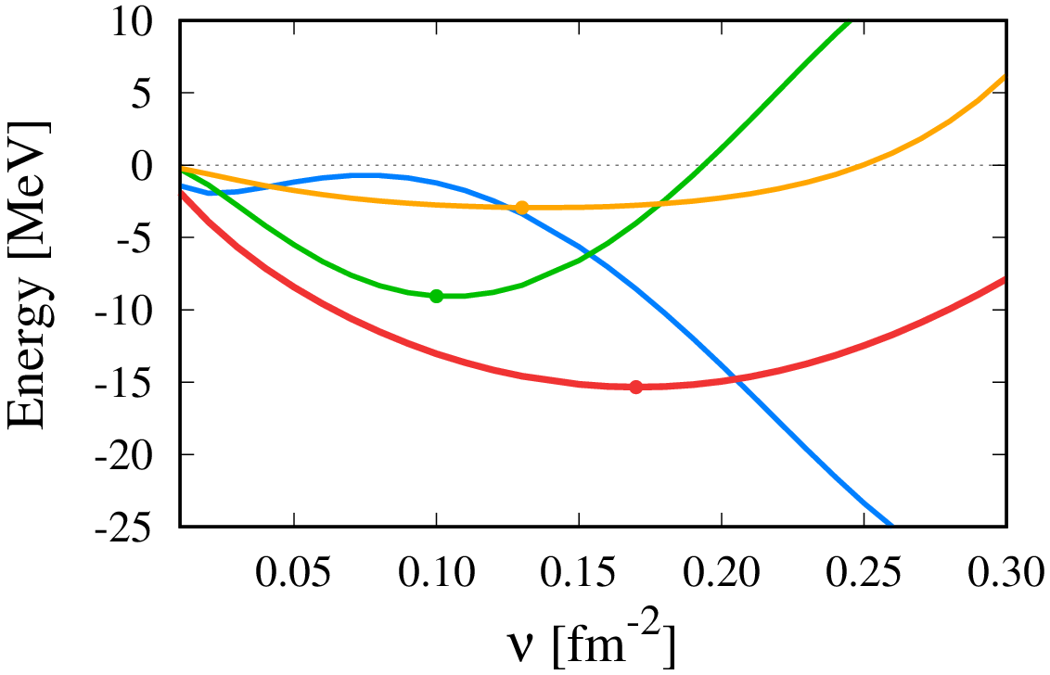
Many-body terms of $F^{†}HF$
Correlated Hamiltonian $\tilde{H}={\tilde{H}}_{2\text{−}body}+{\tilde{H}}_{3\text{−}body}+⋯+{\tilde{H}}_{A\text{−}body}$
4-body
3-body
³H
3-body
⁴He
Energy
2-body
Energy
wide
$ρ_{low}$
compact
$$ρ_{high}$$
2-body
Many-body terms play a decisive role for energy saturation
NO energy saturation within 2-body term
PTEP (2017) 073D01

Slide 13
High-Momentum Antisymmetrized Molecular Dynamics (HM-AMD)
TM et al. PTEP (2017) 111D01 Tensor correlation vs. TOSM
Lyu et al. PTEP (2018) 011D01 HM-AMD + TOAMD with AV8’
TM PTEP (2018) 031D01 Short-range correlation with AV4’
Lyu et al. arXiv:1807.11213 Submitted to RPC
Zhao et al. arXiv:1811.00271 Submitted to RPC

Slide 14
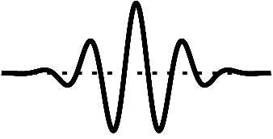
TOAMD for p-shell nuclei
In TOAMD, single configuration of AMD for s-shell nuclei ⇒ extend to multi-configuration of AMD (AMD+GCM)
Multi-AMD bases to represent the NN correlations.
High-Momentum AMD (HM-AMD)
Kimura (2014, priv. comm.), Itagaki-Tohsaki (PRC97(2018) 014304)
$Z$: Centroid of Gaussian wave packet $\left\langle r\right\rangle = Re\left(Z\right)$ Spatial position → clustering, halo $\left\langle p\right\rangle =2ℏν Im\left(Z\right)$ Momentum component → high-momentum
High-momentum in nucleon-pair is shown to describe short-range & tensor correlations as full 2p-2h excitations.
$$φ_{N}∝e^{−ν{(r−Z)}^{2}}$$
$$Z$$

Slide 15
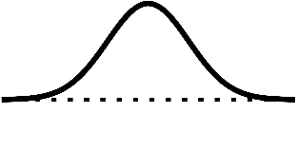
High-momentum AMD (HM-AMD)
Utilize imaginary positions in Gaussian wave packets.
$Z=iD$ with $\left|D\right|=0, 1, 2,⋯,10 fm$
$\left\langle p\right\rangle =2ℏν Im\left(Z\right)=2ℏνD$
pair ansatz : $Z\left(p\right)=iD, Z\left(n\right)=−iD$
Opposite momentum direction (Itagaki)
Large relative-momentum leading to 2p-2h effect
Two directions of $D$: spin-$∥$ ($z$), spin-$⊥$ ($x$)
$Ψ_{HM−AMD }=\sum_{i}{C_{i} Φ_{AMD}(D_{i})}$
Extendable to multi HM-pairs
$$\sim 5 {fm}^{−1}$$
$$e^{−ν{(r−iD)}^{2}}$$
$$iD$$
$$e^{−νr^{2}}$$
cf. TOAMD
$$Z=0$$
$$−iD$$
$$e^{−ν{(r+iD)}^{2}}$$
PTEP (2017) 111D01, (2018) 011D01

Slide 16
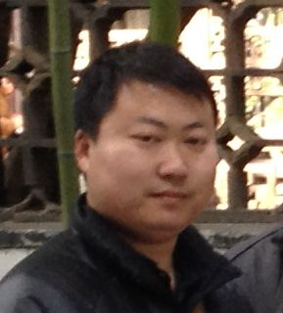
Lyu’s work: HM-AMD + TOAMD
(HM-TOAMD)
(RCNP, Osaka)
Hybridization of HM-AMD and TOAMD
TOAMD : Single correlation function $F_{S}, F_{D}$
HM-AMD : One high-momentum pair
V_{NN}: AV8’ bare potential
$$|\left.Φ_{hybrid}(D)\right\rangle =\left(1+F_{S}{+F}_{D}\right)|\left.Φ_{HM\text{−}AMD}\right\rangle$$
$$iD$$
F
$$e^{−ν{(r±iD)}^{2}}$$
$$\left\langle p\right\rangle =±2ℏνD$$
$|\left.Φ_{HM\text{−}TOAMD}\right\rangle =\sum_{i}{C_{i}|\left.Φ_{hybrid}(D_{i})\right\rangle }$
$$−iD$$

Slide 17
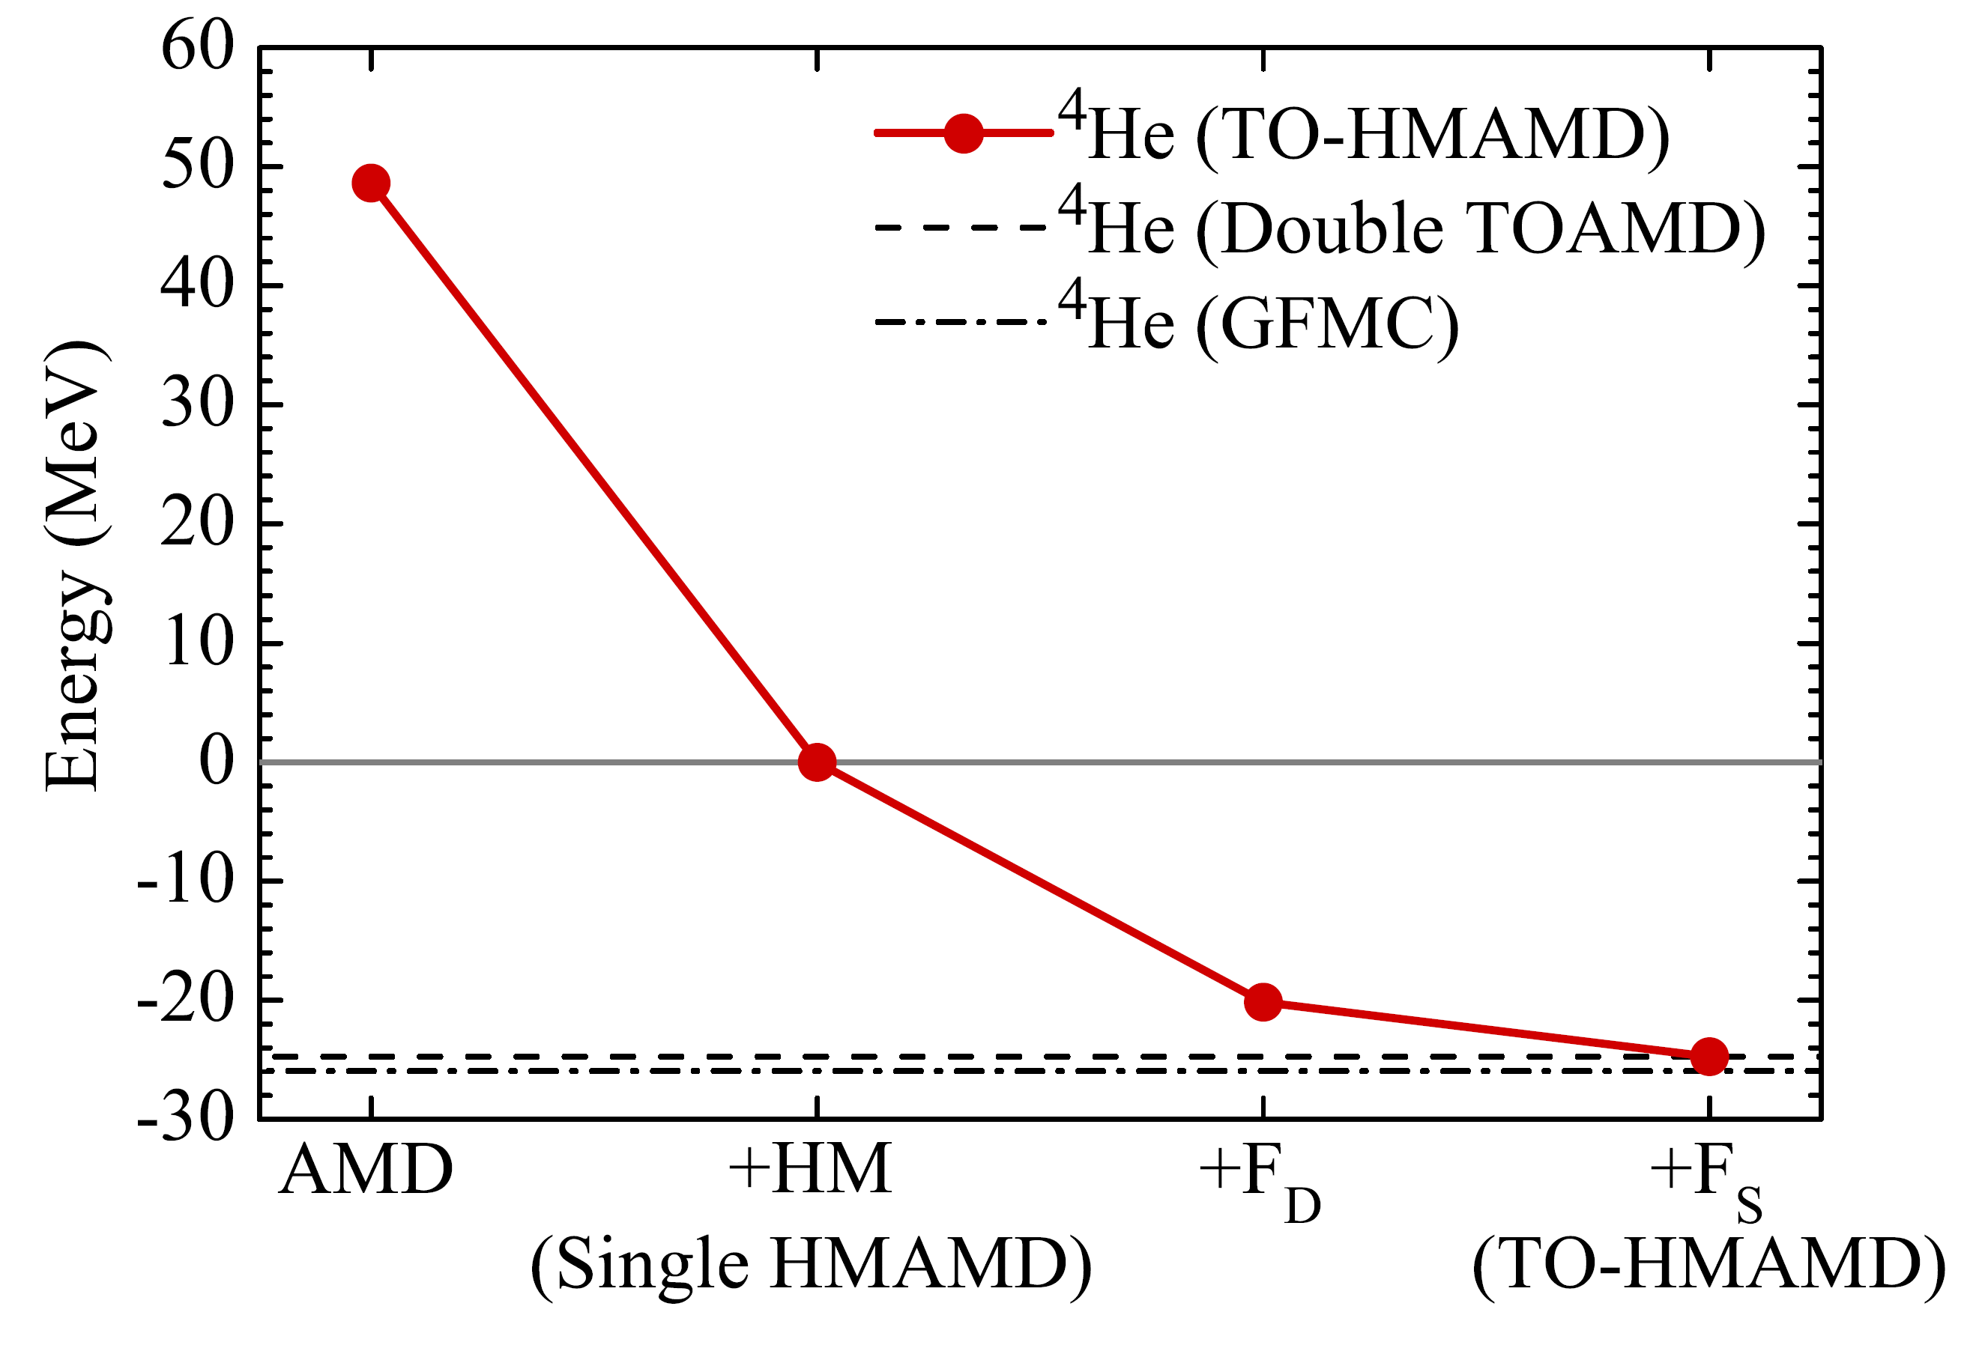
Energy, radius and Hamiltonian components
⁴He with AV8’ bare interaction
Superpose the basis states with different D’s for pairs.
⁴He
Lyu et al.
PTEP 2018 (2018) 011D01,
PRC submitted
Add bases successively

Slide 18
Energy, radius in ⁴He with HM-TOAMD
⁴He with AV8’ bare interaction
Superpose the basis states with different D’s for pairs.
 | HM-TOAMD | TOAMD-F² | GFMC
Energy | -24.74 | -24.74 | -25.93
Kinetic | 95.17 | 97.06 | 102.3
Central | -52.33 | -53.12 | -55.05
Tensor | -63.80 | -64.84 | -68.05
LS | -3.77 | -3.83 | -4.75
Radius | 1.51 | 1.50 | 1.49
[MeV]
[fm]
Lyu et al. PTEP 2018 (2018) 011D01, PRC
p-shell nuclei with HM-TOAMD is in progress.

Slide 19
Summary
Tensor-Optimized AMD (TOAMD)
Successive variational method for nuclei to treat V_{NN} directly.
Correlation functions : F_{D} (tensor) , F_{S} (short-range).
F are independently optimized, better than Jastrow method.
High-momentum AMD (HM-AMD)
High-momentum pairs using imaginary centroids in Gaussian wave packets
Comparison with shell model : “One high-momentum pair” = 2p-2h correlation
Hybrid : HM-TOAMD using V_{NN}
PLB 769 (2017) 213
PRC 96 (2017) 034309
PTEP (2017) 111D01
PTEP (2018) 011D01
Notes:
19

Slide 20
Backup

Slide 21
TOAMD with Double $F$
F
F
AV8’
$$\left(1+F_{S}{+F}_{D}+F_{S}F_{S}+F_{S}F_{D}+F_{D}F_{S}+F_{D}F_{D}\right)|\left.Φ_{AMD}\right\rangle$$
S
D
SS
SD
DS
DD
⁴He
Kinetic/2
F are independent
Good energy with $F^{2}$
Next order is $F^{3}$ such as $F_{S}F_{D}F_{D}$.
Central
Tensor
Correlation functions

Slide 22
TOAMD & Jastrow method
TOAMD : Describe finite nuclei using V_{NN}
Power series expansion using the correlation function $F$
$Φ_{\text{TOA}\text{MD}}=\left(1+F+F^{2}+F^{3}+⋯\right)×Φ_{\text{AMD}}$
$F_{D}$ : D-wave transition from tensor force
$F_{S}$ : Short-range repulsion in central force
Jastrow method
$Φ_{\text{Jastrow}}=\prod_{i<j}^{A}{\left(1+f_{ij}\right)} ×Φ_{0}$(reference state)
Product form : common correlation $f_{ij}$ among all pairs.
Variational Monte Carlo (VMC) is utilized to calculate $\left\langle H\right\rangle$.
Widely used in various fields (cond. matter, atomic, molecular,...)
F are independent
$$F^{n}=F∙F′∙F′′⋯$$
R. Jastrow, Phys. Rev. 98, 1479 (1955)
f
f

Slide 23
TOAMD & VMC with Jastrow
V_{NN} : AV6 for central & tensor forces omit LS, L², (LS)² from AV14
Common $F$
Energy (MeV)
TOAMD (power series) gives better energy than VMC (Jastrow) from variational point of view
³H
Few-body
⁴He
Independent optimization of all F
PRC 96 (2017) 034309
Correlation functions
$$F_{D}F_{D}$$
JPS magazine (2017) Dec. 867

Slide 24
Variation of multi-$F$ in TOAMD
AV6
$$\left(1+F_{S}{+F}_{D}+F_{S}F_{S}+F_{S}F_{D}+F_{D}F_{S}+F_{D}F_{D}\right)|\left.Φ_{AMD}\right\rangle$$
S
D
SS
SD
DS
DD
Few-body
same
Kinetic/2
F
F
Central
Common $F$
³H
Tensor
Free F
Correlation functions

Slide 25
Diagrams of cluster expansion - V_{NN} -
2-body
3-body
4-body
bra
F
F
V
V
V
F
ket
5-body
6-body

Slide 26
Diagrams of cluster expansion, Kinetic energy
1-body
2-body
3-body
4-body
bra
F
F
T
T
T
F
ket
uncorrelated
kinetic energy
5-body

Slide 27
Convergence of HM-AMD
V_{NN} : Central : Volkov No.2 with M=0.6 LS & Tensor : G3RS bare force
$$iD$$
⁴He
HM-AMD
with 1 pair
$$−iD$$
Tensor-optimized shell model (TOSM), complete 2p-2h.
“Criterion”
(0s)⁴
Add bases successively

Slide 28
Energy surface with the shift D_{z}
V_{NN} : Central Volkov No.2 with M=0.6, Coulomb, LS & Tensor : G3RS bare force
TM, K. Kato, K. Ikeda PTP113 (2005) 763
(0s)⁴
$$ν=0.25 {fm}^{−2}$$
2 bases : (0s)⁴
+ pn pair with D_{z}
Converge
⁴He
Superpose by increasing D_{z}
$\left\langle k\right\rangle =2νD_{z}$
$=2.5 {fm}^{−1}>k_{F}$
$$\left\langle k\right\rangle = 5 {fm}^{−1}$$
low-k
high-k

Slide 29
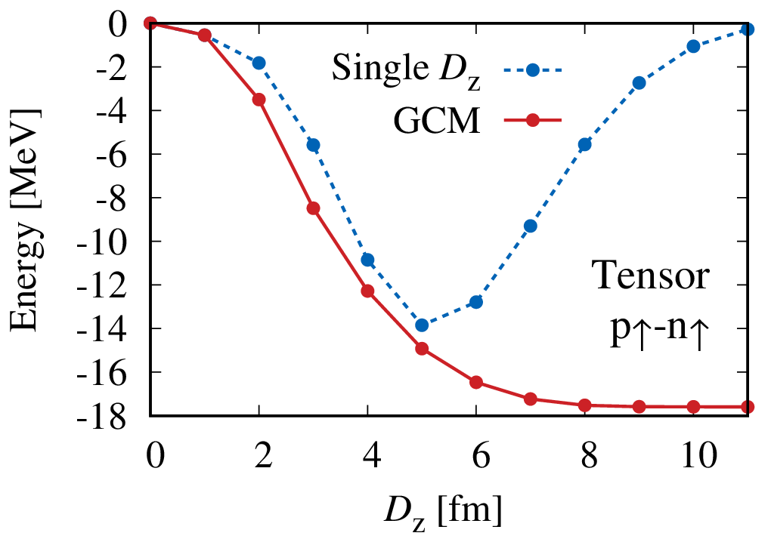
Hamiltonian Component in HM-AMD
⁴He
$$\left\langle k\right\rangle \sim 5 {fm}^{−1}$$
$$\left\langle p\right\rangle =\left\langle ℏk\right\rangle =2ℏν Im\left(Z\right) \\ ν=0.25 {fm}^{−2}$$

Slide 30
HM-AMD & TOSM for ⁴He
Myo, Sugimoto, Kato, Toki, Ikeda Prog. Theor. Phys. 117 (2007) 257
Tensor-Optimized Shell Model
$|\left.TOSM\right\rangle =$ $\sum_{i_{0}}{C_{i_{0}}\left.|0p0h,i_{0}\right\rangle }+\sum_{i_{1}}{C_{i_{1}}\left.|1p1h,i_{1}\right\rangle }+\sum_{i_{2}}{C_{i_{2}}\left.|2p2h,i_{2}\right\rangle }$
(MeV) | HM-AMD | TOSM
Energy | −64.7 | −65.2
Kinetic | 83.6 | 84.8
Central | −83.6 | −84.1
Tensor | −66.3 | −67.7
LS | 0.8 | 0.9
Coulomb | 0.9 | 0.9
NO truncation of particle states in TOSM using Gaussian expansion with high-L more than 10ℏ
HM-AMD = TOSM
(1 pair) (full 2p-2h)
$$e^{−ν{(r±iD)}^{2}}$$
Next, bare V_{NN} (Lyu, Isaka)

Slide 31
Tensor-optimized Shell Model for ⁴He
$|\left.TOSM\right\rangle =$ $\sum_{i_{0}}{C_{i_{0}}\left.|0p0h,i_{0}\right\rangle }+\sum_{i_{1}}{C_{i_{1}}\left.|1p1h,i_{1}\right\rangle }+\sum_{i_{2}}{C_{i_{2}}\left.|2p2h,i_{2}\right\rangle }$
NO truncation of particle states using Gaussian expansion
⁴He
Myo, Sugimoto, Kato, Toki, Ikeda Prog. Theor. Phys. 117 (2007) 257
9 Gaussian bases for each orbit with L
“Criterion” to examine 2p-2h effect
(0s)⁴
(single particle orbit)

Slide 32
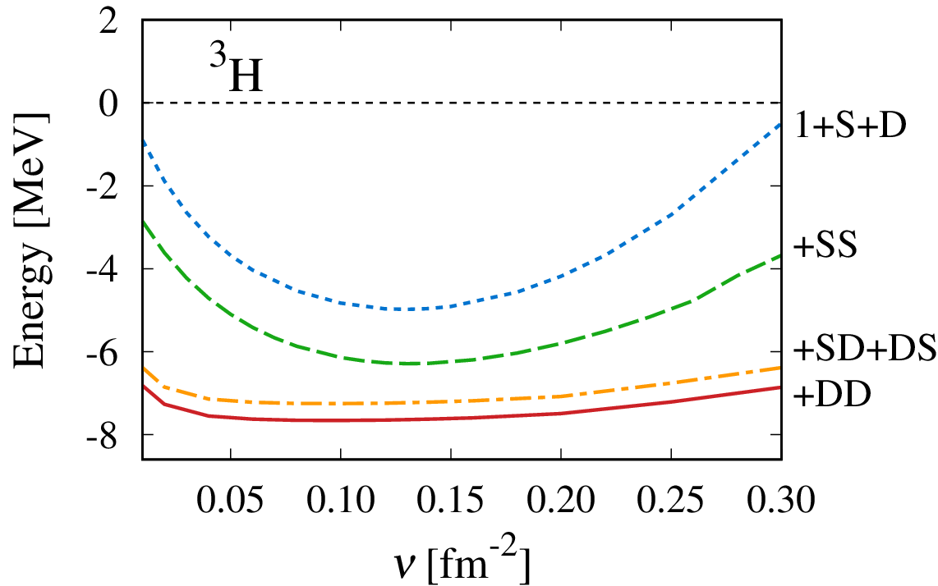
Double $F$ effect in TOAMD
F
F
AV8’
$$\left(1+F_{S}{+F}_{D}+F_{S}F_{S}+F_{S}F_{D}+F_{D}F_{S}+F_{D}F_{D}\right)|\left.Φ_{AMD}\right\rangle$$
Single
SS
SD
DS
DD
$$φ∝e^{−ν{(r−Z)}^{2}}$$
³H
$$ν=\frac{1}{2b^{2}}$$
$$\frac{ℏ^{2}}{m}ν=\frac{ℏω}{2}$$
Single
F are independent
+SS
Getting close to the GFMC energy.
ν-dependence is small due to the flexibility of F.
+SD+DS
+DD
wide, $ρ_{low}$
compact, $ρ_{high}$

Slide 33
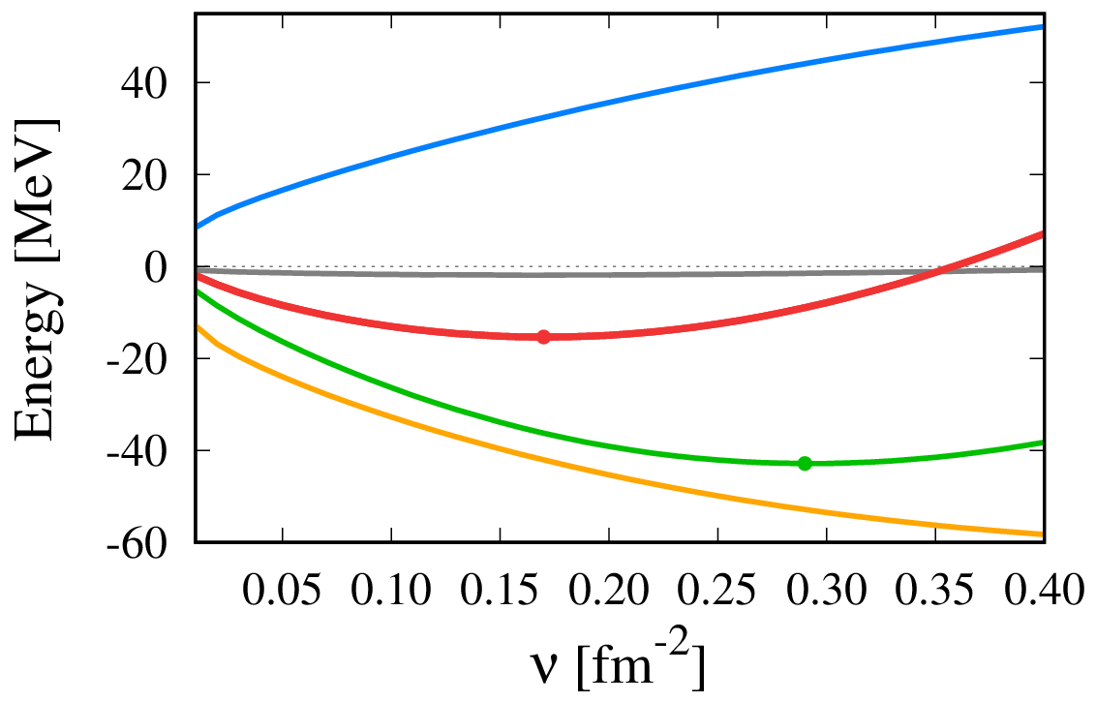
TOAMD with single $F$
F
$$\left(1+F_{D}{+F}_{S}\right)\text{|}\left.Φ_{AMD}\right\rangle$$
Kinetic
$$×\frac{1}{2}$$
³H
⁴He
Energy
LS
Central
Tensor
wide
$ρ_{low}$
compact
$$ρ_{high}$$
$$ν=\frac{1}{2b^{2}}, \frac{ℏ^{2}}{m}ν=\frac{ℏω}{2}$$
$$φ∝e^{−ν{(r−Z)}^{2}}$$
Large cancelation of T & V makes the small total energy.
$\left\{Z_{i}\right\}=0$, s-wave configuration of AMD w.f.

Slide 34
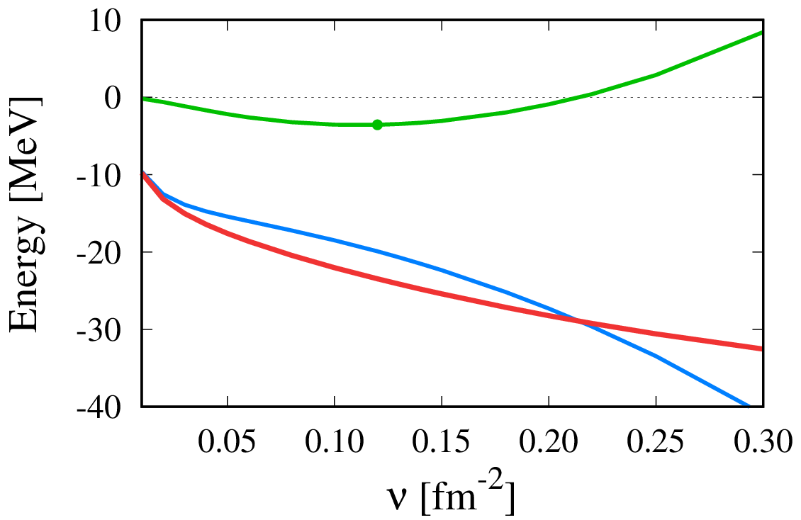
Many-body terms of $F^{†}HF$ in ³H
uncorrelated kinetic
$$\frac{ℏ^{2}}{m}ν=\frac{ℏω}{2}$$
Kinetic
Full
T+ 2-body
same trend in central & tensor
2-body > 3-body not negligible
3-body
Central
Tensor
wide, $ρ_{low}$
comprtact, $ρ_{high}$

Slide 35
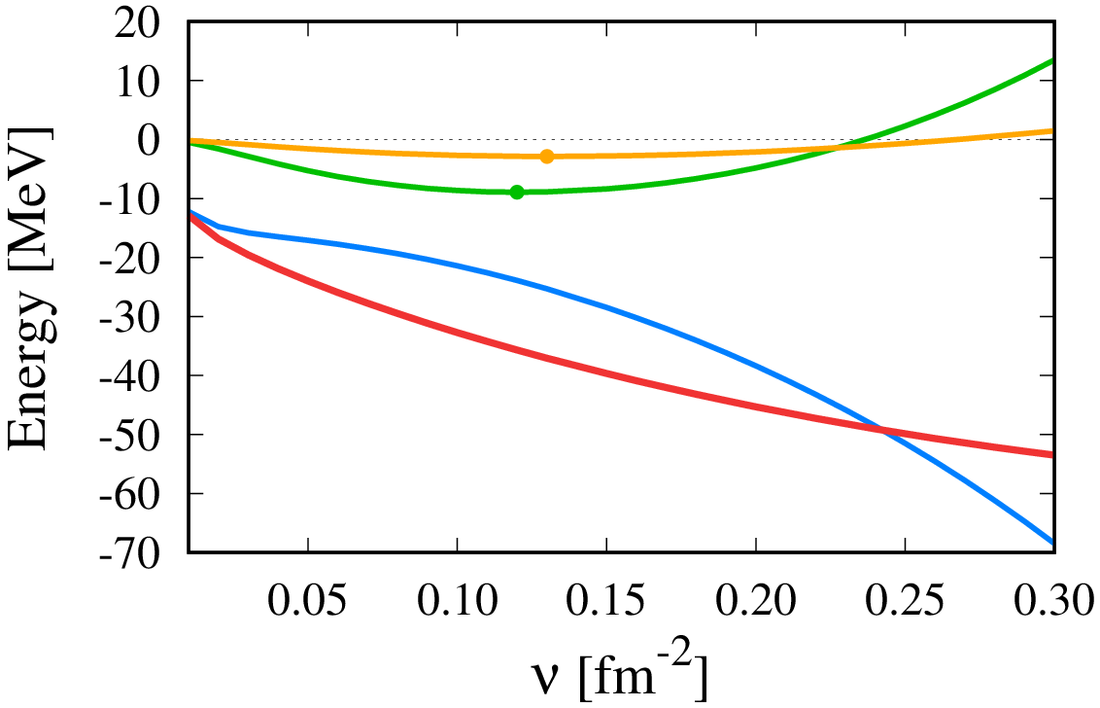
Many-body Hamiltonian terms in ⁴He
PTEP (2017) 073D01
Kinetic
Full
1+2 body
3-body
Higher-body term tends to give smaller scale, but, not ignored.
4-body
Central
Tensor
wide, $ρ_{low}$
compact, $ρ_{high}$

Slide 36
Variation of multi-$F$ in TOAMD
AV8’
$$\left(1+F_{S}{+F}_{D}+F_{S}F_{S}+F_{S}F_{D}+F_{D}F_{S}+F_{D}F_{D}\right)|\left.Φ_{AMD}\right\rangle$$
S
D
SS
SD
DS
DD
PTEP (2017) 073D01
cf. Jastrow ansatz
$F_{D}\left(r\right),F_{S}(r)$ are fixed at single level, and used in $F^{2}$ terms
³H
ΔE=1.4 MeV
F are independent as a full variation
Correlation functions

Slide 37
Variation of multi-$F$ in TOAMD
AV8’
$$\left(1+F_{S}{+F}_{D}+F_{S}F_{S}+F_{S}F_{D}+F_{D}F_{S}+F_{D}F_{D}\right)|\left.Φ_{AMD}\right\rangle$$
S
D
SS
SD
DS
DD
same
Kinetic/2
F
³H
F
Fixed $F$
Central
Few-body
Free F
Tensor
Correlation functions

Slide 38
Variation of multi-$F$ in TOAMD
AV8’
$$\left(1+F_{S}{+F}_{D}+F_{S}F_{S}+F_{S}F_{D}+F_{D}F_{S}+F_{D}F_{D}\right)|\left.Φ_{AMD}\right\rangle$$
S
D
SS
SD
DS
DD
PTEP (2017) 073D01
cf. Jastrow ansatz
⁴He
$F_{D}\left(r\right),F_{S}(r)$ are fixed at single level, and used in $F^{2}$ terms
ΔE=2.3 MeV
F are independent as a full variation
Correlation functions

Slide 39
Variation of multi-$F$ in TOAMD
AV8’
$$\left(1+F_{S}{+F}_{D}+F_{S}F_{S}+F_{S}F_{D}+F_{D}F_{S}+F_{D}F_{D}\right)|\left.Φ_{AMD}\right\rangle$$
S
D
SS
SD
DS
DD
same
Kinetic/2
⁴He
F
F
Fixed $F$
Central
Free F
Tensor
Independent optimization of all F
Correlation functions

