Slide 1
Impact of quark flavor violating SUSY on h(125) decays at future lepton colliders
K. Hidaka
Tokyo Gakugei University
Collaboration with
H. Eberl, E. Ginina (HEPHY Vienna)
Reference:
Phys. Rev. D 113, 015011 (2026) [arXiv:2511.20523]
KEK-PH2026, Feb 16-19 2026, KEK, Japan

Slide 2

1. Introduction
What is the SM-like Higgs boson discovered at LHC?
This is one of the most important issues in the present particle physics field!
Here we study a possibility that it is the lightest Higgs boson of the
Minimal Supersymmetric Standard Model (MSSM), focusing on the decays h⁰(125) $→$c c̅ , b b̅ , b s̅ , γ γ, g g , Zγ with special emphasis on Supersymmetric Quark Flavor Violation (QFV).

Slide 3
2. MSSM with general QFV
Key parameters in the MSSM with general QFV are:
* QFV parameters: c̃_{L/R} – t̃_{L/R} & s̃_{L/R} – b̃_{L/R} mixing parameters
* QFC parameter: t̃_{L} – t̃_{R} & b̃_{L} – b̃_{R} mixing parameters
In the MSSM with MFV (minimal flavor violation),
these QFV parameters are absent!

Slide 4
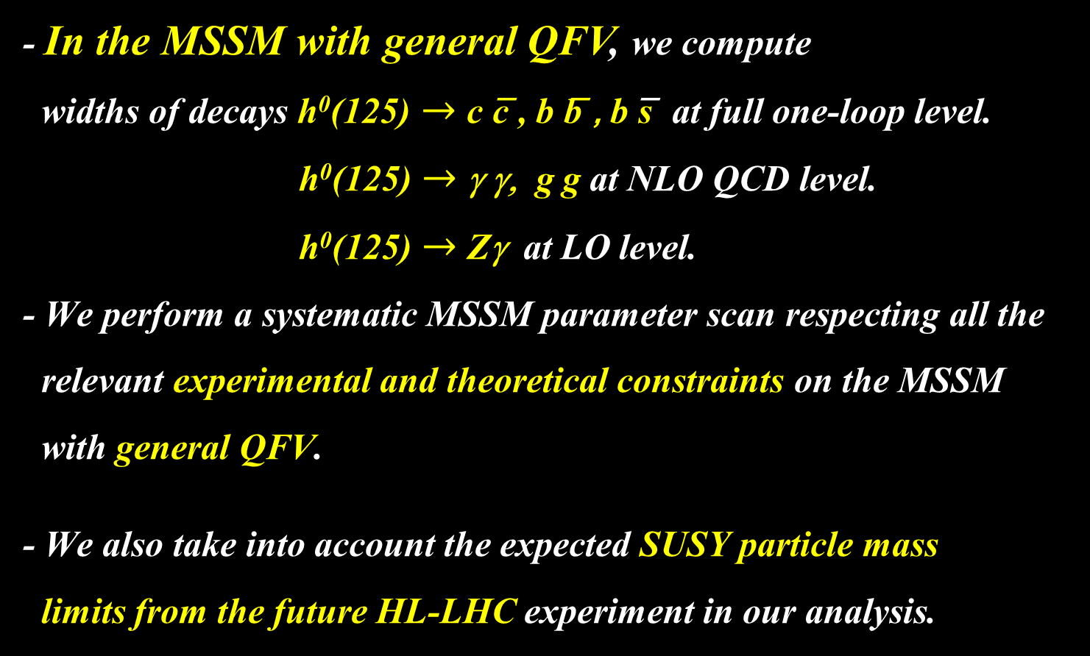
3. Parameter scan
- In the MSSM with general QFV, we compute
widths of decays h⁰(125) $→$c c̅ , b b̅ , b s̅ at full one-loop level.
h⁰(125) $→$ γ γ, g g at NLO QCD level.
h⁰(125) $→$ Zγ at LO level.
- We perform a systematic MSSM parameter scan respecting all the
relevant experimental and theoretical constraints on the MSSM
with general QFV.
- We also take into account the expected SUSY particle mass
limits from the future HL-LHC experiment in our analysis.
Notes:
Experimental constraint from B(b -> s l+ l-) ;
The low-s region (1 GeV^2 < s < 6 GeV^2) is dominated by the Wilson
coefficients C_9 and C_10, has sizable integrated branching ratio and is very
sensitive to the C_7 - C_9 interference. In the following, we utilize the latter
to put constraints on the Wilson coefficients C_7,8,9,10.
We calculate the integrated branching ratio in the low-s region following Ref. [52]:

Slide 5
3.1 Constraints on the MSSM
We respect the following experimental and theoretical constraints:
(1) The LHC limits on the SUSY particle masses.
(2) The constraint on (m_{A / H+ ,} tanβ ) from MSSM Higgs boson search at LHC.
The constraints on the QFV parameters from the B & K meson data.
etc.
(4) The constraints from the observed Higgs boson mass and couplings at LHC ; e.g.
121.6 GeV < m_h⁰ < 128.6 GeV (allowing for theoretical uncertainty) ,
0.68 < κ_{b} < 1.11 (ATLAS), 0.68 < κ_{b} < 1.32 (CMS)
(5) The experimental limit on SUSY contributions to the electroweak ρ parameter
Δ ρ (SUSY) < 0.0012.
(6) Theoretical constraints from the vacuum stability conditions for the
trilinear couplings T_{Uαβ} and T_{Dαβ} .
Notes:
Experimental constraint from B(b -> s l+ l-) ;
The low-s region (1 GeV^2 < s < 6 GeV^2) is dominated by the Wilson
coefficients C_9 and C_10, has sizable integrated branching ratio and is very
sensitive to the C_7 - C_9 interference. In the following, we utilize the latter
to put constraints on the Wilson coefficients C_7,8,9,10.
We calculate the integrated branching ratio in the low-s region following Ref. [52]:

Slide 6
3.2. Parameter scan
We compute the h⁰(125) decay widths in the
MSSM with general QFV.
- We take parameter scan ranges as follows:
10 < tanβ < 80
2500 < M₃ < 5000 GeV
100 < M₂ < 2500 GeV
100 < M₁ < 2500 GeV
100 < μ < 2500 GeV
1350 < m_{A}(pole) < 6000 GeV
etc. etc.
1 TeV < M_{SUSY} < 5 TeV
In the parameter scan, all of the relevant experimental and
theoretical constraints are imposed.
377180 parameter points are generated and 3208 points
survive the constraints.

Slide 7
4. h⁰ → c c̅ , b b̅ , b s̅ in the MSSM
Main 1-loop correction to h⁰ → c c̅ :
gluino - su loops [ su = (t̃ - c̃ mixture)]
can be enhanced by large trilinear couplings T_{U23} , T_{U32} , T_{U33}
Main 1-loop corrections to h⁰ → b b̅ & b s̅ :
gluino – sd loops [ sd = (̂b̃ - s̃ mixture)]
can be enhanced by large trilinear couplings T_{D23} , T_{D32} , T_{D33}
chargino - su loops [ su = (t̃ - c̃ mixture)]
can be enhanced by large trilinear couplings T_{U23} , T_{U32} , T_{U33}

Slide 8
In large & mixing scenario;
h⁰ ̴ H₂⁰
g̃
In our scenario, “trilinear couplings“ ( , ,
couplings) = (T_{U23} T_{U32} , T_{U33} ) are large!
couplings are large!
Gluino loop contributions can be large!
Deviation of Γ (h⁰ → c c̅) from SM width can be large!

Slide 9
In large s̃_{R/L} - b̃_{R/L} & b̃_{L} - b̃_{R} mixing scenario;
b
h⁰ ̴ - sα H₁⁰ + cα H₂⁰
d̃_{1,2}
d̃_{1,2} ̴ s̃_{R/L} + b̃_{R/L}
h⁰
g̃
d̃_{1,2}
b̅ / s̅
In our scenario, “trilinear couplings“(T_{D23} T_{D32} , T_{D33} ) =
(s̃_{R} - b̃_{L} - H₁⁰ , s̃_{L} - b̃_{R} - H₁⁰ , b̃_{L} - b̃_{R} - H₁⁰ couplings) are large!
d̃_{1,2} - d̃_{1,2} - h⁰ couplings are large!
Gluino loop contributions can be large!
Deviation of Γ (h⁰ → b b̅/s̅ ) from SM width can be large!

Slide 10
In large c̃_{R/L} - t̃_{R/L} & t̃_{L} - t̃_{R} mixing scenario;
b
h⁰ ̴ H₂⁰
ũ_{1,2}
ũ_{1,2} ̴ c̃_{R/L} + t̃_{R/L}
h⁰
χ̃±
χ̃± ~ W̃± + H̃±
ũ_{1,2}
b̅ / s̅
In our scenario, “trilinear couplings“ ( , ,
couplings) = (T_{U23} T_{U32} , T_{U33} ) are large!
couplings are large!
Chargino loop contributions can be large!
Deviation of Γ (h⁰ → b b̅/s̅ ) from SM width can be large!

Slide 11
4.1 Deviation of the width from the SM prediction
- Deviation of the width from the SM prediction:
_ _ _
DEV(h⁰ -> X X) = Γ(h⁰ -> X X)_{MSSM} / Γ (h⁰ -> X X)_{SM} - 1
X = c, b

Slide 12
4.1 Deviation of the width from the SM prediction
- Deviation of the width from the SM prediction:
_ _ _
DEV(h⁰ -> X X) = Γ(h⁰ -> X X)_{MSSM} / Γ (h⁰ -> X X)_{SM} - 1
X = c, b
Coupling modifier:
κ_{X} = g(h⁰X X) / g(h⁰X X)_{SM}
DEV - κ_{X} relation:
DEV(h⁰ -> X X) = κ_{X}² – 1

Slide 13
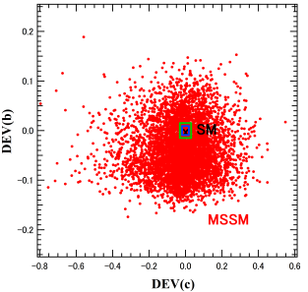
Scatter plot in DEV(h⁰ -> c c̅) - DEV(h⁰ -> b b̅) plane
Expected 1 sigma error at ILC250 + HL-LHC
DEV(h⁰ -> b b̅)
Expected 1 sigma error at ILC250/500 + HL-LHC
DEV(h⁰ -> c c̅)
DEV(h⁰ -> c c̅) and DEV(h⁰ -> b b̅) can be very large simultaneously!:
DEV(h⁰ -> b b̅) can be as large as ~ ±20%
DEV(h⁰ -> c c̅) can be as large as ~ ±60%
DEV(h⁰ -> c c̅) is very small < O(1)% in MSSM with MFV!
ILC can observe such large deviations from SM at high significance (arXiv:2206.08326)!:
Δ DEV(h⁰ -> c c̅) = (3.6%, 2.4%, 1.8%) at (ILC250, ILC250/500, ILC250/500/1000)
Δ DEV(h⁰ -> b b̅) = (1.7%, 1.1%, 0.9%) at (ILC250, ILC250/500, ILC250/500/1000)

Slide 14
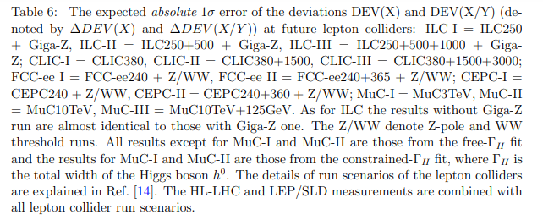
Expected absolute 1 sigma errors of the deviations DEVs at future lepton colliders
Jorge de Blas et al., Snowmass2021 Report: arXiv:2206.08326 [hep-ph];
Private communication with Jorge de Blas.

Slide 15
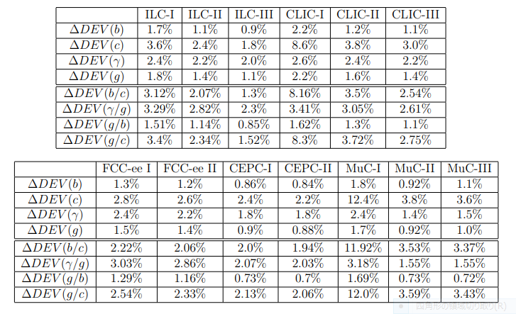
Expected absolute 1 sigma errors of the deviations DEVs at future lepton colliders

Slide 16


4.2. BR(h⁰ → b s̅ / s b̅)
BR(h⁰ -> b s̅ / s b̅) $≅$ 0 ( < 10 ⁻⁷ ) (SM)
BR(h⁰ -> b s̅ / s b̅) $≅$ 0 (MSSM with MFV)
BR(h⁰ -> b s̅ / s b̅) can be as large as ~ 0.15% (MSSM with QFV)!
(See also Gomez-Heinemeyer-Rehman, PR D93 (2016) 095021 [arXiv:1511.04342]. )
ILC(250+500+1000) sensitivity could be ~ 0.1% (at 4 σ significance)!
Private communication with Junping Tian;
See also Barducci et al., JHEP 12 (2017) 105 [arXiv:1710.06657].
Expected FCC-ee bound is BR(h⁰ -> b s̅ / s b̅) < 4.5· 10 ⁻⁴ (at 95% CL)
See M. Selvaggi, talk at FCC Physics Performance Meeting, 18 Mar 2024.
Expected CEPC bound is BR(h⁰ -> b s̅ / s b̅) < 2.2· 10 ⁻⁴ (at 95% CL)
See H. Liang et al., arXiv:2310.03440.

Slide 17
4.3 Deviation of width ratio from the SM prediction
- The deviation of the width ratio from the SM prediction:
DEV(b/c) = [Γ (b) / Γ (c)]_{MSSM} / [Γ (b) / Γ (c)]_{SM} - 1
_
Γ (X) = Γ (h⁰-> X X)
We find;
the experimental measurement errors as
well as the MSSM prediction errors
tend to cancel out significantly in the width ratios.

Slide 18
Scatter plot in T_{U32} – DEV(b/c) plane
DEV(b/c)
SM
T_U32 (GeV)
c̃_{L} – t̃_{R} mixing parameter
There is a strong correlation between T_{U32} – DEV(b/c)!
DEV(b/c) can exceed ~ +100% for large T_{U32} !
- Expected absolute 1 σ error of DEV(b/c) at ILC:
ΔDEV(b/c) = (3.1%, 2.1%, 1.3%) at (ILC250, ILC250+500, ILC250+500+1000).
[Jorge de Blas et al., Snowmass2021 Report: arXiv:2206.08326;
Private communication with Jorge de Blas.]
- ILC can observe such large deviation from SM at very high significance!

Slide 19
Expected absolute 1 sigma errors of the deviations DEVs at future lepton colliders

Slide 20
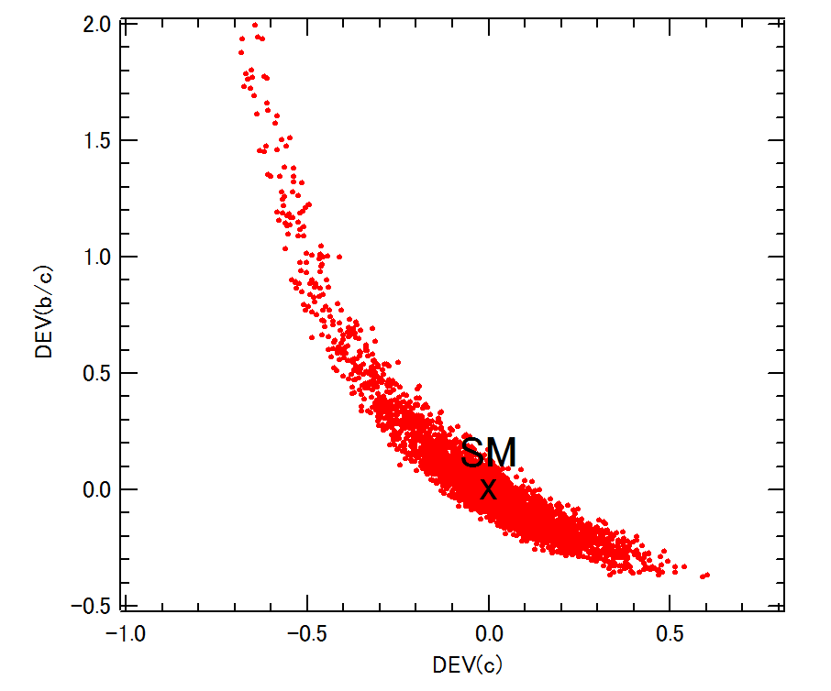
Scatter plot in DEV(b/c) – DEV(c) plane
DEV(b/c)
DEV(c)
There is a very strong correlation between DEV(b/c) – DEV(c)!
DEV(b/c) and DEV(c) can be very large simultaneously!
- Expected absolute 1 σ error of DEV(c) and DEV(b/c) at ILC:
Δ DEV(c) = (3.6%, 2.4%, 1.8%) at (ILC250, ILC250+500, ILC250+500+1000)
ΔDEV(b/c) = (3.1%, 2.1%, 1.3%) at (ILC250, ILC250+500, ILC250+500+1000).
[Jorge de Blas et al., Snowmass2021 Report: arXiv:2206.08326;
Private communication with Jorge de Blas.]
- ILC can observe such large deviation from SM at very high significance!

Slide 21
Expected absolute 1 sigma errors of the deviations DEVs at future lepton colliders

Slide 22

5. h⁰ → γ γ, g g, Zγ in the MSSM
Main 1-loop contributions to h⁰ $→$ γ γ , Ζ γ :
[W⁺/ top-quark / su] - loops [ su = (t̃ - c̃ mixture)]
The su-loops can be enhanced by large trilinear couplings T_{U23} , T_{U32} , T_{U33} ,
resulting in sizable deviation of Γ (h⁰ → γ γ , Ζ γ ) from the SM width!
Main 1-loop contributions to h⁰ → g g:
[top-quark / su] - loops [ su = (t̃ - c̃ mixture)]
The su-loops can be enhanced by large trilinear couplings T_{U23} , T_{U32} , T_{U33 ,}
resulting in sizable deviation of Γ (h⁰ → g g) from the SM width!

Slide 23
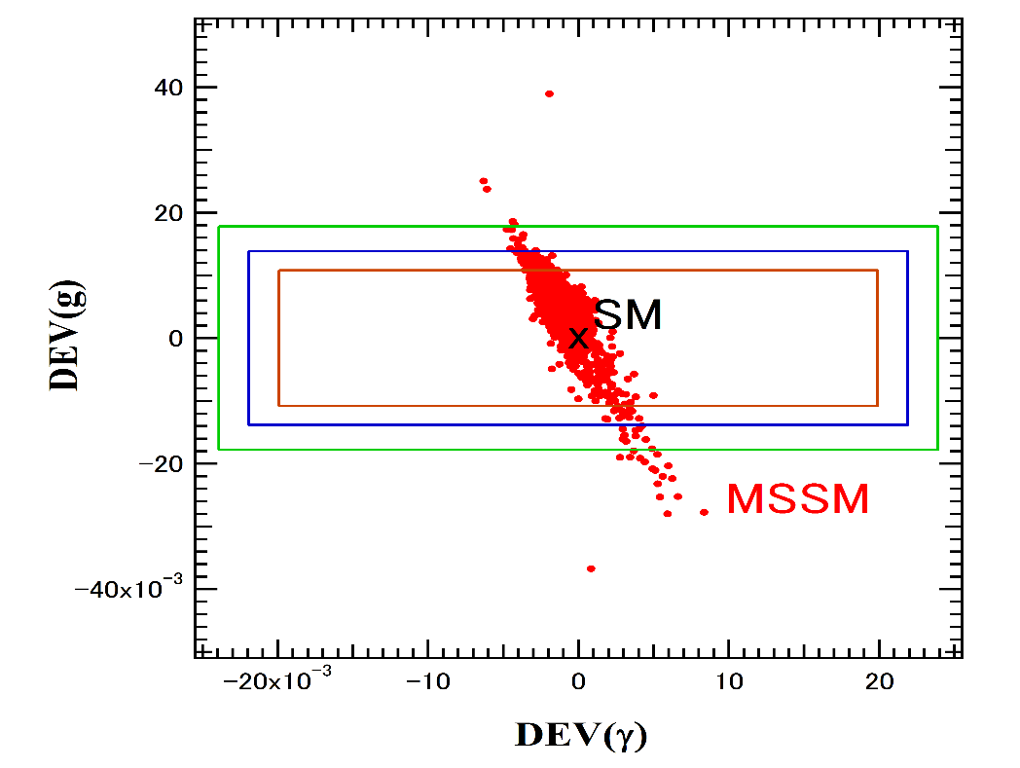
Scatter plot in DEV(h⁰ → γ γ ) - DEV(h⁰ → g g) plane
Expected 1 sigma error at ILC250 + HL-LHC
DEV(h⁰ → g g)
Expected 1 sigma error at ILC250/500/1000 + HL-LHC
DEV(h⁰ → γ γ )
DEV(h⁰ → γ γ ) and DEV(h⁰ → g g) can be sizable simultaneously!:
DEV(h⁰ → γ γ ) can be as large as ±1%
DEV(h⁰ → g g) can be as large as ±4%.
DEV(h⁰ → g g) can be as large as +4% and −7% from a contour plot analysis.
Expected absolute 1 σ errors at (ILC250, ILC250+500, ILC250+500+1000):
Δ DEV(h⁰ → γ γ ) = (2.4%, 2.2%, 2.0%)
Δ DEV(h⁰ → g g) = (1.8%, 1.4%, 1.1%)
[Jorge de Blas et al., Snowmass2021 Report: arXiv:2206.08326]
- ILC can observe such sizable deviation DEV(h⁰ → g g) at high significance!

Slide 24
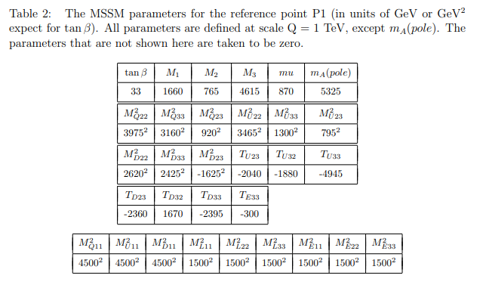
6. Benchmark scenario
From the allowed MSSM parameter points in the scan, we have selected
a benchmark point P1 shown in Table 2 .

Slide 25
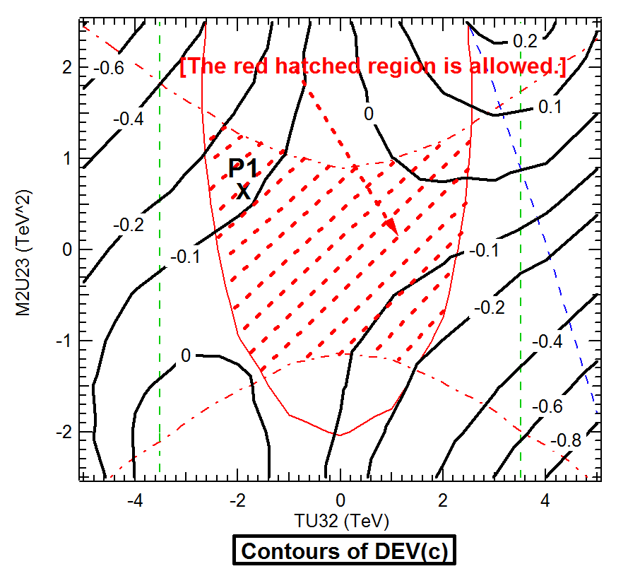
Contours of DEV(h⁰ -> c c̅) in T_{U32} - M²_{U23} plane around P1
We find that DEV(c) can be very large (about -30% to 10%) in a sizable region allowed by all the constraints including the expected sparticle mass limits from the future HL-LHC experiment!

Slide 26
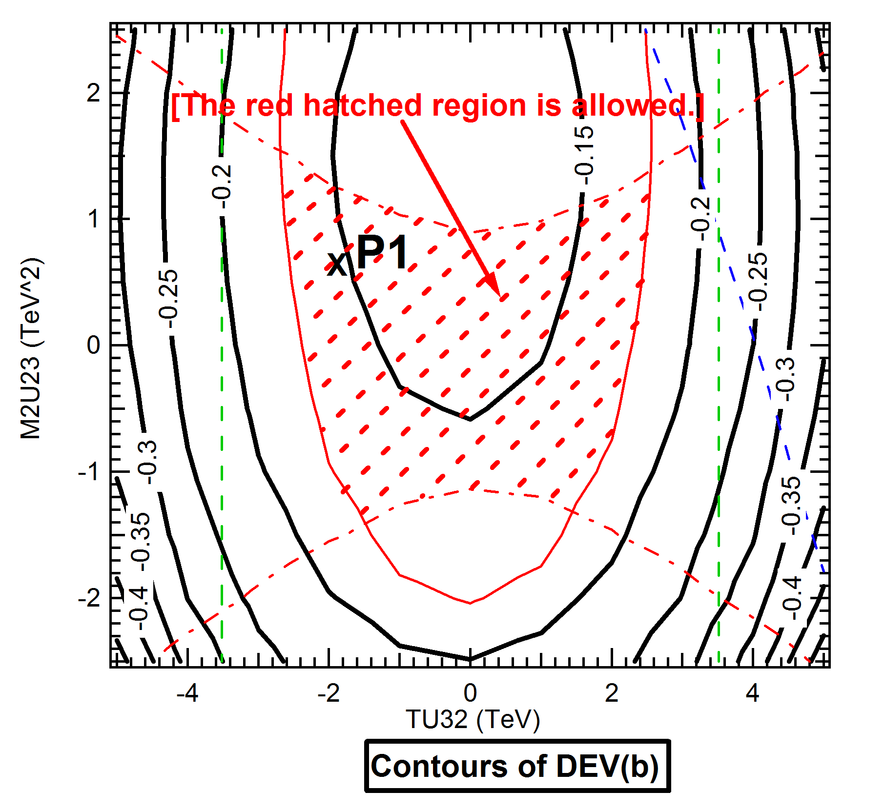
Contours of DEV(h⁰ -> b b̅) in T_{U32} - M²_{U23} plane around P1
We find that DEV(b) can be very large (about -10% to -18%) in a sizable region allowed by all the constraints including the expected sparticle mass limits from the future HL-LHC experiment!

Slide 27
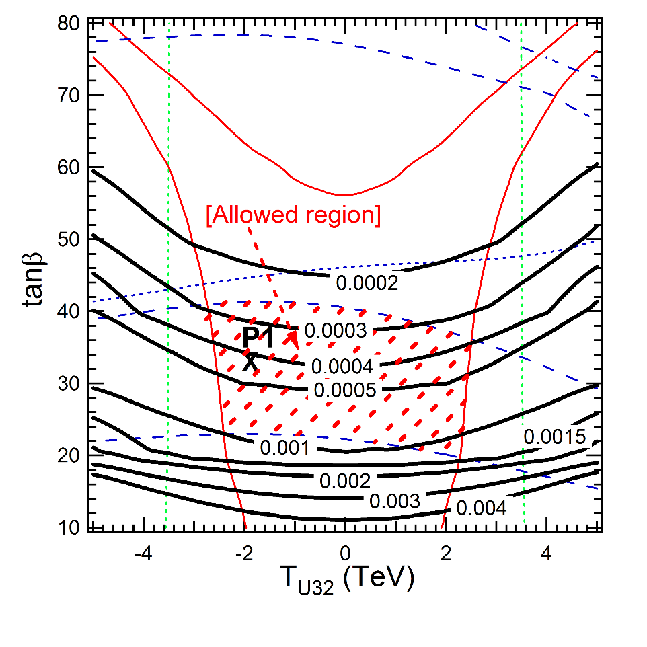
Contours of B(h⁰ -> b s̅ / s b̅) in T_{U32} – tanβ plane around P1
- B(h⁰ -> b s̅ / s b̅) can be as large as ~ 0.15% in a sizable region allowed by all the
constraints including the expected sparticle mass limits from the future HL-LHC!
ILC(250 + 500 + 1000) sensitivity could be ~ 0.1% at 4σ significance!
Private communication with Junping Tian;
See also Barducci et al., JHEP 12 (2017) 105 [arXiv:1710.06657].

Slide 28
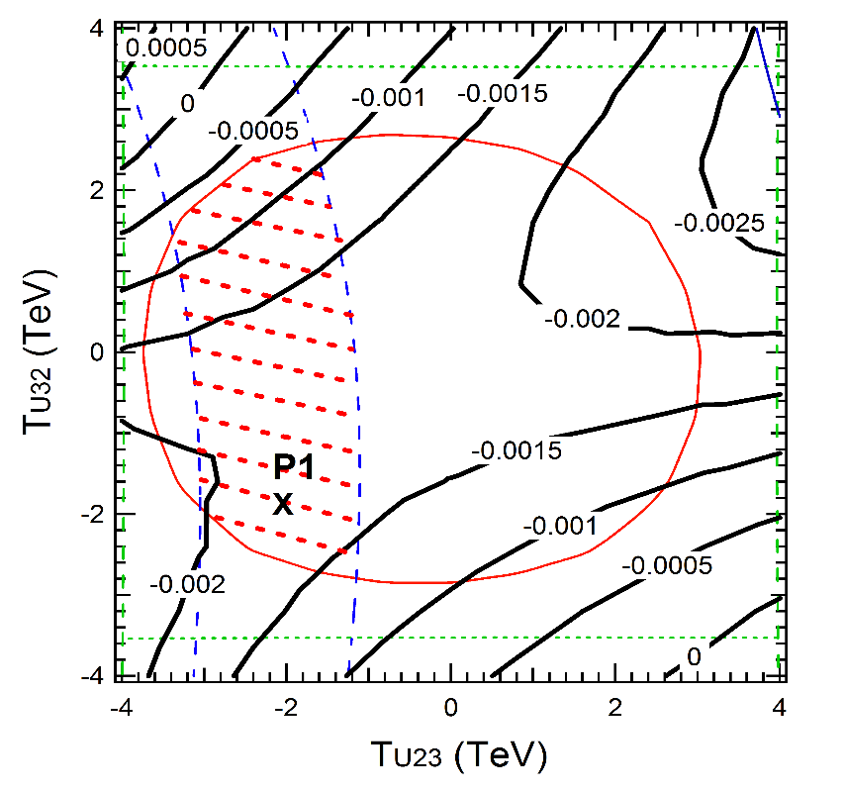
Contours of DEV(h⁰ -> Zγ ) in T_{U23} - T_{U32} plane around P1
DEV(Zγ ) is very small in theT_{U23} - T_{U32} plane around P1.

Slide 29
8. Conclusion
- We have studied the decays
h⁰ (125GeV) → c c̅ , b b̅ , b s̅ , γ γ, g g, Zγ in the MSSM with general QFV.
- For the first time, we have performed a systematic MSSM parameter scan
respecting all of the relevant theoretical and experimental constraints.
- In strong contrast to the usual studies in the MSSM with minimal flavor violation (MFV),
we have found that the deviations of these MSSM decay widths and width ratios
from the SM values can be quite sizable in the MSSM with general QFV.
- All of these large deviations in the h (125) decays are due to
large c̃ - t̃ mixing & large c̃ / t̃ involved trilinear couplings T_{U23}, T_{U32}, T_{U33} and
large s̃ - b̃ mixing & large s̃ / b̃ involved trilinear couplings T_{D23}, T_{D32}, T_{D33} .
- Future lepton colliders such as ILC, CLIC, CEPC, FCC-ee and MuC can
observe such sizable deviations from the SM at high signal significance
even after the failure of SUSY particle discovery at the HL-LHC.
- In case the deviation pattern shown here is really observed at the lepton colliders,
then it would strongly suggest the discovery of QFV SUSY (the MSSM with general QFV).

Slide 30
Our analysis suggests the following:
PETRA/TRISTAN e- e+ collider discovered virtual Z⁰ effect for the first time.
Later, CERN p p̄ collider discovered the Z⁰ boson.
Similarly, lepton colliders, such as ILC, could discover virtual Sparticle effects for the first time in h⁰(125) decays!
Later, FCC-hh p p collider could discover the Sparticles!

Slide 31
In summary:
The effect of quark flavor violating (QFV) MSSM
on h(125) decays to cc, bb, bs, γγ, gg can be quite
significant, making measurement of these decay widths at
future lepton colliders a very sensitive probe of QFV SUSY.

Slide 32
END
Thank you!

Slide 33
Backup

Slide 34
Impact of quark flavor violating SUSY on h(125) decays at future lepton colliders
K. Hidaka
Tokyo Gakugei University
Collaboration with
H. Eberl, E. Ginina (HEPHY Vienna)
Reference:
arXiv:2511.20523 (to be published in Phys. Rev. D)

Slide 35

1. Introduction
What is the SM-like Higgs boson discovered at LHC?
It can be the SM Higgs boson.
It can be a Higgs boson of New Physics.
This is one of the most important issues in the present particle physics field!
Here we study a possibility that it is the lightest Higgs boson of the
Minimal Supersymmetric Standard Model (MSSM), focusing on the decays h⁰(125) $→$c c̅ , b b̅ , b s̅ , γ γ, g g with special emphasis on Supersymmetric Quark Flavor Violation (QFV).

Slide 36
2. MSSM with general QFV
Key parameters in this study are:
* QFV parameters: c̃_{L/R} – t̃_{L/R} & s̃_{L/R} – b̃_{L/R} mixing parameters
* QFC parameter: t̃_{L} – t̃_{R} & b̃_{L} – b̃_{R} mixing parameters
Μ ²_{Q23} = (c̃_{L} – t̃_{L} mixing parameter) = (s̃_{L} – b̃_{L} mixing parameter)
Μ ²_{U23} = (c̃_{R} – t̃_{R} mixing parameter)
Μ ²_{D23} = (s̃_{R} – b̃_{R} mixing parameter)
Τ_{U23} = (c̃_{R} – t̃_{L} mixing parameter)
Τ_{U32} = (c̃_{L} – t̃_{R} mixing parameter)
Τ_{U33} = (t̃_{L} – t̃_{R} mixing parameter)
Τ_{D23} = (s̃_{R} – b̃_{L} mixing parameter)
Τ_{D32} = (s̃_{L} – b̃_{R} mixing parameter)
Τ_{D33} = (b̃_{L} – b̃_{R} mixing parameter)

Slide 37
2. MSSM with general QFV
Key parameters in this study are:
* QFV parameters: c̃_{L/R} – t̃_{L/R} & s̃_{L/R} – b̃_{L/R} mixing parameters
* QFC parameter: t̃_{L} – t̃_{R} & b̃_{L} – b̃_{R} mixing parameters
These QFV parameters are absent in the MSSM with
minimal flavor violation (MFV)!

Slide 38
3. Constraints on the MSSM
We respect the following experimental and theoretical constraints:
(1) The LHC limits on the SUSY particle masses.
(2) The constraint on (m_{A / H+ ,} tanβ ) from MSSM Higgs boson search at LHC.
The constraints on the QFV parameters from the B & K meson data.
etc.
(4) The constraints from the observed Higgs boson mass and couplings at LHC ; e.g.
121.6 GeV < m_h⁰ < 128.6 GeV (allowing for theoretical uncertainty) ,
0.68 < κ_{b} < 1.11 (ATLAS), 0.68 < κ_{b} < 1.32 (CMS)
(5) The experimental limit on SUSY contributions to the electroweak ρ parameter
Δ ρ (SUSY) < 0.0012.
(6) Theoretical constraints from the vacuum stability conditions for the
trilinear couplings T_{Uαβ} and T_{Dαβ} .
Notes:
Experimental constraint from B(b -> s l+ l-) ;
The low-s region (1 GeV^2 < s < 6 GeV^2) is dominated by the Wilson
coefficients C_9 and C_10, has sizable integrated branching ratio and is very
sensitive to the C_7 - C_9 interference. In the following, we utilize the latter
to put constraints on the Wilson coefficients C_7,8,9,10.
We calculate the integrated branching ratio in the low-s region following Ref. [52]:

Slide 39
* We also take into account the expected SUSY particle
mass limits from the future HL-LHC experiment in
our analysis.
[1] X. Cid Vidal et al., ”Report from Working Group 3: Beyond the Standard Model
physics at the HL-LHC and HE-LHC”, CERN Yellow Rep: Monogr. 7 (2019) 585-865
[arXiv:1812.07831 [hep-ph]].
[2] T. Bose et al., ”Report of the Topical Group on Physics Beyond the Standard Model
at Energy Frontier for Snowmass 2021”, arXiv:2209.13128 [hep-ph].
[3] ATLAS Collaboration, ATLAS Notes ATL-PHYS-PUB-2012-001, ATL-PHYS-PUB2013-002,
ATL-PHYS-PUB-2014-010, and ATL-PHYS-PUB-2018-048.
[4] C. M. Berggren, talk at The European Physical Society Conference on High Energy
Physics (EPS-HEP2023), 21-25 August 2023, Hamburg, Germany.
[5] H. Gilmer, talk at the 40th International Conference on High Energy Physics, virtual
conference (ICHEP2020), 28 Jul - 6 Aug 2020, Prague, Czech Republic.
[6] M. Narain et al., ”The Future of US Particle Physics - The Snowmass 2021 Energy
Frontier Report”, arXiv:2211.11084 [hep-ex].
[7] H. Bahl, P. Bechtle, S. Heinemeyer, S. Liebler, T. Stefaniak and G. Weiglein, Eur.
Phys. J. C 80 (2020) 916 [arXiv:2005.14536 [hep-ph]].
Phys. Rev. D 91 (2015) 015007 [arXiv:1411.2840 [hep-ph]]
JHEP 1606 (2016) 143 [arXiv:1604.02366 [hep-ph]]]
IJMP A34 (2019) 1950120 [arXiv:1812.08010 [hep-ph]]
PoS(EPS-HEP2021) 594, 2021 [arXiv:2111.02713 [hep-ph]]
PoS(ICHEP2022) 536, 2022 [arXiv:2211.07243 [hep-ph]]
PoS(EPS-HEP2023) 487, 2023
Notes:
Experimental constraint from B(b -> s l+ l-) ;
The low-s region (1 GeV^2 < s < 6 GeV^2) is dominated by the Wilson
coefficients C_9 and C_10, has sizable integrated branching ratio and is very
sensitive to the C_7 - C_9 interference. In the following, we utilize the latter
to put constraints on the Wilson coefficients C_7,8,9,10.
We calculate the integrated branching ratio in the low-s region following Ref. [52]:

Slide 40
* Constraints from W boson mass data:
The recent m_{W} data from CDF II [1] disagrees significantly with the previous
world average. (-> See backup slides.)
[1] CDF Collaboration, Science 376, 170–176 (2022)
This issue of the m_{W} data is not yet settled.
Hence, we do not take into accont this m_{W} constraint on the MSSM
parameters in our analysis.
Notes:
Experimental constraint from B(b -> s l+ l-) ;
The low-s region (1 GeV^2 < s < 6 GeV^2) is dominated by the Wilson
coefficients C_9 and C_10, has sizable integrated branching ratio and is very
sensitive to the C_7 - C_9 interference. In the following, we utilize the latter
to put constraints on the Wilson coefficients C_7,8,9,10.
We calculate the integrated branching ratio in the low-s region following Ref. [52]:

Slide 41
* Constraint from muon g-2:
- Tension btw the new Fermilab muon g-2 data [1] and the SM prediction
is ~ 5 sigma..
- In our scenario with heavy sleptons/sneutrinos with masses of about
1.5 TeV the MSSM loop contributions to muon g-2 are too small to
explain this tension.
However;
- The tension btw the muon g-2 data and the SM prediction with lattice QCD [2]
is only ~ 1.6 sigma!
- Moreover, the SM prediction in the data-driven approach using the recent
CDM-3 data [3] supports the SM prediction with the lattice QCD [2]!
[1] Muon g-2 Collaboration, arXiv:2308.06230 [hep-ex].
[2] BMW Collaboration, Nature 593 (2021) 51 [arXiv:2002.12347[hep-lat]].
[3] CMD-3 Collaboration, arXiv:2302.08834 [hep-ex].
Notes:
Experimental constraint from B(b -> s l+ l-) ;
The low-s region (1 GeV^2 < s < 6 GeV^2) is dominated by the Wilson
coefficients C_9 and C_10, has sizable integrated branching ratio and is very
sensitive to the C_7 - C_9 interference. In the following, we utilize the latter
to put constraints on the Wilson coefficients C_7,8,9,10.
We calculate the integrated branching ratio in the low-s region following Ref. [52]:

Slide 42
* Constraint on the MSSM QFV parameters from B(Z - > b s):
The current best experimental upper limit on B(Z - > b s) can not give any
significant constraint on the sstrange-sbottom and scharm -stop mixings.
(see D. Atwood et al., Phys. Rev. D66(2002) 093005 [arXiv:hep-ph/0203200])
Note that no experimental upper limit on B(Z -> b s) is listed in PDG2022 !
Notes:
Experimental constraint from B(b -> s l+ l-) ;
The low-s region (1 GeV^2 < s < 6 GeV^2) is dominated by the Wilson
coefficients C_9 and C_10, has sizable integrated branching ratio and is very
sensitive to the C_7 - C_9 interference. In the following, we utilize the latter
to put constraints on the Wilson coefficients C_7,8,9,10.
We calculate the integrated branching ratio in the low-s region following Ref. [52]:

Slide 43
4. Parameter scan
We compute the h⁰(125) decay widths in the
MSSM with general QFV.
- We take parameter scan ranges as follows:
10 < tanβ < 80
2500 < M₃ < 5000 GeV
100 < M₂ < 2500 GeV
100 < M₁ < 2500 GeV
100 < μ < 2500 GeV
1350 < m_{A}(pole) < 6000 GeV
etc. etc.
1 TeV < M_{SUSY} < 5 TeV
In the parameter scan, all of the relevant experimental and
theoretical constraints are imposed.
377180 parameter points are generated and 3208 points
survive the constraints.

Slide 44
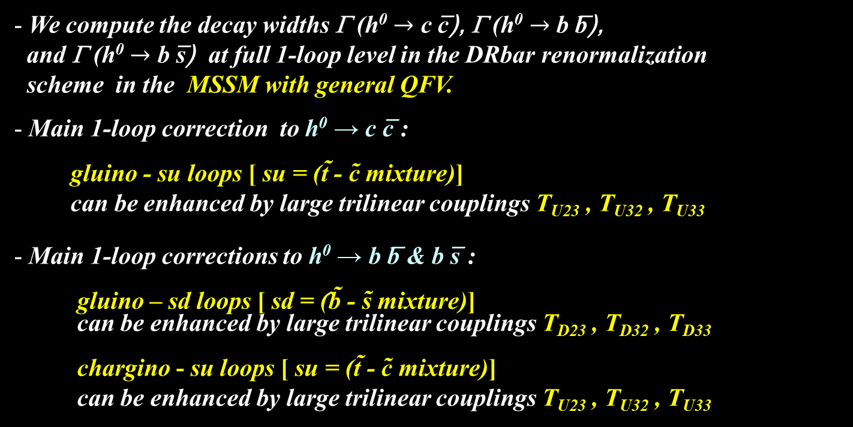
5. h⁰ → c c̅ , b b̅ , b s̅ in the MSSM
We compute the decay widths Γ (h⁰ $→$ c c̅), Γ (h⁰ $→$ b b̅),
and Γ (h⁰ $→$ b s̅) at full 1-loop level in the DRbar renormalization
scheme in the MSSM with general QFV.
Main 1-loop correction to h⁰ → c c̅ :
gluino - su loops [ su = (t̃ - c̃ mixture)]
can be enhanced by large trilinear couplings T_{U23} , T_{U32} , T_{U33}
Main 1-loop corrections to h⁰ → b b̅ & b s̅ :
gluino – sd loops [ sd = (̂b̃ - s̃ mixture)]
can be enhanced by large trilinear couplings T_{D23} , T_{D32} , T_{D33}
chargino - su loops [ su = (t̃ - c̃ mixture)]
can be enhanced by large trilinear couplings T_{U23} , T_{U32} , T_{U33}

Slide 45
In large & mixing scenario;
h⁰ ̴ H₂⁰
g̃
In our scenario, “trilinear couplings“ ( , ,
couplings) = (T_{U23} T_{U32} , T_{U33} ) are large!
couplings are large!
Gluino loop contributions can be large!
Deviation of Γ (h⁰ → c c̅) from SM width can be large!

Slide 46
In large s̃_{R/L} - b̃_{R/L} & b̃_{L} - b̃_{R} mixing scenario;
b
h⁰ ̴ - sα H₁⁰ + cα H₂⁰
d̃_{1,2}
d̃_{1,2} ̴ s̃_{R/L} + b̃_{R/L}
h⁰
g̃
d̃_{1,2}
b̅ / s̅
In our scenario, “trilinear couplings“(T_{D23} T_{D32} , T_{D33} ) =
(s̃_{R} - b̃_{L} - H₁⁰ , s̃_{L} - b̃_{R} - H₁⁰ , b̃_{L} - b̃_{R} - H₁⁰ couplings) are large!
d̃_{1,2} - d̃_{1,2} - h⁰ couplings are large!
Gluino loop contributions can be large!
Deviation of Γ (h⁰ → b b̅/s̅ ) from SM width can be large!

Slide 47
In large c̃_{R/L} - t̃_{R/L} & t̃_{L} - t̃_{R} mixing scenario;
b
h⁰ ̴ H₂⁰
ũ_{1,2}
ũ_{1,2} ̴ c̃_{R/L} + t̃_{R/L}
h⁰
χ̃±
χ̃± ~ W̃± + H̃±
ũ_{1,2}
b̅ / s̅
In our scenario, “trilinear couplings“ ( , ,
couplings) = (T_{U23} T_{U32} , T_{U33} ) are large!
couplings are large!
Chargino loop contributions can be large!
Deviation of Γ (h⁰ → b b̅/s̅ ) from SM width can be large!

Slide 48
5.1 Deviation of the width from the SM prediction
- Deviation of the width from the SM prediction:
_ _ _
DEV(h⁰ -> X X) = Γ(h⁰ -> X X)_{MSSM} / Γ (h⁰ -> X X)_{SM} - 1
X = c, b
Coupling modifier:
κ_{X} = g(h⁰X X) / g(h⁰X X)_{SM}
DEV - κ_{X} relation:
DEV(h⁰ -> X X) = κ_{X}² – 1

Slide 49
Scatter plot in DEV(h⁰ -> c c̅) - DEV(h⁰ -> b b̅) plane
Expected 1 sigma error at ILC250 + HL-LHC
DEV(h⁰ -> b b̅)
Expected 1 sigma error at ILC250/500 + HL-LHC
DEV(h⁰ -> c c̅)
DEV(h⁰ -> c c̅) and DEV(h⁰ -> b b̅) can be very large simultaneously!:
DEV(h⁰ -> c c̅) can be as large as ~ ±60%.
DEV(h⁰ -> b b̅) can be as large as ~ ±20%.
ILC can observe such large deviations from SM at high significance (arXiv:2206.08326)!:
Δ DEV(h⁰ -> c c̅) = (3.6%, 2.4%, 1.8%) at (ILC250, ILC250/500, ILC250/500/1000)
Δ DEV(h⁰ -> b b̅) = (1.7%, 1.1%, 0.9%) at (ILC250, ILC250/500, ILC250/500/1000)

Slide 50
Expected absolute 1 sigma errors of the deviations DEVs at future lepton colliders
Jorge de Blas et al., Snowmass2021 Report: arXiv:2206.08326 [hep-ph];
Private communication with Jorge de Blas.

Slide 51
Expected absolute 1 sigma errors of the deviations DEVs at future lepton colliders

Slide 52
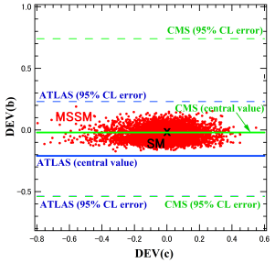
Scatter plot in DEV(h⁰ -> c c̅) - DEV(h⁰ -> b b̅) plane
DEV(h⁰ -> b b̅)
DEV(h⁰ -> c c̅)
DEV(h⁰ -> X X) = κ_{X}² – 1
Recent LHC data:
DEV(h⁰ -> b b̅) = -0.21 +0.44/-0.33 (95% CL) (ATLAS) (arXiv:2207.00092)
DEV(h⁰ -> b b̅) = -0.02 +0.76/-0.52 (95% CL) (CMS) (arXiv:2207.00043)
Both SM and MSSM are consistent with the recent ATLAS/CMS data!
The errors of the recent ATLAS/CMS data are too large!

Slide 53


5.2 BR(h⁰ → b s̅ / s b̅)
BR(h⁰ -> b s̅ / s b̅) $≅$ 0 ( < 10 ⁻⁷ ) (SM)
BR(h⁰ -> b s̅ / s b̅) $≅$ 0 (MSSM with MFV)
BR(h⁰ -> b s̅ / s b̅) can be as large as ~ 0.15% (MSSM with QFV)!
(See also Gomez-Heinemeyer-Rehman, PR D93 (2016) 095021 [arXiv:1511.04342]. )
ILC(250+500+1000) sensitivity could be ~ 0.1% (at 4 σ significance)!
Private communication with Junping Tian;
See also Barducci et al., JHEP 12 (2017) 105 [arXiv:1710.06657].
Expected FCC-ee bound is BR(h⁰ -> b s̅ / s b̅) < 4.5· 10 ⁻⁴ (at 95% CL)
See M. Selvaggi, talk at FCC Physics Performance Meeting, 18 Mar 2024.
Expected CEPC bound is BR(h⁰ -> b s̅ / s b̅) < 2.2· 10 ⁻⁴ (at 95% CL)
See H. Liang et al., arXiv:2310.03440.

Slide 54
Scatter plot in T_{D23} - BR(h⁰ -> b s̅ / s b̅) plane
ILC(250+500+1000) sensitivity at 4 σ significance
← 0.1%
1.0X10⁻³
0.75
BR(h⁰ -> b s̅ / s b̅)
0.5
0.25
0
T_D23 (GeV)
s̃_{R} – b̃_{L} mixing parameter
There is a strong correlation between T_{D23} - BR(h⁰ -> b s̅ / s b̅)!
BR(h⁰ -> b s̅ / s b̅) can be as large as 0.1% for large T_{D23} !
ILC(250 + 500 + 1000) sensitivity could be ~ 0.1% at 4 sigma significance!
Private communication with Junping Tian;
See also Barducci et al., JHEP 12 (2017) 105 [arXiv:1710.06657].
- LHC & HL-LHC sensitivity should not be so good due to huge QCD BG!

Slide 55
5.3 Deviation of width ratio from the SM prediction
- The deviation of the width ratio from the SM prediction:
DEV(b/c) = [Γ (b) / Γ (c)]_{MSSM} / [Γ (b) / Γ (c)]_{SM} - 1
_
Γ (X) = Γ (h⁰-> X X)
We find;
the experimental measurement errors as
well as the MSSM prediction errors
tend to cancel out significantly in the width ratios.

Slide 56
Scatter plot in T_{U32} – DEV(b/c) plane
DEV(b/c)
SM
T_U32 (GeV)
c̃_{L} – t̃_{R} mixing parameter
There is a strong correlation between T_{U32} – DEV(b/c)!
DEV(b/c) can exceed ~ +100% for large T_{U32} !
- Expected absolute 1 σ error of DEV(b/c) at ILC:
ΔDEV(b/c) = (3.1%, 2.1%, 1.3%) at (ILC250, ILC250+500, ILC250+500+1000).
[Jorge de Blas et al., Snowmass2021 Report: arXiv:2206.08326;
Private communication with Jorge de Blas.]
- ILC can observe such large deviation from SM at very high significance!

Slide 57
Expected absolute 1 sigma errors of the deviations DEVs at future lepton colliders

Slide 58
Scatter plot in DEV(b/c) – DEV(c) plane
DEV(b/c)
DEV(c)
There is a very strong correlation between DEV(b/c) – DEV(c)!
DEV(b/c) and DEV(c) can be very large simultaneously!
- Expected absolute 1 σ error of DEV(c) and DEV(b/c) at ILC:
Δ DEV(c) = (3.6%, 2.4%, 1.8%) at (ILC250, ILC250+500, ILC250+500+1000)
ΔDEV(b/c) = (3.1%, 2.1%, 1.3%) at (ILC250, ILC250+500, ILC250+500+1000).
[Jorge de Blas et al., Snowmass2021 Report: arXiv:2206.08326;
Private communication with Jorge de Blas.]
- ILC can observe such large deviation from SM at very high significance!

Slide 59
Expected absolute 1 sigma errors of the deviations DEVs at future lepton colliders

Slide 60

6. h⁰ → γ γ, g g in the MSSM
As the h⁰ decays to photon photon and gluon gluon are loop-induced decays,
these decays are very sensitive to New Physics!
We compute the widths Γ (h⁰ $→$ γ γ) and Γ (h⁰ $→$ g g) at NLO QCD level
in the MSSM with general QFV .
Main 1-loop contributions to h⁰ $→$ γ γ :
[W⁺/ top-quark / su] - loops [ su = (t̃ - c̃ mixture)]
The su-loops can be enhanced by large trilinear couplings T_{U23} , T_{U32} , T_{U33} ,
resulting in sizable deviation of Γ (h⁰ → γ γ) from the SM width!
Main 1-loop contributions to h⁰ → g g:
[top-quark / su] - loops [ su = (t̃ - c̃ mixture)]
The su-loops can be enhanced by large trilinear couplings T_{U23} , T_{U32} , T_{U33 ,}
resulting in sizable deviation of Γ (h⁰ → g g) from the SM width!

Slide 61


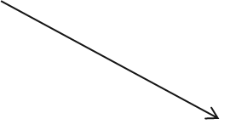

γ
X
X = W ⁺/ t / ũ_{1,2}
h⁰
X
γ
g
X
h⁰
X = t / ũ_{1,2}
X

Slide 62
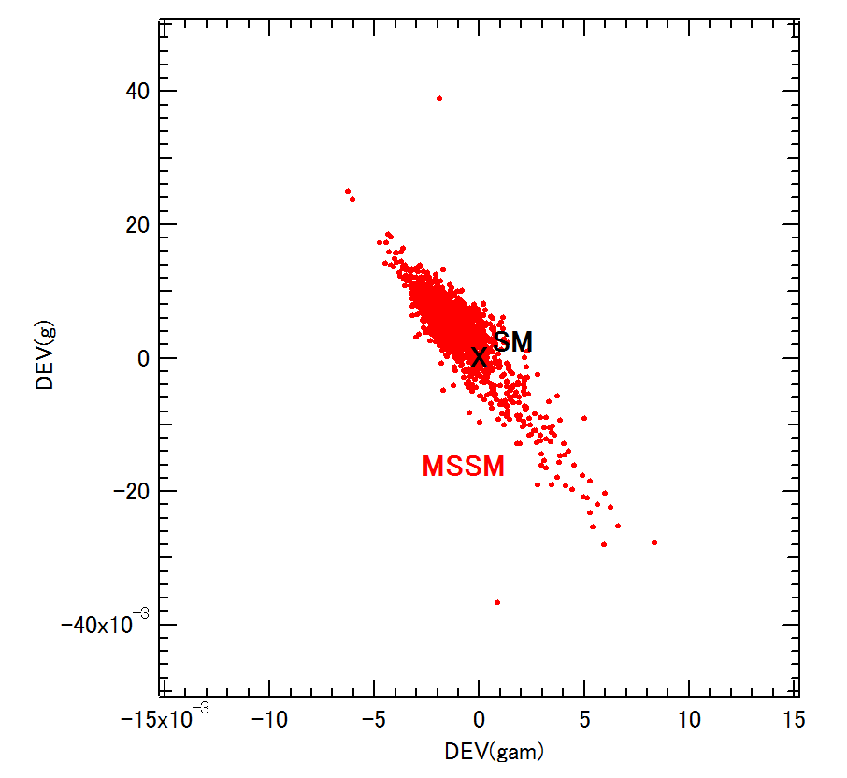
Scatter plot in DEV(h⁰ → γ γ ) - DEV(h⁰ → g g) plane
DEV(h⁰ → g g)
DEV(h⁰ → γ γ )
There is a strong correlation between DEV(h⁰ → γ γ ) and DEV(h⁰ → g g)!
DEV(h⁰ → γ γ ) and DEV(h⁰ → g g) can be sizable simultaneously!:
DEV(h⁰ → γ γ ) can be as large as ~ ±1%
DEV(h⁰ → g g) can be as large as ~ ±4%.
Expected absolute 1 σ errors at (ILC250, ILC250+500, ILC250+500+1000):
Δ DEV(h⁰ → γ γ ) = (2.4%, 2.2%, 2.0%)
Δ DEV(h⁰ → g g) = (1.8%, 1.4%, 1.1%)
[Jorge de Blas et al., Snowmass2021 Report: arXiv:2206.08326;
Private communication with Jorge de Blas.] (See Backup slides)
- ILC can observe such sizable deviation DEV(h⁰ → g g) at high significance!

Slide 63
Expected absolute 1 sigma errors of the deviations DEVs at future lepton colliders

Slide 64
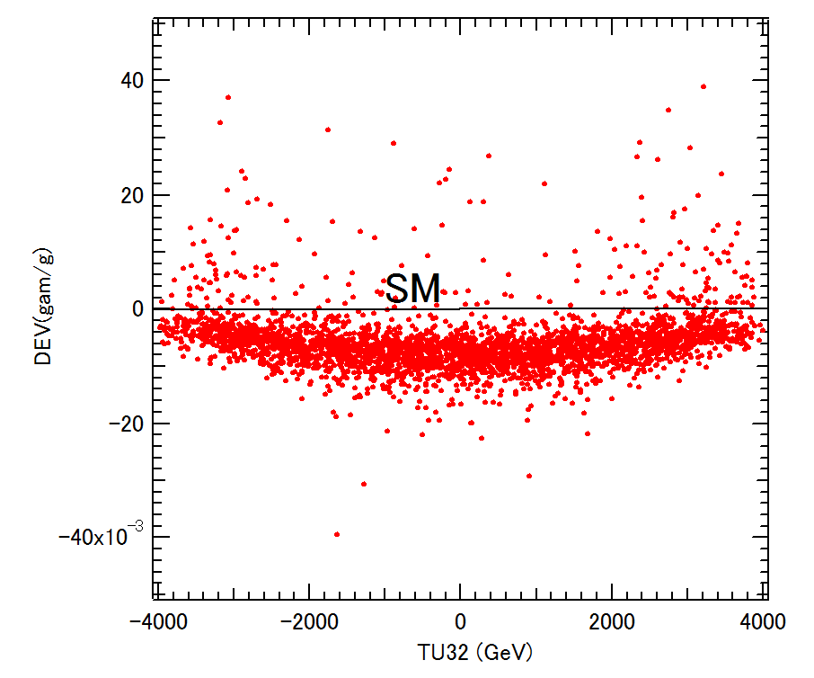
Scatter plot in T_{U32} – DEV(γ / g) plane
MSSM
DEV(γ / g)
T_U32 (GeV)
c̃_{L} – t̃_{R} mixing parameter
There is a strong correlation between T_{U32} – DEV(γ / g) !
DEV(γ / g) can be as large as ~ + 4% for large T_{U32}! (from scatter plot analysis)
~ + 8% for large T_{U32} ! (from contour plot analysis)
- Expected absolute 1 sigma error of DEV(γ / g) at ILC:
Δ DEV(γ / g) = (3.3%, 2.8%, 2.3%) at (ILC250, ILC250+500, ILC250+500+1000).
[Jorge de Blas et al., Snowmass2021 Report: arXiv:2206.08326;
Private communication with Jorge de Blas.] (See Backup slides)
- ILC can observe such sizable deviation from SM at high significance.

Slide 65
Expected absolute 1 sigma errors of the deviations DEVs at future lepton colliders

Slide 66
7. Benchmark scenario
- In our analysis we also take into account the expected sparticle mass limits
from the future HL-LHC experiment .
- From the allowed MSSM parameter points in the scan, we have selected
a benchmark point P1 shown in Table 2 .
- This benchmark scenario P1 satisfies also all the expected sparticle mass limits
[including (𝑚_{𝐴 /𝐻+} , tan𝛽) limits] from future HL-LHC experiment .
[ see CERN Yellow Rep., arXiv:1812.07831;
Snowmass Rep. of EF, arXiv:2209.13128; ... ]
- The resulting physical masses of the particles are shown in Table 3.

Slide 67
Benchmark scenario P1

Slide 68
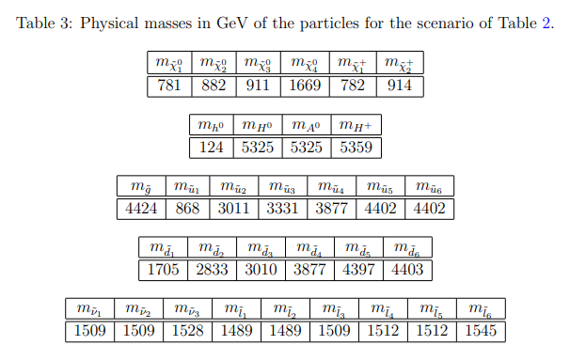
Physical masses for Benchmark scenario P1

Slide 69
Contours of DEV(h⁰ -> c c̅) in T_{U32} - M²_{U23} plane around P1
We find that DEV(c) can be very large (about -30% to 10%) in a sizable region allowed by all the constraints including the expected sparticle mass limits from the future HL-LHC experiment!

Slide 70
Contours of DEV(h⁰ -> b b̅) in T_{U32} - M²_{U23} plane around P1
We find that DEV(b) can be very large (about -10% to -18%) in a sizable region allowed by all the constraints including the expected sparticle mass limits from the future HL-LHC experiment!
For DEV(g), DEV(γ ), DEV(γ /g) and DEV(b/c) we have obtained similar results
to those for DEV(c) and DEV(b).

Slide 71
Contours of B(h⁰ -> b s̅ / s b̅) in T_{U32} – tanβ plane around P1
- B(h⁰ -> b s̅ / s b̅) can be as large as ~ 0.15% in a sizable region allowed by all the
constraints including the expected sparticle mass limits from the future HL-LHC!
ILC(250 + 500 + 1000) sensitivity could be ~ 0.1% at 4σ significance!
Private communication with Junping Tian;
See also Barducci et al., JHEP 12 (2017) 105 [arXiv:1710.06657].

Slide 72
8. Conclusion
- We have studied the decays
h⁰ (125GeV) → c c̅ , b b̅ , b s̅ , γ γ, g g in the MSSM with general QFV.
- For the first time, we have performed a systematic MSSM parameter scan
respecting all of the relevant theoretical and experimental constraints.
- In strong contrast to the usual studies in the MSSM with minimal flavor violation (MFV),
we have found that the deviations of these MSSM decay widths and width ratios
from the SM values can be quite sizable in the MSSM with general QFV.
- All of these large deviations in the h (125) decays are due to
large c̃ - t̃ mixing & large c̃ / t̃ involved trilinear couplings T_{U23}, T_{U32}, T_{U33} and
large s̃ - b̃ mixing & large s̃ / b̃ involved trilinear couplings T_{D23}, T_{D32}, T_{D33} .
- Future lepton colliders such as ILC, CLIC, CEPC, FCC-ee and MuC can
observe such sizable deviations from the SM at high signal significance
even after the failure of SUSY particle discovery at the HL-LHC.
- In case the deviation pattern shown here is really observed at the lepton colliders,
then it would strongly suggest the discovery of QFV SUSY (the MSSM with general QFV).

Slide 73
Our analysis suggests the following:
PETRA/TRISTAN e- e+ collider discovered virtual Z⁰ effect for the first time.
Later, CERN p p̄ collider discovered the Z⁰ boson.
Similarly, lepton colliders, such as ILC, could discover virtual Sparticle effects for the first time in h⁰(125) decays!
Later, FCC-hh p p collider could discover the Sparticles!

Slide 74
END
Thank you!

Slide 75

Backup Slides

Slide 76
Expected absolute 1 sigma errors of the deviations DEVs at future lepton colliders
Jorge de Blas et al., Snowmass2021 Report: arXiv:2206.08326 [hep-ph];
Private communication with Jorge de Blas.

Slide 77
Expected absolute 1 sigma errors of the deviations DEVs at future lepton colliders

Slide 78
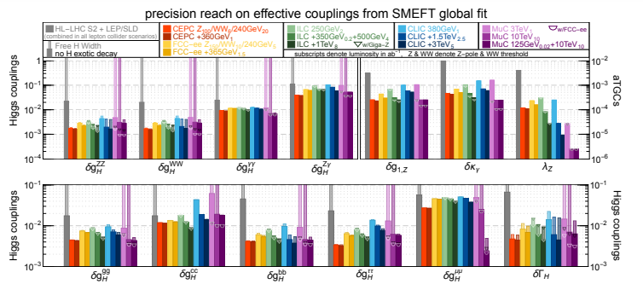
Higgs couplings at future colliders
Snowmass2021 Report: arXiv:2206.08326
(See Fig. 3 in page 37; Table 29 in page 40)
Higgs coupling precision at future colliders

Slide 79
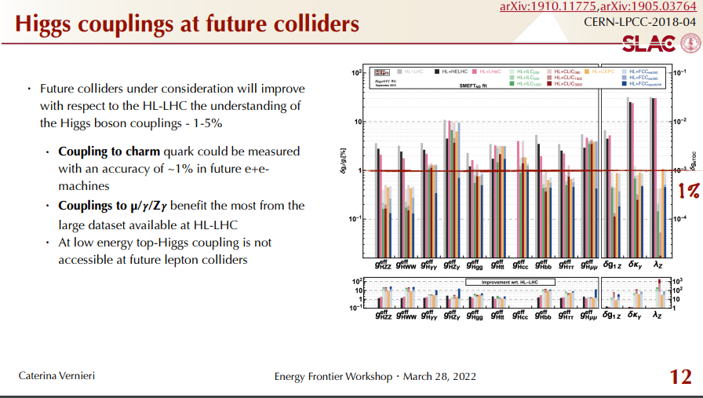
Higgs couplings at future colliders
ESU2020 Report: arXiv:1905.03764
Higgs coupling precision in % at future colliders

Slide 80
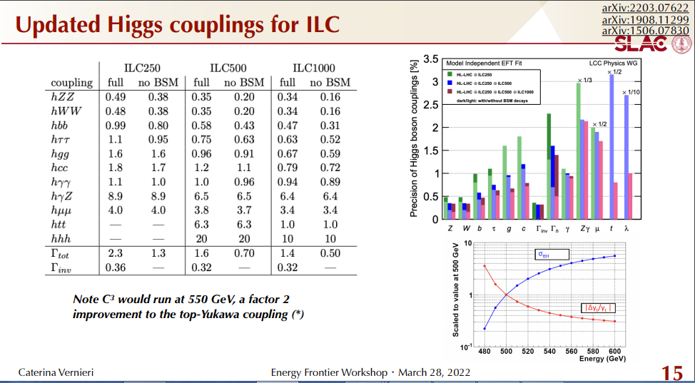
Higgs couplings at future colliders
ILC White Paper (Snowmass2021): arXiv:2203.07622
(See Fig. 12.1 in page 255; Table 12.2 in page 256)
Higgs coupling precision in % for ILC

Slide 81
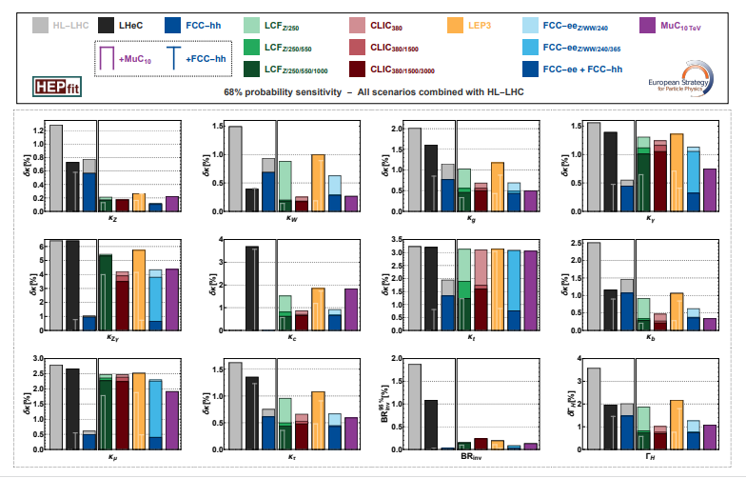
Higgs coupling precision at future colliders
Physics Briefing Book: arXiv:2511.03883

Slide 82
DEV error - coupling error relation
Δ DEV(h → X X) = 2 δ g(hXX)
δ g(hXX) = [Expected relative error of coupling g(hXX)]
Δ DEV(h → X X) = [Expected absolute error of deviation
DEV(h → X X)]

Slide 83
2. MSSM with QFV
The basic parameters of the MSSM with QFV:
{tanβ, m_{A} , M₁ , M₂ , M₃ , μ , M²_{Q,αβ} , M²_{U,αβ} , M²_{D,αβ} , T_{Uαβ} , T_{Dαβ} }
(at Q = 1 TeV scale ) (α,β = 1,2,3 = u, c, t or d, s, b)
tanβ : ratio of VEV of the two Higgs doublets <H⁰ ₂>/<H⁰₁>
mA : CP odd Higgs boson mass (pole mass)
M_{1,} M₂ ,M₃ : U(1), SU(2),SU(3) gaugino masses
μ : higgsino mass parameter
M²_{Q,αβ} : left squark soft mass matrix
M²_{Uαβ} : right up-type squark soft mass matrix
M²_{Dαβ} : right down-type squark soft mass matrix
T_{Uαβ} : trilinear coupling matrix of up-type squark and Higgs boson
T_{Dαβ} : trilinear coupling matrix of down-type squark and Higgs boson

Slide 84
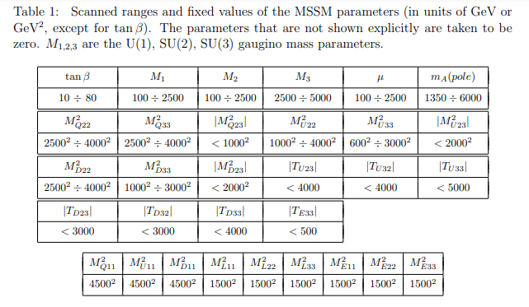
4. Parameter scan for h⁰ decay in the MSSM

Slide 85
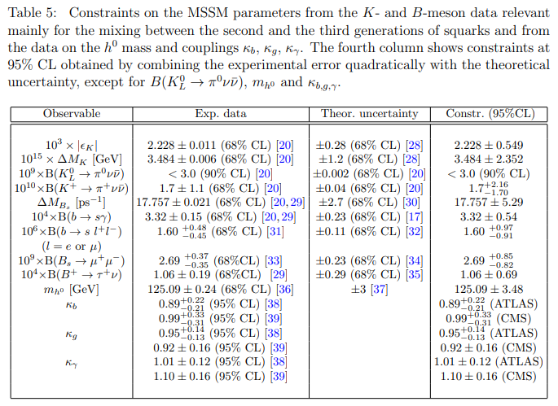
Constraints on the MSSM parameters from K & B meson and h⁰ data:

Slide 86
* Constraints from W boson mass data:
The recent m_{W} data from CDF II [1] disagrees significantly with the previous
world average. (-> See backup slides.)
[1] CDF Collaboration, Science 376, 170–176 (2022)
This issue of the m_{W} data is not yet settled.
Hence, we do not take into accont this m_{W} constraint on the MSSM
parameters in our analysis.
Notes:
Experimental constraint from B(b -> s l+ l-) ;
The low-s region (1 GeV^2 < s < 6 GeV^2) is dominated by the Wilson
coefficients C_9 and C_10, has sizable integrated branching ratio and is very
sensitive to the C_7 - C_9 interference. In the following, we utilize the latter
to put constraints on the Wilson coefficients C_7,8,9,10.
We calculate the integrated branching ratio in the low-s region following Ref. [52]:

Slide 87
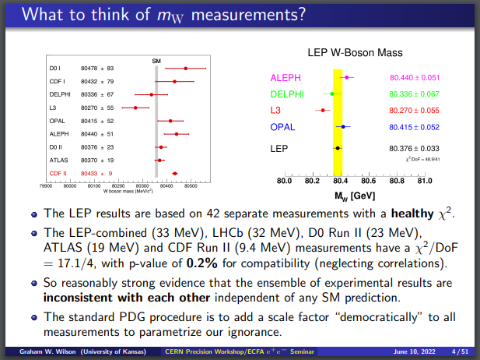
From G. Wilson’s talk at ECFA Higgs Factory seminars: Precision physics in the e+e- -> WW region, June 10 2022: https://indico.cern.ch/event/1163667/

Slide 88
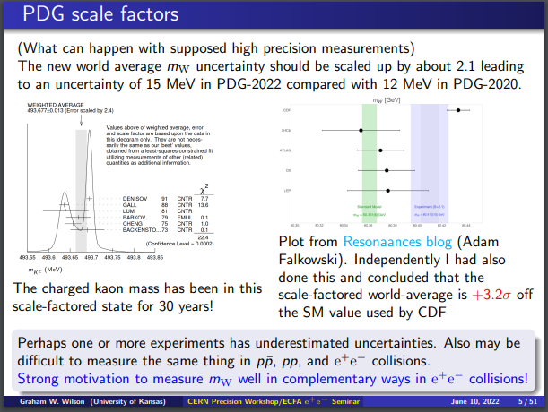

Slide 89
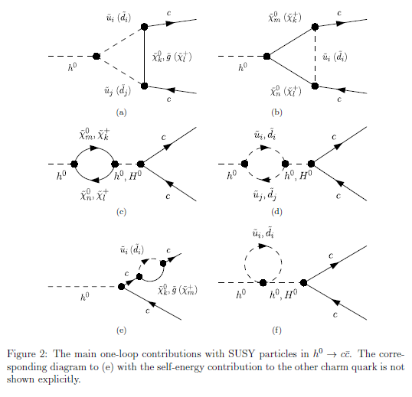
_
Main SUSY one-loop contributions to h⁰ -> c c

Slide 90
Caveat for very large DEV(h⁰ -> c c̅)
MSSM
SM
DEV(h⁰ → c c̅)
T_U32 (GeV)

Slide 91
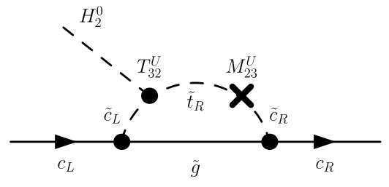

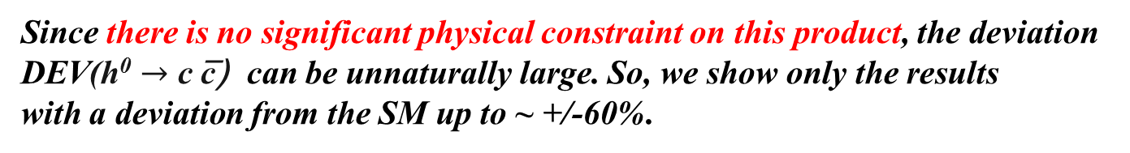
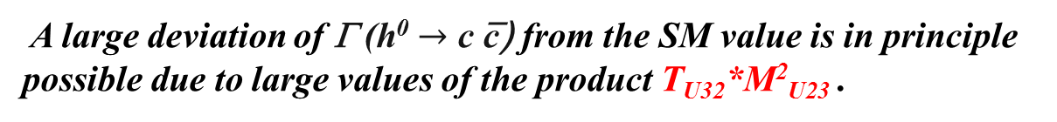
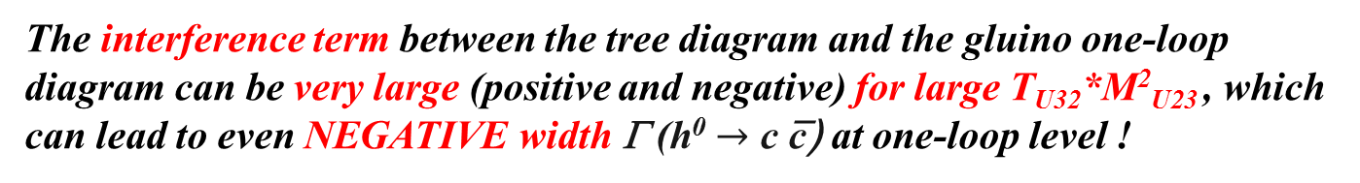
Caveat for very large DEV(h⁰ -> c c̅)
h⁰ ~
Gluino loop contribution to h⁰ $→$ c c̅ can be very
large (positive and negative) for large T_{U32}*M²_{U23}!
T_{U32}
M²_{U23}
The interference term between the tree diagram and the gluino one-loop
diagram can be very large (positive and negative) for large T_{U32}*M²_{U23} , which
can lead to even NEGATIVE width Γ (h⁰ $→$ c c̅) at one-loop level !
In this case perturbation theory breaks down!
A large deviation of Γ (h⁰ $→$ c c̅) from the SM value is in principle possible due to large values of the product T_{U32}*M²_{U23} .
Since there is no significant physical constraint on this product, the deviation DEV(h⁰ $→$ c c̅) can be unnaturally large. So, we show only the results
with a deviation from the SM up to ~ +/-60%.

Slide 92
Contours of DEV(h⁰ -> c c̅) in T_{U32} - M²_{U23} plane

Slide 93
Effect of Resummation of the bottom Yukawa coupling at large tanβ
As for Γ (h⁰ -> b b̅ ) & Γ (h⁰ -> b s̅ / s b̅), we have considered the large tanβ
enhancement and the resummation of the bottom Yukawa coupling [1].
It turns out, however, that in our case with large m_{A} close to the decoupling Higgs limit, the resummation effect (Δ_{b} effect) is very small (< 0.1%) [2].
[1] M. Carena et al., Nucl. Phys. B 577 (2000) 88 [hep-ph/9912516].
[2] H. Eberl, E. Ginina, A. Bartl, K. Hidaka and W. Majerotto, JHEP 06
(2016) 143 [arXiv:1604.02366 [hep-ph]];
E. Ginina, A. Bartl, H. Eberl, K. Hidaka and W. Majerotto,
PoS(EPS-HEP2015)146 [arXiv:1510.03714 [hepph]].

Slide 94
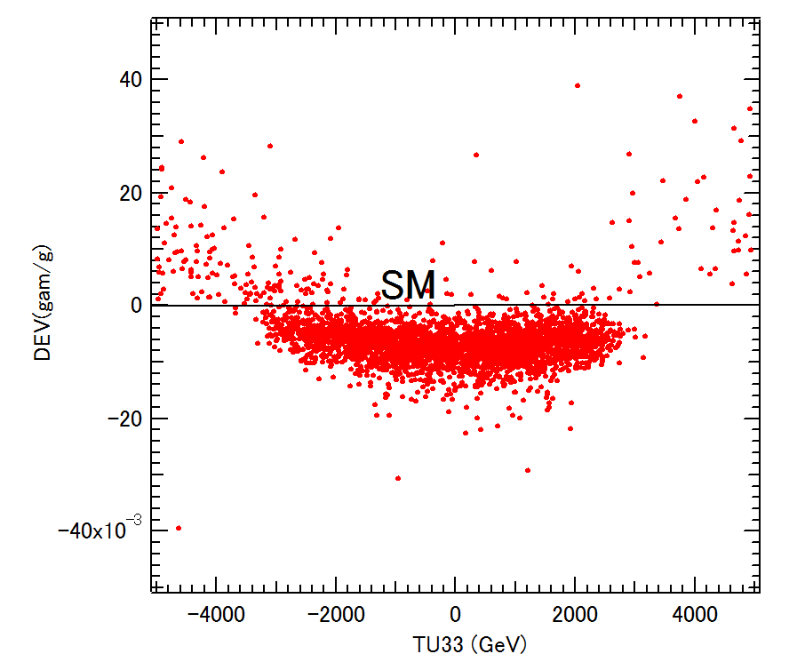
Scatter plot in T_{U33} – DEV(γ / g) plane
MSSM
DEV(γ / g)
T_U33 (GeV)
t̃_{L} – t̃_{R} mixing parameter
There is a strong correlation between T_{U33} – DEV(γ / g) !
DEV(γ / g) can be as large as ~ +4% for large T_{U33} !

Slide 95
8. Conclusion
- We have studied the decays
h⁰ (125GeV) → c c̅ , b b̅ , b s̅ , γ γ, g g in the MSSM with general QFV.
Performing a systematic MSSM parameter scan respecting all of the relevant theoretical
and experimental constraints , we have found the followings:
* DEV(h⁰ -> c c̅) and DEV(h⁰ -> b b̅) can be very large simultaneously! :
DEV(h⁰ -> c c̅) can be as large as ~ ± 60%,
DEV(h⁰ -> b b̅) can be as large as ~ ± 20%.
* The deviation of the width ratio Γ (h⁰ -> b b̅) / Γ (h⁰ -> c c̅)
from the SM value can exceed ~ +100%.
* BR(h⁰ -> b s̅ / s b̅) can be as large as ~ 0.15%!
ILC(250 + 500 + 1000) sensitivity could be ~ 0.1% at 4 sigma signal significance!

Slide 96
* DEV(h⁰ -> γ γ ) and DEV(h⁰ -> g g) can be sizable simultaneously! :
DEV(h⁰ -> γ γ ) can be as large as ~ ±1%,
DEV(h⁰ -> g g) can be as large as ~ ±4%.
* The deviation of the width ratio Γ (h⁰ -> γ γ )/ Γ (h⁰ -> g g) from the SM value
can be as large as ~ -4% to +8% .
* There is a very strong correlation between DEV(h⁰ -> γ γ )
and DEV(h⁰ -> g g). This correlation is due to the fact that the stop-loop
(stop-scharm mixture loop) contributions dominate the two DEVs.
- All of these large deviations in the h⁰ (125) decays are due to
large c̃ - t̃ mixing & large c̃ / t̃ involved trilinear couplings T_{U23}, T_{U32}, T_{U33} and
large s̃ - b̃ mixing & large s̃ / b̃ involved trilinear couplings T_{D23}, T_{D32}, T_{D33}.
Future lepton colliders such as ILC, CLIC, CEPC, FCC-ee can observe
such large deviations from SM at high significance!
In case the deviation pattern shown here is really observed at the future lepton colliders, then it would strongly suggest the discovery of QFV SUSY (MSSM with general QFV)!

