Slide 1




Topological Boundary States As Open Quantum Systems
YITP, Kyoto University Masatoshi Sato

Slide 2
Outline
1. Non-Hermitian Topological Phases
2. Hidden Non-Hermiticity of Topological Boundary States
Notes:
文献リストを書く

Slide 3
Non-Hermitian Topological Phases

Slide 4
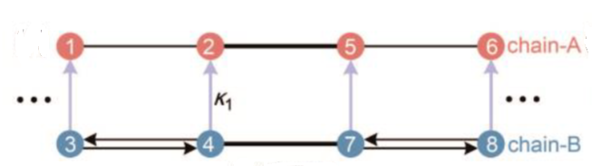

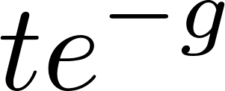
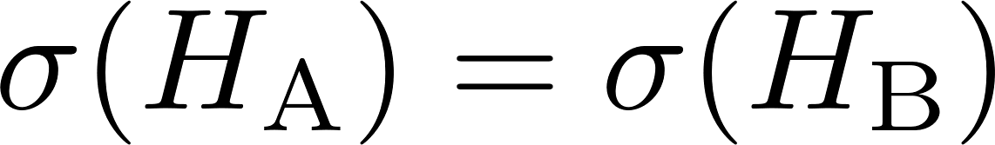
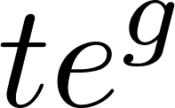
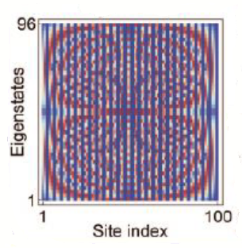
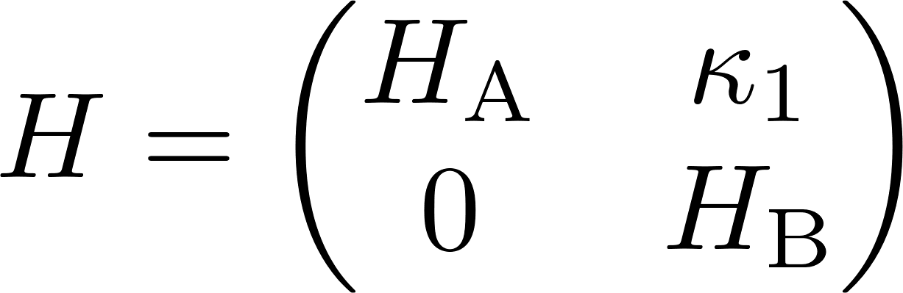
Why should we consider non-Hermiticity?
Recent technology enables us to imitate quantum phenomena in classical systems, with controlled non-Hermiticity
Hermitian H_{A} (extended mode)
w/ same spectra
Hatano-Nelson H_{B} (localized mode)
[Li-Wang-Cai-Shimomura-Yang-MS-Ma (25)]
Exceptional Deficiency
(= macroscopic # of EPs)
All HN modes disappear in the eigenstates
Notes:
Recent technology enable us to imitate quantum phenomena in classical system, with controlled non-Hermiticity.
We can imitate quantum phenomena in classical systems, where we can easily introduce non-Hermiticity. 例外点の

Slide 5
Non-Hermiticity in quantum systems
Hamiltonians in quantum systems are usually supposed to be Hermitian, but this assumption is no so obvious.
A quasi-particle or excitation has a finite lifetime in open systems or due to interactions or disorders
Non-Hermiticity
Even when the original Hamiltonian is Hermitian, the effective Hamiltonian can be non-Hermitian
Notes:
How about pure quantum systems

Slide 6
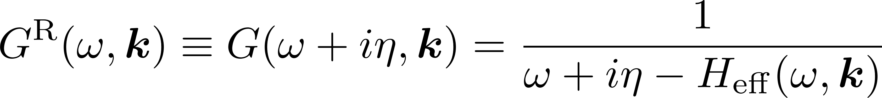
One can directly introduce the non-Hermiticity in quantum theories as the self-energy of the Green function
retarded (two-point) Green function
Non-Hermiticity
Generally, details of the self-energy is hard to be derived
However, topological arguments enable us to obtain robust results w/o using the details if we retain correct symmetries and gap structures

Slide 7
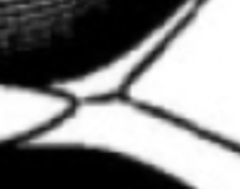
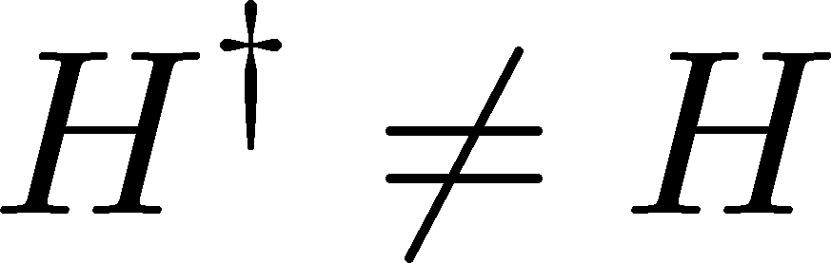
Importantly, non-Hermiticity gives novel features in top. physics
1) Non-Hermitian generalization of top. phase
[Esaki-MS-Hasebe-Kohmoto (11), Shen-Zhen-Fu (18)]
2) New Symmetry
Hermitian conj. of TRS, PHS, CS are possible
TRS
PHS
CS
Non-Hermitian case
38 classes
A
0
0
0
AIII
0
0
1
AZ sym
10 classes
AI
BDI
D
DIII
AII
CII
C
CI
1
1
0
-1
-1
-1
0
1
0
1
1
1
0
-1
-1
-1
0
1
0
1
0
1
0
1
AZ† sym (=Hermitian conj. of AZ)
10 classes
SLS+AZ sym (=Hermitian conj. of CS+AZ sym)
27 classes
double-counting
-9 classes
10 classes (AZ classes)
[Kawabata-Shiozaki-Ueda-MS (19) ]

Slide 8



For the effective theories, the conventional Altland-Zirnbauer symmetries becomes their Hermitian conjugation version
Hermitian conj. of AZ symmetries (= AZ$†$symmetries)
TRS$†$
PHS$†$
CS
ex.) TRS$†$
TRS
retarded Green fn
adv. Green fn
retarded Green fn
retarded Green fn

Slide 9
3) Multiple gap structures
[Kawabata-Shiozaki-Ueda-MS (19)]
Hermitian case
non-Hermitian case
[Esaki-MS-Hasebe-Kohmoto (11)]
E
ReE
“empty”
(Re E> E_{F})
Real line gap
empty state
(E > E_{F})
Fermi energy line
Fermi energy
ImE
occupied state
(E < E_{F})
“occupied”
(Re E < E_{F})
unique gap
ReE
“occupied”
(Im E <E_{F})
Fermi energy line
We have multiple definition of gaps
ImE
Imaginary line gap
“empty”
(Im E > E_{F})

Slide 10
We can also introduce one more different gap according to point-like definition of the Fermi energy
Re E
point gap
Re E
Fermi energy point
ImE
ImE
No distinction b/w
occupied & empty
Importantly, the point gap can describe new type of topological phase transition
[Gong-Ashida-Kawabata-Higashikawa-Takasan-Ueda (18)]
Re E
Re E
Topological
Non-Top
ImE
ImE

Slide 11
For topological classification, the following two theorems are crucial.
Theorem 1.
[Esaki-MS-Hasebe-Kohmoto (11), Kawabata-Shiozaki-Ueda-MS (19), Ashida-Gong-Ueda (20)]
If a non-Hermitian Hamiltonian has a line gap, it can be continuously deformed into a Hermitian (or anti-Hermitian) Hamiltonian
non-Hermitian
Hermitian
ReE
E
Fermi energy line
ImE
Fermi energy
Line gap top phases are classified as Hermitian top phases
Notes:
非エルミートハミルトニアンの場合には、それぞれのギャップに対して、それぞれトポロジカル数が与えられる。
ラインギャップが開いている場合には、ハミルトニアンはエルミートハミルトニアンに連続変形できる。したがって、トポロジカル相の分類は、エルミートハミルトニアンのトポロジカル相の分類に帰着する

Slide 12
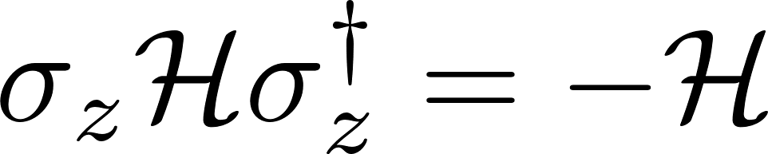
Theorem 2.
[Gong-Ashida et al, (18), Kawabata-Shiozaki-Ueda-MS (19)]
If a non-Hermitian Hamiltonian has a point gap, it can be mapped into a top insulator w/CS.
Point gapped non-Hermitian system
Topological insulator w/ CS
Re E
E
CS
point gapped
ImE
gapped
E_{P}
Point gap of non-Hermitian H is closed if and only if gap of Hermitian H is closed
Point gap top phases are also classified as Hermitian top phases (w/CS)
Notes:
ポイントギャップのトポロジカル相の分類もエルミートハミルトニアンの分類に帰着できる
したがって、エルミートハミルトニアンの分類から非エルミートハミルトニアンの分類を得ることが可能である。

Slide 13
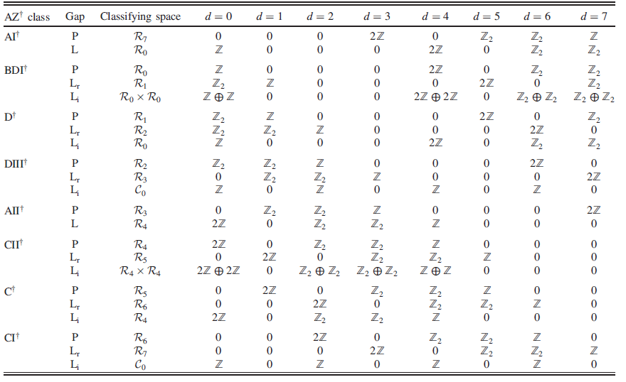

Based on 38 sym. classes and 3 different gaps, we complete classification of gapful (and gapless) non-Hermitian top. phases
[Kawabata-Shiozaki-Ueda-MS(18), Kawabata-Bessho-MS (19)]
Gapful TP (AZ$†$ sym)
We have multiple top.#s corresponding to multiple gap structures
We also have topological tables for the remaining 28 classes …
Notes:
対称性について

Slide 14
Hidden non-Hermiticity of topological boundary states

Slide 15
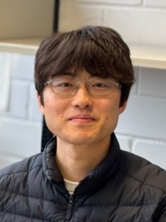




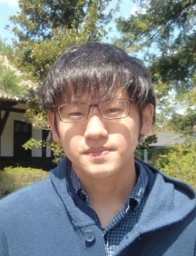
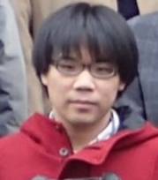
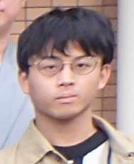
In collaboration with
Yusuke Nakai
(YITP -> RIKEN)
Kenji Shimomura
(YITP )
Ken Shiozaki
(YITP )
Ruel Dsouza
(MPI, Stuttgart)
Andreas Schnyder
(MPI, Stuttgart)
Daichi Nakamura
(ISSP)
Kohei Kawabata
(ISSP)
Shu Hamanaka
(Kyoto)
Y. Nakai, R. Dsouza, D. Nakamura, S. Hamanaka, A. Schnyder, MS, arXiv:2502.16729
D. Nakamura, K. Shiozaki, K.Shimomura, MS, K. Kawabata, PRL (25)
Notes:
川畑さん、塩崎さん、下村さんもあげる

Slide 16
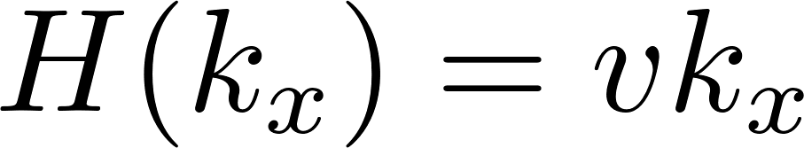
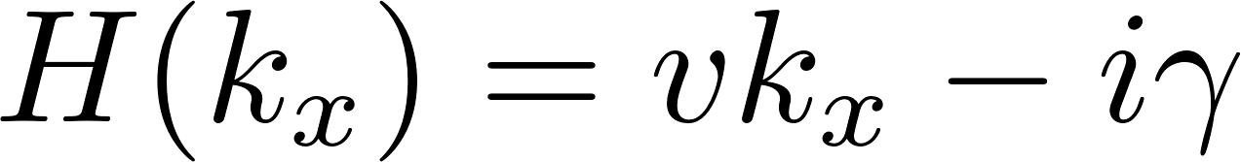
Quantum Hall state
chiral edge state
boundary
loss
unidirectional along edge
unidirectional along edge
loss
Hermitian
non-Hermitian
Because of the unidirectional motion, the chiral edge state may exhibit non-Hermiticity even w/o dissipation or other sources of explicit non-Hermiticity.
Notes:
To see this property, let us consider quantum Hall state

Slide 17
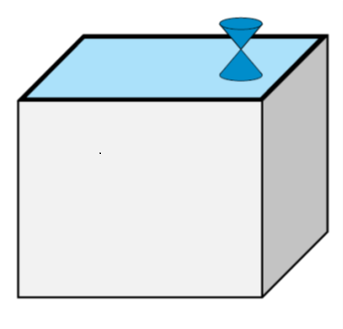
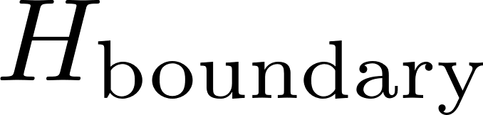

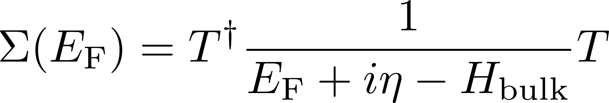
Non-Hermitian description of topological boundary states
[Nakamura-Inaka-Okuma-MS(23), Hamanaka-Yoshida-Kawabata(24)]
Topological boundary modes have quantum anomaly. Thus, they cannot describe quantum effects sufficiently, and the proper description needs the bulk contribution. We can include the bulk influence as an environment
system
environment
Effective surface Hamiltonian in the retarded Green’s fn
Non-Hermiticity
Top. boundary modes in TIs have hidden non-Hermiticity

Slide 18
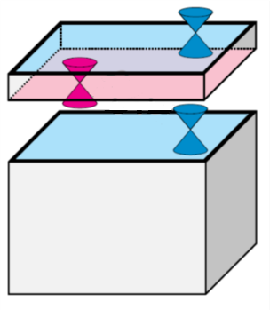
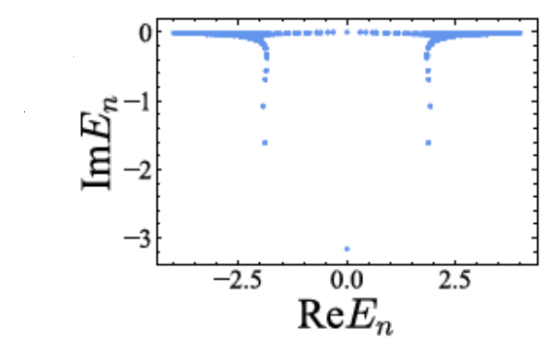
Ex.) 3D topological insulator
top bdry state
bottom bdry state mixed with bulk
Anomaly is cancelled b/w top and bottom bdry states
[Bessho-MS(21)]
Topological boundary modes in TIs have hidden non-Hermiticity due to quantum anomaly

Slide 19
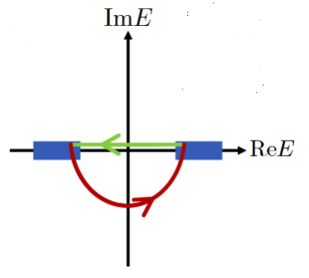
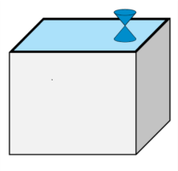
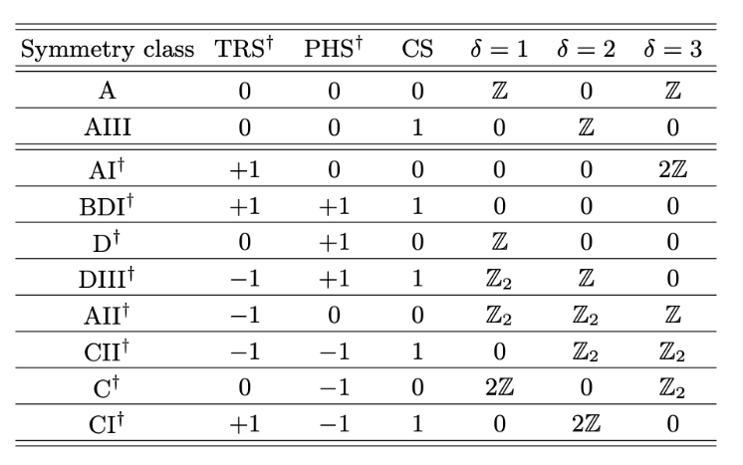
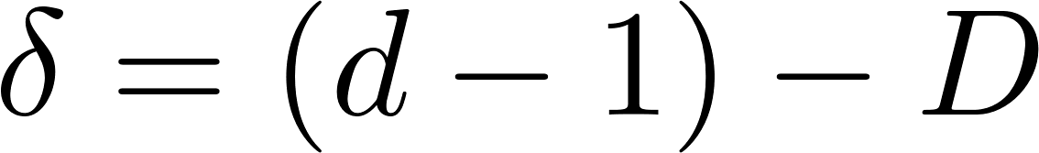
The top. boundary modes in the effective Hamiltonian have the same top. # as the original one, but in a different manner
d-dim. TI
(d-1)-dim. top. bry state
point-gap top. #
[Schnyder-Ryu-Furusaki-Ludwig (08)]
[Kawabata-Shiozaki-Ueda-MS (18)]
space-dim.
co-dim of defect

Slide 20
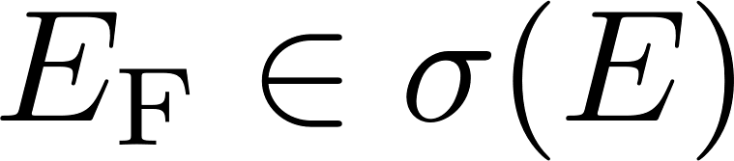
Notably, once one allows non-Hermiticity, one can introduce new gaps even for gapless systems in a conventional Hermitian sense.
Hermitian case
non-Hermitian case
Im E
Imaginary line gap
gapless
Gapless
Re E
No overlap with an imaginary line
Fermi energy
E
Im E
Point gap
gapless
Re E
No overlap with a complex energy point
Gapless states may have non-Hermitian top#s !!
Notes:
Notably, the non-Hermiticity provides a new perspective of gapless states.
重要なのは、通常の意味でギャップが閉じていても、非エルミートの意味でギャップが開いている場合が可能であることである。

Slide 21
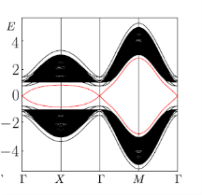


Importantly, the hidden non-Hermiticity enables us to explain/predict new topological phenomena for gapless states
1. Imaginary line gap top#
Detachable surface states in TIs
[Nakamura-Shiozaki-Shimomura-MS-Kawabata PRL(25)]
Ex.) 3D winding #=2 class DIII TSC
detached top surface state
[Altland et al, PRX (24)]
detached surface state
additional top #
Im E
Im E
Re E
Re E
Imaginary line gap
bulk state
2D class DIII$†$
Z
P
L_{r}
Z₂
L_{i}
Imaginary line gap
Z
Chern #
2. Point gap top#
Callan-Rubakov effects in TIs
[Nakai-Douza-Nakamura-Hamanaka-Schnyder-MS (25)]
Notes:
ここに表を入れて説明をする。

Slide 22
Callan-Rubakov effects in TIs

Slide 23
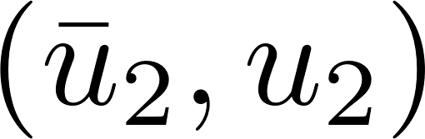
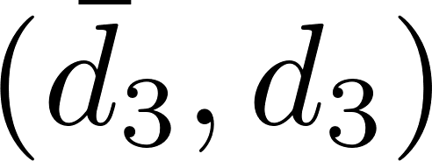
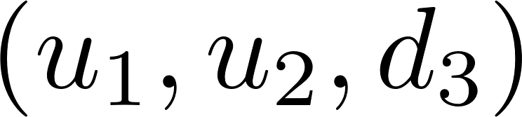
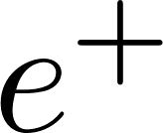
What is the Callan-Rubakov effect?
[Rubakov(81), Callan(82)]
Monopole catalysis of proton decay in grand unified theory
pion
or
proton
positron
monopole
GUT allows proton decay via exchanges of GUT scale (10¹⁶ GeV) heavy bosons or quantum tunneling. However, such short length scale processes are usually strongly suppressed in the low energy (= decoupling theorem).
Nevertheless, the cross-section of the quark-monopole scattering is very large in the low energy and independent of the GUT scale, and a proton decays without suppression.

Slide 24
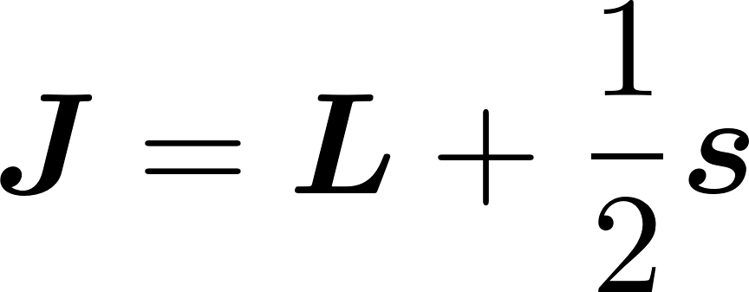
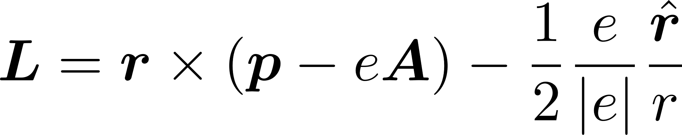
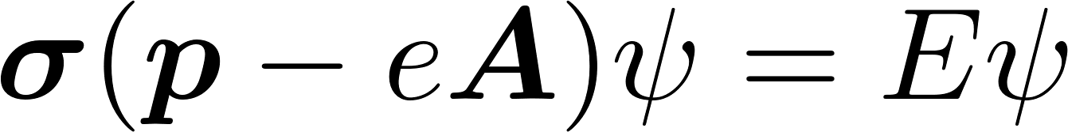
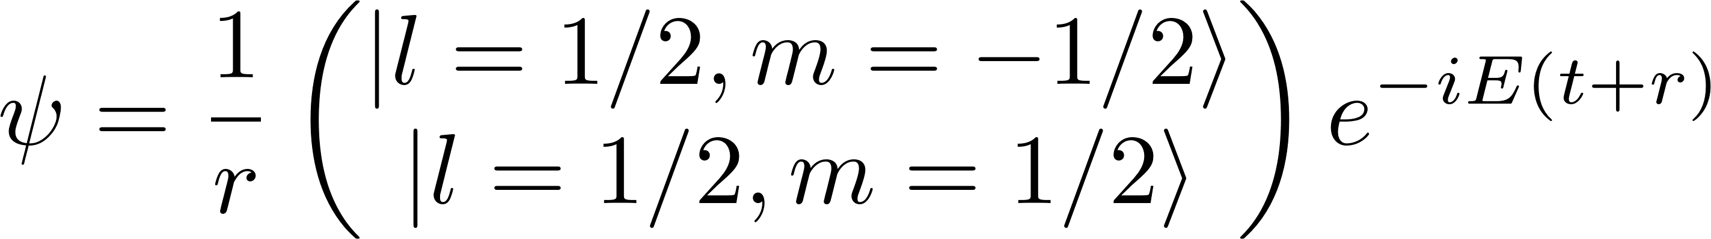
Why can the cross-section become large in low energy?
A special mode w/o backscattering
ang. mom. of quark
w/ monopole
monopole
J=0 sector
From the Weyl equation for a quark (e>0), we have
only incoming mode, no outgoing mode
[Kazama et al (77)]
No backscattering! = Funneling of quark
Therefore, low energy quarks can reach the tiny core of the monopole w/o suppression by the funneling effect

Slide 25
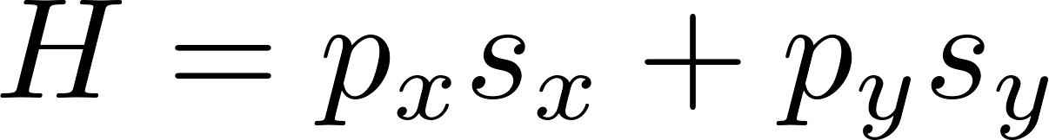
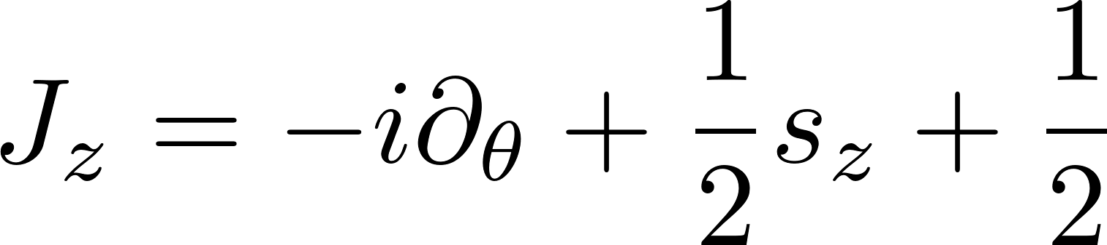
Callan-Rubakov effect in TIs
[Nakai-Douza-Nakamura-Schnyder-MS (24)]
We consider a 2+1 dim surface gapless Dirac fermion on TIs with a pi-flux instead of a 3+1 dim quark (=Weyl fermion) with a monopole
2+1 dim surface fermion
angular momentum in the z-direction
pi-flux
Remarkably, the surface fermion has a similar incoming mode w/o backscattering.
Notes:
我々の見つけたこと
設定の説明と図

Slide 26
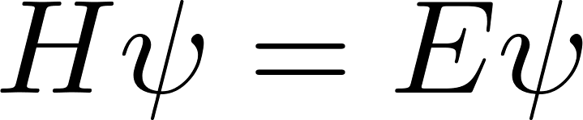
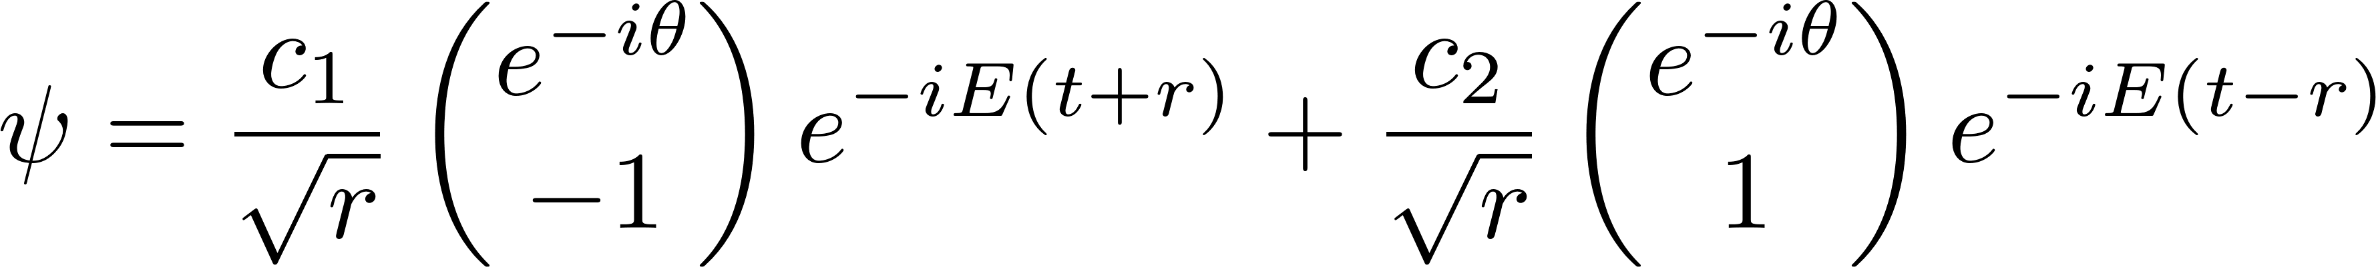
Jz=0 sector
From the Schrodinger equation , we have
incoming mode
outgoing mode
time-reversal symmetry
According to the Kramers theorem, the incoming state is orthogonal to the outgoing state, so it cannot be back scattered into the outgoing state.
Thus, we have a funneling of the surface Dirac fermion to the pi-flux w/o backscattering
Callan-Rubakov effect in TIs
[Weidemann et al (20)]
Notes:
According to the Kramers theorem, the incoming mode is orthogonal to the outgoing mode, so there is no backscattering b/w them. Thus, the surface mode can reach the core of the line defect without backscattering.
-> Callan-Rubakov effect in TIs

Slide 27

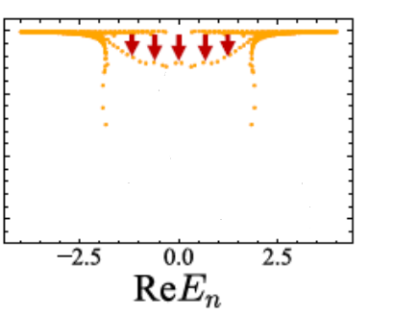

Notably, we can identify the funneling mode as a non-Hermitian skin mode by the non-Hermitian description of topological boundary modes
w/o line defect
w/ line defect
(pi-flux/dislocation)
surface state
surface state
complex energy modes due to bulk inf.
complex energy modes due to bulk inf.
funneling mode
Notes:
Actually, the Callan-Rubakov effect induces the dissipationless coupling b/w surface and defect. Thus, once we consider only the surface, the surface mode get a finite lifetime due to the coupling. Thus, the relevant mode has a imaginary energy.

Slide 28
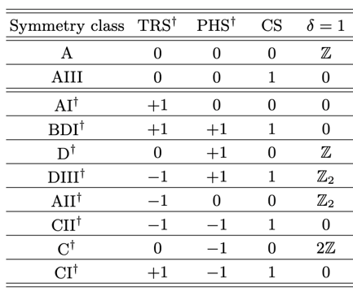
Actually, the funneling mode for the Callan-Rubakov effect is non-Hermitian topological modes, i.e. non-Hermitian skin modes
c.f.) Teo-Kane (10)
d-1=2: surface
space-dim.
dim of sphere enclosing
soliton/defect
D=1: line defect
w/ line defect
funneling mode
[Kawabata-Shiozaki-Ueda-MS (19) ]
(defect) skin modes
Callan-Rubakov effect is robust and topological !

Slide 29
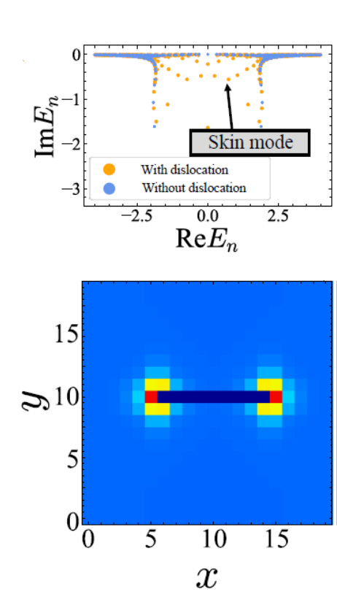
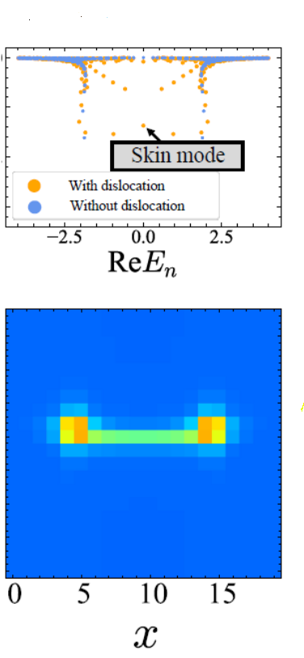

In addition to pi-flux, edge and screw dislocations in TIs exhibit a similar Callan-Rubakov effect if they support helical gapless states
edge dislocation
screw dislocation
effective spectrum of surface state
TI w/dislocation
surface LDOS

Slide 30
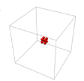
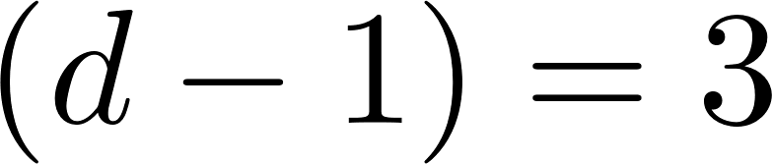

Corresponding to the J=0 mode in the original Callan-Rubakov effects, we also have a funneling mode to a monopole for 3 spatial dimensional Weyl fermion
Monopole skin effect
[Okuma-Shiozaki-Kawabata-MS(20),
Okuma-MS(21)]

Slide 31
Summary
Topological boundary modes in TIs have hidden non-Hermiticity due to quantum anomaly even without dissipation.
The non-Hermitian description enables additional topological numbers, revealing new aspects of topological boundary states. Callan-Rubakov effects in TIs Detachable surface states in TIs
The Callan-Rubakov effects may result in the strong correlation effects (fermion condensation) due to the accumulation of states
[Nakai-Douza-Nakamura-Schnyder-MS (25)]
[Altland et al (24)]
[Nakamura-Shiozaki-Shimomura-MS-Kawabata (24), Shiozaki-Nakamura-Shimomura-MS-Kawabata (24)]]

