Slide 1
Fundamental structure of string geometry theory
Matsuo Sato (Hirosaki U.)
M. S. Int.J.Mod.Phys.A34 (2019)1950126
M. S. , Y. Sugimoto (POSTECH) Eur.Phys.J.C80 (2020) 789
M. S. , Y. Sugimoto Nucl.Phys.B956 (2020) 115019
M. Honda (Waseda U.), M. S. Int.J.Mod.Phys.A 35 (2020) 2050176
M. Honda, M. S., T. Tohshima (Hirosaki U.) Adv.High Energy Phys. (2021) 9993903
M. S., Y. Sugimoto, K. Uzawa (Kwansei Gakuin U.) Phys.Rev.D 106 (2022) 8, 086006
M. S., K. Uzawa Phys.Rev.D 107 (2023) 6, 066023
K. Nagasaki (Hirosaki U.), M. S., G. Tanaka (Meiji Gakuin U.) arXiv:2309.10394
K. Hatakeyama (Kyoto U.) , M. S., G. Tanaka arXiv:2404.19413
M. S., T. Tohshima Adv.High Energy Phys. (2025) 7148232
M. S. arXiv:2511.02310
K. Nagasaki, M. S. arXiv:2511.03357
M. S., M. Takeuchi (Yamaguchi U.) arXiv:2511.04145
R. Kudo (Ube T. C.), K. Nagasaki, M. S. in preparation
K. Nagasaki, M. S., G. Tanaka in preparation

Slide 2
Definition

Slide 3
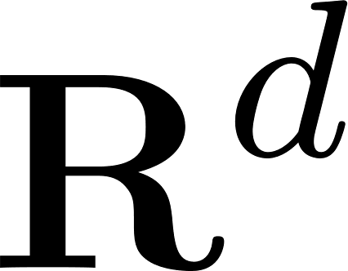






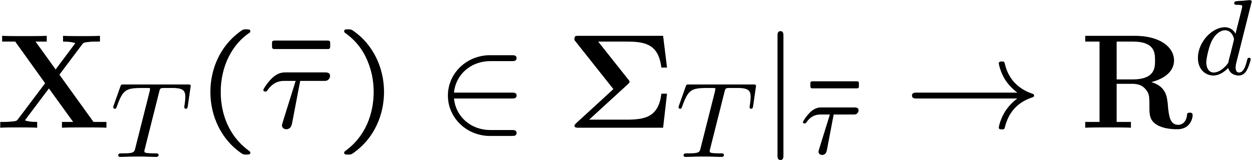


The model space of string geometry
model space of finite dim. manifolds
model space of string geometry
( : represents each chart)
3 kinds of coordinates
: string geometry time
: super vierbein
super Riemann surface
many body states of strings
string geometry time global time on

Slide 4

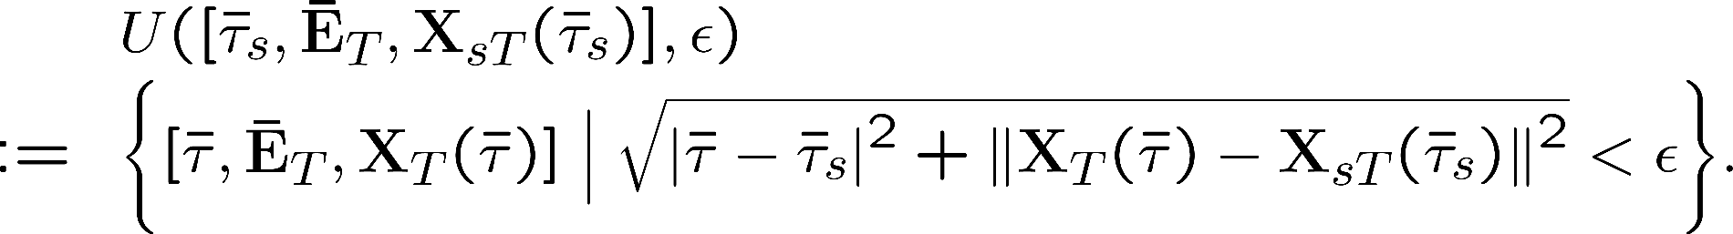
The topology of string geometry and string manifolds
We define an -open neighborhood of by
fixed
is a discrete variable
String manifolds are constructed by patching open sets of the model space

Slide 5






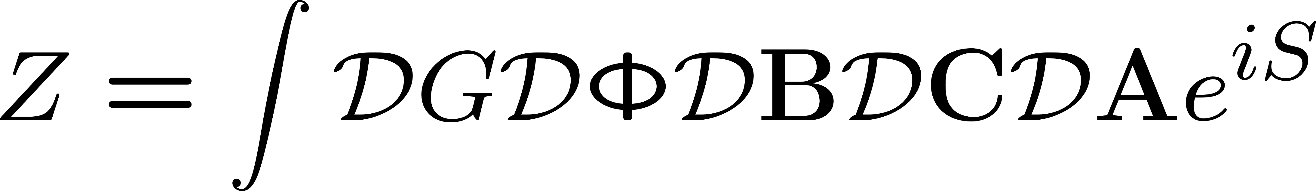
Fields, action, path-integral
Component representation
Ex.
On heterotic charts,
Fit (completely mixed under the diffeo )
Metric
: discrete variable
As well as other fields
Action
An extension of supergravities to a theory on the string manifolds.
Strongly constrained by T-symmetry (extension of T-duality)
is a “quantum” parameter (different with quantum parameter )
Path-integral

Slide 6
Non-renormalization theorem

Slide 7









Non-renormalization theorem
M.S. arXiv:2511.02310
: discrete coordinate The action does not include differential w. r. t.
Propagators satisfy
: the coefficients of in the action
The propagator is proportional to
: 2D graviton coordinate
: 2D gravitino coordinate
Loop diagrams are proportional to
No loop correction in string geometry theory
No renormalization No problem on non-renormalizability of path-integral over the metric

Slide 8
Non-perturbative effect in string coupling

Slide 9
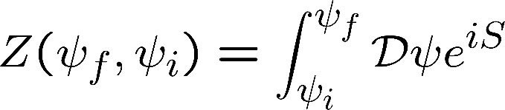
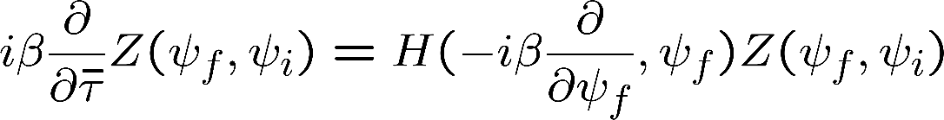



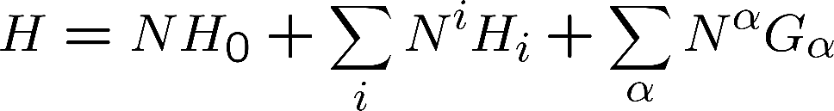






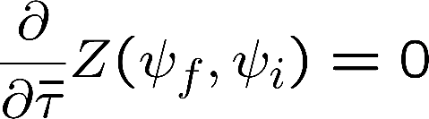



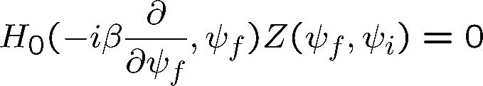
Dynamics changing backgrounds
M.S. arXiv:2511.02310
Path-integral is a wave function that satisfies
Schroedinger equation
: arbitrary field
: initial and final values of
Gravitational system
(lapse)
(Hamiltonian constraint)
(shift)
auxiliary fields
constraints
(momentum constraint)
differentiate
(Gauss law)
: the path-integral does not depend on the string geometry time
but only on our time
the zero mode of
gives the negative sign of the metric
Schroedinger equation : determines dynamics of the path-integral

Slide 10
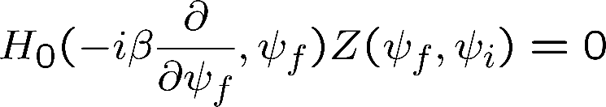

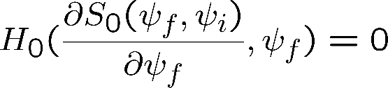


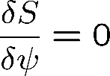



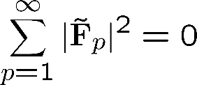


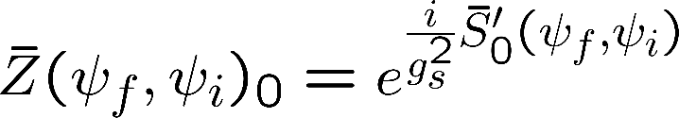
Dynamics changing backgrounds (cont.)
Semi-classical expansion
Schroedinger equation
Hamilton-Jacobi equation
That is, is obtained by substituting a solution to the equation of motion
with boundary values into the action
* The solution is allowed to take a complex value
In case of a real value, is a classical solution
In case of a complex value, is an instanton that passes though classically forbidden regions
The constant expectation value of dilaton depends as ,
where we have assumed , which is a result from the Hodge duality satisfied by perturbative string vacua
In string theory,
renormalize

Slide 11





Dynamics changing backgrounds (cont.)
If we set on local minima of a potential, takes a complex value in a classically forbidden region
becomes a transition amplitude representing a tunneling effect
between semi-stable vacua,
which has non-perturabative dependence of string coupling
A state on a local minimum transits to another local minimum with lower energy by the tunneling effect
No loop correction effective action = classical action
The minimum of the classical potential in string geometry theory will determine a true vacuum in string theory

Slide 12
String geometry time and our time
The time in string geometry theory is
In the beginning of the universe and are independent,
there is no time evolution,
instanton effects with respect cause vacuum transitions,
and the true vacuum will be realized.
After that, string perturbation is realized around the true vacuum,
time evolution becomes non-trivial,
and can be identified,
and thus our unitary time evolution will be achieved.

Slide 13
Deriving perturbative strings

Slide 14

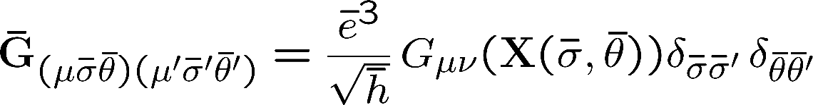
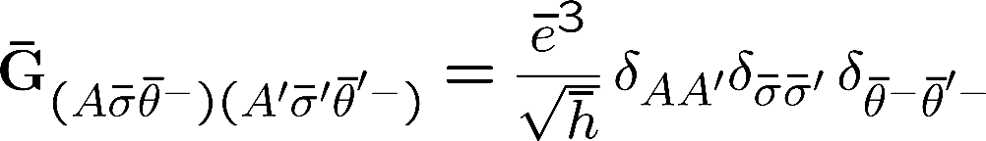

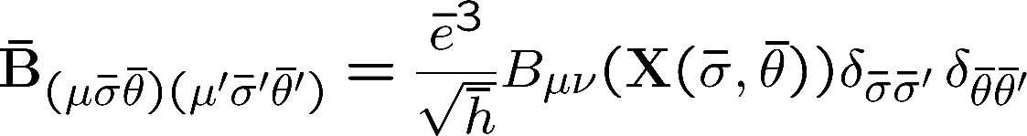
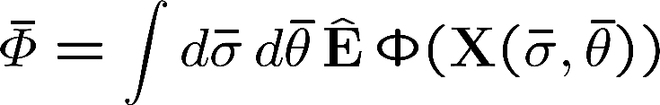
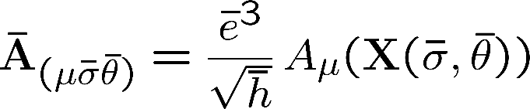
Heterotic perturbative vacua
Heterotic perturbative vacua
: string backgrounds
Fluctuations around these vacua give perturbative strings
when satisfies a 2nd order differential equation
Given later
The others are 0

Slide 15


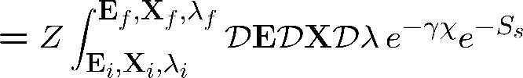


Deriving the path-integral of perturbative heterotic superstrings
From the tree level two-point correlation functions of a fluctuation of the metric
around the heterotic perturbative vacua, ,
we derived the path-integrals of E8xE8 het, and SO(32) het perturbative strings on the string backgrounds
up to any order: K. Nagasaki, M.S. ’23
where is the action of the perturbative heterotic superstring on
No loop correction path-integrals of perturbative strings up to any order in is derived in the tree level in
As well as Type IIA, IIB, SO(32) I. M.S. (2019)、M.S., K. Uzawa (2023)、K. Nagasaki, M.S., G. Tanaka (2023)

Slide 16
String geometry phenomenology

Slide 17
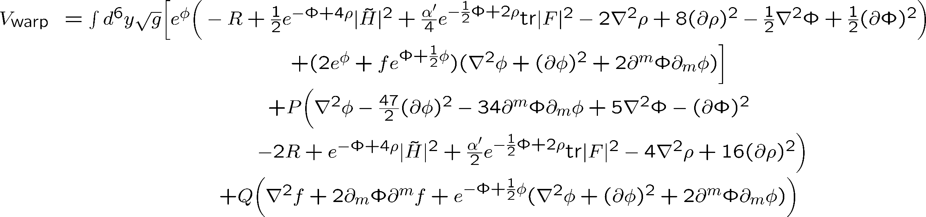
Potential for heterotic string backgrounds
Restrict the classical potential in string geometry theory to the heterotic perturbative vacua
Take particle limit
Warped compactification
Potential for heterotic string backgrounds
Determine
The backgrounds are restricted to the heterotic perturbative vacua
Consistency of fluctuations (Weyl inv.)
String backgrounds need to be solutions to the e. o. m. of heterotic supergravity
Solution space = string landscape = region of the potential
Conjecture: The true heterotic vacuum will be determined by the minimum of the potential among the solutions.
The true vacuum in string theory will be determined
by comparing with the minimum values of the other true Type II, I vacua.

Slide 18
Analysis of the potential for string backgrounds
The number of pertrubative vacua is above 10⁵⁰⁰ (string landscape)
Almostly impossible to analyze analytically in a straightforward way
Numerical calculation (can find generally)
Discretize the potential by Regge calculus, optimize by genetic algorism, and accelerate by
reinforcement learning
With Gota Tanaka (Meiji Gakuin U.)
String geometry phenomenology

Slide 19


String geometry phenomenology
The potential for sting backgrounds is an energy of the backgrounds
Substitute a string phenomenological model with free parameters to the potential
The minimum of the potential for the free parameters determines the free parameters
The ground state among the model (string backgrounds)
A local minimum of the potential
Partial region of string landscape
Compare with the local minima of the other model
The lower model will be near the true vacuum in string theory (the minimum)
Through sequential studies, we will be able to identify the true vacuum in string theory
With Maki Takeuchi (Yamaguchi U.) ( hetero, )
Toru Masuda (Kogakuin U.) (IIB, CICY orientifold, fractional branes, quiver Standard Model)
Especially, the potential in the first principle, string geometry theory, does not require
the 4D naturalness nor hierarchy problem
Chance to revive for string phenomenological models that were rejected by naturalness or hierarchy problems!

Slide 20
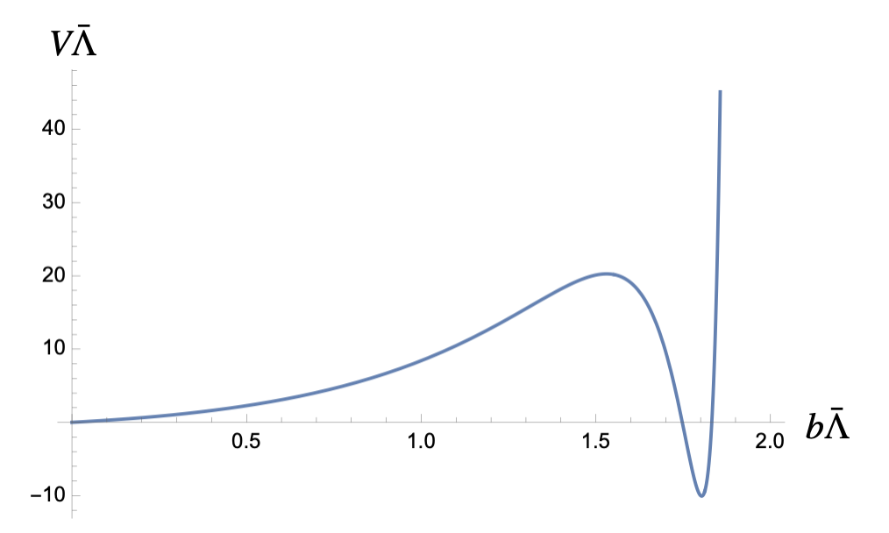
An example of the ground state of a string phenomenological model
M.S., Maki Takeuchi (Yamaguchi U.) arXiv:2511.04145
For a string phenomenology GUT model with constant dilaton, 0 flux of B-field, compactification,
which is a family of solutions to the e. o. m. of heterotic supergravity,
we find the minimum of the potential and obtain the ground state.
As a result, we obtain a non-trivial relation between the free paremters, namely compactification scale and flux.
potential energy
flux × (compactification volume)^{1/3}
0
GUT
For 3-generation models,
compactification
scale
string
scale
Supergravity approximation is valid for the compactification

Slide 21
Backups

Slide 22
Motivation for string geometry
Fundamental problem on string theory
What is a non-perturbative formulation of string theory that determines the 6D extra dimensions?
Necessary to reconsider what is the space-time in stirng theory
In string perturbations,
Particles are made of strings
Space-time is made of points
Natural extension: quantum space-time has stringy fluctuations
In a non-perturbative formulation of string theory,
Space-time is also made of strings
Principle of string geometry theory
One of the candidates of non-perturbative formulations of sting theory

Slide 23
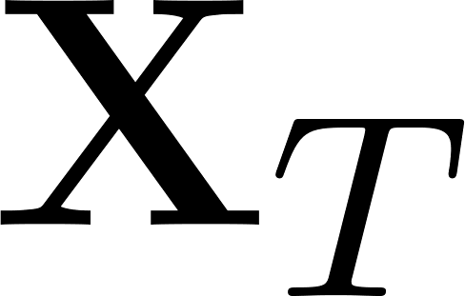
Worldsheets in string geometry
Trajectories in asymptotic processes in the model space represents
super Riemann surfaces in
reproduce the right supermoduli space.

Slide 24








計量の符号
＜計量＞
※ は離散変数
＜計量の符号＞
のゼロモード 方向のみマイナス符号
、ゼロモード以外 、 、 方向はプラス符号。

Slide 25
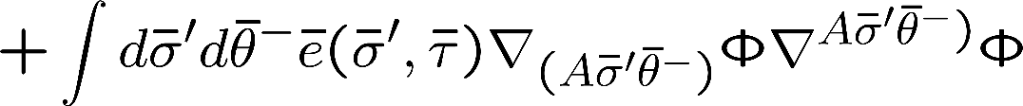





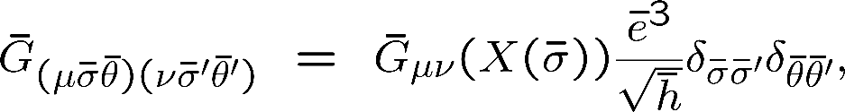

弦多様体上の場
インデックスと超対称性
ヘテロチャートでは、
超対称変換 で任意の作用が不変。
※ターゲット超対称性は
一般には仮定されない。
IIA、IIBチャートでは、同様に 超対称性を持つ。
弦多様体上の場は超場；インデックスの に関し展開することで超対称multiplet
例
インデックスの依存性により、場はスカラー、非アーベリアンゲージ場、計量、完全反対称高階場に分類
超弦理論の非摂動論的定式化では、理論の背景が弦理論の真空をパラメトライズする弦背景、
つまり超重力理論の場を含むのが自然：弦幾何理論の場合
…
最小の組
10次元の計量
弦多様体上の場：
エルミートゲージ場

Slide 26
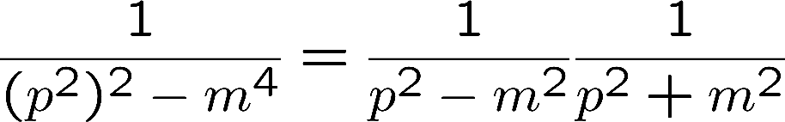





作用の決定
作用が満たすべき条件
(1) 作用はゴーストが含まれないように微分は２階まで
c.f.
ゴースト pole
一方向に次元還元
T双対変換
IIA弦背景
IIB弦背景
T双対変換の拡張
弦幾何理論が超弦理論の非摂動論的定式化であるためには
IIA真空とIIB真空の両方を含んでいることが必要
(2)
type II チャート ( )で1方向に次元還元した弦幾何理論の作用はT双対変換の拡張で不変になるべき
(3)
ヘテロチャート（ ）で1方向に次元還元した弦幾何理論の作用は
と ヘテロT双対変換の拡張で不変になるべき

Slide 27

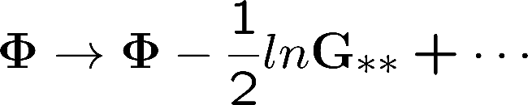


作用の決定
は条件(1)(2)(3)をみたす
M.S., T. Tohshima 2024
理論に含まれるスカラー , の＊方向のT双対変換：
スカラーポテンシャルはない
上記の作用にほぼ唯一に決定されるだろう。

Slide 28

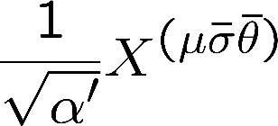
結合定数
作用
T対称性のため、可能な結合定数は上記作用の 、 のみ。
は座標に次元を与えるパラメータ：弦座標に で依存
オーバーオールの は 弦幾何理論の経路積分の「量子補正」パラメータ
分配関数

Slide 29
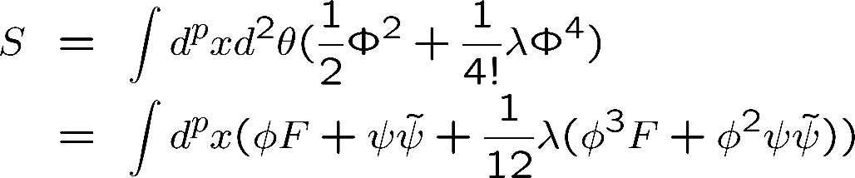


非繰り込み定理（続き）
一般に に比例するダイアグラムは作用で 積分を実行し、全ダイアグラムを計算すれば
ボソンループとフェルミオンループがキャンセルして0となる
例 微分項のない理論
( )
超ループダイアグラムは
に比例するので0になる
成分表示でもボソンループとフェルミオンループがキャンセルして全ループダイアグラムは0
+
=0

