Slide 1
Closing address for KEK Theory Workshop 2025
Jun Nishimura (KEK, SOKENDAI)

Slide 2
The focus this year was topological properties, bulk-boundary or (A)dS/CFT correspondence, open quantum systems, non-Hermiticity…
1st day : Dec.16(Tue)
Tetsuya Onogi “APS index and the domain-wall fermion”
Yuya Kusuki “Model-independent methods in boundary and interface”
Kazumi Okuyama “Recent developments in double-scaled SYK”
2nd day : Dec.17(Wed)
Masatoshi Sato “Topological boundary states as open quantum systems”
Takahiro Sagawa “Topology of nonlinear”
Yasuaki Hikida “Complex saddles of de Sitter gravity via holography”
3rd day: Dec.18(Thu)
Kazuya Yonekura “Heterotic string theory and N=(0,1) supersymmetric field theory”
Kanato Goto “Holography for a closed universe with a quantum reference frame”

Slide 3
Topology, boundary
Tetsuya Onogi “APS index and the domain-wall fermion”
Atiyah-Singer index theorem
Ind(D) = n₊ - n₌ = Q (topological charge)
→ Generalization to a manifold with a boundary
Atiyah-Patodi-Singer theorem
Key: The use of spectral flow as a function of mass.
Chiral symmetry (massless fermion) is not essential.
Q=1
s

Slide 4

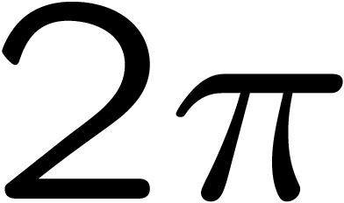

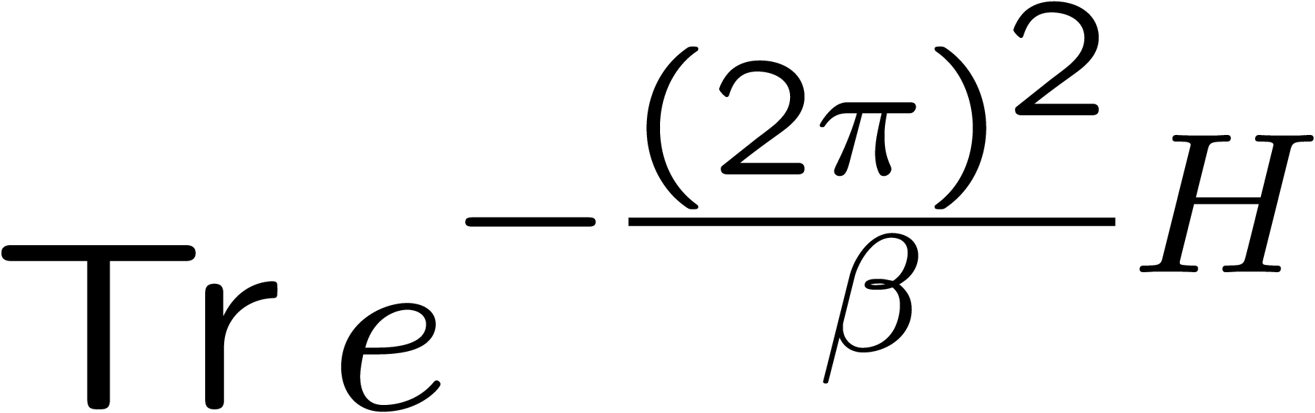
Yuya Kusuki
“Model-independent methods in boundary and interface”
CFT_{L}
CFT_{R}
CFT
trivial
interface
boundary
Folding interface → Boundary CFT
“conformal bootstrap” method
Equivalence between
two different cuts

Slide 5
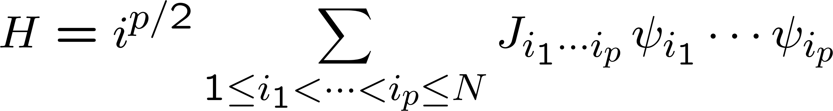
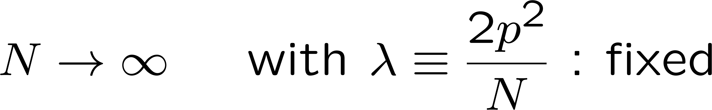
Kazumi Okuyama
“Recent developments in double-scaled SYK”
SYK model [Sachdev-Ye (‘93), Kitaev (’15)]
Gaussian random numbers
SSB of the emergent conformal symmetry at low energy
leads to NG modes (action with Schwarzian derivative)
dual gravity description
= 2d dilaton gravity (Jackiw–Teitelboim gravity) on AdS₂
Dynamical d.o.f. is Schwarzian mode describing the fluctuation
of AdS₂ boundary.
double-scaled SYK = not only low energy but also high energy

Slide 6
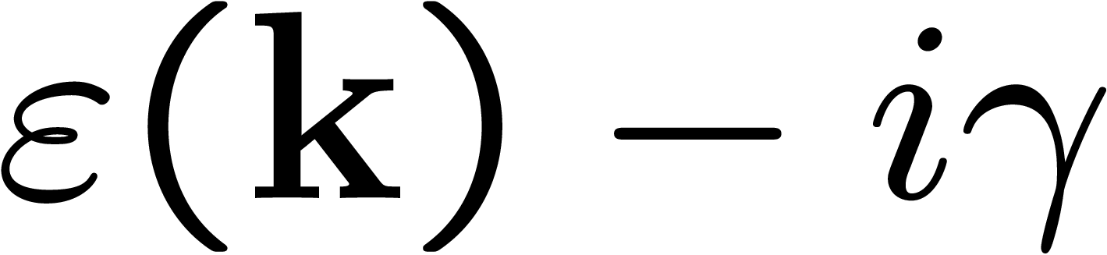



Topology, boundary, open quantum systems
Masatoshi Sato “Topological boundary states as open quantum systems”
Non-Hermiticity in quantum systems
A quasi-particle or excitation has a finite life-time in open systems due to interactions or disorders. →
Multiple gap structures
Hermitian case
Non-Hermitian case
Real line gapped
Point gapped
empty
empty state
topological
Fermi
energy
occupied state
occupied
→ complete classification of non-Hermitian topological phases.

Slide 7
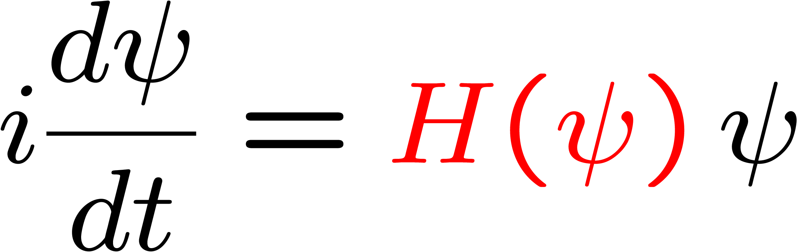
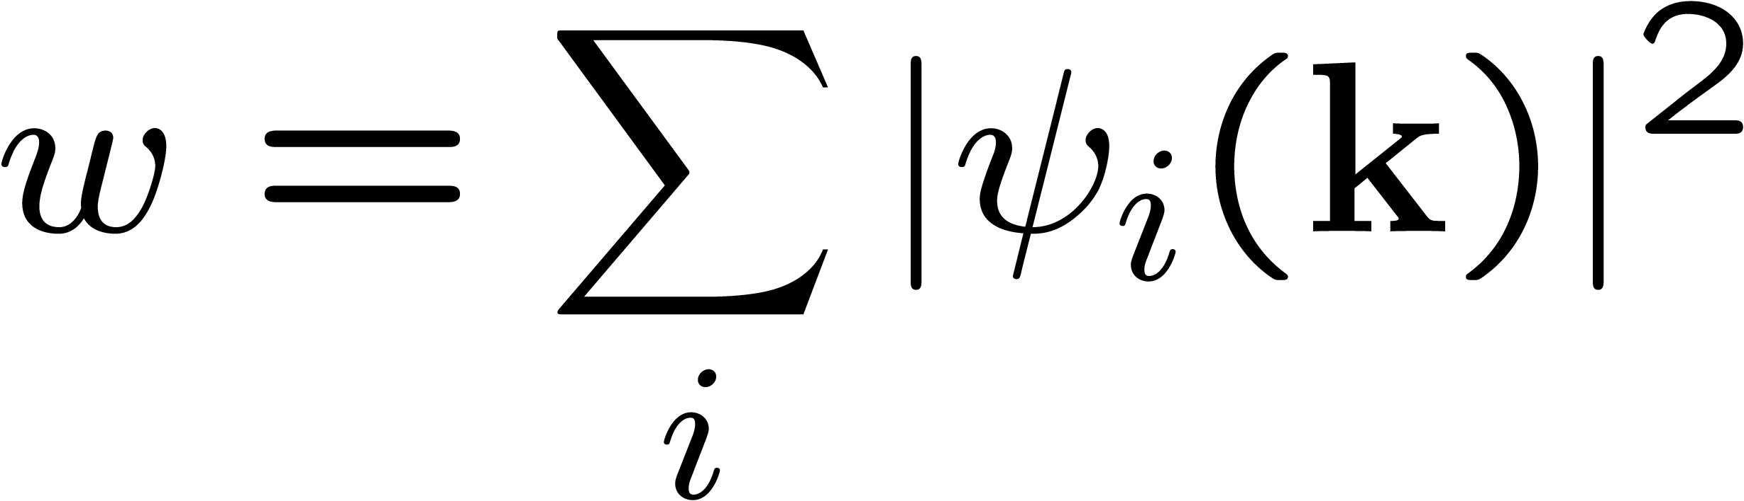
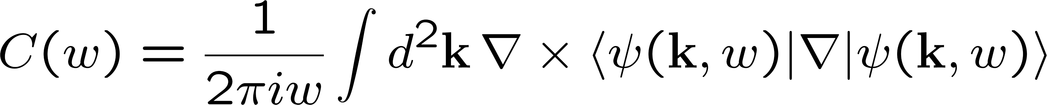

Topology, non-Hermitian, nonlinear dynamics
Takahiro Sagawa “Topology of nonlinear dynamics”
nonlinear dynamics
state dependent Hamiltonian
nonlinear Chern number
solvable toy model
topological synchronization
(synchronized at the edge
v.s. chaotic in the bulk)
topological to chaotic transition
mass
0
+1
Chern # = 0
-1

Slide 8

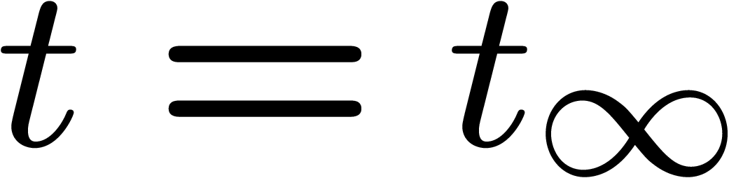
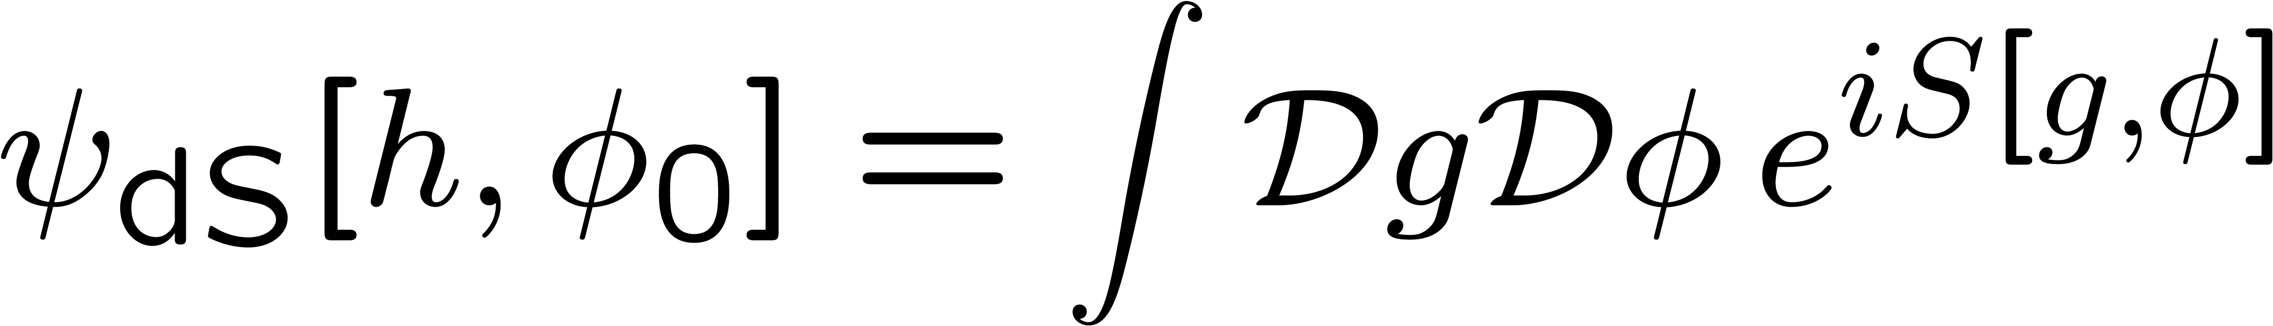
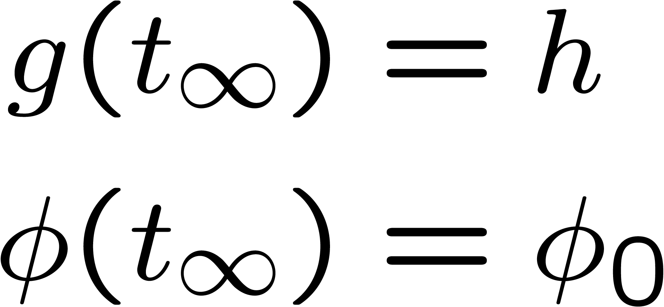

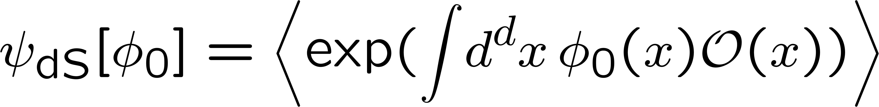
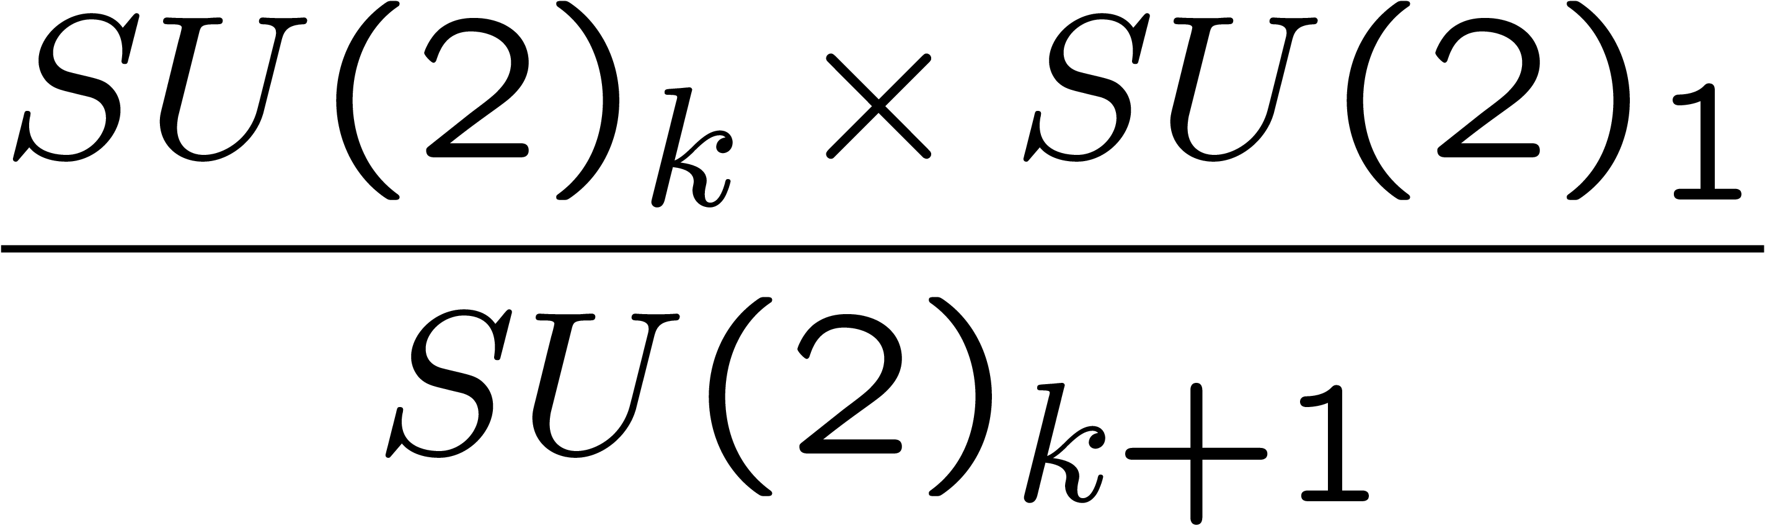
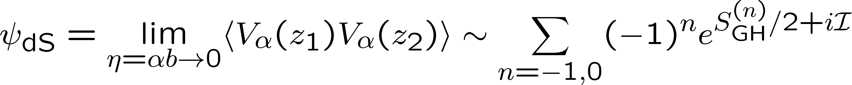
dS/CFT correspondence
Yasuaki Hikida
“Complex saddles of de Sitter gravity via holography”
dS correspondence Maldacena (’03)
Hartle-Hawking wave function
generating functional of correlation function in dual CFT
Einstein gravity on dS₃
with matters at classical level
2d coset model
with imaginary central charge
consistent with Kontsevich-Segal-Witten criterion on allowable complex metrics

Slide 9
Fruitful discussions among reseachers from various fields
Quantum Gravity
(holography, JT/SYK, dS/CFT)
Condensed Matter Physics
(topological phases
in open systems)
Topology in gauge theory
(Index theorem in the case
of a mfd w/ boundary)

Slide 10
Special thanks to:
Kotaroh Miura (among all the organizers)
Home page of this workshop, management of the scientific program
Yuko Ohno (secretary of KEK Theory Center)
support for travel expenses, accommodation, banquet, coffee break
Ph.D students (microphones, banquet, setting-up etc.)
Sakura Itatani
Mikage Kobayashi
Shotaro Kawanago
Shirabe Endo
Tomoya Nishiki
Naoyuki Yamamori
Cheng-Tsung Wang

Slide 11
See you again in KEK Theory Workshop 2026 !

