Slide 1
SINQ–MLF Mini Workshop “Advancing Neutron Facilities Together 2025”
October 23, 2025
Neutron Instruments at MLF
Neutron Science Section, MLF Division, J-PARC Center
Mitsutaka Nakamura
Gabriele Sala

Slide 2
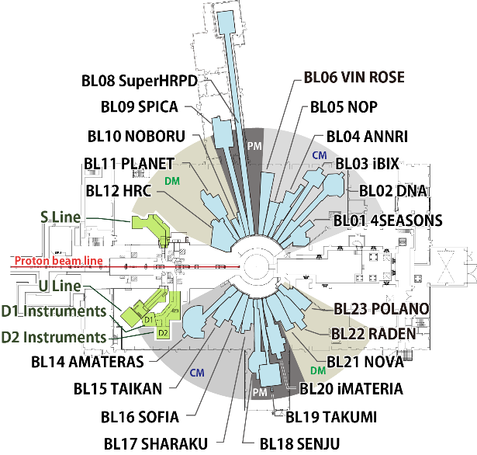
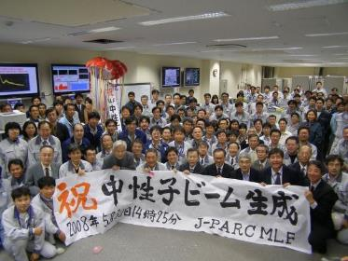
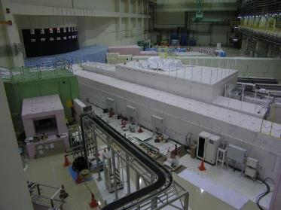
23 Neutron Beam Ports
Operation: 21 (October, 2025)
May 30, 2008
Congratulation!
MLF 1st beam
May 30, 2008
MLF Experimental Hall

Slide 3
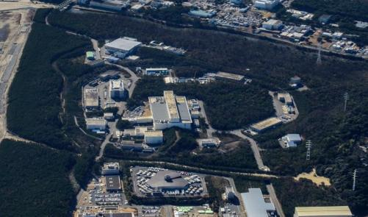

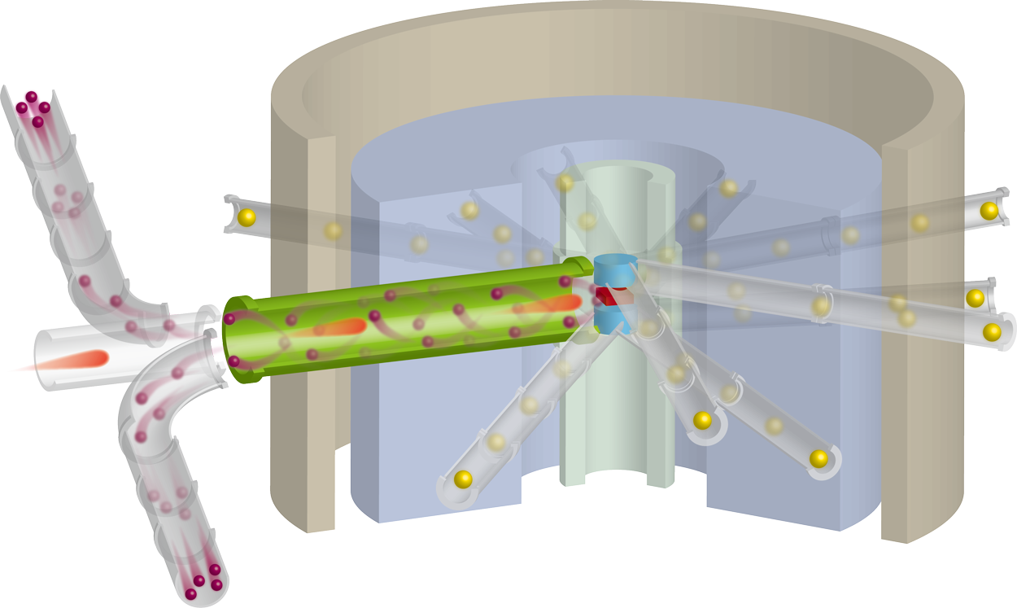
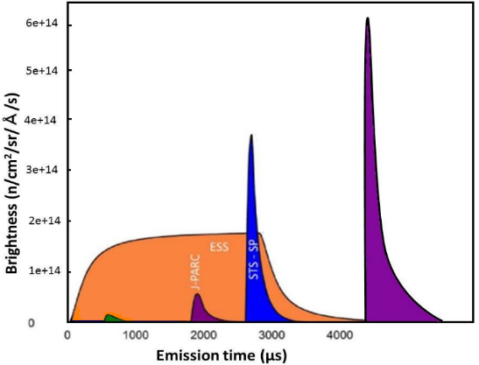
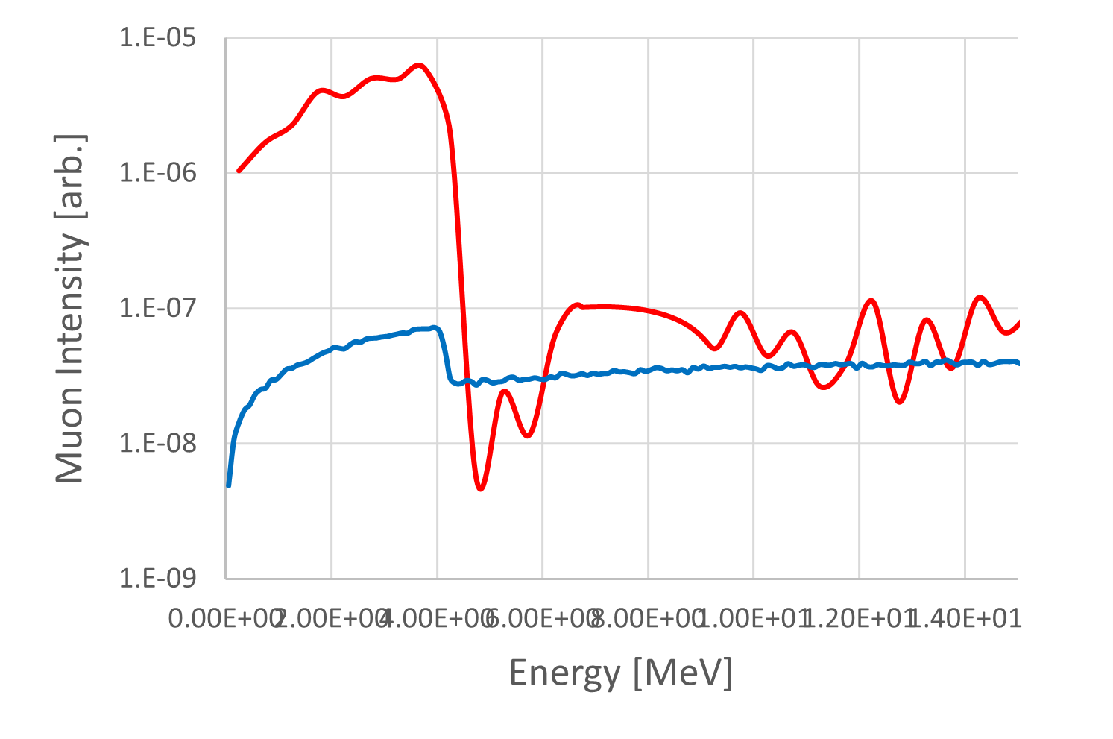
Actions to advance the MLF future plan
J-PARC TS2
TS1
TS2
To foster momentum for future development, the facility is moving forward with the “MLF-double” program.
3GeV RCS
Review current performance "MLF2030"
Upgrade planning of TS1
“MLF-double”
Construction of TS2 and operation
6e+14
5e+14
4e+14
3e+14
2e+14
1e+14
0
Neutron Brightness
J-PARC
TS2
20xx~
ESS
2027~
SNS-STS
2034~
Brightness (n/cm²/sr/Å/s)
SNS-FTS
2006~
J-PARC
TS1
2008~
Muon beam intensity
Emission time (μs)

Slide 4
Aiming to double the effective intensity of TS1
MLF-double program

Slide 5
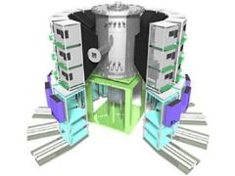
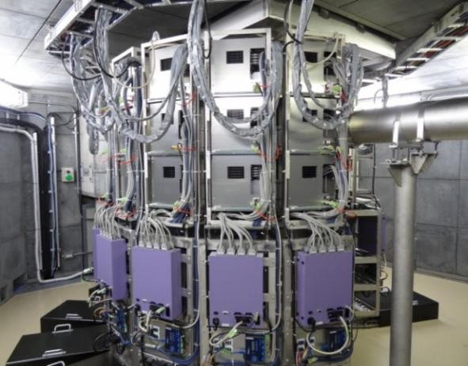
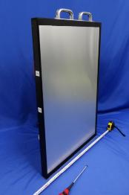
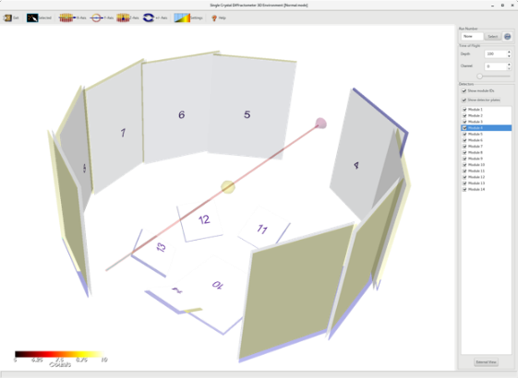
Examples of initiatives under the “MLF-double” program #1
BL18
Detector
Installing the newly developed large detectors
830 mm
545 mm
Gapless diffraction image!!
Exploring ways to make effective use of older detector

Slide 6
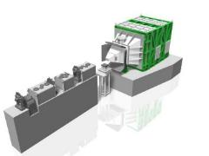
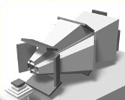
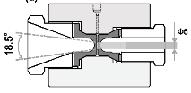
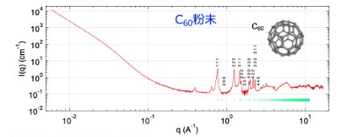
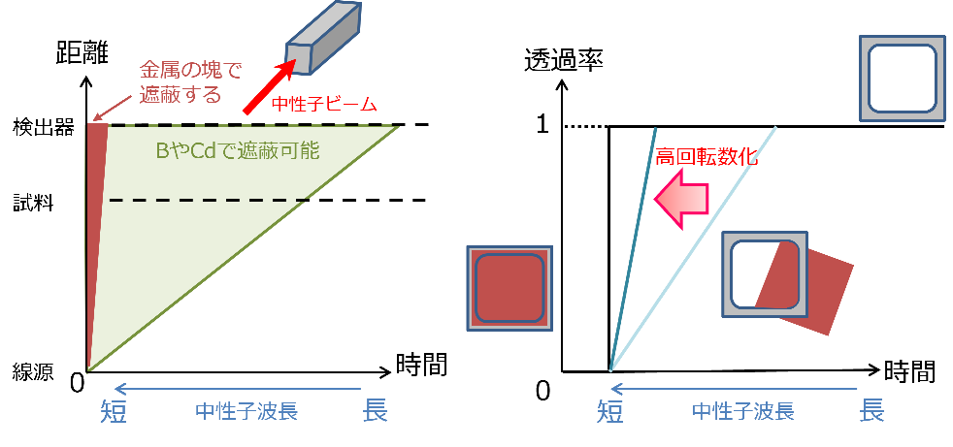
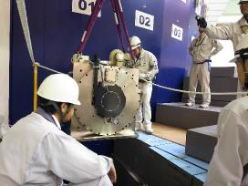

Examples of initiatives under the “MLF-double” program #2
BL15
Current Situations and Challenges
Chopper
〇 Problems:
Small-angle bank
Medium/High-angle Banks Unavailable in Extreme SE
Limited q-Range Restricts BL15 TAIKAN
High-angle bank
Beam
Incident
neutrons
Medium-angle bank
Sample, SE
Scattered neutrons
＠BL15 TAIKAN
〇 Measures:
Distance
Transmission
$$q=4πsinθ/λ$$
Shielded by bulk metal
Beam
BL01
Det.
Speed-up
Effective use of short wavelength neutrons
θ:fixed ; small λ → increase q
Sample
Shielded by B and Cd
High-speed rotation of T0 chopper
25Hz → 100Hz
Source
Time
Time
Short
Wavelength
Long
Short
Wavelength
Long
〇 Ripple effect:
High-Precision Insight into Hierarchical Structures under Extreme Conditions
25Hz → 100Hz;
q_{max}: 1.8A⁻¹ → 6.2A⁻¹

Slide 7
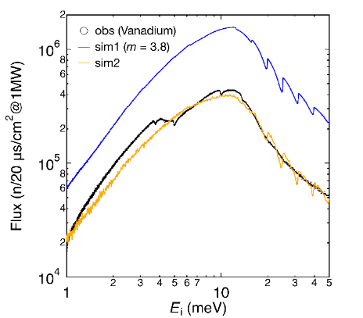
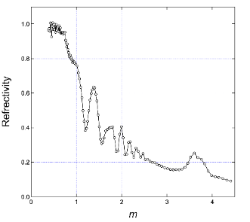
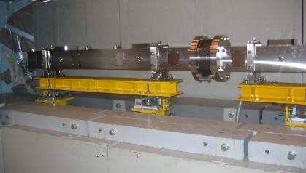
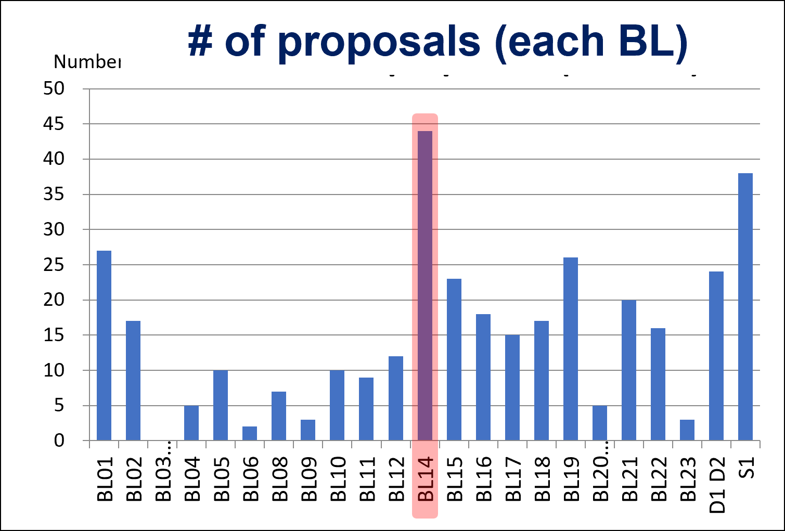
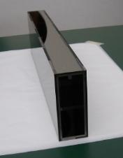
Examples of initiatives under the “MLF-double” program #3
BL14
Guide tube
Current Situations and Challenges
Flux at sample position
〇 Low neutron flux:
Simulation
Compared to the simulation, the actual neutron flux is significantly lower—only around one-third to one-fourth.
× 3~4
〇 Performance degradation of the guide mirror:
Measured
Reflectivity data of existing mirror
Nominal
The issue has been pinpointed, and simulations indicate a 3–4× improvement in intensity.
Reflectivity
Fabricated in FY2025
Guide length: 11 m; m-value = 3–4,
reflectivity = 80–90%
Installed in FY2026
Measured
2023B
〇 Ripple effect:
A world-class instrument, already flooded with users, is finally ready to shine.

Slide 8
Activities toward TS2 #2
Evaluating TS2 instruments requires understanding our current position through comparison with TS1.
Applying state-of-the-art Monte Carlo simulations to the existing TS1 instrument
  → Sala’s talk
Review current performance "MLF2030"
Upgrade planning of TS1
“MLF-double”
Construction of TS2 and operation
We were experts in instrument simulation 20 years ago
But now …
Especially, Young staff has no experience
Activities toward TS2 #1
Close collaboration between users and the facility
MLF Roadmap WS
- 1st : August 26, 2025, 2nd: March 14, 2026
- 3rd, 4th : To be held in FY2026

