Slide 1

HELLO

Slide 2


Me

Slide 3

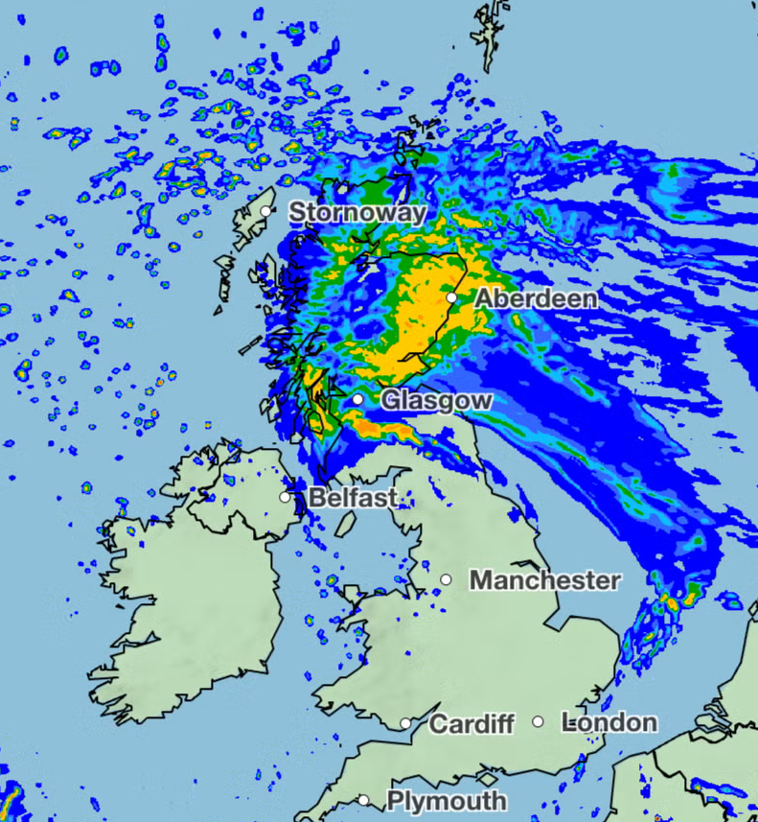
Edinburgh
Where I Live

Slide 4
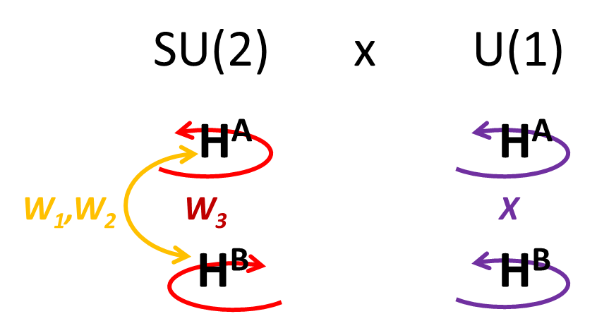
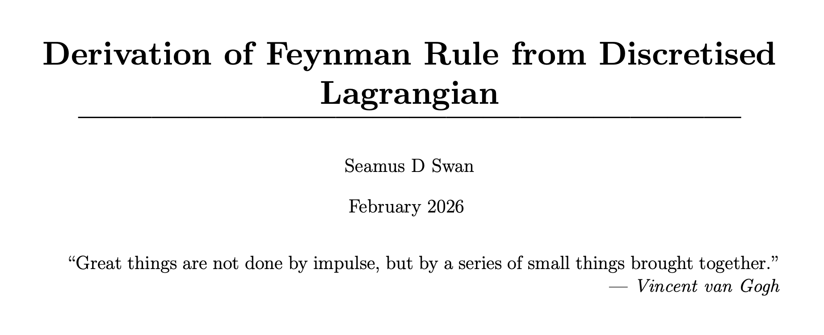
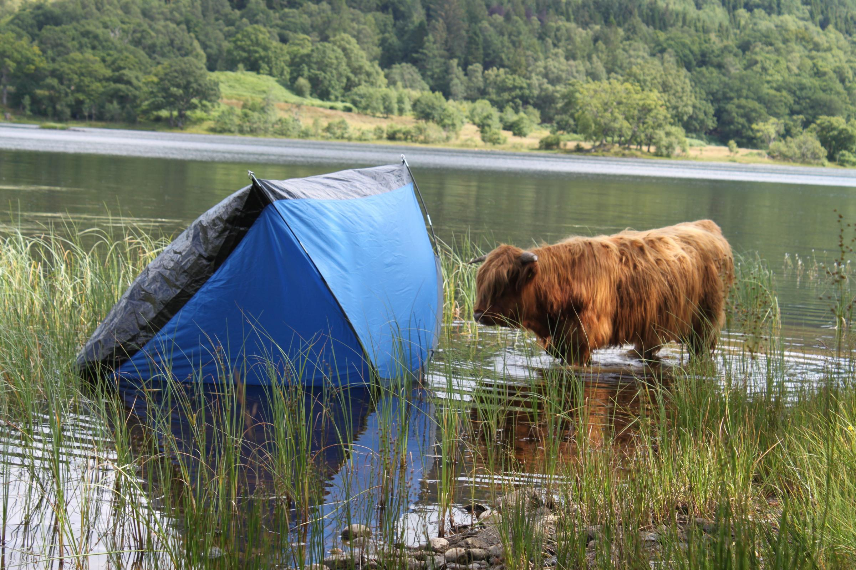

Interests

Slide 5
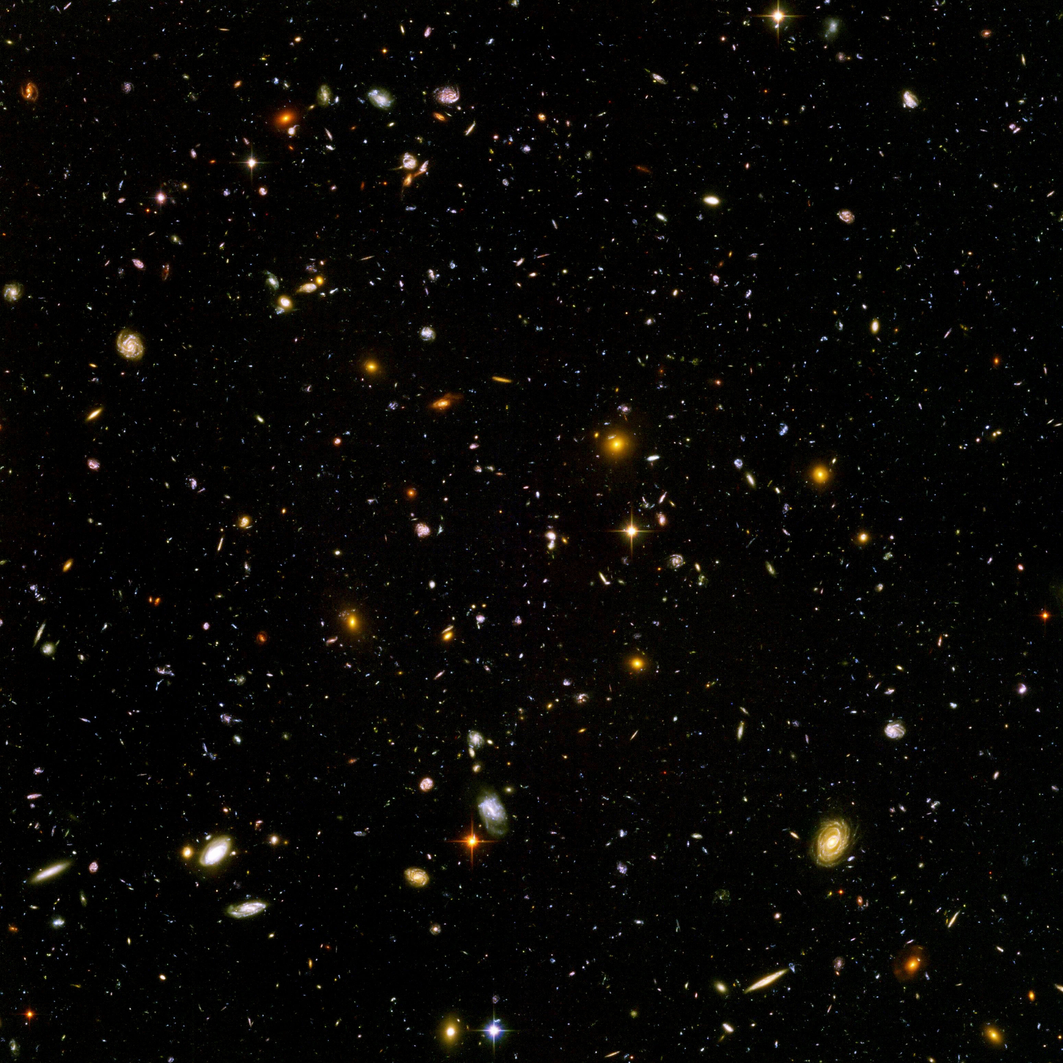
Where Do Divergences Arise?

Slide 6


A Continuous Universe
y
P = 0.00…11
QFT ↔︎ Probabilistic
P =0.5
$∆x∆p ≥ \frac{ℏ}{2}$
$$e^{+}$$
x

Slide 7
Divergences
Divergence → Non-extreme theory
Cosmological Constant Problem
QFT
Order 122 difference!!!

Slide 8
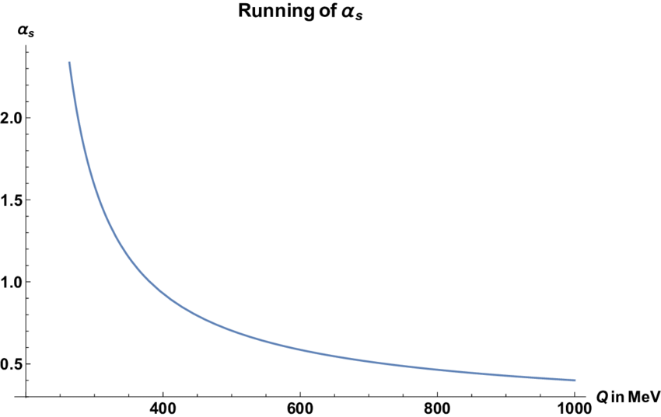
Divergences

Slide 9
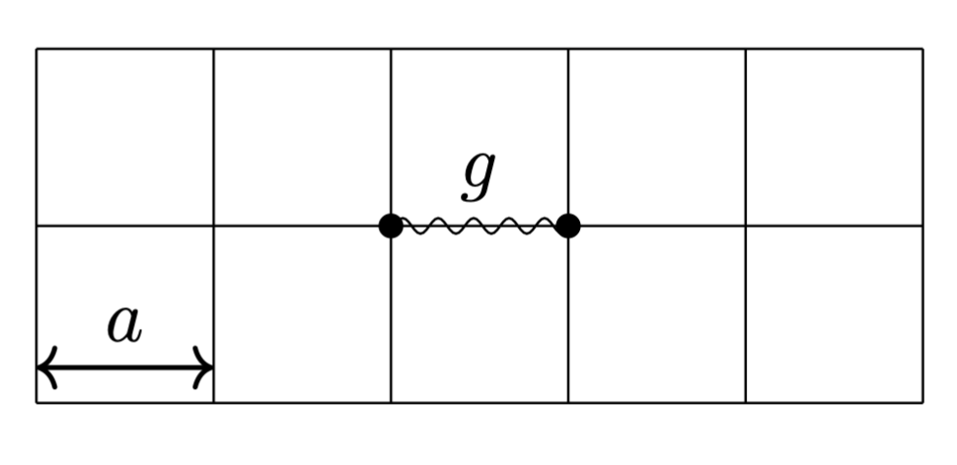
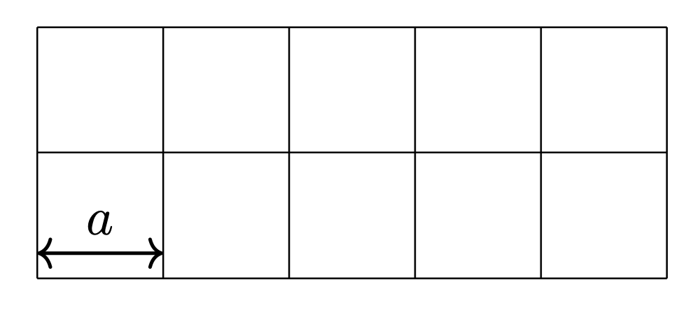


The Lattice
Smallest Length $a.$
Lattice Coupling Parameter$β.$
“Cut-off” energy/momentum → Removes Divergences

Slide 10

The Simulation
Monte Carlo ↔︎ Weighted Sampling
Possible Measurements:
Particle Masses
Decay Rates

Slide 11

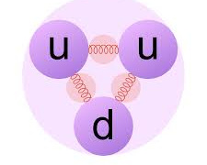
What We Observe
Confined
Deconfined
Phase Transition

Slide 12


