Slide 1
Electron Injector and Linear Accelerator
The 9th International School on Beam Dynamics and Accelerator Technology (ISBA26)
Hosted by Hiroshima University
Masao KURIKI
Hiroshima University

Slide 2
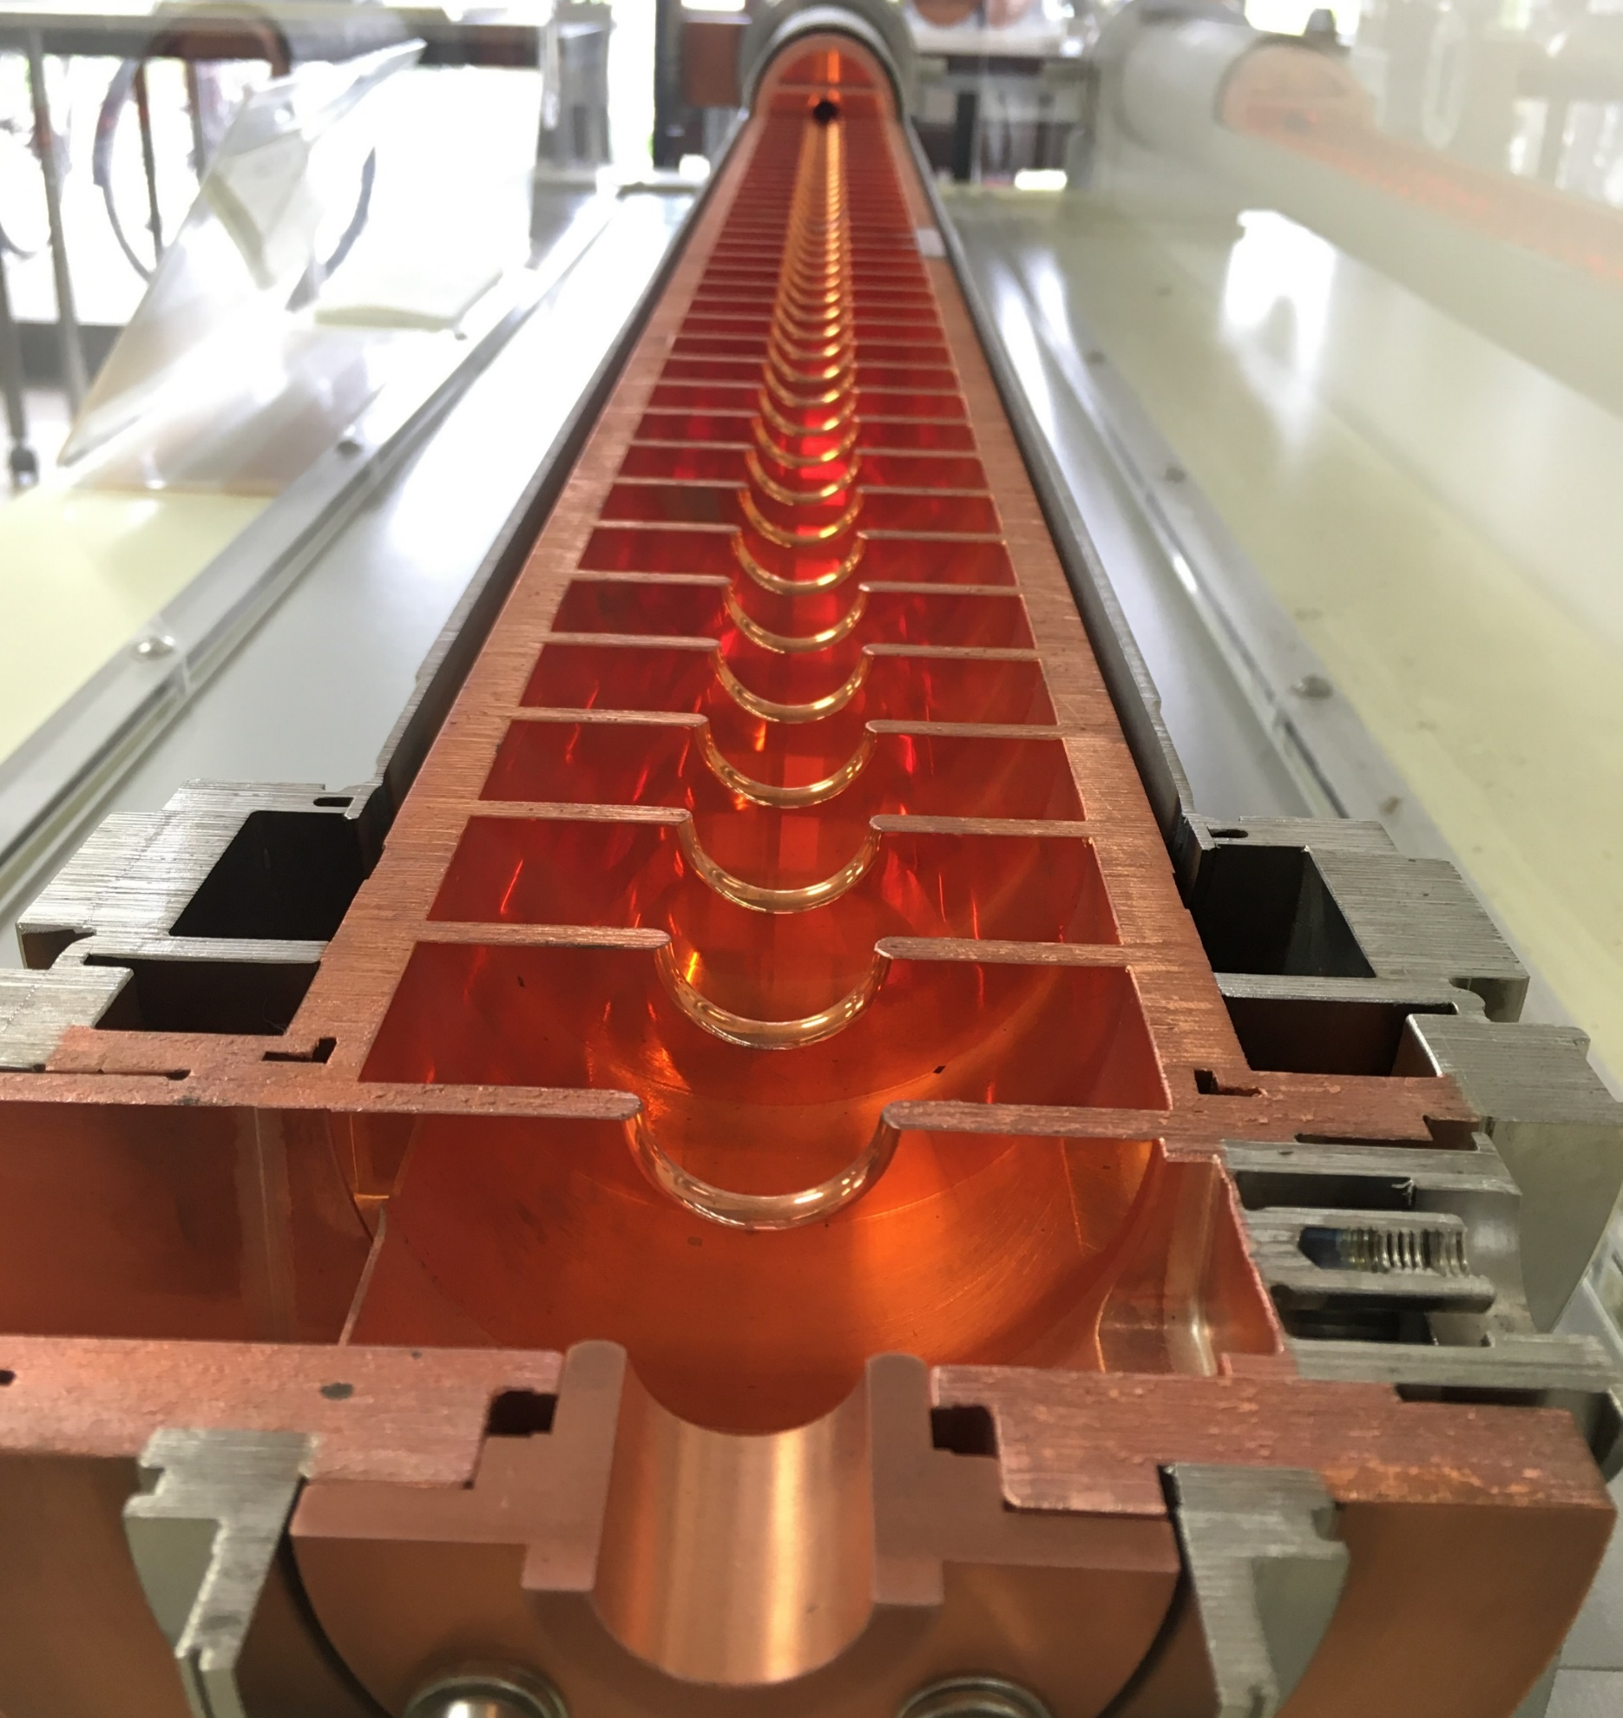
Electron Injector and
Linear Accelerator
Introduction
Injector
Linear Accelerator
Linear Accelerator
Beam loading and its control
Summary
Summary

Slide 3
Introduction

Slide 4
What is Linear Accelerator?
A linear accelerator consists of a particle source, accelerator sections, and an application area.
A linear accelerator is an accelerator that does not have an orbit in the accelerator section.
The accelerator can have an electrostatic accelerator or a radio-frequency accelerator.
Particle source
Accelerator
Application
LINAC
LINAC
Not
a LINAC

Slide 5
Static and RF LINAC
In an electrostatic linear accelerator, the beam energy is limited by the discharge limit. They are suitable for continuous high-current low energy electron beam.
Beams from radio-frequency linear accelerators are localized bunches in time that are sufficiently shorter than the period of the radio frequency. The repetition of the bunch is at its maximum at the frequency of the accelerating RF. Continuous beam acceleration is impossible, but there is no upper energy limit in principle.
In this lecture, we study the electron RF LINAC.
Continuous beam
Bunched beam

Slide 6
Components of LINAC
A LINAC is composed from
Electron Gun and Injetor ( Prof. Qian)
RF accelerator (RF cavity by Prof. Fang, SC accelerator by Prof. Zhai)
Beam diagnostic section (Beam Diagnostics by Prof. Leng)
Application area (Collider, FEL, Industrial Application, Medical Application, etc. )
Beam dump

Slide 7
A typical configuration of Electron Linac
Particle source
Injector
Accelerator
Application
Beam Dump
Electron beam is generated. The temporal structure depends on the technology.
The beam is transformed to a bunched structure for RF acceleration
The bunched beam is boosted by the accelerator section.
The beam is used for various applications.
The beam is dumped with the appropriate radiation shield.

Slide 8
Electron Gun

Slide 9
Elements of Electron Gun
Cathode (Electron Emitter)
Extraction Field

Slide 10
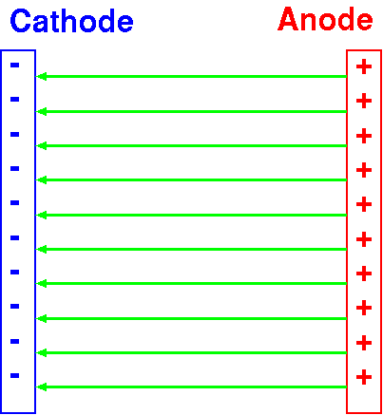
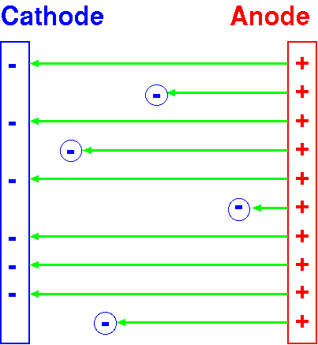
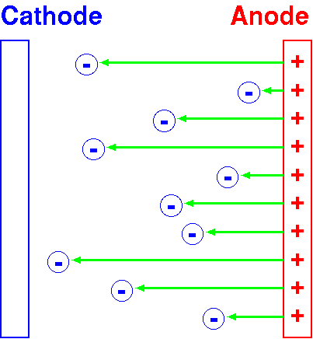
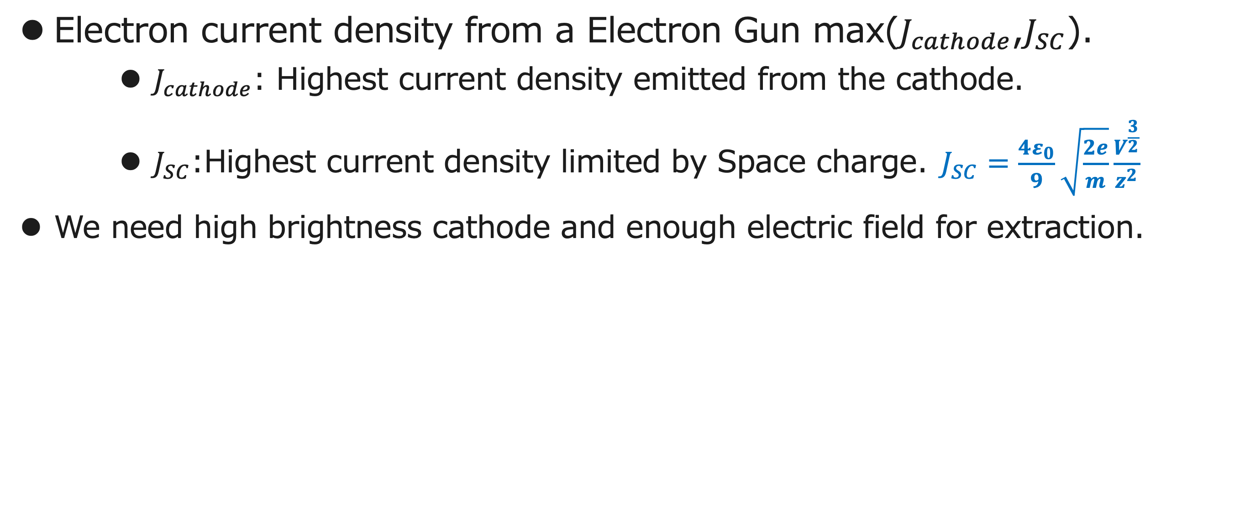
How Much Current ?
Electron current density from a Electron Gun max($J_{cathode}$,$J_{SC}$).
  $J_{cathode}$: Highest current density emitted from the cathode.
  $J_{SC}$:Highest current density limited by Space charge.$J_{SC}=\frac{4ε_{0}}{9}\sqrt{\frac{2e}{m}}\frac{V^{\frac{3}{2}}}{z^{2}}$
We need high brightness cathode and enough electric field for extraction.

Slide 11
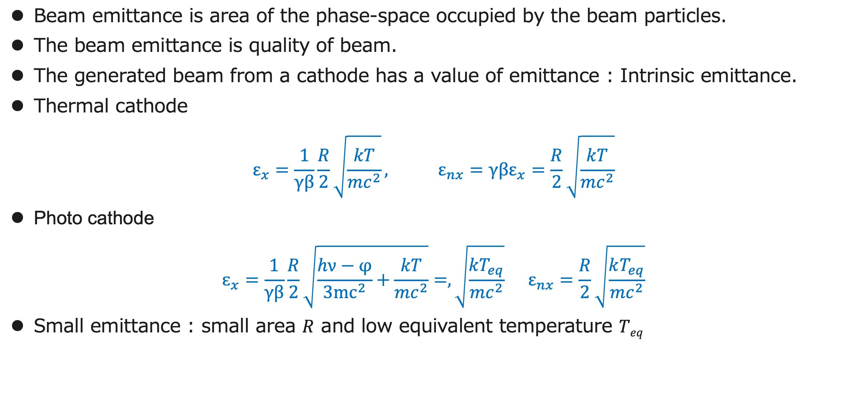
Beam Emittance
Beam emittance is area of the phase-space occupied by the beam particles.
The beam emittance is quality of beam.
The generated beam from a cathode has a value of emittance : Intrinsic emittance.
Thermal cathode
$$ε_{x}=\frac{1}{γβ}\frac{R}{2}\sqrt{\frac{kT}{{mc}^{2}}}, ε_{nx}=γβε_{x}=\frac{R}{2}\sqrt{\frac{kT}{{mc}^{2}}}$$
Photo cathode
$$ɛ_{x}=\frac{1}{γβ}\frac{R}{2}\sqrt{\frac{hν−φ}{{3mc}^{2}}+\frac{kT}{{mc}^{2}}}=,\sqrt{\frac{{kT}_{eq}}{{mc}^{2}}} ε_{nx}=\frac{R}{2}\sqrt{\frac{kT_{eq}}{{mc}^{2}}}$$
Small emittance : small area $R$ and low equivalent temperature $Teq$

Slide 12
Injector

Slide 13
Role of Injector
The role of injector is preparing “beautiful electron bunches” for acceleration.
What is “the beautiful bunch”?
  Confined in a small region: the bunch is concentrated in a longitudinal small region comparing with the RF period.
  Good synchronization: The bunch repetition is synchronized with RF period.
  No deformation: No correlations among degree of freedom, no non-linear deformation in phase-space of a degree of freedom.

Slide 14
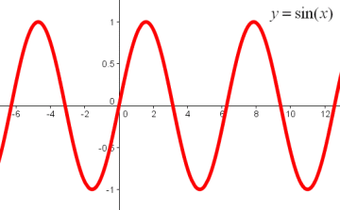
Good concentration and Synchronization
Beautiful !
Bunch length (longitudinal distribution) should be much shorter than RF period for uniform acceleration.
All bunches should be placed on a same phase.
Not beautiful

Slide 15
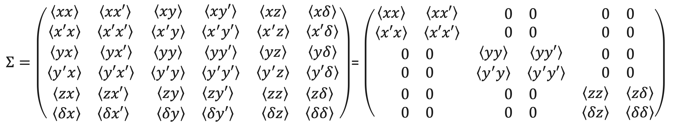
No deformation
w’
No correlation among degree of freedoms, e.g. x and y.
No non-linear deformation in a degree of freedom,e.g. x and x’.
w
$Σ=\left(\begin{matrix}\begin{matrix}\left\langle xx\right\rangle & \left\langle xx′\right\rangle \\ \left\langle x′x\right\rangle & \left\langle x′x′\right\rangle \end{matrix} & \begin{matrix}\left\langle xy\right\rangle & \left\langle xy′\right\rangle \\ \left\langle x^{′}y\right\rangle & \left\langle x^{′}y′\right\rangle \end{matrix} & \begin{matrix}\left\langle xz\right\rangle & \left\langle xδ\right\rangle \\ \left\langle x^{′}z\right\rangle & \left\langle x′δ\right\rangle \end{matrix} \\ \begin{matrix}\left\langle yx\right\rangle & \left\langle yx′\right\rangle \\ \left\langle y^{′}x\right\rangle & \left\langle y′x′\right\rangle \end{matrix} & \begin{matrix}\left\langle yy\right\rangle & \left\langle yy′\right\rangle \\ \left\langle y^{′}y\right\rangle & \left\langle y^{′}y′\right\rangle \end{matrix} & \begin{matrix}\left\langle yz\right\rangle & \left\langle yδ\right\rangle \\ \left\langle y^{′}z\right\rangle & \left\langle y′δ\right\rangle \end{matrix} \\ \begin{matrix}\left\langle zx\right\rangle & \left\langle zx′\right\rangle \\ \left\langle δx\right\rangle & \left\langle δx′\right\rangle \end{matrix} & \begin{matrix}\left\langle zy\right\rangle & \left\langle zy′\right\rangle \\ \left\langle δy\right\rangle & \left\langle δy′\right\rangle \end{matrix} & \begin{matrix}\left\langle zz\right\rangle & \left\langle zδ\right\rangle \\ \left\langle δz\right\rangle & \left\langle δδ\right\rangle \end{matrix}\end{matrix}\right)$= $\left(\begin{matrix}\begin{matrix}\left\langle xx\right\rangle & \left\langle xx′\right\rangle \\ \left\langle x′x\right\rangle & \left\langle x′x′\right\rangle \end{matrix} & \begin{matrix}0 & 0 \\ 0 & 0\end{matrix} & \begin{matrix}0 & 0 \\ 0 & 0\end{matrix} \\ \begin{matrix}0 & 0 \\ 0 & 0\end{matrix} & \begin{matrix}\left\langle yy\right\rangle & \left\langle yy′\right\rangle \\ \left\langle y^{′}y\right\rangle & \left\langle y^{′}y′\right\rangle \end{matrix} & \begin{matrix}0 & 0 \\ 0 & 0\end{matrix} \\ \begin{matrix}0 & 0 \\ 0 & 0\end{matrix} & \begin{matrix}0 & 0 \\ 0 & 0\end{matrix} & \begin{matrix}\left\langle zz\right\rangle & \left\langle zδ\right\rangle \\ \left\langle δz\right\rangle & \left\langle δδ\right\rangle \end{matrix}\end{matrix}\right)$

Slide 16
What is Wrong?
w’
If there is any correlation between degree of freedoms, or in a degree of freedom, the beam size (or projected emittance) is inflated.
The inflated “emittance” can‘t be recovered by any linear transformation ( quadrupole and drift).
w

Slide 17
Pre-bunching

Slide 18
Pre-bunching
Some particle source generates continuous beam.
Any RF accelerator can’t accelerate the continuous beam. It should be transformed into a bunched beam structure.
The repetition of the bunch should be exactly the same as that of the accelerator RF or its sub-harmonics.
The bunched structure is made by an RF cavity whose frequency is the same as the accelerator or its sub-harmonics.
After the pre-bunching, the basic beam structure is formed.
Bunched beam
Continuous beam
RF period or its sub-harmonics

Slide 19
Velocity modulation and Pre-bunching
The continuous beam passes through the pre-bunch RF cavity.
Particles are accelerated or decelerated depending on the RF phase resulting in a velocity modulation on the beam.
Accelerated particles move forward and decelerated particles move backward after the modulation.
Particles are gathered at the zero-cross of pre-bunching RF with an appropriate drift length.

Slide 20
Bunching

Slide 21
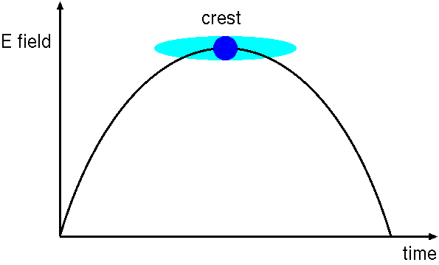
Bunch Compression
In RF accelerators, the beam should be concentrated in a short period of longitudinal space for uniform acceleration.
In some case, extremely short bunch length is required.
The bunch compressor (Buncher) shortens the bunch length down to an adequate size.

Slide 22
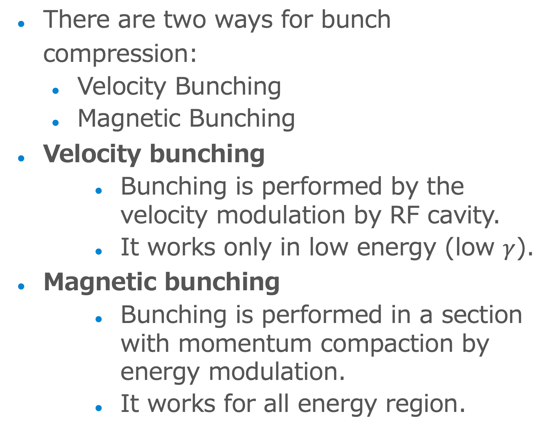
There are two ways for bunch compression:
  Velocity Bunching
  Magnetic Bunching
Velocity bunching
  Bunching is performed by the velocity modulation by RF cavity.
  It works only in low energy (low $γ$).
Magnetic bunching
  Bunching is performed in a section with momentum compaction by energy modulation.
  It works for all energy region.
Acceleration
Deceleration
Acceleration
Deceleration

Slide 23
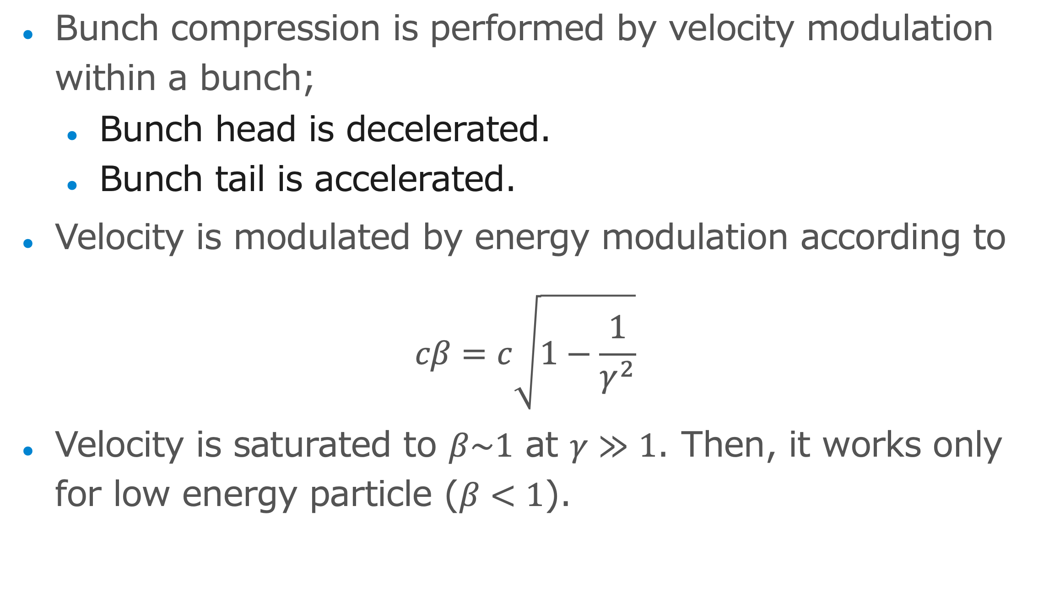
Velocity Bunching
Bunch compression is performed by velocity modulation within a bunch;
  Bunch head is decelerated.
  Bunch tail is accelerated.
Velocity is modulated by energy modulation according to
$$cβ=c\sqrt{1−\frac{1}{γ^{2}}}$$
Velocity is saturated to $β\sim 1$ at $γ≫1$. Then, it works only for low energy particle ($β<1$).

Slide 24
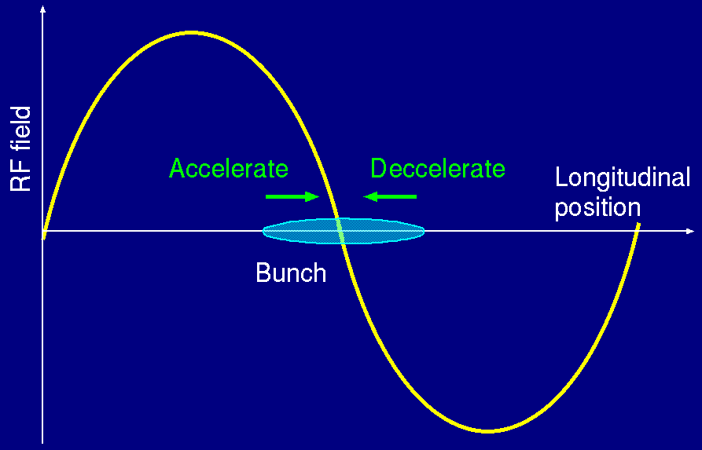
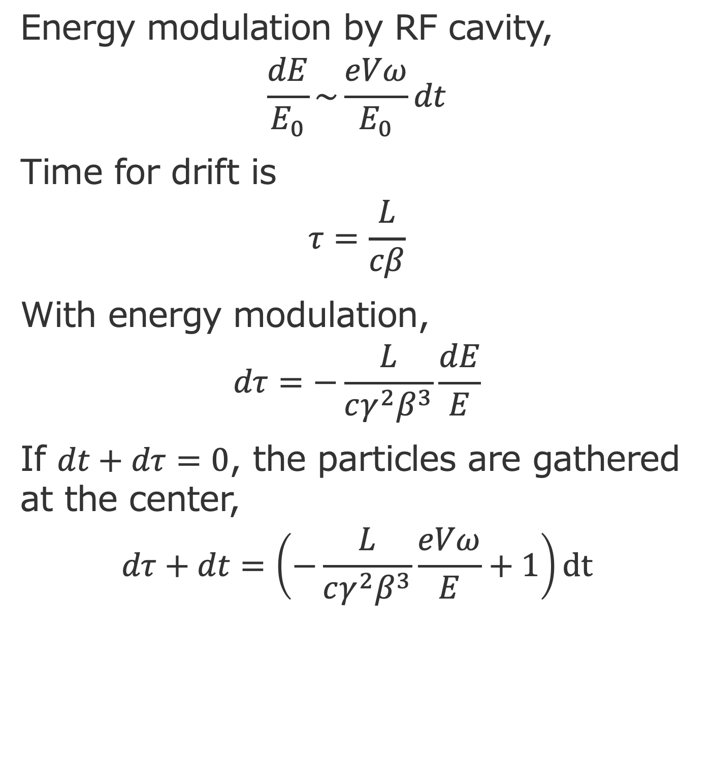
Energy modulation by RF cavity,
$$\frac{dE}{E_{0}}\sim \frac{eVω}{E_{0}}dt$$
Time for drift is
$$τ=\frac{L}{cβ}$$
With energy modulation,
$$dτ=−\frac{L}{cγ^{2}β^{3}}\frac{dE}{E}$$
If $dt+dτ=0$, the particles are gathered at the center,
$$dτ+dt=\left(−\frac{L}{cγ^{2}β^{3}}\frac{eVω}{E}+1\right)dt$$
dE/E
t
dt
dτ

Slide 25
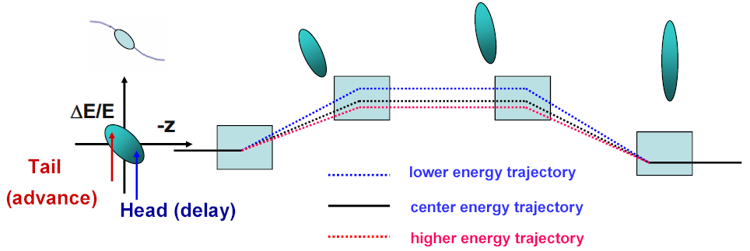
Magnetic Bunching
Energy Modulation: RF cavity.
Momentum compaction: different paths for different energy.
The bunch head (tail) travels a longer (shorter) path and the bunch length becomes shorter.
By E.S. Kim

Slide 26
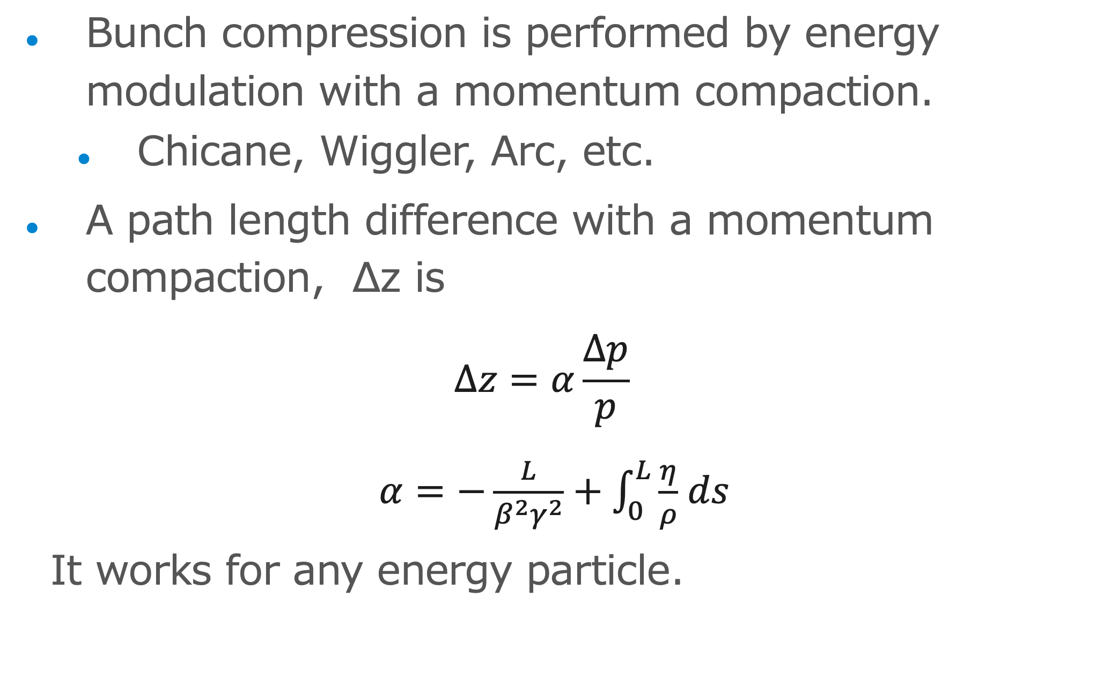
Bunch compression is performed by energy modulation with a momentum compaction.
  Chicane, Wiggler, Arc, etc.
A path length difference with a momentum compaction, ∆z is
$$∆z=α\frac{∆p}{p}$$
$α=−\frac{L}{β^{2}γ^{2}}+\int_{0}^{L}{\frac{η}{ρ}}$ $ds$
It works for any energy particle.

Slide 27
Matrix Formalism
Bunching can be
formalized with transfer matrix in linear approximation.
Energy modulation is
made by RF (acc- and deceleration).
Drift space (velocity bunching) or momentum compaction (magnetic bunching) rotates the beam in phase space with 90 deg.
δ(ΔE/E)
Acceleration
z
Deceleration
Drift

Slide 28
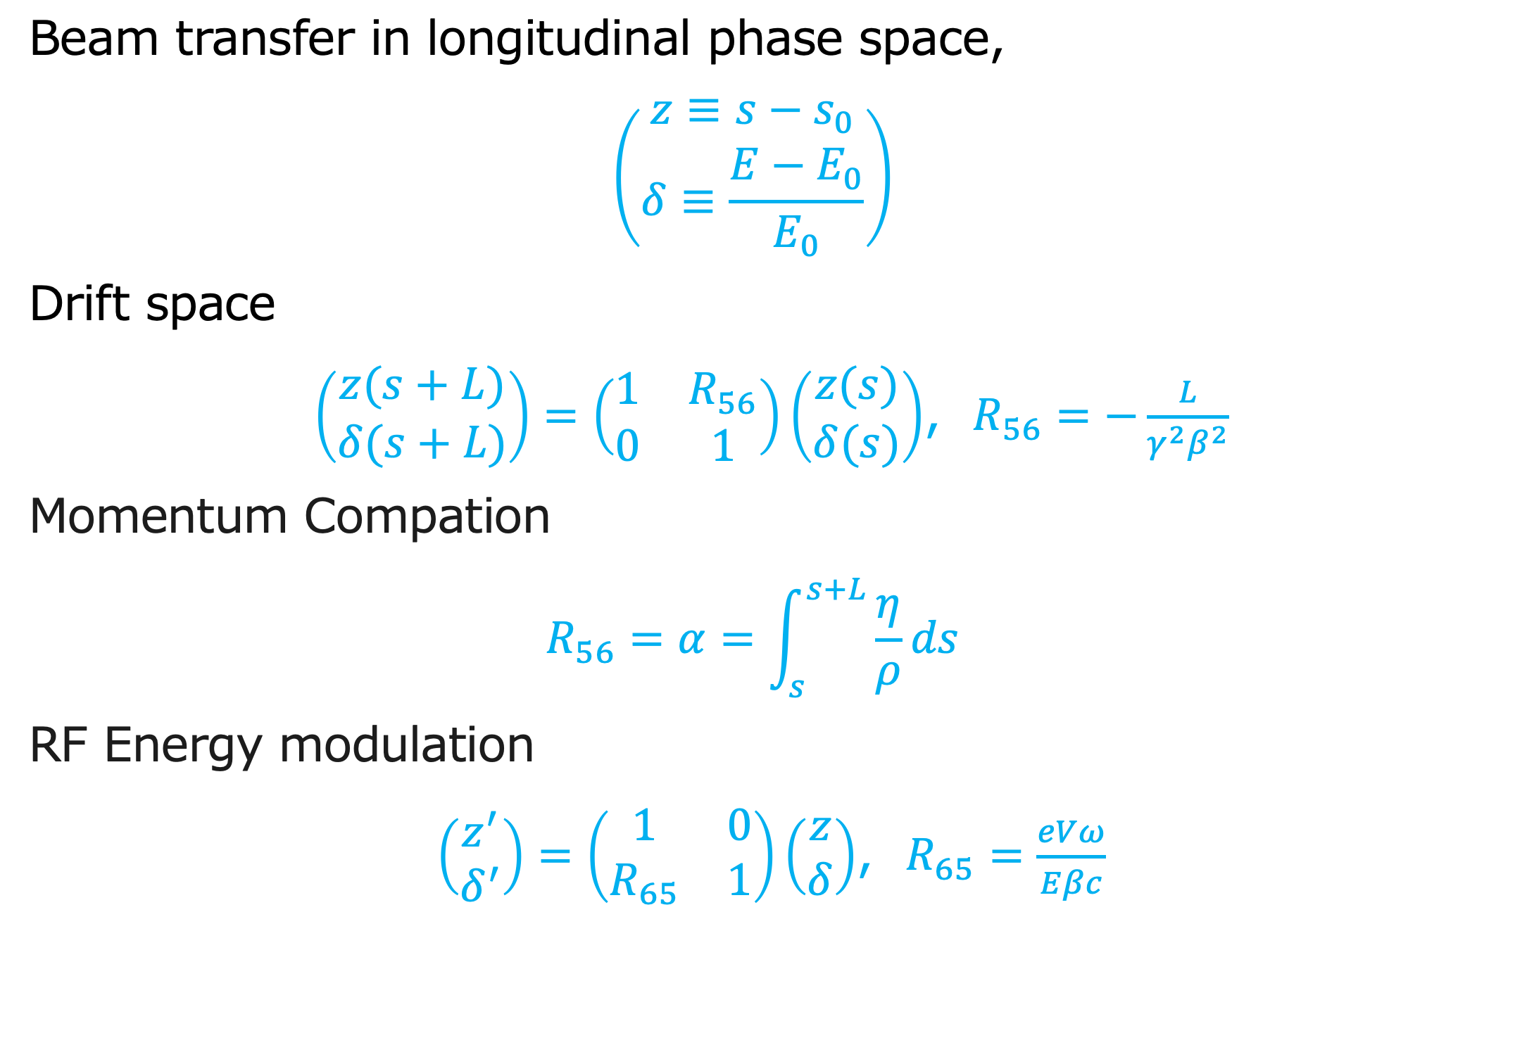
R-matrices
Beam transfer in longitudinal phase space,
$$\left(\begin{matrix}z≡s−s_{0} \\ δ≡\frac{E−E_{0}}{E_{0}}\end{matrix}\right)$$
Drift space
$\left(\begin{matrix}z(s+L) \\ δ(s+L)\end{matrix}\right)=\left(\begin{matrix}1 & R_{56} \\ 0 & 1\end{matrix}\right)\left(\begin{matrix}z(s) \\ δ(s)\end{matrix}\right)$, $R_{56}=−\frac{L}{γ^{2}β^{2}}$
Momentum Compation
$$R_{56}=α=\int_{s}^{s+L}{\frac{η}{ρ}ds}$$
RF Energy modulation
$\left(\begin{matrix}z^{′} \\ δ^{′}\end{matrix}\right)=\left(\begin{matrix}1 & 0 \\ R_{65} & 1\end{matrix}\right)\left(\begin{matrix}z \\ δ\end{matrix}\right)$, $R_{65}=\frac{eVω}{Eβc}$

Slide 29
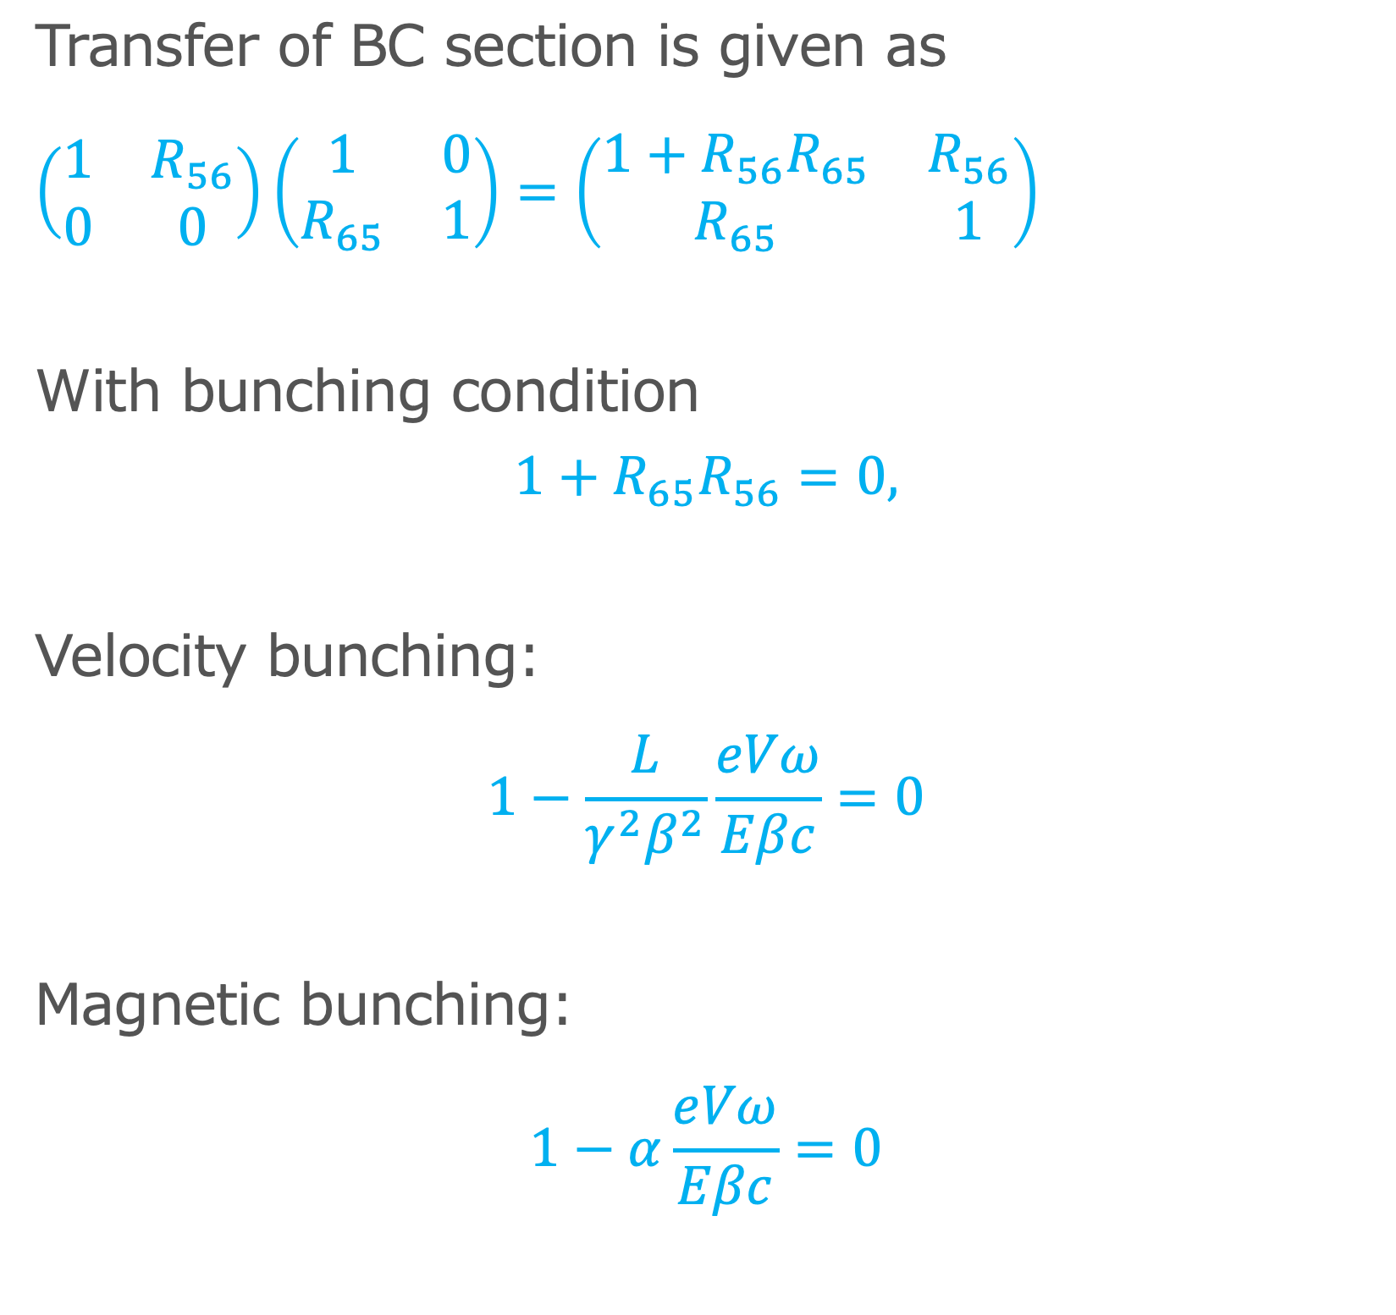
Transfer of BC section is given as
$\left(\begin{matrix}1 & R_{56} \\ 0 & 0\end{matrix}\right)\left(\begin{matrix}1 & 0 \\ R_{65} & 1\end{matrix}\right)=\left(\begin{matrix}1+R_{56}R_{65} & R_{56} \\ R_{65} & 1\end{matrix}\right)$
With bunching condition
$$1+R_{65}R_{56}=0,$$
Velocity bunching:
$$1−\frac{L}{γ^{2}β^{2}}\frac{eVω}{Eβc}=0$$
Magnetic bunching:
$$1−α\frac{eVω}{Eβc}=0$$
δ(ΔE/E)
R65
z
R56

Slide 30
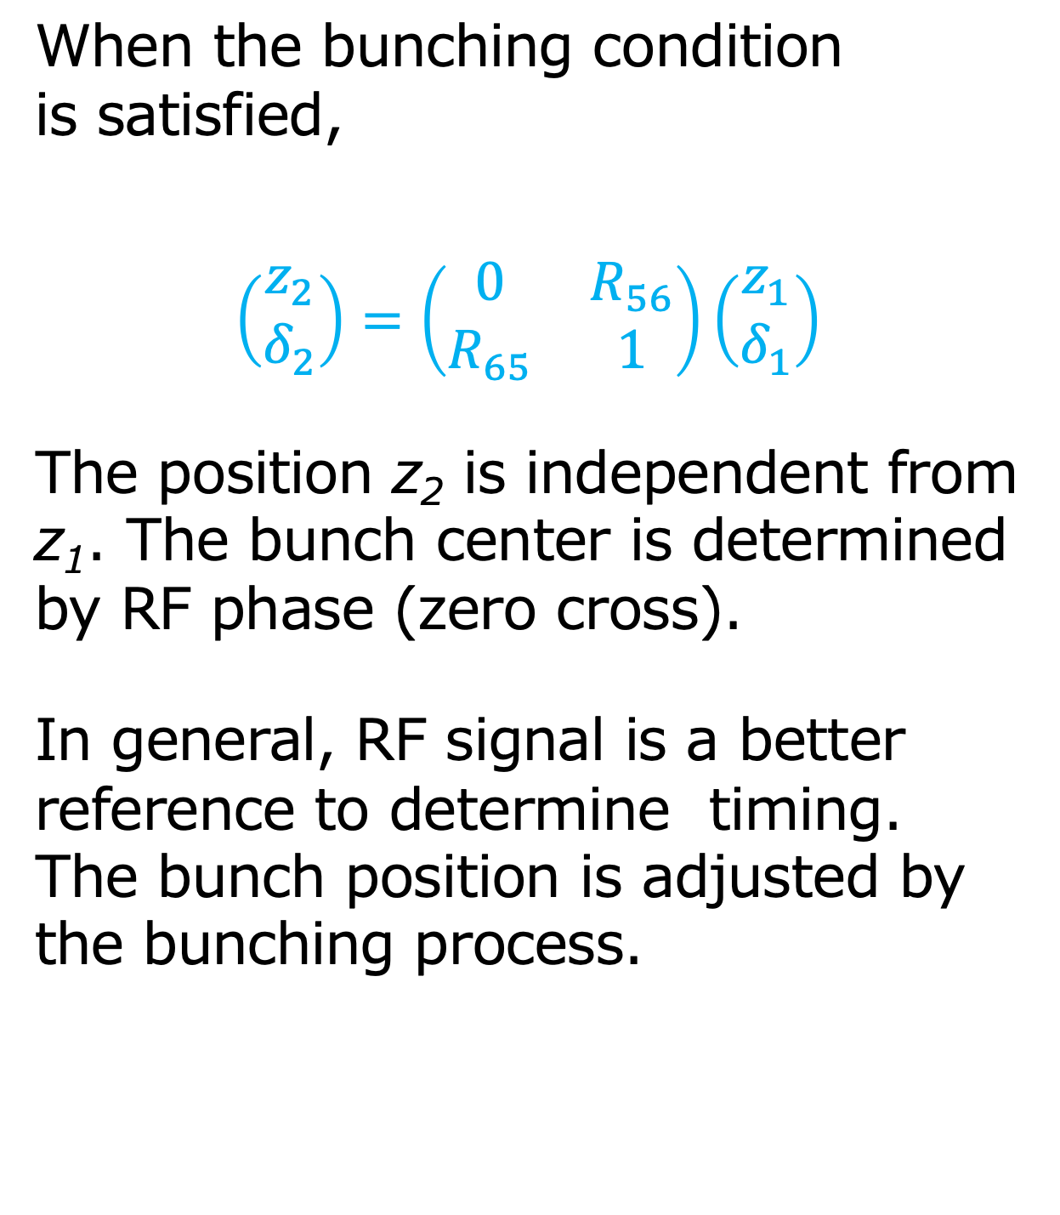
When the bunching condition
is satisfied,
$$\left(\begin{matrix}z_{2} \\ δ_{2}\end{matrix}\right)=\left(\begin{matrix}0 & R_{56} \\ R_{65} & 1\end{matrix}\right)\left(\begin{matrix}z_{1} \\ δ_{1}\end{matrix}\right)$$
The position z₂ is independent from z₁. The bunch center is determined by RF phase (zero cross).
In general, RF signal is a better reference to determine timing. The bunch position is adjusted by the bunching process.
δ(ΔE/E)
R65
z
R56

Slide 31
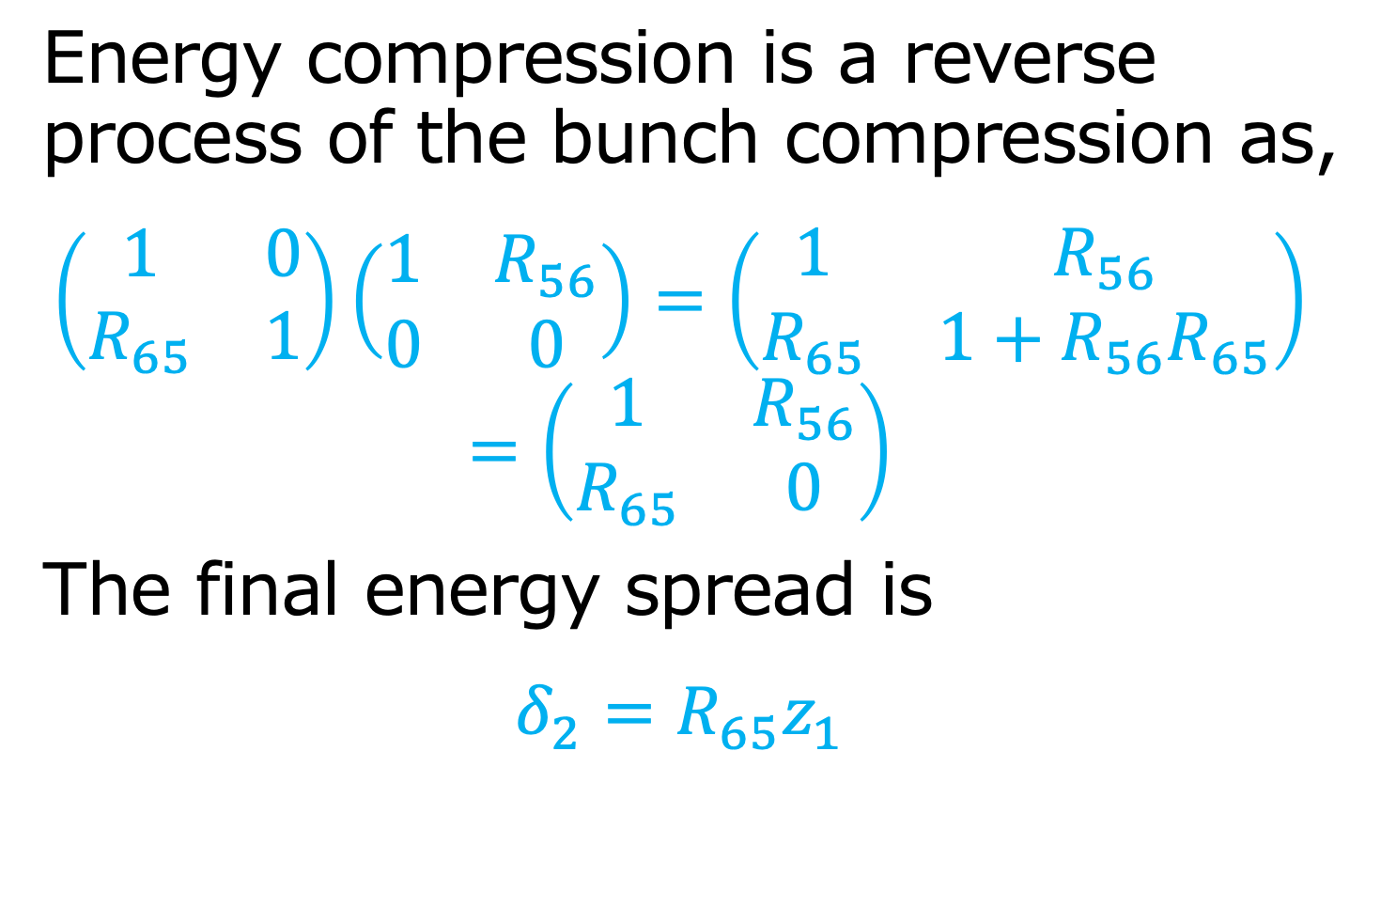
Energy Compression
Energy compression is a reverse
process of the bunch compression as,
$$\left(\begin{matrix}1 & 0 \\ R_{65} & 1\end{matrix}\right)\left(\begin{matrix}1 & R_{56} \\ 0 & 0\end{matrix}\right)=\left(\begin{matrix}1 & R_{56} \\ R_{65} & 1+R_{56}R_{65}\end{matrix}\right)$$
$$=\left(\begin{matrix}1 & R_{56} \\ R_{65} & 0\end{matrix}\right)$$
The final energy spread is
$$δ_{2}=R_{65}z_{1}$$
δ(ΔE/E)
R65
z
R56

Slide 32
Space charge emittance growth

Slide 33
Emittance growth by Space Charge
Space charge effect is deformation of the bunch shape in the phase space by Lorentz force.
If the charge density is uniform, the force is linear. In this case, the emittance is still conserved.
If the charge density is not uniform, e.g. Gaussian, the force is non-linear. RMS emittance shows a significant growth.
w’
w

Slide 34
Slice mismatch
If the bunch intensity is not uniform in longitudinal direction (z), the emittance growth occurred even the density is uniform in x and y.
The emittance growth is due to slice mismatch, where each slice feels different Lorentz force.
A typical example: Bunch center (pink) is more dense than the bunch end (blue).
w’
w

Slide 35
Emittance growth compensation
Solenoid focusing can fix the emittance growth due to the slice mismatch.
Solenoid focus the slices.
By drifting, the slices rotates clockwise.
The low density slice come to the waist ealier than the high density, so it catches up the high density slice.
w’
w’
w’
w
w
w

Slide 36
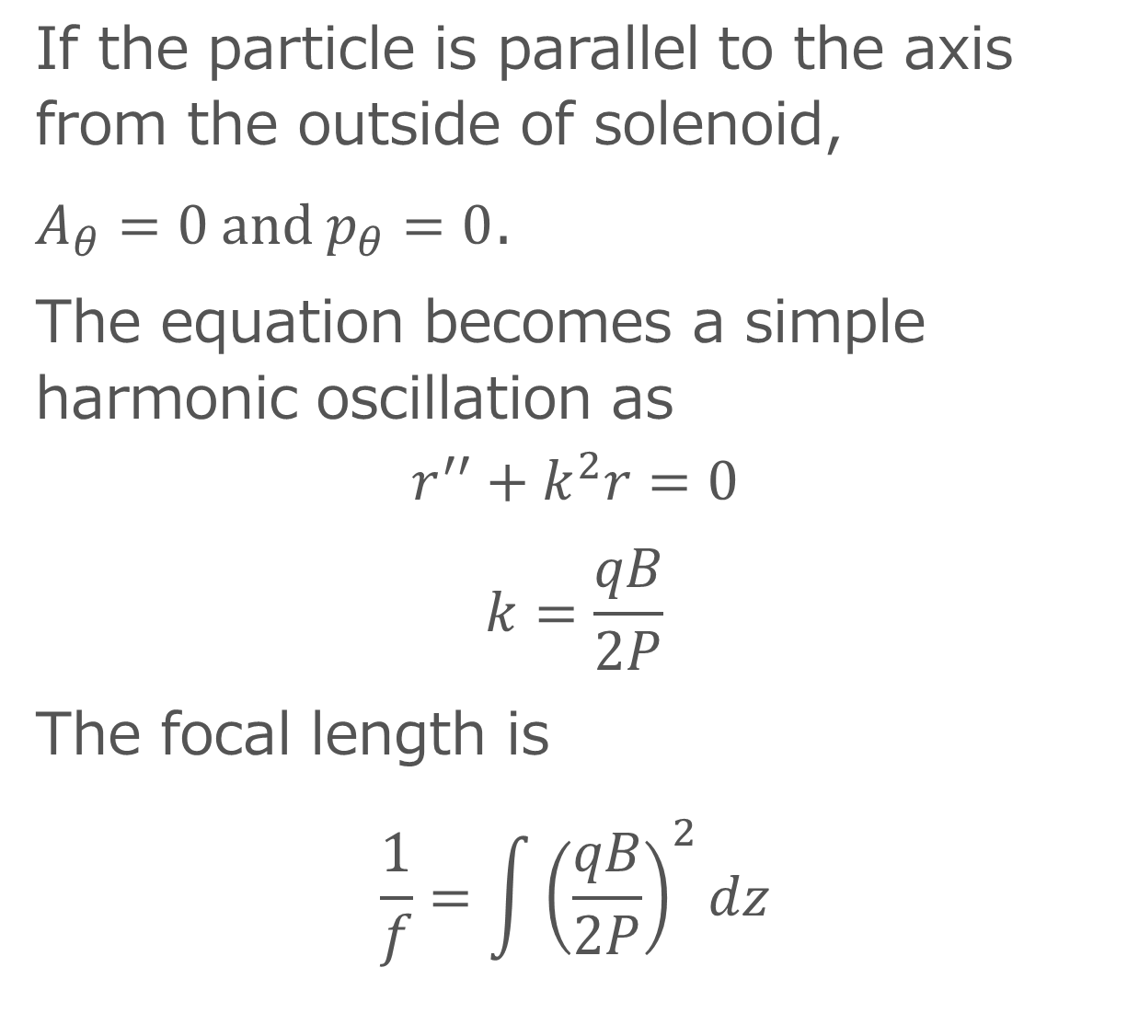
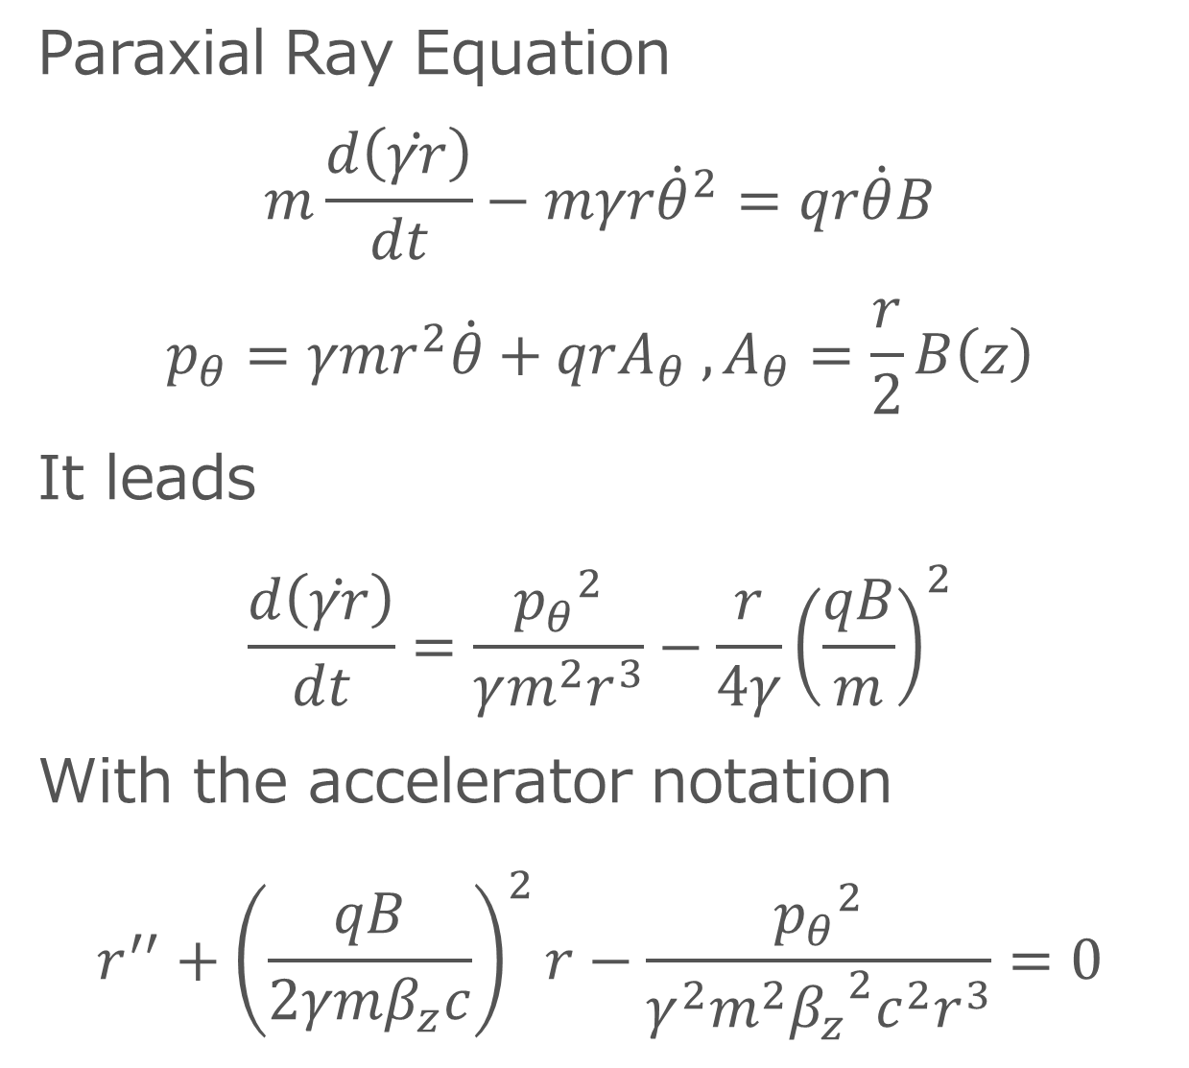
Solenoid focusing
Paraxial Ray Equation
$$m\frac{d\left(\dot{γr}\right)}{dt}−mγr{\dot{θ}}^{2}=qr\dot{θ}B$$
$$p_{θ}=γmr^{2}\dot{θ}+qrA_{θ} ,A_{θ}=\frac{r}{2}B\left(z\right)$$
It leads
$$\frac{d\left(\dot{γr}\right)}{dt}=\frac{{p_{θ}}^{2}}{γm^{2}r^{3}}−\frac{r}{4γ}{\left(\frac{qB}{m}\right)}^{2}$$
With the accelerator notation
$$r^{′′}+{\left(\frac{qB}{2γmβ_{z}c}\right)}^{2}r−\frac{{p_{θ}}^{2}}{γ^{2}m^{2}{{β_{z}}^{2}c^{2}r}^{3}}=0$$
If the particle is parallel to the axis from the outside of solenoid,
$A_{θ}=0$ and $p_{θ}=0$.
The equation becomes a simple harmonic oscillation as
$$r^{′′}+k^{2}r=0$$
$$k=\frac{qB}{2P}$$
The focal length is
$$\frac{1}{f}=\int{{\left(\frac{qB}{2P}\right)}^{2}dz}$$

Slide 37
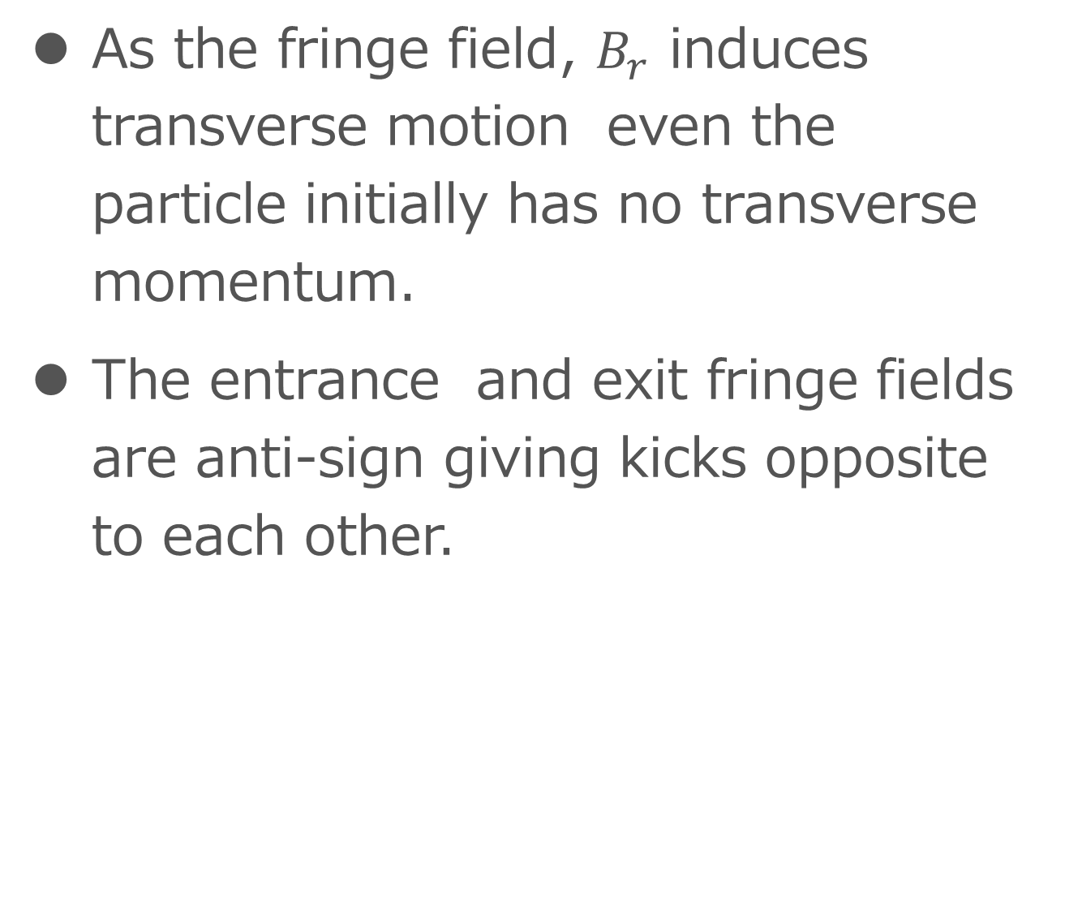
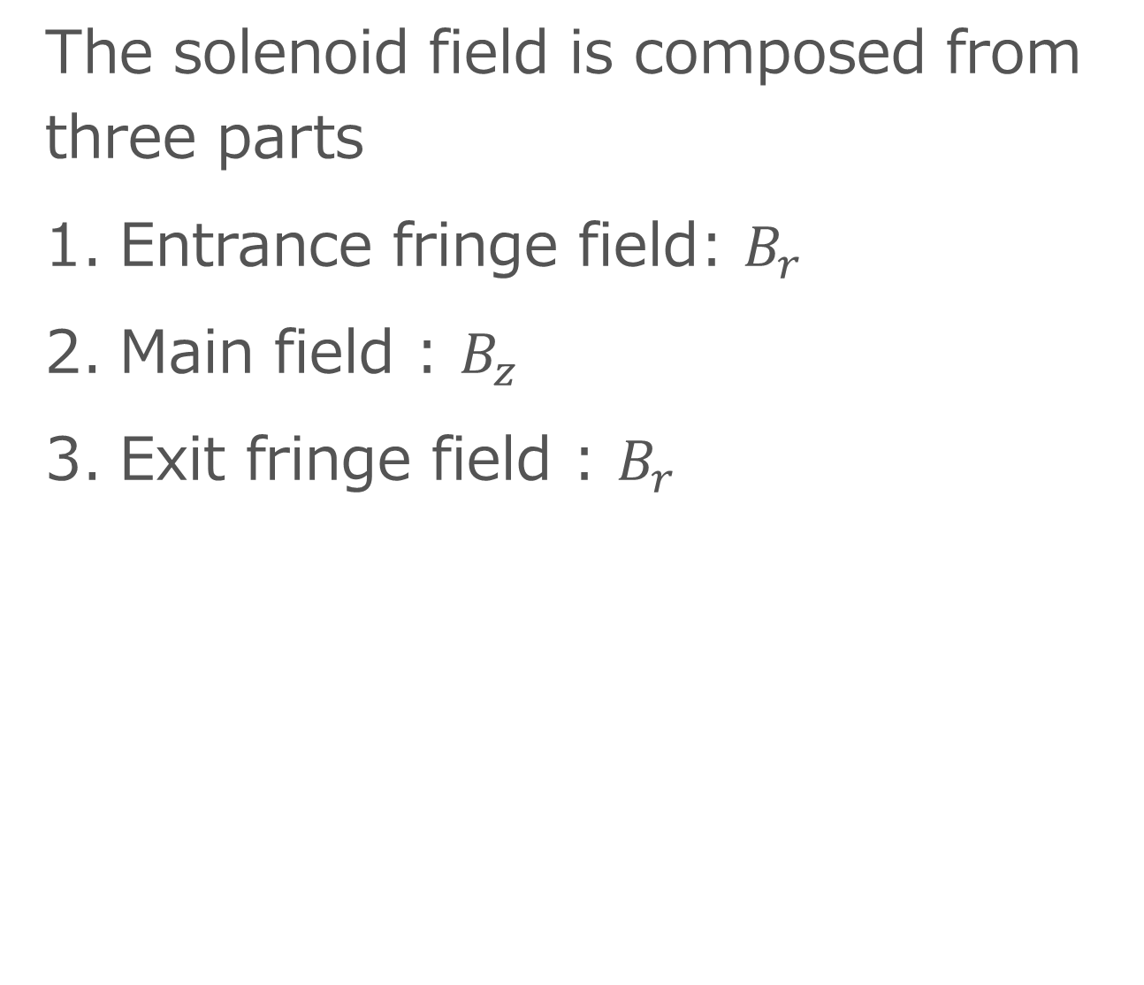
Fringe field
The solenoid field is composed from three parts
Entrance fringe field: $B_{r}$
Main field : $B_{z}$
Exit fringe field : $B_{r}$
As the fringe field, $B_{r}$ induces transverse motion even the particle initially has no transverse momentum.
The entrance and exit fringe fields are anti-sign giving kicks opposite to each other.

Slide 38
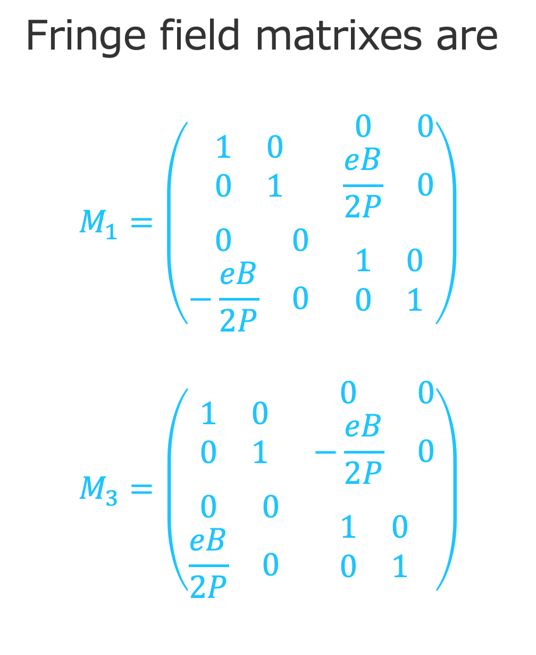
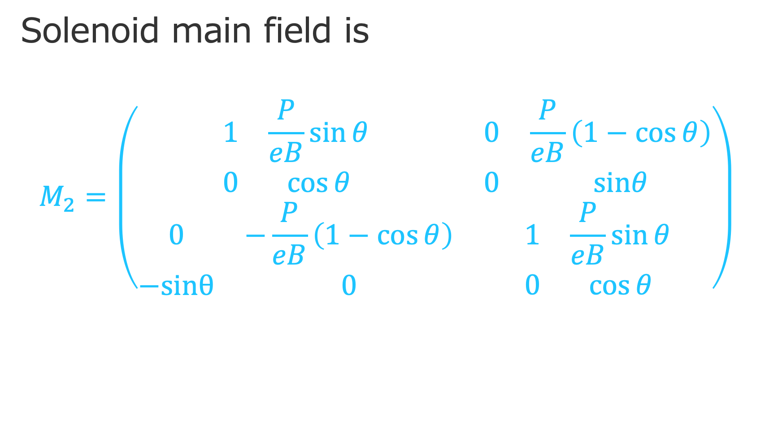



Transfer Matrix of a Solenoid
$$M_{2}$$
$$M_{1}$$
$$M_{3}$$
Fringe field matrixes are
$$M_{1}=\left(\begin{matrix}\begin{matrix}1 & 0 \\ 0 & 1\end{matrix} & \begin{matrix}0 & 0 \\ \frac{eB}{2P} & 0\end{matrix} \\ \begin{matrix}0 & 0 \\ −\frac{eB}{2P} & 0\end{matrix} & \begin{matrix}1 & 0 \\ 0 & 1\end{matrix}\end{matrix}\right)$$
$$M_{3}=\left(\begin{matrix}\begin{matrix}1 & 0 \\ 0 & 1\end{matrix} & \begin{matrix}0 & 0 \\ −\frac{eB}{2P} & 0\end{matrix} \\ \begin{matrix}0 & 0 \\ \frac{eB}{2P} & 0\end{matrix} & \begin{matrix}1 & 0 \\ 0 & 1\end{matrix}\end{matrix}\right)$$
Solenoid main field is
$$M_{2}=\left(\begin{matrix}\begin{matrix}1 & \frac{P}{eB}\sin{θ} \\ 0 & \cos{θ}\end{matrix} & \begin{matrix}0 & \frac{P}{eB}\left(1−\cos{θ}\right) \\ 0 & sinθ\end{matrix} \\ \begin{matrix}0 & −\frac{P}{eB}\left(1−\cos{θ}\right) \\ −sinθ & 0\end{matrix} & \begin{matrix}1 & \frac{P}{eB}\sin{θ} \\ 0 & \cos{θ}\end{matrix}\end{matrix}\right)$$

Slide 39
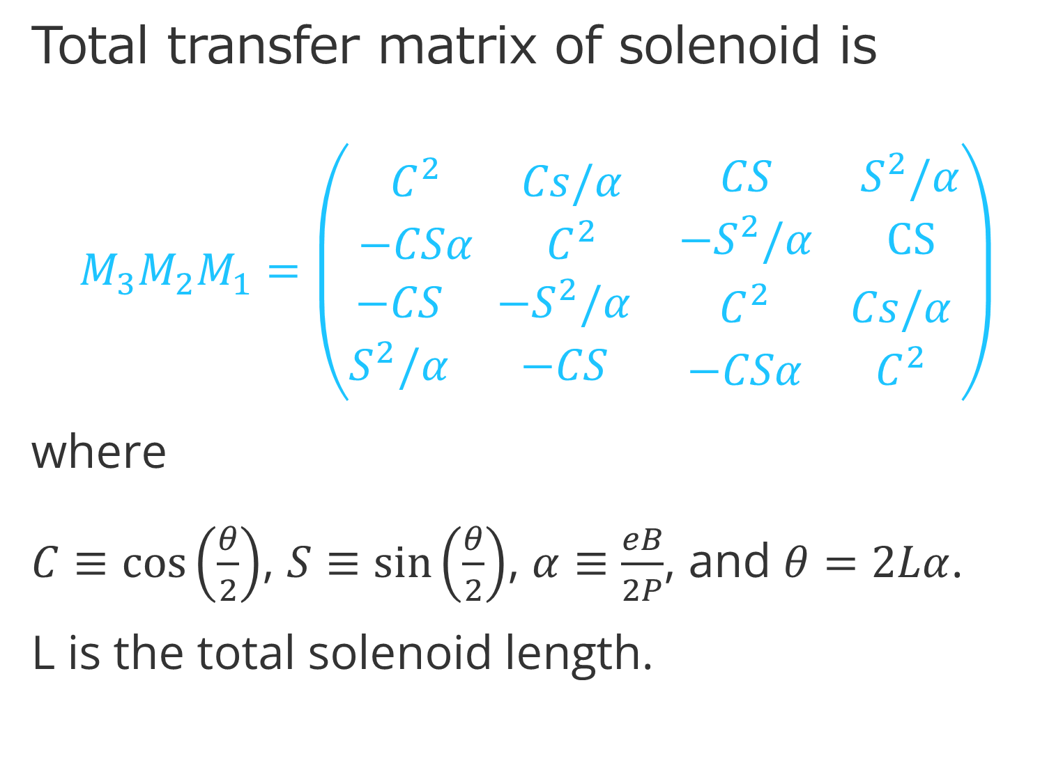
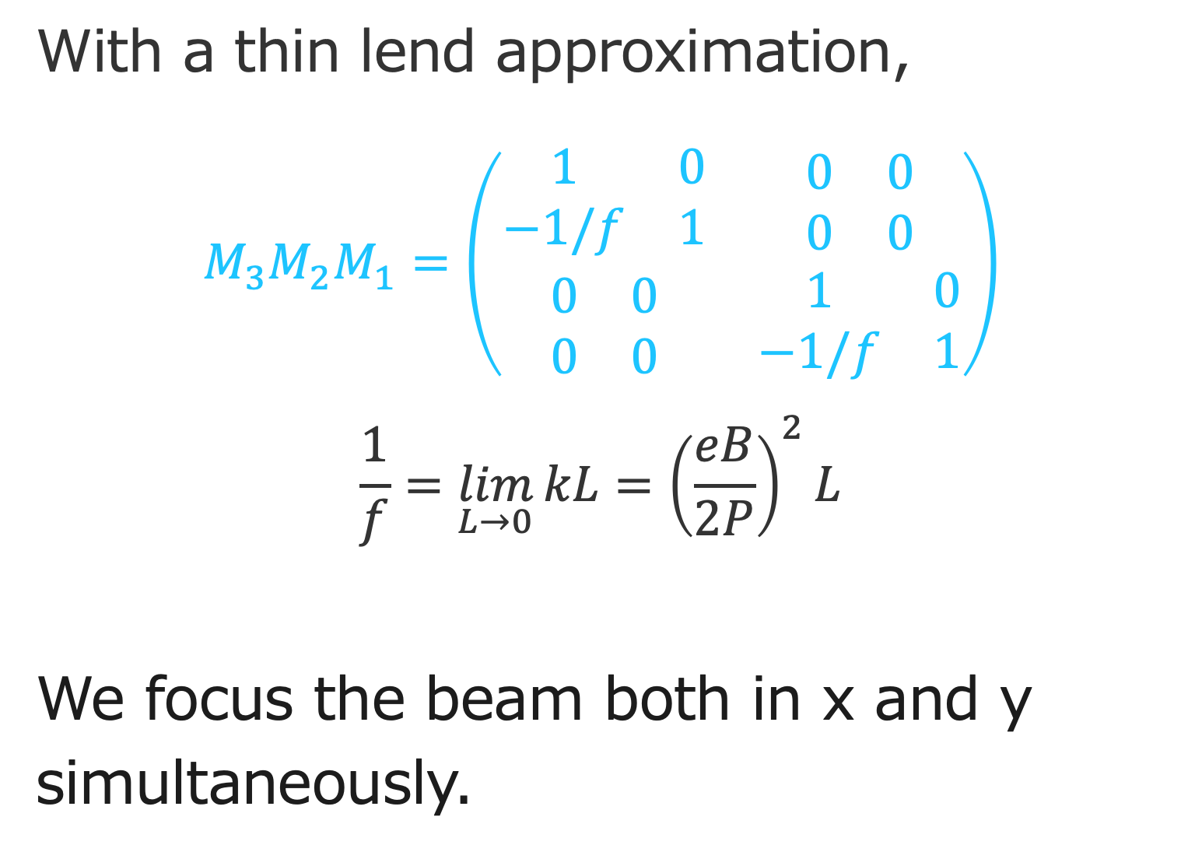
Total transfer matrix of solenoid is
$$M_{3}M_{2}M_{1}=\left(\begin{matrix}\begin{matrix}C^{2} & Cs/α \\ −CSα & C^{2}\end{matrix} & \begin{matrix}CS & S^{2}/α \\ {−S}^{2}/α & CS\end{matrix} \\ \begin{matrix}−CS & −S^{2}/α \\ S^{2}/α & −CS\end{matrix} & \begin{matrix}C^{2} & Cs/α \\ −CSα & C^{2}\end{matrix}\end{matrix}\right)$$
where
$C≡\cos\left(\frac{θ}{2}\right)$, $S≡\sin\left(\frac{θ}{2}\right)$, $α≡\frac{eB}{2P}$, and $θ=2Lα$.
L is the total solenoid length.
With a thin lend approximation,
$$M_{3}M_{2}M_{1}=\left(\begin{matrix}\begin{matrix}1 & 0 \\ −1/f & 1\end{matrix} & \begin{matrix}0 & 0 \\ 0 & 0\end{matrix} \\ \begin{matrix}0 & 0 \\ 0 & 0\end{matrix} & \begin{matrix}1 & 0 \\ −1/f & 1\end{matrix}\end{matrix}\right)$$
$$\frac{1}{f}=\lim_{L→0}{kL}={\left(\frac{eB}{2P}\right)}^{2}L$$
We focus the beam both in x and y simultaneously.

Slide 40
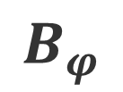
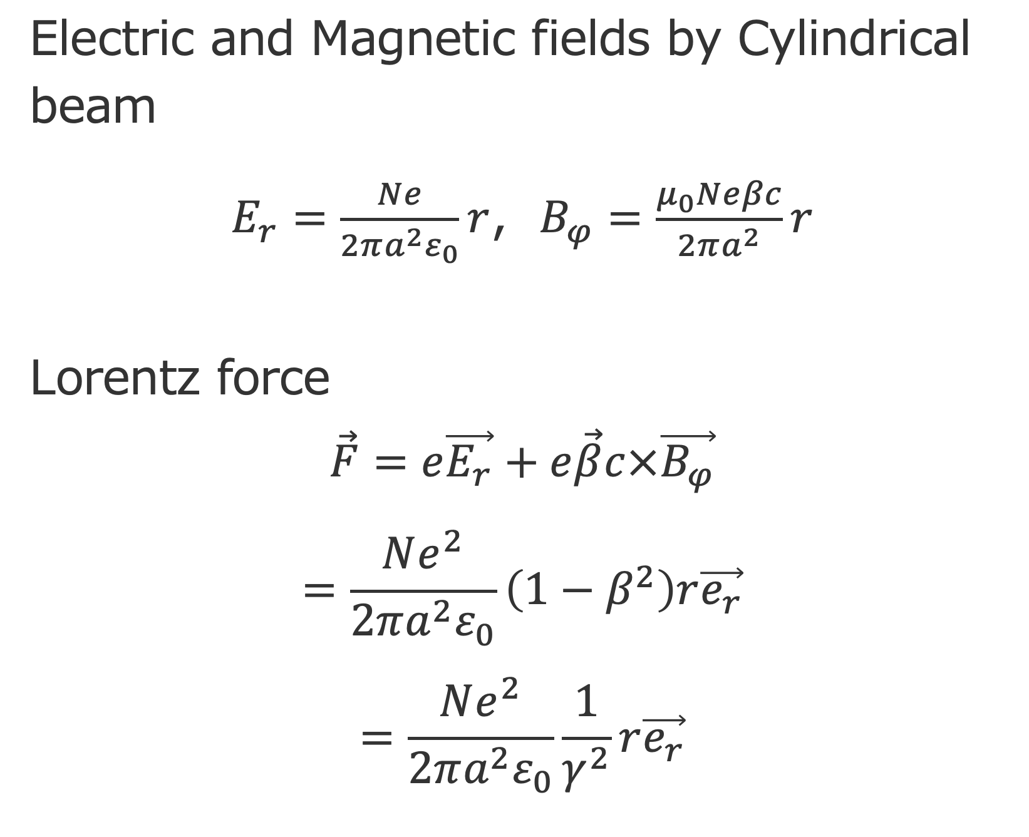


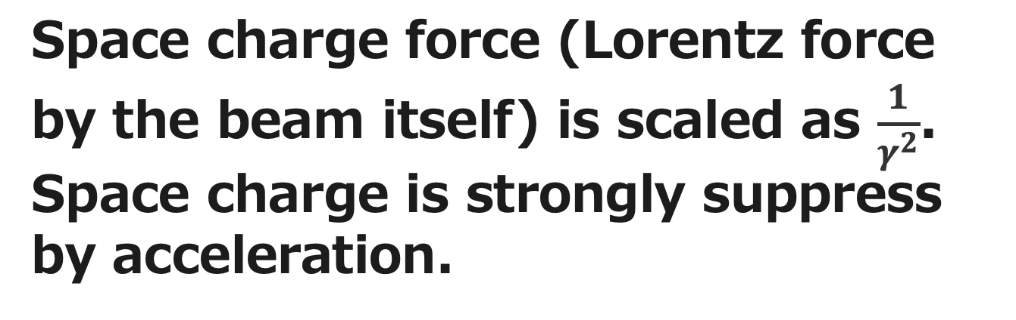

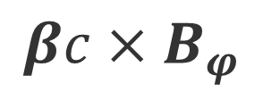
Space Charge Compensation
$$r$$
Electric and Magnetic fields by Cylindrical beam
$E_{r}=\frac{Ne}{2πa^{2}ε_{0}}r$, $B_{φ}=\frac{μ_{0}Neβc}{2πa^{2}}r$
Lorentz force
$$\vec{F}=e\vec{E_{r}}+e\vec{β}c×\vec{B_{φ}}$$
$$=\frac{Ne^{2}}{2πa^{2}ε_{0}}\left(1−β^{2}\right)r\vec{e_{r}}$$
$$=\frac{Ne^{2}}{2πa^{2}ε_{0}}\frac{1}{γ^{2}}r\vec{e_{r}}$$
$$φ$$
I
$${βc×B}_{φ}$$
$$B_{φ}$$
$$E_{r}$$
Space charge force (Lorentz force by the beam itself) is scaled as $\frac{1}{γ^{2}}$.
Space charge is strongly suppress by acceleration.

Slide 41
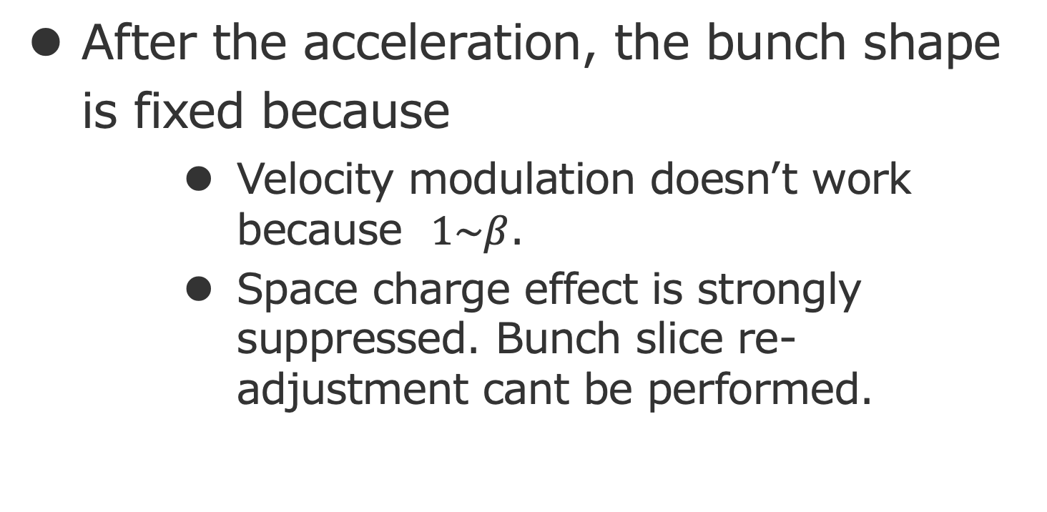
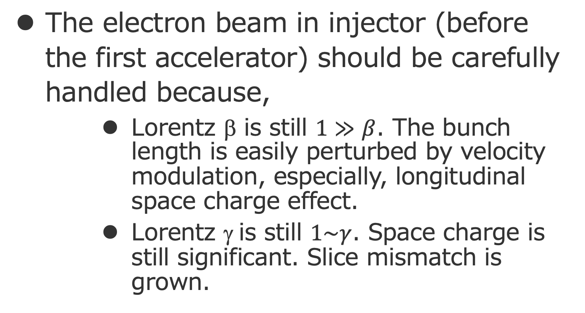
Where should we place the first accelerator?
The electron beam in injector (before the first accelerator) should be carefully handled because,
  Lorentz β is still $1≫β$. The bunch length is easily perturbed by velocity modulation, especially, longitudinal space charge effect.
  Lorentz γ is still $1\sim γ$. Space charge is still significant. Slice mismatch is grown.
After the acceleration, the bunch shape is fixed because
  Velocity modulation doesn’t work because $1\sim β$.
  Space charge effect is strongly suppressed. Bunch slice re-adjustment cant be performed.
Conclusion
Place the first accelerator where , the bunch length is minimized and the slice is re-aligned.

Slide 42
Bunch motion synchronization
δ
w’
R65
z
w
R56
Now, put the first accelerator!
Over focused, too late !

Slide 43
δ
δ
δ
δ
δ
z
z
z
z
z
E-gun
Solenoid
Buncher
Accelerator
w’
w’
w’
w’
w’
w’
w
w
w
w
w
w

Slide 44
Linear Accelerator

Slide 45
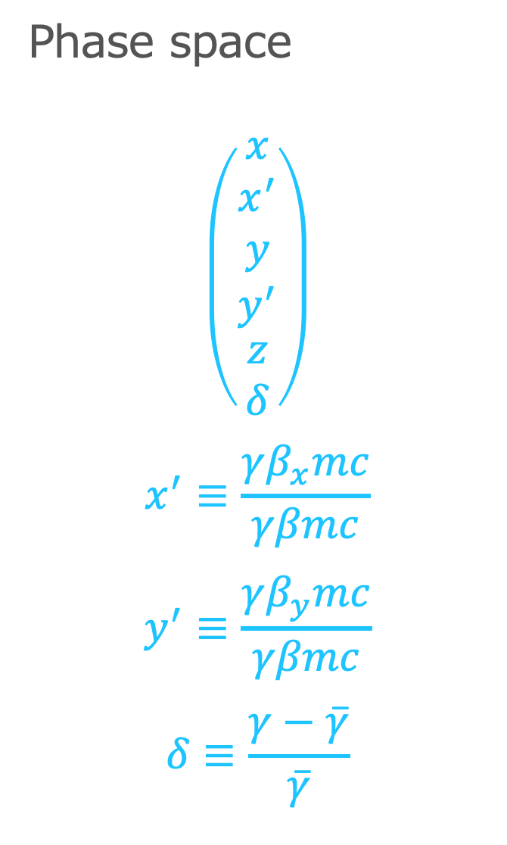
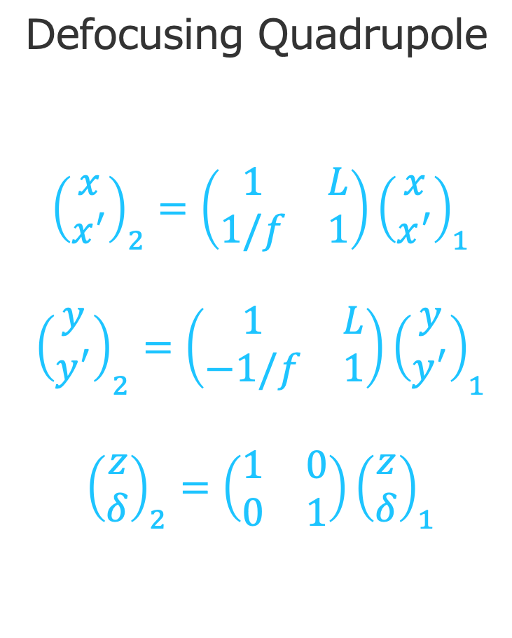
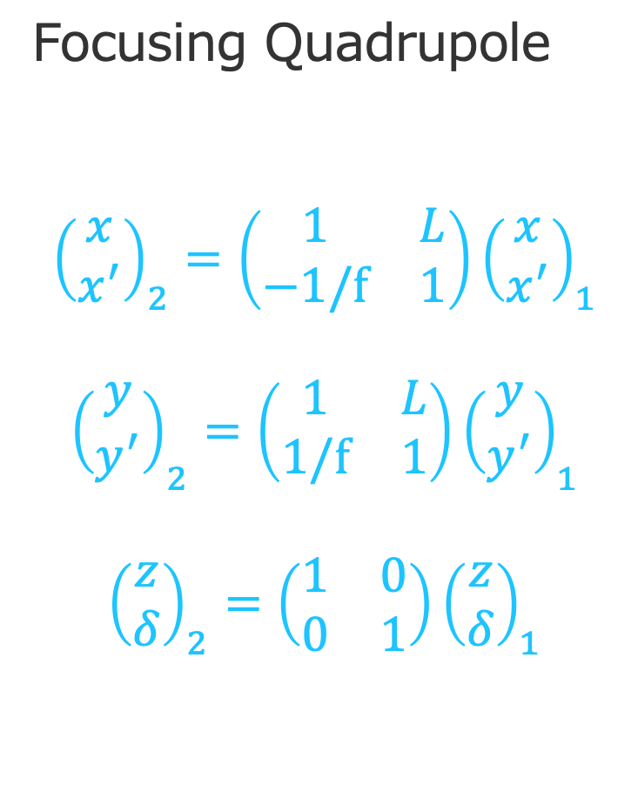
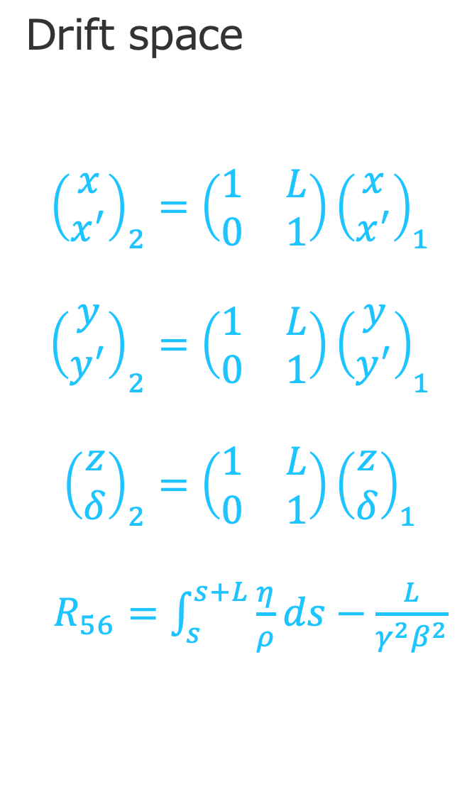
Beam Transfer
Phase space
$$\left(\begin{aligned}\begin{aligned}\begin{matrix}x \\ x^{′} \\ y\end{matrix} \\ y^{′}\end{aligned} \\ z \\ δ\end{aligned}\right)$$
$$x^{′}≡\frac{γβ_{x}mc}{γβmc}$$
$$y^{′}≡\frac{γβ_{y}mc}{γβmc}$$
$$δ≡\frac{γ−\overline{γ}}{\overline{γ}}$$
Drift space
$${\left(\begin{matrix}x \\ x^{′}\end{matrix}\right)}_{2}=\left(\begin{matrix}1 & L \\ 0 & 1\end{matrix}\right){\left(\begin{matrix}x \\ x^{′}\end{matrix}\right)}_{1}$$
$${\left(\begin{matrix}y \\ y^{′}\end{matrix}\right)}_{2}=\left(\begin{matrix}1 & L \\ 0 & 1\end{matrix}\right){\left(\begin{matrix}y \\ y^{′}\end{matrix}\right)}_{1}$$
$${\left(\begin{matrix}z \\ δ\end{matrix}\right)}_{2}=\left(\begin{matrix}1 & L \\ 0 & 1\end{matrix}\right){\left(\begin{matrix}z \\ δ\end{matrix}\right)}_{1}$$
$R_{56}=\int_{s}^{s+L}{\frac{η}{ρ}ds}−\frac{L}{γ^{2}β^{2}}$
Focusing Quadrupole
$${\left(\begin{matrix}x \\ x^{′}\end{matrix}\right)}_{2}=\left(\begin{matrix}1 & L \\ −1/f & 1\end{matrix}\right){\left(\begin{matrix}x \\ x^{′}\end{matrix}\right)}_{1}$$
$${\left(\begin{matrix}y \\ y^{′}\end{matrix}\right)}_{2}=\left(\begin{matrix}1 & L \\ 1/f & 1\end{matrix}\right){\left(\begin{matrix}y \\ y^{′}\end{matrix}\right)}_{1}$$
$${\left(\begin{matrix}z \\ δ\end{matrix}\right)}_{2}=\left(\begin{matrix}1 & 0 \\ 0 & 1\end{matrix}\right){\left(\begin{matrix}z \\ δ\end{matrix}\right)}_{1}$$
Defocusing Quadrupole
$${\left(\begin{matrix}x \\ x^{′}\end{matrix}\right)}_{2}=\left(\begin{matrix}1 & L \\ 1/f & 1\end{matrix}\right){\left(\begin{matrix}x \\ x^{′}\end{matrix}\right)}_{1}$$
$${\left(\begin{matrix}y \\ y^{′}\end{matrix}\right)}_{2}=\left(\begin{matrix}1 & L \\ −1/f & 1\end{matrix}\right){\left(\begin{matrix}y \\ y^{′}\end{matrix}\right)}_{1}$$
$${\left(\begin{matrix}z \\ δ\end{matrix}\right)}_{2}=\left(\begin{matrix}1 & 0 \\ 0 & 1\end{matrix}\right){\left(\begin{matrix}z \\ δ\end{matrix}\right)}_{1}$$
Particle motion is expressed with products of the transfer matrix.

Slide 46
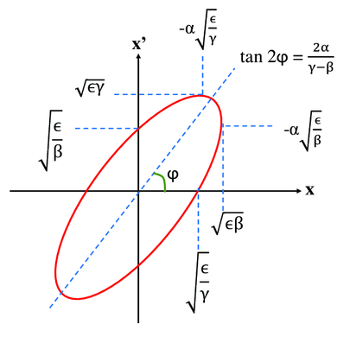
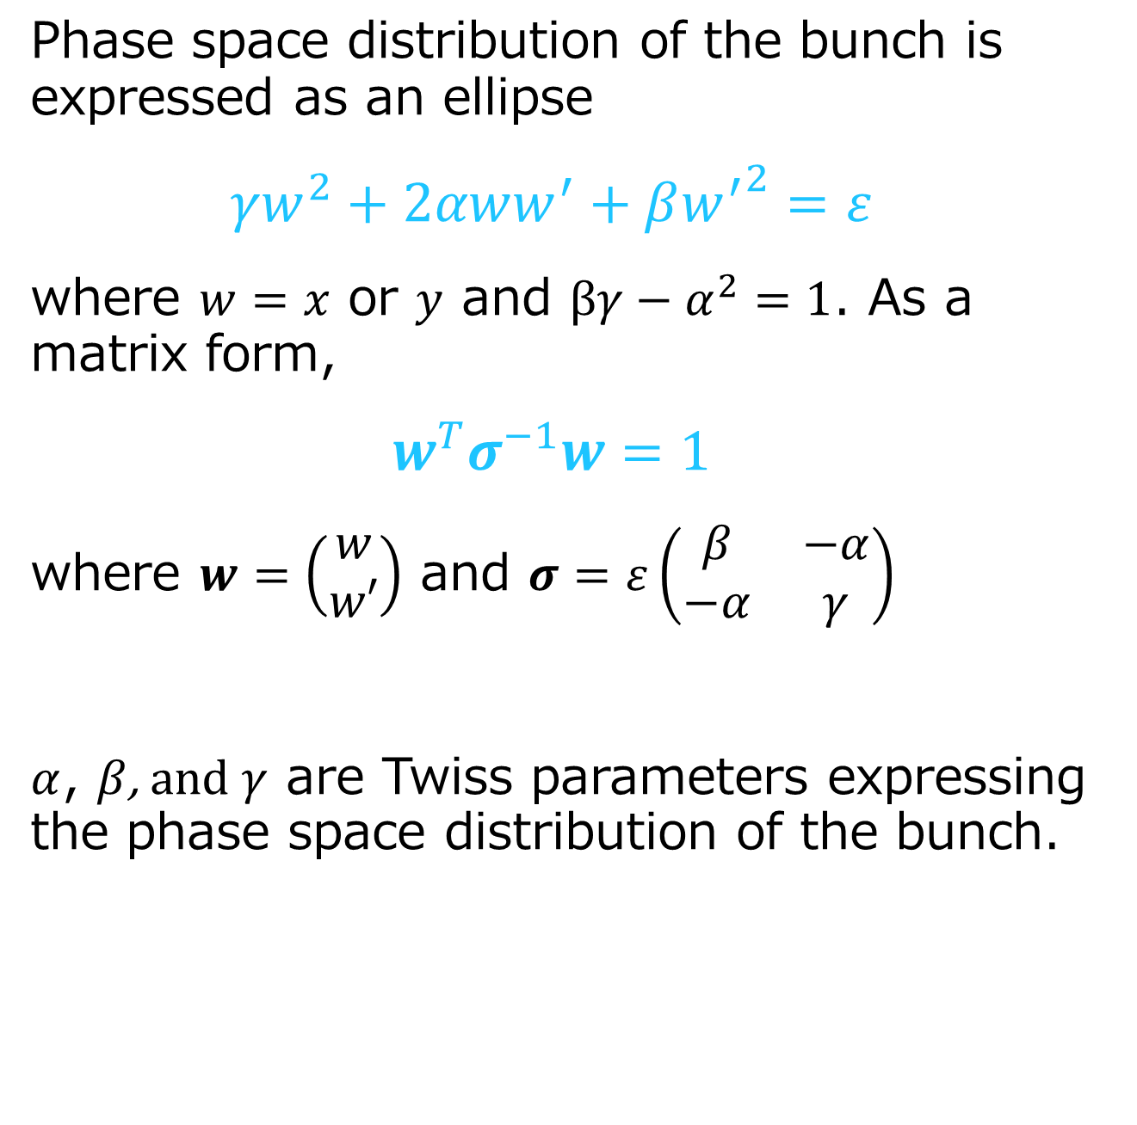
Phase space and Twiss parameters
Phase space distribution of the bunch is expressed as an ellipse
$$γw^{2}+2αww^{′}+β{w^{′}}^{2}=ε$$
where $w=x$ or $y$ and $βγ−α^{2}=1$. As a matrix form,
$$w^{T}σ^{−1}w=1$$
where $w=\left(\begin{matrix}w \\ w′\end{matrix}\right)$ and $σ=ε\left(\begin{matrix}β & −α \\ −α & γ\end{matrix}\right)$
$α$, $β$, and $γ$ are Twiss parameters expressing the phase space distribution of the bunch.
F. Plassard

Slide 47
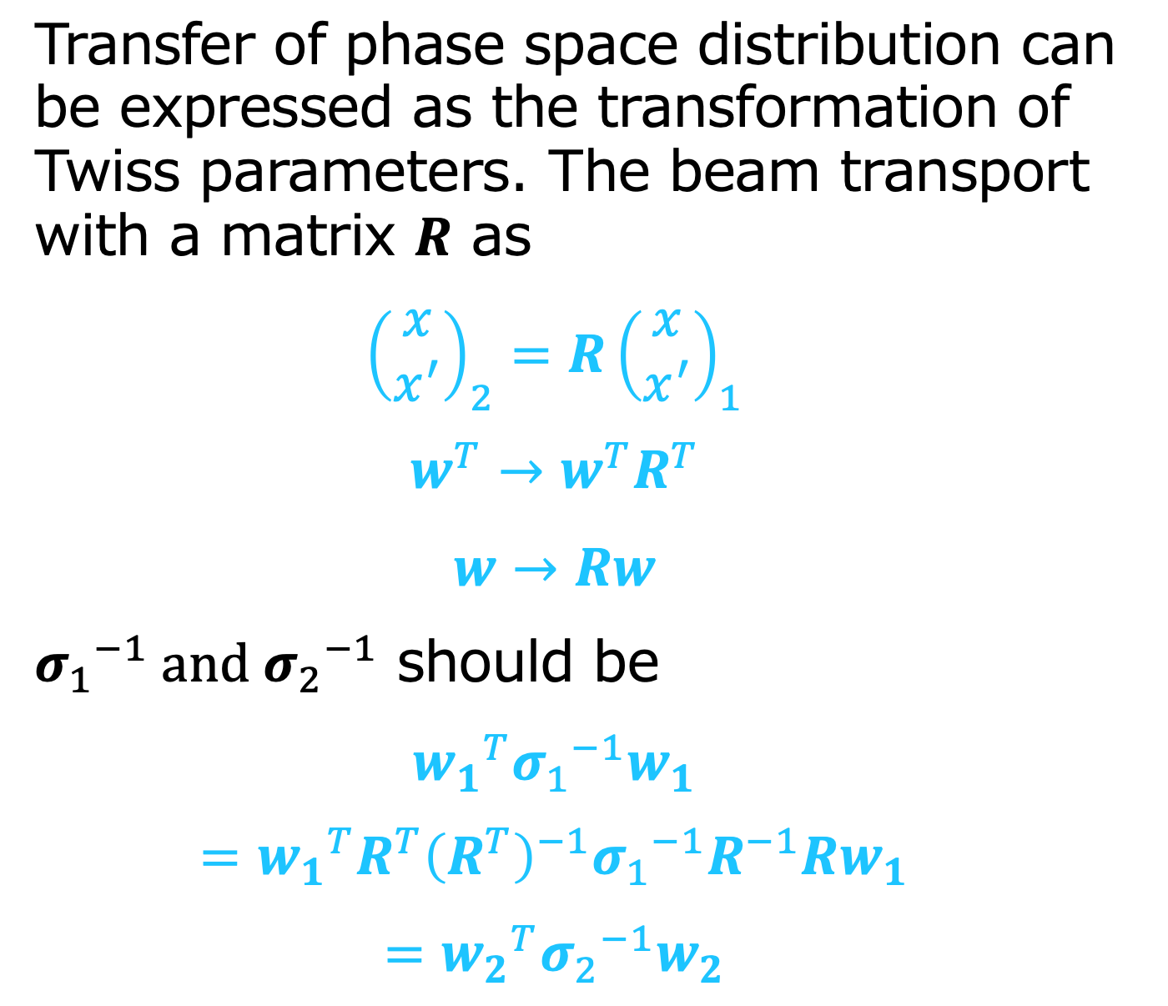
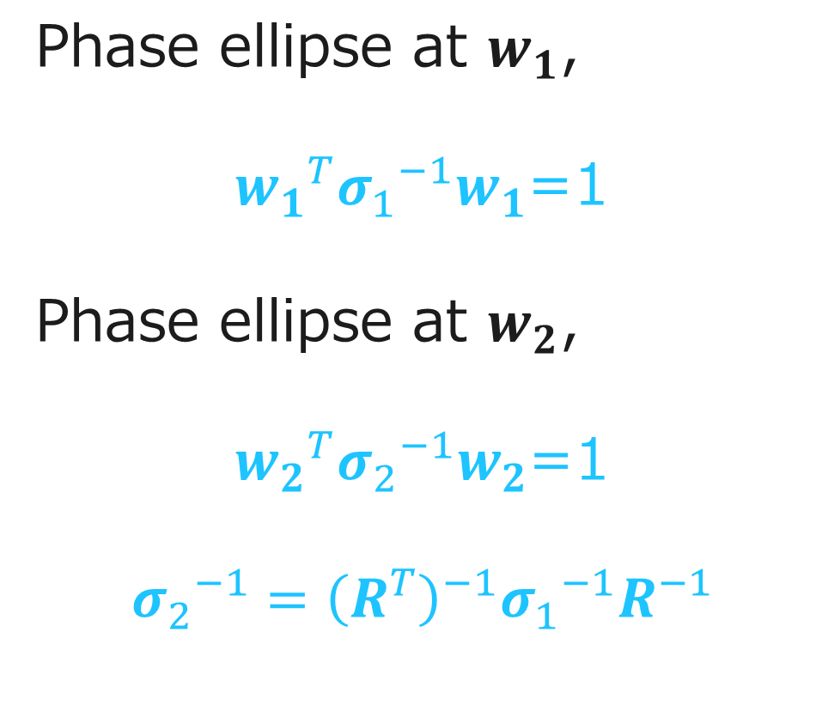
Phase space Transformation
Transfer of phase space distribution can be expressed as the transformation of Twiss parameters. The beam transport with a matrix $R$ as
$${\left(\begin{matrix}x \\ x^{′}\end{matrix}\right)}_{2}=R{\left(\begin{matrix}x \\ x^{′}\end{matrix}\right)}_{1}$$
$${w^{T}→w}^{T}R^{T}$$
$$w→Rw$$
${σ_{1}}^{−1}$ and ${σ_{2}}^{−1}$ should be
$${w_{1}}^{T}{σ_{1}}^{−1}w_{1}$$
$$={w_{1}}^{T}R^{T}{\left(R^{T}\right)}^{−1}{σ_{1}}^{−1}R^{−1}Rw_{1}$$
$$={w_{2}}^{T}{σ_{2}}^{−1}w_{2}$$
Phase ellipse at $w_{1}$,
${w_{1}}^{T}{σ_{1}}^{−1}w_{1}$=1
Phase ellipse at $w_{2}$,
${w_{2}}^{T}{σ_{2}}^{−1}w_{2}$=1
$${σ_{2}}^{−1}={\left(R^{T}\right)}^{−1}{σ_{1}}^{−1}R^{−1}$$

Slide 48
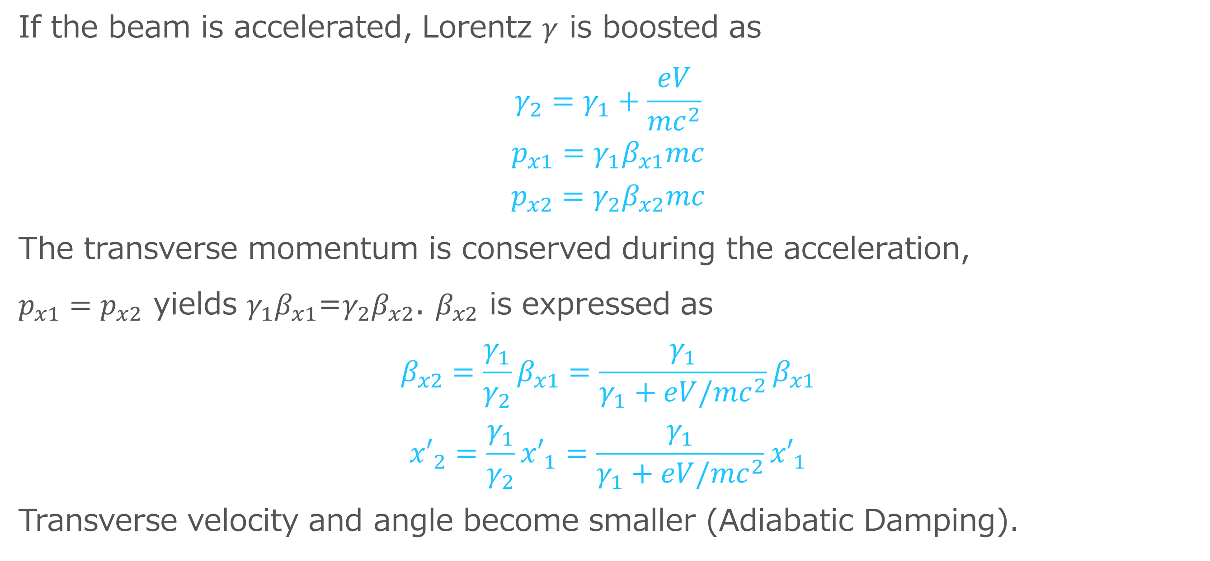
Adiabatic Damping
If the beam is accelerated, Lorentz $γ$ is boosted as
$$γ_{2}=γ_{1}+\frac{eV}{{mc}^{2}}$$
$$p_{x1}=γ_{1}β_{x1}mc$$
$$p_{x2}=γ_{2}β_{x2}mc$$
The transverse momentum is conserved during the acceleration,
$p_{x1}=p_{x2}$ yields $γ_{1}β_{x1}$=$γ_{2}β_{x2}$. $β_{x2}$ is expressed as
$$β_{x2}=\frac{γ_{1}}{γ_{2}}β_{x1}=\frac{γ_{1}}{γ_{1}+eV/{mc}^{2}}β_{x1}$$
$${x′}_{2}=\frac{γ_{1}}{γ_{2}}{x′}_{1}=\frac{γ_{1}}{γ_{1}+eV/{mc}^{2}}{x′}_{1}$$
Transverse velocity and angle become smaller (Adiabatic Damping).

Slide 49
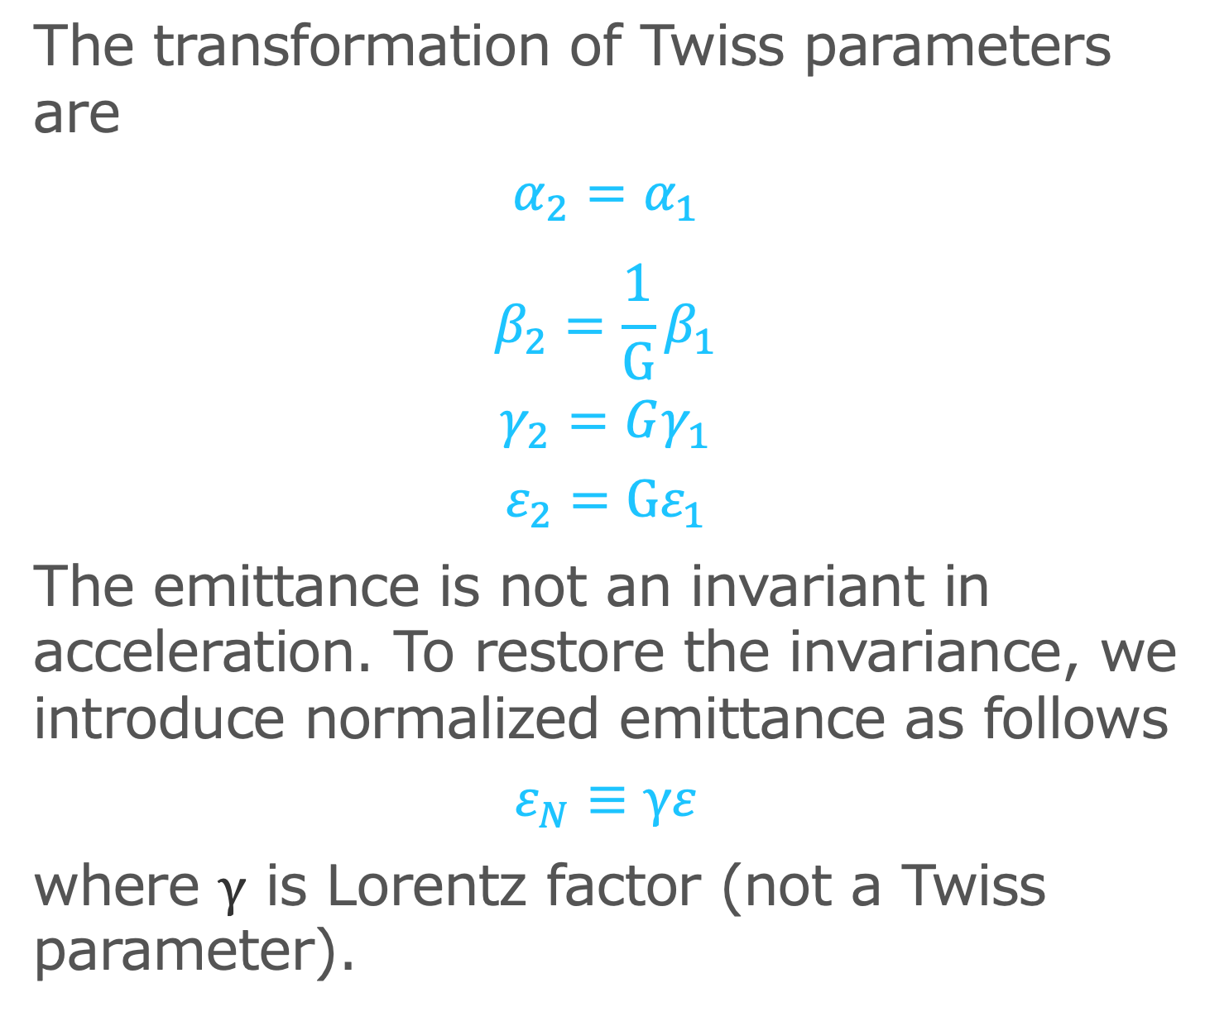
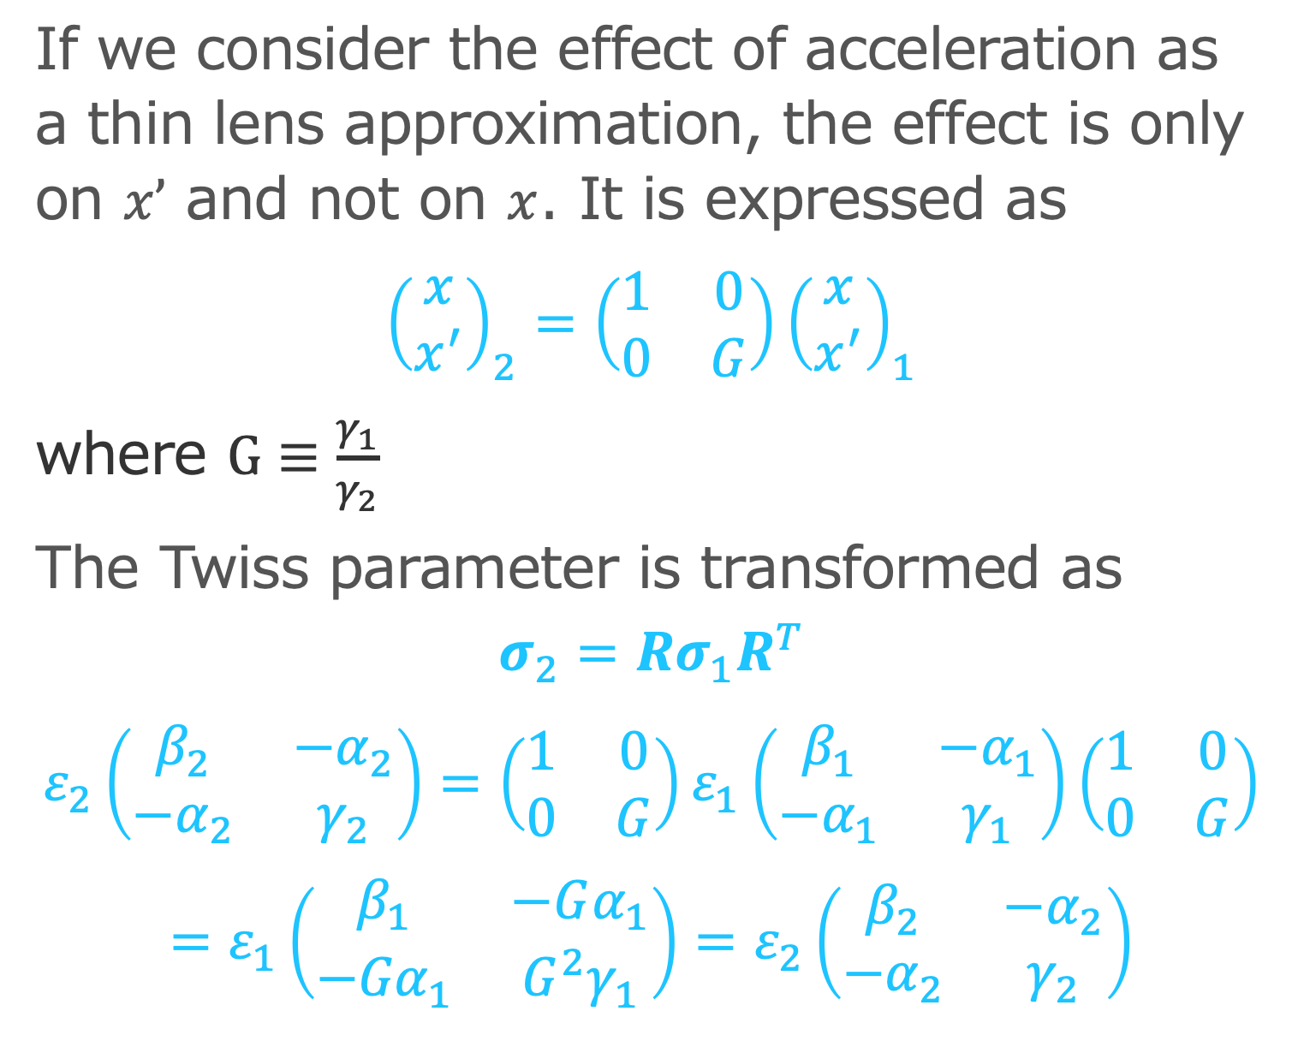
Transfer Matrix of Acceleration
If we consider the effect of acceleration as a thin lens approximation, the effect is only on $x’$ and not on $x$. It is expressed as
$${\left(\begin{matrix}x \\ x^{′}\end{matrix}\right)}_{2}=\left(\begin{matrix}1 & 0 \\ 0 & G\end{matrix}\right){\left(\begin{matrix}x \\ x^{′}\end{matrix}\right)}_{1}$$
where $G≡\frac{γ_{1}}{γ_{2}}$
The Twiss parameter is transformed as
$$σ_{2}={Rσ}_{1}R^{T}$$
$$ε_{2}\left(\begin{matrix}β_{2} & −α_{2} \\ −α_{2} & γ_{2}\end{matrix}\right)=\left(\begin{matrix}1 & 0 \\ 0 & G\end{matrix}\right)ε_{1}\left(\begin{matrix}β_{1} & −α_{1} \\ −α_{1} & γ_{1}\end{matrix}\right)\left(\begin{matrix}1 & 0 \\ 0 & G\end{matrix}\right)$$
$$=ε_{1}\left(\begin{matrix}β_{1} & −Gα_{1} \\ −{Gα}_{1} & G^{2}γ_{1}\end{matrix}\right)=ε_{2}\left(\begin{matrix}β_{2} & −α_{2} \\ −α_{2} & γ_{2}\end{matrix}\right)$$
The transformation of Twiss parameters are
$$α_{2}=α_{1}$$
$$β_{2}=\frac{1}{G}β_{1}$$
$$γ_{2}=Gγ_{1}$$
$$ε_{2}=Gε_{1}$$
The emittance is not an invariant in acceleration. To restore the invariance, we introduce normalized emittance as follows
$$ε_{N}≡γε$$
where $γ$ is Lorentz factor (not a Twiss parameter).

Slide 50
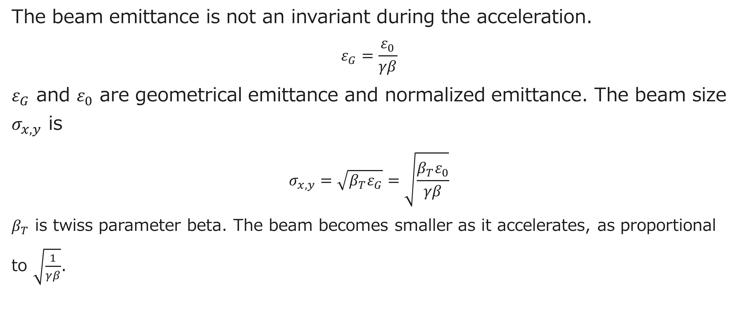
Beam shape over the linac
The beam emittance is not an invariant during the acceleration.
$$ε_{G}=\frac{ε_{0}}{γβ}$$
$ε_{G}$ and $ε_{0}$ are geometrical emittance and normalized emittance. The beam size $σ_{x,y}$ is
$$σ_{x,y}=\sqrt{β_{T}ε_{G}}=\sqrt{\frac{{β_{T}ε}_{0}}{γβ}}$$
$β_{T}$ is twiss parameter beta. The beam becomes smaller as it accelerates, as proportional to $\sqrt{\frac{1}{γβ}}$.

Slide 51
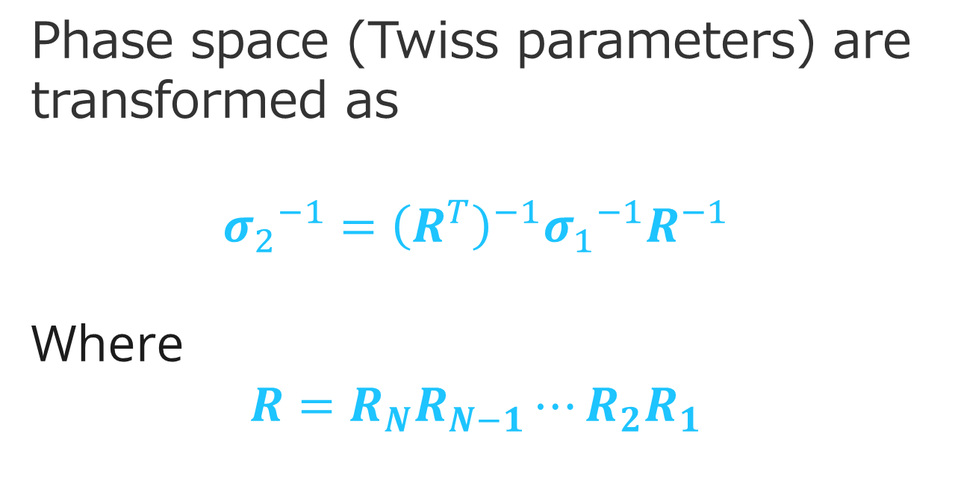
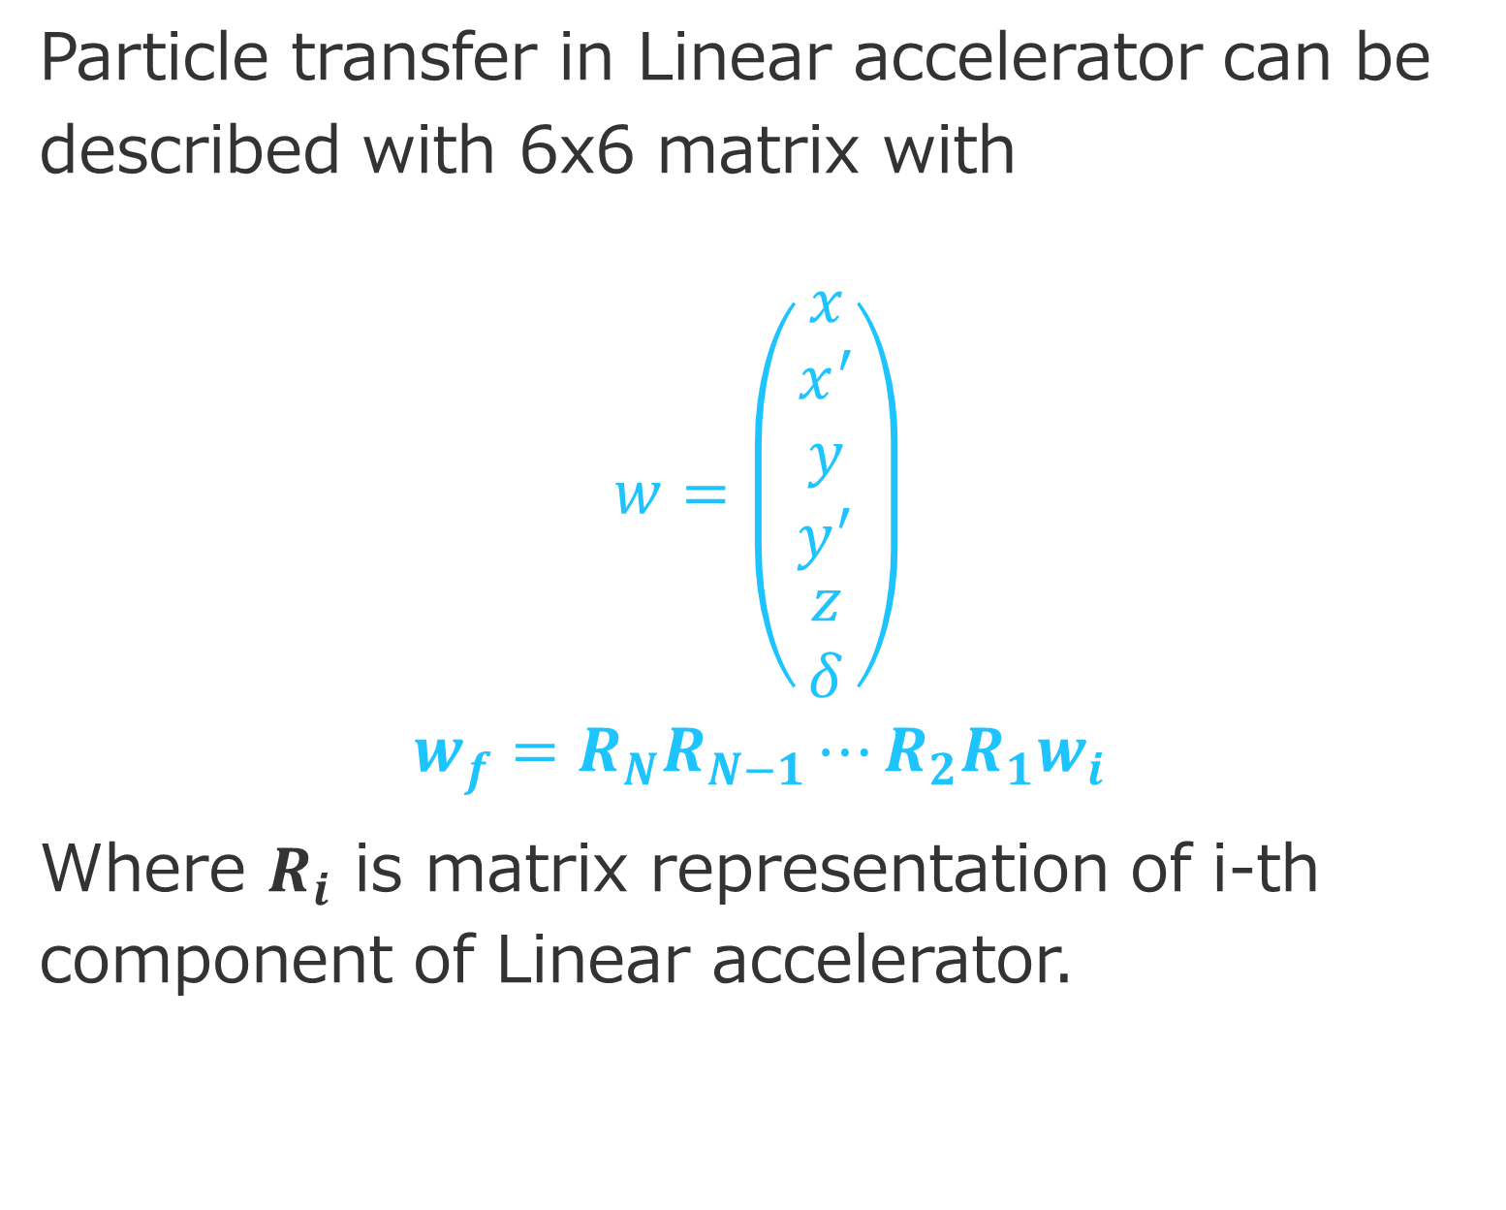
Building Blocks
Particle transfer in Linear accelerator can be described with 6x6 matrix with
$$w=\left(\begin{aligned}\begin{aligned}\begin{matrix}x \\ x^{′} \\ y\end{matrix} \\ y^{′}\end{aligned} \\ z \\ δ\end{aligned}\right)$$
$$w_{f}=R_{N}R_{N−1}⋯R_{2}R_{1}w_{i}$$
Where $R_{i}$ is matrix representation of i-th component of Linear accelerator.
Phase space (Twiss parameters) are transformed as
$${σ_{2}}^{−1}={\left(R^{T}\right)}^{−1}{σ_{1}}^{−1}R^{−1}$$
Where
$$R=R_{N}R_{N−1}⋯R_{2}R_{1}$$

Slide 52
Beam Loading and its control

Slide 53
What is Beam Loading?
We consider multi-bunch acceleration. Many bunches are in a RF pulse.
RF Acceleration field is induced by input RF power.
Initial state : The acceleration field is stabilized by balancing the input power and consumption power.
Beam acceleration : Additional power loss by beam acceleration. Acceleration field is decreased.
Decrease in acceleration electric field due to beam acceleration: beam loading.
Temporal variations in the accelerating field due to beam acceleration: transient beam loading.
Pc
Pin
Acc field
Acc field

Slide 54
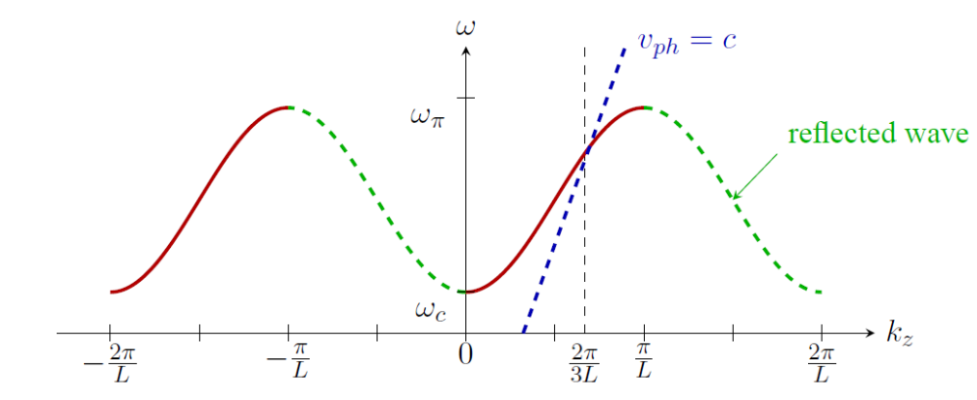
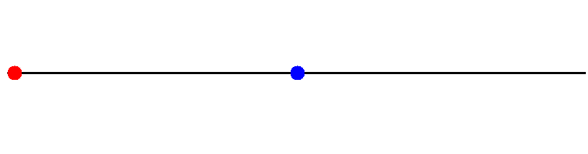
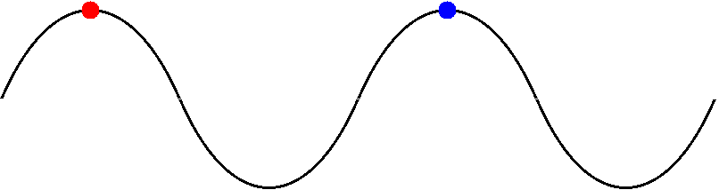


Standing Wave and
Traveling Wave
$$v_{g}=\frac{∂ω}{∂k_{z}}=0$$
$$v_{g}=\frac{∂ω}{∂k_{z}}≠0$$
Notes:
The temporal response to RF input depends on the operating mode (group velocity) of the accelerating cavity.

Slide 55


SW Cavity Power Balance
Pi
Pr
Pr
Matching
Field
$$E_{i}+E_{r}=E_{c}$$
Power
$$P_{i}−P_{r}=P_{c}$$
Pc
Pc
Stored
Start with the full reflection.
Power is gradually filled with a time constant.

Slide 56





Standing Wave Accelerator
Power balance
P_{in}
P_{r}
$$\frac{dW_{0}}{dt}=P_{in}−P_{r}−P_{0}$$
Express in $V0$
V₀
W₀
$$\frac{dW_{0}}{dt}=\frac{Q_{0}}{ω}\frac{dP_{0}}{dt}=\frac{Q_{0}}{ω}2G_{0}V_{0}\frac{dV_{0}}{dt}$$
P₀
With admittance $G0$
$$P_{0}=G_{0}{V_{0}}^{2}$$

Slide 57




Admittance of wage guide (definition of coupling $β$) $G_{wg}={βG}_{0}$
$$P_{in}={βG}_{0}{V_{in}}^{2}$$
$$P_{r}={βG}_{0}{V_{r}}^{2}$$
Matching condition at the coupling window : $V_{in}+V_{r}=V_{0}$
wage guide
cavity
$$\frac{Q_{0}}{ω}2G_{0}V_{0}\frac{dV_{0}}{dt}=P_{in}−P_{r}−P_{0}=−βG_{0}{V_{0}}^{2}+2βG_{0}V_{0}V_{in}−G_{0}{V_{0}}^{2}$$
The equation is summarized with $Q_{0}=\left(1+β\right)Q_{L}$
$$\frac{{2Q}_{L}}{ω}\frac{dV_{0}}{dt}=−V_{0}+\frac{2β}{1+β}V_{in}$$
$$V_{r}$$
$$V_{in}$$
$$V_{0}$$

Slide 58






Differential equation of SW accelerator
$$τ\frac{dV_{0}}{dt}=−V_{0}+αV_{in}$$
$$α≡ \frac{2β}{1+β}$$
$$τ≡\frac{{2Q}_{L}}{ω}$$
Solution with
$V0=0$ at $t=0$
$$V_{0}\left(t\right)=\frac{2β}{1+β}\sqrt{\frac{P_{in}}{βG_{0}}}\left(1−e^{−\frac{t}{τ}}\right)$$

Slide 59

Introduce Beam
Cavity voltage is determined by not only Input power, but also beam current. Beam current is a source to induce cavity voltage.
Beam consume the cavity stored energy as
$$P_{beam}=\frac{1}{T}\int_{0}^{T}{dt}I(t)V_{0}\cos\left(ωt\right)$$
If the beam current $I(t)$ is a delta function on crest,
$$P_{beam}=IV_{0}$$
Power balance is
$$\frac{dW_{0}}{dt}=P_{in}−P_{r}−P_{0}−IV_{0}$$

Slide 60




Differential equation of SW accelerator with Beam
$$τ\frac{dV_{0}}{dt}=−V_{0}+αV_{in}−\frac{I}{\left(1+β\right)G_{0}}$$
Solution with
$V0=0$at $t=0,$
Beam start at $t=tb$
Voltage reduction by beam
$$V_{0}\left(t\right)=\frac{2β}{1+β}\sqrt{\frac{P_{in}}{βG_{0}}}\left(1−e^{−\frac{t}{τ}}\right) \\ −\frac{I}{\left(1+β\right)G_{0}}\left(1−e^{−\frac{t−t_{b}}{τ}}\right)$$

Slide 61




Beam Loading Compensation
Since RF and Beam term have the same time constant $τ,$ $V0$can be constant by adjusting amplitude and timing.
$$V_{0}\left(t\right)=\frac{2β}{1+β}\sqrt{\frac{P_{in}}{βG_{0}}}\left(1−e^{−\frac{t}{τ}}\right) \\ −\frac{I}{\left(1+β\right)G_{0}}\left(1−e^{−\frac{t−t_{b}}{τ}}\right)$$
$$t_{b}=−τln\left(\frac{I}{2}\sqrt{\frac{rL}{βP_{in}}}\right)$$

Slide 62


Beam Loading By Bunched Beam
Beam current by a single bunch (delta function),
$$I=qβcδ\left(z\right)$$
The differential equation (no RF input) is
$$τ\frac{dV}{dt}=−V−\frac{I}{\left(1+β\right)G_{0}}=−V−\frac{qβcδ\left(z\right)}{\left(1+β\right)G_{0}}$$
Integrating on $−ε<t<+ε$ and taking $ε→0$
$$\int_{−ε}^{+ε }{\frac{dV}{dt}dt}=V\left(+ε \right)−V\left(−ε \right)=−2εV−\frac{βcq}{τ\left(1+β\right)G_{0}}$$
$$∆V=−\frac{ωβcq}{{2Q}_{L}G_{0}}=−ζq, ζ≡\frac{ωβc}{{2Q}_{L}G_{0}}$$
giving voltage induced by a single bunch
$$∆V$$

Slide 63


The differential equation for t>0 is
$$τ\frac{dV}{dt}=−V$$
We solve the equation with $V\left(+0\right)=−ζq$
$$V=−ζqu(t)e^{−\frac{t}{τ}}$$
$u(t)$ is Heaviside step function. With many bunches and RF input,
$$V\left(t\right)=\frac{2}{1+β}\sqrt{\frac{βP_{in}}{G_{0}}}\left(1−e^{−\frac{t}{τ}}\right)−ζ\sum{q_{i}u\left(t_{i}\right)e^{−\frac{t−t_{i}}{τ}}}$$

Slide 64

TW Cavity Power Balance
Input
Output
Power flows through cavities with $v_{g}$. No reflection.
The power is filled after the filling time ~ $L/v_{g}$
Rest of power is extracted and dumped.

Slide 65

Traveling Wave Linac
  Assume quasi-constant power flow in TW accelerator.
  $$\frac{dP}{dz}={\left(\frac{dP}{dz}\right)}_{wall}+{\left(\frac{dP}{dz}\right)}_{beam}=−2α\left(z\right)P\left(z,t\right)−IE(z,t)$$
  Expansion with partial derivative
  $$\frac{dP}{dz}=\frac{∂P}{∂z}+\frac{∂P}{∂t}\frac{dt}{dz}=\frac{∂P}{∂z}+\frac{1}{v_{g}}\frac{∂P}{∂t}$$
  $$\frac{∂P}{∂z}+\frac{1}{v_{g}}\frac{∂P}{∂t}+2α\left(z\right)P\left(z,t\right)+IE\left(z,t\right)=0$$

Slide 66




Expression in field,
$$\frac{∂E}{∂z}−\frac{E}{2α}\frac{dα}{dz}+\frac{1}{v_{g}}\frac{∂E}{∂t}+α\left(z\right)E\left(z,t\right)+Iαr=0$$
$$P=\frac{E^{2}}{2αr}$$
$r:$ shunt impedance
Constant Gradient condition $\frac{dα}{dz}=−2α$
$$\frac{∂E(z,t)}{∂z}+\frac{1}{v_{g}}\frac{∂E(z,t)}{∂t}+I(t)αr=0$$

Slide 67

Laplace Transformation
$$ℒ\left[f\left(t\right)\right]≡F\left(s\right)=\int_{0}^{∞}{dtf(t)e^{−st}}$$
In s-domain, differential and integral operation becomes algebraic operation.
$$ℒ\left[\frac{df}{dt}\right]=sF\left(s\right)−f\left(0\right)$$
$$ℒ\left[\int_{0}^{t}{f\left(u\right)du}\right]=\frac{1}{s}F\left(s\right)$$
Differential
Equation f(t)
Differential
Equation F(s)
Laplace transformation
Algebra
Solution
f(t)
Solution
F(s)
Inverse
Laplace transformation

Slide 68


$$\frac{∂E(z,t)}{∂z}+\frac{1}{v_{g}}\frac{∂E(z,t)}{∂t}+I(t)αr=0$$
Laplace transformation
$$\frac{∂E(z,s)}{∂z}+\frac{s}{v_{g}}\frac{∂E(z,s)}{∂t}+I(s)αr=0$$
By integrating with z,
$$E\left(z,s\right)−E\left(0,s\right)e^{st_{z}}+ I(s)r\int_{0}^{z}{αdz}=0$$
By integrating with z again,
$$V\left(s\right)=\frac{ωL}{Q\left(1−e^{−2τ}\right)}\frac{1}{s+\frac{ω}{Q}}E\left(s\right)\left[1−e^{−\left(s+\frac{ω}{Q}\right)t_{f}}\right]$$
$$−\frac{ωrLI(s)}{2Q\left(1−e^{−2τ}\right)s}\left[1−e^{−\frac{ω}{Q}t_{f}}−\frac{ω\left(1−e^{−st_{f}−2τ}\right)}{Q(s+ω/Q)}\right]$$

Slide 69

Input RF E(t) and Beam current,
$$E\left(t\right)=E_{0}u\left(t\right), I\left(t\right)=I_{0}u(t−t_{f})$$
Giving
$$E\left(s\right)=\frac{E_{0}}{s} , I\left(s\right)=\frac{I_{0}}{s}e^{−st_{f}}$$
$$V\left(s\right)=\frac{ωL}{Q\left(1−e^{−2τ}\right)}\frac{1}{s+\frac{ω}{Q}}\frac{E_{0}}{s}\left[1−e^{−\left(s+\frac{ω}{Q}\right)t_{f}}\right]$$
$$−\frac{ωrL}{2Q\left(1−e^{−2τ}\right)}\frac{I_{0}e^{−st_{f}}}{s^{2}}\left[1−e^{−\frac{ω}{Q}t_{f}}−\frac{ω\left(1−e^{−st_{f}−2τ}\right)}{Q(s+ω/Q)}\right]$$
In t-domain,
$$V\left(t\right)=\frac{LE_{0}}{1−e^{−2τ}}\left[\left(1−e^{−\frac{ω}{Q}t}\right)u\left(t\right)−e^{−2τ}\left(1−e^{−\frac{ω}{Q}\left(t−t_{f}\right)}\right)u(t−t_{f})\right]$$
$$−\frac{rLI_{0}}{2}\left[−\frac{ω}{Q}\frac{e^{−2τ}}{{1−e}^{−2τ}}\left(t−t_{f}\right)+\frac{1−e^{−\frac{ω}{Q}\left(t−t_{f}\right)}}{{1−e}^{−2τ}}\right]u(t−t_{f})$$

Slide 70



$$0<t<t_{f}$$
$$V\left(t\right)=\frac{LE_{0}}{1−e^{−2τ}}\left(1−e^{−\frac{ω}{Q}t}\right)$$
$$t>t_{f} and I_{0}=0,$$
$$V\left(t\right)=\frac{LE_{0}}{1−e^{−2τ}}\left(1−e^{−\frac{ω}{Q}t_{f}}\right)=LE_{0}$$
$$t_{f}$$

Slide 71


$$t>t_{f} and I=I_{0}u(t−t_{f}),$$
$$V\left(t\right)=LE_{0}−\frac{rLI_{0}}{2}\left[−\frac{ω}{Q}\frac{e^{−2τ}}{{1−e}^{−2τ}}\left(t−t_{f}\right)+\frac{1−e^{−\frac{ω}{Q}\left(t−t_{f}\right)}}{{1−e}^{−2τ}}\right],$$

Slide 72






Amplitude Modulation
Amplitude modulation on E(t) for compensation,
$$E\left(t\right)=E_{0}u(t)+E_{1}u(t−t_{f})$$
$$E\left(s\right)=\frac{E_{0}}{s}+\frac{E_{1}}{s}e^{−st_{f}}$$

Slide 73





Two components AM
$$E\left(t\right)=E_{0}u\left(t\right)+E_{1}u\left(t−t_{f}\right)+E_{2}\left(t−t_{f}\right)u\left(t−t_{f}\right)$$
$−E_{2}\left(t−t_{f}\right)u(t−2t_{f})$

Slide 74
Summary
Linear accelerator is a concept of accelerator which doesn’t have an orbit with accelerator section.
The beam is generated and is bunched for RF acceleration.
Slice mismatch by space charge should be fixed by solenoid focusing.
The place of the first accelerator should be synchronized to the bunching and slice adjustment for high performance acceleration.
To accelerate a multi-bunch pulse uniformly, the beam loading should be controlled.

