Slide 1
Foundation of FEL
Takashi Tanaka
RIKEN SPring-8 Center

Slide 2
Introduction
Coherent radiation
Amplification mechanism in FELs
Classification of FELs
Overview of Single-Pass FELs
Example of FEL Simulations

Slide 3
Introduction
Coherent radiation
Amplification mechanism in FELs
Classification of FELs
Overview of Single-Pass FELs
Example of FEL Simulations

Slide 4
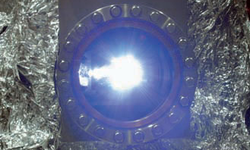
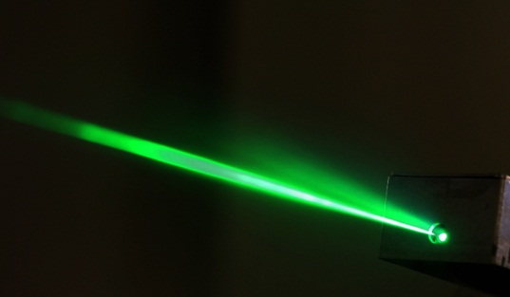
Synchrotron Radiation & Laser
Photon Science
SR
Laser
first observed in 1947
radiation by a relativistic electron beam
work as laser-like sources, where conventional lasers are not available
first realized in 1960
fully coherent source by stimulated emission
applicable in spectral regions where reflective mirrors are available

Slide 5
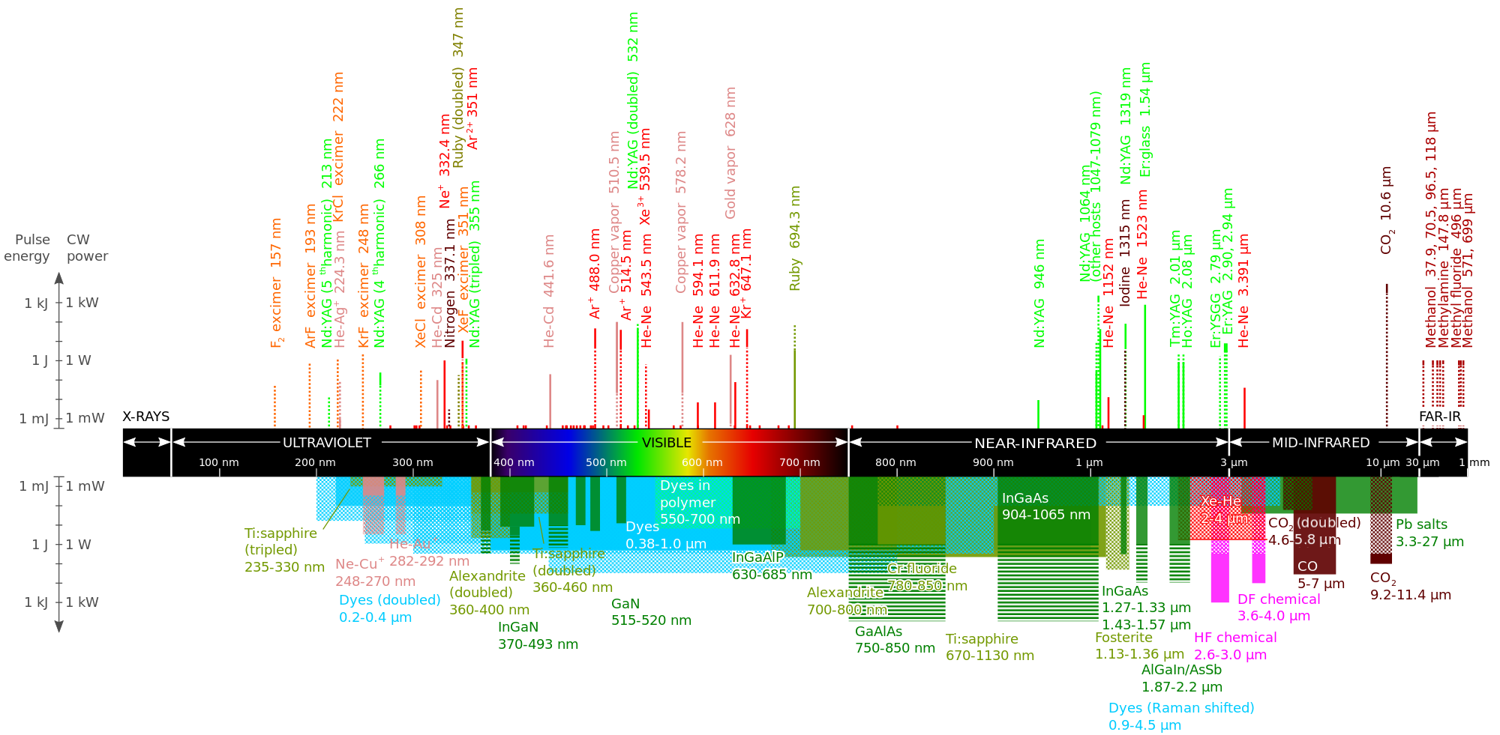
Wavelengths Available with Lasers
No mirrors -> no practical lasers
SR has been a good alternative to “X-ray” lasers!

Slide 6
SR Sources
Magnets to deflect the electron beam and generate SR.
Bending Magnet (BM)
Insertion Device (ID)
Undulator
Wiggler

Slide 7
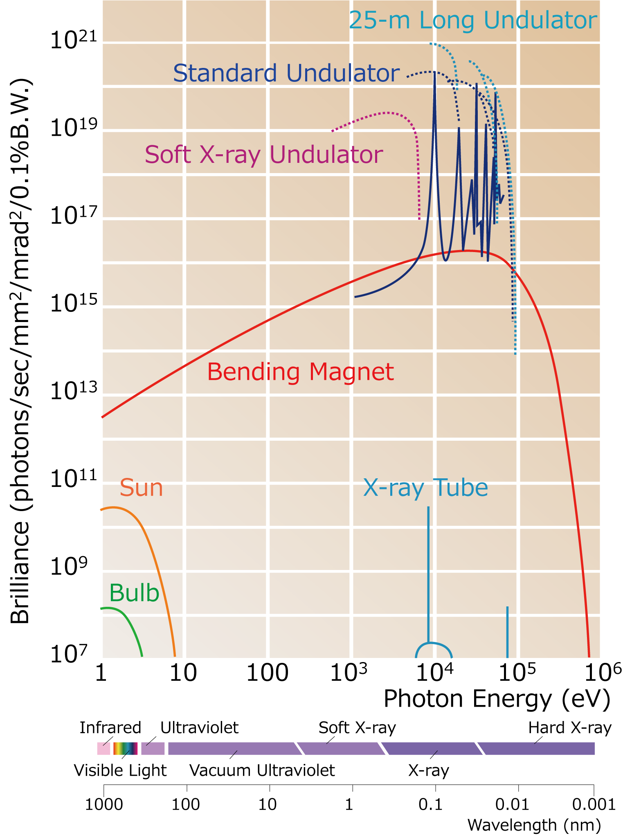
Comparison with Various Sources
Brilliance of SPring-8 and other conventional sources
SR provides much higher brilliance, but total power is not that high.
What is brilliance?

Slide 8
What is Brilliance ?
Brilliance(photons/sec/mm²/mrad²/0.1%B.W.)
~
Total Power
Source Size x Angular Divergence x Band Width
Brilliance specifies the quality of light for observation of microscopic objects.
The brilliance of a light source with a high total power is not necessarily high.

Slide 9

Brilliance of Typical Light Sources
Specs of SPring-8
- E = 8GeV
- I = 100mA
- L = 1500m
1mW Laser (pointer)
100W Bulb
Which brilliance is higher?

Slide 10
Example of Brilliance Estimation
Item | Bulb | Laser Pointer
Total Power (W) | 100 | 10⁻³
Angular Div. (mrad²) | 4πx10⁶ | 1
Source Size: (mm²) | 10² | 1
Bandwidth: (%) | 100 | 0.01
Brilliance (photons/sec/....) | ~10⁸ | ~10¹⁶
Laser is the best light source to observe the microscopic object!

Slide 11
SR: Highly Brilliant X-ray Source
Any (short) wavelength is available
As a light source:
  Small source size (~ electron beam)
  High directivity
  Quasi monochromatic (undulator SR)
SR works as an alternative to lasers in x-ray regions, however, it is not a laser source at all!
What is different?
Why we need FELs?

Slide 12
“Coherence” of SR is Poor!
Coherence of typical 3rd gen. SR
(undulator@0.1nm)
Item | Undulator SR
Temporal | ~10⁻⁵ %
Horizontal | ~0.3%
Vertical | ~30%
Total | ~10⁻⁸ %
Ideally, lasers provide 100% coherent light!

Slide 13
How FEL Benefits?
Item | Undulator SR | FEL (ideal case)
Temporal | ~10⁻⁵ % | ~0.1% (SASE) ~100% (seeded)
Horizontal | ~0.3% | ~100%
Vertical | ~30% | ~100%
Total | ~10⁻⁸ % | ~0.1% (SASE) ~100% (seeded)
FEL Peak brilliance is > 10¹⁰ higher than SR!
  Even so, SR is still advantageous in some aspects: # users, stability, …

Slide 14
Introduction
Coherent radiation
Amplification mechanism in FELs
Classification of FELs
Overview of Single-Pass FELs
Example of FEL Simulations

Slide 15
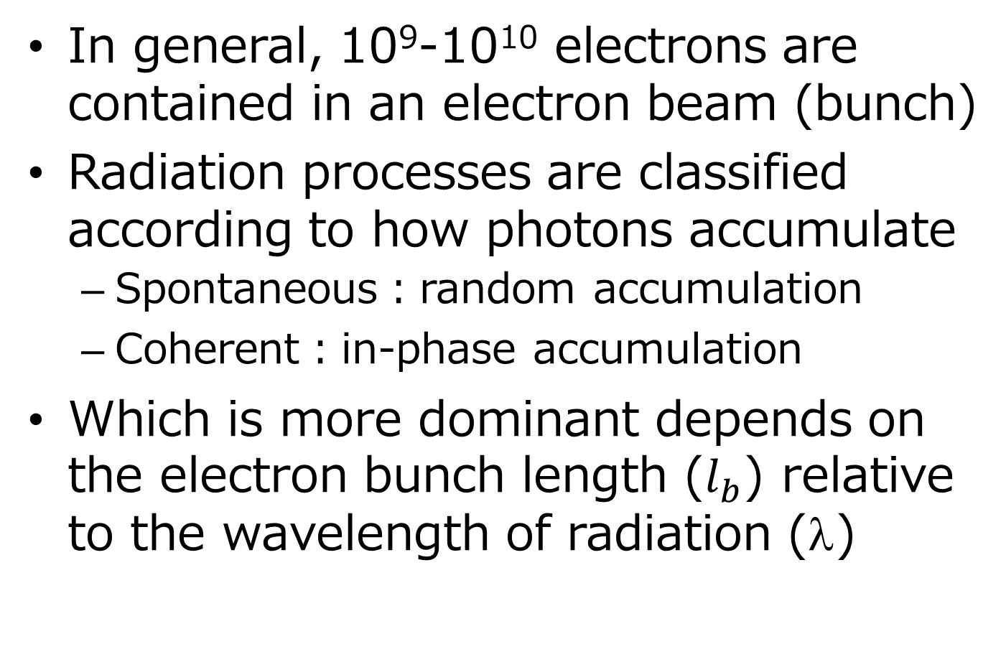
Spontaneous & Coherent Radiation (1)
In general, 10⁹-10¹⁰ electrons are contained in an electron beam (bunch)
Radiation processes are classified according to how photons accumulate
  Spontaneous：random accumulation
  Coherent：in-phase accumulation
Which is more dominant depends on the electron bunch length ($l_{b}$) relative to the wavelength of radiation (λ)

Slide 16


Spontaneous & Coherent Radiation (2)
λ
Spontaneous
$$l_{b}$$
Coherent
$$l_{b}$$

Slide 17
Spontaneous & Coherent Radiation (3)
Spontaneous Radiation
  Bunch Length > Wavelength
  Summation as photons: # photons enhanced by N (=# electrons)
Coherent Radiation
  Bunch Length < Wavelength
  Summation as waves: amplitude enhanced by N
  # photons (∝|amplitude|²) by N²
Intensity of coherent radiation is N (=10⁹~10¹⁰) times the spontaneous.

Slide 18
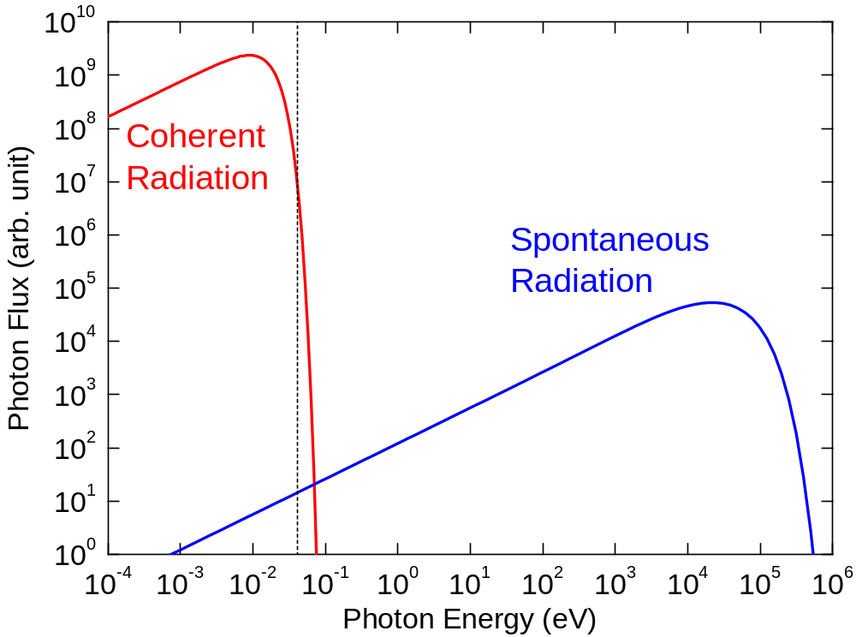
Example of Coherent Radiation
E=8GeV
B=1T
Δt=100fs
Q=100pC
λ=30μm

Slide 19


Coherent Radiation by Microbunches
λ
$$l_{b}$$
Microbunch
λ
Coherent at the wavelength of λ
$$l_{b}$$
FEL is coherent radiation emitted by an electron beam with microbunches

Slide 20
Introduction
Coherent radiation
Amplification mechanism in FELs
Classification of FELs
Overview of Single-Pass FELs
Example of FEL Simulations

Slide 21


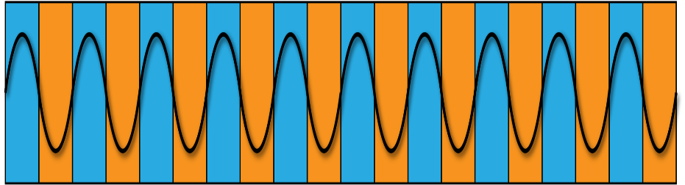
Basic Concept of FELs
Electron Beam
Microbunches
x
Undulator
z
Seed Light
Amplified Light
What’s the laser medium in FELs?
Free electrons?
Free electrons moving in the undulator field!

Slide 22
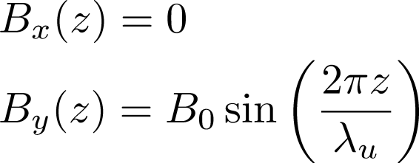
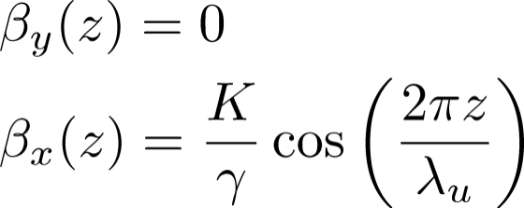
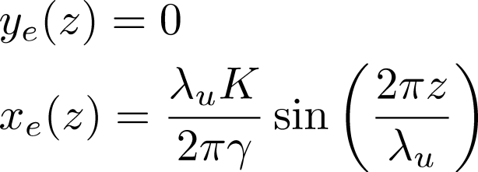
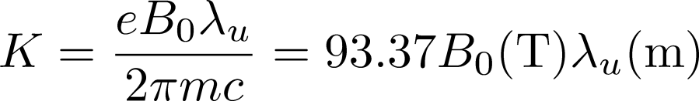




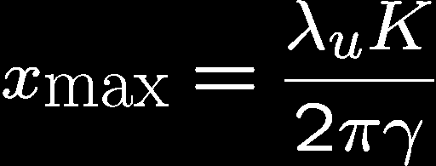
Electron Trajectory in an Undulator
Undulator field with period λ_{u}
Transverse
Velocity
Trajectory
K Value
Deflection Parameter
E=8GeV,K=1,λ_{u}=5cm：β_{xmax}=64μrad, x_{max}=0.5μm

Slide 23
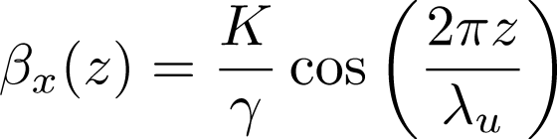
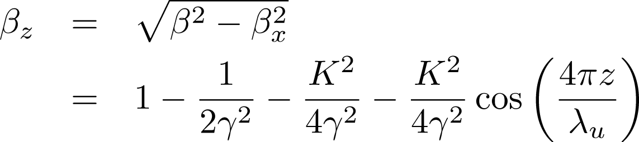
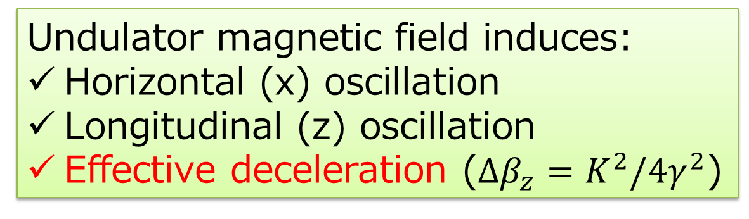
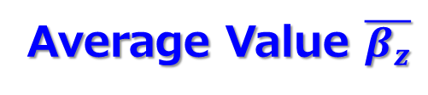
Velocity Modulations
transverse velocity
Oscillating Term
longitudinal velocity
Original value
Average Value $\overline{β_{z}}$
Undulator magnetic field induces:
  Horizontal (x) oscillation
  Longitudinal (z) oscillation
  Effective deceleration ($Δβ_{z}=K^{2}/4γ^{2}$)

Slide 24
Keywords to Understand Amplification
The electron trajectory is linked to important 4 keywords in FEL:
  Slippage Effect
  Fundamental Wavelength
  Continuous Interaction
  Longitudinal Dispersion

Slide 25



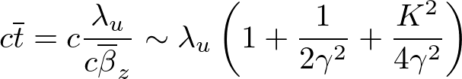
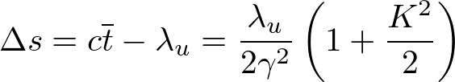
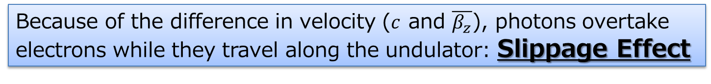
Slippage
x
e⁻
z
photon
: slippage length over λ_{u}
= fundamental wavelength λ₁
Because of the difference in velocity ($c$ and $\overline{β_{z}}$), photons overtake electrons while they travel along the undulator: Slippage Effect

Slide 26


Fundamental Wavelength
x
z
Radiation with λ₁ is in phase with e⁻
  Intense spontaneous radiation at λ₁
  Continuous interaction between radiation and e⁻ (next slide)

Slide 27
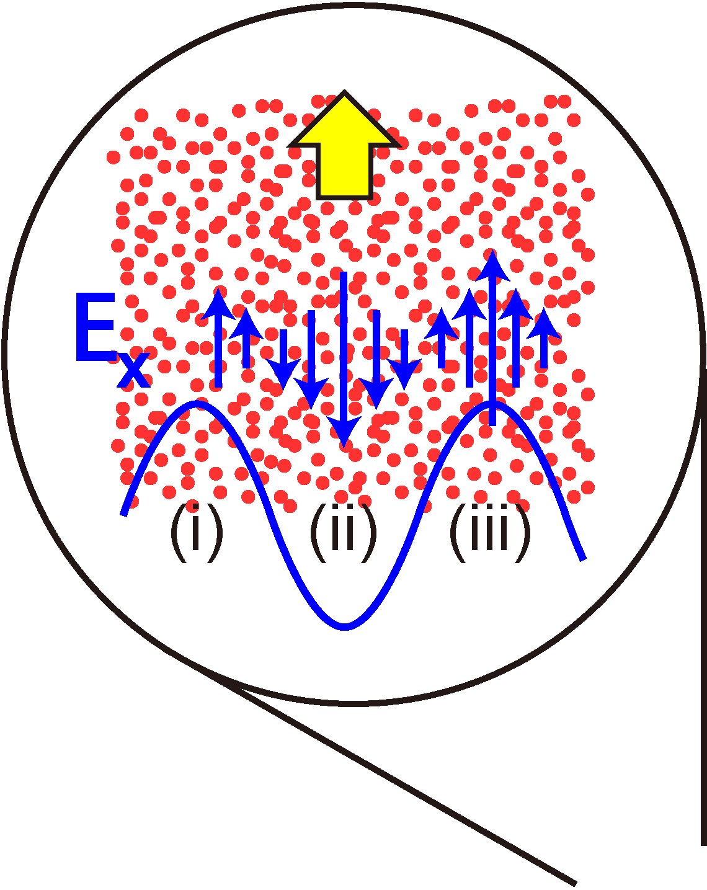
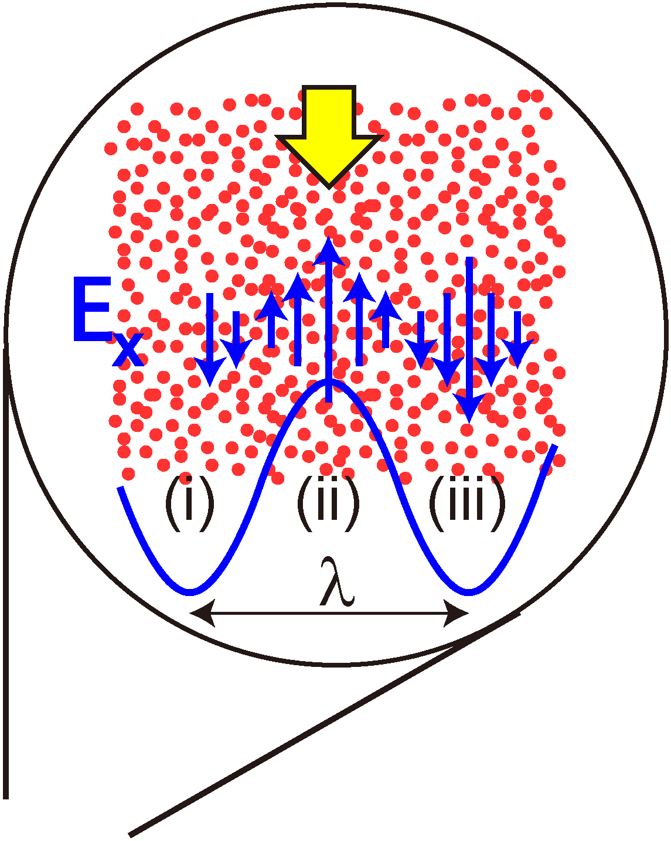
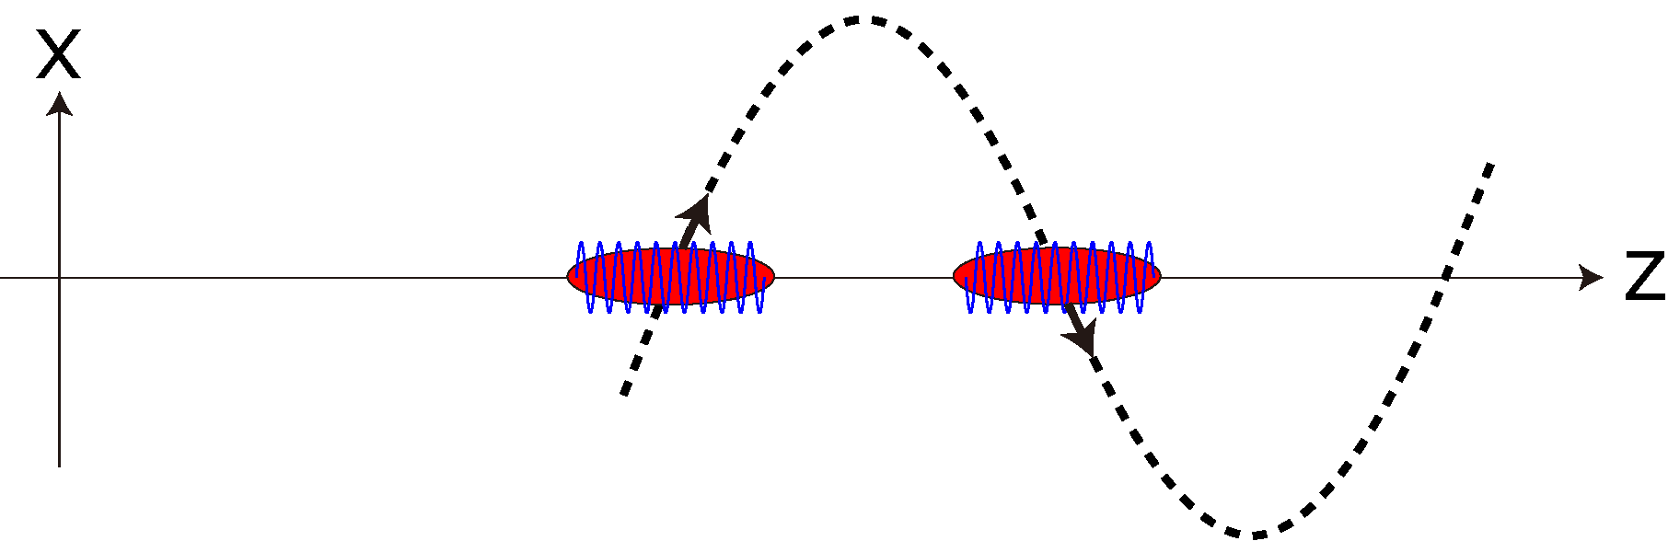
Interaction with Radiation
Continuous interaction with radiation
Δγ > 0 in (ii), (iv,…)
Δγ < 0 in (i), (iii), (v,…)
Periodic energy modulation with λ₁

Slide 28


Longitudinal Dispersion
Higher-energy electrons go ahead of lower-energy ones
x
e⁻(γ)
z
e⁻(γ’<γ)

Slide 29
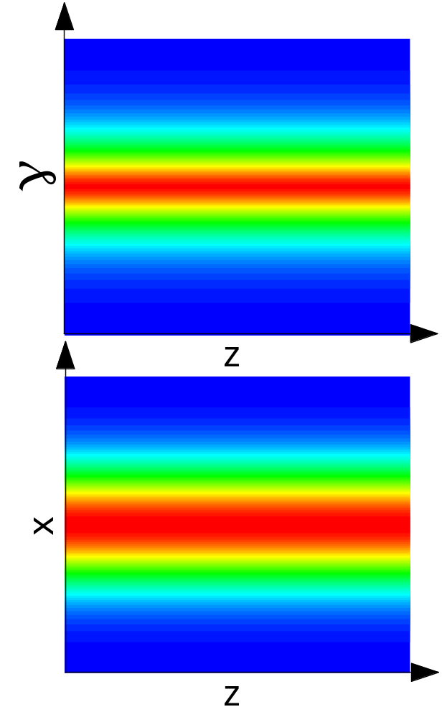
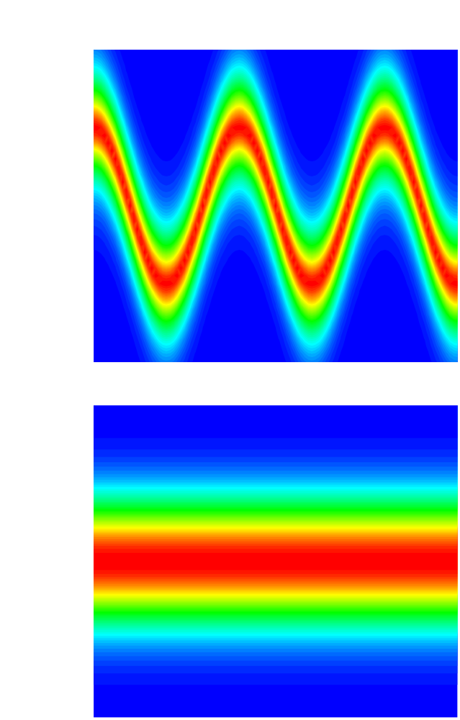
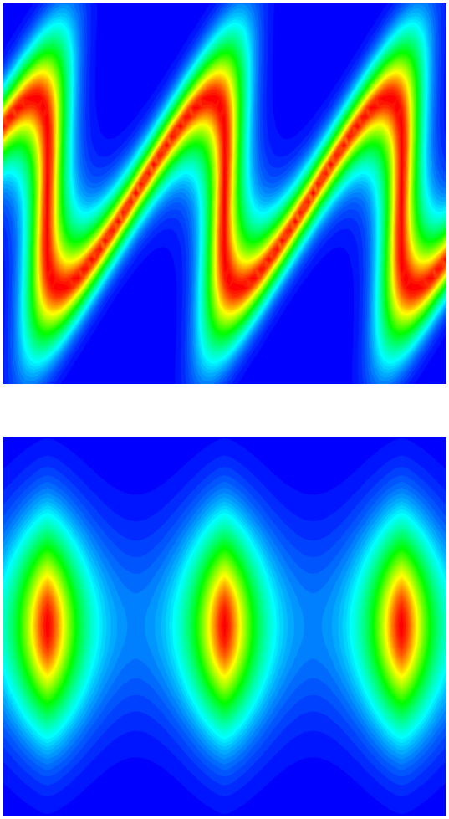
Microbunch Formation in Phase Space
λ₁
Interaction with Radiation
Longitudinal Dispersion

Slide 30
Mechanism of Microbunch Formation
Sinusoidal Magnetic Field
Horizontal Oscillation
Effective Deceleration
Radiation with λ₁
Slippage
Continuous Interaction
Longitudinal Dispersion
Energy Modulation
Density Modulation
(Microbunch)

Slide 31
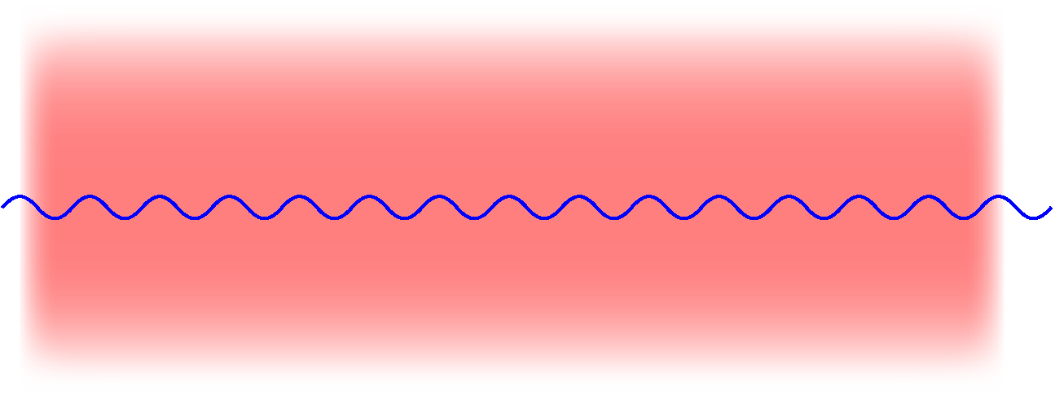
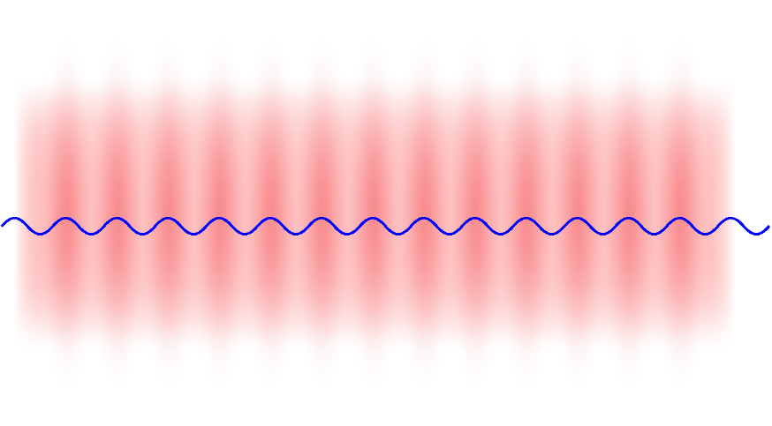
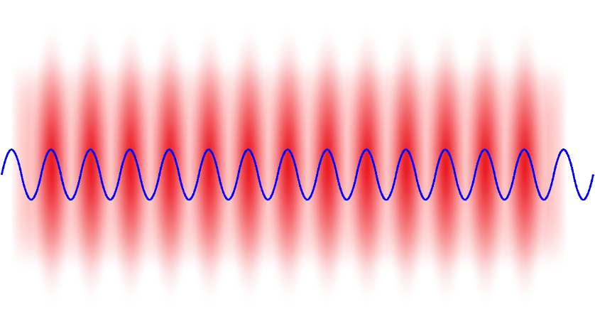
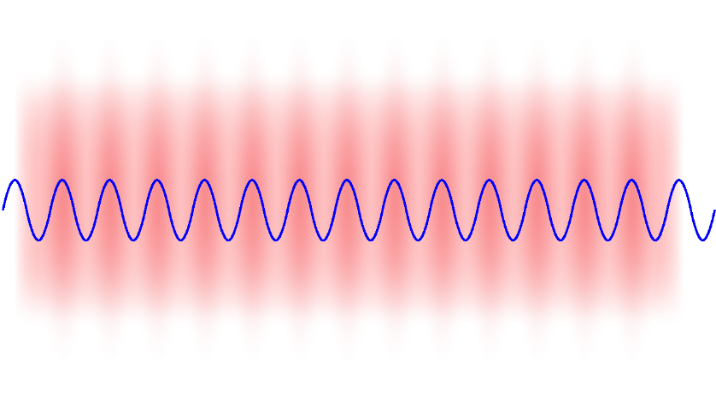
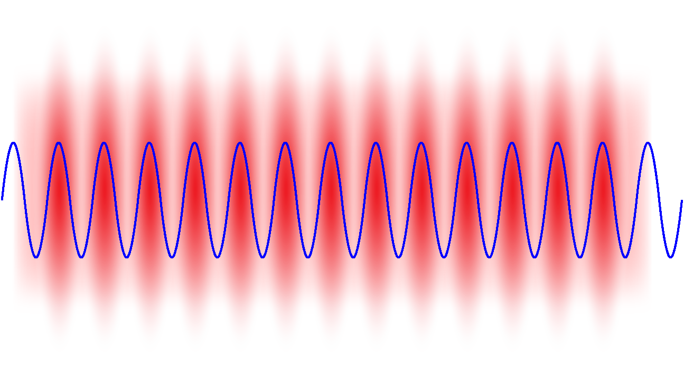
FEL Amplification
FEL Amplification =
Positive Feedback Loop of
Microbunching through interaction with radiation
Intensify radiation by coherent radiation
Microbunching
Coherent Radiation
Microbunching
Coherent Radiation

Slide 32
Introduction
Coherent radiation
Amplification mechanism in FELs
Classification of FELs
Overview of Single-Pass FELs
Example of FEL Simulations

Slide 33
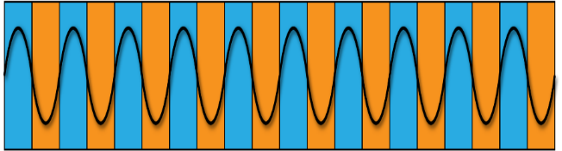
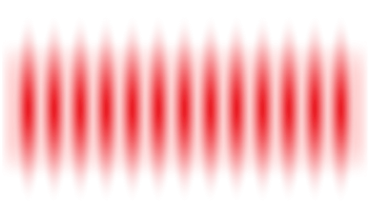

Classification of FELs
The e- beam moving in the undulator works to “amplify” light
To achieve lasing in FEL, we need
  High gain in total
  Seed light to be amplified
The FELs can be classified according to how to arrange the above conditions
Microbunches
Electron Beam
x
Undulator
z
Seed Light
Amplified Light

Slide 34
Oscillator FELs
Oscillator FEL: original concept
Undulator
Mirror(Optical Cavity)
Amplified many times by different electrons
Mode selection by the optical cavity
    single mode laser is possible
    challenging in shorter-λ (x-ray) regions

Slide 35
Oscillator FELs
High rep. rate needed (bunch interval = cavity length)
  storage Ring
  multi-bunch linac
Requirement for lasing
  gain/pass > cavity loss
Difficult to be achieved for shorter wavelengths (<100 nm)
  no practical mirrors
Single-Pass FELs

Slide 36
Single Pass (SP) FELs
Difficulty in oscillator FELs can be overcome by enhancing the gain/pass
  Long undulator
  Higher electron density (lower emittance, higher peak current)
Seed light is amplified by many orders of magnitude even with a single pass
  No cavity is necessary
All of the short-λ FELs currently in operation are of this type

Slide 37
Introduction
Coherent radiation
Amplification mechanism in FELs
Classification of FELs
Overview of Single-Pass FELs
Example of FEL Simulations

Slide 38
Requirements for “X-ray” SP-FELs
Parameter | Unit | 3rd Gen. SR Facility | X-ray FELs
Emittance | m.rad | 10⁻⁸~10⁻⁹ | 10⁻¹⁰~10⁻¹¹
Peak Current | A | 1~100 | 10³~10⁴
Energy Spread | % | 0.1 | 0.01
“High Density” e- beam:
not only in 4D (x,y,x’,y’)
but also in 6D (x,y,x’,y’,t,γ)

Slide 39
Generating a High-Density e⁻ Beam (1)
Improvement of emittance and energy spread using Linear Accelerators, instead of Storage Rings
LINAC
RING
ε | ∝ | γ⁻¹
σ_{γ}/γ | ∝ | γ⁻¹
ε | ∝ | γ²
σ_{γ}/γ | ∝ | γ
“the higher, the better”
“the lower, the better” (but more difficult to operate)

Slide 40
Generating a High-Density e⁻ Beam (2)
Enhancement of the peak current
  “Chirping” and “Compressing”
Applying an Energy chirp
e⁻ beam
Higher
Lower
RF Cavity
I
e⁻ beam
Chicane
t
Bunch Compression

Slide 41
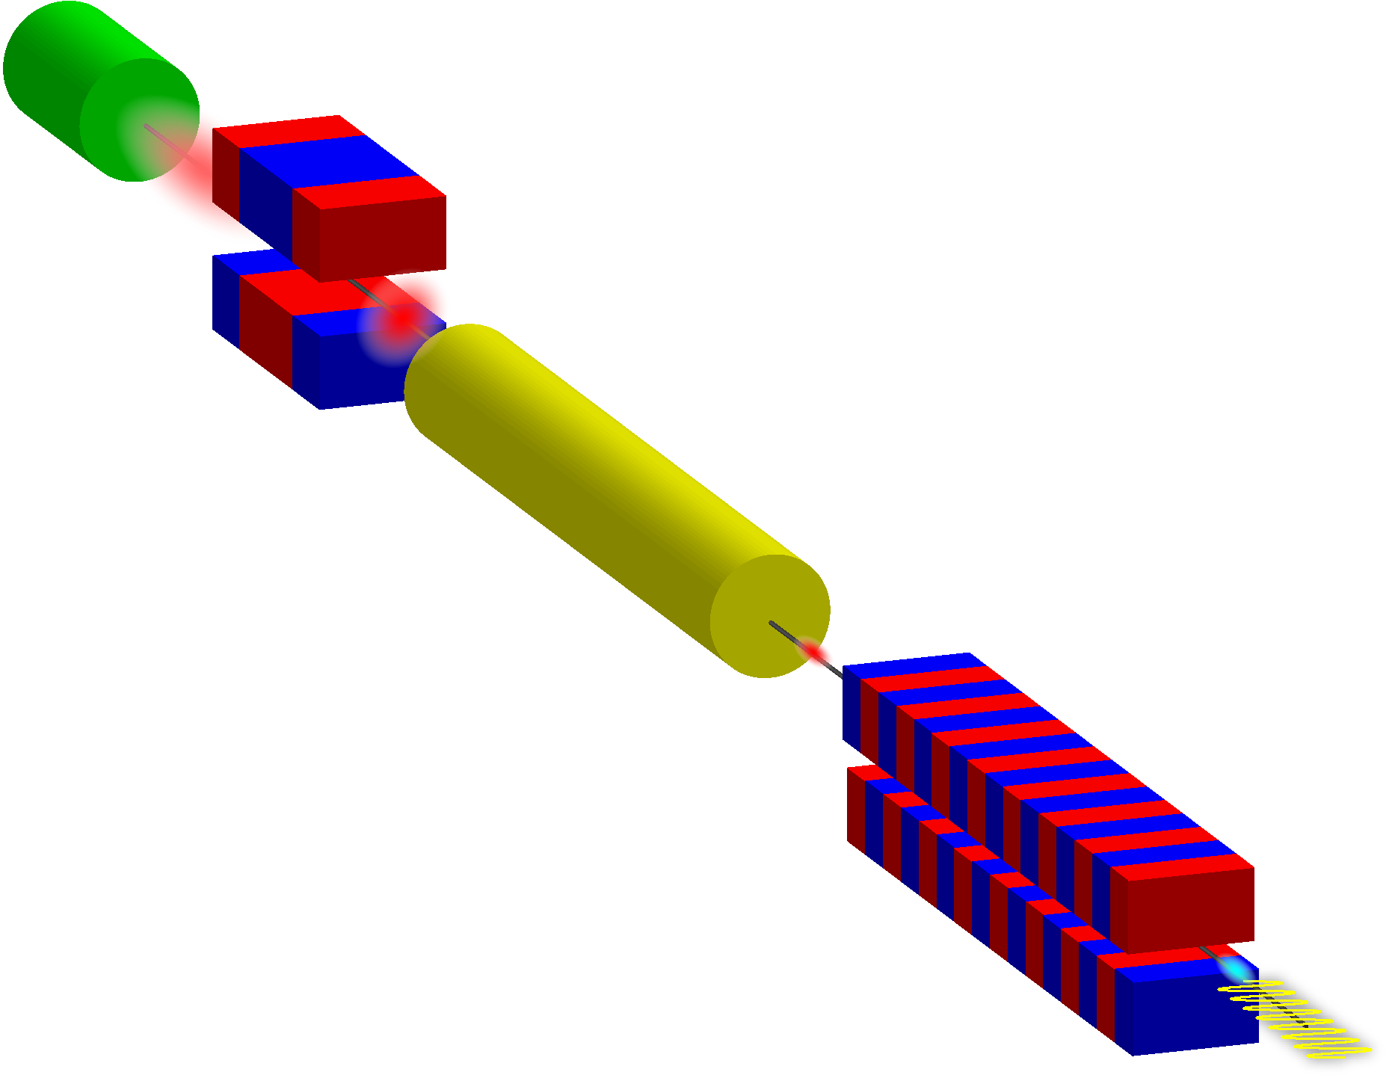
General Layout of SP FELs
Injector
Bunch
Compressor
Highly-brilliant Electron Beam
Main
Accelerator
Undulator
FEL
Pulse
FEL amplification takes place here!

Slide 42
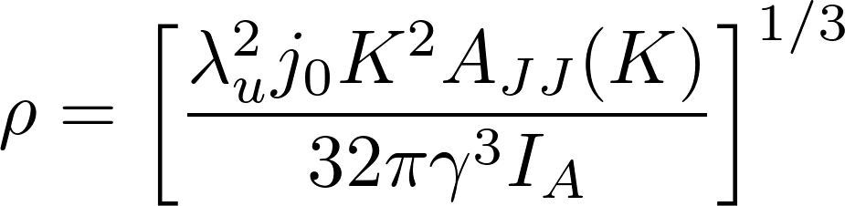
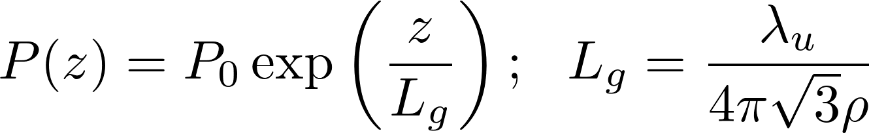
Important Parameters in SP-FEL(1)
主要パラメータ
FEL Parameter ρ
  Dimensionless parameter related to the efficiency (10⁻²~10⁻⁴)
  FEL bandwidth scales as ρ
Gain Length L_{g}
  Undulator length needed to amplify the radiation power by e=2.718

Slide 43
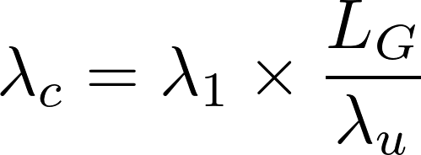
Important Parameters in SP-FEL(2)
主要パラメータ
Cooperation (Coherence) Length λ_{c}
  Slippage length in one gain length
  Determines the longitudinal coherence of radiation (spike width) in SASE FELs
slippage in one undulator period
# of periods in one gain length

Slide 44


Important Parameters in SP-FEL(3)
主要パラメータ
Saturation Power P_{sat}
  Maximum Power Reached in FEL
Saturation Length L_{sat}
  Undulator length to reach saturation
Conversion efficiency from e- to radiation is ρ
Number of undulator periods for saturation is ρ⁻¹

Slide 45
Type of SP-FELs
Further classified, according to “how to prepare the seed light“
Self-Amplified Spontaneous Emission (SASE)
  Shot noise (spontaneous radiation)
  No limit on λ, but poor temporal coherence
Seeded FEL
  External laser light
  High temporal coherence, but shorter-λ is challenging

Slide 46
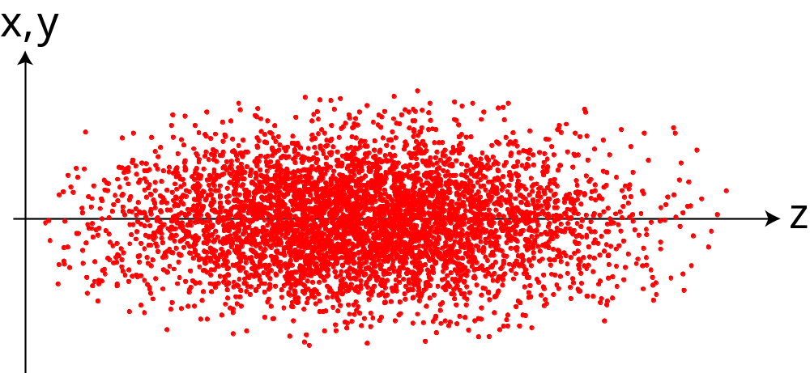
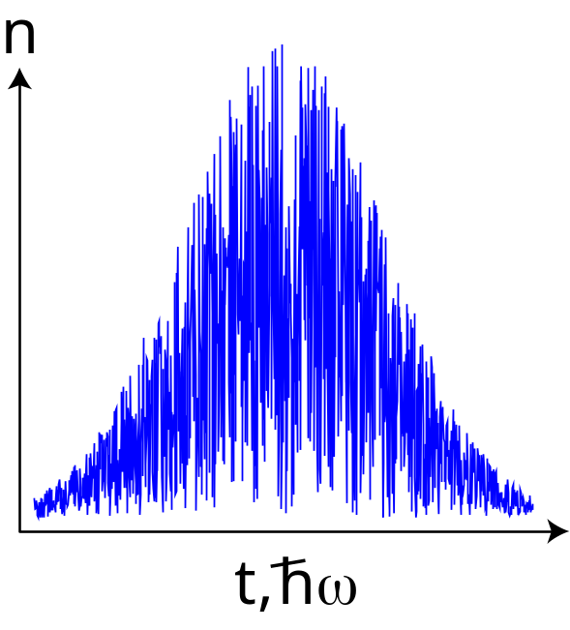
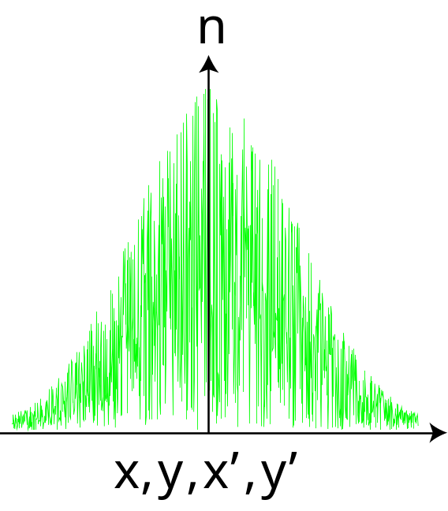
Shot Noise: Source of SASE
e- distribution contains sparse and dense areas
Radiation profile
temporal
spectral
spatial
angular

Slide 47
Seeded FEL
Inject “coherent light” synchronously with e- beam
Temporal coherence is significantly improved, if peak power is higher than the shot noise
Two difficulties
  How to guarantee overlapping with the e- beam?
  How to reach shorter wavelength?

Slide 48
How to Realize Short-λ Seeded FEL?
High Power Laser
HHG
Undulator
Gas Target
Dispersive
Section
HGHG
Modulator
Radiator
High Power Laser
Self Seed
Monochromator

Slide 49
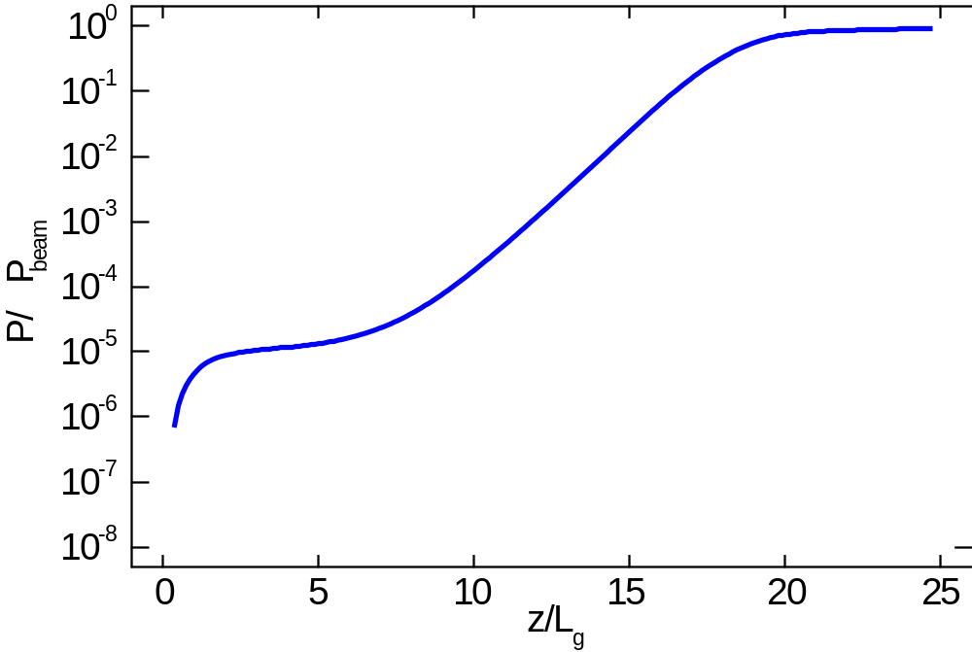
Typical “Gain Curve” in SASE
Spont. Rad (SASE)
Exponential Amp.
Saturation
ρ

Slide 50
Introduction
Coherent radiation
Amplification mechanism in FELs
Classification of FELs
Overview of Single-Pass FELs
Example of FEL Simulations

Slide 51
FEL Simulation
Numerical characterization of radiation is important in many aspects
  deduce the e- beam quality
  design an experiment
Analytical formulas available, but just for a rough estimation
Rigorous simulations needed for quantitative evaluation

Slide 52
General Method for FEL Simulation
Express the e- bunch by a large number (~10⁶) of macroparticles
  Each macroparticle represents
Undulator is divided into many steps
Within a single step:
  solves the equation of motion for each macroparticle in 6D phase space
  computes the radiation growth by microbunching

Slide 53
Parameters for Simulation
Electron Beam |  | Undulator
Energy | 1 GeV | Period | 50 mm
Bunch Charge | 200 pC | Peak Field | 0.43 T
RMS Bunch Length | 70 fsec | K Value | 2.03
Peak Current | 1.2 kA | Length | 3 m x 10
Norm. Emittance | 1 μm | Source Parameter
Energy Spread | 10⁻⁴ | FEL Parameter | 2.7x10⁻³
Average Beta | 10 m | Gain Length | 1.04 m
Beam Size (σ) | 70 μm | Wavelength | 20 nm
Angular Div. (σ) | 7 μrad | Photon Energy | 62 eV
As an example, results with an FEL simulation code SIMPLEX* are presented in the followings
*T. Tanaka, Journal of Synchrotron Radiation 22, 1319 (2015)
Note: major upgrade in progress

Slide 54
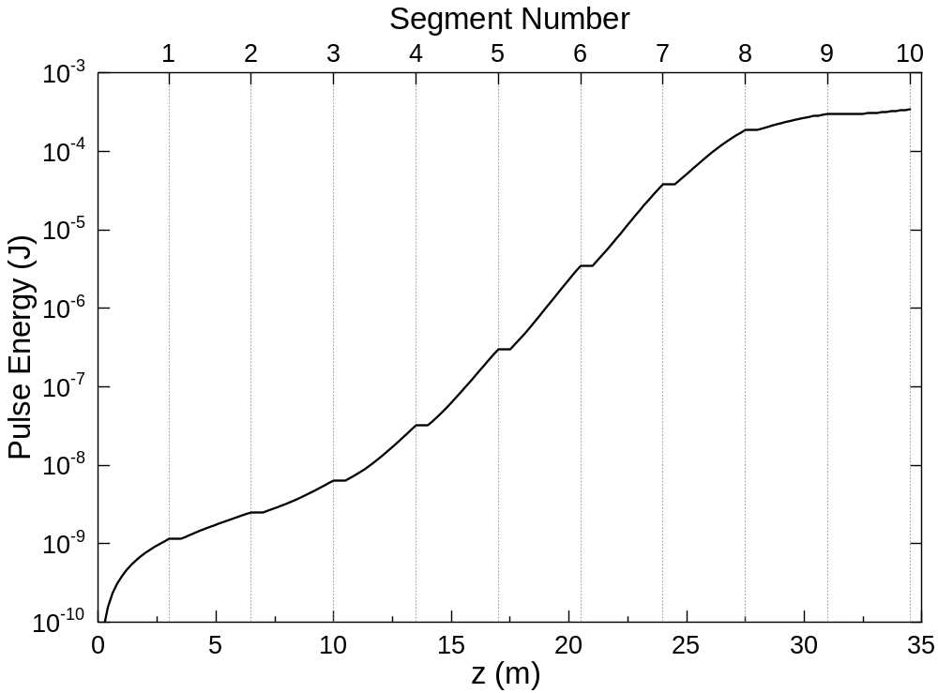
Gain Curve

Slide 55
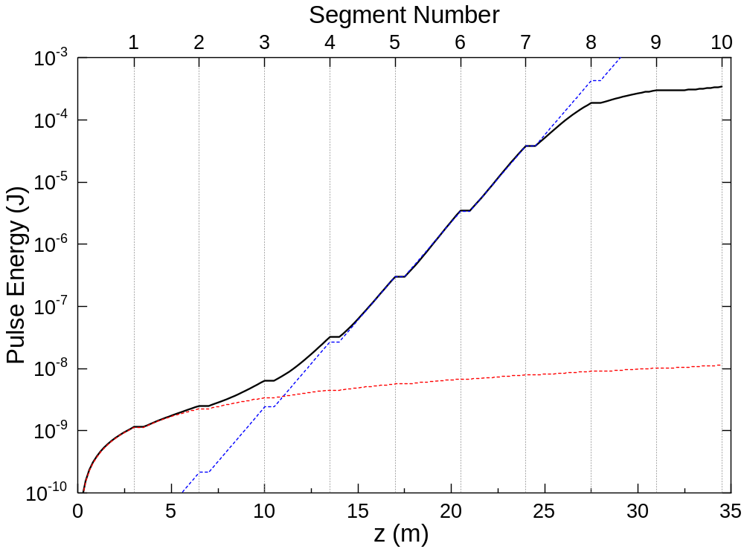
Gain Curve
Exponential
Growth
Spontaneous
Radiation

Slide 56
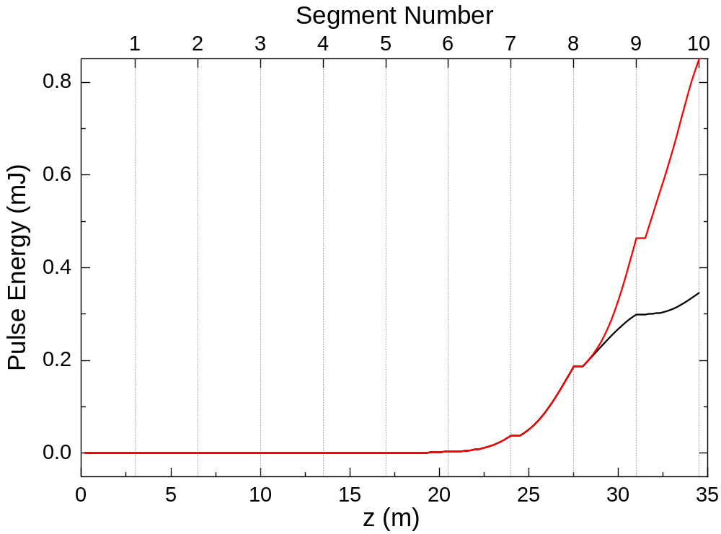
Power Enhancement by “Tapering”
Tapering:
dK/dz=-6x10⁻³

Slide 57
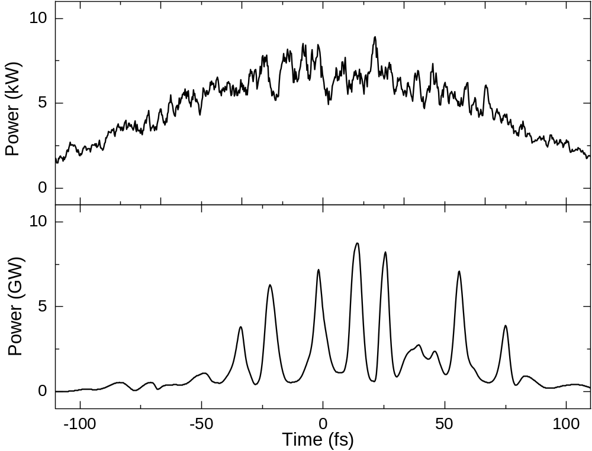
Temporal Profile
@Segment 1
@Segment 10

Slide 58
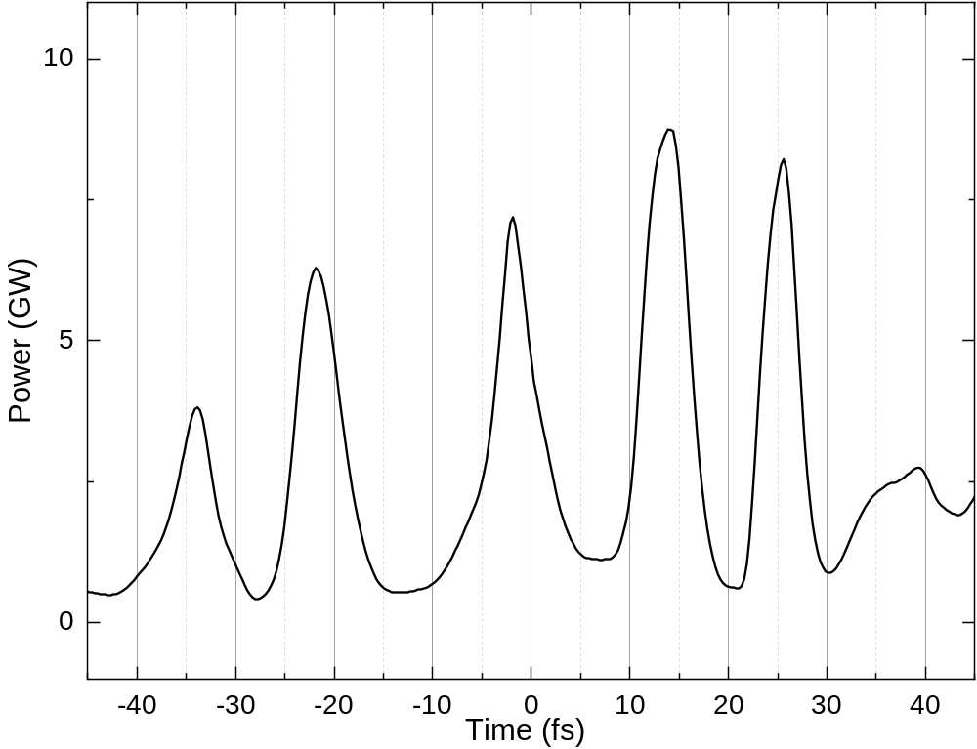
Spike Width vs. Cooperation Length
λ_{c}/c=1.4fs
6fs

Slide 59
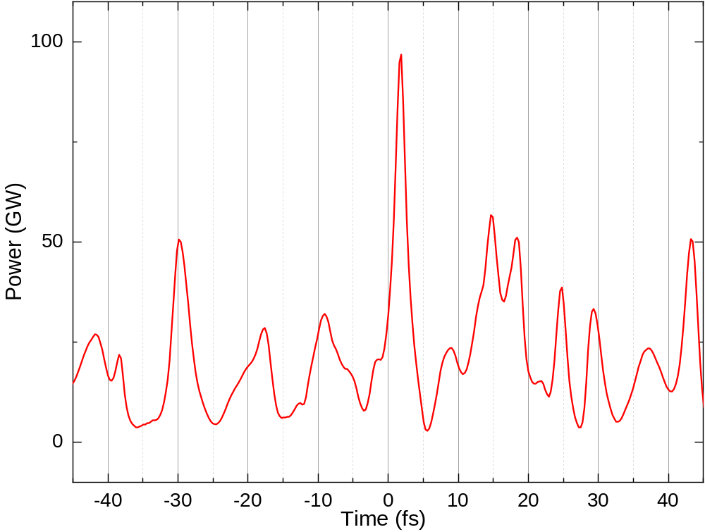
Spike Width vs. Cooperation Length
Gain Doubled
1.2kA⇒4.8kA
1 μm⇒0.5μm
λ_{c}/c=0.7fs
3fs

Slide 60
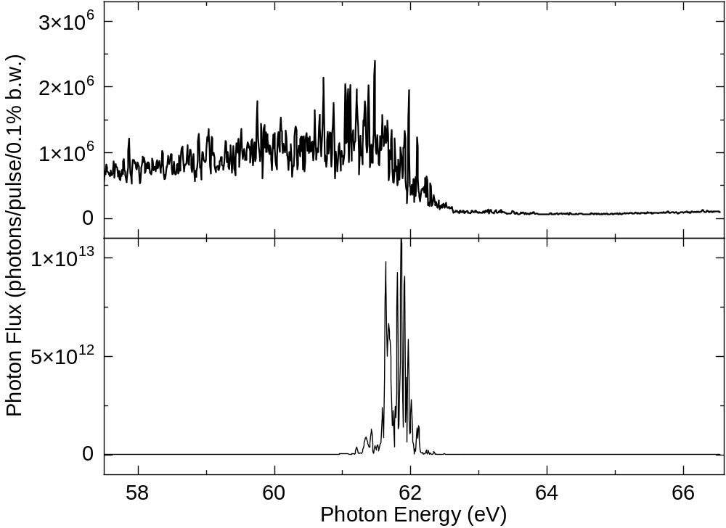
Spectrum
@Segment 1
@Segment 10

Slide 61
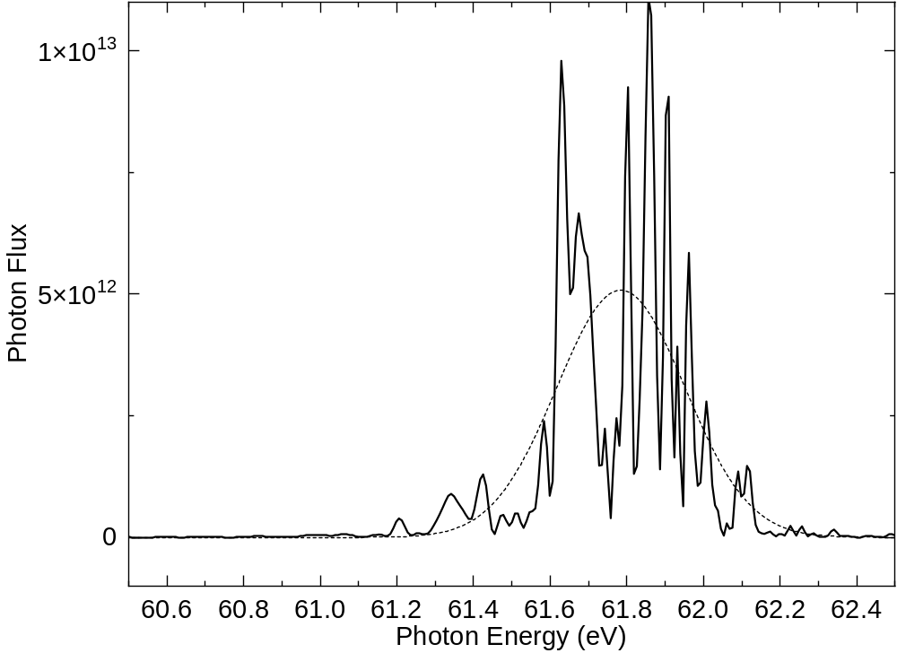
Bandwidth vs. FEL Parameter
ρω=0.17eV
0.4eV

Slide 62
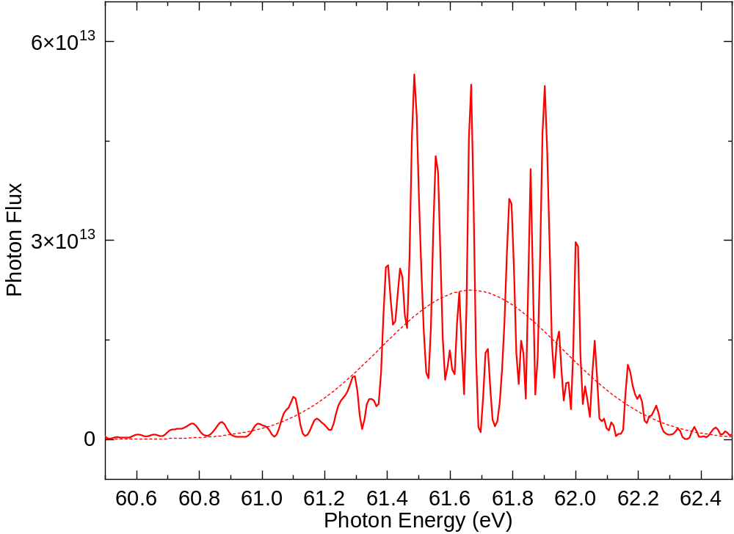
Bandwidth vs. FEL Parameter
Gain Doubled
1.2kA⇒4.8kA
1 μm⇒0.5μm
ρω=0.33eV
0.7eV

Slide 63
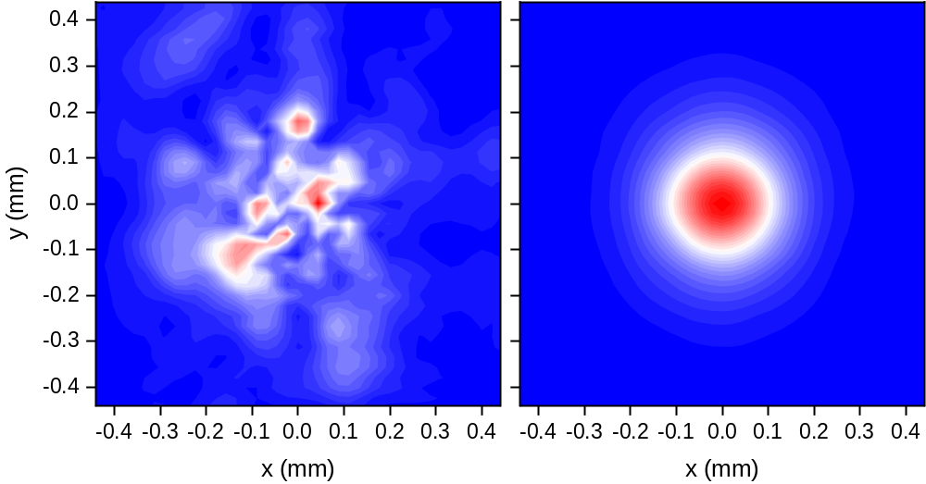
Spatial Profile
@Segment 1
@Segment 10

Slide 64

Angular Profile
@Segment 1
@Segment 10

Slide 65

Formation of Microbunches
@Segment 7
0.067fs=20nm

Slide 66
Visualization of Lasing Process
Click here to see animations showing:
  evolution of radiation profiles (temporal, spectral, spatial & angular)
  motion of macroparticles

Slide 67
Seeding Option
Seeding by coherent light improves the temporal coherence (spectral property)
Coherent light with λ=20nm
  Not impossible by HHG, but not so easy (as FEL seeding)
  HGHG (FERMI) scheme is more standard as of now
  Even so, let us assume “20nm/1MW/ 30fs” pulse is available & see how seeding works

Slide 68

Gain Curve
Seeded
SASE

Slide 69

Temporal/Spectral Profiles
Seeded
SASE

Slide 70

Shot-to-Shot Fluctuation
Seeded
SASE

Slide 71

10-Shot Average
Seeded
SASE

Slide 72
Technical Issues
Realization of seeded FELs requires:
  Spatial and temporal synchronization
  Generation of coherent light
FEL performances are more sensitive to the e- beam quality
  Energy chirp is the most critical
Many seeded-FEL schemes proposed
  toward shorter wavelengths
  toward shorter pulse lengths

Slide 73
Other Topics …
FEL equation: derivation and solution
3D and other effects to evaluate the practical FEL gain
Self seeding for shorter wavelengths
Special schemes for pulse shortening
Polarization property and its control
Details of numerical methods for FEL simulations
…

Slide 74
Thank you for attention!

