Slide 1
Error Diagnosis System Report
Layne Fujioka

Slide 2
Currently errors occurs during uptime of the detector
This forces the people watching (shifters) to identify, contact people to fix it, then restart the system
By automatically detecting errors and determining who the shifters should contact, we can mitigate the amount of downtime experienced
With less downtime everyone is happy

Slide 3
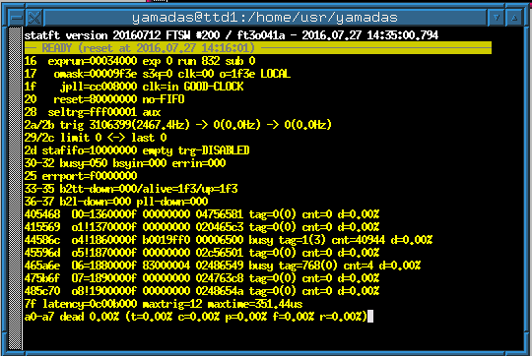
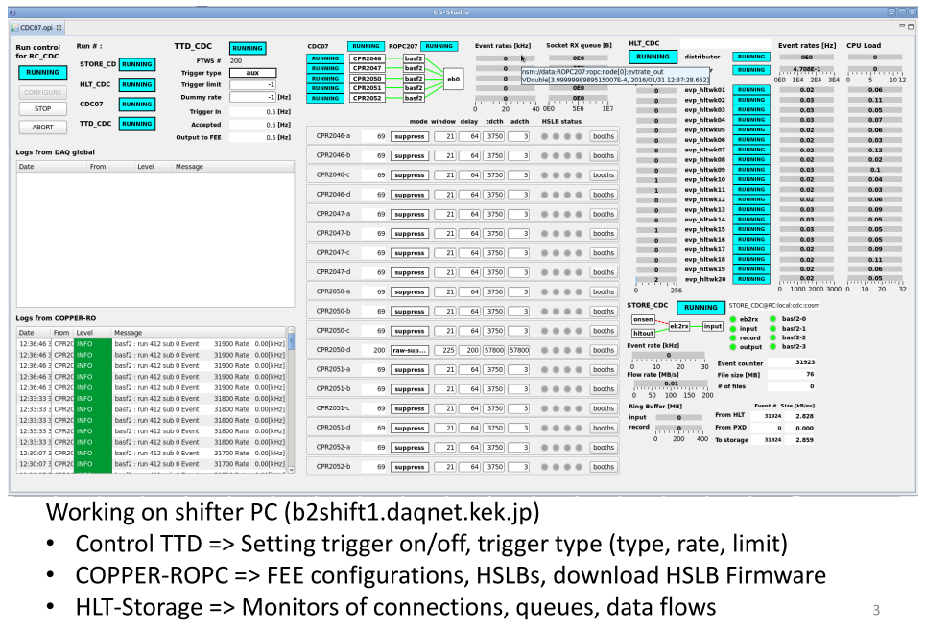
When errors occur, currently we check;
➁
1, log message from DAQ processes
2, output of statft
3, status indicator of SLC system
->
Diagnose these info. and provide shifters
what to do.
➂
①
Message windows to shifters ?

Slide 4
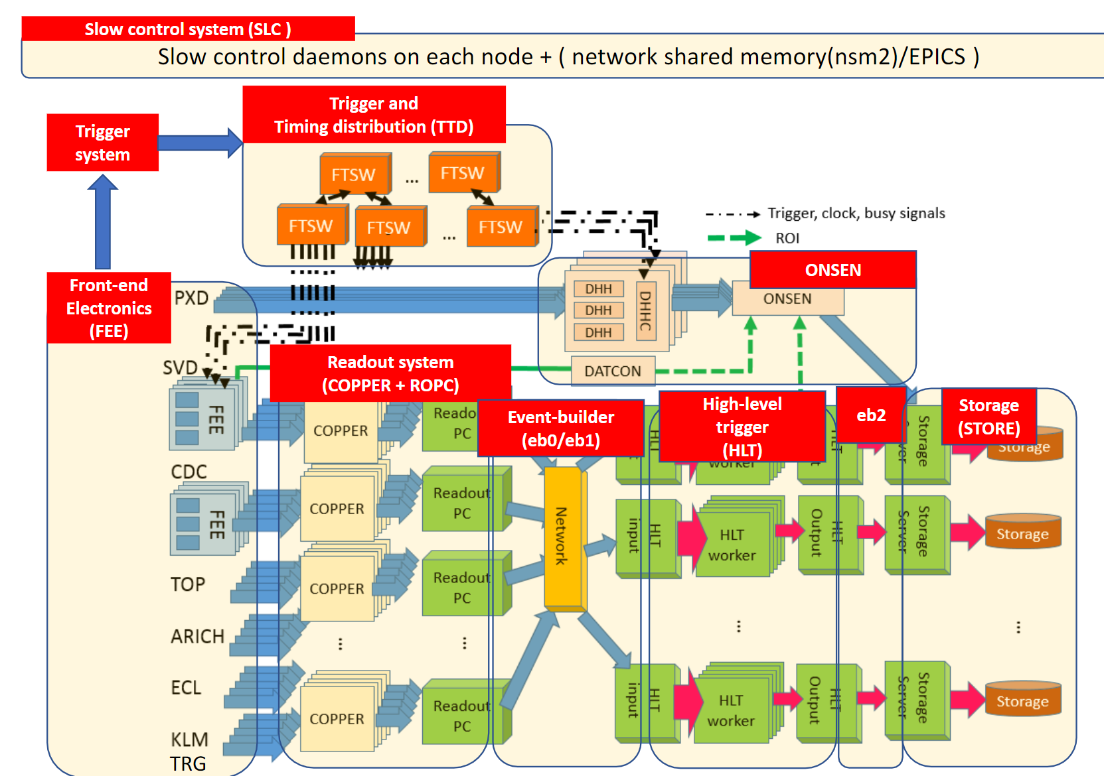

Slide 5
I either get BUSY or errors to deal with
There are two places, COPPER and FEE
COPPER takes information from the subdetectors to the readout PCs
FEE (front end electronics) of subdetectors for collect information

Slide 6
High Level Flowchart:
Check log messages
Do the log messages match any diagnosed cases in .xml file?
Check statft 184
Local mode?
Any errors?
First busy check
Check state of SLC
rcstate of the subdetector in ERROR or FATAL?

Slide 7
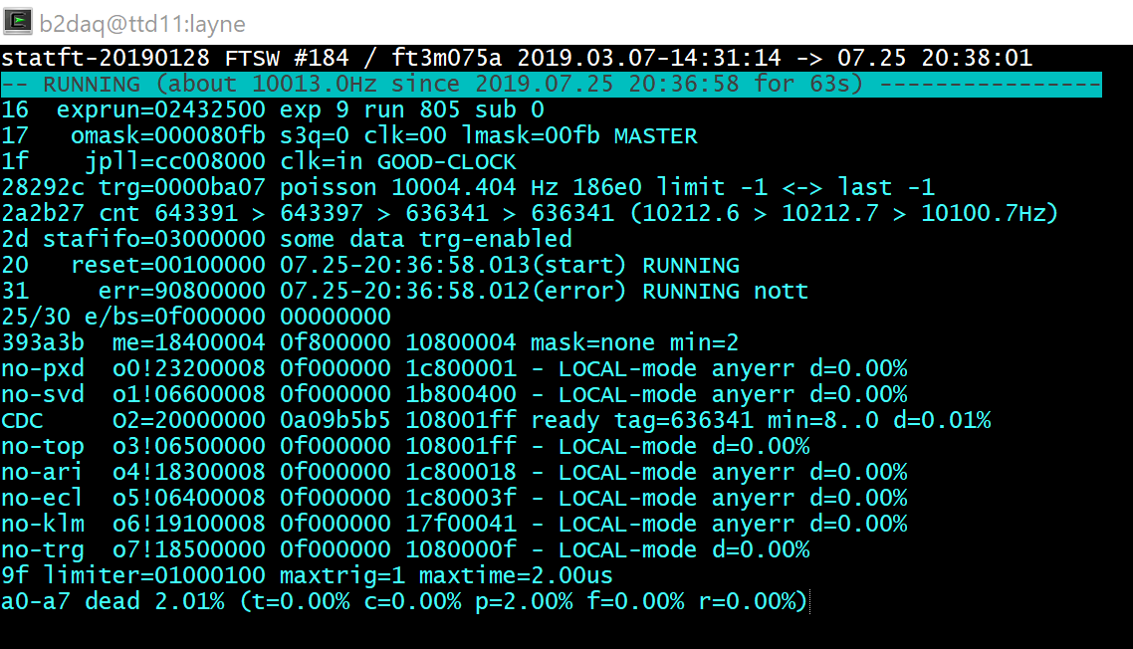
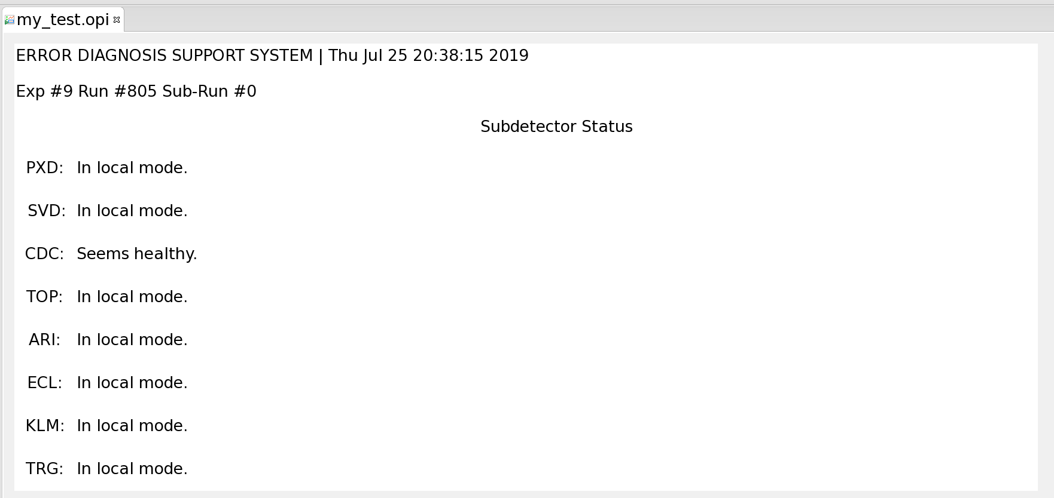
ttd11
rospare01

Slide 8
Dealing with errors

Slide 9
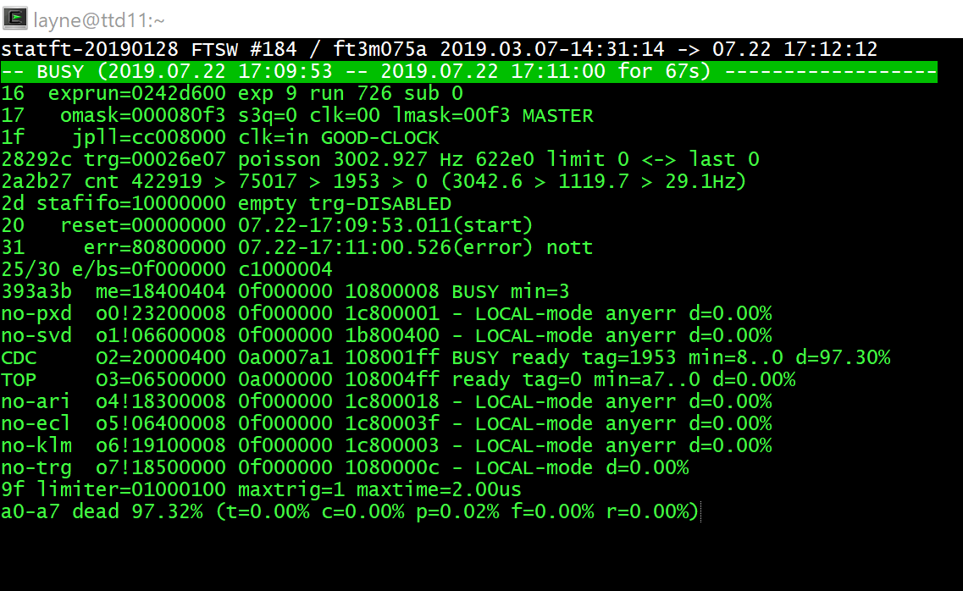
Parsing

Slide 10
local mode?
no
b2ldown?
yes
b2ldown detected, no additional information
no
rerr, ferr,
fifoerr, b2llost?
yes
call subdetector experts
no
yes
ttdown, ttlost?
yes
FEE or COPPER?
FEE
call subdetector experts
no
COPPER
anyerr?
yes
undiagnosed error
call DAQ experts
no
Good!
no
BUSY?
yes
more work…

Slide 11
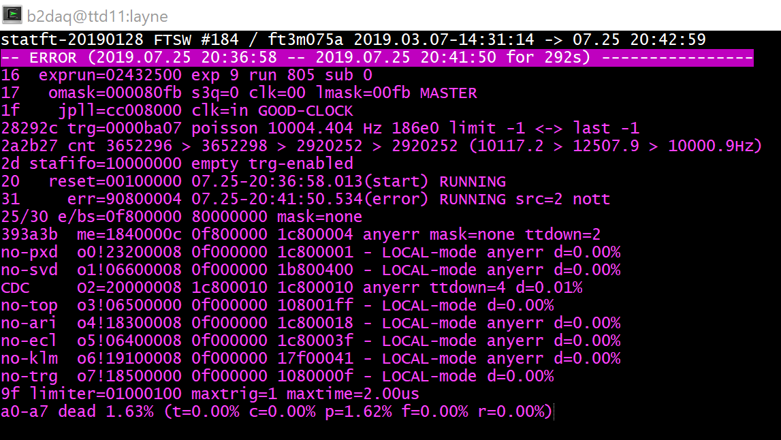
Example 1:

Slide 12
Example 1:

Slide 13
local mode?
no
b2ldown?
yes
b2ldown detected, no additional information
no
rerr, ferr,
fifoerr, b2llost?
yes
call subdetector experts
no
yes
ttdown, ttlost?
yes
FEE or COPPER?
FEE
call subdetector experts
no
COPPER
anyerr?
yes
undiagnosed error
call DAQ experts
no
Good!
no
BUSY?
yes
more work…

Slide 14
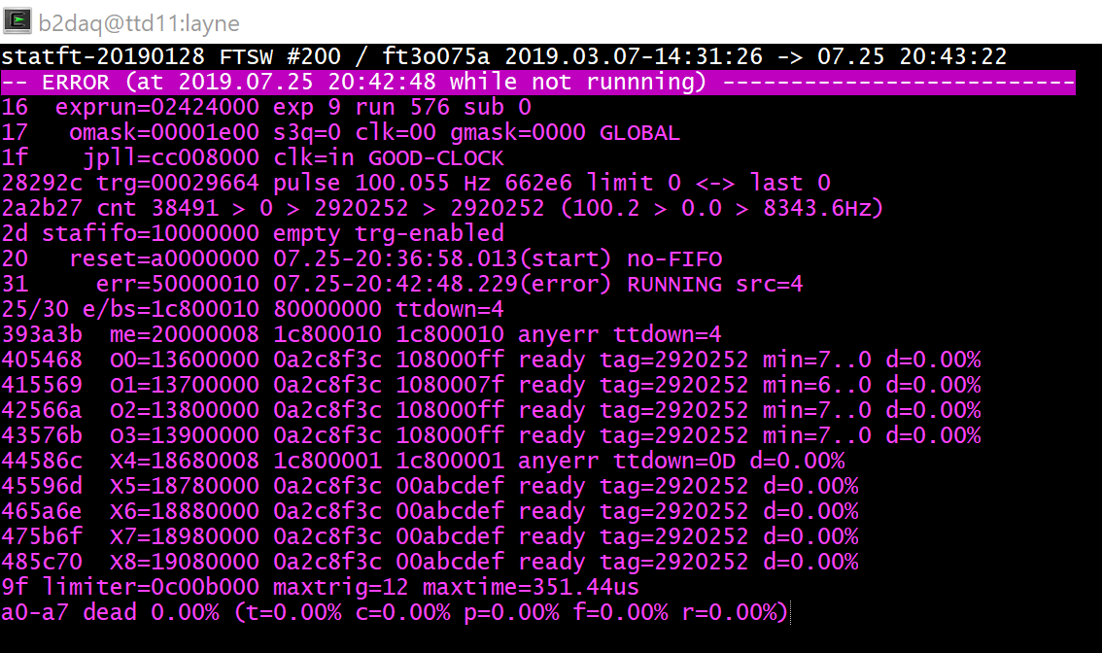

Slide 15
local mode?
no
b2ldown?
yes
b2ldown detected, no additional information
no
rerr, ferr,
fifoerr, b2llost?
yes
call subdetector experts
no
yes
ttdown, ttlost?
yes
FEE or COPPER?
FEE
call subdetector experts
no
COPPER
anyerr?
yes
undiagnosed error
call DAQ experts
no
Good!
no
BUSY?
yes
more work…

Slide 16
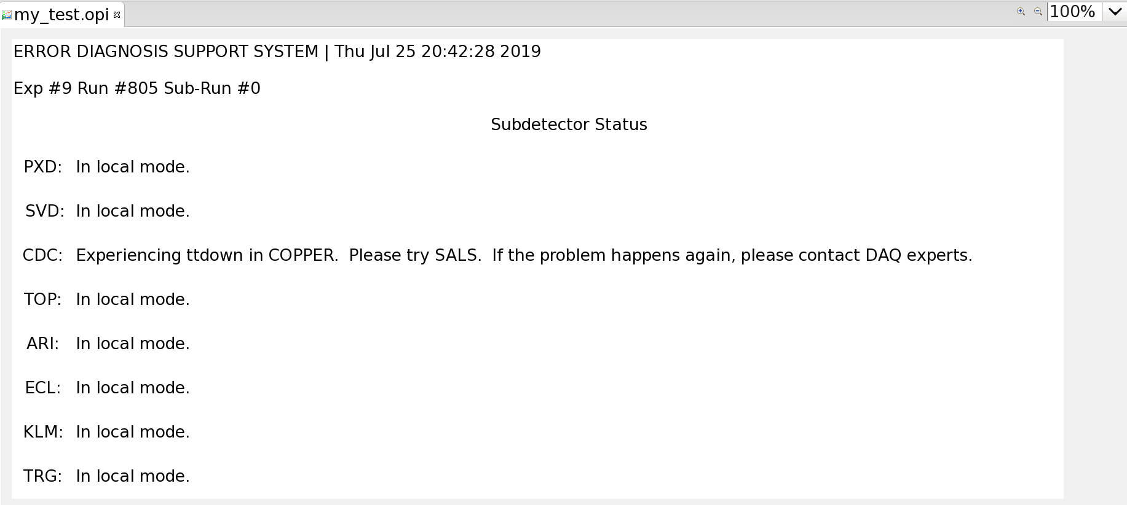

Slide 17
Dealing with BUSY

Slide 18
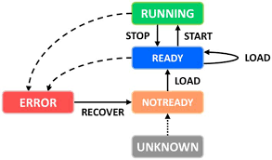
Flow chart for analyzing BUSY
Source of information :
Yellos = statft
Sky blue = run controller state
Red = Log
BUSY in statft !
FEE
“Call sub-detector experts !”
BUSY source ?
COPPER
ERROR state of SLC ?
No
Event # < 500 ?
Yes
“Call sub-detector experts !”
Error message in log ?
No
“Call DAQ expert !”
Run controller state
Yes
DAQ related error
Diagnose with the messages
FEE related error
“Call sub-detector experts !”
or FATAL

Slide 19
BUSY from FEE or COPPER?
Unfortunately BUSY does not show a number like the statft case
Must parse the subdetector statft to figure out if the BUSY is from FEE or COPPER
If it is from COPPER proceed.
If it is from FEE call the subdetector expert.

Slide 20
Example 2:

Slide 21
Example 2:

Slide 22
Flow chart for analyzing BUSY
Source of information :
Yellos = statft
Sky blue = run controller state
Red = Log
BUSY in statft !
FEE
“Call sub-detector experts !”
BUSY source ?
COPPER
ERROR state of SLC ?
No
Event # < 500 ?
Yes
“Call sub-detector experts !”
Error message in log ?
No
“Call DAQ expert !”
Run controller state
Yes
DAQ related error
Diagnose with the messages
FEE related error
“Call sub-detector experts !”
or FATAL

Slide 23
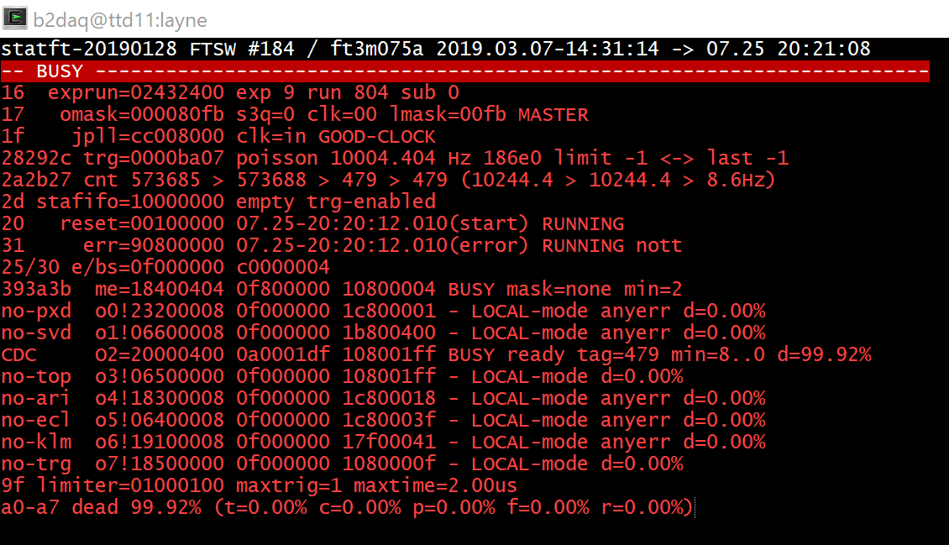

Slide 24
Example 2:

Slide 25
Flow chart for analyzing BUSY
Source of information :
Yellos = statft
Sky blue = run controller state
Red = Log
BUSY in statft !
FEE
“Call sub-detector experts !”
BUSY source ?
COPPER
ERROR state of SLC ?
No
Event # < 500 ?
Yes
“Call sub-detector experts !”
Error message in log ?
No
“Call DAQ expert !”
Run controller state
Yes
DAQ related error
Diagnose with the messages
FEE related error
“Call sub-detector experts !”
or FATAL

Slide 27
Parsing Log Files
Calling queries for log records repeatedly cause the node to get stuck
Solution: call logs during the time of the detected error and two cycles after
If no match is found in the logs database, output a default message

Slide 28
If error state in SLC
Pull FATAL and ERROR logs
Check 3 times
Match against vector of diagnosed messages in program
If no match was found, tell the shifters “undiagnosed message”

Slide 29
Example 3:
Using two different commands, we can make two different error log messages appear in the database
I can use two different strings in my program to match and return different messages to the shifters

Slide 30
“Call DAQ expert”
“Invalid Magic word”
“Call sub-detector expert”
“Invalid event_number”
Output for shifters
In my program
From DAQ database

Slide 31
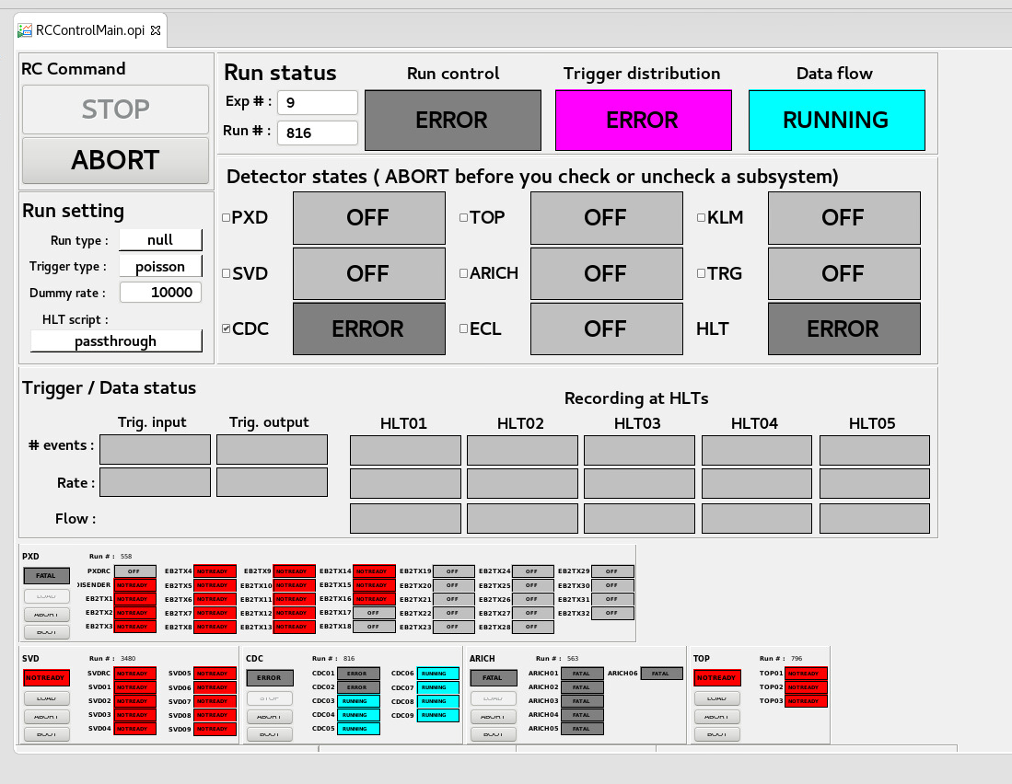
In both cases:

Slide 32
In both cases:

Slide 33
Flow chart for analyzing BUSY
Source of information :
Yellos = statft
Sky blue = run controller state
Red = Log
BUSY in statft !
FEE
“Call sub-detector experts !”
BUSY source ?
COPPER
ERROR state of SLC ?
No
Event # < 500 ?
Yes
“Call sub-detector experts !”
Error message in log ?
No
“Call DAQ expert !”
Run controller state
Yes
DAQ related error
Diagnose with the messages
FEE related error
“Call sub-detector experts !”
or FATAL

Slide 34
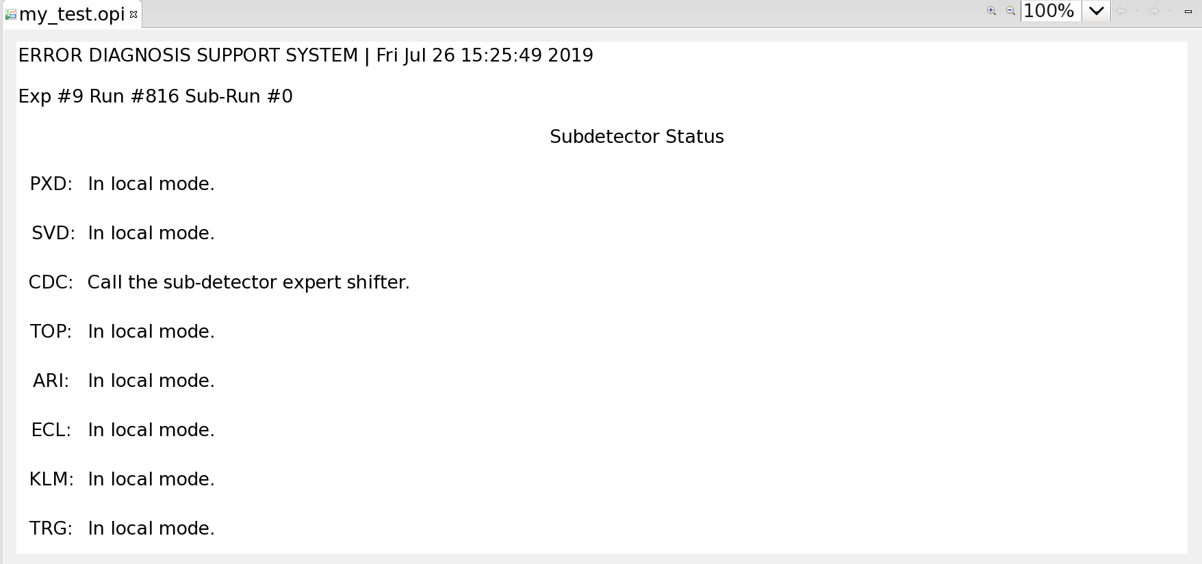

Slide 35
Future Steps
Eventually things are not supposed to run on ttd11 (where statft is pulled from) so something else needs to be done for the first step
It may be helpful to record new log messages so they can be added into the program later

Slide 36
Conclusion
I learned first hand how much work goes into keeping a detector up and running…
The various ways data is communicated / transported between different places
I learned some C++
Tsukuba has very good ramen

Slide 37
Thank you!!!

